Slide 1

Staffing Vacancies in SY 23-24 for October 1, 2024 Cycle Created by Research & Analytics

Slide 2
What is the Nature of Staffing Vacancies at IDEA?
1) How long are vacancies (median and mean and SD)?
2) How many vacancies (median, mean and SD)?
3) What is the most # of vacancies at one "time“?
(time = week, month, quarter, semester)
4) Add box plots and histograms.

Slide 3
Data Background
Jobvite Data for HA and Staffing – shows when a job is posted or filled
Employee Data: Tyler Munis, Power Schools – shows employe number, name, course name taught, school year, hire date, start date, FMLA data for leave
Subjects: Math, English Language Arts, Science, Social Studies
“Grade” is binned into 1st – 5th, 6th – 8th, and 9th-12th, unless otherwise denoted by the course name to a specific individual grade for that course.
“Region is inclusive of all Texas regions, including all Texas schools that have accountability ratings A-F.
When Semester Exam data comes in for 2021-2022, we will rerun code with the new data to get this year’s results.

Slide 4
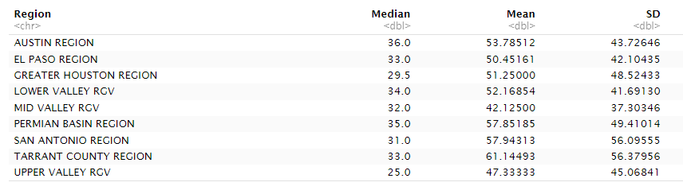
Median, Mean, and SD by Region for Vacancy Length (in Days)

Slide 5

Summary Statistics After Grouping by Region

Slide 6
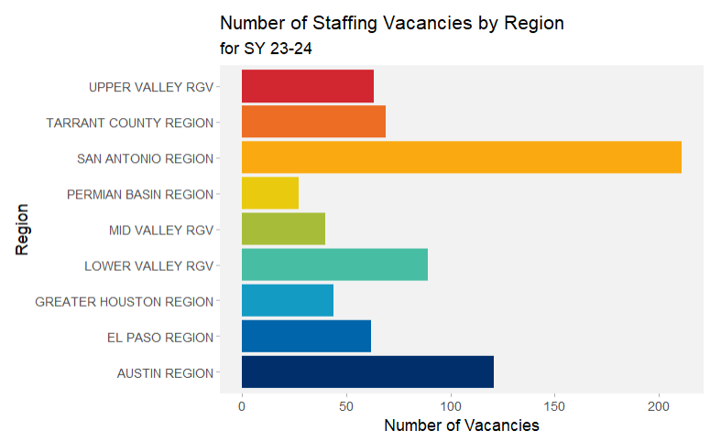
Number of Staffing Vacancies were Highest in San Antonio, Followed by Austin.

Slide 7
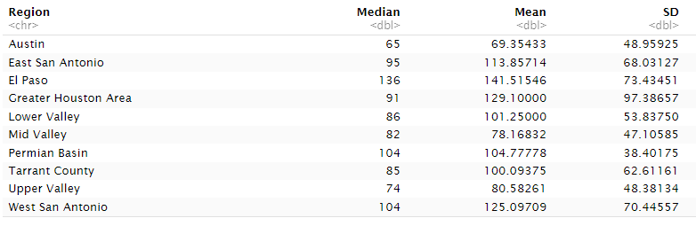
Median, Mean, and SD by Region for FMLA Length (in Days)

