Slide 1

Staffing Vacancies in SY 23-24 for October 1, 2024 Cycle Created by Research & Analytics

Slide 2
What is the Nature of Staffing Vacancies at IDEA?
1) How long are vacancies at IDEA for teacher roles?
2) How many vacancies are at IDEA for teacher roles?
3) What is the highest number of vacancies during a single time period?
(time = week, month, quarter, semester)
4) Graphs, box plots, and histograms of data.

Slide 3
Data Background
Jobvite Data for HA and Staffing – shows when a job is posted or filled
Employee Data: Tyler Munis, Power Schools – shows employee number, name, course name taught, school year, hire date, start date, FMLA data for leave
Subjects: Math, English Language Arts, Science, Social Studies
“Grade” is binned into 1st – 5th, 6th – 8th, and 9th-12th, unless otherwise denoted by the course name to a specific individual grade for that course.
Region is inclusive of all Texas regions, and campus includes all Texas schools that have accountability ratings A-F.
Time periods are derived from role posting date, hire date, and start date.

Slide 4
Vacancy Data
Vacancies are for teaching positions
Vacancies are when there is an opening for a teaching role that needs to be filled
Vacancies can vary in length of time (from the time the position is open or posted, to the time the role is filled – and there is no longer that vacancy).

Slide 5
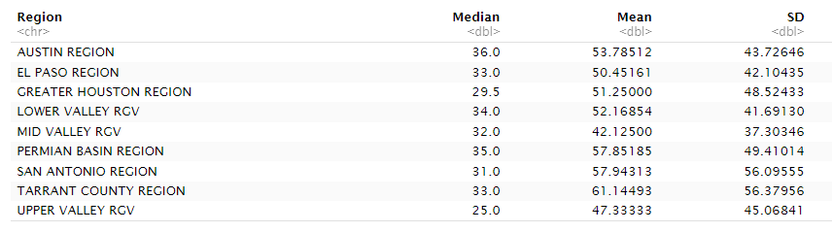
Median, Mean, and SD by Region for Vacancy Length (in Days)

Slide 6

Summary Statistics for Vacancies After Grouping by Region

Slide 7
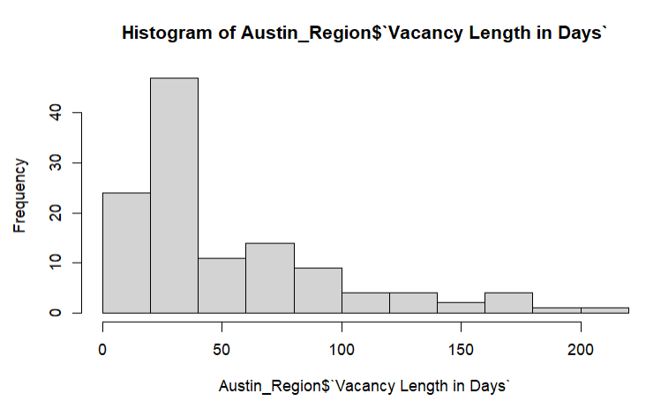
Austin Vacancy Lengths in Days

Slide 8
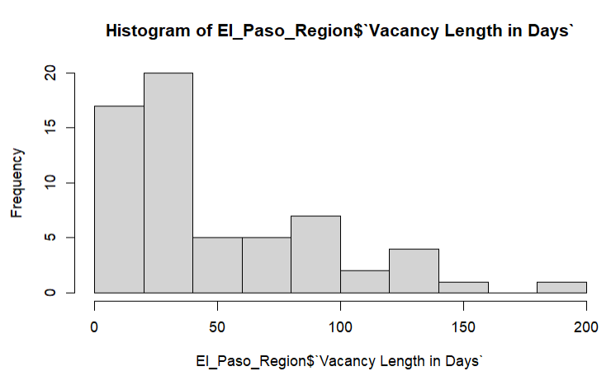
El Paso Vacancy Lengths in Days

Slide 9
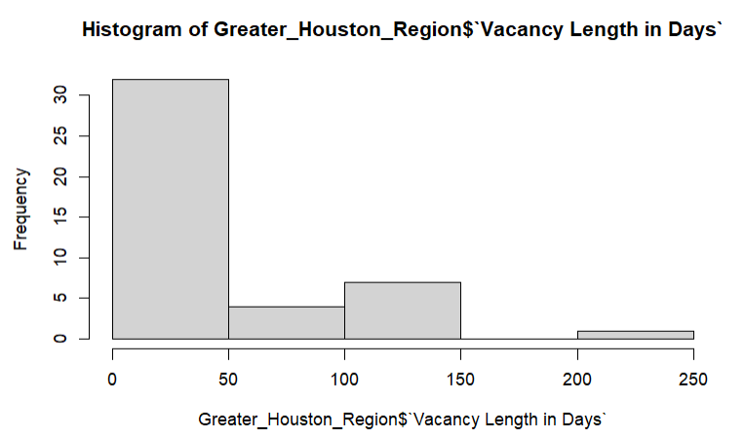
Greater Houston Area Vacancy Lengths in Days

Slide 10
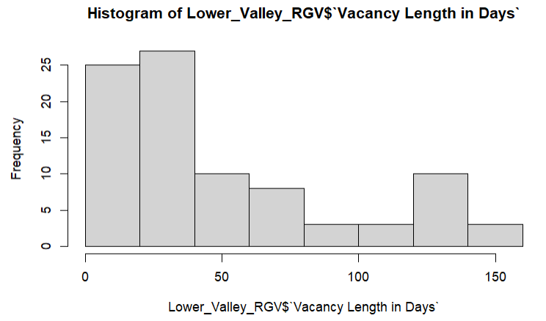
Lower Valley RGV Vacancy Lengths in Days

Slide 11
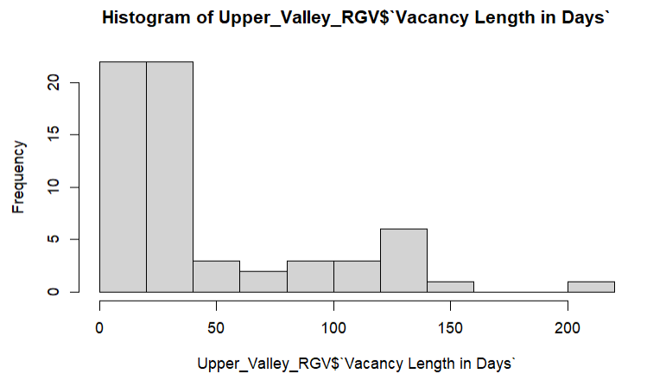
Upper Valley RGV Vacancy Lengths in Days

Slide 12
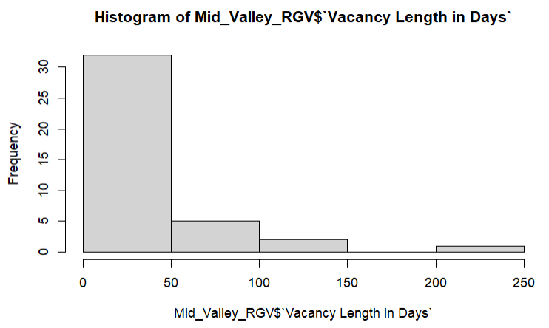
Mid Valley RGV Vacancy Lengths in Days

Slide 13
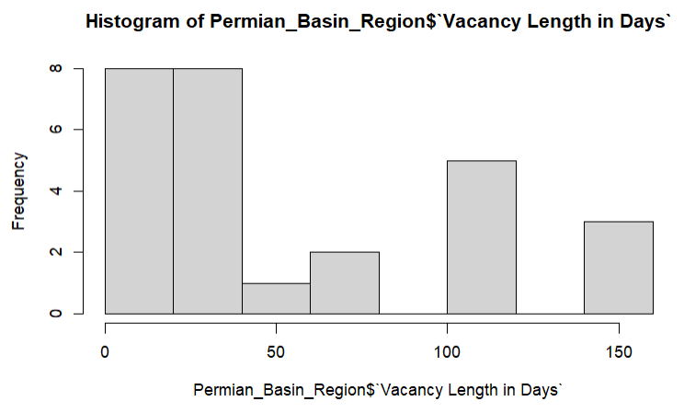
Permian Basin Vacancy Lengths in Days

Slide 14
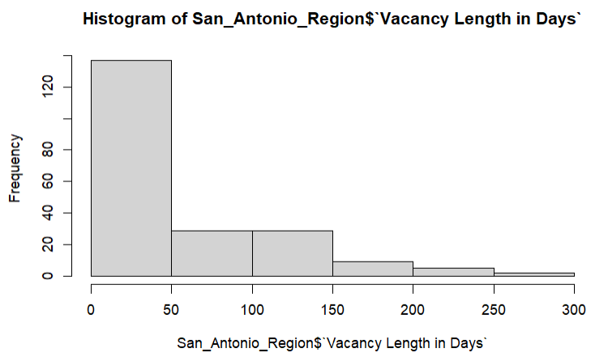
San Antonio Vacancy Lengths in Days

Slide 15
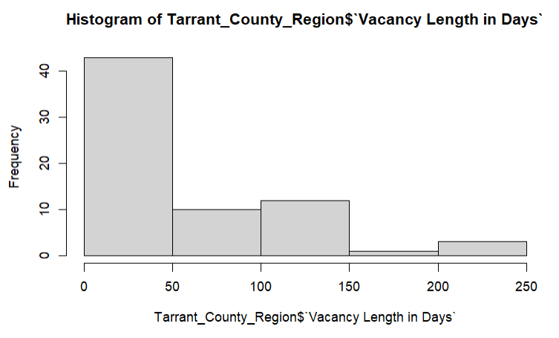
Tarrant County Vacancy Lengths in Days

Slide 16
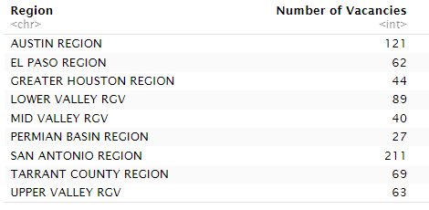
Number of Staffing Vacancies Varied by Region
San Antonio had the highest count of Staffing Vacancies and Permian Basin had the lowest.

Slide 17
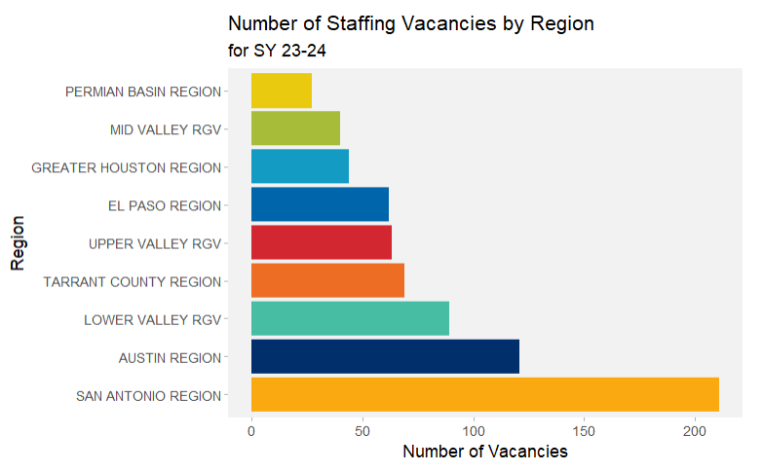
Number of Staffing Vacancies were Highest in San Antonio, Followed by Austin.

Slide 18
FMLA Data
FMLA is Family Medical Leave and is time off for medical or family (such as having a child) absences
FMLA leave length of time is counted in days, starting from the first day the employee is absent with leave to the return-to-work date.
FMLA leave can vary in length of time (depending on how many days the employee applied for and was approved for).

Slide 19
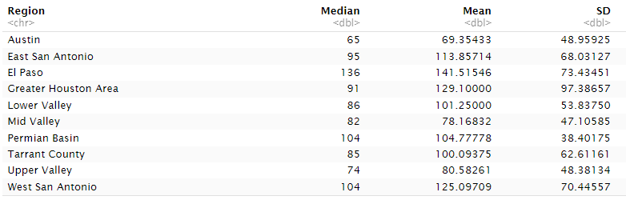
Median, Mean, and SD by Region for FMLA Length (in Days)

Slide 20
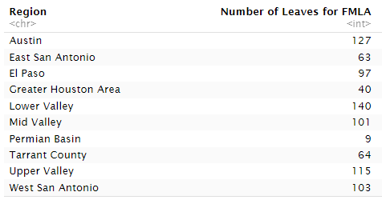
Number of Teacher Leaves from FMLA Varied by Region
Lower Valley RGV had the highest count of teacher leaves from FMLA, and Permian Basin had the lowest.

Slide 21
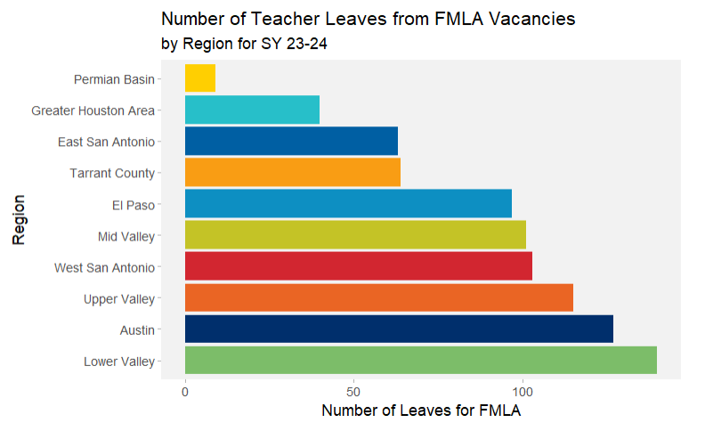
Number of Teacher Leaves from FMLA were Highest in Lower Valley RGV, Followed by Austin.

