Slide 1
Open source cheminformatics software by Ideaconsult Ltd
Toxtree 1.51 - estimates toxic hazard by applying a decision tree approach
Toxmatch 1.05 – A chemical similarity evaluation tool
Ambit Discovery
Ambit Database Tools 1.30
QMRF repository
Ambit XT
Partner in OpenTox FP7 project
Partner in CADASTER FP7 project
Notes:
Open source cheminformatics software by Ideaconsult Ltd. Sofia, Bulgaria
CDK Workshop at EBI April 20-21 2009

Slide 2
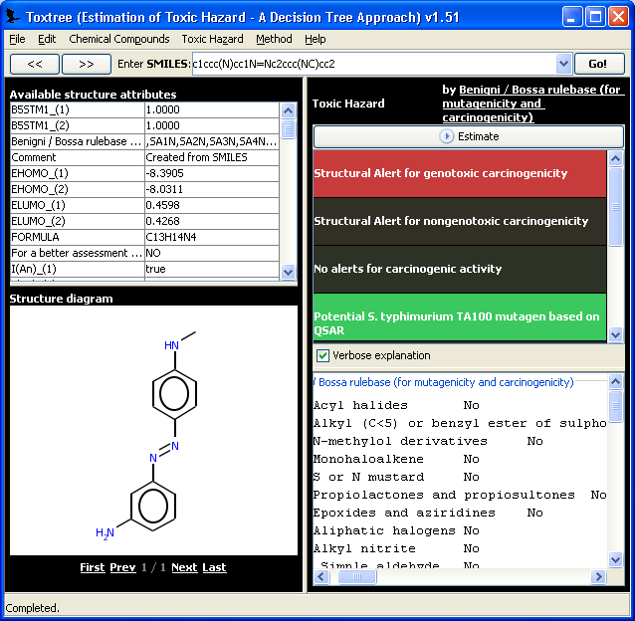
Toxtree 1.51
Estimates toxic hazard by applying a decision tree approach.
Full-featured and flexible user-friendly open source software
  New decision trees with arbitrary rules can be built with the help of graphical user interface or by developing new plug-ins in Java code
  GPL license
Platform independent
Input:
  datasets from various compatible file types
  SMILES
  built-in 2D structure diagram editor.
Output
  SDF, MOL, CSV, MS Excel, CML, TXT, PDF, HTML
Batch mode
5 classification schemes (plug-ins) for various endpoints assessment available
Notes:
Toxtree could be applied to datasets from various compatible file types. User-defined molecular structures are also supported - they could be entered by SMILES, or by using the built-in 2D structure diagram editor.
Open source cheminformatics software by Ideaconsult Ltd. Sofia, Bulgaria
CDK Workshop at EBI April 20-21 2009

Slide 3
Toxtree 1.51 plug-ins:
Cramer rules (Cramer G. M., R. A. Ford, R. L. Hall, Estimation of Toxic Hazard - A Decision Tree Approach, J. Cosmet. Toxicol., Vol.16, pp. 255 -276, Pergamon Press, 1978);
Verhaar scheme for predicting toxicity mode of actions (Verhaar HJM, van Leeuwen CJ and Hermens JLM (1992) Classifying environmental pollutants. 1.Structure-activity relationships for prediction of aquatic toxicity. Chemosphere 25, 471-491);
A decision tree for estimating skin irritation and corrosion potential, based on rules published in “The Skin Irritation Corrosion Rules Estimation Tool (SICRET), John D. Walker, Ingrid Gerner, Etje Hulzebos, Kerstin Schlegel, QSAR Comb. Sci. 2005, 24, pp378-384”;
A decision tree for estimating eye irritation and corrosion potential, based on rules published in “Assessment of the eye irritating properties of chemicals by applying alternatives to the Draize rabbit eye test: the use of QSARs and in vitro tests for the classification of eye irritation, Ingrid Gerner, Manfred Liebsch & Horst Spielmann, Alternatives to Laboratory Animals, 2005, 33, pp. 215-237”;
A decision tree for estimating carcinogenicity and mutagenicity, based on the rules published in the accompanying document: “The Benigni / Bossa rulebase for mutagenicity and carcinogenicity – a module of Toxtree”, by R. Benigni, C. Bossa, N. Jeliazkova, T. Netzeva, and A. Worth.
Notes:
New decision trees with arbitrary rules can be built with the help of graphical user interface or by developing new plug-ins in Java code.
Verhaar scheme was developed under the framework of AMBIT project.
The scheme for Eye irritation and corrosion potential estimation was developed by Ivanka Tsakovska.
Open source cheminformatics software by Ideaconsult Ltd. Sofia, Bulgaria
CDK Workshop at EBI April 20-21 2009

Slide 4
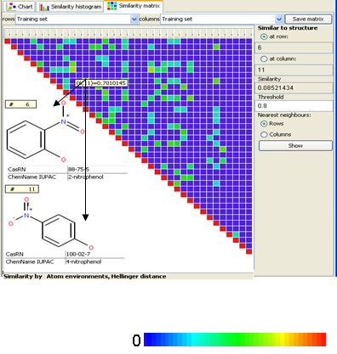
Toxmatch 1.05
Provides means to compare a chemical or set of chemicals to a toxicity dataset through the use of similarity indices
  Intended use is one to many or many to many quantitative read-across
  To help in the systematic formation of groups and read-across
Includes datasets for four toxicity endpoints to facilitate endpoint specific read-across
  aquatic toxicity
  bioconcentration factor
  skin sensitisation
  skin irritation
Developed under the terms of an Joint Research Centre (JRC) contract
Flexible open-source software application
Platform independent
G. Patlewicz, N. Jeliazkova, A. Gallegos Saliner, A. P. Worth, Toxmatch-a new software tool to aid in the development and evaluation of chemically similar groups,SAR and QSAR in Environmental Research, 19:3, 397 — 412(2008)
Notes:
The aquatic toxicity dataset is a copy of DSSTox EPA Fathead Minnow Acute Toxicity dataset (April 2006 update) containing 617 chemicals
The bioconcentration factor dataset comprises LogBCF values for 610 non-ionic chemicals
The skin sensitisation dataset contains local lymph node assay (LLNA) data for 210 chemicals, as published by Gerberick et al (2005)
A qualitative classification of potency category and reaction domain is also reported for each compound, where potency category is one of non-sensitiser, weak sensitiser, moderate sensitiser, strong sensitiser, extreme sensitiser (as defined by Kimber et al., 2003) and reaction domain is one of Michael acceptors (MA), SNAr electrophiles, SN2 electrophiles, Schiff base formers (SB), Acylating agents, Nonreactive and special cases (as defined by Roberts et al., 2007)
The skin irritation dataset consists of 72 chemicals, labelled according to EU/GHS classification for skin irritation potential (NI - not irritating, MI - mild irritation, R38 - irritating). The data arises from several sources including the US EPA TSCA (Toxic Substances Control Act) inventory and the ECETOC databank.
Open source cheminformatics software by Ideaconsult Ltd. Sofia, Bulgaria
CDK Workshop at EBI April 20-21 2009

Slide 5
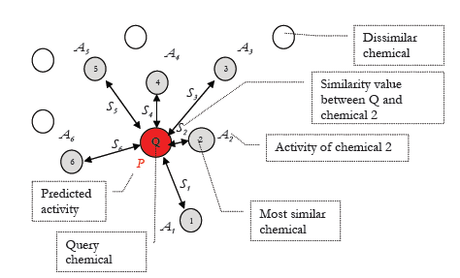
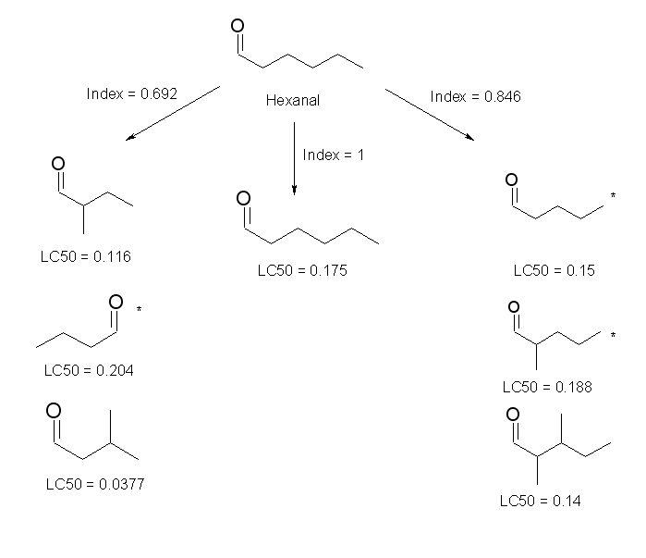
Toxmatch 1.05 - methods
Structure representations
  Descriptors
  Fingerprints
  Atom environments
Similarity indices (pair wise)
  Euclidean distance
  Cosine similarity
  Hodgkin-Richards Index
  Tanimoto distance
  Tanimoto distance on fingerprints
  Hellinger distance on atom environments
  Maximum Common Structure similarity
Similarity to a set
  Similarity between a query structure and a representative point of the set (e.g. the dataset centre or a consensus fingerprint)
  Average similarity between a query structure and the nearest k structures
Descriptor generation
  EHOMO, ELUMO, Log P, MW can be calculated
Verhaar and BfR skin irritation schemes as available in Toxtree are included
Notes:
G. Patlewicz, N. Jeliazkova, A. Gallegos Saliner, A. P. Worth, Toxmatch-a new software tool to aid in the development and evaluation of chemically similar groups,SAR and QSAR in Environmental Research, 19:3, 397 — 412(2008)
Open source cheminformatics software by Ideaconsult Ltd. Sofia, Bulgaria
CDK Workshop at EBI April 20-21 2009

Slide 6
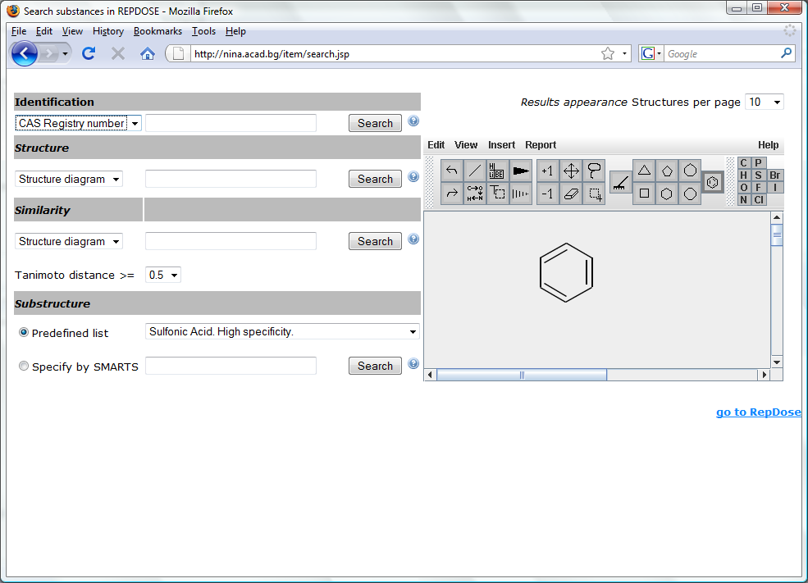
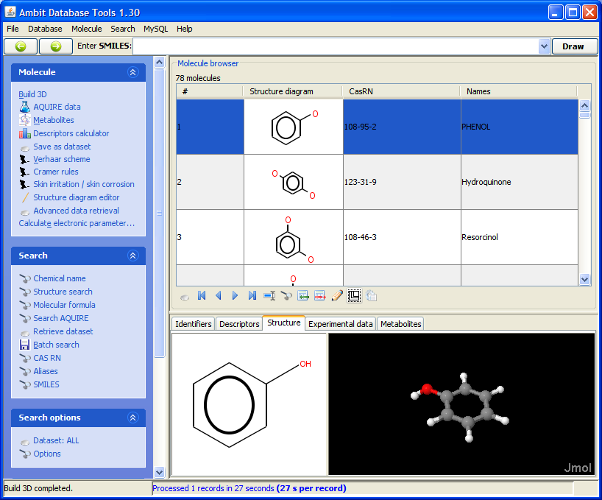
AMBIT
Developed within the framework of CEFIC LRI project “Building blocks for a future (Q)SAR decision support system: databases, applicability domain, similarity assessment and structure conversions”.
Consists of a relational database and functional modules allowing a variety of evaluations flexible structure, similarity and other queries.
Applications:
  Ambit Database tools 1.30 (on the right)
  Ambit Discovery (applicability domain assessment)
  Ambit Online
Notes:
Source code, mailing lists, bug trackers and feature request trackers available at http://sourceforge.net/projects/ambit
Open source cheminformatics software by Ideaconsult Ltd. Sofia, Bulgaria
CDK Workshop at EBI April 20-21 2009

Slide 7
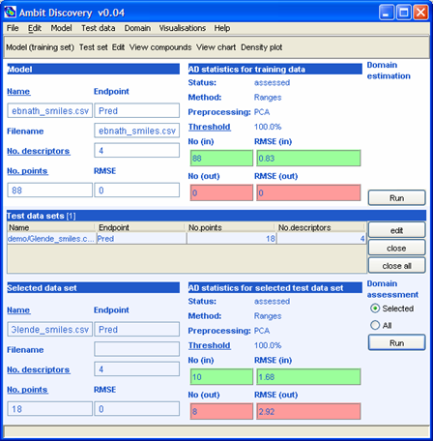
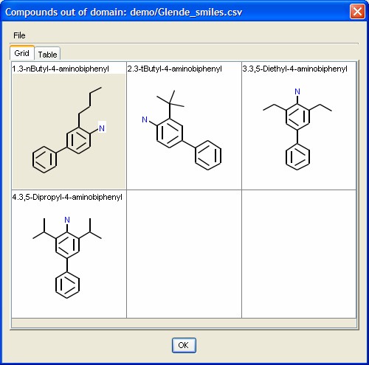
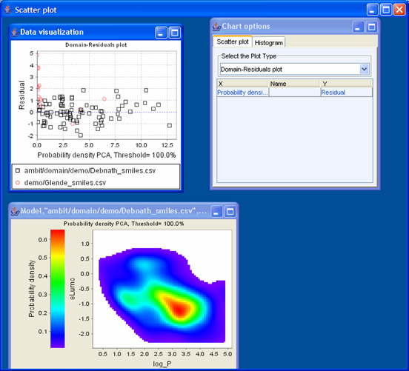
AMBIT Discovery
Software for applicability domain assessment
Methods:
  Ranges
  Euclidean distance
  City-block Distance
  Probability Density
  Fingerprints
    Consensus fingerprint + Tanimoto distance
    Consensus fingerprint + Missing fragments
  Atom environments
    Consensus atom environments + Hellinger distance
    kNN + Tanimoto distance
    Ranking
More options
  Threshold
  Preprocessing (e.g. PCA)
  Center
Results from multiple methods are automatically combined.
Joanna Jaworska, Nina Nikolova-Jeliazkova, How can structural similarity analysis help in category formation, SAR and QSAR in Environmental Research, vol 18, 3-4 (2007)
Notes:
Joanna Jaworska, Nina Nikolova-Jeliazkova, How can structural similarity analysis help in category formation, SAR and QSAR in Environmental Research, vol 18, 3-4 (2007)
Open source cheminformatics software by Ideaconsult Ltd. Sofia, Bulgaria
CDK Workshop at EBI April 20-21 2009

Slide 8
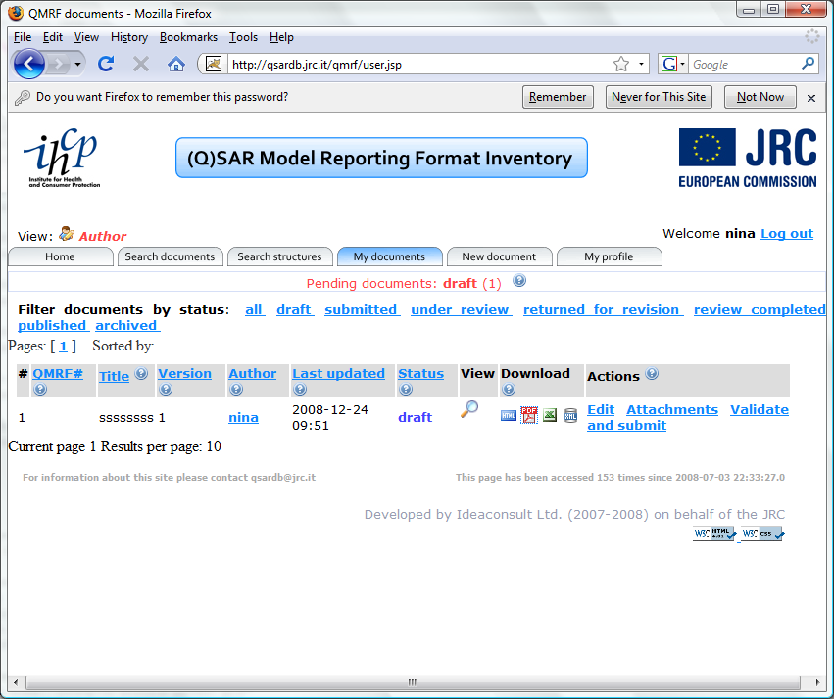
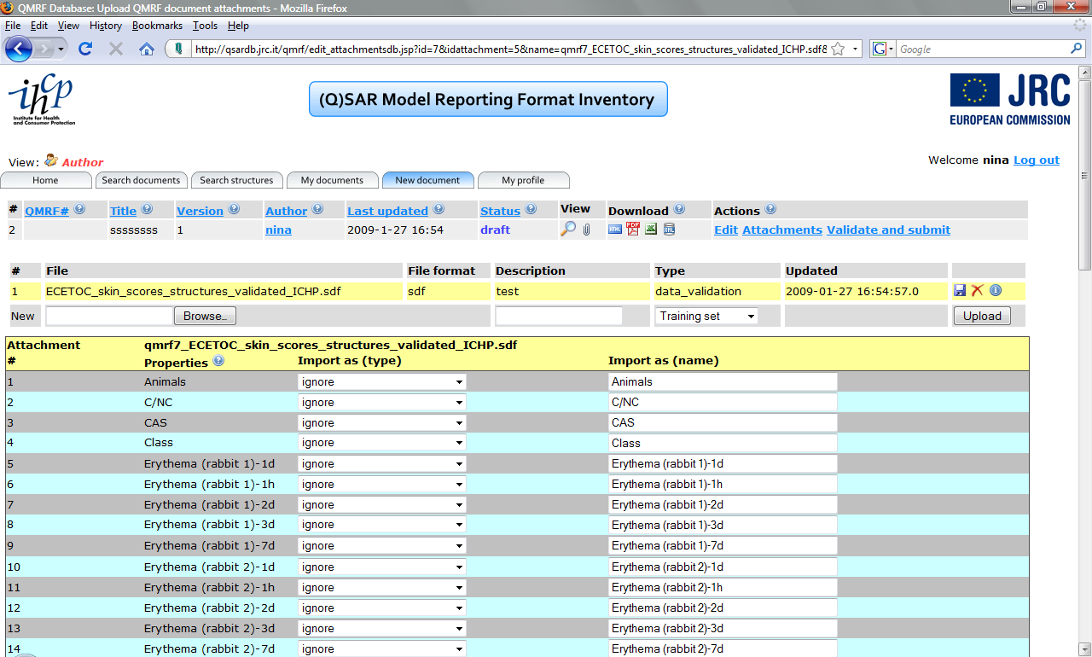
AMBIT Extensions
ECB commissioned an extension to develop a reference site for retrieving robust summaries of (Q)SAR models in QSAR Model Reporting Format (QMRF)
AMBIT 2.0 – under development (CEFIC LRI contract)
Custom extensions for third parties
http://qsardb.jrc.it
Notes:
Open source cheminformatics software by Ideaconsult Ltd. Sofia, Bulgaria
CDK Workshop at EBI April 20-21 2009

Slide 9
QMRF Repository - summary
QMRF repository so far provides information about models, not the models themselves. There is a textual description of the models, even equations for simple models, but not a generic way for automatic execution of the models.
QMRF repository at JRC is based on (extended) AMBIT database, runs under Tomcat server, implementation is based on JSP with custom tags to support structure/similarity search.
Available for testing at http://qsardb.jrc.it
Possible further development:
    PMML is an emerging standart for model storage, maintained by the Data Mining Group http://www.dmg.org/
  Allows storage of most types of models (regression, decision trees, SVM and neural networks as examples)
  Supported by major statistical packages (SAS, SPSS, R, IBM Intelligent Miner, Salford Systems (CART 6.0), Weka )
  XML based, will be easy to integrate with QMRF (also XML based)
  It may need to be extended to support data types specific for cheminformatics (e.g. structures, fragments).

Slide 10
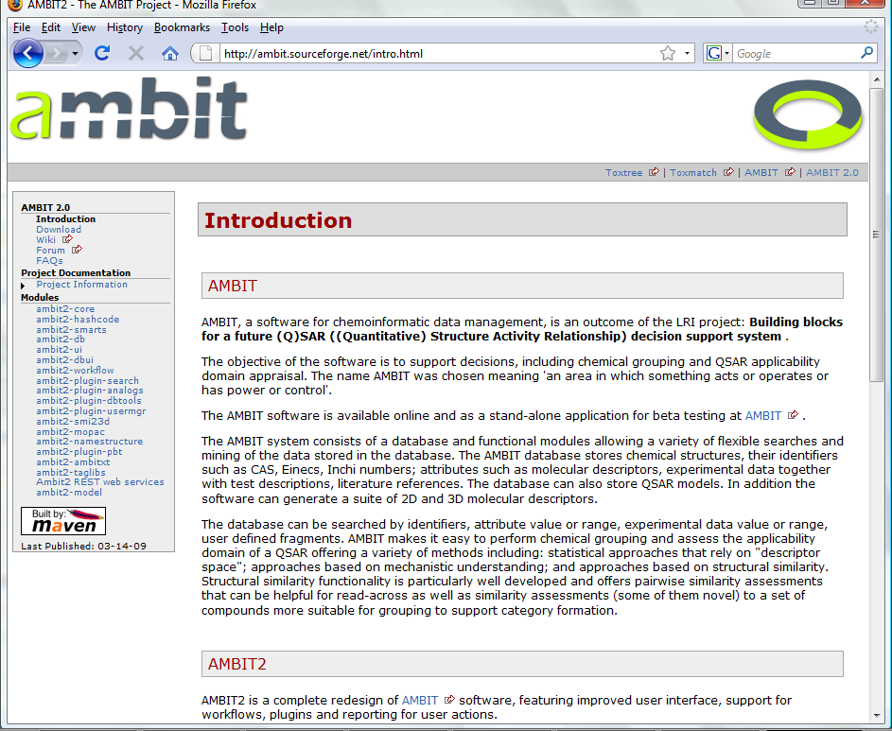
AMBIT 2.0 (under development)
Built upon AMBIT software
Objectives:
  Develop an open source user friendly software, providing a set of functionalities to facilitate registration of the chemicals for REACH.
  Improve the user friendliness by introduction of workflow capabilities
  Develop a set of defined workflows for analogue identification and PBT assessment.
Close collaboration with industry
JAVA implementation
LGPL license
Composed of several modules
http://ambit.sourceforge.net/
Notes:
Under development, initial release planned for December 2008, final release for June 2009
Open source cheminformatics software by Ideaconsult Ltd. Sofia, Bulgaria
CDK Workshop at EBI April 20-21 2009

Slide 11
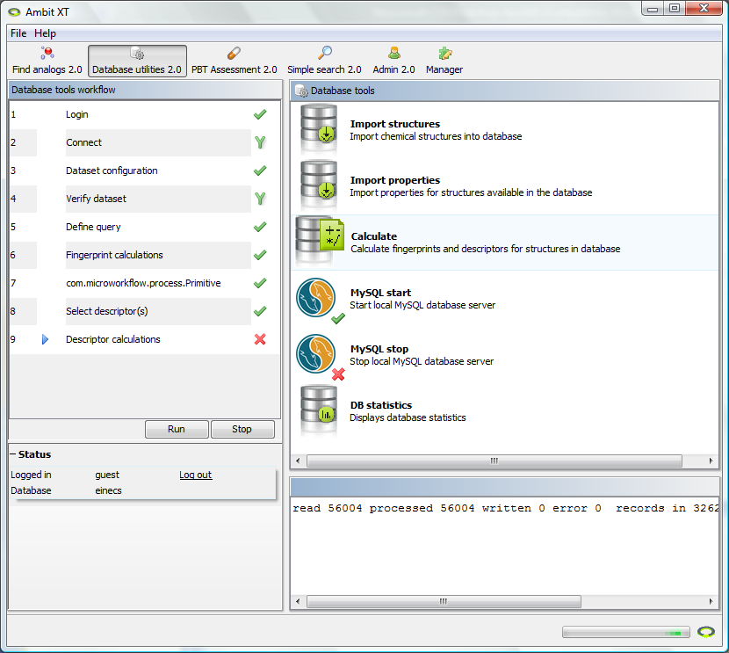
AMBIT XT – workflow support
A standalone application (GUI for AMBIT 2.0)
Data provenance
  history of the updates of the chemicals information.
Data quality
  Easy way for comparison between different sources
Flexible storage for measured data for different endpoints
  Easy way to extract all relevant information for a chemical; many formats available for toxicological data
Recording of user actions
Easy entry of complex structural alerts to facilitate grouping
Molecular descriptors
Improved data entrance and visualization
Embedded workflow engine
Modular application (flexible plug-in support)
Notes:
Open source cheminformatics software by Ideaconsult Ltd. Sofia, Bulgaria
CDK Workshop at EBI April 20-21 2009

Slide 12



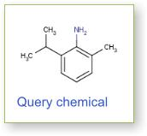
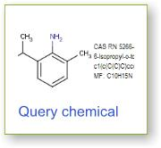
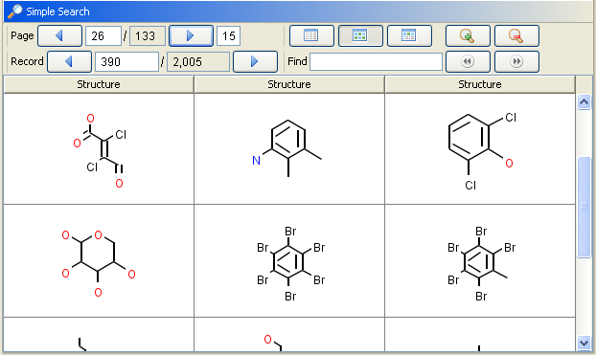






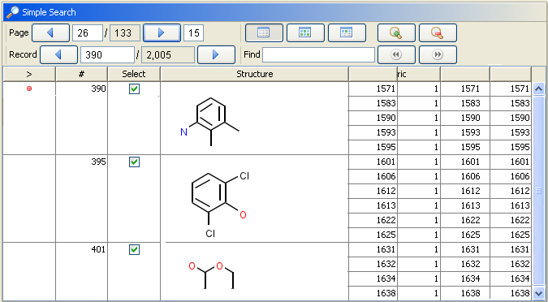

A workflow in AMBIT XT

Slide 13
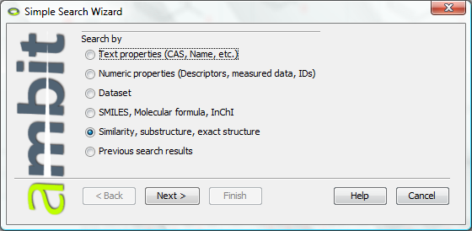
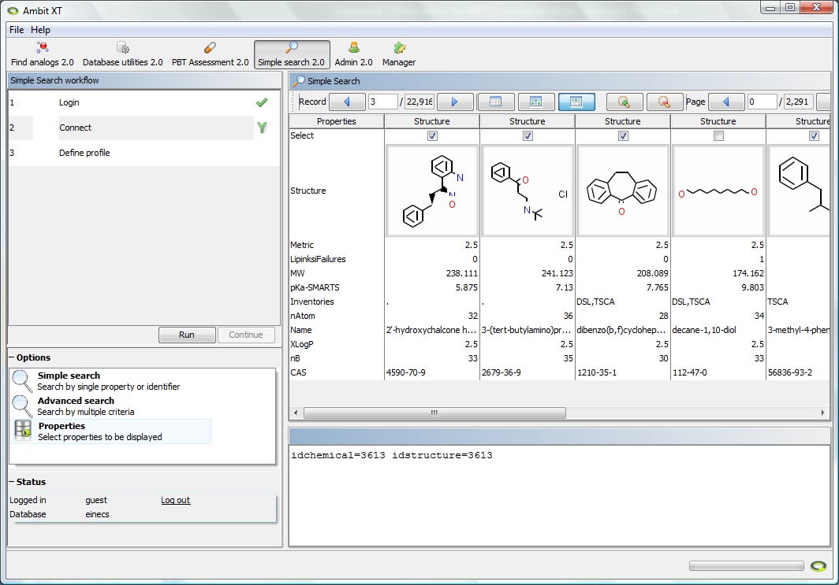
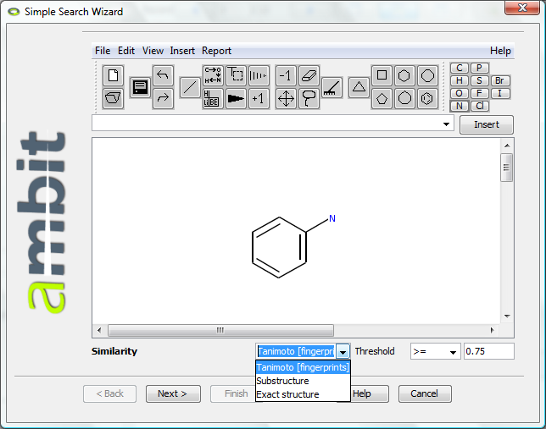
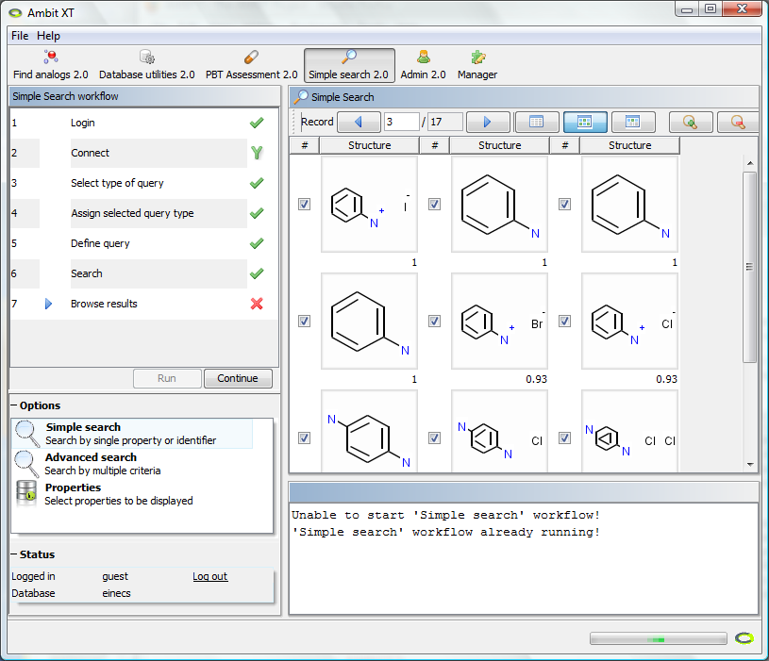
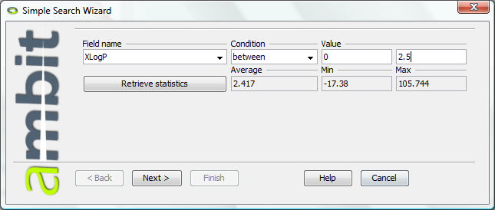
AMBT XT – Search example

Slide 14
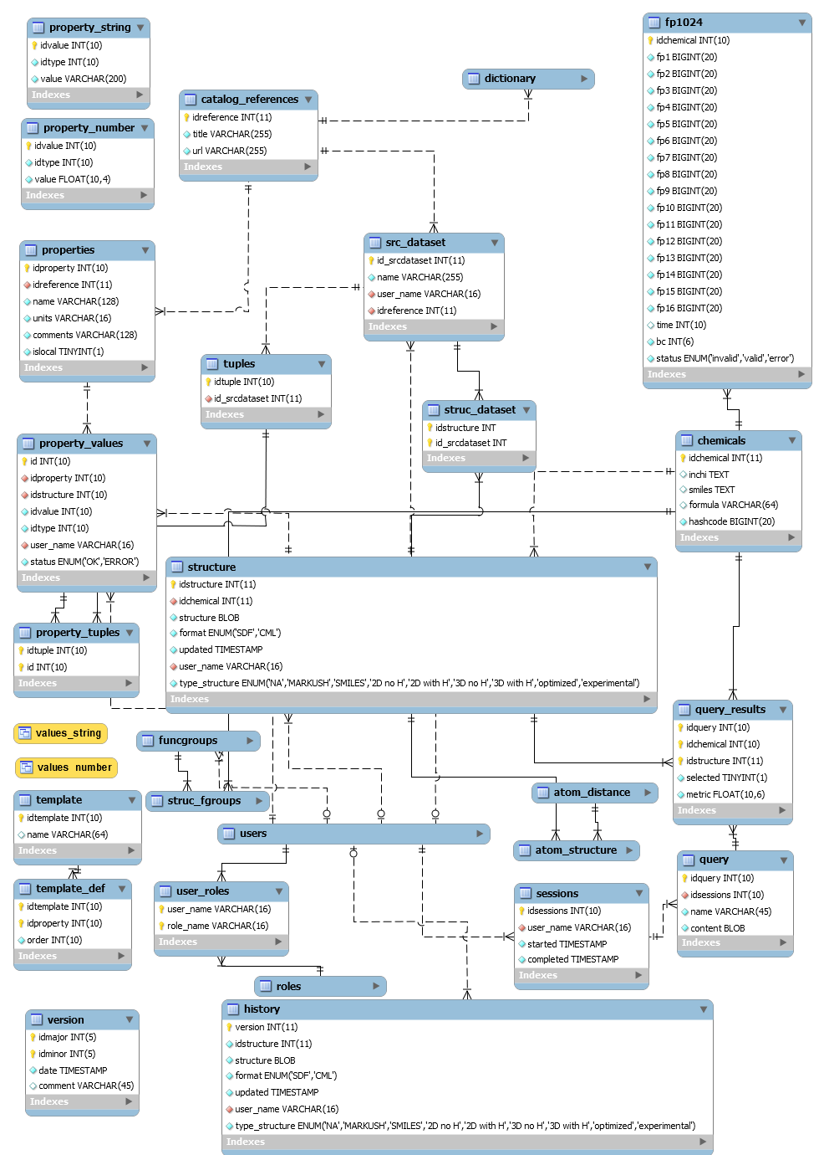
AMBIT 2.0 Database
Generic structure, allowing to store chemical structures in arbitrary format and with arbitrary number and type of properties and descriptors
  Properties are stored as name-value pairs
  Support for tuples (set of related values – e.g. test study conditions and results)
  User defined templates – the user can set a special meaning to any set of properties (e.g. properties X,Y,Z characterize skin irritation experiments)
Data provenance – where the data came from, who imported it, Literature reference for each data item
Fast (sub)structure and similarity searching
Calculation of descriptors
  By CDK, AMBIT, OpenMOPAC
Notes:
Open source cheminformatics software by Ideaconsult Ltd. Sofia, Bulgaria
CDK Workshop at EBI April 20-21 2009

Slide 15
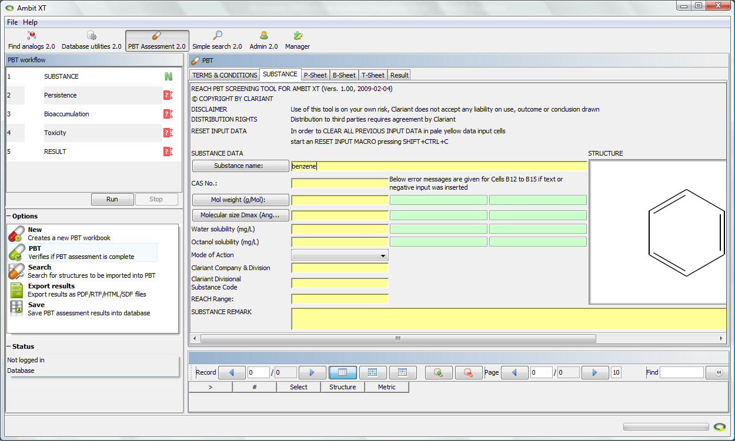
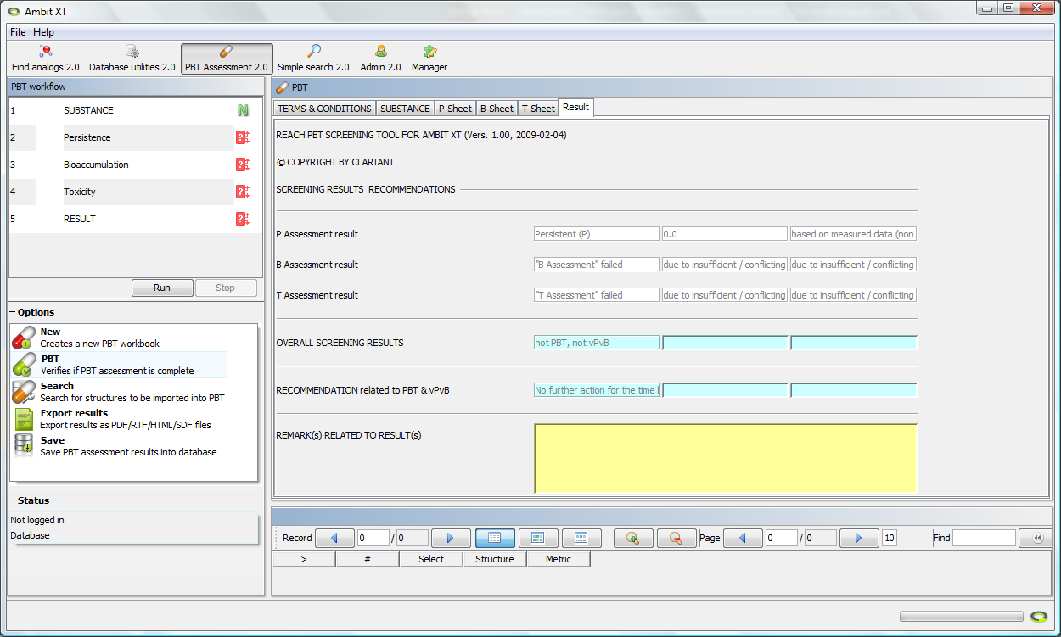
Module for PBT assessment
Developed by Clariant for AMBIT XT
P
B

Slide 16
OpenTox project (FP7)
HEALTH-2007-1.3.3 Promotion, development, acceptance and implementation of QSARs (quantitative structure-activity relationship) for toxicology
11 Partners
http://opentox.org
The goal
  To develop a predictive toxicology framework with a unified access to toxicological data, (Q)SAR models and supporting information.
  Provide tools for the integration of data from various sources (public and confidential), for the generation and validation of (Q)SAR models, libraries for the development and integration of new (Q)SAR algorithms and validation routines.
  Attract toxicological experts without (Q)SAR expertise as well as model and algorithm developers.
  Move beyond existing attempts to solve individual research issues, by providing flexible and user friendly framework that integrates existing solutions and new developments.

Slide 17
OpenTox summary
The overall objective of the proposed project is to develop a framework, that provides a unified access to toxicity data, (Q)SAR models, procedures supporting validation and additional information that helps with the interpretation of (Q)SAR predictions.
The proposed OpenTox framework will be accessible at three levels:
  A simple and intuitive interface for toxicological experts, that provides unified access to (Q)SAR predictions, toxicological data, (Q)SAR models and supporting information
  An expert interface for the streamlined development and validation of new (Q)SAR models
  An application programming interface (API) for the development, integration and validation of new (Q)SAR algorithms

Slide 18
THE CHEMISTRY DEVELOPMENT KIT
Acknowledgement: – all the products make use of

