Slide 1
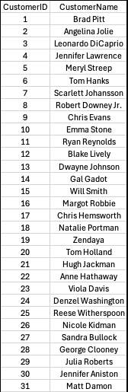
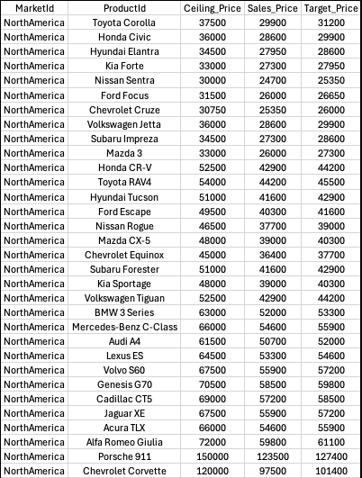
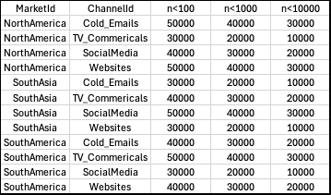

JumpPenguin – Raw Data List
Order
SalesVolume
*Kwargs
Ads cost depending on NofOrder
1st Trigger : low sales product
2nd Trigger : SolutionOffer for each Martket

Slide 2
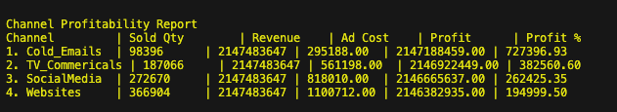

JumpPenguin – Channel Profitability Report
Profitability Rank
Cold Emails
Social Media
TV_Commercials
Websites

Slide 3
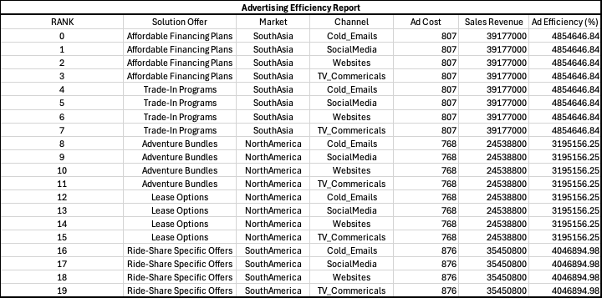
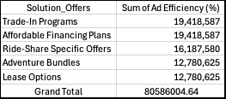

JumpPenguin – Advertising Efficiency Report
Summary - 1
Ads Efficiency Rank
Categorized by Solution Offers
Trad-In Programs
Affordable Financing Plans
Categorized by Markets
SouthAsia
NorthAmerica
SouthAmerica

Slide 4
JumpPenguin – Advertising Efficiency Report
Summary - 1
Ads Efficiency Rank
Categorized by Solution Offers
Trad-In Programs
Affordable Financing Plans
Categorized by Markets
SouthAsia
NorthAmerica
SouthAmerica

Slide 5
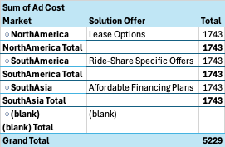
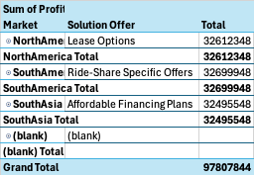
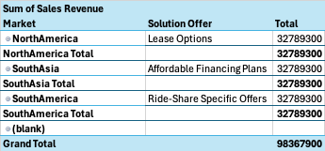
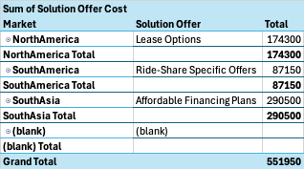
JumpPenguin – MarketProfitability Report
-
+
=
Summary - 1
MarketProfitabilityRank
Formula = (SalesRevenue-AdsCost-SolutionOfferCost= Profit)
NorthAmerica with Lease Options
SouthAmerica with Ride-Share Specific Offers
SouthAsia with Affordable Financing Plans

