Slide 1

The Topic : Analyzing the Predictive Power of Financial Variables on Loan Defaults Using Classification Models
Author : Jiwon Mok
Scripts Link :https://github.com/ideal-jiwon/R_lab/blob/main/Final_Jiwon.docx
The Goal of the Analysis
Results of the analysis
Classification Models
The primary goal of the analysis is to find the factors leading to loan default and develop a machine learning algorithms to predict the possibility of an applicants. The analysis will be based on the data of over 4,000 customers who are using loans from the National bank, and variables are used to find what are driving to the loan default: i. Interest rate ii. Debt-to-income ratio iii. History of bankruptcy iv. Annual income v. Home ownership vi. Loan term.
History of bankruptcy, debt-to-income ratio, and home ownership have insignificant influences on defaulting rate of loans. Thus, these three factors should be not be the consideration when banks approve the loan customers. On the other hand, loan interest rate, annual income, and loan term are the determinants showing the huge difference. Specifically, loan interest rate is shown to be higher to the people who default the loans. On top of that, the longer the loan term is, the higher default rate is based on the finding from comparing the difference between the 5 years loan and 3 years loan term. Finding three dominant factors to defaulting loans is important for the company since they can reduce the loss.
Logistic Regression Model, Random Forest Model, and LDA Model.Through Machine Learning modeling, three dominant factors are found, and ROC AUC is also used for the accuracy, 99%, 99%, and 97.6% are measured in logistic regression model, LDA model, and Random Forest model for each. It manifests that higher ROC AUC rate proves that it has more accurate result. Therefore, logistic regression model supports loan defaulting rate is greatly affected by installment, the amount of loan, interest rate, and loan term.

Slide 2
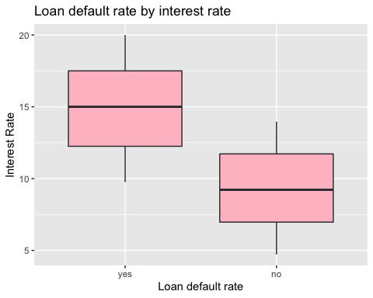
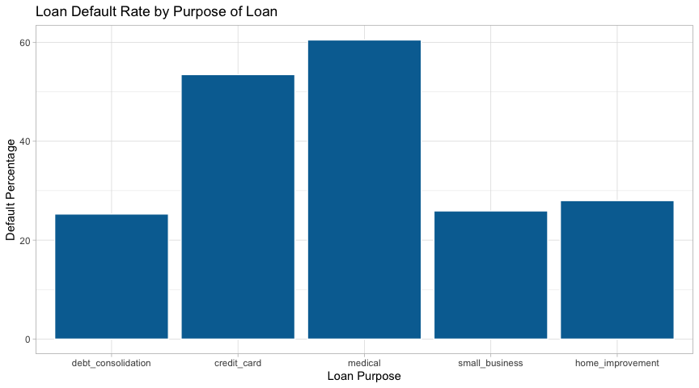
1.
Are there differences in loan default rates by loan purpose?
2.
Does higher interest rate result in higher loan default rate?
3.
Are customers with bankruptcy history more likely to default the loans in the future?
Yes, the data indicates that credit card and medical loans have significantly larger default rates than any other type of loan.
No. There is no significant difference in loan default rates. The data collected based on 486 customers, 41.76% of them have the history of bankruptcy. Among 3264, 36.6% of them do not default the loans, which is significant. Therefore, compared to other factors, the history of bankruptcy does not make the big difference in lowering loan default rate.
Yes. Higher interest rate is more likely to result in loan default rate based on the box plot below. The average interest rate among customers who default lone is 14.89 while people who do not default lone use the program at 9.34. It proves that higher interest rate is more likely to result in higher loan default rate. Among customers who have default loans, minimum interest rate is 9.75 and the highest interest rate is 20.00. Compared to them, customers who have not default loans show the far lower interest rate as 4.72 and 13.97 for minimum and maximum for each. Therefore, it shows that there is the clear relationship that higher interest rate leads to the higher defaulting loan rate to customers.

Slide 3
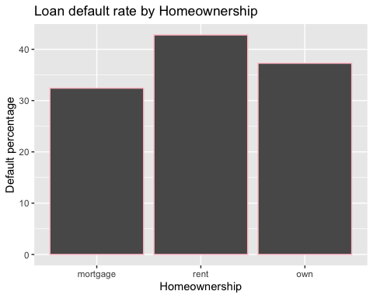
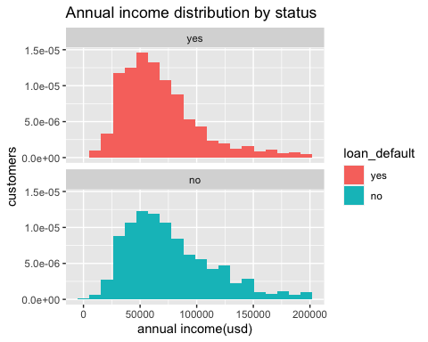
4.
Do people who have home are less likely to default loans?
5.
Do people who have higher income are less likely to default the loans?
No, homeownership is not the factor of leading to defaulting loan. People who own their home show 37% of loan_default rate while people who rent the house show 42.79. The rate is slightly higher at 5%. It is not the principal component.
Yes, Customers who default on their loans have lower income than customers who have not. From 100k, the proportion of customers who have not default on their loans is far higher than those who have not.

Slide 4
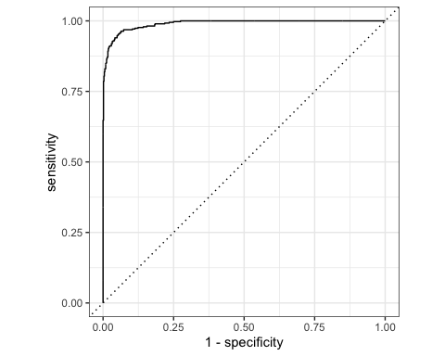


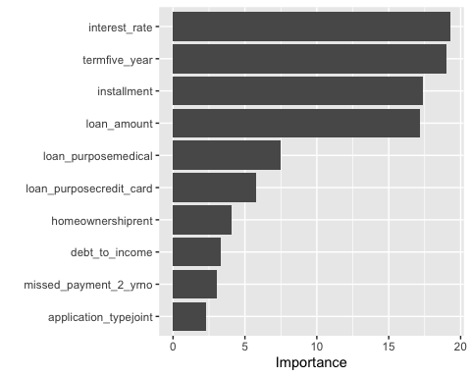
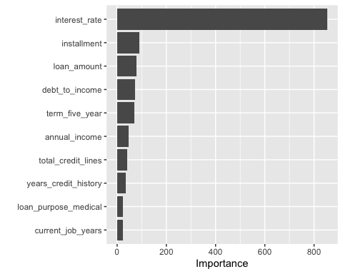
6. Predictive Modeling
Analysis
In this analysis, three classification models are used: Logistic Regression Model, Random Forest Model, and LDA Model. Through Machine Learning modeling, three dominant factors are found, and ROC AUC is also used for the accuracy, 99%, 99%, and 97.6% are measured in logistic regression model, LDA model, and Random Forest model for each. It manifests that higher ROC AUC rate proves that it has more accurate result. Therefore, logistic regression model supports loan defaulting rate is greatly affected by installment, the amount of loan, interest rate, and loan term.
Resolution Notes
First, bank should change the loan term from 5 years to 3 years. Based on the results from logistic regression model, the number of people with 5 years loan account for the second biggest part in defaulting on the loans. In statistics, 3 years loan has a half of defaulting rate, and thereby the it is recommended to reduce the loan term from 5 years to 3 years. It will not only reduce loan default rate but also encourage more customers to continuously loan the money.
Second, bank should loan the people who have higher annual income rate. In the data, it was noticeable that people with higher annual rate show more less default rate. Therefore, based on this result, banks should try to keep customers who are with higher annual income and higher the standard for the people who can be eligible for loan program.
Third, bank should reduce interest rate to lower the loan default rate since it is turned out as the most determining factor for the loan default rate. In summary table, 90% of customers who have not paid were using loan program at the interest rate higher than 10% while other customers with less interest rate were more likely to pay their money back to the bank. Default rate is 0 within the customers with the interest rate lower than 9%. If the bank is willing to focus on reducing loan defaulting rates, lower interest rate will result in significant difference.
Logistic Regression Model
LDA Model
2.
Random Forest Model
1.
3.
Random Forest Model

