Slide 1
Interpretable Decision Sets: A Joint Framework for Description and Prediction
Himabindu Lakkaraju, Stephen H. Bach, Jure Leskovec
Presented By: Rebecca Adaimi
Ronshee Chawla

Slide 2
Outline
Introduction
Motivation
Interpretable Decision Sets and its Properties
Learning Decision Sets
Experimental Evaluation
Summary

Slide 3
Introduction
Learning interpretable models is challenging due to tradeoff between interpretability and accuracy.
Rule-based models widely used for learning interpretable models (decision trees, decision lists).
Stated in terms of input features
No dependence on any latent variables or representations
Concise, logical rules used to make interpretable predictions
Structure connecting a set of rules plays a key role in designing interpretable models.

Slide 4
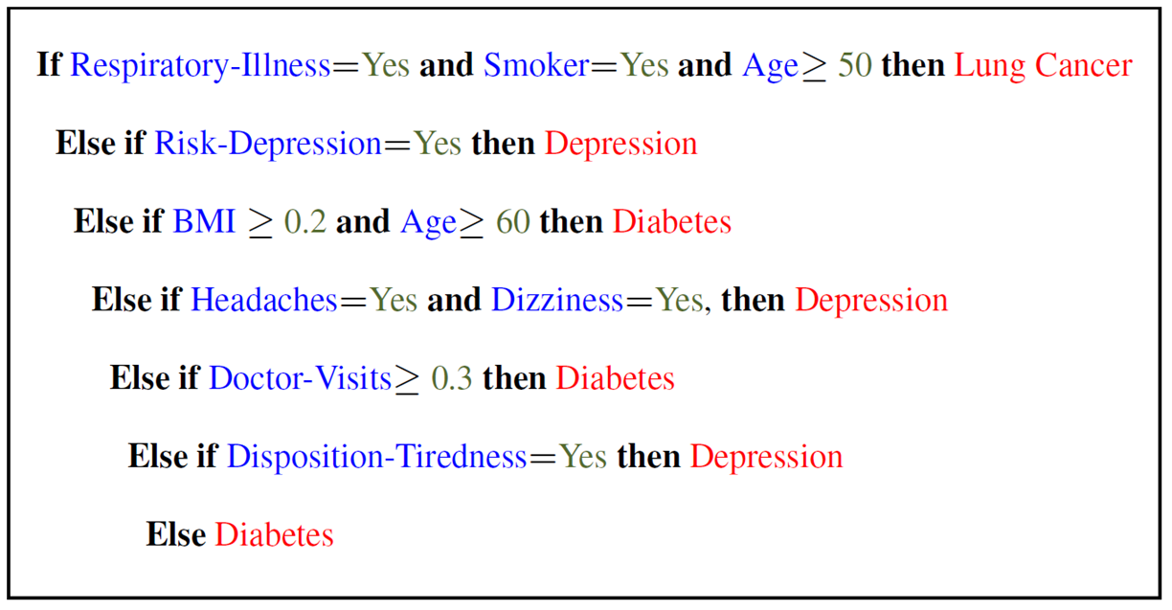
Motivation
Decision lists:
Predict when a rule is true
Collection of if-then-else statements
Drawbacks associated with decision lists:
New rules can only cover increasingly narrow slices of the feature space
Interpretability becomes challenging when size of the rules increases
Difficult to understand all the conditions that must be satisfied before applying a rule
Narrow rules for most classes in multi-class classification
Example of a decision list
Notes:
Decision lists are considered more interpretable than a general decision tree because of its reduced complexity.
2nd drawback: Even if the first few rules in the list are interpretable, each additional rule becomes less so because it only applies to more and more narrow situations, i.e., a given rule only applies to those data points that do not satisfy any of the preceding rules.
Multiclass classification drawback: In effect, some classes are only described as alternatives after other classes have been considered, a serious problem for domain experts who want equally good
rules for all the classes in the data.

Slide 5
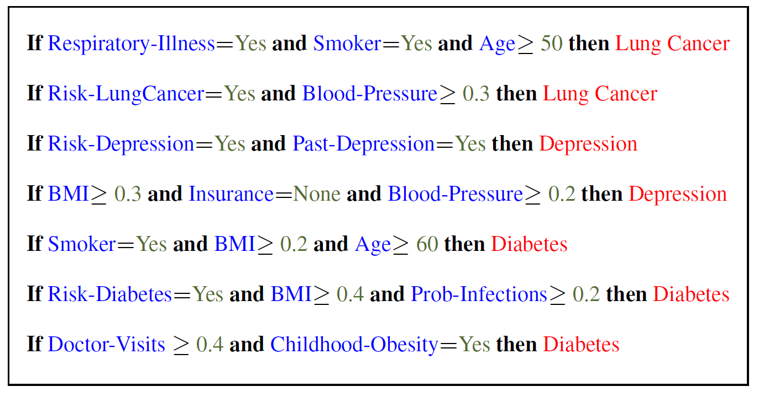
Interpretable Decision Sets
Collection of if-then rules with no precedence in order.
No hierarchy due to absence of else statements.
Default label assigned to data points when not covered by any rule or covered by rules indicating different classes.
Each rule is an independent classifier that can assign its label.
Example of a decision set
Notes:
Non-hierarchical structure of decision sets is the key to interpretability.

Slide 6
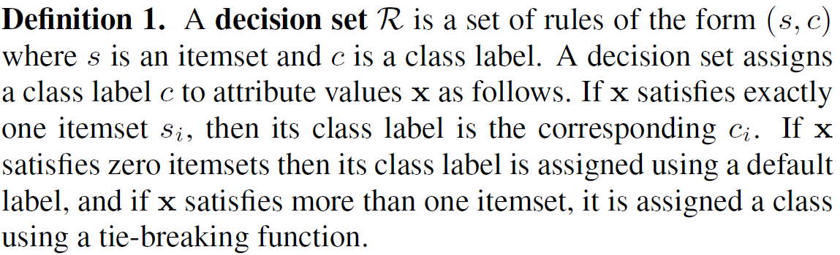
Interpretable Decision Sets
Decision sets defined using itemsets
Notes:
An itemset s is a filter for data points, defined as a conjunction of one or more predicates of the form (attribute; operator; value), e.g., (x1 > 5).
Given attribute values x, we say that x satisfies s if all the predicates in s are true when evaluated on x.
A rule is a tuple (s; c) where s is an itemset and c is a class label.

Slide 7
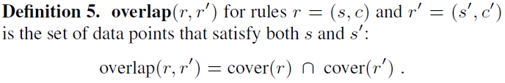
Properties of Interpretable Decision Sets
Based on interpretability

Slide 8
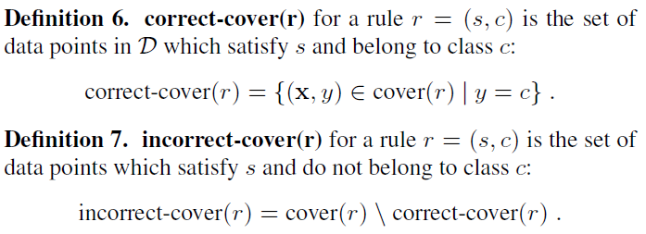
Properties of Interpretable Decision Sets
Based on accuracy
Used to reason about the precision and recall of the entire decision set.

Slide 9



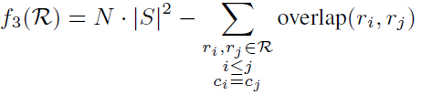
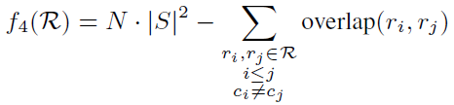

Learning Decision Sets
Objective Function: Interpretability Terms
For decision sets with a smaller number of rules
For fewer predicates in the decision set, where
For favoring decision sets with rules that do not overlap in the feature space
For encouraging the decision set to have at least one rule that predicts each class
Notes:
Minimizing size encourages decision sets with a small number of rules.
Minimizing length captures the notion that interpretable rules are short and concise.
However, conciseness alone is not sufficient for an interpretable decision set. Interpretability also requires providing the user with a clear description of decision boundaries for all the classes in the
data.
We use cover to denote how many datapoints satisfy the itemset of a rule, which is necessary for defining subsequent metrics.
Finally, minimizing overlap encourages each rule to cover an independent part of the feature space.

Slide 10



Learning Decision Sets
Objective Function: Accuracy Terms
Favoring rules with small incorrect-cover sets for encouraging precision
Favoring decision sets that correctly cover data points with at least one rule for encouraging recall
Overall objective function (where $λ_{i}≥0$ for all $i∈\{1, …, 7\}$)
Notes:
We can measure a decision set’s overall accuracy by evaluating it on test data, but we also need to measure the accuracy of its rules individually during learning.
If |correct-cover(r)| is high and |incorrect-cover(r)| is low, then the rule r is precise and contributes towards a higher precision for the decision set. (How much it contributes depends on |cover(r)|) On the other hand, having a high recall requires many data points to be correctly covered.

Slide 11
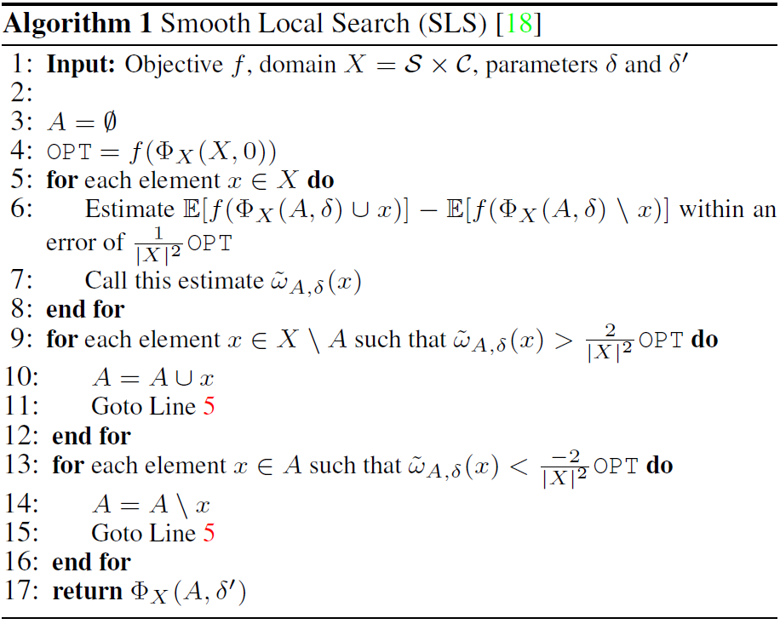
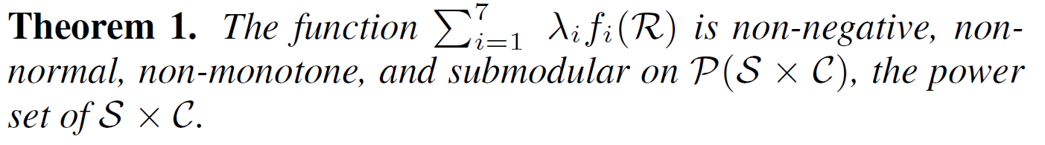
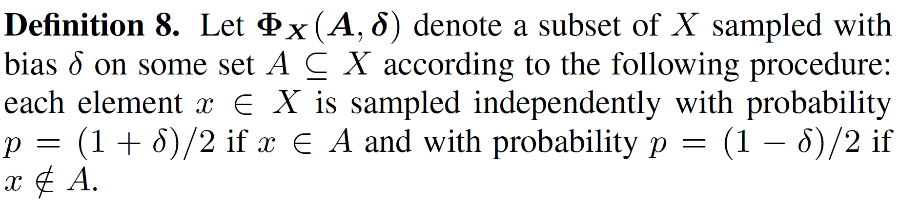
Learning Decision Sets

Slide 12
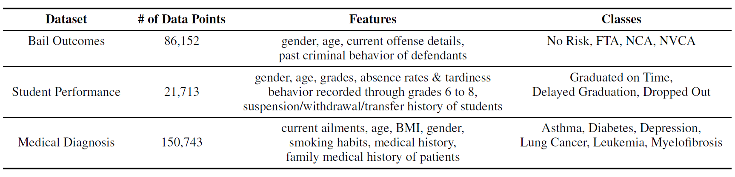
Experimental Evaluation
Datasets: real-world datasets: bail outcomes, student performance, and medical diagnosis
Baselines for Comparison: Bayesian Decision Lists (BDL), CN2, Classification Based on Associations (CBA), Logistic Regression, Random Forests, Gradient Boosting, and Decision Trees
Parameter Selection: coordinate ascent with AUC evaluation while satisfying bounds on interpretability
Candidate Itemsets Generation: Apriori Algorithm (frequent itemset mining)
Notes:
Bail outcome: dataset consists of details of defendants released on bail
Classes: defendant not arrested while out on bail and appears for further court dates, FTA: the defendant fails to appear for further court dates, NCA, the defendant commits a non-violent crime, and NVCA: the defendant commits a violent crime.
Student performance dataset: consists of records of student who were set to graduate in 2012 and 2013.
Medical Diagnosis dataset: consists of records of 150k patients.
Baselines for comparison: interpretable rule-based systems: BDL, CN2, and CBA
CBA: designed to bridge the gap between association rule mining and classification and so optimized for predictive accuracy
CN2 is a decision set learning alg which does not explicitly account for conciseness or overlap
BDL: optimizes for conciseness and predictive accuracy
Apriori algorithm: identifies the frequent individual items in the database and extending them to larger item sets as long as those item sets appear sufficiently often in the database. The frequent item sets determined by Apriori can be used to determine association rules which highlight general trends in the database

Slide 13
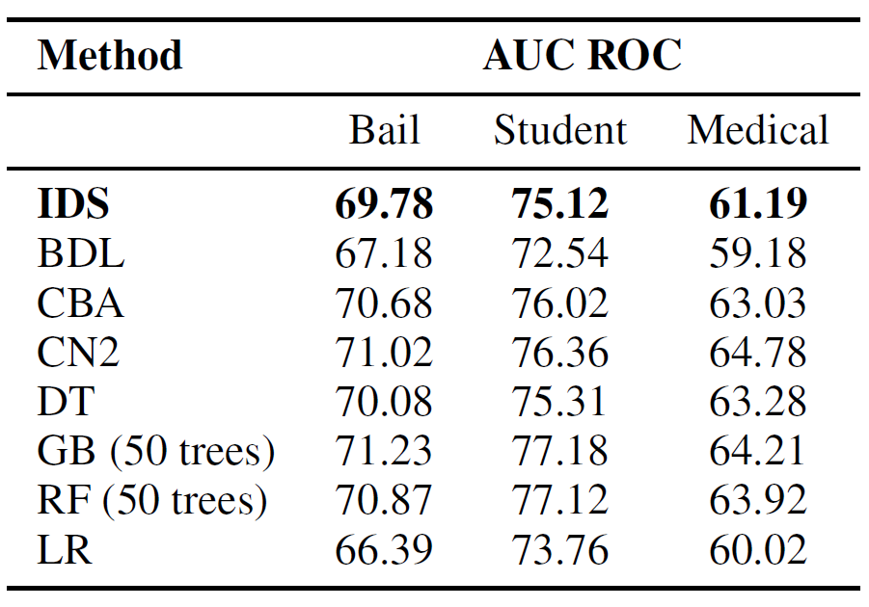
Classification Performance
Prediction Tasks:
behavior of defendant released on bail
whether a student will not graduate high school on time or drop out
which disease a patient is likely to be diagnosed with
Evaluation Metric: micro-averaged AUC (average of per-class AUCs)
Notes:
The probability that data point d belongs to some class c is the precision of rule r. That is, the fraction of data points classified by r to class c that truly belong to c. Since our prediction tasks are multi-class, we used micro-averaged AUC. We binarized the classes in the data using a one vs. all strategy and computed the AUC for each class. Micro-averaged AUC is the average of these per-class AUCs.
IDS exhibits comparable performance as CBA, CN2, and decision trees on bail and student data. As for Medical, it slightly under-performs. This is useful as it shows that IDS has comparable performance with models that exclusively optimize for predictive accuracy.
Comparable performance to CN2, CBA, and DT on Bail and Student

Slide 14
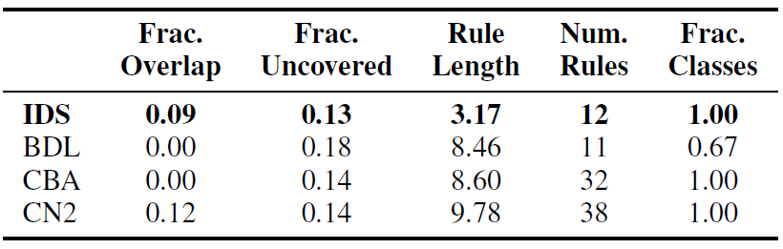
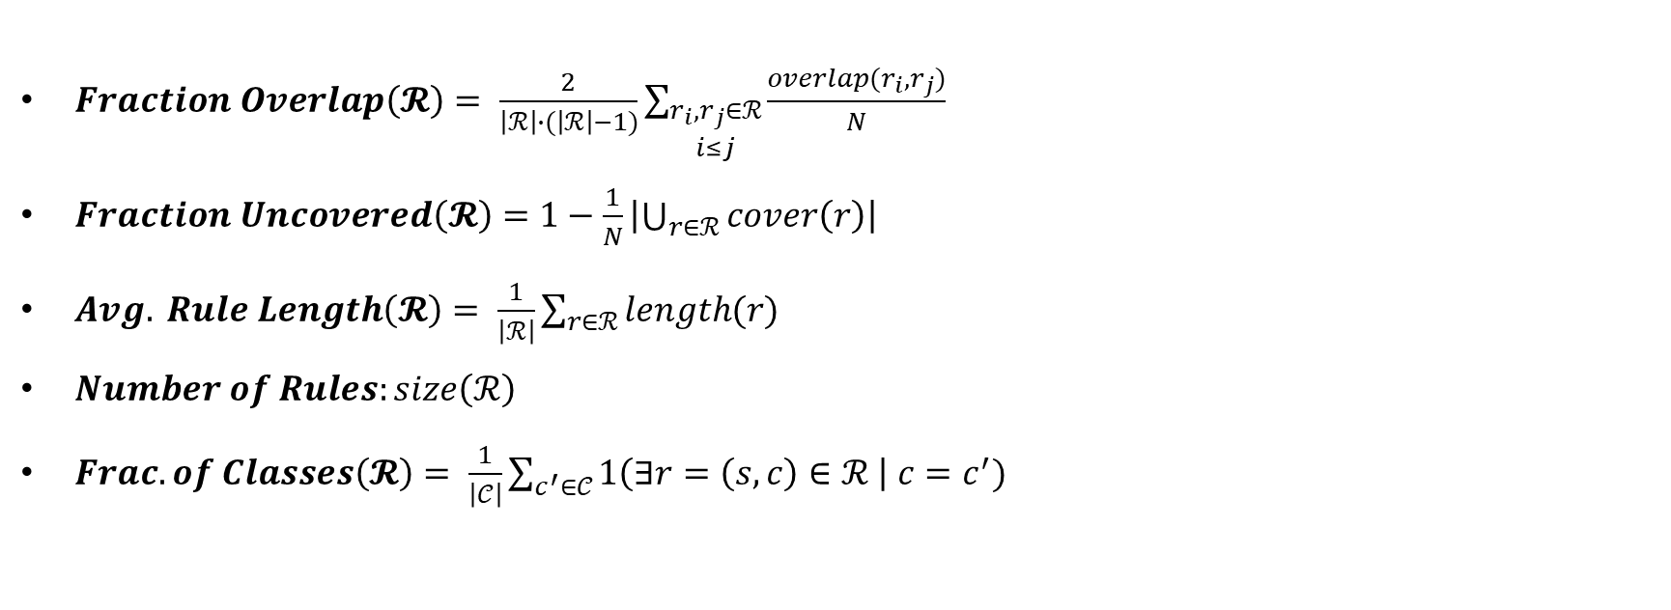
Quantifying Interpretability
$Fraction Overlap\left(𝓡\right)= \frac{2}{\left|ℛ\right|∙(\left|ℛ\right|−1)}\sum_{\begin{aligned}r_{i},r_{j}∈ℛ \\ i≤j\end{aligned}}{\frac{overlap(r_{i},r_{j})}{N}}$
$Fraction Uncovered\left(𝓡\right)=1−\frac{1}{N}\left|\bigcup_{r∈ℛ}{cover\left(r\right)}\right|$
$Avg. Rule Length\left(𝓡\right)= \frac{1}{\left|ℛ\right|}\sum_{r∈ℛ}{length(r)}$
$Number of Rules:size\left(ℛ\right)$
$Frac. of Classes\left(𝓡\right)= \frac{1}{\left|𝒞\right|}\sum_{c^{′}∈𝒞}{1\left(∃r=\left(s,c\right)∈ℛ \right| c=c^{′})}$
Medical Dataset
Notes:
Fraction overlap: captures the extent of overlap between every pair of rules in a decision set R. Smaller overlap means higher interpretability.
Fraction Uncovered: computes the fraction of data points not covered by any rule in a decision set R.
Avg rule Length: the average number of predicates in a rule.
Number of rules
Fraction of Classes: measures the fraction of class labels predicted by at least one rule in a decision set R.
For Frac of Classes: IDS, CBA, and CN2 account for all classes. BDL produces a decision list which leaves out two of the less common but very important classes that correspond to rare types of blood cancers.

Slide 15
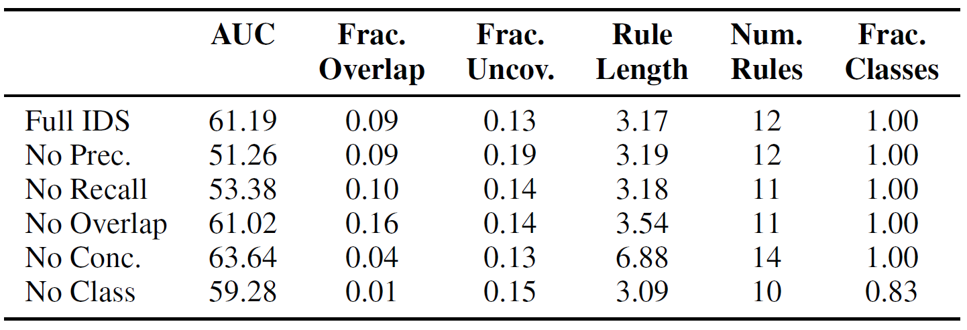
Ablation Studies
$$arg\max_{ℛ⊆S×C}{λ_{1}f_{1}(ℛ})+λ_{2}f_{2}\left(ℛ\right)+λ_{3}f_{3}\left(ℛ\right)+λ_{4}f_{4}\left(ℛ\right)+λ_{5}f_{5}\left(ℛ\right)+λ_{6}f_{6}\left(ℛ\right)+λ_{7}f_{7}(ℛ)$$
Conciseness
Overlap
Class
Precision
Recall
Medical Dataset
Notes:
Exploring the impact of various components of the objective function
They experiment with various ablations of the model by excluding components from the objective function one at a time.
What is interesting to see is that excluding the precision leads to a large fraction of data points uncovered. This is because the precision ensures the coverage of data points.
No class leads to a decision set that does not describe a rare type of blood cancer.
➔ Each term in objective contributes to the overall goal of learning accurate and interpretable decision sets

Slide 16
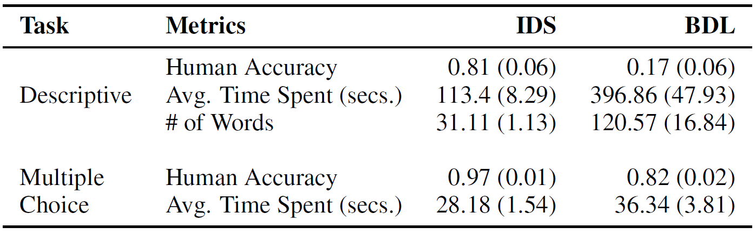
Human Judgment of Interpretability
A rule-based model is considered interpretable if a human can understand the model’s decision boundaries.
User Study Design:
Comparison with BDL
47 students
Description questions and multiple choice questions
Medical Dataset
Notes:
Description questions: Each of the questions required the user to explain in plain language all the characteristics of a patient suffering from a particular disease based on the rules presented.
Human accuracy: fraction of correct answers
People were more accurate and faster in answering questions based on the decision sets as opposed to decision lists.

Slide 17
Conclusion
Framework for learning interpretable decision sets by optimizing both accuracy and interpretability
Proposed a non-monotone submodular objective function
➔ Decision sets are as accurate as other methods but more interpretable

