Slide 1

Interpretable Decision Sets: A Joint Framework for Description and Prediction Himabindu Lakkaraju, Stephen H. Bach, Jure Leskovec
Critique by Shubham Sharma and Jie Hua

Slide 2
Key Takeaways
Independent decision set VS chain of if-then-else statements
Combined Objective for interpretable model.
Interpretability and Accuracy
Experiments show that the independent set is more interpretable compared to other rule-based model.

Slide 3
Critique #1.
In general, rule-based method is not so interpretable when the decision boundary is complicated.
For big data, this method is limited by the expressive power of the pre-mined set of rules.

Slide 4
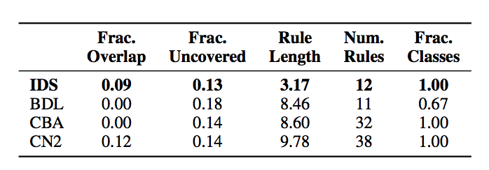
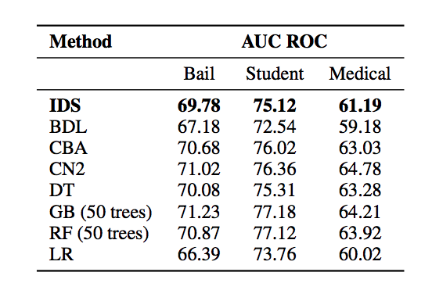
Can we really evaluate the method?
AUC scores are comparable and all other experiments (containing interpretability metrics) are evaluated only on ONE dataset
These metrics are a part of the loss function so this method, evaluated on those is bound to perform better

Slide 5
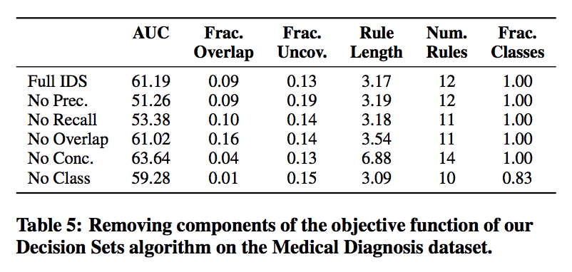
Are all loss function terms important?
“These results demonstrate that each term in objective (1) contributes to the overall goal of learning accurate and interpretable decision sets”
This maybe application dependent: e.g. No conciseness provides better AUC and less overlap but more rule length and number of rules

Slide 6
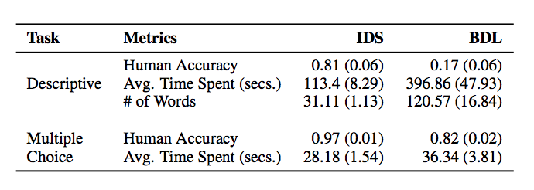
Restricted User study
Comparison done to the lowest AUC score and the lowest fractional classes method for this dataset. Compare to others?
User study done again on the same medical dataset
Participants of the user study are 47 data mining students: having some domain knowledge

