Slide 1
Controlling Polarization in Personalization: An Algorithmic Framework
L. Elisa Celis, Sayash Kapoor, Farnood Salehi, Nisheeth Vishnoi
Presented By: Rebecca Adaimi
Ronshee chawla

Slide 2
Outline
Introduction
Why Does Polarization Occur?
Contributions
Formal Definitions
Model Description
Algorithmic Results
Empirical Results
Conclusion and Extensions

Slide 3

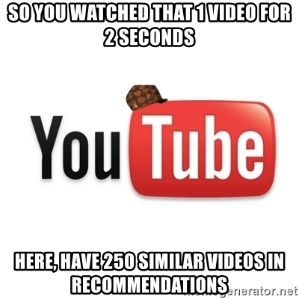

Introduction
Prevalence of personalization in day-to-day life
News and social media feeds, online advertising, product recommendation.
Higher utility and efficiency for the platform, as well as increased user satisfaction.

Slide 4
Introduction
Polarization as a consequence of personalization:
Propagation or creation of biases which can influence decisions or opinions.
Examples: Google search results after 2016 presidential election, targeting people on Facebook.
Naïve solution: Hide certain user characteristics.
Can we design personalization algorithms that allow us to avoid polarization yet still optimize individual utility?
Notes:
Google search results differ significantly based on political preferences in the month following the 2016 elections in the United States.
loss to the utility for both the user and the platform

Slide 5
Why Does Polarization Occur?
Online learning using content selection algorithms to maximize positive feedback and revenue.
Maintain and update a user-specific probability distribution.
Corresponding probability distribution concentrates as the algorithm learns more about the user.
Notes:
At every time-step, the algorithm must select a piece of content to display to a given user, and feedback is obtained in the form of whether they click on, purchase or hover over the item.
user-specific probability distribution (from which one selects content) is maintained and updated according to feedback given.

Slide 6
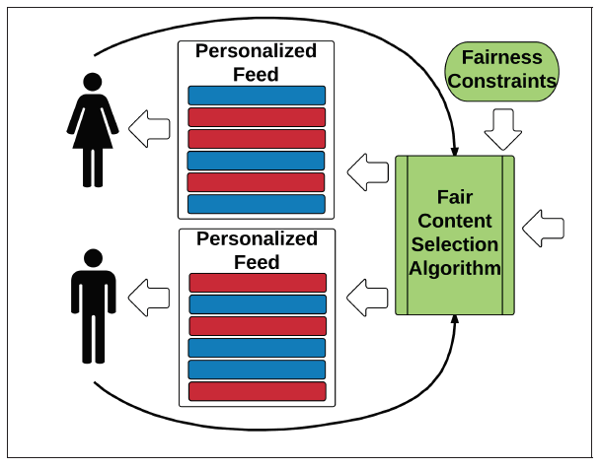
Contributions
A simple framework introduced which allows to place constraints on the probability distribution from which content is sampled.
Existing algorithm for the unconstrained bandit setting used with polarization constraints.
Scalable algorithm with provable guarantees.

Slide 7

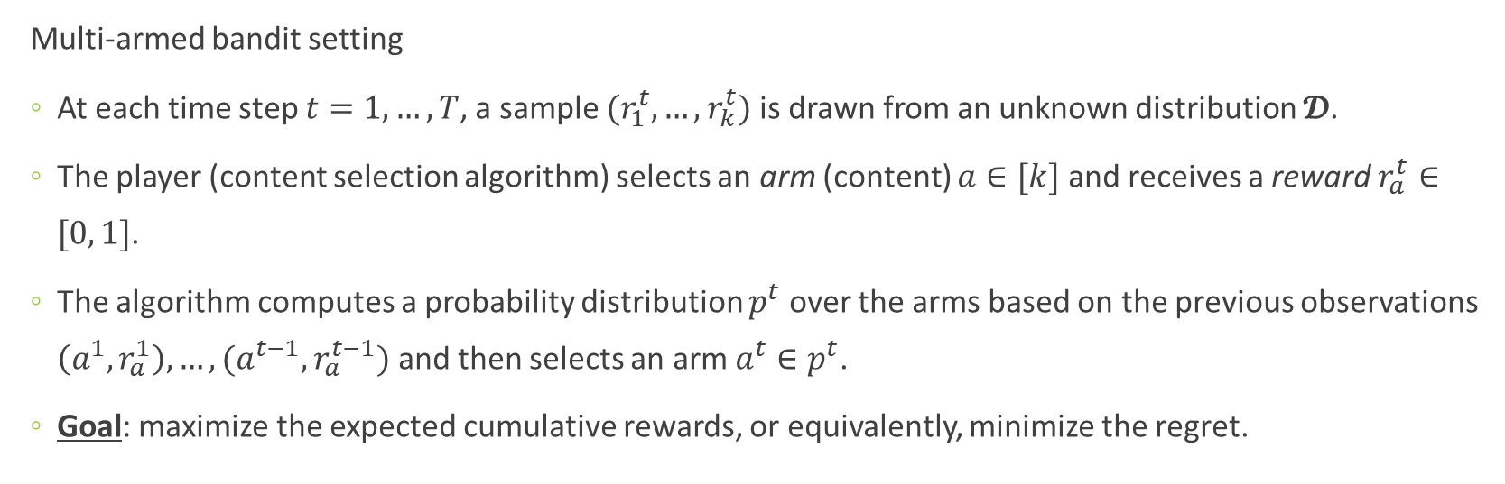
Formal Definitions
Multi-armed bandit setting
At each time step $t=1, …, T$, a sample $(r_{1}^{t}, …,r_{k}^{t})$ is drawn from an unknown distribution $𝓓$.
The player (content selection algorithm) selects an arm (content) $a∈[k]$ and receives a reward $r_{a}^{t}∈[0, 1]$.
The algorithm computes a probability distribution $p^{t}$ over the arms based on the previous observations $\left(a^{1}, r_{a}^{1}\right), …,(a^{t−1}, r_{a}^{t−1})$ and then selects an arm $a^{t}∈p^{t}$.
Goal: maximize the expected cumulative rewards, or equivalently, minimize the regret.
Notes:
Slot machine example at first: decide which machines to play, how many times to play each machine and in which order to play them, and whether to continue with the current machine or try a different machine.
A feature of bandit algorithms is that the probability distribution on the arms, that the algorithm is learning, converges to the action with the best expected reward; i.e., the entire probability mass ends up on a single arm, and hence in a single group – causing polarization.

Slide 8
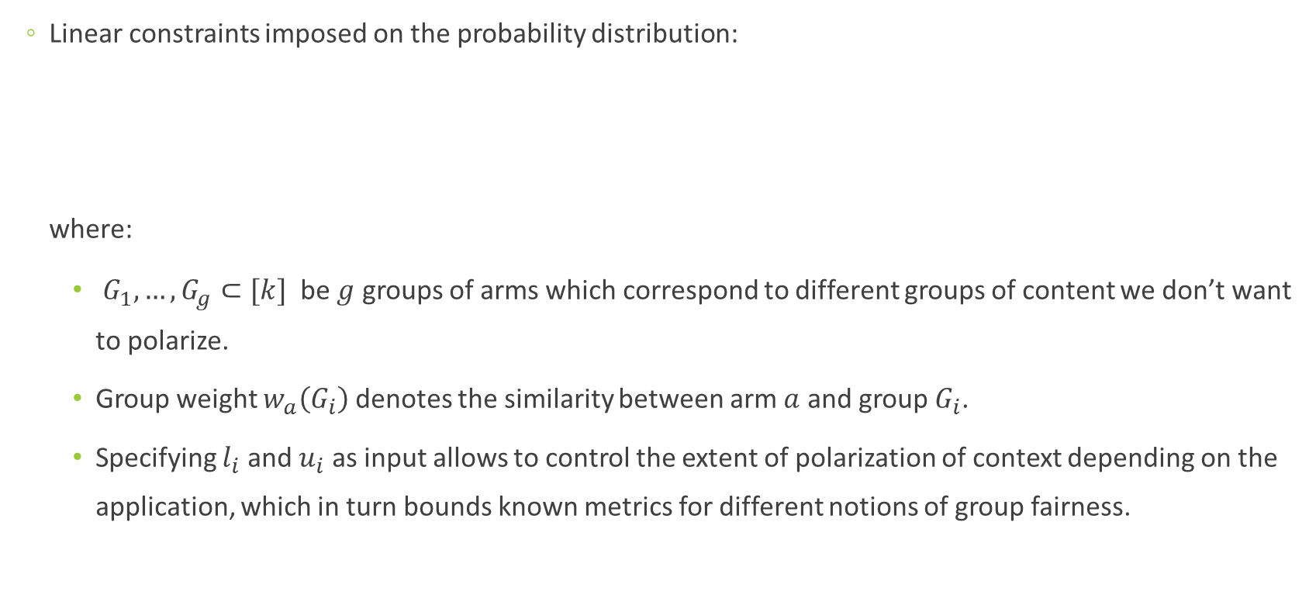
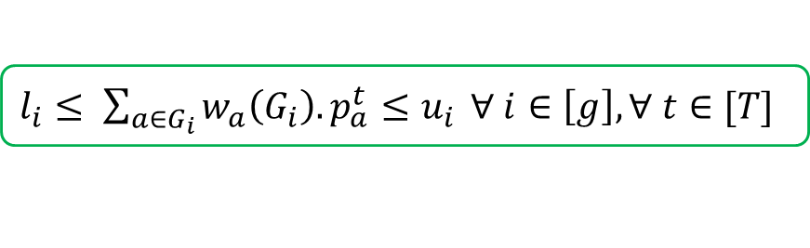
Model Description
Linear constraints imposed on the probability distribution: where:
$G_{1}, …, G_{g}⊂[k]$ be $g$ groups of arms which correspond to different groups of content we don’t want to polarize.
Group weight $w_{a}\left(G_{i}\right)$ denotes the similarity between arm $a$ and group $G_{i}$.
Specifying $l_{i}$ and $u_{i}$ as input allows to control the extent of polarization of context depending on the application, which in turn bounds known metrics for different notions of group fairness.
$l_{i}≤ \sum_{a∈G_{i}}{w_{a}\left(G_{i}\right).p_{a}^{t}≤u_{i}} ∀ i∈\left[g\right], ∀ t∈[T]$
Notes:
For each group $G_{i}$, let $l_{i}$ be a lower bound and $u_{i}$ be an upper bound on the amount of weighted probability mass that we allow the content selection algorithm can place on this group.
Importantly, though simple, these constraints are versatile enough to control polarization with respect to a variety of metrics which can measure the extent of polarization, or lack thereof, in a given algorithm. This is due to the fact that several fairness metrics depend, e.g., on the ratio or difference between the probability mass on two groups, hence can be implemented by picking appropriate lower/upper bound parameters for the constraints in our setting to give an immediate fairness guarantee.
For instance, following our earlier discussion on news articles, a conservative leaning news article might have a group weight of 0.9 for the conservative articles group and a group weight
of 0.1 for the liberal articles group, whereas a neutral article might have both of these weights as 0.5.
These constraints allow for personalization across groups, as well as at the group level.
risk difference

Slide 9
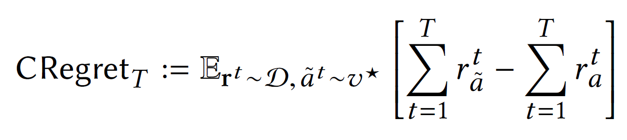


Model Description
Goal: to check how well the algorithm performs against the best constrained solution by minimizing constrained regret.
is the point in the constraint set $C$ with the highest expected reward.

Slide 10
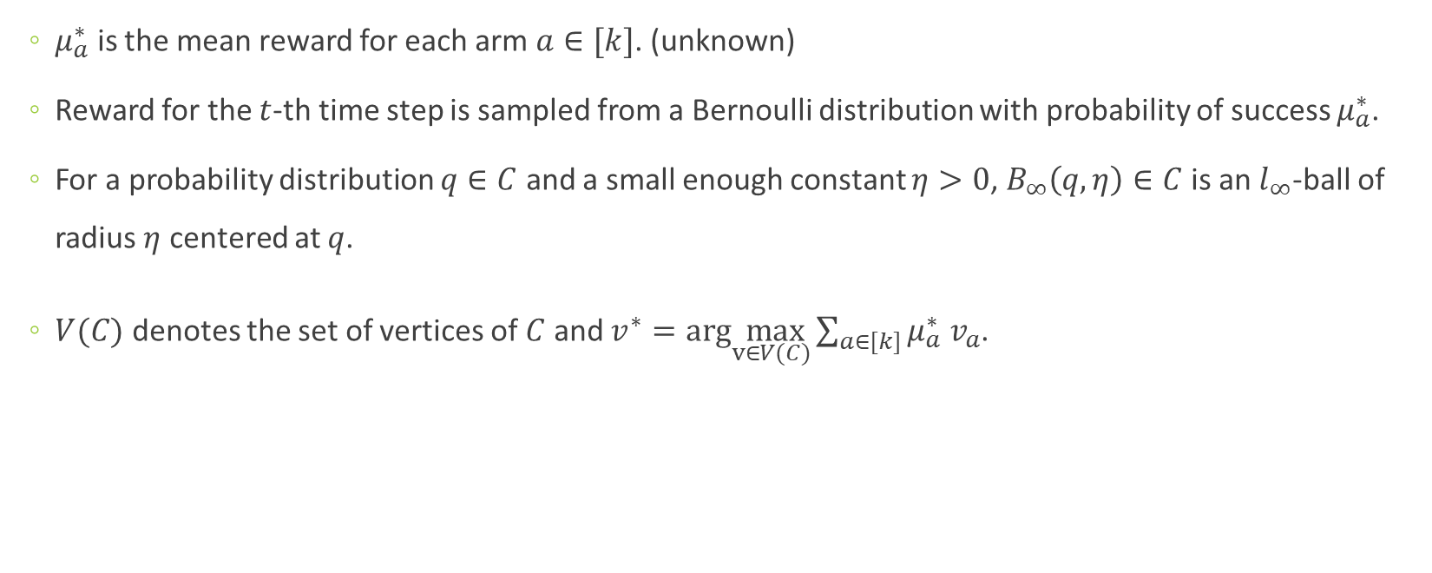
Algorithmic Results
$μ_{a}^{∗}$ is the mean reward for each arm $a∈[k]$. (unknown)
Reward for the $t$-th time step is sampled from a Bernoulli distribution with probability of success $μ_{a}^{∗}$.
For a probability distribution $q∈C$ and a small enough constant $η>0$, $B_{∞}\left(q, η\right)∈C$ is an $l_{∞}$-ball of radius $η$ centered at $q$.
$V(C)$ denotes the set of vertices of $C$ and $v^{∗}=arg\max_{v∈V(C)}\sum_{a∈[k]}{μ_{a}^{∗} v_{a}}$.

Slide 11
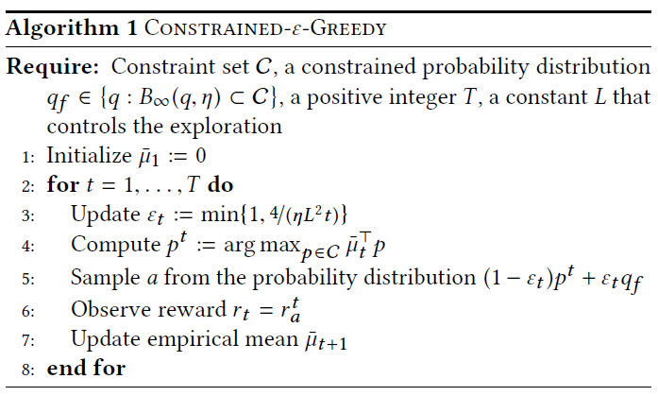
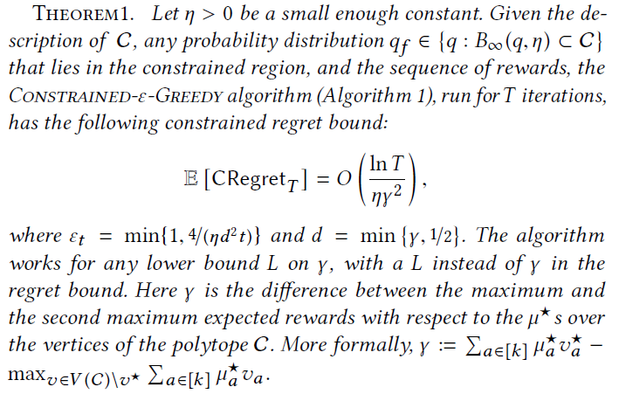
Algorithmic Results
Notes:
Explain the algorithm step by step using the details of section 4.1 Overview of Algorithm 1
-$μ_{a}^{∗}$ is the mean reward for each arm $a∈[k]$. (unknown)
-Reward for the $t$-th time step is sampled from a Bernoulli distribution with probability of success $μ_{a}^{∗}$.
-For a probability distribution $q∈C$ and a small enough constant $η>0$, $B_{∞}\left(q, η\right)∈C$ is an $l_{∞}$-ball of radius $η$ centered at $q$.
-$V(C)$ denotes the set of vertices of $C$ and $v^{∗}=arg\max_{v∈V(C)}\sum_{a∈[k]}{μ_{a}^{∗} v_{a}}$.

Slide 12
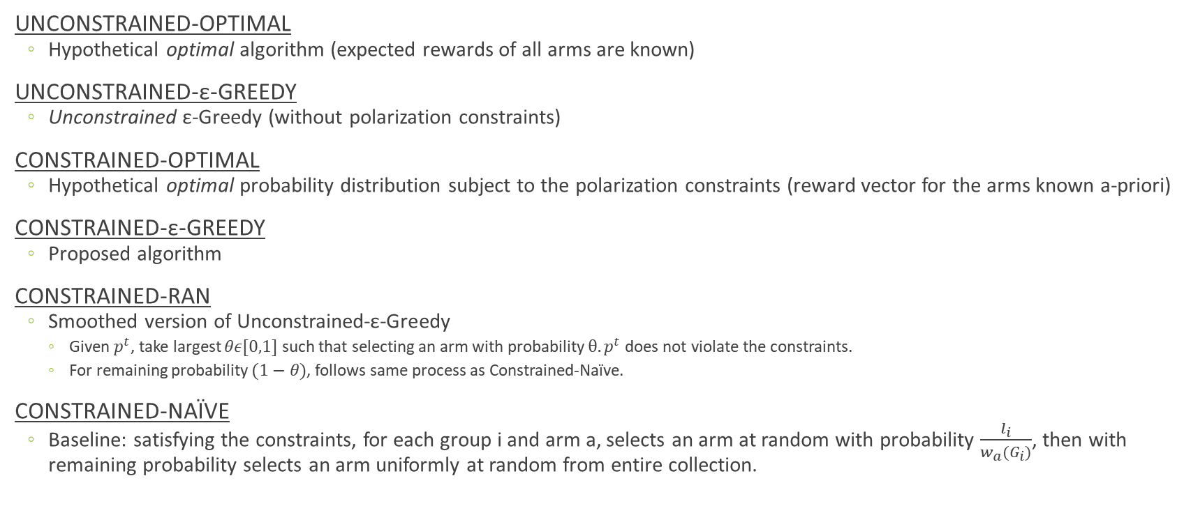
Empirical Results
UNCONSTRAINED-OPTIMAL
Hypothetical optimal algorithm (expected rewards of all arms are known)
UNCONSTRAINED-ε-GREEDY
Unconstrained ε-Greedy (without polarization constraints)
CONSTRAINED-OPTIMAL
Hypothetical optimal probability distribution subject to the polarization constraints (reward vector for the arms known a-priori)
CONSTRAINED-ε-GREEDY
Proposed algorithm
CONSTRAINED-RAN
Smoothed version of Unconstrained-ε-Greedy
Given $p^{t}$, take largest $θε[0,1]$ such that selecting an arm with probability $θ.p^{t}$ does not violate the constraints.
For remaining probability $(1−θ)$, follows same process as Constrained-Naïve.
CONSTRAINED-NAÏVE
Baseline: satisfying the constraints, for each group i and arm a, selects an arm at random with probability $\frac{l_{i}}{w_{a}(G_{i})}$, then with remaining probability selects an arm uniformly at random from entire collection.

Slide 13
Experimental Setup
PoliticalNews Dataset
Arms: news articles
Groups: Liberal and Conservative
Categories: right, right-leaning, neutral, left-leaning, left
Reward: Bernoulli variable with mean proportional to likes on Facebook
MovieLens Dataset
Arms: movies
Groups: 19 genres
Categories: k-means clustering (k=25)
Reward: Gaussian with average rating a user gave to movies associated with an arm as mean
YOW Dataset
Similar to MovieLens

Slide 14
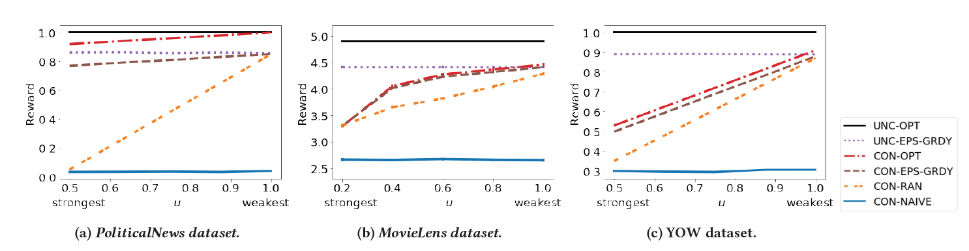
Reducing Polarization on the Reward
Effect of varying upper bound constraint (polarization constraint) on normalized cumulative reward
Notes:
PoliticalNews Dataset:
online news articles over a span of 30 days (23rd July – 21st August, 2018), along with the number of Facebook likes that each article received as of 22nd August, 2018.
Labels: left, left-leaning, neutral, right-leaning or right
For each day, we encode each article as an arm with Bernoulli reward with mean proportional to the number of likes on Facebook
Group weights:
Liberal Group (w(L)): 0, 0.25, 0.5, 0.75 and 1 on right, right leaning, neutral, left-leaning and left articles respectively
Conservative Group (w(C)): 1, 0.75, 0.5, 0.25 and 0 on right, right-leaning, neutral, left-leaning and left articles respectively
MovieLens Dataset:
Each movie is also affiliated with one or more of 19 genres (e.g., sci-fi, romance, thriller).
Meta-categories formed based on movie genres using a blackbox k-means clustering algorithm with k = 25
Reward associated with an arm is given by a Gaussian where the mean is the average rating the user gave to movies associated with representative cluster arm, and standard deviation = 0.1.
For a genre i (i $∈$ [19]) and movie category a, the group weight $w_{a}(G_{i})$ is set to be the i^{th} coordinate of the cluster center of movie category a found by the k-means clustering.
Critique
No error bars
Not plotted normalized cumulative reward for MovieLens

Slide 15
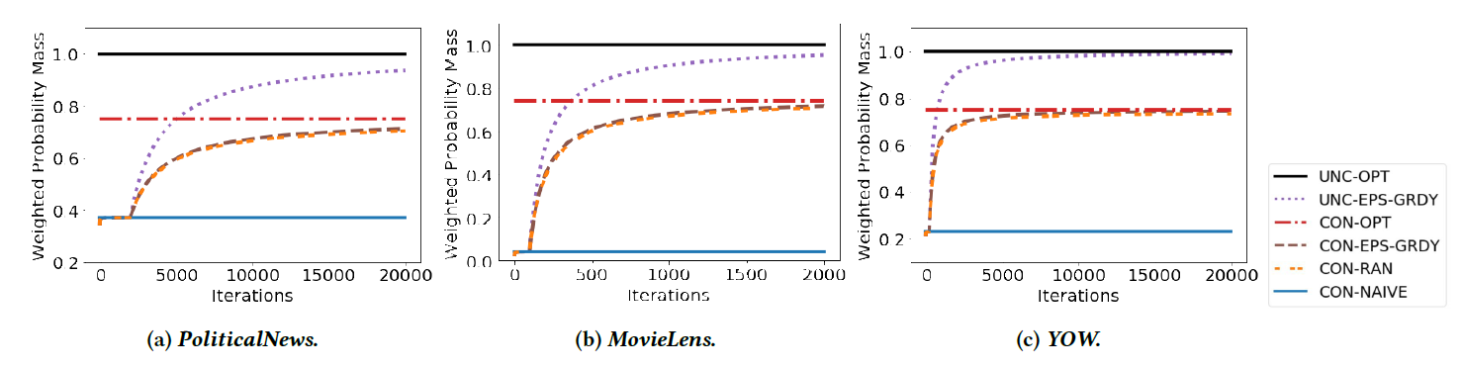
Polarization Over Time
Avoiding polarization and enforcing diversification
Notes:
for each dataset we plot the normalized cumulative weighted probability mass on the best group for each datapoint against the number of iterations, with the u = 0.75.

Slide 16
Conclusion
Combating polarization in personalization algorithms that learn user behavior.
(Constrained-ε-Greedy) A simple bandit algorithm modified to perform well with respect to regret while satisfying polarization constraints.
LIMITATIONS & FUTURE WORK:
A limitation to the Constrained-ε-Greedy is the fact that they assume the group levels and weights for each piece of content are given.
Extending the work to a dynamic setting where the type of content changes over time (e.g. using restless bandit techniques).
Testing the algorithm in the field to capture user satisfaction would give deeper insights into the benefits and tradeoffs between personalization and diversification.
Notes:
- These labels would either need to be inferred from the data, which could bring with it additional bias associated with this learning algorithm, or would need to be self-reported, which can lead to adversarial manipulation.

Slide 17
THANK YOU!

