Slide 1
Mitigating Poisoning Attacks on Machine Learning Models: A Data Provenance Based Approach
Nathalie Baracaldo, Bryant Chen, Heiko Ludwig, and Jaehoon Amir Safavi
Critiqued by: Rebecca Adaimi
Ronshee Chawla

Slide 2
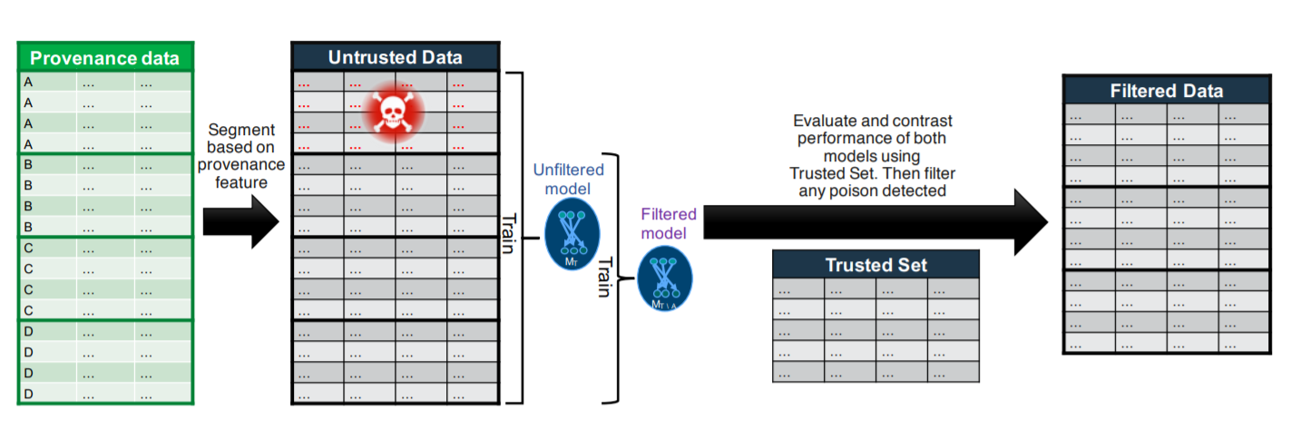
Paper Highlights
A method for detecting and filtering poisonous data using data provenance for identifying groups of data that are highly likely of being poisoned
Provenance-based defense for partially trusted and fully untrusted datasets

Slide 3
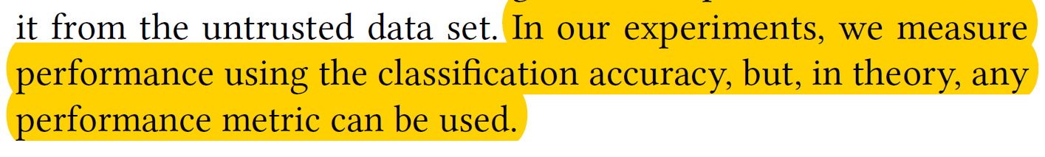
Classification Accuracy Is Not ENOUGH!
Will their approach still work for other metrics?
Notes:
Breast cancer data

Slide 4
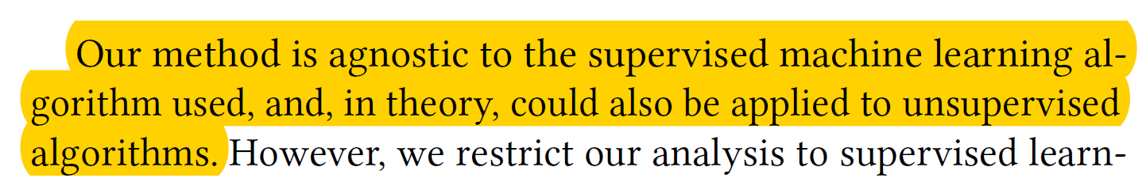
What About Unsupervised Learning?
How would the algorithm decide what is poisonous and what is not?
Notes:
Clustering example

Slide 5
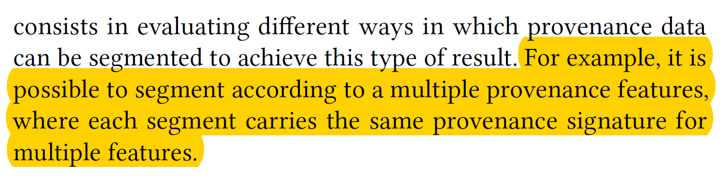
EXPONENTIAL Runtime!!
Number of segments can be exponential w.r.t number of provenance features

Slide 6
APPROPRIATE Segmentation!
Poisonous data originate from a limited number of sources.
The probability of poisoning is highly correlated across samples in each group segmented using provenance meta-data.
How do we know what is an “appropriate” segmentation of the training data?

Slide 7
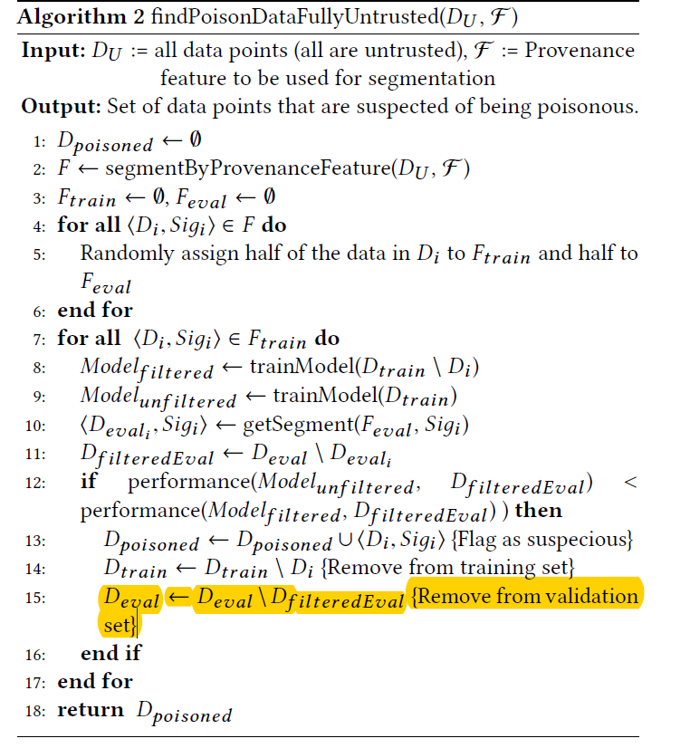
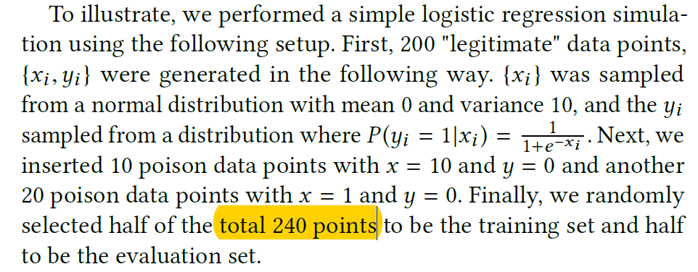
Minor Critiques

