Slide 1

MINOR PROJECT-JCD891
Semester II, Jan-May, 2023
IDS for CAN Bus Security
Presented By:
Arihant Jammar
[2022JCS2669]
Under the guidance of:
Prof. Vireshwar Kumar
[viresh@cse.iitd.ac.in]
IIT Delhi
May-2023

Slide 2
Introduction
Intra-vehicular security: safeguard from cyber-attacks and unauthorised access.
Electronic Control Units, or ECUs.: Need For Security
Function of ECUs: fuel injection, ignition, emissions control, shifting of gears based on vehicle speed, antilock braking system (ABS), airbags, heating, ventilation, air conditioning (HVAC), audio-video systems, navigation systems etc.
Controller Area Network Bus or CAN bus: communication protocol
Robert Bosch (1980s)
Attack on CAN bus: Flooding Attack, Spoofing Attack, Fuzzing Attack, DoS Attack etc.
Notes:
Keeping a vehicle’s electronic systems and networks safe from cyber-attacks and unauthorised access.
ECUs are electronic devices controlling various functions of a vehicle.
Without effective intra-vehicular security, cyber-attacks could compromise the safety and functionality of a vehicle.
CAN Bus :used in vehicles to enable communication between various electronic control units (ECUs).
An attack on the CAN bus, such as a flooding or spoofing attack, can lead to security vulnerabilities in the intra-vehicular systems, allowing attackers to manipulate or control critical functions, such as the brakes or steering potentially causing accidents. Putting passengers and other road users at risk.

Slide 3
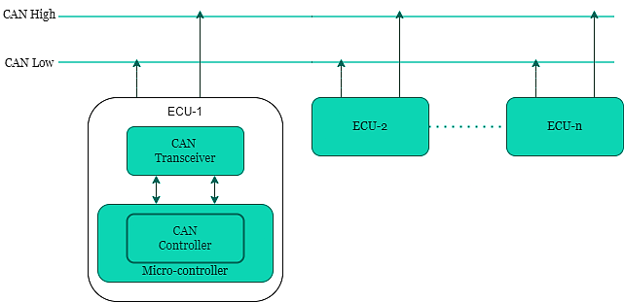
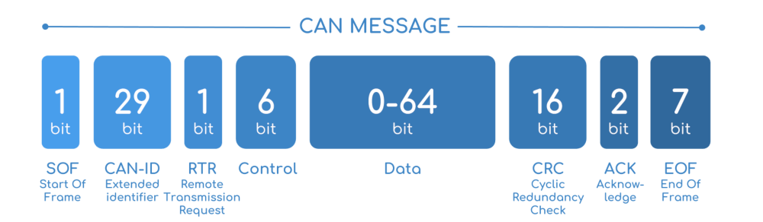
Multi-master serial communication
Differential signalling
CAN bus frame: basic data transmission unit.
Limitations:
Authentication Mechanism
Encryption
Integrity Check
Limited Bandwidth
Security Threats:
Message tampering
Eavesdropping
Denial-of-service (DoS) attacks.
Fig.1: CAN bus architecture
Fig.2: CAN bus frame
Notes:
Fig.1 represents the CAN bus architecture.
CAN uses a multi-master serial communication system that allows devices to communicate with each other using a shared communication bus
Multi-master means multiple nodes can initiate comms and transmit data on the CAN bus
It uses Differential Signalling to transmit data
Differential signalling is data transmission through a pair of wires, where one wire carries the signal and the other carries its inverse. This technique helps reduce noise, improve the communication's reliability, and reduce errors caused during transmission.
Some important fields are:
Arbitration Field: Determines message priority and ensures that the highest priority message gets transmitted first.
Control Field: Specifies the data field's length and identifies the message type being transmitted (e.g., data frame or remote frame).
Data Field: Contains the transmitted data, up to 8 bytes.
CRC Field: Provides error detection by generating a checksum of the data and ensuring that it matches the transmitted value.
Acknowledgement Field: Confirms that the message was received correctly by the other nodes in the network.
End of Frame Field: Signals the end of the message and prepares the network for transmitting the following message.
Violation of the confidentiality, integrity, and availability (CIA) of information transmitted through the network.

Slide 4
Literature Review
Jeep Cherokee incident: Miller and Valasek
Division of Analysis:
Attack Detection: reading CAN frames.
Attack Prevention techniques: Intrusion Detection System.
Attacks
DoS
Spoofing
Fabrication
Fuzzing
Message Injection
Replay
Sniffing
Notes:
Jeep Cherokee incident in which an attacker carried out a cyberattack on the vehicle in the year 2015. In this incident, attackers Miller and Valasek were then able to send commands to the engine and wheels through the car's internal CAN. Due to this, the vents started blasting cold air at the maximum setting, the radio was blaring at full volume, and the windshield wipers turned on. The incident lead Fiat Chrysler to recall 1.4 million Jeep Cherokees and issued a patch closing that vulnerability. Post this incident, extensive research has been carried out in the field of attack detection and attack prevention on CAN.
Analysis of existing literature on CAN Security, details regarding various security problems, and solutions.

Slide 5
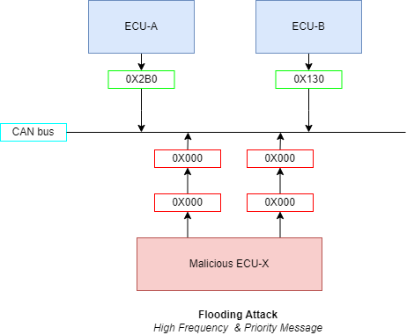
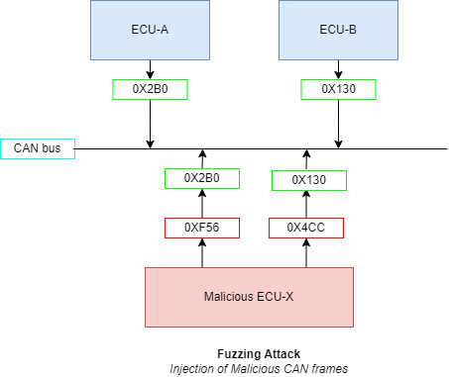
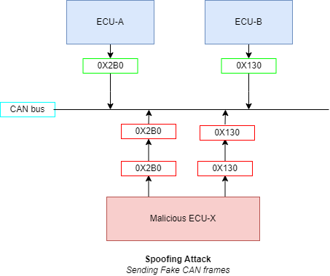
Attack Scenarios
Fig.3: Flooding Attack
Fig.4: Fuzzing Attack
Fig.5: Spoofing Attack
Notes:
Flooding: In a flooding attack, an attacker sends a large number of messages to the network in a short period of time, overwhelming the network and causing it to stop functioning correctly.
Fuzzing: Fuzzing is a type of attack where an attacker sends a large number of invalid or unexpected messages to the network in an attempt to trigger errors or vulnerabilities in the software or hardware components of the system.
Spoofing: This attack involves an attacker sending messages to the CAN bus network impersonating a legitimate node.
Fabrication: The attacker can fabricate messages by spoofing source IDs, modifying message content, or altering the priority of messages
Sniffing: A sniffing attack on a CAN bus involves an attacker passively eavesdropping on the communication between nodes on the bus.

Slide 6
Attack Prevention: Intrusion Detection System
Rule Based
Machine Learning Based
IDS Algorithms | Advantages | Limitations
Generative Adversarial Networks | Self Training for Unknown Attacks | Hardware Cost
Specification Based | Detect Known Attacks | Cannot detect unknown attacks or zero-day attacks
Support Vector Machine | Classify between Error and Attack | High Cost and vulnerability to environment change
Flow Based | Simple Algorithm | Works only on Periodic signals
Analysis of Arbitration ID Sequences | Less computation and memory requirements | Highly vulnerable to sequence forging.
Neural networks | High Accuracy and Low value of Loss | High Training Time
Notes:
An Intrusion Detection System is crucial in securing the CAN bus network. It monitors the network traffic and detects any suspicious activity or security threats. It can identify security incidents in real-time and provide alerts or take automated actions to mitigate the risks such as blocking the attack messages, shutting down or quarantining the affected nodes.
Rule Based Design detects the CAN message as malicious that does not adhere to either periodicity, frequency, signal, payload. But it is challenging to cover a complete set of features that depict the expected behaviour of CAN, so this system has high false alarm rates and low detection rates.
Various Machine Learning techniques such as Artificial Neural Networks (ANN), Deep Neural Networks(DNN), Convolutional Neural Networks(CNN), and Generative Adversarial Networks(GAN) are used to design IDSs having better detection rates, but these methods have higher computing costs and complexities

Slide 7
Intrusion Detection System (IDS)
Convolutional Neural Network (CNN) based IDS model for the intra-vehicular network (IVN) has been used for identifying normal and abnormal activities on the CAN bus.
Advantages of CNN:
high-dimensional data
learn features
local connectivity
parameter efficiency
Notes:
High-dimensional data: such as images and videos, which makes them well-suited for processing the complex and heterogeneous data generated by CAN bus networks.
Feature learning: automatically learns features from the raw data, which can help identify complex patterns and relationships within the data.
Local connectivity: learn spatial relationships between adjacent data and identify patterns in time-series data.
Parameter-efficiency: fewer parameters than other deep neural networks, so less computation, time, and storage requirements.
IDS has been trained and tested on the publicly available and self-prepared attack dataset.

Slide 8
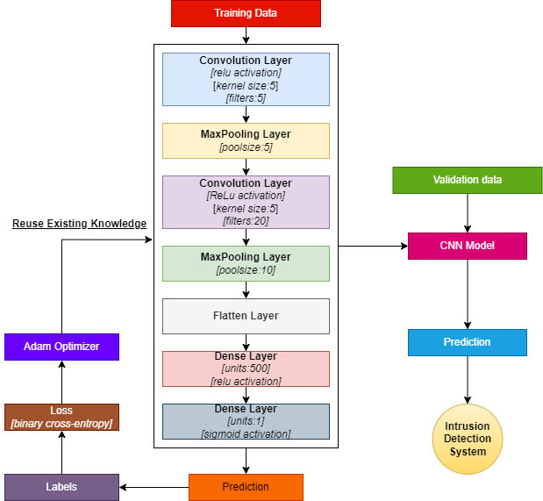
CNN IDS
Deep transfer learning-based
CAN_ID, DLC, Data_Field and Label as features.
CNN model architecture: 7 layers.
Data re-scaling: minimum-maximum normalisation.
Adam optimiser: hyperparameter optimisation.
Dataset split
Fig.6: CNN model Architecture
Notes:
It is a deep transfer learning-based method to transfer the knowledge contained in the current training domain to the target domain and combine the target domain with building an efficient IDS to improve detection accuracy.
The normal and attack scenarios are labelled by 0 and 1 respectively.
Each layer takes the previous layer outputs as inputs for the current layer and performs some nonlinearities to transform it into a multivariate series whose dimensions are defined by the number of filters in each layer.
Loss: The difference between predicted and actual output.
Binary cross-entropy: Measures distance between predicted and actual probability distribution for binary classification tasks.
Adam optimiser: An algorithm for updating parameters of a neural network during training. It uses adaptive learning rates to improve efficiency and convergence speed.
Dense layer, also known as a Fully Connected layer, is typically used at the end of the network to perform classification on the features extracted by the preceding convolutional and pooling layers.

Slide 9
Attack Dataset Preparation
Normal,0.000000,280,8,00 00 A3 7E 00 00 00 00
Normal,0.002135,284,8,00 00 00 00 86 00 00 00
Normal,0.004485,106,8,0C 54 00 00 00 00 00 00
Normal,0.006124,197,8,00 00 00 00 00 00 00 00
Normal,0.014049,106,8,0C 54 00 00 00 00 00 00
Normal,0.016060,103,8,00 00 00 00 00 00 00 00
Normal,0.022054,197,8,00 00 00 00 00 00 00 00
Normal,0.024439,106,8,0C 54 00 00 00 00 00 00
Normal,0.034068,106,8,0C 50 00 00 00 00 00 00
Normal,0.000000,280,8,00 00 A3 7E 00 00 00 00
Normal,0.002135,284,8,00 00 00 00 86 00 00 00
Attack,0.002635,000,8,00 00 00 00 00 00 00 00
Attack,0.003135,000,8,00 00 00 00 00 00 00 00
Attack,0.003635,000,8,00 00 00 00 00 00 00 00
Attack,0.004135,000,8,00 00 00 00 00 00 00 00
Normal,0.004485,106,8,0C 54 00 00 00 00 00 00
Attack,0.004985,000,8,00 00 00 00 00 00 00 00
Attack,0.005485,000,8,00 00 00 00 00 00 00 00
Fig 7.: Attack Free Dataset
Fig.8: DoS Attack Dataset
Notes:
The CAN Bus data was collected using the OBD port of the Car.
The Data was filtered out using the regular expression and reduced to 5 CAN frame fields.
The timestamp differences are computed and the average timestamp difference is used for further evaluation.
The timestamp differences which are less than the average timestamp difference are the valid location where the attack frames are inserted.
The threshold limits the number of frames inserted between two timestamps that follow the sequence order.
The different attack frames inserted are replay, DoS, and Fuzzy attacks.
The previously developed IDS is used to train and test the dataset generated above. Each of the datasets is trained and tested separately.

Slide 10
Attack Dataset Preparation
Normal,0.000000,280,8,00 00 A3 7E 00 00 00 00
Normal,0.002135,284,8,00 00 00 00 86 00 00 00
Attack,0.003135,284,8,00 00 00 00 86 00 00 00
Attack,0.004135,284,8,00 00 00 00 86 00 00 00
Normal,0.004485,106,8,0C 54 00 00 00 00 00 00
Attack,0.005485,284,8,00 00 00 00 86 00 00 00
Attack,0.006485,284,8,00 00 00 00 86 00 00 00
Normal,0.006124,197,8,00 00 00 00 00 00 00 00
Attack,0.007124,284,8,00 00 00 00 86 00 00 00
Normal,0.014049,106,8,0C 54 00 00 00 00 00 00
Normal,0.182193,197,8,00 00 00 00 00 00 00 00
Normal,0.184495,106,8,0C 50 00 00 00 00 00 00
Normal,0.194174,106,8,0C 50 00 00 00 00 00 00
Normal,0.198151,280,8,00 00 A4 7E 00 00 00 00
Attack,0.198651,288,8, AE 1E 28 19 AB FA 49 02
Normal,0.200169,284,8,00 00 00 00 86 00 00 00
Normal,0.202010,197,8,00 00 00 00 00 00 00 00
Normal,0.204330,106,8,0C 50 00 00 00 00 00 00
Normal,0.214174,106,8,0C 50 00 00 00 00 00 00
Normal,0.216166,103,8,00 00 00 00 00 00 00 00
Fig 9: Replay Attack Dataset
Fig.10: Fuzzing Attack Dataset

Slide 11
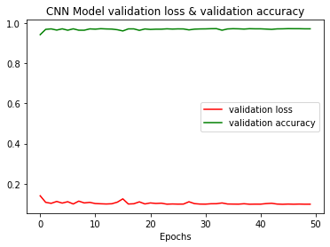
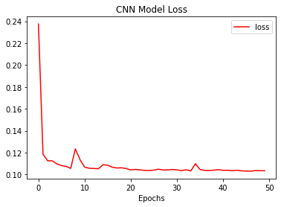
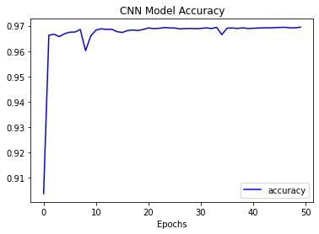
Results
Loss | 10.12%
Accuracy | 97.06%
ROC Score | 0.9783
Precision (Normal) | 1.00
Recall (Normal) | 0.96
F1-Score (Normal) | 0.98
Fig. 11: CNN Model Scores on Available Dataset
Figure 12: Validation Loss & Validation Accuracy Vs Epochs
Fig. 13: Loss Vs Epochs
Fig. 14: Accuracy Vs Epochs

Slide 12
Loss | 25.38%
Accuracy | 55.14%
Fig. 15: CNN Model Scores on Replay Attack Dataset
Loss | 2.56%
Accuracy | 4.98%
Fig. 16: CNN Model Scores on Fuzzy Attack Dataset
Loss | 17.39%
Accuracy | 73.01%
Fig. 17: CNN Model Scores on DoS Attack Dataset

Slide 13
Conclusion
Literature Review on CAN Security.
A deep-transfer learning-based CNN model has been used as IDS in automotive vehicles.
The attack detection model has an overall accuracy score of 97.06% and a loss of 10.12%.
Notes:
The model has proven its potential to efficiently exhibit anomalous data identification to protect the CAN network that can also be extended in other emerging applications within critical infrastructures where automation and secure data processing are the main challenges.

Slide 14
Thank You!

