Slide 1
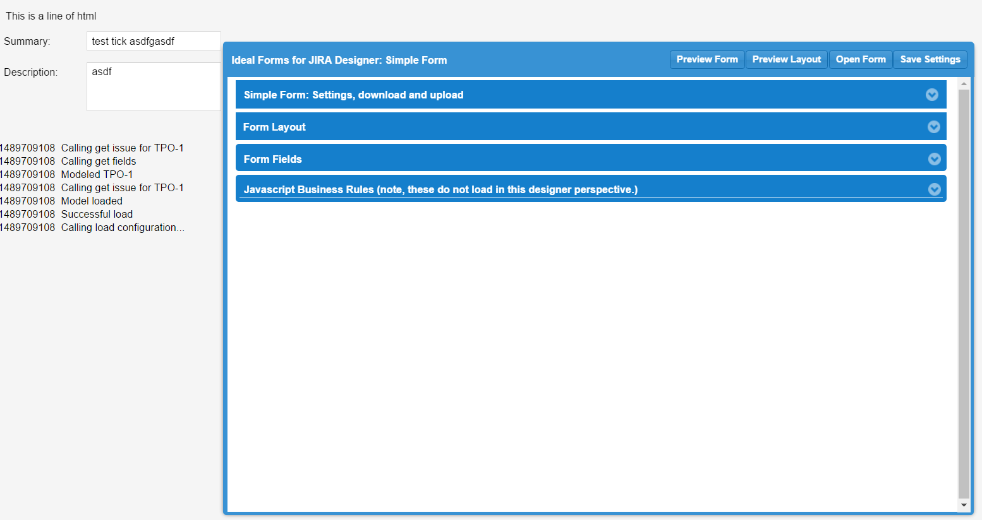
Previewed Form
Form Settings, moveable dialog window with all settings
Debug Log

Slide 2
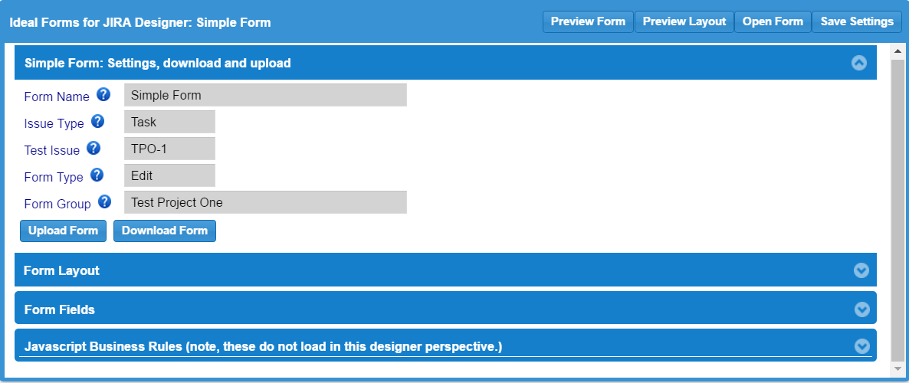

Slide 3
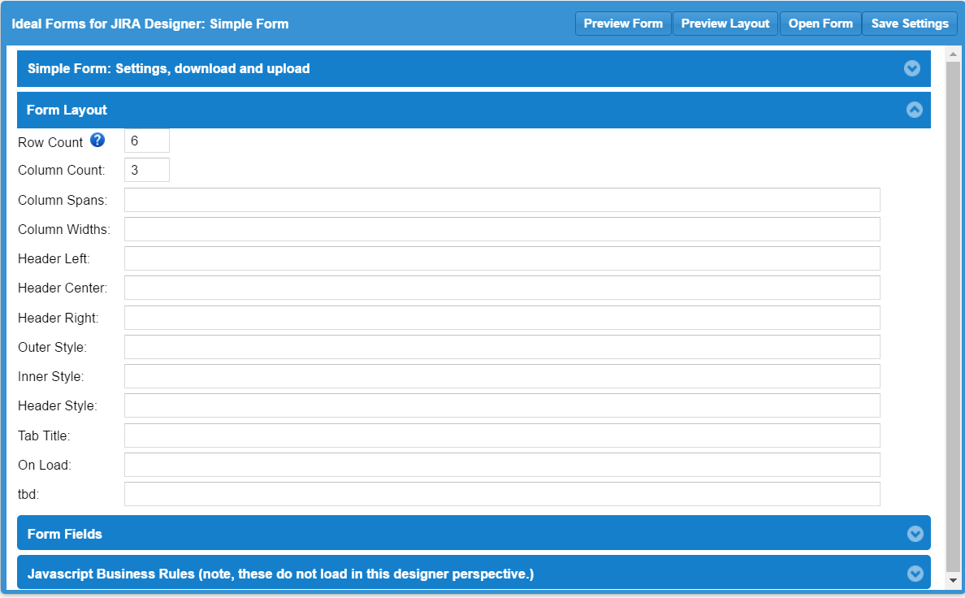

Slide 4
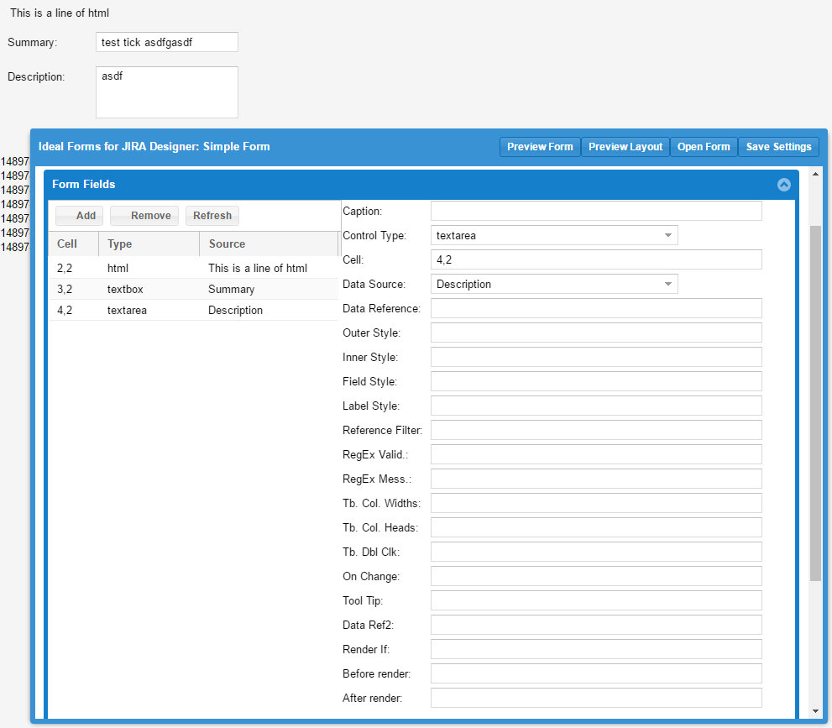

Slide 5
Outer Container
Inner Container
Label
Field

