Slide 1


Great Expectations: A ring to rule them all
Pablo Lozano Santiuste
Royal Society - Benders

Slide 2


Slide 3
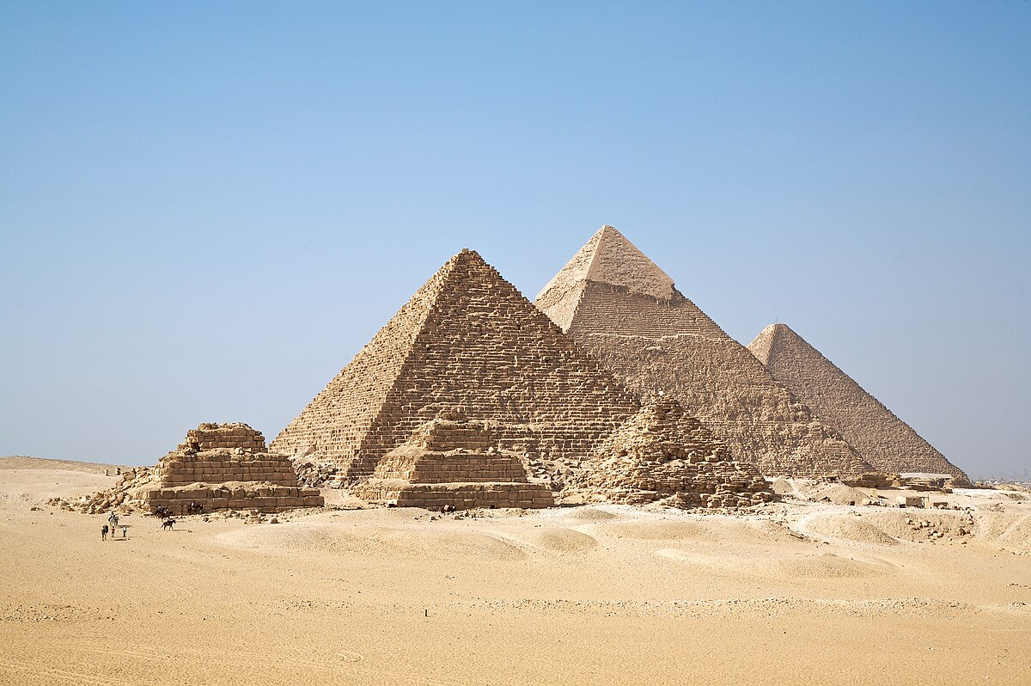

Slide 4


Slide 5


Talk Structure
+
https://github.com/idealista/great_expectations_talk

Slide 6
Data test
movies_metadata
  adult
  belongs_to_collection
  budget
  genres
  homepage
  id
  imdb_id
  original_language
  original_title
  overview
  popularity
  poster_path
  production_companies
  production_countries
  release_date
  revenue
  runtime
  spoken_languages
  status
  tagline
  title
  video
  vote_average
  vote_count

Slide 7

Data Quality – Why I’ts important?
Data Quality focus on Data Assets regardless of how the data was generated.
Completeness
Timeless
Validity
Integrity
Uniqueness
Consistency

Slide 8
Use cases
Business: If we are buying data from external providers
Business: If we are selling data to external providers
If we are ingesting data into our domain
If we depends strongly from other domains
If we scrap websites :)

Slide 9
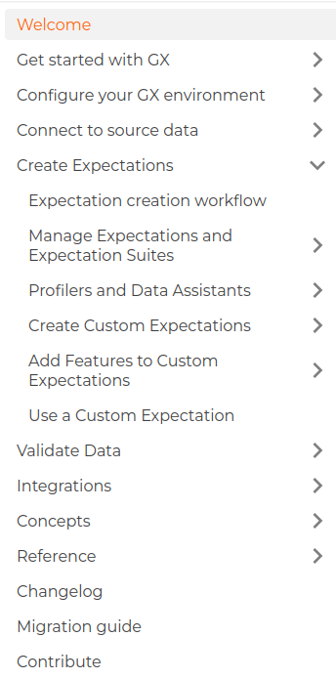
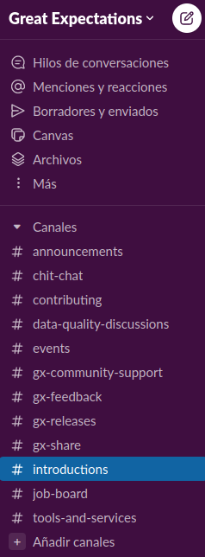


Great Expectations
Documentation
Github
Slack

Slide 10
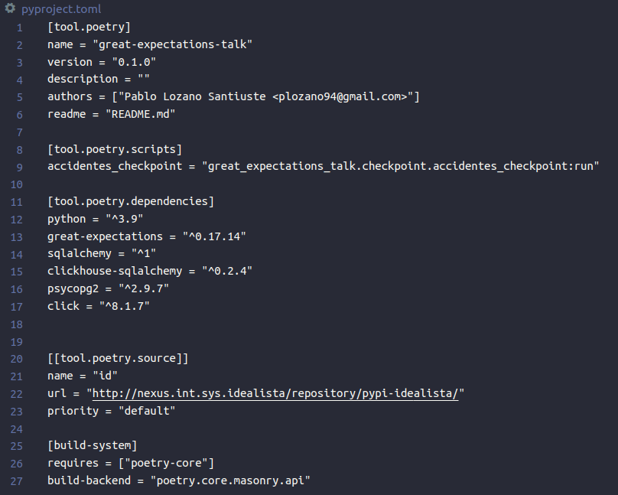
¿Como instalamos la herramienta?

Slide 11
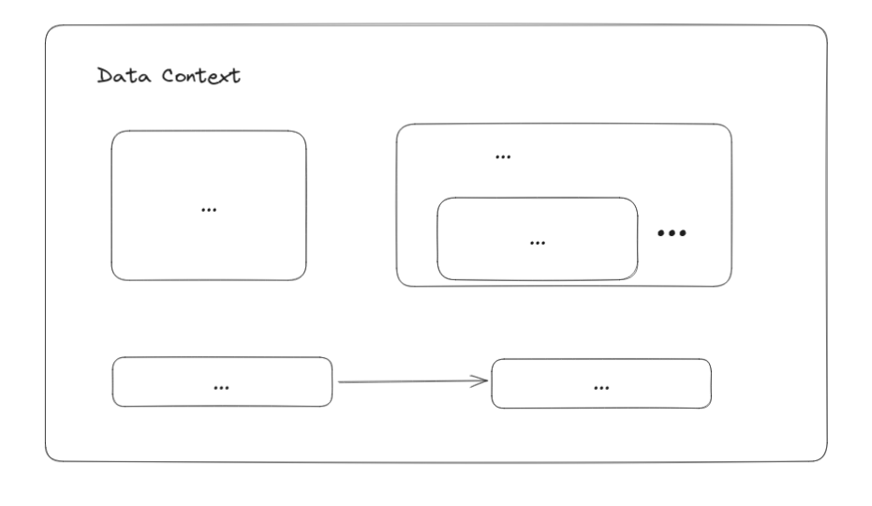
Great Expectations
Glossary
Data Context
  EphemeralDataContext
  FileDataContext
  CloudDataContext

Slide 12
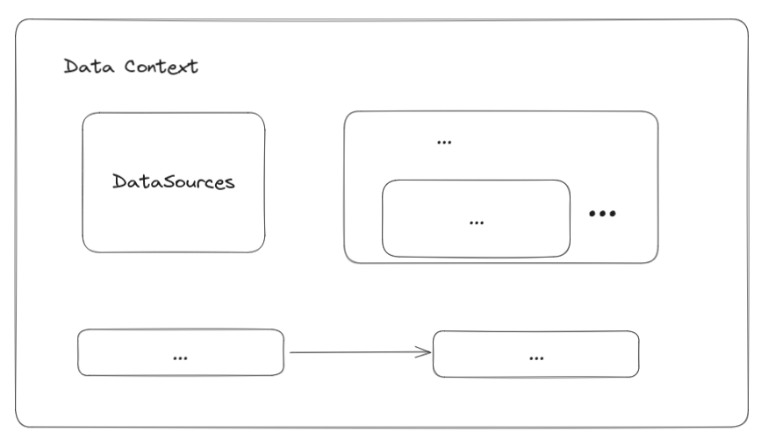
Great Expectations
Glossary
Data Sources
  AWS Athena
  BigQuery
  MSSQL
  MySQL
  PostgreSQL
  Redshift
  Snowflake
  SQLite
  Trino
  ClickHouse
  Potentially Any SQLALchemy compatible

Slide 13
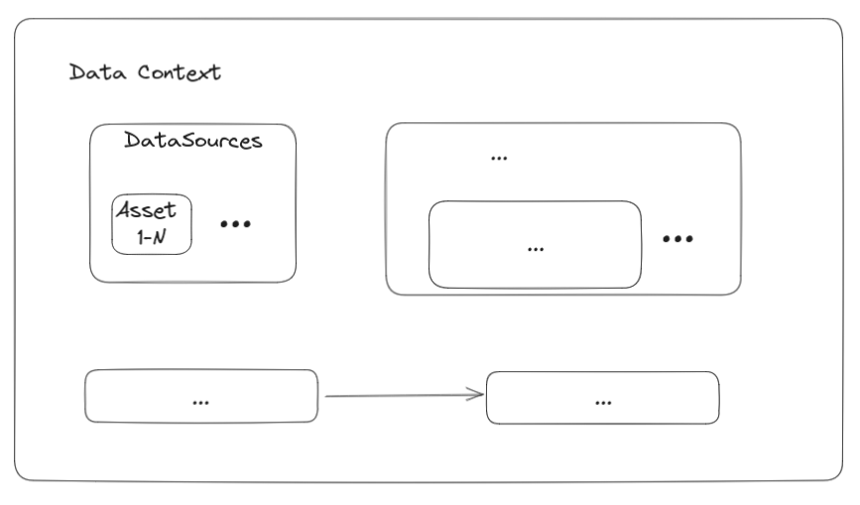
Great Expectations
Glossary
Data Assets → Basically tables in GX world
  Splitters
  Sorters

Slide 14
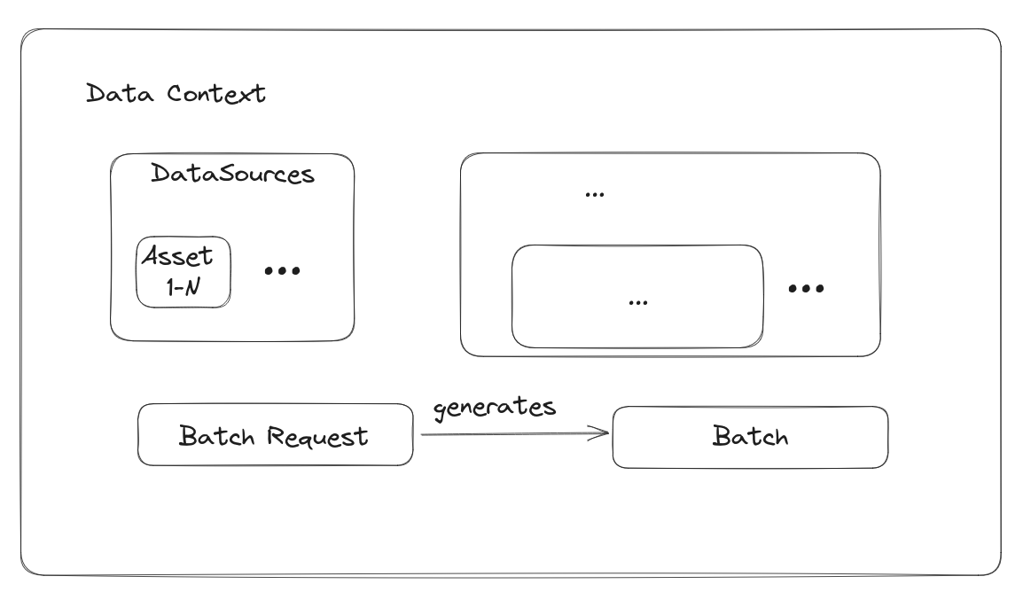
Great Expectations
Glossary
Batch Requests: A Batch Request contains all the necessary details to query the appropriate underlying data.
You could fetch only last ingested data in an incremental daily table and validate only that part.
Also you could only fetch a partition of the table in order to auto generate expectations (ALERT!!! SPOILER)

Slide 15
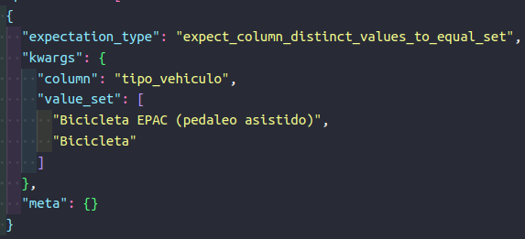
Great Expectations
Glossary
Cambiarrrr
Expectations
  JSON based
  Common parameters:
    Columns involved
    Threshold values
    Others

Slide 16
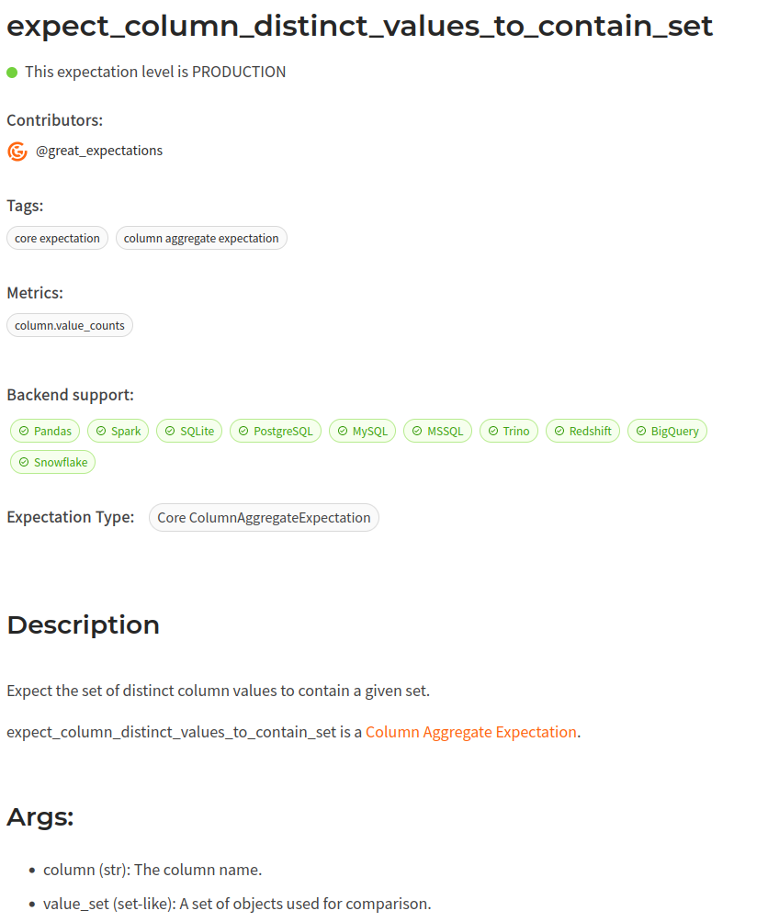
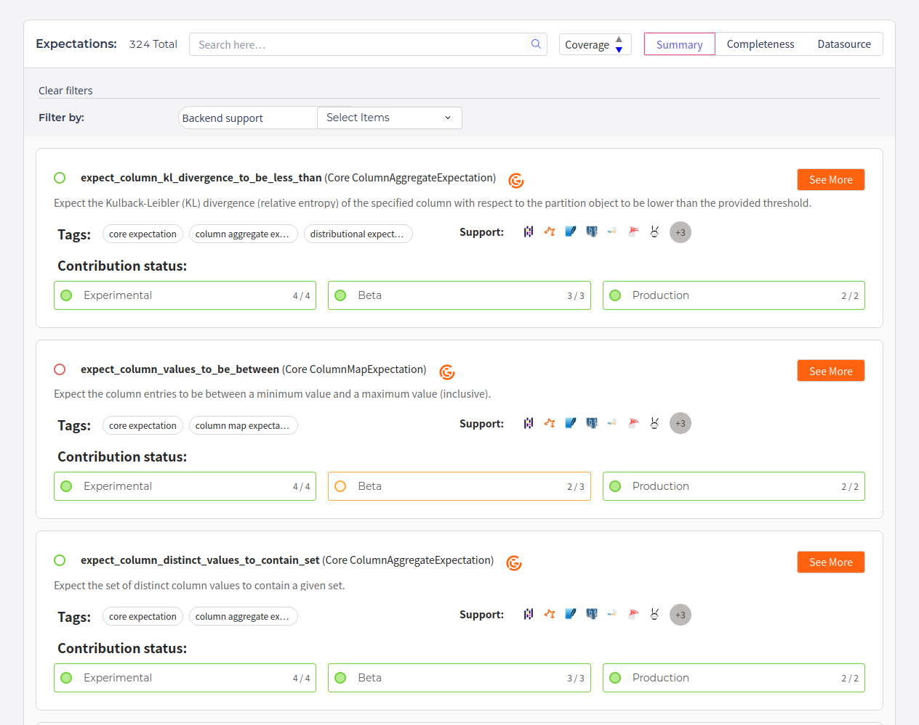
Great Expectations
Glossary
Expectations Gallery

Slide 17
Great Expectations
Glossary
Expectations Examples
expect_column_mean_to_be_between
expect_table_columns_to_match_set
expect_column_value_lengths_to_be_between
expect_multicolumn_sum_to_equal
expect_compound_columns_to_be_unique
expect_column_kl_divergence_to_be_less_than

Slide 18
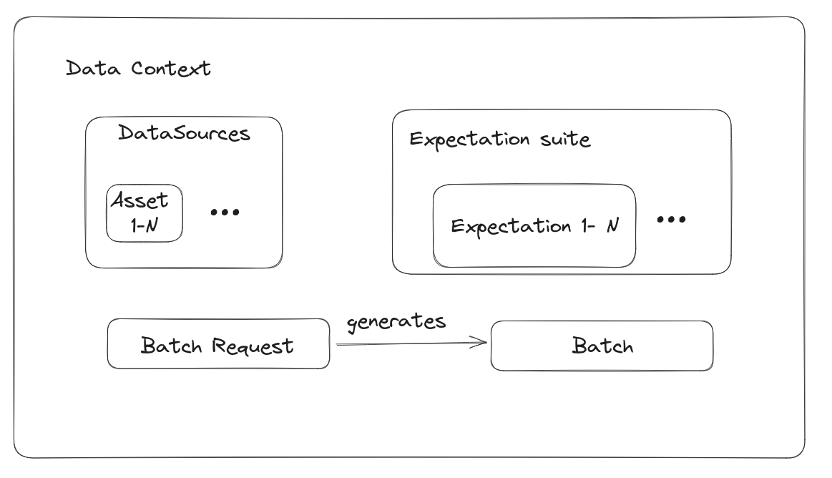
Great Expectations
Glossary
Expectation Suite: grouping a bunch of expectations

Slide 19
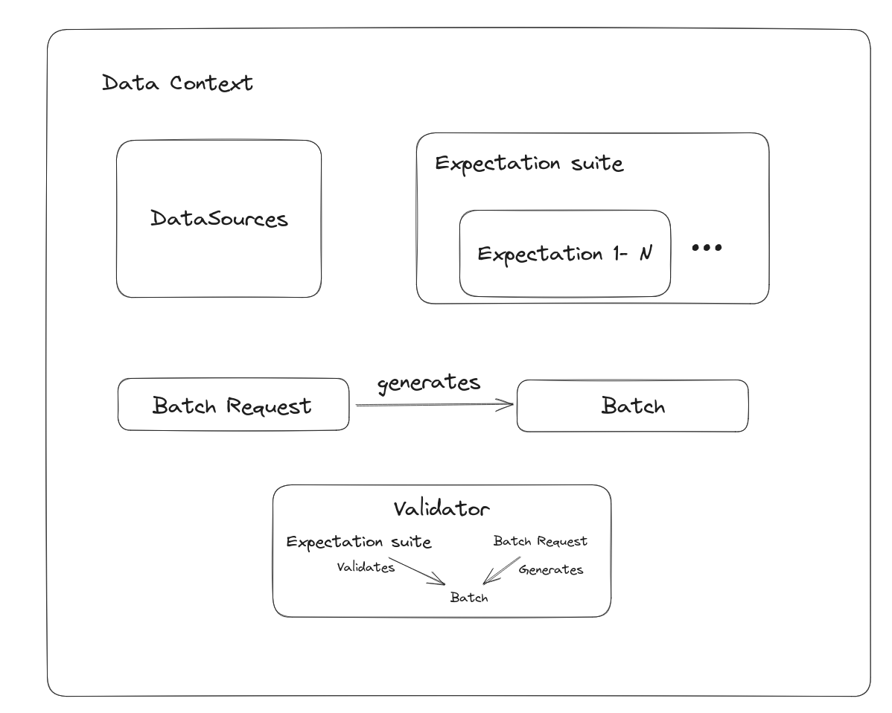
Great Expectations
Glossary
Validators: are responsible for running an Expectation Suite against a Batch Request.

Slide 20
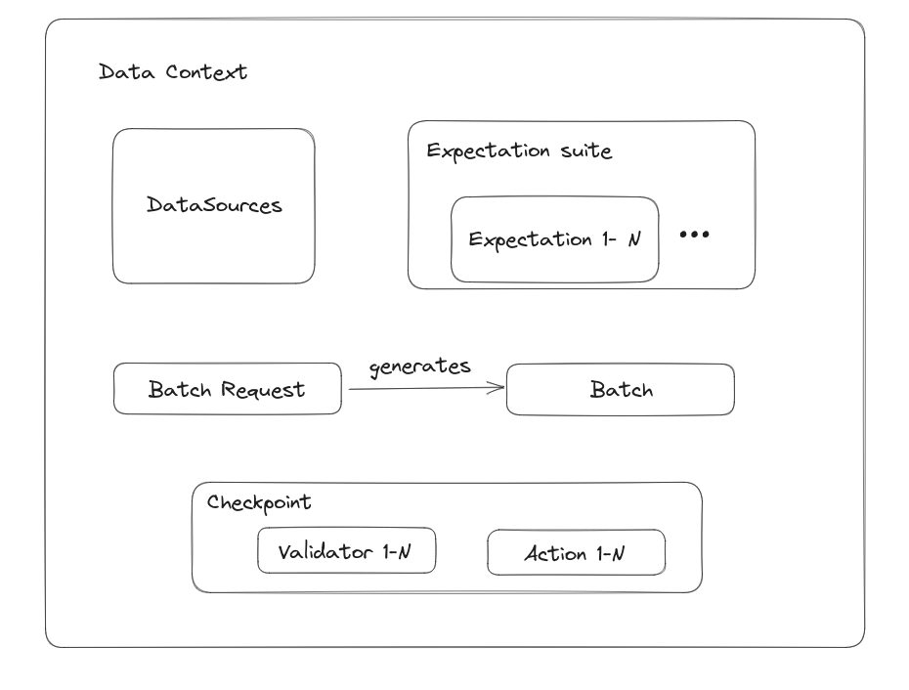
Great Expectations
Glossary
Checkpoint: A convenient abstraction for bundling the Validation of a Batch (or Batches) of data against an Expectation Suite (or several), as well as the Actions that should be taken after the validation..

Slide 21
Great Expectations
Glossary
Actions:
  Store Data Docs
  Store Metrics
  Store Validation Results
  Email notification
  Slack notification
  MS Teams notification
  Ops Genie Notification..

Slide 22
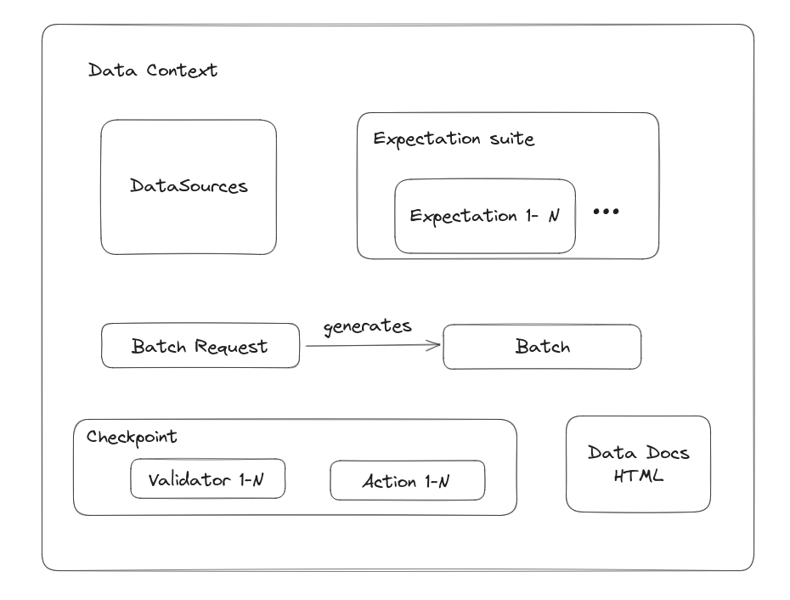
Great Expectations
Glossary
Data Docs:
  Azure
  GCS
  S3
  File System

Slide 23
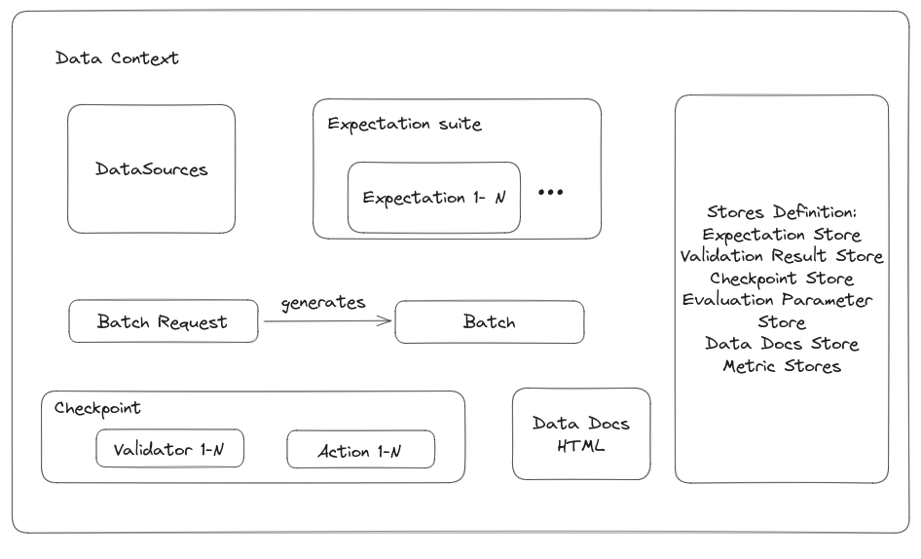
Great Expectations
Glossary
Stores:
  Expectation Store
  Validation Result Store
  Checkpoint Store
  Evaluation Parameter Store
  Data Docs Store
  Metric Stores

Slide 24
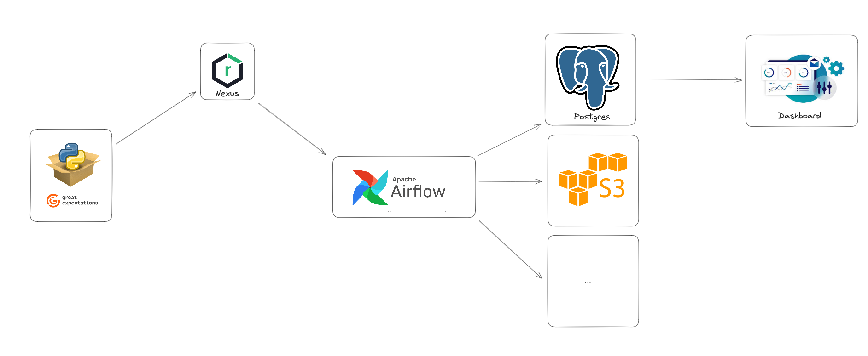
Great Expectations
Production time

Slide 25
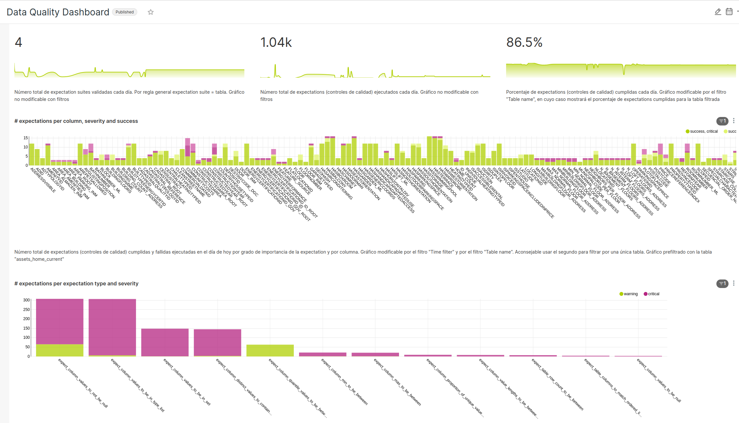
Great Expectations
Production time

Slide 26
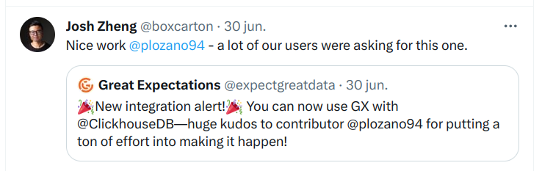

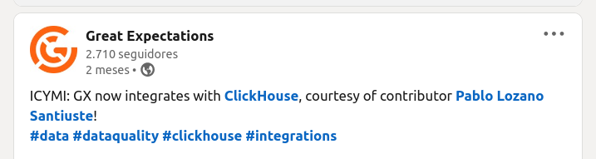

Great Expectations
Project contribution

Slide 27

Gracias!
Ruegos y Preguntas

