Slide 1


News Articles Sorting
Raushan Kumar
2021MSBDA033

Slide 2
Objective
In today’s world, data is power. With News companies having terabytes of data stored in servers, everyone is in the quest to discover insights that add value to the organization. With various examples to quote in which analytics is being used to drive actions, one that stands out is news article classification.
Now a days on the Internet there are a lot of sources that generate immense amounts of daily news. In addition, the demand for information by users has been growing continuously, so it is crucial that the news is classified to allow users to access the information of interest quickly and effectively. This way, the machine learning model for automated news classification could be used to identify topics of untracked news and/or make individual suggestions based on the user’s prior interests.

Slide 3
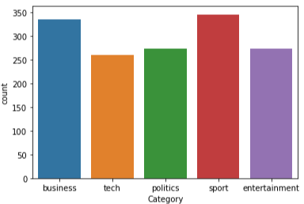
Data Description
The data is downloaded from kaggle i.e BBC news Dataset
The dataset provided to us contains many rows, and 2 independent
features. We aim to predict category of a news. So this clearly is a
classification problem, and we will train the classification models to
predict the desired outputs based on input News.
Article Id – Article id unique given to the record
Article – Text of the header and article
Category – Category of the article (tech, business, sport, entertainment, politics)

Slide 4
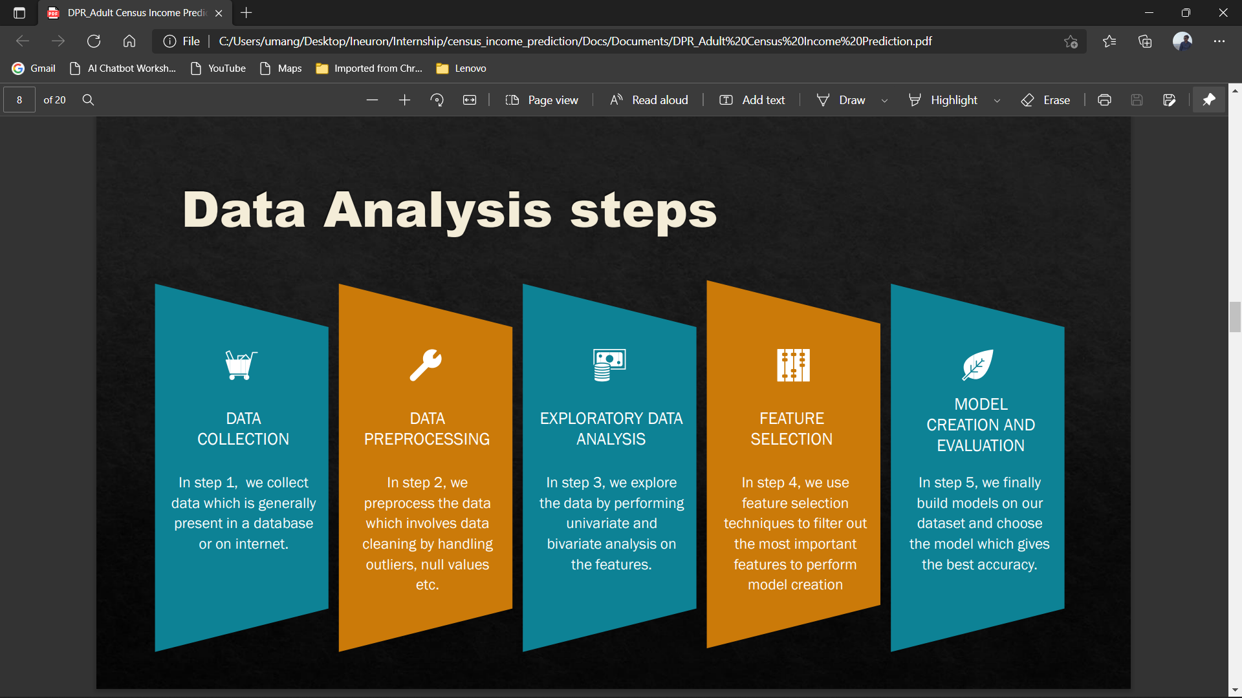
Data Analysis step

Slide 5
Data Preprocessing
Our data is not preprocessed and it contains a lot of punctuations and numbers. To convert raw data as a preprocessed format(like removing punctuations, numbers, single character, multiple spaces). We had created a function “preprocess_text”
After the raw text is preprocessing, we have to encode our labels to numerical encoding as they were categorically encoded before.

Slide 6
Feature Engineering
Checking for imbalanced dataset
Tokenize Data
Stemming
Removing Stopwords
TF IDF Vectorizer

Slide 7
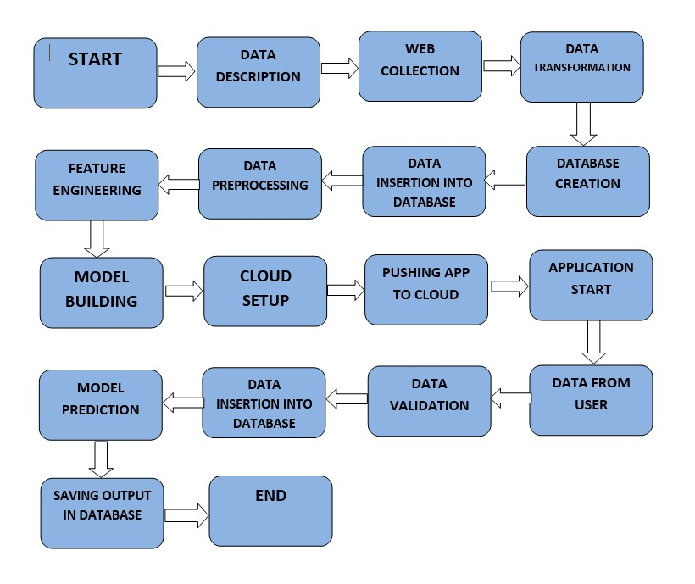
Architecture

Slide 8
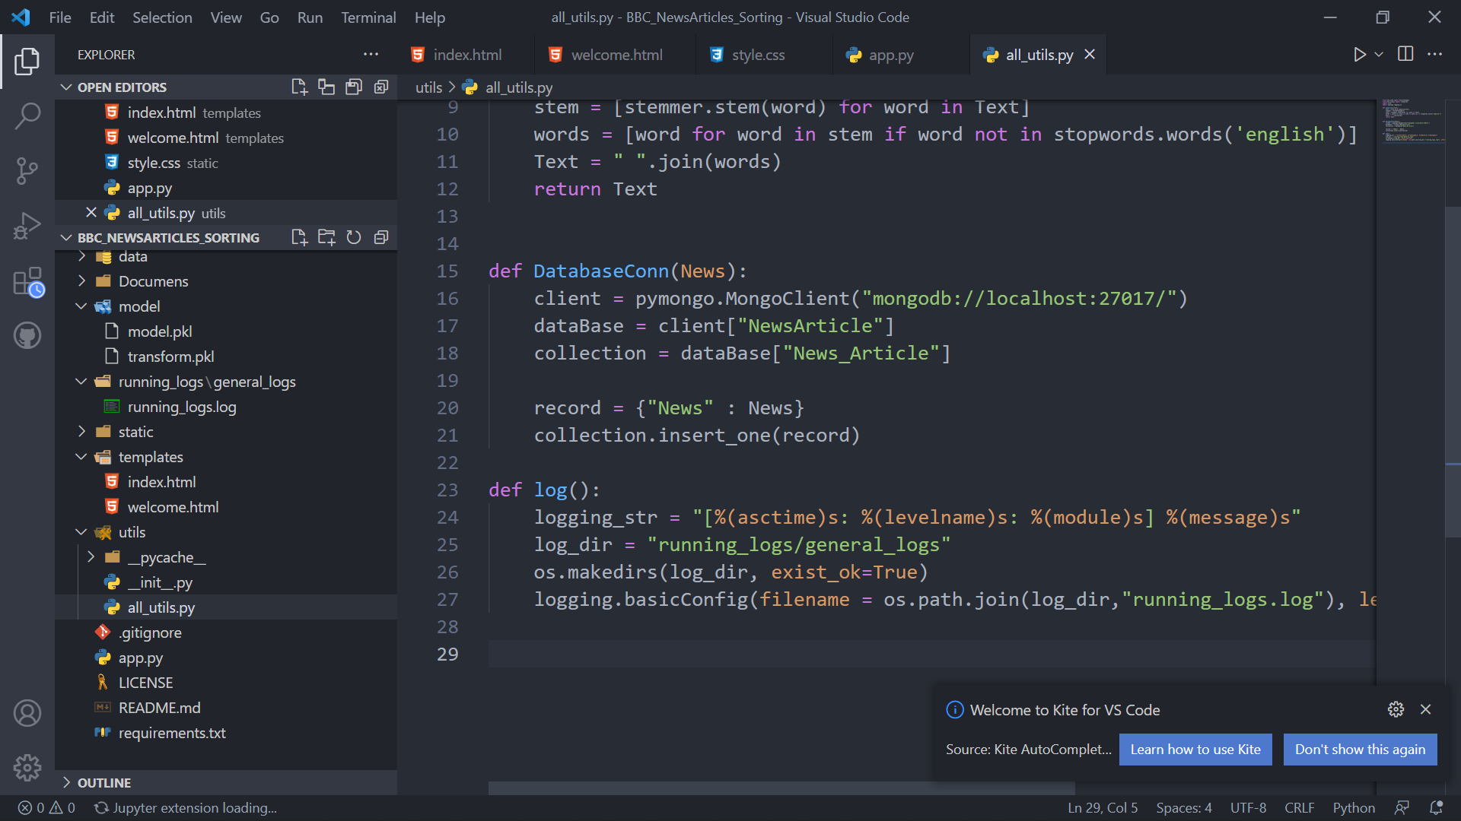

Database
Create Database
Create Collection
Insertion of Data

Slide 9
Model Selection
In model training , used two different Machine Learning model
Evaluate Classification Models using Logistic Regression and Random Forest Classifier.
First we trained Logistic Regression Model with the Accuracy of 97%.
And Second Trained the Random Forest classifier Model with the accuracy of 94%.
Select the model with the best score for model deployment.

Slide 10
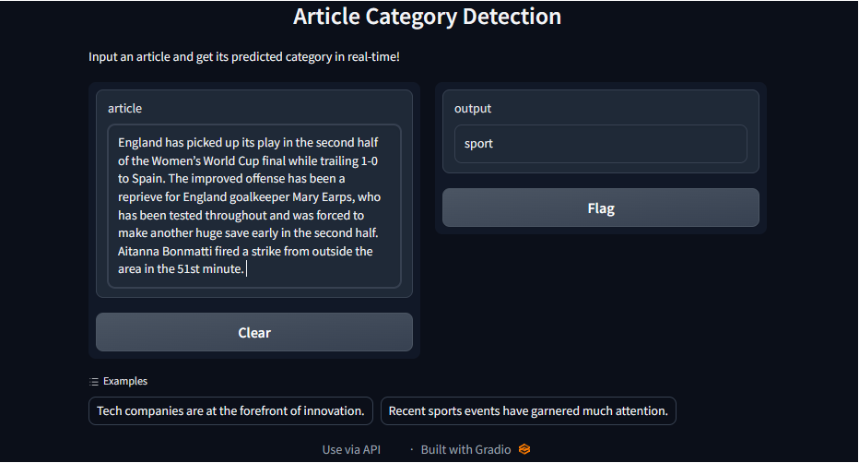
Model Deployment
The final model is deployed using Azure Cloud platform using flask framework.

Slide 11
Thank You

