Slide 1

Data-Driven Transactions
Configure the form. Don’t code it.
Schema-driven, multi-step government transactions — with validation, payments and integrations built into the flow
Notes:
Open with the one-liner: every form in this platform is data, not code. A business analyst can define a complete multi-step transaction — including validation, payment and downstream integrations — by editing a schema. No developer, no deployment.

Slide 2



One platform, three jobs
Every transaction is defined as data — so the same engine runs any form
Configure
Integrate
Extract
Define steps, fields, tabs, choices and rules in a schema. Publish instantly — no code release.
Drop payment steps and outbound webhooks into the flow to hand off to other systems mid-journey.
Completed transactions are available through an open API and pushed to subscribers in real time.
Notes:
Frame the rest of the talk around these three: Configure (how you build a form), Integrate (how the form does more than collect data — payments, hand-offs), Extract (how other systems get the results out). The demo follows the same order.

Slide 3




How it works
A transaction definition drives everything downstream
Transaction definition
Form engine
Transaction
Downstream
Schema stored in MongoDB: steps, fields, rules, payment config, webhook URL
Renders the schema as a branded, multi-step wizard at runtime
Submitted data saved with status: free → pending → complete
Stripe payment, outbound webhooks, pull API for 3rd parties
Change the definition → every new transaction follows the new rules. No rebuild, no redeploy.
Notes:
React + Express + MongoDB. The key design point is that TransactionForm fetches the definition at load time and renders it — so the definition is the single source of truth. Status lifecycle: free (no payment), pending (sent to Stripe), complete (paid).

Slide 4
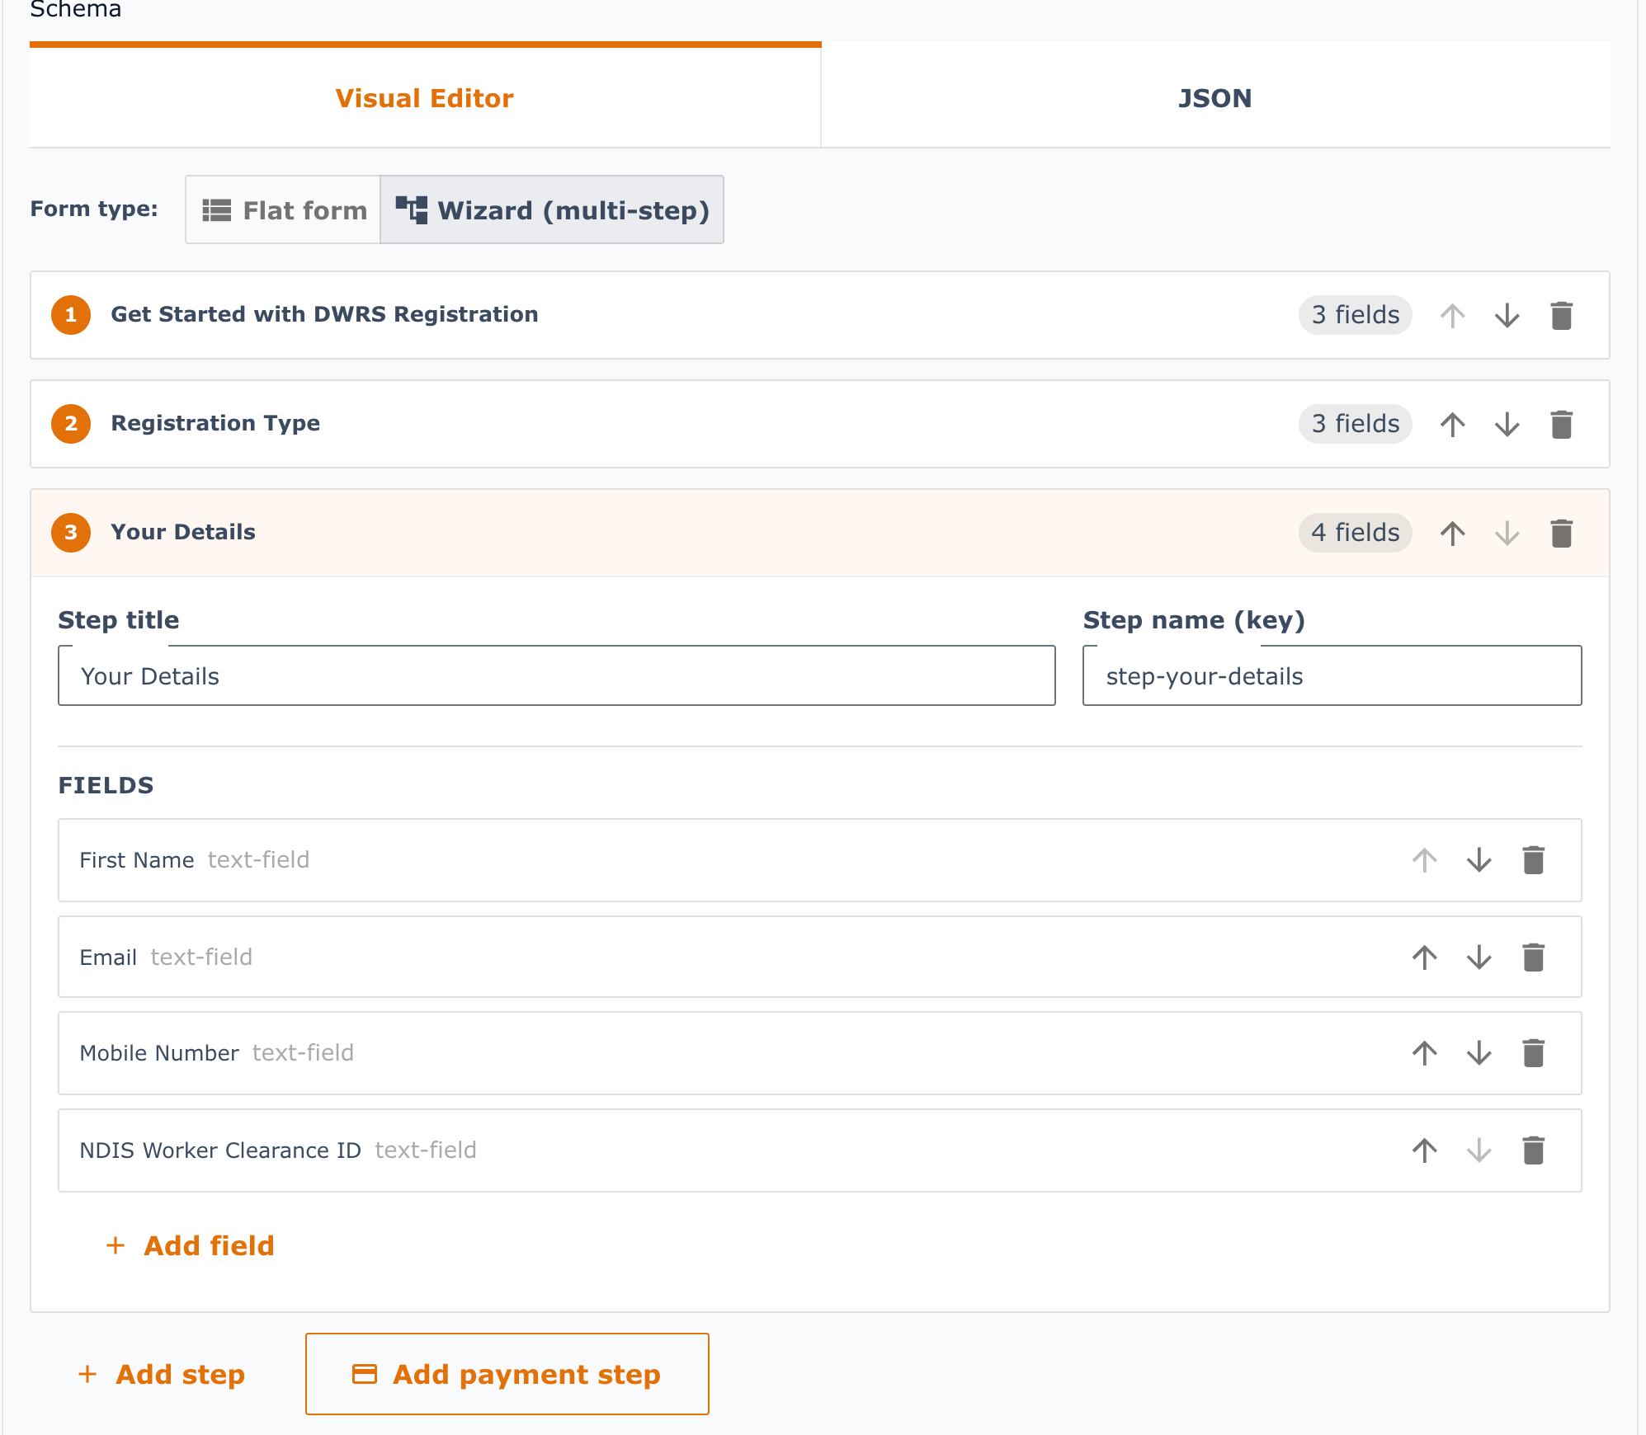
Configuring the steps
Steps are declared in the schema — the wizard, navigation and progress come for free
txndef.schema
// Disability Worker Registration (DWRS)
{ "component": "wizard",
"fields": [
{ "name": "step-getting-started",
"title": "Get Started",
"nextStep": "step-registration-type",
"fields": [ /* tabs, text */ ] },
{ "name": "step-registration-type",
"nextStep": "step-your-details", … },
{ "name": "step-your-details",
"nextStep": "payment", … },
{ "name": "payment", "type": "payment" }
]
}
Same definition in the Visual Editor: add, reorder and edit steps and fields
Notes:
This is a real definition from the demo data (DWRS registration). Each step has a name, title, fields and nextStep. Rich content — tabs, headings, bullet lists — lives inside steps. nextStep can also be conditional (a 'when/stepMapper'), so the registration type answer can route applicants down different paths.

Slide 5
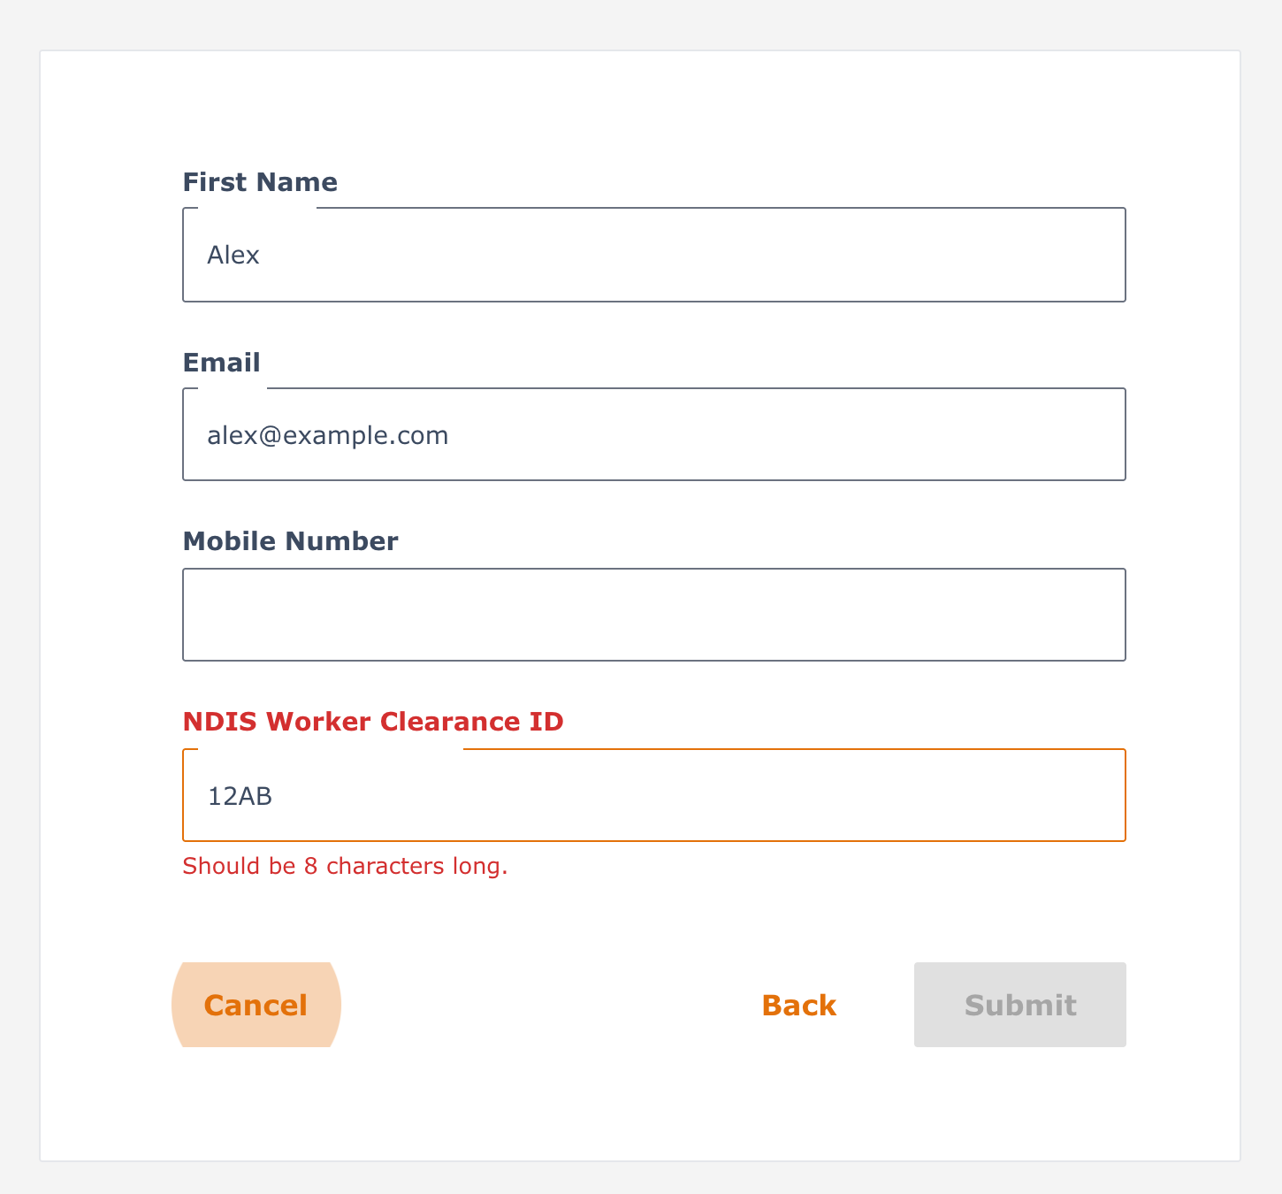
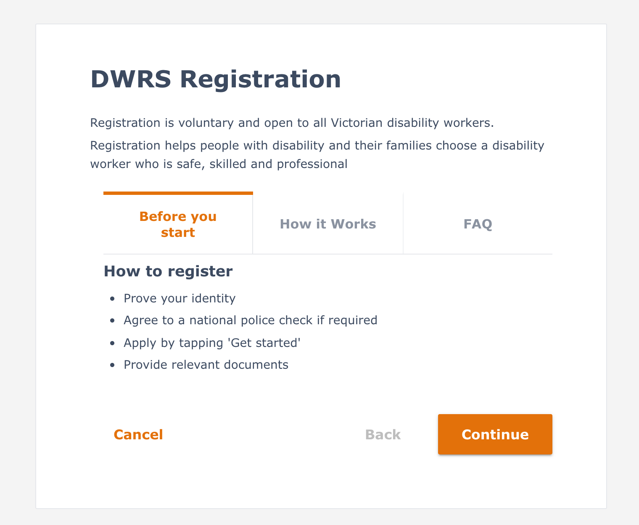
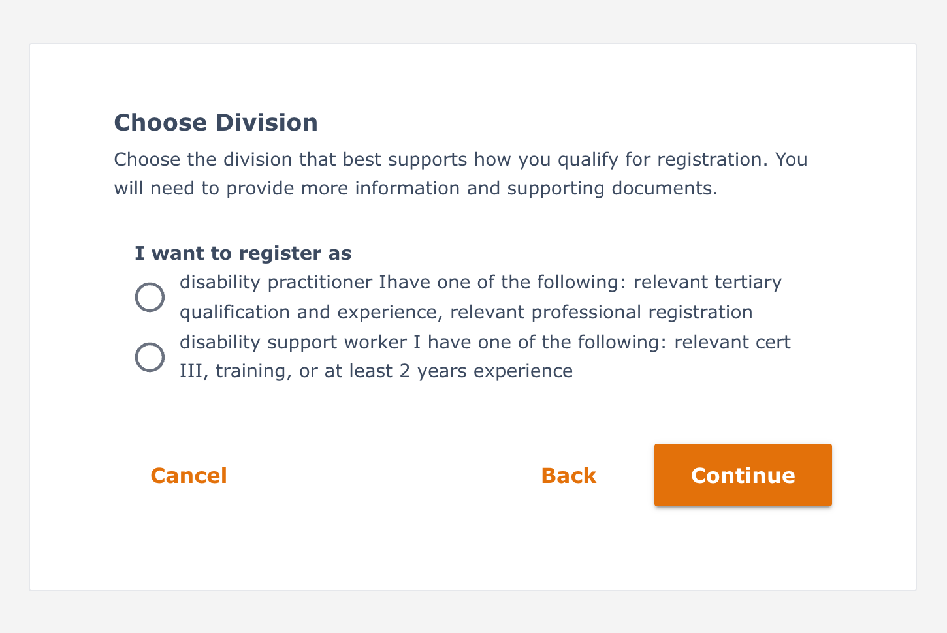
What the applicant sees
The same schema, rendered as a branded Service Victoria–style wizard
1 Get Started
2 Registration Type
3 Your Details
Rich content and tabs
Choices that shape the path
Fields with live validation
Notes:
These are live screenshots of the DWRS definition from the previous slide. Nothing on these screens was hand-coded: the tabs, headings, radio choices, field labels, the Continue/Back navigation and the error message all come from the schema. The orange banner and card styling come from a single shared theme, so every form looks consistent.

Slide 6
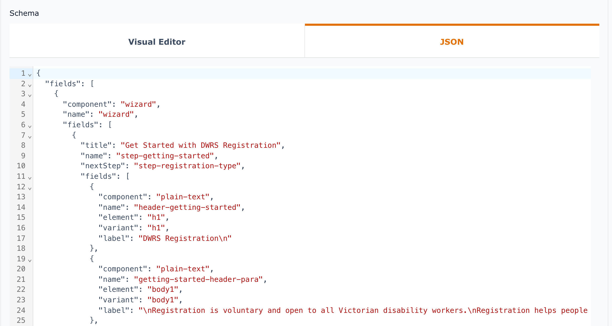


Built for analysts and developers
Two synchronised editors over the same definition
Visual Editor
Add and reorder steps, pick field types, attach validation rules and configure payment — no JSON required.
JSON Editor
The full schema with syntax highlighting. Copy between environments, version-control forms, reach every advanced option.
Notes:
In the demo, open a definition under /txndefs and flip between the Visual Editor and JSON tabs — changes in one appear in the other. Emphasise: analysts can own the forms; developers aren't a bottleneck.

Slide 7
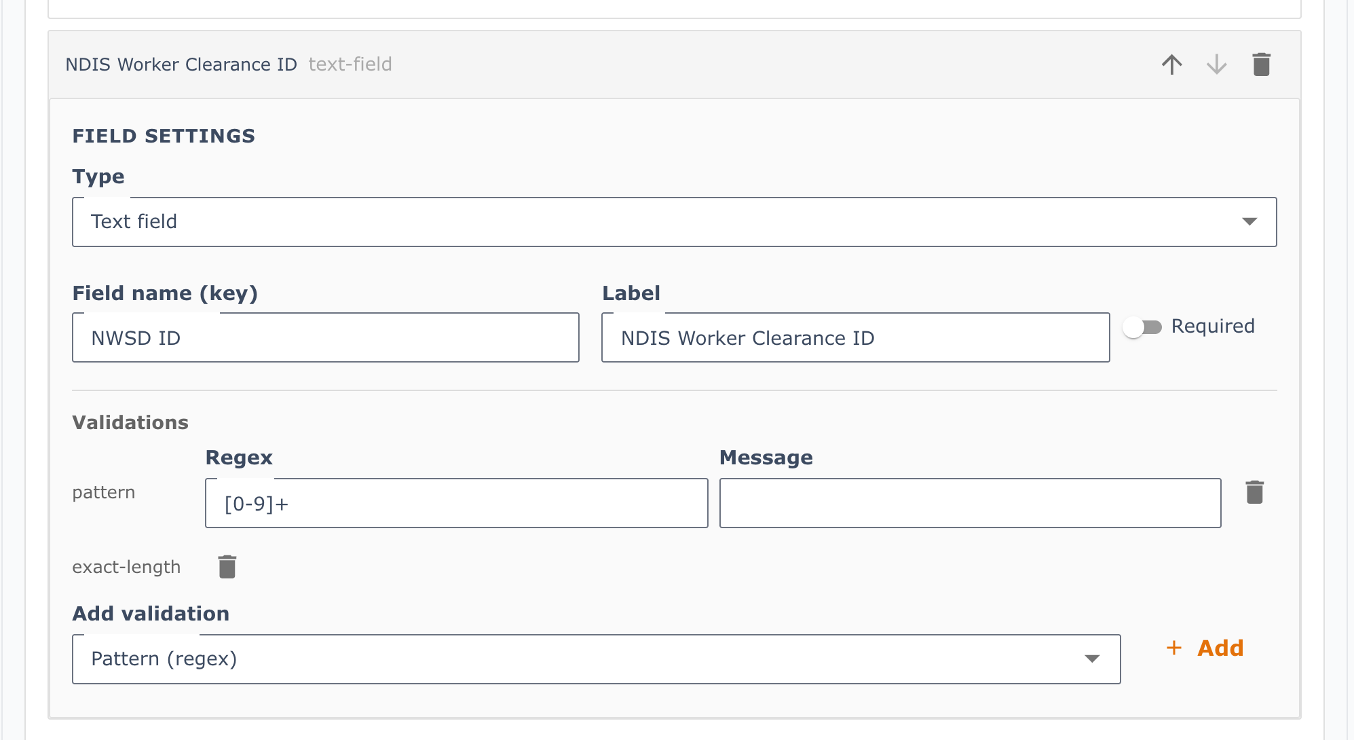
Validation: configured, not coded
Pick a rule in the editor — the form enforces it immediately
Editor: NWSD ID must be digits, exactly 8 long
Applicant: can’t submit until it’s right
Notes:
Left: the Visual Editor on the NDIS Worker Clearance ID field, with a regex pattern and an exact-length rule. Right: the applicant's view — '12AB' is rejected with 'Should be 8 characters long' and Submit stays disabled. In the demo, do this live: add a rule, save, reload the form.

Slide 8




Validation at every layer
Simple rules are declarative — complex logic plugs into the same pipeline
Field rule — from the live DWRS form
Field
{ "component": "text-field",
"name": "NWSD ID",
"validate": [
{ "type": "pattern", "pattern": "[0-9]+" },
{ "type": "exact-length", "threshold": 8 }
] }
Formats, lengths, patterns, required — instant feedback as the user types
Step & cross-field
Show / hide on answers, branch paths, compare fields against each other
Server-side
Required · pattern · min / max length · exact length · numeric ranges · URL · conditional visibility
Re-validate every submission; enforce business rules the browser can’t be trusted with
The schema declares the rule. The engine decides where it runs.
External systems
Look up registries, verify identity, check eligibility before a step completes
Notes:
Show the NWSD ID field in the demo — type letters or 7 digits and the form refuses to continue. That's a declarative rule in the schema. The same validator pipeline accepts custom and asynchronous validators, and the server re-checks submissions, so the model extends naturally to heavyweight checks: registry lookups, identity verification, eligibility rules, cross-field consistency. The applicant just sees a clean form; the complexity stays in the background.

Slide 9

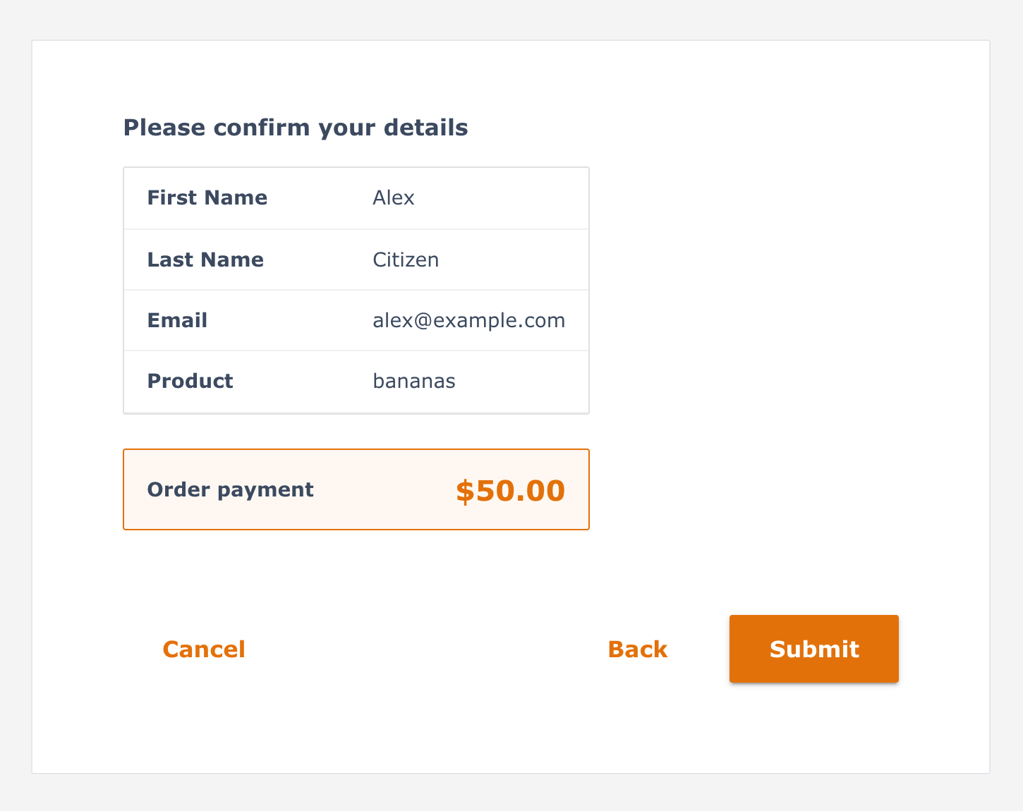



Integrating inside the flow: payments
A payment is just another step in the schema
Payment step
Summary
{ "name": "payment",
"type": "payment",
"amount_cents": 5000,
"currency": "aud",
"description":
"Registration fee" }
Applicant confirms details and fee
Stripe Checkout
Hosted page; card data never touches us
Confirmed
No payment code per form. Change the fee, currency or description in the definition and it applies to the next applicant.
Stripe webhook marks it complete
Hand-off
Webhook notifies downstream systems
Notes:
The form engine detects any wizard step with type: payment, injects a read-only PaymentSummary, and on submit calls POST /payment/create-checkout-session. The transaction is saved as pending, the user goes to Stripe, and Stripe's webhook flips it to complete. Free forms skip all this and save as 'free'. The same pattern — a typed step that hands off to an external service — is how further integrations (identity, document checks, bookings) slot in.

Slide 10


Getting the data out
Pull on demand, or have it pushed the moment a transaction completes
Pull API
Outbound webhook
Returns every complete and free transaction for a definition
Fires on completion if webhook_url is set
$ curl localhost:5050/api/transactions/{id}
[{
"_id": "6a2271ef…6d",
"status": "complete",
"payment_amount": 5000,
"data": {
"first_name": "Alex",
"product": "bananas" …
} }]
POST {webhook_url}
{ "event": "transaction.completed",
"txndef_name": "DWRS",
"transaction": {
"status": "complete",
"data": { … } } }
Notes:
Two models. Pull: any system can GET all completed and free transactions for a definition — great for reporting, batch jobs, BI tools. Push: set a webhook_url on the definition and the server POSTs the full transaction the moment it completes (after payment, or immediately for free forms). The data shape mirrors the field names in the schema, so consumers get exactly what the form collected.

Slide 11
Calling the API with curl
Plain HTTP + JSON — any language, tool or platform can consume it
$ API=http://localhost:5050 # the server
$ ID=6a226fff816eba41437ddf38 # a transaction definition ("pay banana")
1 · List definitions and their IDs
2 · Inspect a definition’s steps
$ curl -s $API/txndef | jq -r '.[] | "\(._id) \(.name)"'
66396e466d6b9f2a08710c38 DWRS
6a226fff816eba41437ddf38 pay banana
$ curl -s $API/txndef/$ID \
| jq -c '.schema.fields[0].fields[] | {name, type}'
{"name":"step-details","type":null}
{"name":"step-payment","type":"payment"}
3 · Pull completed transactions
4 · Export straight to CSV
$ curl -s $API/api/transactions/$ID \
| jq '.[] | {status, payment_amount, data}'
{ "status": "complete", "payment_amount": 5000,
"data": { "first_name": "Alex", … } }
$ curl -s $API/api/transactions/$ID | jq -r \
'.[] | [.data.email, .status] | @csv' > out.csv
"alex@example.com","complete"
Notes:
All four commands are verified against the demo data. Setting API and ID as shell variables keeps the commands short on screen. Recipe 1 finds the ID of any definition; recipe 2 shows the schema is itself queryable (you can see the payment step); recipe 3 is the 3rd-party pull API — only complete and free transactions are returned, never pending ones; recipe 4 shows how trivially the data drops into Excel or a reporting pipeline. jq is optional — plain curl returns the raw JSON. Note: the pull API is open today; production would add an API key or OAuth.

Slide 12






Connects to the systems you already run
Anything with an HTTP endpoint can sit before, during or after a transaction
Payments
Stripe (live today)
Compliance checks
Identity
Police check, registries
Transaction
engine
Verify before submit
Reporting / BI
Case management
Pull API feeds dashboards
Open a case on completion
Notifications
Email / SMS receipts
Notes:
Payments via Stripe is working today and is the template for the rest. The engine gives you three integration points: typed steps inside the wizard (like payment), server-side checks on submission, and outbound webhooks on completion — plus the pull API. Identity, compliance checks, case management and notifications all fit one of those hooks without changing how forms are authored.

Slide 13







Under the hood
The demo stack — open-source, containerised, runs on a laptop
Browser
React 18
Vite
MUI 5
React Router
Data Driven Forms
Forms
Open-source React library that renders forms from JSON schemas — started by Red Hat
Data Driven Forms 3
React Final Form
Editor
CodeMirror 6
Visual schema editor
<FormRenderer
schema={txndef.schema} // straight from MongoDB
componentMapper={mui + payment-summary + …}
validatorMapper={{ 'same-email': () =>
(value, all) => value !== all.email
? 'Email does not match' : undefined }} />
API
Node 20
Express 4
Data
MongoDB 7
Component mapper schema names → MUI components, plus our own
Payments
Stripe Checkout
Webhooks
Validator mapper built-in rules + custom, cross-field and async
Runtime
Docker Compose
Conditions & wizard show/hide on answers, branching step paths
Notes:
The form engine is Data Driven Forms (@data-driven-forms/react-form-renderer with the MUI component mapper, v3), an open-source library started at Red Hat and built on React Final Form. We hand it the schema from MongoDB; it does the rendering, state, wizard navigation and validation. Three extension points: componentMapper maps schema names to React components (we add payment-summary and bullet-list); validatorMapper adds custom validators (the same-email cross-field check in the snippet is in the codebase today, and validators can be async, so they can call server APIs and registries); and conditions/stepMapper drive show-hide logic and branching wizards. Everything else is a conventional MERN stack: React 18 with Vite and MUI 5, Express 4 on Node 20, MongoDB 7, Stripe for payments, all run with Docker Compose.

Slide 14
Demo walkthrough
About 10 minutes — follows Configure → Integrate → Extract
1
Open the definition
5
Pay
Transaction Definitions → DWRS → Edit. Flip Visual Editor ↔ JSON.
Use “pay banana”: confirm $50.00 → Stripe Checkout with test card 4242 4242 4242 4242.
2
Change a step live
6
Watch the hand-off
Add a field or edit a step title; save. Nothing redeploys.
Status flips to complete; webhook payload lands at the webhook URL.
3
Fill a transaction
7
Pull the data
Transaction Definitions → Create Transaction. Walk the tabs and pick a registration type.
Run the curl recipes in a terminal — the new record is there, ready for CSV.
4
Trip the validation
Tip: point webhook_url at a request inspector (e.g. webhook.site) so the audience sees the push arrive live.
Enter a 7-digit or alphabetic NWSD ID — the step won’t advance.
Notes:
Step 2 is the moment that lands: edit the schema, save, and open a new transaction — the change is there immediately. Step 4: show the validation error, then fix it. Step 5: Stripe test mode, card 4242 4242 4242 4242, any future expiry, any CVC. Step 6: refresh the transaction list to show 'complete', then switch to the webhook inspector tab. Step 7: run the curl recipes from the 'Calling the API with curl' slide (the Bruno collection in /bruno works too).

Slide 15

Before you present
Local environment checklist
.env has STRIPE_SECRET_KEY (test) and STRIPE_WEBHOOK_SECRET from stripe listen
# 1. Start the stack (client :8081, server :5050, mongo)
docker compose up --build
# 2. Load the demo data (first run only)
docker compose exec mongo \
mongorestore --noOptionsRestore --gzip /dump
# 3. Forward Stripe events (separate terminal)
stripe listen --forward-to \
localhost:5050/payment/webhook
DWRS definition has a payment step and webhook_url set
Webhook inspector open in a browser tab
Terminal ready with API and ID set for the curl recipes (jq installed)
Browser tabs: /txndefs and /transactions
Notes:
Do a full dry run beforehand. If the Stripe CLI isn't forwarding, payments will stay 'pending' — that's the most common demo failure. The webhook secret changes each time you run stripe listen, so update .env and restart the server if needed.

Slide 16


Get the code
Open source — clone it, run it locally, build your own transactions
github.com/ideapod/dd-transactions
$ git clone https://github.com/ideapod/dd-transactions.git
$ cd dd-transactions && docker compose up --build
$ docker compose exec mongo mongorestore --noOptionsRestore --gzip /dump
Includes demo data, a Bruno API collection and a full README.
Scan to open the repo
Notes:
Leave this up while taking questions so people can scan the QR code. The repo URL is also a clickable link in the deck. The three commands get the full stack running with the demo data; Stripe test keys go in .env for the payment flow.

Slide 17
Why it matters
Days, not sprints
One engine, every form
New transactions are configured, not built
Consistent branding, validation and accessibility
Open by default
Complexity stays hidden
Payments, APIs and webhooks connect it to everything else
Deep rules and checks run behind a simple applicant journey
Questions?
Notes:
Close on the business outcome: faster delivery of new transactions, consistency, and an open integration model. Invite questions — likely ones: security of the open API (can add auth), hosting (Docker, currently self-hosted Mongo), and how complex validation is authored.

