Slide 1

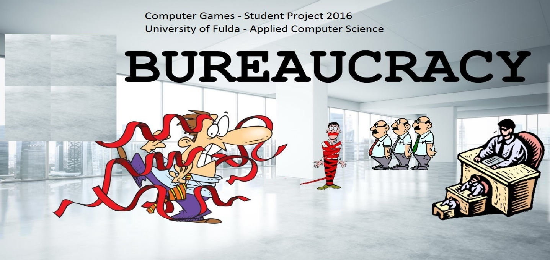
Burocracy Game Final Presentation
Computer Games Software Development
Supervisor: Prof. Dr. Grimm, AI, HS-Fulda
Sami Jaby ElHaramein
Ivan Chistov

Slide 2
Bureaucracy Game – Content Index
- 01. The idea behind creating the Game
- 02. Main Characters and playing events
- 03. Rules when playing
- 04. Technical Part and Realization
- 05. Problems and Troubleshooting

Slide 3
Bureaucracy game – the idea behind
Storyline
The idea for this game came from the experience, communication and rumors
accumulated and spread by the people in result of the contact between the ‘normal’ persons (citizens) and the different authorities, agencies and administration.
Most of those contacts between administration and citizens are reportedly
frustrating and connected with long waiting times and in some cases with mistakes.

Slide 4
Main characters – and playing events
Characters and objects in the Game
In this Game there are two main characters and lots of surrounding objects.
The scene is an usual office where are lot of tables with computers and shelves.

Slide 5
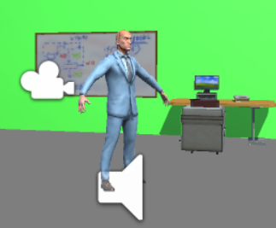
Main characters – and playing events
Characters and objects in the Game
1-character is the player itself. He can run or walk between the tables in the office
and also can work on any table or to dig around in the shelves. The player also
can hide himself behind some office furniture if needed and also he/she should
be able to reach the floor elevator door when needed.

Slide 6
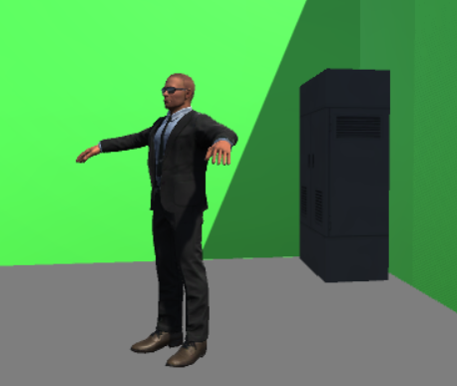
Main characters – and playing events 2
Characters and objects in the Game - 2
2-character is the bureaucrat. He stands next to the floor elevator door. The bureaucrat can throw objects to the player (runner) in order to decrease his collected score.

Slide 7

Main characters – and playing events
Characters and objects in the Game - 3
While planning and designing the Game the GDT decided originally to have 3 levels:
- level1: the bureaucrat can throw letters which are light objects and decrease the
scores of the player by 5, however the score is displayed in the upper left side of the screen.

Slide 8
Rules when playing
The Runner character may act as following:
It can work on a bureau or dig around in the shelves seeking heritage
Working on a bureau brings game-money to the Runner and he can use the collected
funds in order to be able to escape from the current game level through an elevator
The elevator opens its doors only if the Runner has enough money or heritage.
The runner can run and jump in order to avoid thrown objects

Slide 9
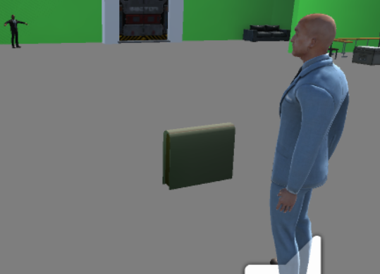
Rules when playing 2
The Bureaucrat character may act as following:
On bureaucrat object impact with player character, player looses heritage(score).

Slide 10
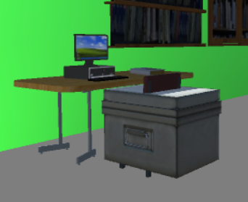
Rules when playing
Score Increase:
The player can increase his score if:
He passed by the each desk and collected boxes, each box has 5 points.
He stayed next to a desk which has one point only.

Slide 11
Technical Part and Realization 2
Scripts – short description
walk (controlling player steps sound)
randomly throwing (controlling throwing objects on player)
pause & start (controlling pause and start menu)
player control (controlling all player actions and sore adjustment)
third person orbit cam (controlling the camera following the player)
object jump (controlling the boxes movement around)

Slide 12
Technical Part and Realization 3
Scripts – developer part
walking - Sami
randomly throwing - Sami
pause & start - Ivan
player control - Sami
third person orbit cam - Ivan
object jump - Ivan

Slide 13
Thank you
☺
Sami Jaby ElHaramein, GSD HS-Fulda
Ivan Chistov, AI HS-Fulda
2016

