Slide 1
Machine Learning
Lecture 2
1.1. Classifying is not very different from Predicting
1.2. Training a Simple Classifier
Youngsup Kim
idebtor@gmail.com
Handong Global University

Slide 2
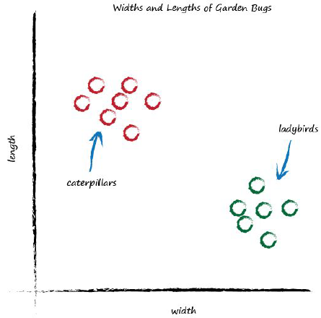
1.1. Classifying is not very different from Predicting
The following graph shows the measured widths and lengths of garden bugs.
The caterpillars are thin and long, and the ladybirds are wide and short.

Slide 3
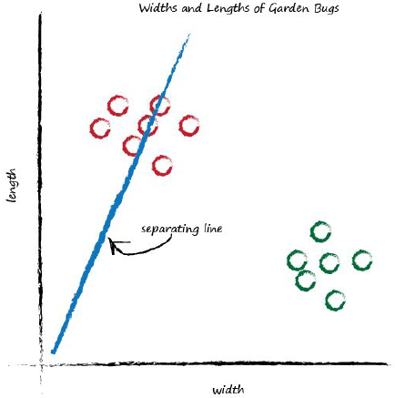
1.1. Classifying is not very different from Predicting
Linear functions give straight lines when you plot their output against input.
The adjustable parameter c changed the slope of that straight line.
What happens if we place a straight line over that plot?

Slide 4
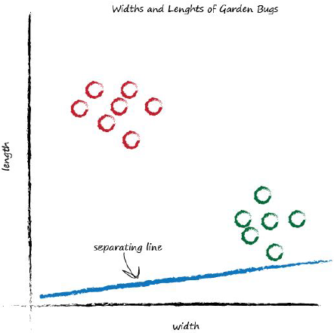
1.1. Classifying is not very different from Predicting
The line can be used to separate different kinds of things.
It could be used to classify an unknown bug based on its measurements.
By adjusting the slope again the graph below is obtained.

Slide 5
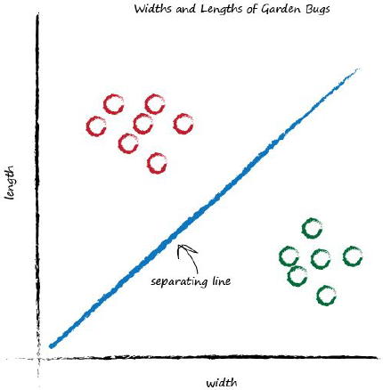
1.1. Classifying is not very different from Predicting
Adjusting again the slope the line that neatly separates caterpillars from ladybirds is obtained and, therefore, can be used as classifier of bugs.

Slide 6
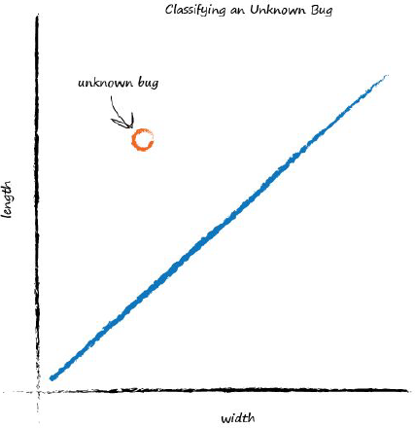
1.1. Classifying is not very different from Predicting
In the following plot, the unknown bug can be seen that is a caterpillar because it lies above the line.
This classification is simple but pretty powerful already!

Slide 7
1.1. Classifying is not very different from Predicting
Notes:
It was seen how a linear function inside a simple predictors can be used to classify previously unseen data.
Some crucial element were skipped intentionally, such as: How do we get the right slope? How do we improve a line we know isn’t a good divider between the two kinds of bugs?
The answer to that is again at the very heart of how neural networks learn, and we’ll look at this next.

Slide 8

1.2. Training a Simple Classifier
The aim is to train a linear classifier to correctly classify bugs as ladybirds or caterpillars. How to do this?
Instead of developing mathematical theory, another way will be adopted and will help to understand mathematics better.
The following table shows two examples of bugs, ladybird and caterpillar.
This is a set of examples of truth used to teach a predictor or a classifier and is called the training data.

Slide 9
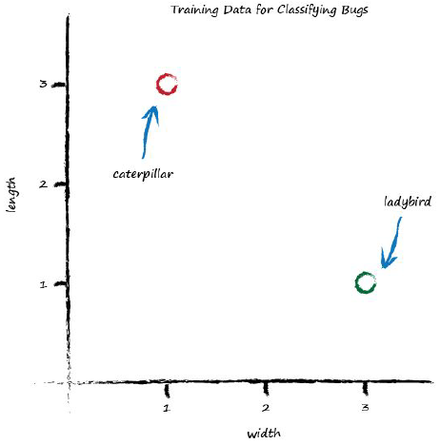
1.2. Training a Simple Classifier
Visualizing data is often very helpful to get a better understand of it. The next plot shows the two training data examples:

Slide 10
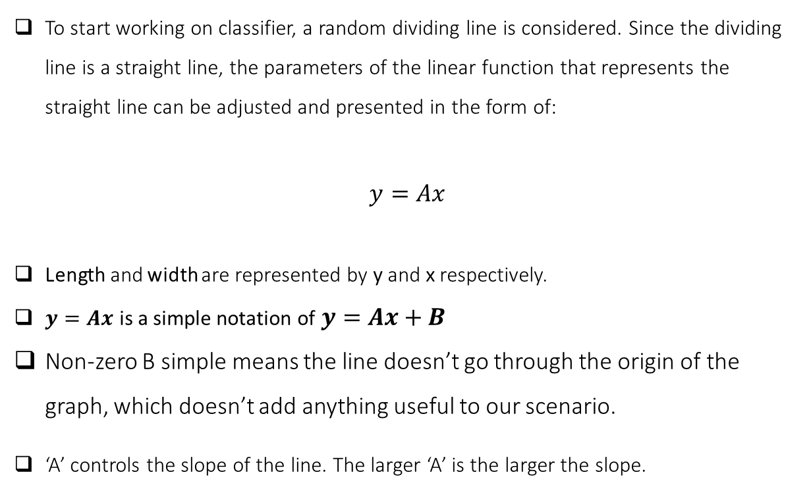
1.2. Training a Simple Classifier
To start working on classifier, a random dividing line is considered. Since the dividing line is a straight line, the parameters of the linear function that represents the straight line can be adjusted and presented in the form of:
$$y=Ax$$
Length and width are represented by y and x respectively.
$y=Ax$ is a simple notation of $y=Ax+B$
Non-zero B simple means the line doesn’t go through the origin of the graph, which doesn’t add anything useful to our scenario.
‘A’ controls the slope of the line. The larger ‘A’ is the larger the slope.

Slide 11
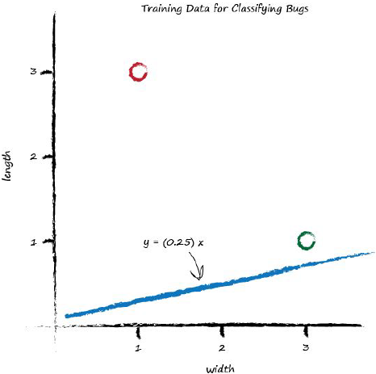
1.2. Training a Simple Classifier
For A = 0.25 (to get started), the dividing line is y = 0.25x.
Plot this line on the same plot of training data is obtained the following scenario:

Slide 12
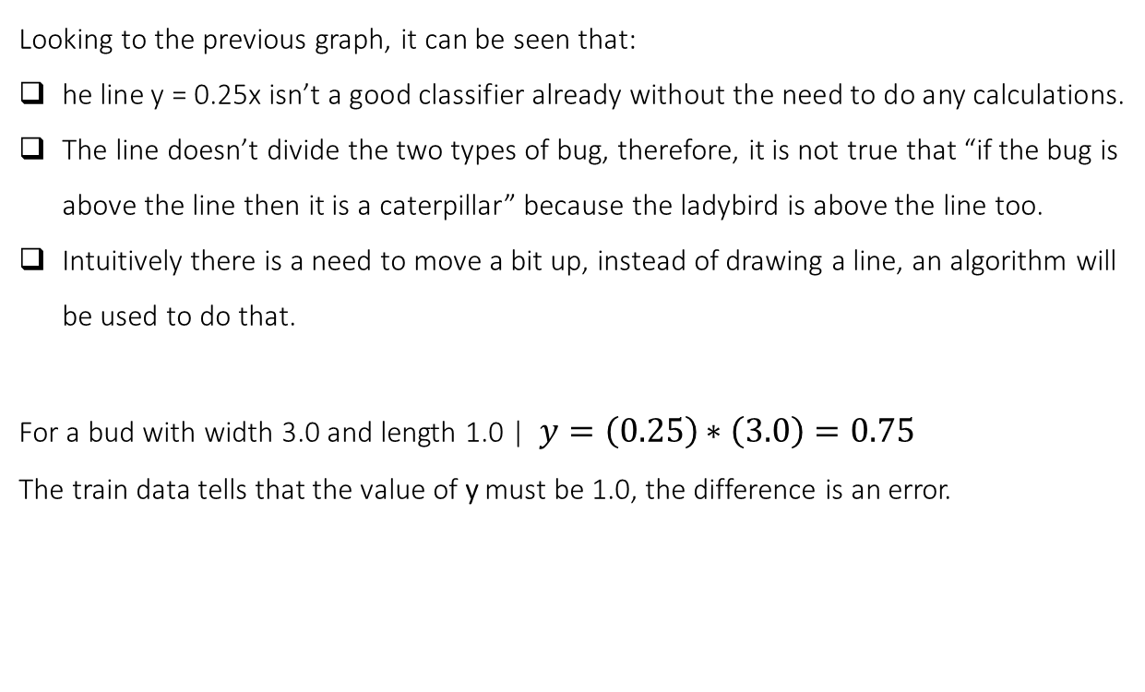
1.2. Training a Simple Classifier
Looking to the previous graph, it can be seen that:
he line y = 0.25x isn’t a good classifier already without the need to do any calculations.
The line doesn’t divide the two types of bug, therefore, it is not true that “if the bug is above the line then it is a caterpillar” because the ladybird is above the line too.
Intuitively there is a need to move a bit up, instead of drawing a line, an algorithm will be used to do that.
For a bud with width 3.0 and length 1.0 | $y=\left(0.25\right)∗\left(3.0\right)=0.75$
The train data tells that the value of y must be 1.0, the difference is an error.

Slide 13
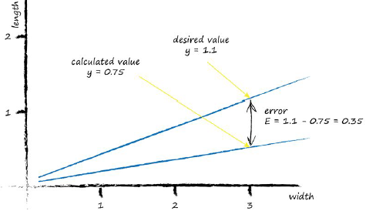
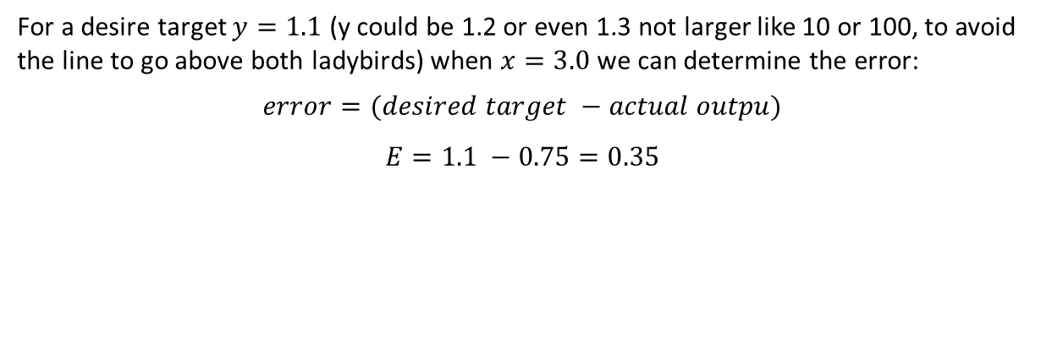
1.2. Training a Simple Classifier
For a desire target $y=1.1$ (y could be 1.2 or even 1.3 not larger like 10 or 100, to avoid the line to go above both ladybirds) when $x=3.0$ we can determine the error:
$$error=(desired target −actual outpu)$$
$E=1.1 −0.75=0.35$

Slide 14
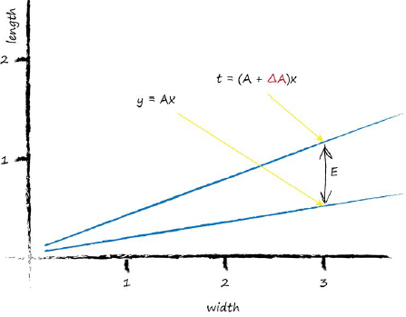

1.2. Training a Simple Classifier
The objective is to use the error to refine parameter A, for this to be possible the relation between A and the error E must be encountered to understand how a change in one affects the other.
For the linear classifier:
$$y=Ax$$
The desired value is:
$$t=\left(A+ΔA\right)x$$

Slide 15
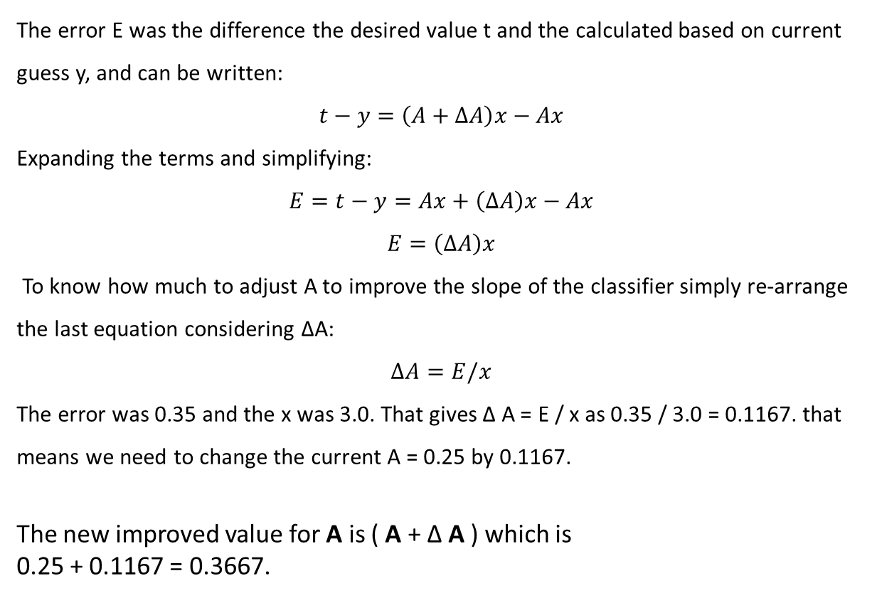
1.2. Training a Simple Classifier
The error E was the difference the desired value t and the calculated based on current guess y, and can be written:
$$t−y=\left(A+ΔA\right)x−Ax$$
Expanding the terms and simplifying:
$$E=t−y=Ax+\left(ΔA\right)x−Ax$$
$$E=\left(ΔA\right)x$$
To know how much to adjust A to improve the slope of the classifier simply re-arrange the last equation considering ΔA:
$$ΔA=E/x$$
The error was 0.35 and the x was 3.0. That gives Δ A = E / x as 0.35 / 3.0 = 0.1167. that means we need to change the current A = 0.25 by 0.1167.
The new improved value for A is ( A + Δ A ) which is 0.25 + 0.1167 = 0.3667.

Slide 16
1.2. Training a Simple Classifier
For a true pairing of x = 1.0 and y = 3.0 and updated A = 0.3667:
y = 0.3667 * 1.0 = 0.3667. That’s not very close to the training example y = 3.0
Setting the desired target value at t = 2.9 error E = (2.9 - 0.3667) = 2.5333.
Update the A:
ΔA = E / x ΔA = 2.5333 / 1.0 = 2.5333
A = 0.3667 + 2.5333 = 2.9.
That means for x = 1.0 the function gives 2.9 as the answer, which is what the desired value was.

Slide 17
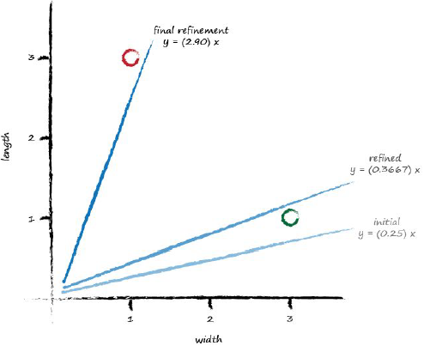
1.2. Training a Simple Classifier
The following plot shows the initial line, the line updated after learning from the first training example, and the final line after learning from the second training example. When updating for each training data example, all we get is that the final update simply matches the last training example closely.

Slide 18
1.2. Training a Simple Classifier
How the fact of the final update simply matches the last training example closely can be fixed?
This is obtained by moderating the updates what is an important idea in machine learning. Instead of jumping enthusiastically to each new A, a fraction
of the change ΔA is taken, so that we move in the direction that the training example suggests, but do so slightly cautiously, keeping some of the previous value.
The moderation can dampen the impact of those errors or noise contained sometimes in training data.
ΔA = L (E / x )
Moderating factor is often called a learning rate (L).

Slide 19
1.2. Training a Simple Classifier
For L=0.5:
A = 0.25. and x = 0.3
y = 0.25 * 3.0 = 0.75.
A desired value of t = 1.1 gives us an error of E = 0.35.
The Δ A = L ( E / x ) = 0.5 * 0.35 / 3.0 = 0.0583.
The updated A is 0.25 + 0.0583 = 0.3083.
A = 0.3083 and x = 3.0
y = 0.3083 * 3.0 = 0.9250. therefore, the line falls on the wrong side.
A = 0.3083 and x = 1.0
y = 0.3083 * 1.0 = 0.3083.
The desired value was 2.9 so the error E = (2.9 0.3083) = 2.5917.
The Δ A = L ( E / x ) = 0.5 * 2.5917 / 1.0 = 1.2958.
The even newer A is now 0.3083 + 1.2958 = 1.6042.

Slide 20
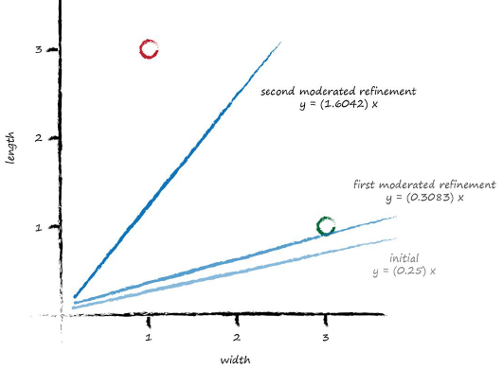
1.2. Training a Simple Classifier
With these two simple training examples, and a relatively simple update method using a moderating learning rate , we have very rapidly arrived at a good dividing line y = Ax where A is 1.6042.

Slide 21
1.2. Training a Simple Classifier
Key Points:
We can use simple maths to understand the relationship between the output error of a linear classifier and the adjustable slope parameter. That is the same as knowing how much to adjust the slope to remove that output error.
A problem with doing these adjustments naively, is that the model is updated to best match the last training example only, discarding all previous training examples. A good way to fix this is to moderate the updates with a learning rate so no single training example totally dominates the learning.
Training examples from the real world can be noisy or contain errors. Moderating updates in this way helpfully limits the impact of these false examples.

