Slide 1
Machine Learning
Lecture 2
2.1. Sometimes One Classifier is not enough
2.2. Neurons, Nature's Computing Machines
Youngsup Kim
idebtor@gmail.com
Handong Global University

Slide 2
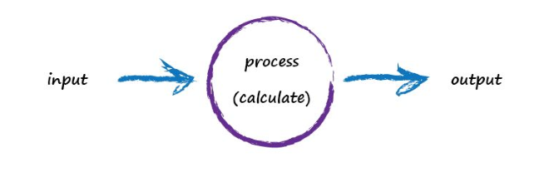
Limitations of Linear Classifier
Simple predictors and classifiers that take some input , do some calculation and output and answer although pretty effective, are not enough to solve some of the more interesting problems we hope to apply neural networks

Slide 3
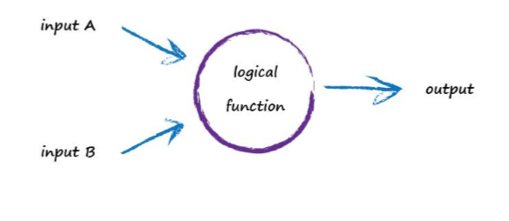
Limitations of Linear Classifier
Let us consider the example of a perceptron that takes two inputs and outputs an answer
Such a neuron could be used to mimic the example of a logical operator

Slide 4
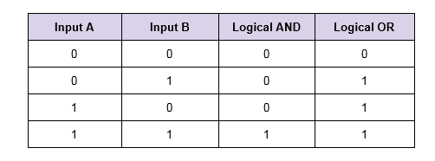
Limitations of Linear Classifier
If considering the case of a neuron that applies the Logical AND or Logical OR the operation of the neuron could be described from the following table, given the two inputs.

Slide 5
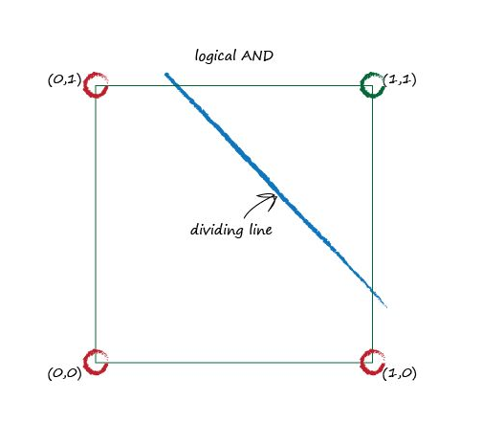
Limitations of Linear Classifier
A simple classifier for the Logical AND operation on a cartesian plane, would look like this:
Note: Clearly, it is possible to find a single line that separates/classifies the 0s and 1s

Slide 6
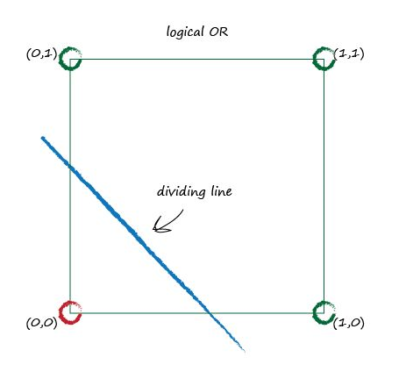
Limitations of Linear Classifier
A simple classifier for the Logical OR operation on a cartesian plane, would look like this:
Note: Clearly, it is possible to find a single line that separates/classifies the 0s and 1s

Slide 7
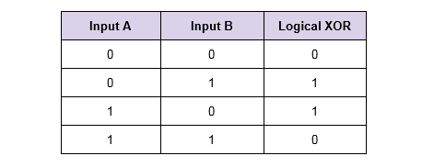
Limitations of Linear Classifier
Let us consider then our simple classifier for another Logical operation, the Logical XOR for example, which operation can be described by the table below

Slide 8
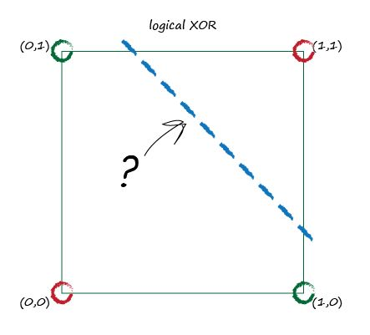
Limitations of Linear Classifier
A simple classifier for the Logical XOR operation on a cartesian plane, would look like this:
Note: It now becomes hard, to identify a single line that separates/classifies the 0s and 1s

Slide 9
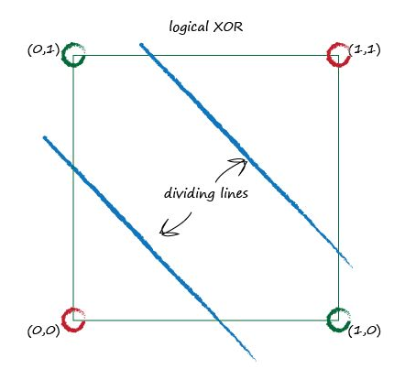
Limitations of Linear Classifier
Another approach then needs to be applied to classify the 0s and 1s in the case of Logical XOR operation. Luck fully there is a simple solution for that problem
Note: Two lines, can be used to separates/classifies the 0s and 1s in the case of Logical XOR

Slide 10
Limitations of Linear Classifier
Conclusion: Clearly is not possible to always find a simple line that classifies/separates the outputs of a certain function.
Most problems in the real world are not that simple. Finding a simple linear classifier becomes especially difficult or impossible in the case of multi dimensional inputs or relationships that are naturally not linear.
Key Points:
A simple linear classifier can’t separate data where that data itself isn’t governed by a single linear process. For example, data governed by the logical XOR operator illustrates this.
However the solution is easy, you just use multiple linear classifiers to divide up data that can’t be separated by a single straight dividing line.

Slide 11
Biological Neural Network and Artificial Neural Network
The concept of Artificial Neural Network is based on the idea of how Biological Neural Network work, on the idea of learning by seeing enough examples and developing an internal method for identifying future cases.
When we were two years old, our parents didn’t teach us how to recognize a dog by measuring the shape of its nose or the contours of its body. We learned to recognize by being shown multiple examples and being corrected when we made the wrong guess, by doing so we refined our internal model that allowed us to identify a dog, until we became very good at it.
In machine learning instead of giving the computer a list of rules to solve the problem, we give it a model with which it can evaluate examples, and small set of instructions to modify the model when it makes a mistake.

Slide 12
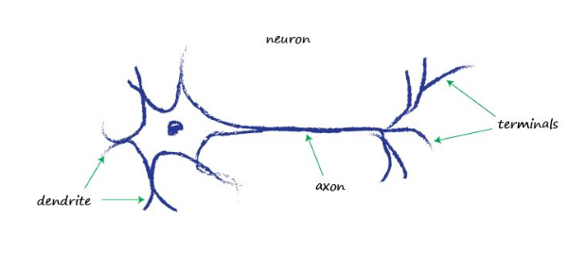
Biological Neural Network and Artificial Neural Network
For us to better understand, let us look at how the brain works. Starting from its basic unit, the Neuron.
A biological neuron is composed of dendrites which receive the input signals, a core, and an axon that releases the output signal from the neuron via its terminals.

Slide 13
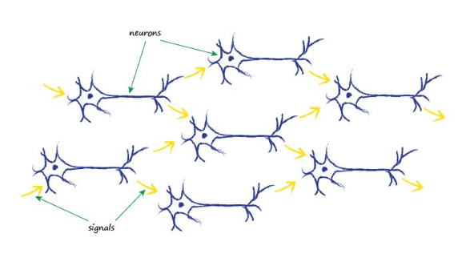
Biological Neural Network and Artificial Neural Network
One Biological Neuron is Connected to multiple other neurons, forming a neural network.
Neurons transmit an electrical signal from one end to the other. A fruit fly has about 100,000 neurons. Human brain has about 100 billion neurons

Slide 14
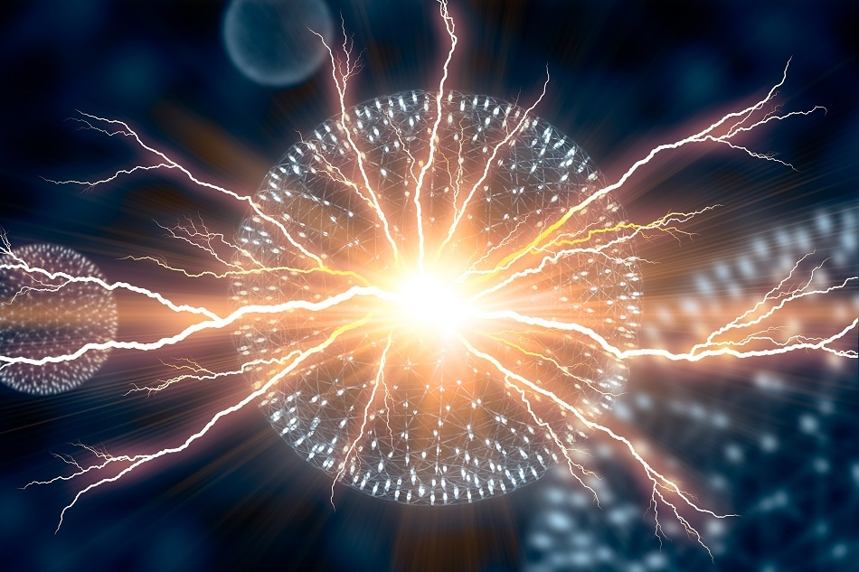
Neuron Activation
Not every time input signals get into the Neuron, and output is produced. There is a certain limit called Threshold that must be met for the Neuron to be activated, and an output being produced.
Biological Neurons send electrical signals to each other. The signals go inside the neuron through the dendrites. Depending on the strength of the input(s) , the neuron will be activated and an output is produced that goes to other neuron(s)

Slide 15
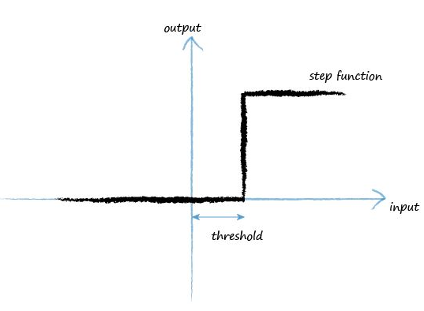
Activation Function
A function that describes the activation of a neuron is called activation function. A simple activation function would look like the following, called Step Function:
Note: Below a certain limit (threshold), in comparison to the input signal, no output is produced (the output is 0), but above that limit (threshold) the neuron is activated and there is output.

Slide 16
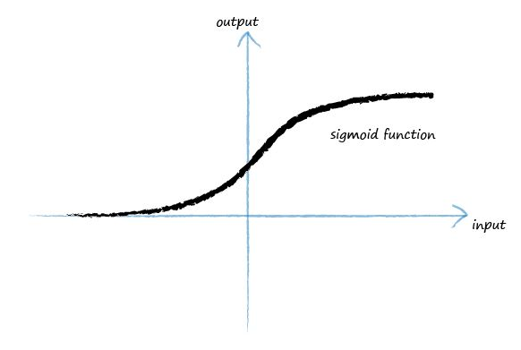
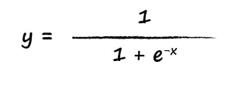
Activation Function
Another function is generally used to represent the activation of neurons due to its behavior that is more natural and realistic. That function is called Sigmoid Function, has a S shape and its value is always between 0 and 1.
Note: As the input (x) tends to minus infinity, which means for a relatively small input signal the function tends to zero (inactive), but from a certain point (threshold) and forth, which means for a value superior than the threshold the function tends to 1 (active).

Slide 17
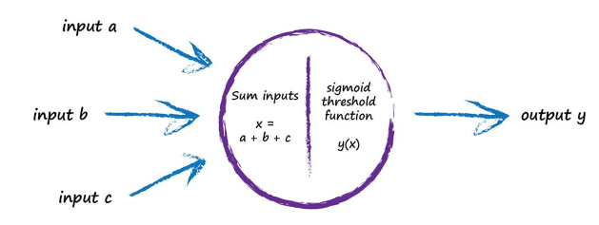
Activation Function
The operation of e neuron could then be described with the following image:
Note: Several inputs reach the neuron, which are summed and submitted to an activation function that decides based on the inputs if the neuron will be activated and an output will be generated, or the input is not strong enough resulting on it being absolved.

Slide 18
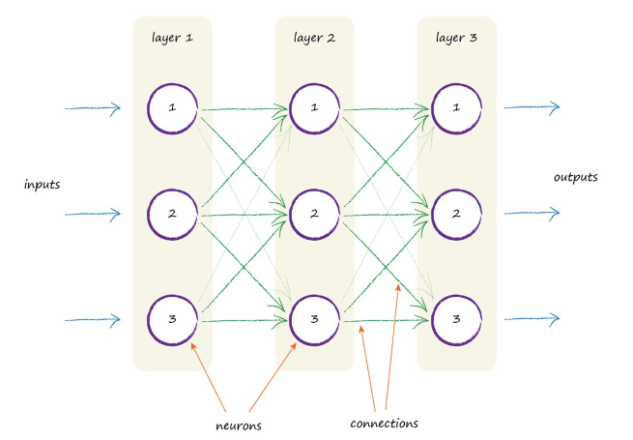
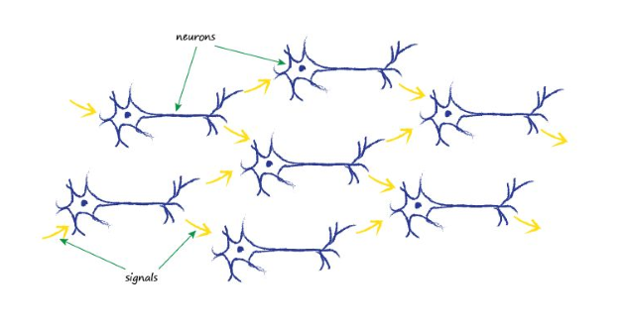
Biological Neural Network vs Artificial Neural Network
Let us now look side by side how an artificial neural network looks in comparison to a biological neural network.
Note: As you can see, an artificial neural network (shown on the right side), is not identical to a biological neural network (shown on the left). In the artificial neural network the neurons are arranged in blocks called layers and, in each layer,, every neuron is connected to all neurons on the following layer.

Slide 19
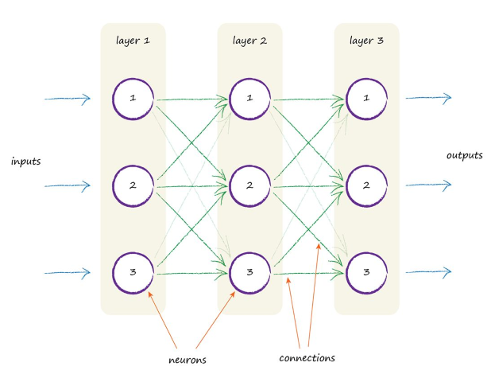
Artificial Neural Network
An artificial neural network is composed of multiple layers, and in each layer, there are multiple neurons. The neurons from one layer are connected to the neurons on the following layer through links called connections.

Slide 20
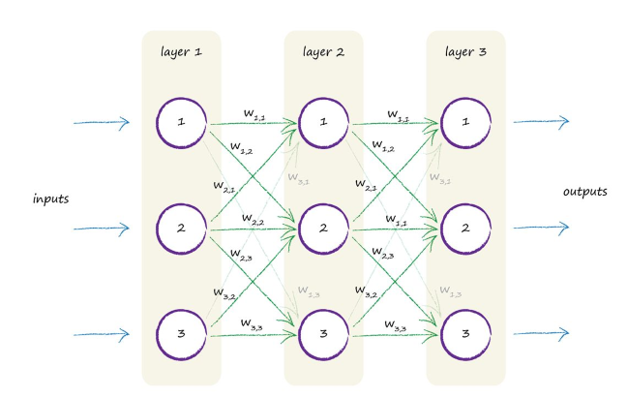
Artificial Neural Network
In an artificial neural network the links (connections) from neurons have an associated value, called weights of the link, which varies from link to link and can be understood as the importance that such connection has on the output.

Slide 21
Artificial Neural Network
The learning process of the neural network consists on refining the weights (adjusting the weights) of the links until the network can properly classify (generate appropriate outputs), for a given set of inputs.

Slide 22
Biological Neural Network vs Artificial Neural Network
Conclusion: Artificial neural networks take much of their implementation on the principle of how the biological neural network operates, and tries to provide means for the computer to learn based on examples, by submitting multiple sets of examples and in each example refining the weights, the contributions of each link in the neural network until the network learns to properly classify the subject of study.
Key Points:
Biological brains seem to perform sophisticated tasks like flight, finding food, learning language, and evading predators, despite appearing to have much less storage and running much slower than modern computers.
Biological brains are also incredibly resilient to damage and imperfect signals compared to traditional computer systems.
Biological brains, made of connected neurons, are the inspiration for artificial neural networks.

