Slide 1
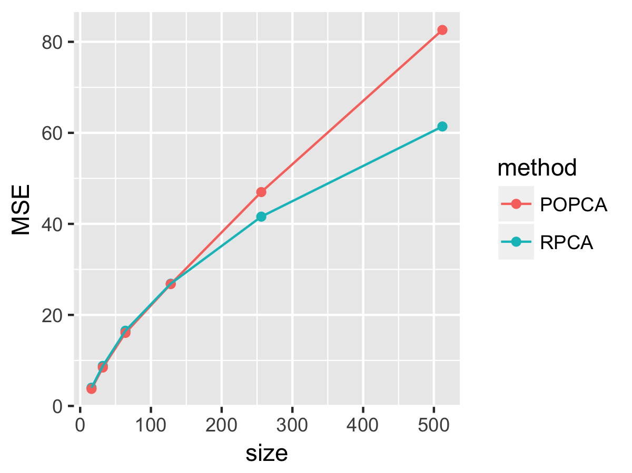
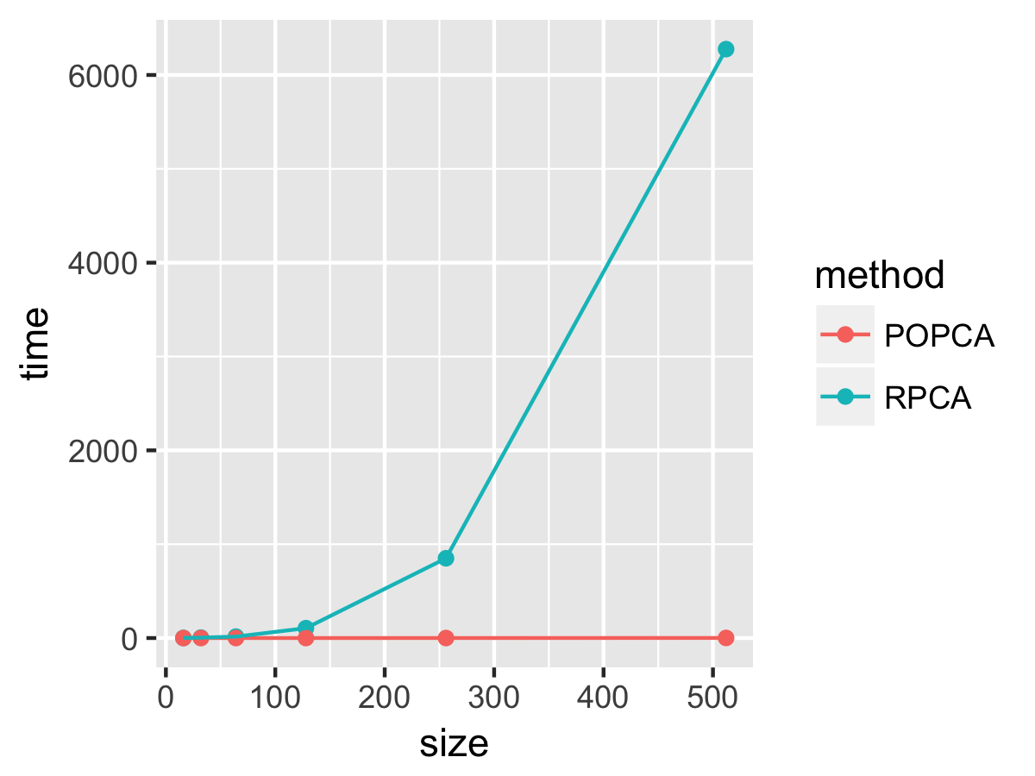
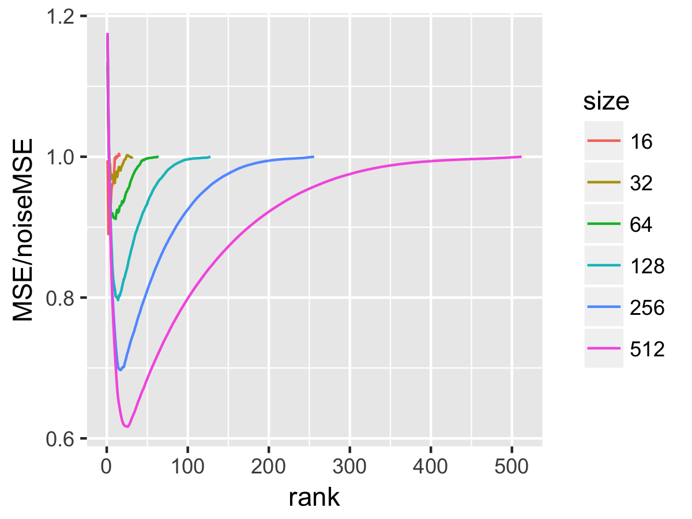
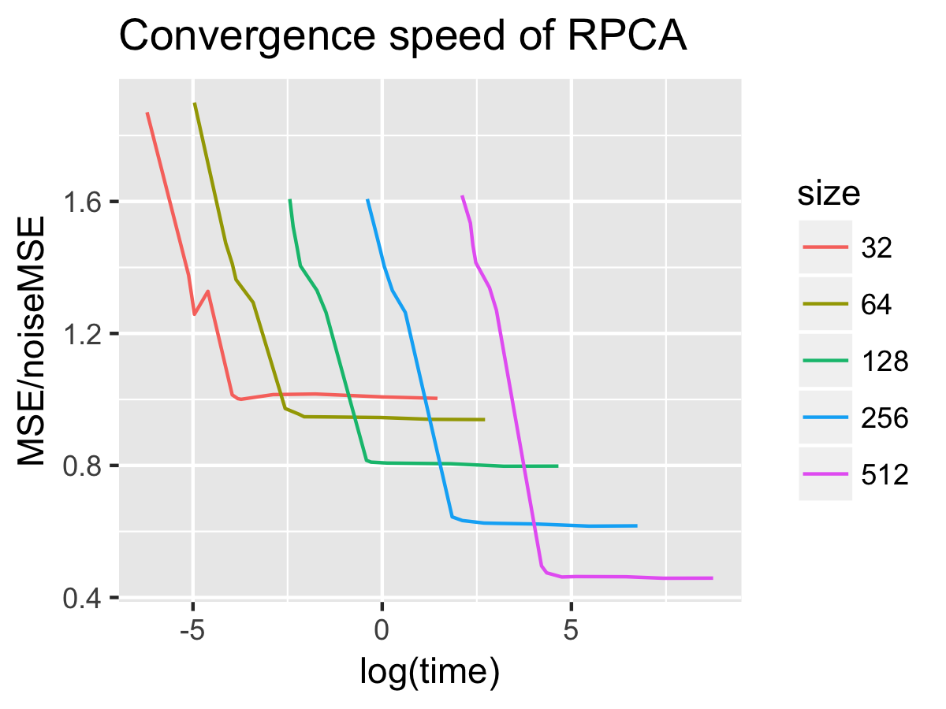
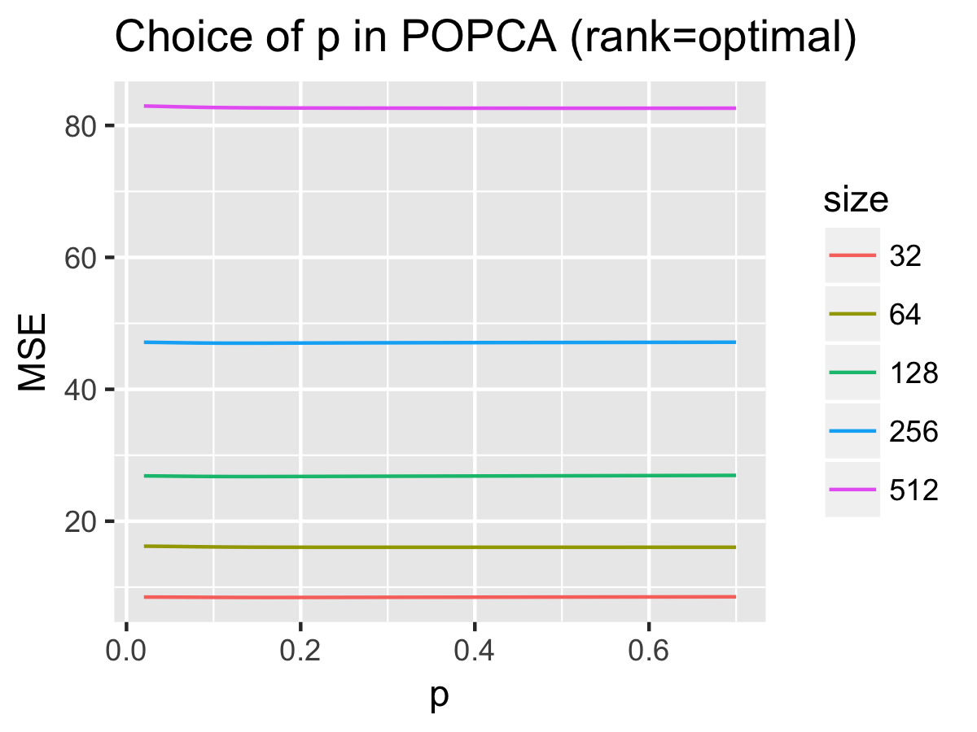
Denoising with Subspace Learning
Department of Statistics
Chen, Haoyu (hchen36@ncsu.edu) Gong, Renfei (rgong2@ncsu.edu) Liu, Bowen (bliu17@ncsu.edu)
POPCA
Algorithm 1 POPCA
Noise Model
Robust-PCA
Optimization Problem
Optimization Problem
Simulation
Algorithm
Algorithm
Time - POPCA /RPCA – image size
Origin / Noise / POPCA /RPCA
MSE – time/rank
Figure 1.
MSE – time
MSE – p

