Slide 1
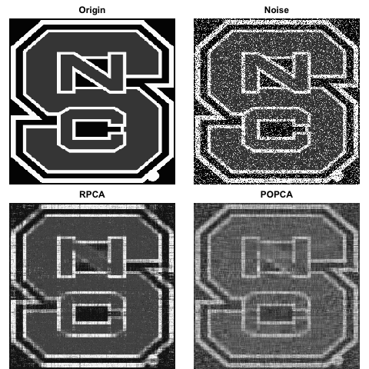
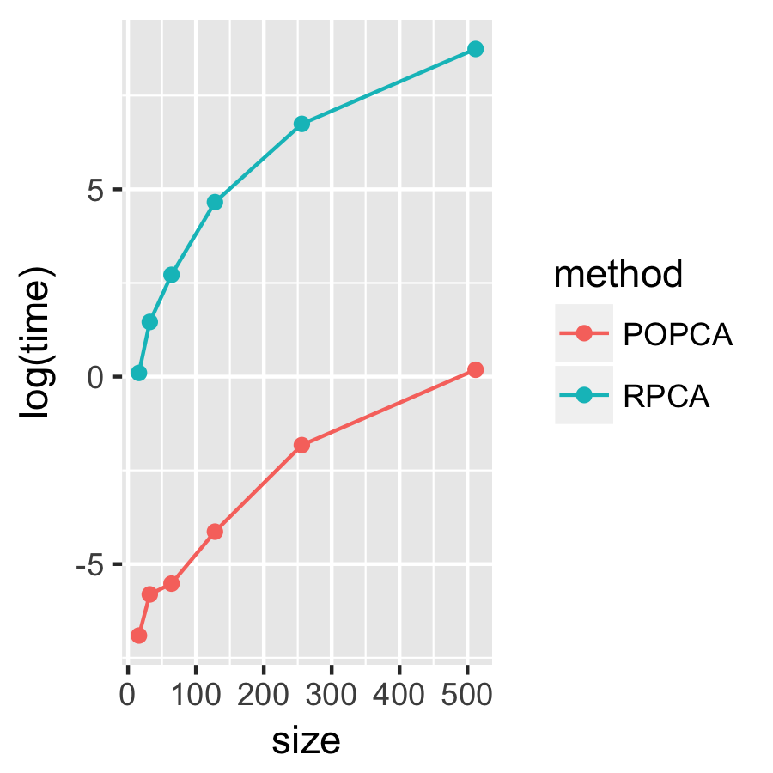
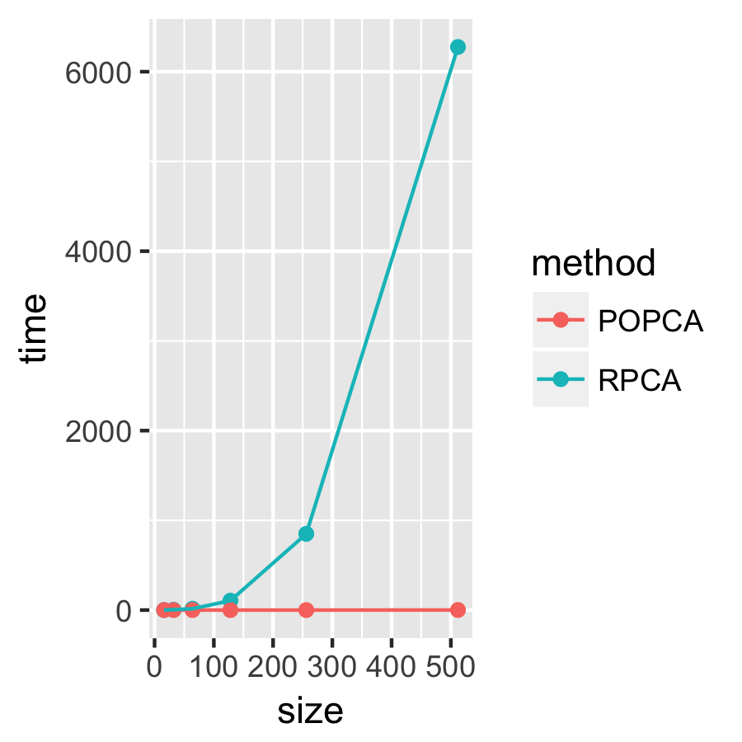
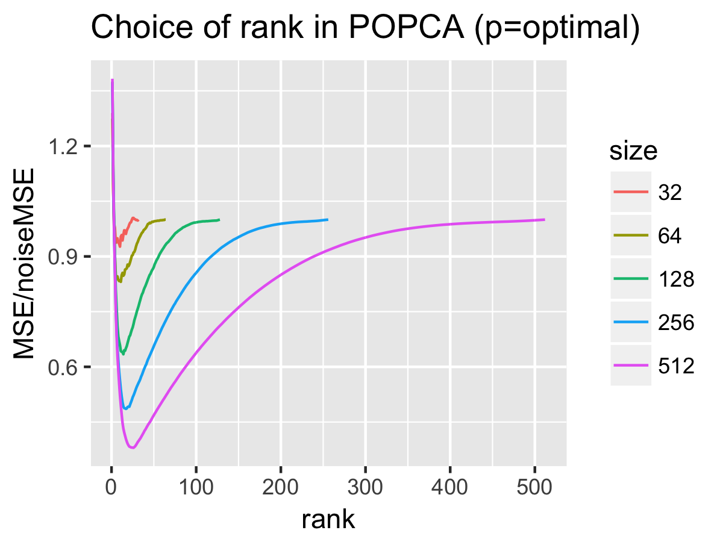
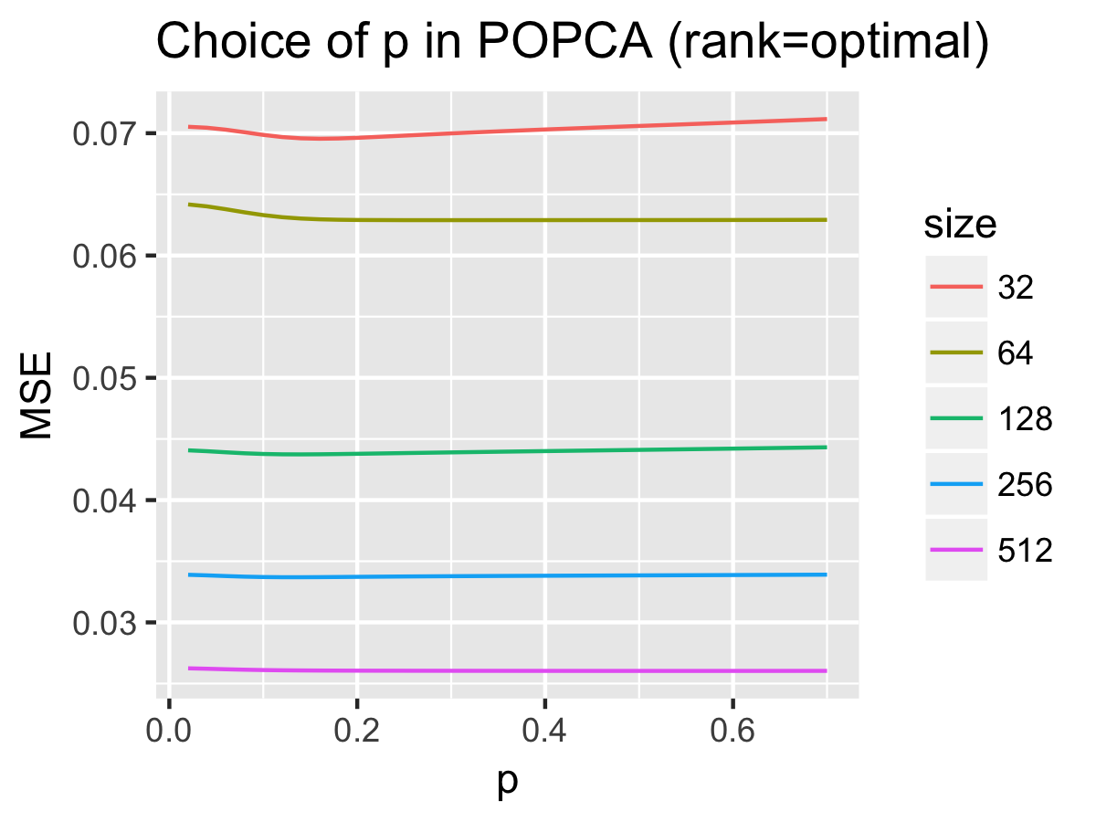
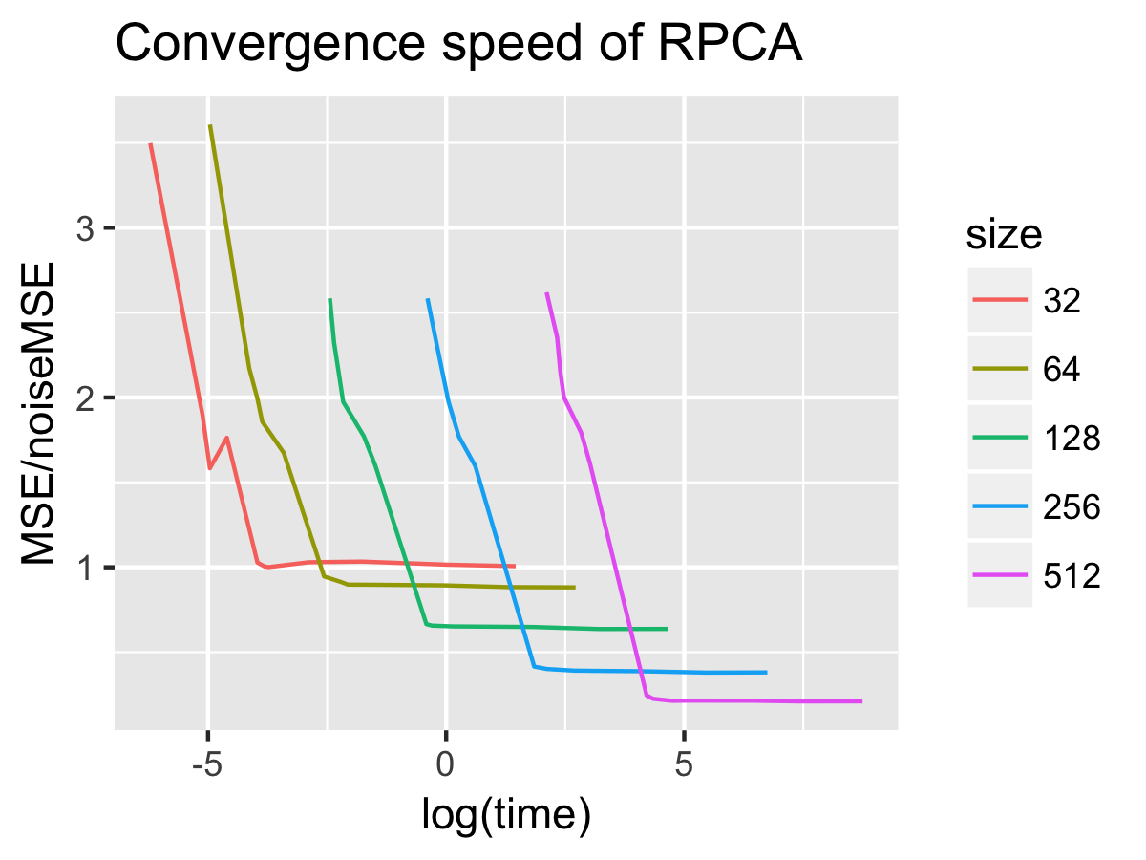
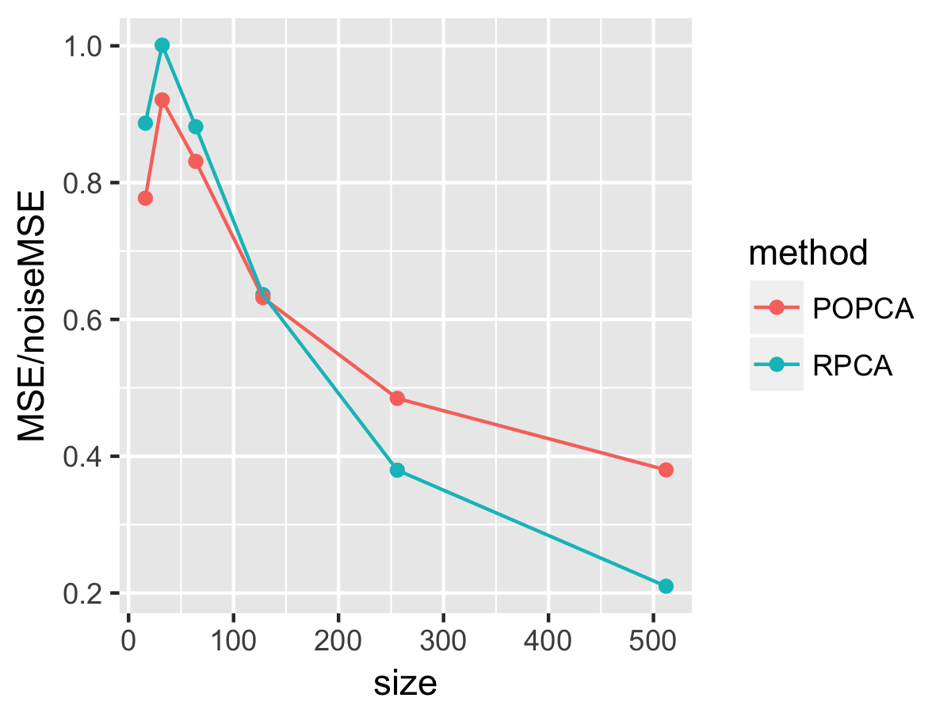
Denoising with Subspace Learning
Department of Statistics
Chen, Haoyu (hchen36@ncsu.edu) Gong, Renfei (rgong2@ncsu.edu) Liu, Bowen (bliu17@ncsu.edu)
Introduction
Noise Model
Partially Observed PCA
Digital images are often corrupted by impulse noise due to transmission errors, malfunctioning pixel elements in the camera sensors, faulty memory locations, and timing error in analog-to-digital conversion. An important characteristic of this type of noise is that only part of the pixels are corrupted and the rest are untouched. Assuming that the original image has low rank, Robust Principal Component Analysis (RPCA ) is widely used to recover the image. However, it uses SVD in every iteration and costs quite a lot of time. To reduce the running time, we propose Partially Observed Principal Component Analysis (POPCA) to take advantage of the explicit solution of PCA. To do that, we need a variance-covariance matrix for the column vectors of the image. We manage to subtract the effect of noise to get an unbiased estimator for the variance-covariance matrix.
For a given clear image, we can obtain the corrupted image by two steps. 1) Choose noise pixels and 2) choose the pixel value. In our model, we pick noise pixels from a Binomial distribution with corruption probability p. Then for each noise pixel, we generate their value from a Uniform distribution. Therefore, for input image matrix X, the observed corrupted image has
Optimization Problem
Let x⁽¹⁾,…,x^{(m)} be the column vectors in an image X and are iid with certain distribution, and Π denote a projection matrix from ℝ^{n} to an k−dimensional subspace. We want to minimize the mean square error of the projected image
Robust PCA
Comparison
Optimization Problem
When all elements in X can be observed, the traditional solution to this minimization problem is a matrix consisting of the k leading eigenvectors of C. But when there is noise in X, we would like to decompose an unbiased estimation of C. If the noise is generated as in our noise model, then each element of the covariance matrix can be estimated by
Robust PCA breaks the noisy image into two parts: D = A + E, where A is the original image and, E is the noise, assuming that A has low rank and E is sparse. To find A and E, we solve the problem:
The top left image is NC State logo of size 256 by 256, and it is not of full rank. Using the noise model stated above, we generated the top right noise picture with p=0.3.
The second line shows two recovered images by POPCA and RPCA method. We can see that at this size, RPCA has a better performance.
Algorithm
is the l¹-norm of vec(E).
POPCA
First, we replace the constraint with a penalty term:
Algorithm
Then, we implement FISTA method to A and E separately. For the A part, the proximal mapping of nuclear norm is to first find the SVD, and then do the soft threshold to each of the singular values. For the E part, the proximal mapping of the l¹-norm is to take the soft threshold of each element.
Complexity
The SVD step in both algorithms determines that each iteration is O(n³). However, POPCA has great advantage over RPCA since it needs only one step while RPCA using FISTA needs O(1/ε^{1/2}) steps. As image size gets larger
RPCA
where t_{k}, the extrapolating parameter for FISTA, is chosen as t_{k+1}² - t_{k+1} = t_{k}² to obtain a convergence rate of O(k⁻²), while µ_{k+1} = max{0.9µ_{k} , µ₀} decreases exponentially until reaching a preset minimum µ₀.
Performance
The proportion of MSE remained vs log of running time. As the proportion of MSE deducted increases linearly, the time cost grows exponentially, before the proportion of MSE deducted reaches its limit.
When image size is small, POPCA does better work, and it is still acceptable when the problem scales up. Notice that when the input matrix is rather small, RPCA gives output even worse than corrupted picture.
In our algorithm, there are two free parameters. The above figures give us some guidance on the choice of p and rank(k), The minimum of the mean square error occurs at relatively small rank, and it grows slowly with image size n. Once we have chosen the optimal rank, the choice of p does not have much effect on MSE, especially when the image size gets bigger.

