Slide 1
AI Enabled
Baby Health Care System
Presented By: Deepankar Sharma

Slide 2
01
Why Patent?
contents
02
Problem Identification
03
Prior Existing Solution
04
Physical Structure of our Solution
05
Operation/Function/Use
06
Feedback

Slide 3
Why Patent?
01
Granting of a property right to an inventor by sovereign authority
Provides Exclusive Right to prevent others from taking advantage of your invention.
Can take legal actions against people who are using your patented invention without permission.

Slide 4
01
How can we file a Patent?
Disclosure of the Invention ----> detailed explanation
signing of a Non-Disclosure Agreement with your Patent Agent
can go with non-disclosure within university premises ( depends )
Novelty Search ( optional ) -----> check for patentablity of your invention
Patent Drafting --------> Techno-legal document , might want to hire some professional attorney
Filing the Drafted Patent Application in Government Patent Office
Patent Publishing
max 18 months after filing

Slide 5
01
Scope of Patent
Patent Act, 2005, defines the "invention" as a new product or as process involving an inventive step and capable of industrial application.
An invention is capable of industrial application if it satisfies the three conditions cumulatively:
can be made;
can be used in at least one field of activity;
can be reproduced with the same characteristics as many as necessary.

Slide 6
Problem Identification
02
Both Parents are busy/working
Single Parent
Small babies can’t say what they want
Not every parents know the best (specially first time)
Insufficient Childcare

Slide 7
Prior Existing Solutions
03
Baby sitters
Childcare Institutions
Let some relative or guardian take care
Baby Care toys (not smart enough)

Slide 8
03
Problems with the Prior Existing Solutions
Separation Anxiety
Stressful
Social Isolation
.
Bonding issues

Slide 9
Physical Structure of Our Solution
04
Community App (Advices from Others)
Reinforcement Learning Assistant (Learn as Child Grows)
CNN and NLP for Emotion Recognition

Slide 10
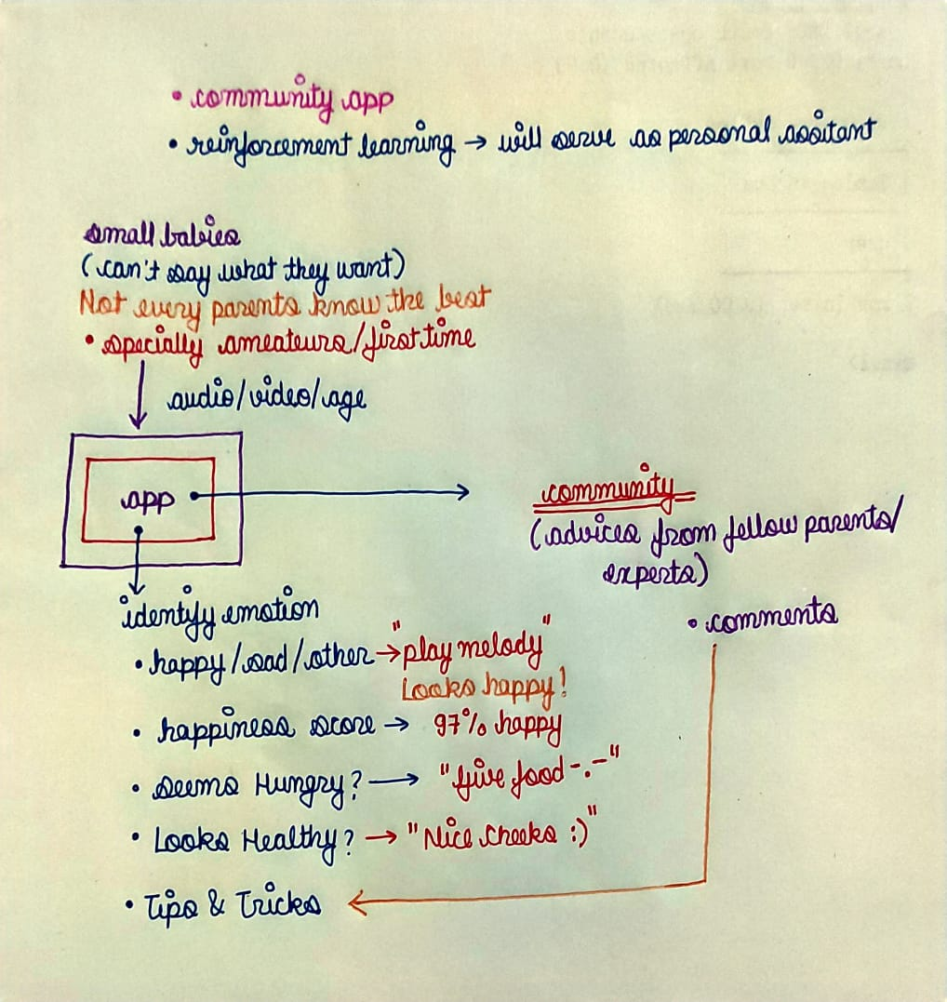
04
Physical Structure of Our Solution

Slide 11
Operations/Functions/Use
05
Facial Mood Detection Classifier
Voice Mood Detection Classifier
Customized AI Assistant using RL
Recommendation System for arbitary actions (identify genre)

Slide 12
05
Operations/Functions/Use
Customizable
Cloud
Being built upon RL the system will learn according the child specifically so it will always be flexible and customized to the indivisual child.
Instead of building everything from scratch , we can leverage already available cloud APIs.
Community
Deployable
The community environment will make this app dedicated for the purpose of parenting where people can interact with other parents..
Later Objective but it’s about deploying the app into customized robots.

Slide 13

Feedback
06

Slide 14
THANK YOU!

