Slide 1

Graphic Era Hill University
BBA-309 Business Strategy
Submitted to:
Mr. Udit Pandey
(Ass. Prof), GEHU

Slide 2
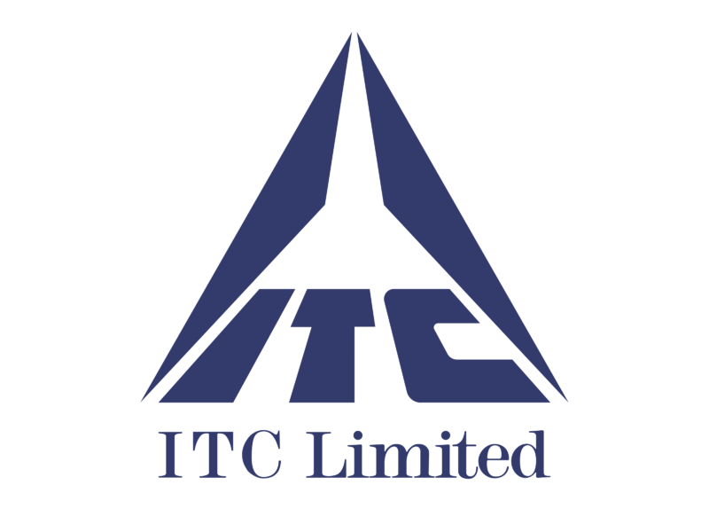
Imperial Tobacco Company of India Limited (ITC).
PRESENTED BY
Babita Karmiyal, Deepak Birkhani, Deepankar Sharma

Slide 3
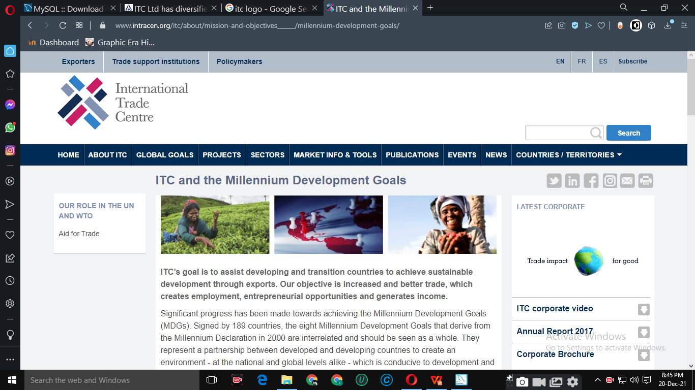
to avoid confusion, NOT THIS ITC !!!!!!!

Slide 4
Contents
HISTORY OF ITC
INTRODUCTION OF ITC
COMPANY PROFILE
VISION & MISSION
GOALS AND OBJECTIVES
CORPORATE LEVEL STRATEGIES
PRODUCTS
CONCLUSION

Slide 5
HISTORY OT ITC
24 Aug 1910 – ITC incorporated under the name of 'Imperial Tobacco Company of India Limited'.
1925– ITC’s Packaging & Printing Business Division was set up as a strategic backward integration for ITC’s Cigarettes business.
1974 – The Company's ownership progressively Indianised, and the name of the Company was changed to ITC Limited (Indian Tobacco Company).
1975 – The Co. launched its HOTEL BUSINESS which was named ‘ITC-Welcome group Hotel Chola’.
1979 – ITC entered the Paperboards Business by promoting. Bhadrachalam Papaerboards Limited, which today has become the market leader in India.
1985 – Surya Nepal Pvt. Ltd.
2000-21 - ITC continues to foray into the Greeting, Gifting and Stationery products and FMCG products

Slide 6
Introduction
ITC is one of India's foremost private sector companies with a Gross Sales Value of ₹ 74,979 crores and Net Profit of ₹ 13,032 crores (as on 31.03.2021).
ITC has a diversified presence in FMCG, Hotels, Packaging, Paperboards & Specialty Papers and Agri-Business.
ITC's aspiration to be an exemplar in sustainability practices is manifest in its status as the only company in the world, of its size and diversity, to be carbon, water and solid waste recycling positive.

Slide 7
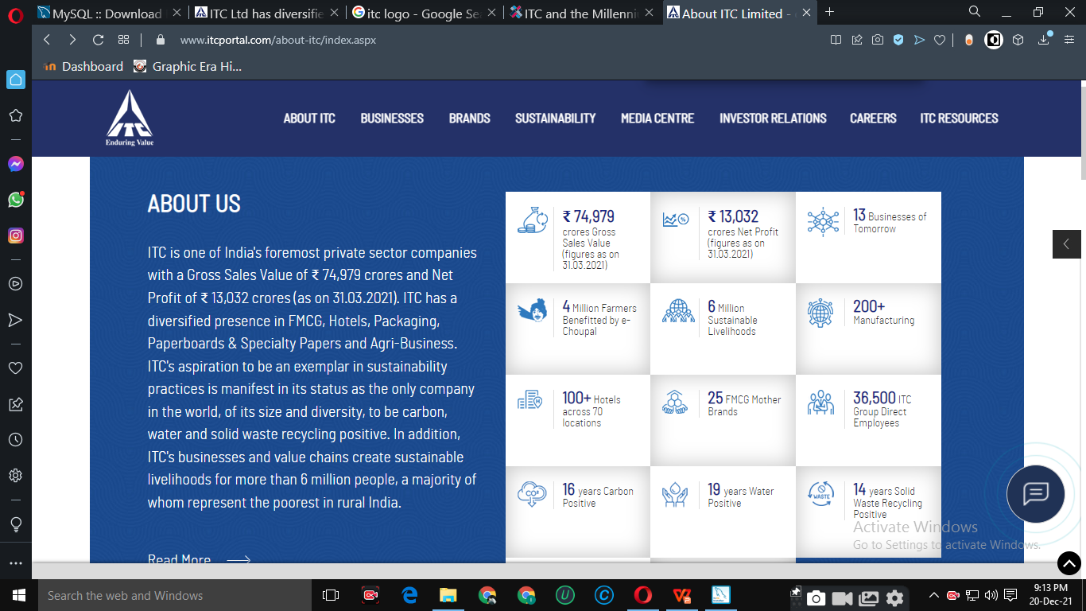
Continue…
In addition, ITC's businesses and value chains create sustainable livelihoods for more than 6 million people, a majority of whom represent the poorest in rural India.

Slide 8
PROFILE OF ITC
Type: Public
Traded as: BSE: 500875 BSE SENSEX Constituent
Industry: Conglomerate
Predecessor(s):
Founded: August 24, 1910^{[1]} (as Imperial Tobacco Company of India) Founder(s) Henry Overton Wills
Headquarters: Virginia House, Kolkata,West Bengal, India
Chairman: Sanjiv Puri(Chairman & MD)
Products: Tobacco, Hotels, Paperboards & specialty papers, packaging, agri-business, packaged foods & confectionery, IT, branded apparel, personal care, stationery, safety matches and other FMCG products
Revenue : ₹ 74,979 crores
Net Profit : ₹ 13,032 crores (as on 31.03.2021)
Employees : 36,500 (2021)
Website : www.itcportal.com

Slide 9
VISION & MISSION
Vision: Sustain ITC’s position as one of India’s most valuable corporations through world class performance, creating growing value for the Indian economy and the Company’s stakeholders.
Mission: To enhance the wealth generating capability of the enterprise in a globalizing environment, delivering superior and sustainable stakeholder value.

Slide 10
GOALS AND OBJECTIVES:
'Nation First: Sab Saath Badhein': ITC is investing in India's future by building world-class consumer goods factories and iconic hospitality assets that will contribute to the country's competitive capacity. These investment projects underpin the Company's support to the Government's "Make in India" vision.
Leveraging Institutional Strengths: The competitiveness of ITC's diverse businesses rest on the strong foundations of institutional strengths derived from its deep consumer insights, cutting-edge Research & Development, differentiated product development capacity, brand-building capability, world-class manufacturing infrastructure, extensive rural linkages, efficient trade marketing and distribution network and dedicated human resources.
Multiple Drivers of Growth

Slide 11
CORPORATE LEVEL STRATEGIES
Create multiple drivers of growth by developing a portfolio of world class businesses that best matches organisational capability with opportunities in domestic and export markets.
Continue to focus on the chosen portfolio of FMCG, Hotels, Paper, Paperboards & Packaging, Agri Business and Information Technology.
Benchmark the health of each business comprehensively across the criteria of Market Standing, Profitability and Internal Vitality.
Ensure that each of its businesses is world class and internationally competitive.
Enhance the competitive power of the portfolio through synergies derived by blending the diverse skills and capabilities residing in ITC's various businesses.
Create distributed leadership within the organisation by nurturing talented and focused top management teams for each of the businesses.
Continuously strengthen and refine Corporate Governance processes and systems to catalyse the entrepreneurial energies of management by striking the golden balance between executive freedom and the need for effective control and accountability.

Slide 12
POSITIONING OF ITC
TOUCHING YOUR LIFE EVERYDAY.

Slide 13
THE STARTERS
The Starting point of The company was Imperial Tobacco Co. of India Ltd. The Company manufacture and distribute cigarettes and smoking tobaccos and specialist papers including cigarette tissue papers (Sole manufacturer in the country).
Insignia
India Kings
Classic
Gold Flake
Silk Cut
Navy Cut
Scissors
Capstan
Berkeley
Bristol
Flake.
Due to the Ban on cigarettes adds therefore,
NO PREVIEW AVAILABLE

Slide 14
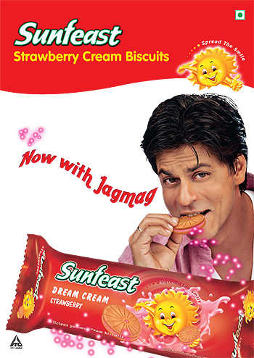
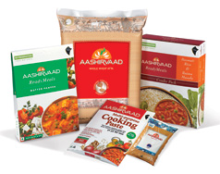


PRODUCT PORTFOLIO

Slide 15
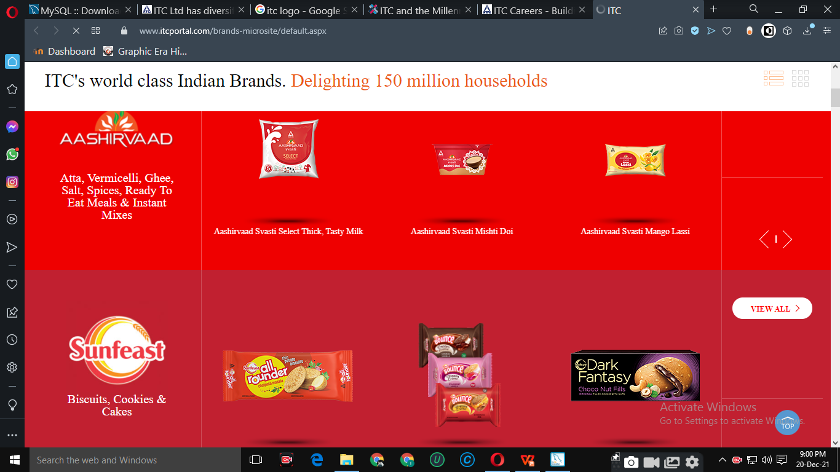
hyperlinked to the portfolio !!!

Slide 16
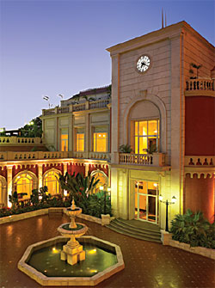
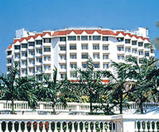
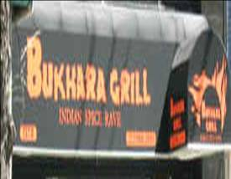
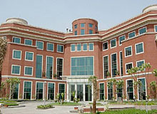
WELOCOME GROUP OF HOTELS

Slide 17

OTHERS PRODUCTS
- Kitchens of India
- Mint-o
- Candy man
- Bingo
- Expression

Slide 18
Competitors of ITC Ltd.
Golden Tobacco Limited
Godfrey Philips India Ltd.
VST Industries Ltd.(Vazir Sultan Tobacco Company)
RTCL Ltd. (Raghunath Tobacco Company Ltd)
Hindustan Unilever Ltd.
Marico

Slide 19

e-Choupal is an initiative of ITC Limited, a large multi business conglomerate in India, to link directly with rural farmers via the Internet for procurement of agricultural and aquaculture products like soybeans, wheat, coffee, and prawns. e-Choupal was conceived to tackle the challenges posed by the unique features of Indian agriculture, characterized by fragmented farms, weak infrastructure and the involvement of numerous intermediaries. The programme involves the installation of computers with Internet access in rural areas of India to offer farmers up-to-date marketing and agricultural information.

Slide 20
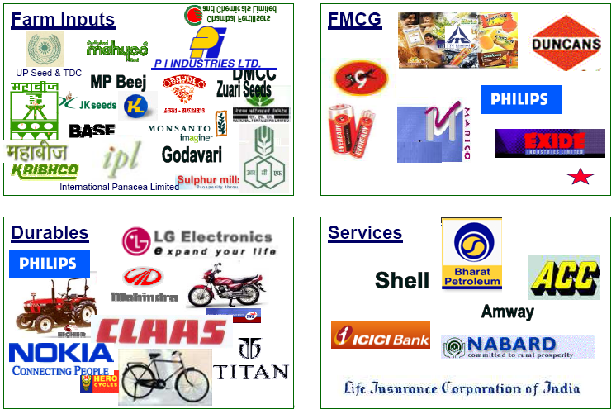
Companies using e- Choupal network

Slide 21
CONCLUSION
ITC promoting their brands through advertisement campaign as well as door to door promotion.
ITC is also focusing on Retailers and Wholesalers to promote their brand.
The demand of their product in very low, because people don’t know about their brands very well.
ITC knows their strength and weakness in the personal care market, so they are applying new concept to overcome their weaknesses.
ITC now offering more margins, exiting offers and long credit period to retailers and wholesalers.
ITC. Working for you. Working for India.

Slide 22




THINK BEFORE SMOKING…….
THANK YOU

