Slide 1
MOOCS PRESENTATION
Using Python to Interact with the Operating System
DEEPANKAR SHARMA
STUDENT ID : 20041299
UNIVERSITY ROLL NO : 2092014

Slide 2
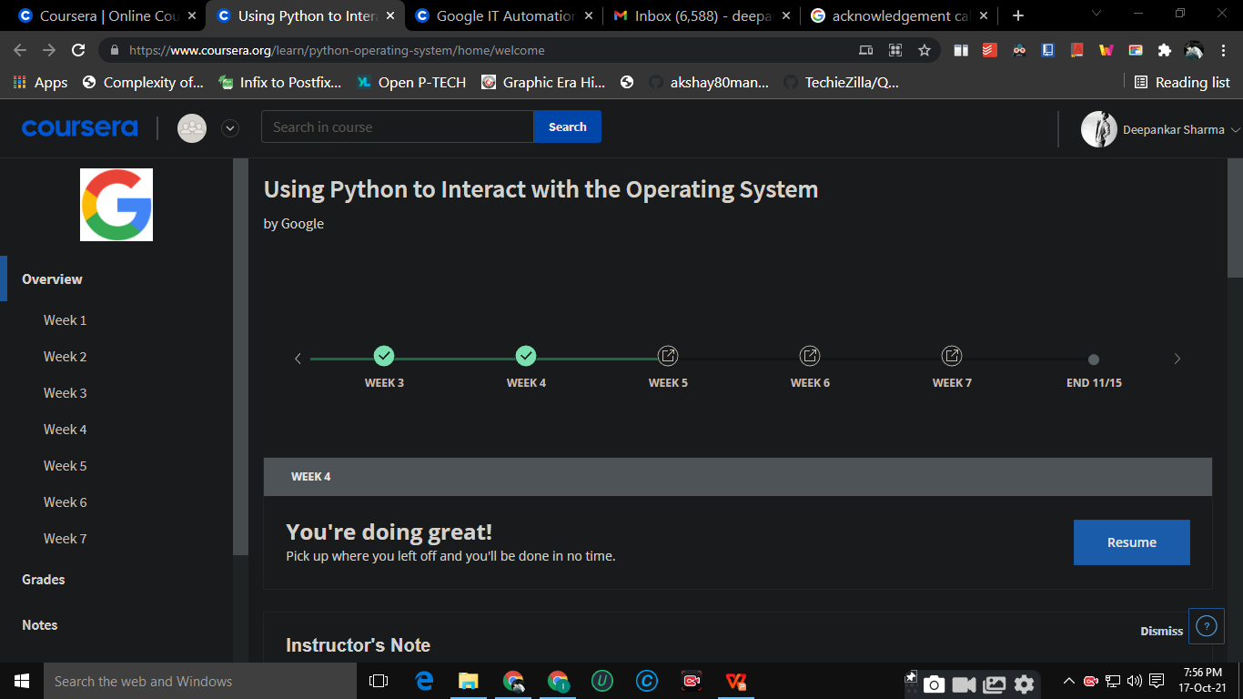
Google IT Automation with Python Professional Certificate
Using Python to Interact with the Operating System

Slide 3
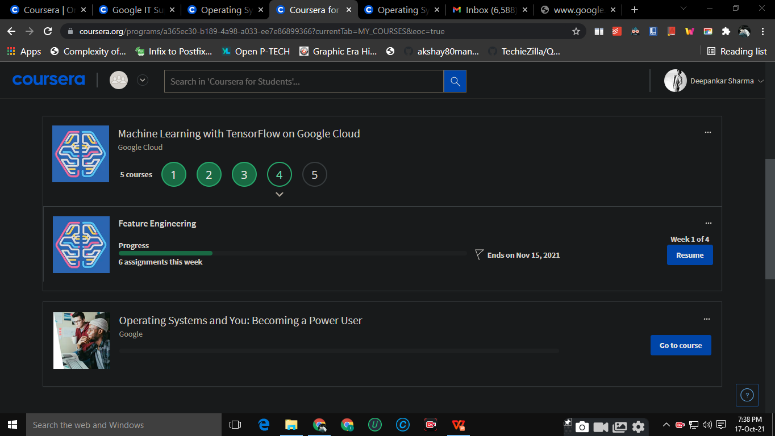
Acknowledgement
I would like to express my special thanks of gratitude to my teacher Mayurika Ma’am , who gave me the golden opportunity to do this wonderful moocs seminar on the topic “Using Python to Interact with the Operating System”.
And also for providing with all the facilities that were required. The fact is I am learning lots of new skills during this course and I’ll surely implement this knowledge in my real time problems too.
REGARDS,
DEEPANKAR SHARMA

Slide 4
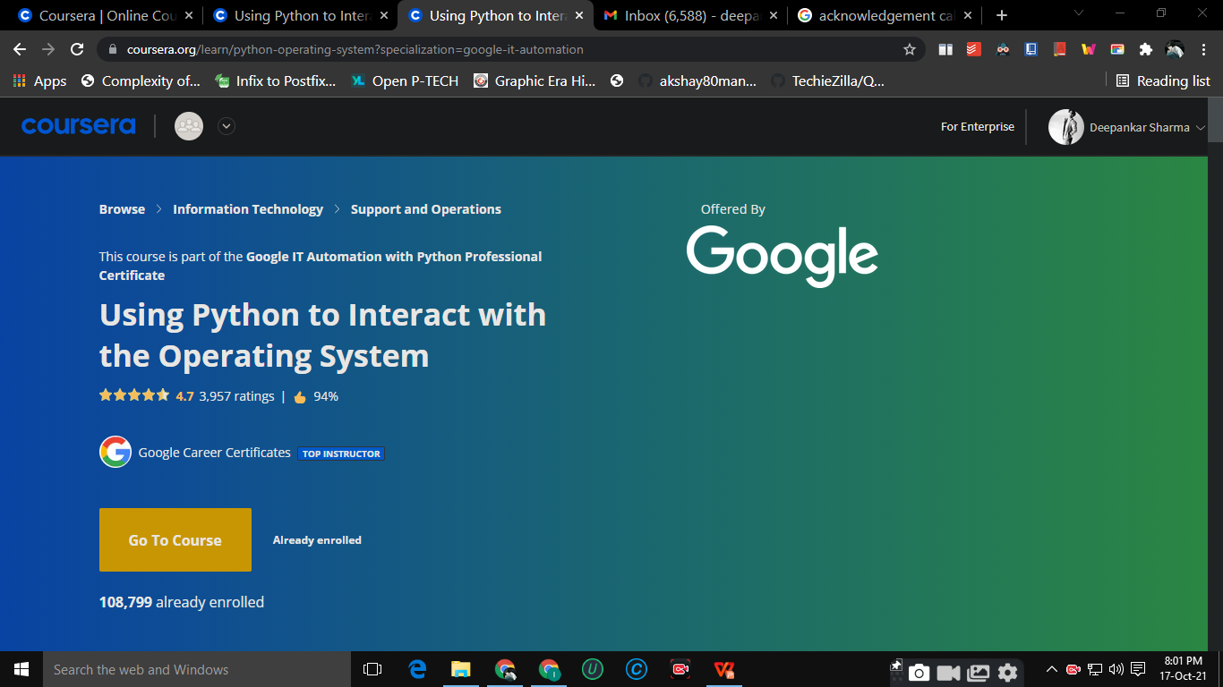
By the end of this course, you’ll be able to manipulate files and processes on your computer’s operating system. You’ll also have learned about regular expressions -- a very powerful tool for processing text files -- and you’ll get practice using the Linux command line on a virtual machine. And, this might feel like a stretch right now, but you’ll also write a program that processes a bunch of errors in an actual log file and then generates a summary file. That’s a super useful skill for IT Specialists to know.
We’ll also explain how to set up your own developer environment in your machine. This is a key step in being able to write and deploy powerful automation tools.

Slide 5
Getting Your Python On
Managing Files with Python
Regular Expressions
Syllabus
Managing Data and Processes
Testing in Python
Bash Scripting
Final Project

Slide 6
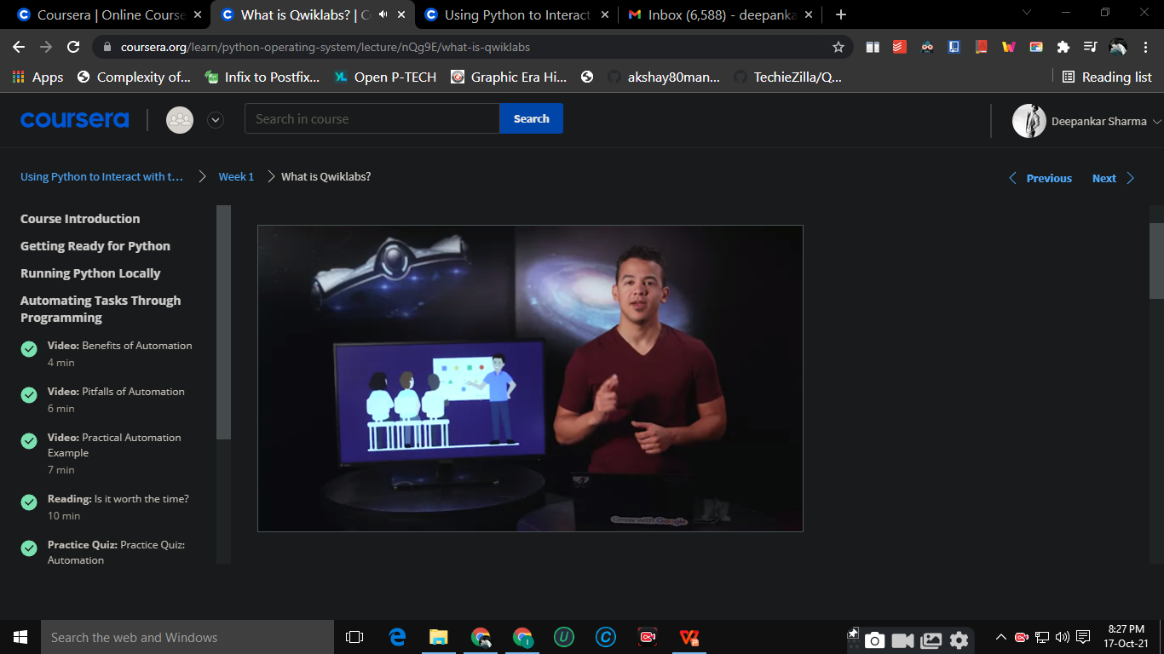
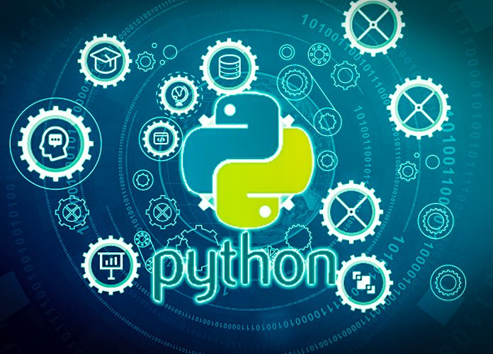
Getting Your Python On
In this module, you’ll learn about the different types of operating systems, and how you can get your python code ready to interact with the operating system. We’ll learn about getting your environment set up and installing additional Python modules that will help you along the way. We’ll rundown interpreted versus compiled language, and how they differ from each other. We’ll dive into the benefits of automation, and point out common pitfalls so you can avoid them. Finally, we’ll learn about Qwiklabs, which will be used for graded assessments.

Slide 7
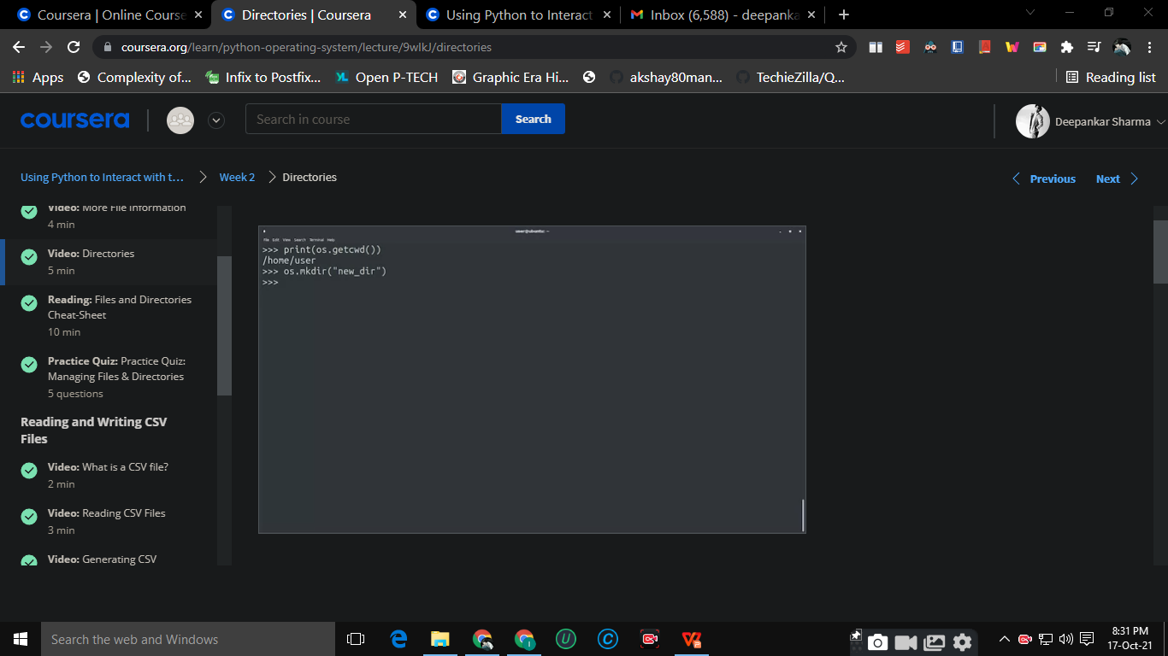
Managing Files with Python
In this module, you’ll learn about reading and writing to files and the commands that will enable you to do this. We’ll learn the importance of managing files and how we can navigate through different directories. We’ll understand how to work with files and how there is a layer of abstraction between Python and the operating system. Finally, we’ll dive into learning about CSV files and how to best utilize them.

Slide 8
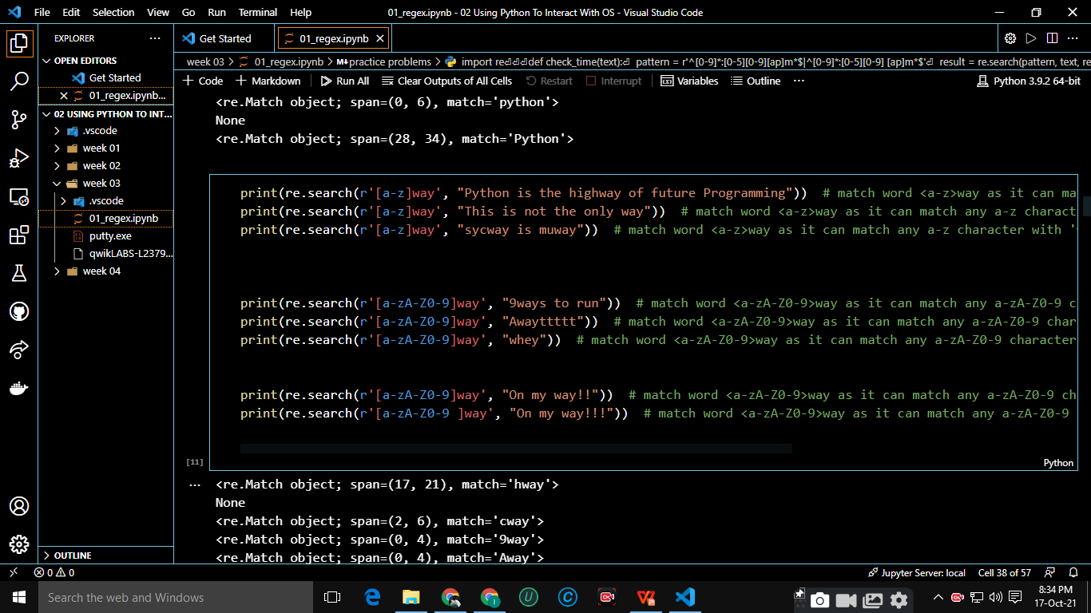
Regular Expressions
In this module, you’ll learn about what a regular expression is and why you would use one. We’ll dive into the basics of regular expressions and give examples of wildcards, repetition qualifiers, escapare characters, and more. Next up, we’ll explore advanced regular expressions and deep dive on repetition qualifiers. You’ll tackle new exercises like capturing groups and extracting PIDs using regexes. Finally, we’ll provide a cheat sheet to serve as your go-to guide for regular expressions.

Slide 9
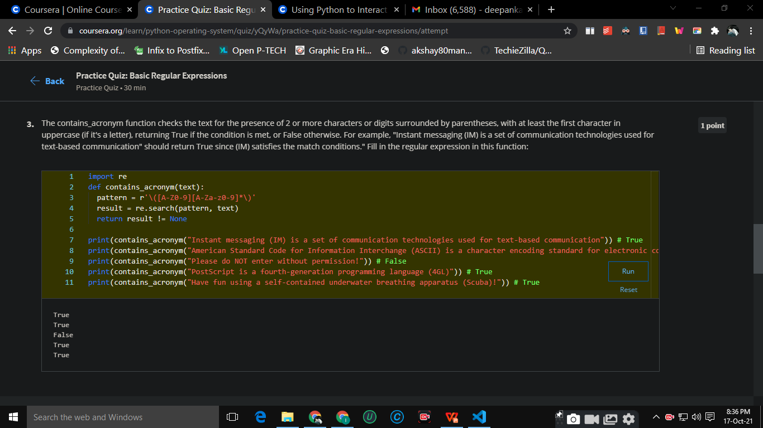
Managing Data and Processes
In this module, we’ll learn about reading and writing to data files based on an interaction with the user. Along the way, we’ll dive into standard streams, environment variables, and command line arguments. Next, we’ll jump into Python subprocesses, including system commands and how they can be used. We’ll review how to obtain output from a system command, and dive into subprocess management, including how to check exit values and manipulate the normal versus error exit values. Finally, we’ll rundown processing log files, and will cover what a log file is, how to filter log files using regular expressions, and how to understand the output captured from log files.

Slide 10
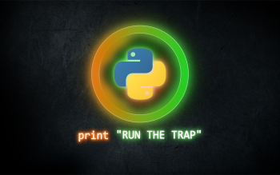
Thank You

