Slide 1
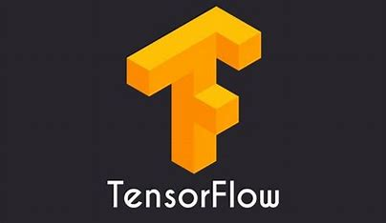
Graphic Era Hill University
MACHINE LEARNING USING TENSORFLOW
Deepankar Sharma
BCA(5)

Slide 2
TENSORFLOW
ADVANTAGES OF TENSORFLOW
TENSORS
CONTENTS
RANK 1, RANK 2 AND n-D TENSORS
KERAS
KERAS SEQUENTIAL AND FUNCTIONAL API

Slide 3
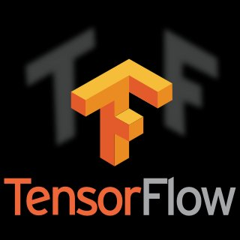
TENSORFLOW
TensorFlow is a free and open-source software library for machine learning and artificial intelligence. It can be used across a range of tasks but has a particular focus on training and inference of deep neural networks.
Fun Fact:
TensorFlow is used by many internal Google products and teams including: Search, Gmail, Translate, Maps, Android, Photos, Speech, YouTube, and Play.
import tensorflow as tf
print("TensorFlow version:", tf.__version__)

Slide 4
ADVANTAGES OF TENSORFLOW
TensorFlow has better computational graph visualizations which are inherent when compared to other libraries like Torch and Theano. Google backs it. And has the advantages of seamless performance, quick updates, and frequent new releases with new features.
This library is designed and updated by Google, so needless to say, and it has come a far way since its initial release.
The TensorFlow architecture uses TPU which makes computation faster than CPU and GPU. Models which are built over TPU can be easily deployed over clouds and works faster compared to the other two.

Slide 5
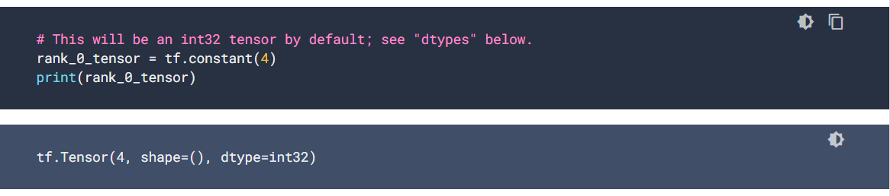
TENSORS
Tensors are multi-dimensional arrays with a uniform type (called dtype).
All tensors are immutable like Python numbers and strings: you can never update the contents of a tensor, only create a new one.

Slide 6
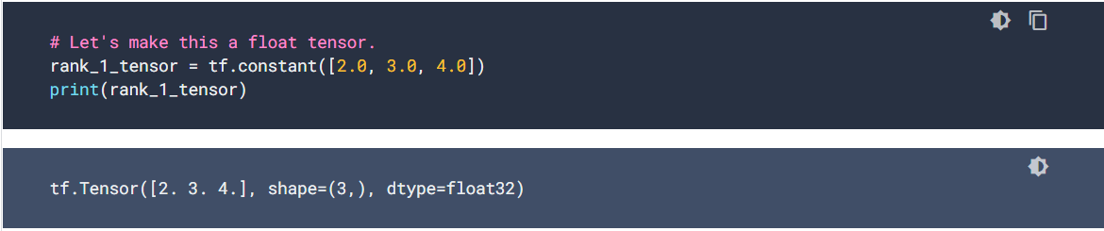
1D-TENSORS
A "vector" or "rank-1" tensor is like a list of values. A vector has one axis:

Slide 7
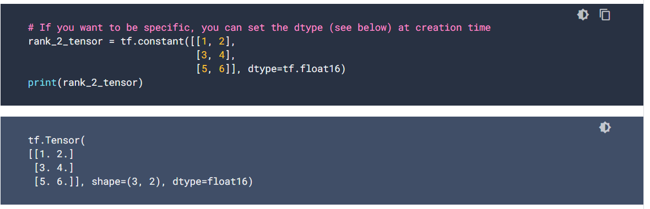
2D-TENSORS
A "matrix" or "rank-2" tensor has two axes:

Slide 8
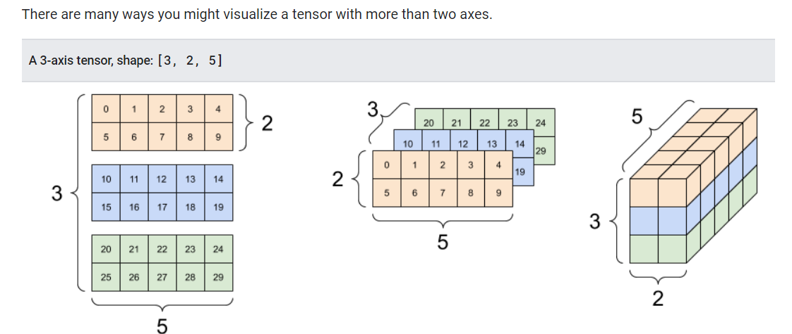
N-D-TENSORS
Tensors may have more axes; here is a tensor with three axes:

Slide 9
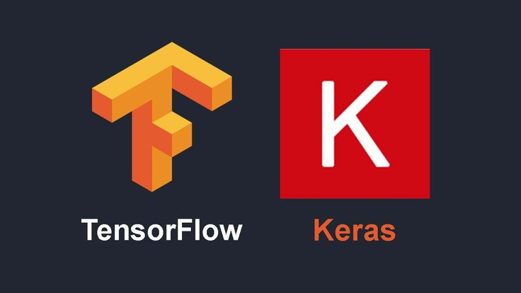
KERAS
Keras is an Open Source Neural Network library written in Python that runs on top of Theano or TensorFlow. It is designed to be modular, fast and easy to use. Keras is high-level API wrapper for the low-level API, capable of running on top of TensorFlow, CNTK, or Theano.
Together with TensorFlow 2, Keras has more adoption than any other deep learning solution -- in every vertical. You are already constantly interacting with features built with Keras -- it is in use at Netflix, Uber.
import tensorflow as tf
from tensorflow import keras

Slide 10
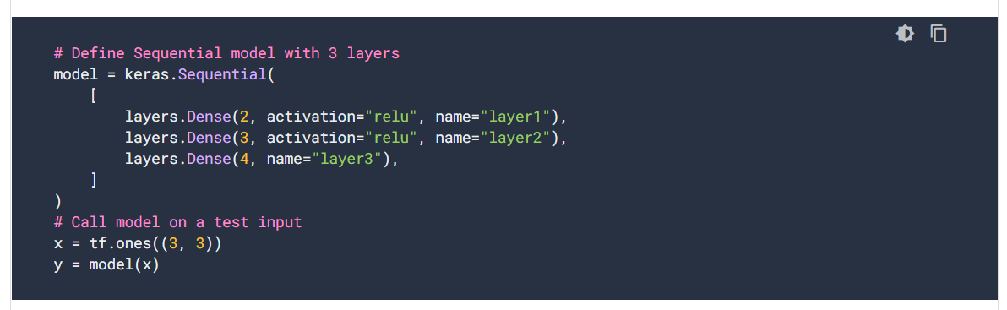
KERAS SEQUENTIAL API
A Sequential model is appropriate for a plain stack of layers where each layer has exactly one input tensor and one output tensor.

Slide 11
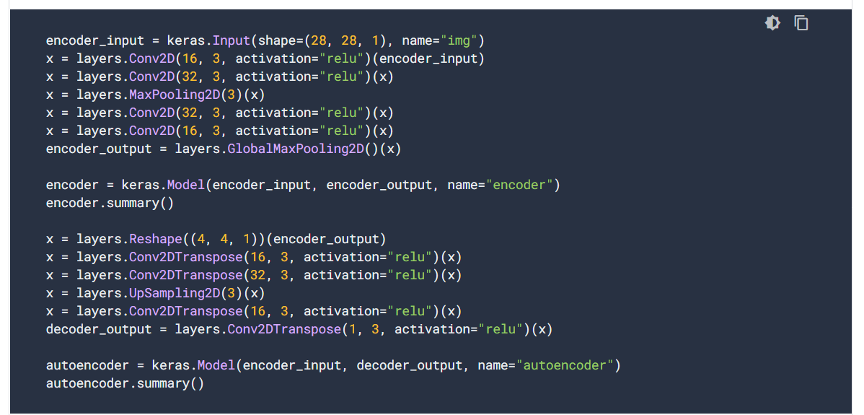
KERAS FUNCTIONAL API
The Keras functional API is a way to create models that are more flexible than the tf.keras.Sequential API. The functional API can handle models with non-linear topology, shared layers, and even multiple inputs or outputs.The main idea is that a deep learning model is usually a directed acyclic graph (DAG) of layers. So the functional API is a way to build graphs of layers.

Slide 12
THANKS

