Slide 1

Core Java Presentation
MOOCS
-Subham Joshi

Slide 2
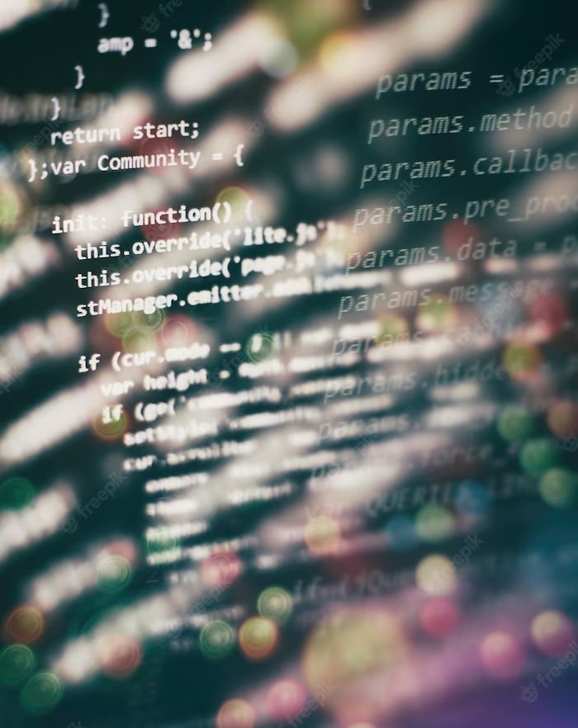
Introduction
Welcome to Mastering the Fundamentals, a comprehensive guide to Core Java Development. This presentation will cover the essential concepts and best practices to help you become a proﬁcient Java developer.

Slide 3

Data Types and Variables
Java has eight primitive data types
and a few non-primitive types. Understanding variables and data types is the foundation of Java
programming.

Slide 4
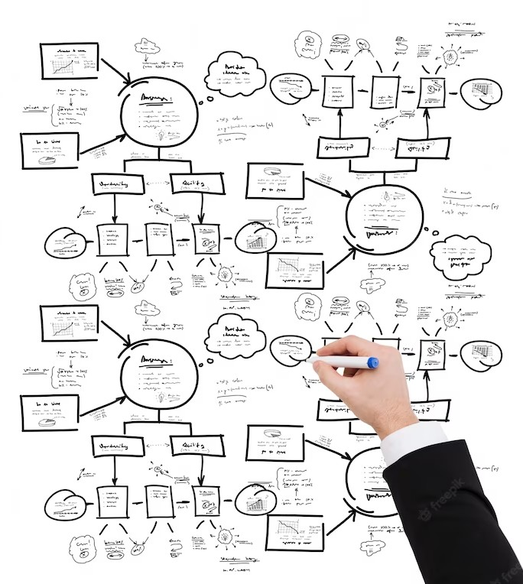
Control Statements
Java has three types of control statements: if-else, switch-case, and loops. Understanding these statements is essential to control the ﬂow of your program.

Slide 5

Object-Oriented Programming
Java is an object-oriented programming language. Understanding the concepts of classes, objects, and inheritance is fundamental to Java Development.

Slide 6


E ception Handling
Exceptions are errors that occur during program execution. Handling these exceptions is crucial to writing robust Java code. We use try-catch blocks to catch and handle exceptions.

Slide 7
Conclusion
Mastering the fundamentals of Core Java Development is essential to becoming a proﬁcient Java developer. By understanding the concepts of data types, control statements, OOP, and exception handling, you are well on your way to writing efﬁcient and robust Java code.

Slide 8
Thanks!

