Slide 1


Simple linear regression
www.kent.ac.uk/learning

Slide 2
Regression
Introduction
We will introduce simple linear regression, in particular we will:
Learn when we can use simple linear regression
Learn the basic quantities involved in simple linear regression
Learn how to use regression in real applications
This presentation is intended for students in initial stages of Statistics. No previous knowledge is required.
Notes:
All of our sessions must have this slide – learning outcomes of tutorial.

Slide 3
Regression
Regression is used to study the relationship between two variables.
We can use simple regression if both the dependent variable (DV) and the independent variable (IV) are numerical.
If the DV is numerical but the IV is categorical, it is best to use ANOVA.

Slide 4
Examples
The following are situations where we can use regression:
Testing if IQ affects income (IQ is the IV and income is the DV).
Testing if hours of work affects hours of sleep (DV is hours of sleep and the hours of work is the IV).
Testing if the number of cigarettes smoked affects blood pressure (number of cigarettes smoked is the IV and blood pressure is the DV).

Slide 5
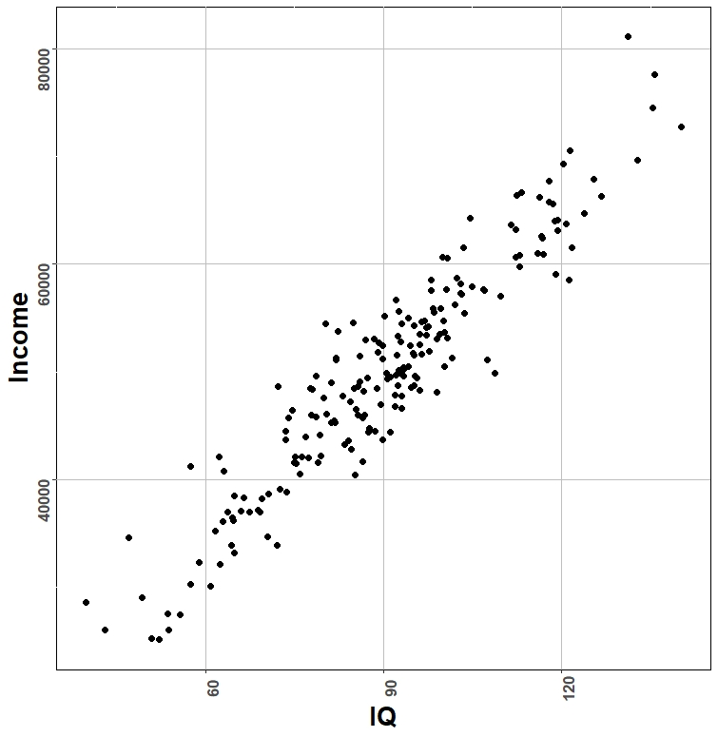
Displaying the data
When both the DV and IV are numerical, we can represent data in the form of a scatterplot.

Slide 6
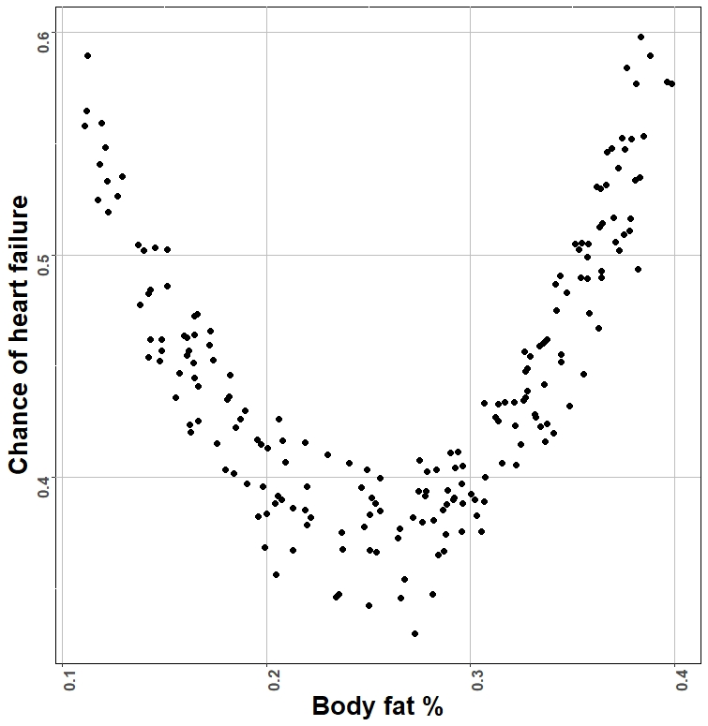
Displaying the data
It is important to perform a scatterplot because it helps us to see if the relationship is linear.

Slide 7
Linear model
In regression, the relationship between Y and X is modelled in the following form:
Y = a + b * X + E
where:
Y is the dependent variable (Income in the example)
X is the independent variable (IQ in the example)
a is an intercept
b is the coefficient
E is an error term for each observation (since there is additional variation not explained by income)

Slide 8
Assumptions of regression
The errors E are normally distributed.
This can be tested by plotting an histogram of the residuals of the regression and checking that they all have a bell shape.
Alternatively, you could use the Shapiro-Wilk test for normality.

Slide 9
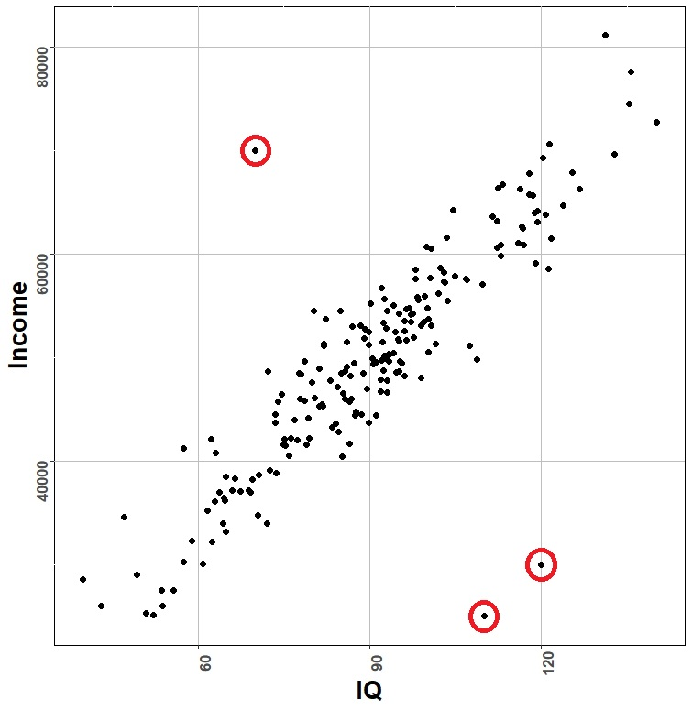
Assumptions of regression
There are no clear outliers
This can be checked by performing the scatterplot. The outliers (circled in red in the figure) can simply be removed from the analysis .

Slide 10
Linear model
We are not interested in the intercept a but only in the coefficient b.
The coefficient b represents the relationship between X and Y.
If b is positive, X has a positive effect on Y (as X increases, Y increases);
If b is negative, X has a negative effect on Y (as X increases, Y decreases).
If b = 0, there is no effect of X on Y.

Slide 11
Hypothesis testing
Regression tests the null hypothesis:
H₀ : There is no effect of X on Y, that is, b = 0.
versus the alternative hypothesis:
H₁ : There is an effect of X on Y, that is, b is not 0.
If the null hypothesis is rejected, we reject the hypothesis that there is no relationship and hence we conclude that there is a significant relationship between X and Y.

Slide 12
Hypothesis testing
How do we know if rejecting the null hypothesis?
We perform regression in SPSS and look at the p-value of the coefficient b.
If the p-value is less than 0.05, we reject the null hypothesis (the variable is significant), otherwise, we do not reject the null hypothesis (the variable is not significant).

Slide 13
Regression in SPSS
(from statistics.leard.com)
Assume that you are trying to investigate the relationship between an individual’s income and the price they pay for a car.
In the data, assume that the price is encoded in the variable Price and the income in the variable Income.

Slide 14
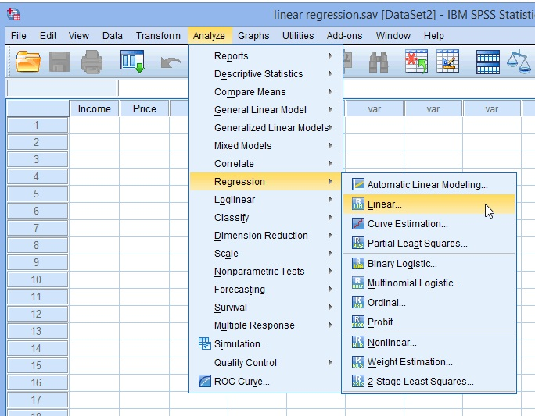
Regression in SPSS
First, go on Analyze > Regression > Linear..

Slide 15
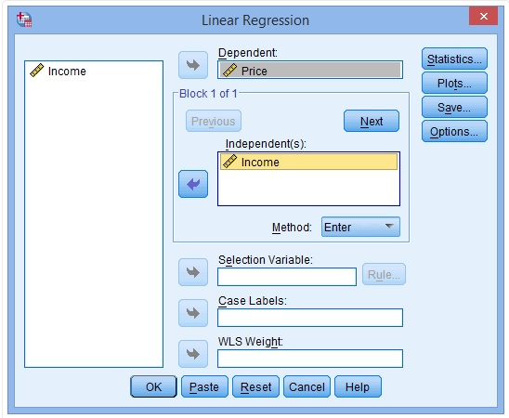
Regression in SPSS
In the Linear Regression box, transfer the DV (price) to the Dependent box and the IV (income) to the Independent(s): box
Finally, click on the OK Button

Slide 16
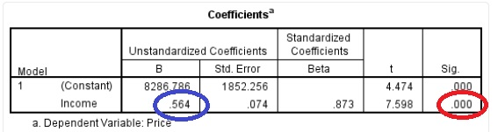
Regression in SPSS
Look for the box “Coefficients” and identify the number under Sig. in the row of the variable Income (circled in red).
That number is the p-value. If this number (in this case 0.000) is less than 0.05, the variable Income is significant, otherwise it is not.

Slide 17
Regression in SPSS
To understand the direction of the effect, look at the number under B in the row of the variable Income (circled in blue).
That number is the coefficient of b. If the number is positive, the effect of income on price is positive, otherwise it is negative.

Slide 18
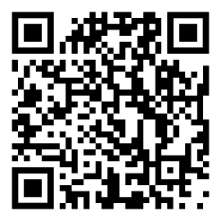
To book a maths/stats appointment…
www.kent.ac.uk/learning

Slide 19
Questions?

