Slide 1
MOOCS BASED SEMINAR
Deep Neural Networks with PyTorch
Presented By : Deepankar Sharma
Course: BCA-5th
University Roll No: 2092014

Slide 2

1 D - Tensors
2 D - Tensors
Linear Regression
CONTENTS
Gradient Descent and Loss

Slide 3

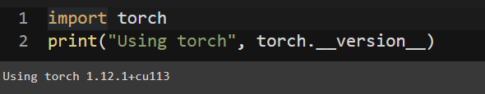
PyTorch
PyTorch is a machine learning framework based on the Torch library, used for applications such as computer vision and natural language processing,originally developed by Meta AI and now part of the Linux Foundation umbrella. It is free and open-source software released under the modified BSD license.
Tesla's development team uses PyTorch for its self-driving cars, including for features like AutoPilot and Smart Summon.

Slide 4
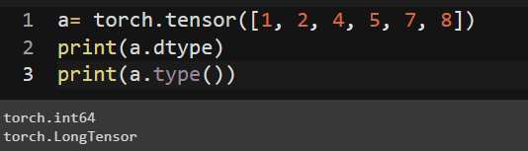
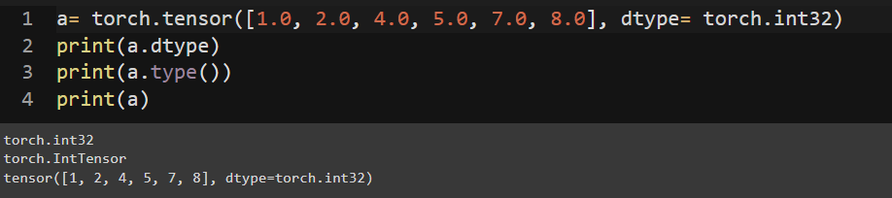
1 D - Tensors

Slide 5
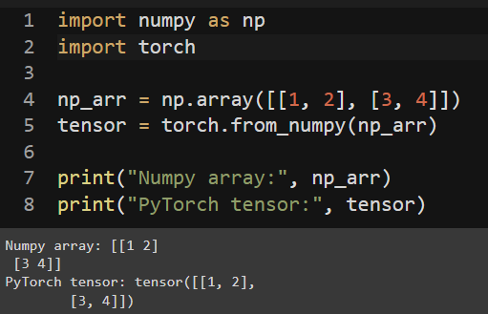
2 D - Tensors

Slide 6
Linear Regression

Slide 7
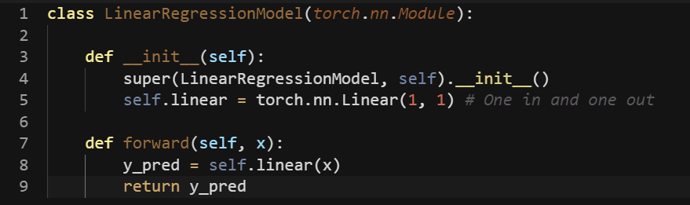
Linear Regression

Slide 8
Gradient Descent and Loss

Slide 9
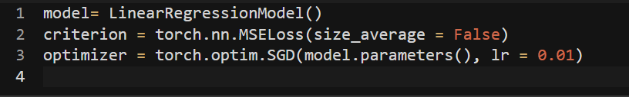
Gradient Descent

Slide 10
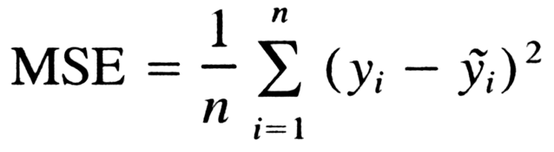
Loss

Slide 11
Feedback
?

Slide 12
THANK YOU

