Slide 1
Realtime Face Recognition Based Attendence Monitoring System

Slide 2
#Team:
Raj Laxmi
(Designing, Presentation)
Aanchal Sharma
(Coding-Python, CV)
Ankit Chauhan
(Documentation , Testing)

Slide 3
# Proposal:
The idea proposes to replace the traditional attendence monitoring systems with an automated face recognition based attendence monitoring system.

Slide 4
# Technology:
Python (Coding)
OpenCV (Computer Vision)
Django (Deployment)
MySQL (Database)
Dlib(VS C++ Toolkit)
JS, HTML, CSS(Frontend)

Slide 5

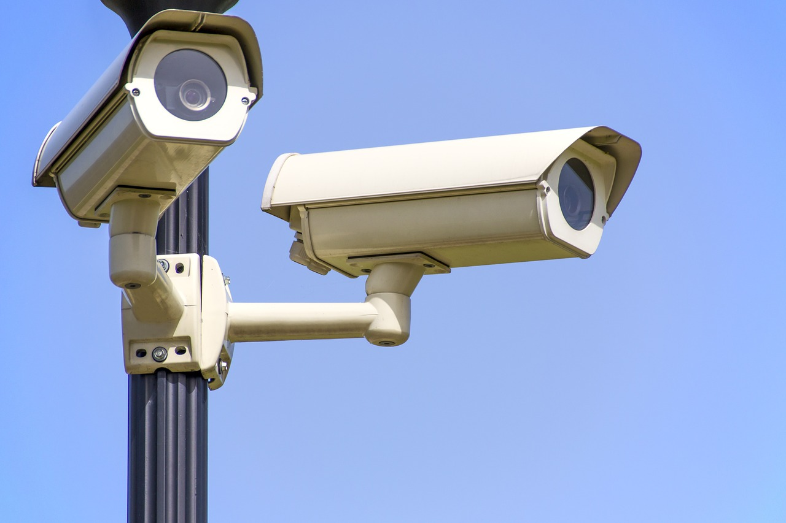
# Overview:
Cameras installed in classrooms will recognize the students and match them corresponding to the students present in database and accordingly it will monitior the attendence automatically.

Slide 6
Thank You !!

