Slide 1
AI Enabled
Baby Health Care System
Presented By: Deepankar Sharma,
Vipin Kumar

Slide 2
AI Enabled Baby Health Care System
Graphic Era Hill University
Mentor: Ms. Richa Pandey, GEHU-Haldwani
Team ID: NAVI-#02
Deepankar Sharma (Team Leader)
Vipin Kumar
Himani Taneja
Aditi Chauhan
Gurpreet Kaur Jassal

Slide 3
01
Problem Identification
contents
02
Problem Statement
03
Prior Existing Solutions
04
Physical Structure of our Solution
05
Operation/Function/Use
06
Feedback

Slide 4
Problem Identification
01
Both Parents are busy/working
Single Parent
Small babies can’t say what they want
Not every parents know the best (specially first time)
Insufficient Childcare

Slide 5
Problem Statement
02
“ Small babies don’t exactly express themselves in words, so this system is focused on identifying their needs with the help of the existing AI technology around us. ”

Slide 6
Prior Existing Solutions
03
Baby sitters
Childcare Institutions
Let some relative or guardian take care
Baby Care toys (not smart enough)

Slide 7
03
Problems with the Prior Existing Solutions
Separation Anxiety
Stressful
Social Isolation
.
Bonding Issues

Slide 8
Physical Structure of Our Solution
04
Community App (Advices from Others)
Reinforcement Learning Assistant (Learn as Child Grows)
CNN and NLP for Emotion Recognition

Slide 9
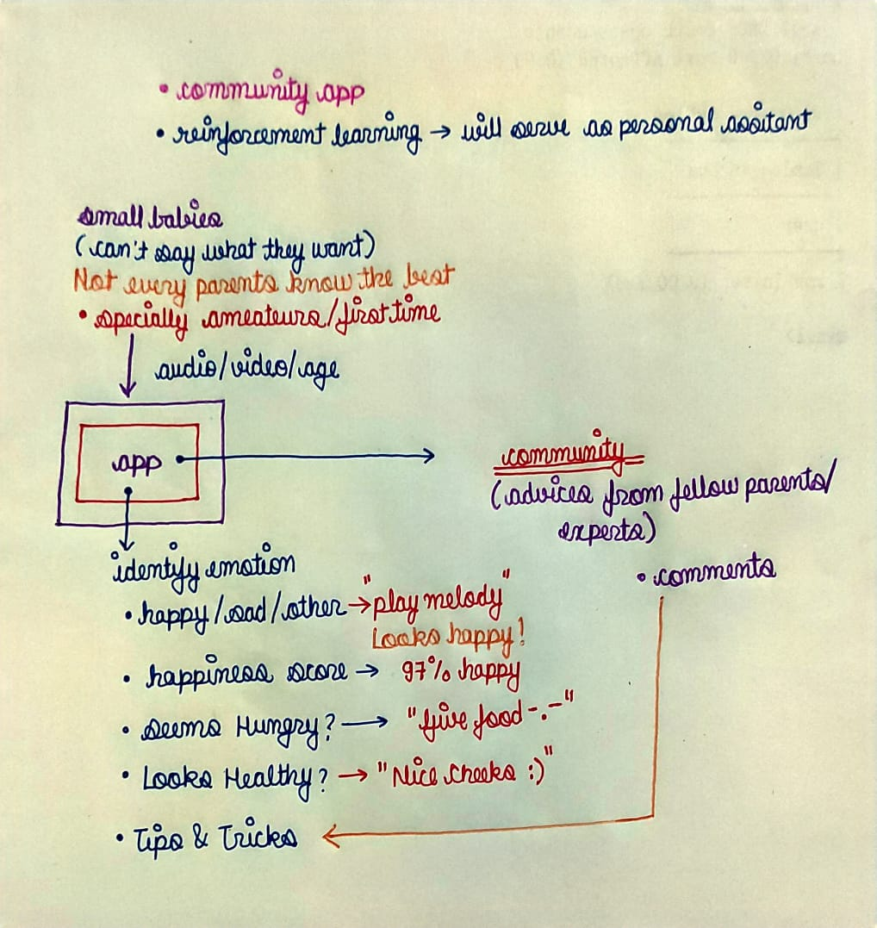
04
Physical Structure of Our Solution

Slide 10
Operations/Functions/Use
05
Facial Mood Detection Classifier
Voice Mood Detection Classifier
Growth Monitoring Dashboard
Customized AI Assistant using RL
Recommendation System for arbitrary actions (identify genre)

Slide 11
05
Operations/Functions/Use
Customizable
Cloud
Being built upon RL the system will learn according the child specifically so it will always be flexible and customized to the indivisual child.
The processing power of the system will be at the cloud.
Community
Deployable
The community environment will make this app dedicated for the purpose of parenting where people can interact with other parents..
Later Objective but it’s about deploying the app into customized robots.

Slide 12

Feedback
06

Slide 13
THANK YOU!

