Slide 1

SEMINAR-1 code : 23OMC107
Directorate of Online and Distance Education (DDOE)
Faculty Assigned: Dr. Umesh Tiwari
Student Name: Deepankar Sharma
Registration Number: 233512013
Course: MCA

Slide 2
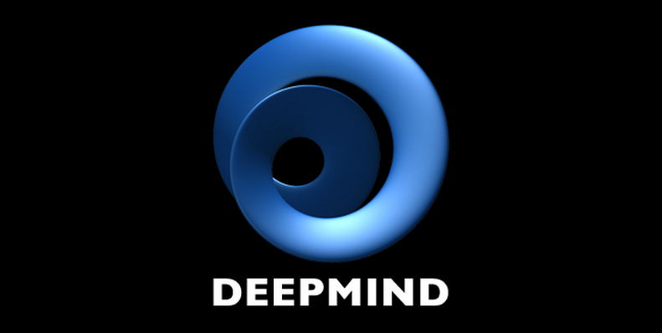
Google Gemini A Multimodal Revolution in AI

Slide 3

Introduction
- What is Gemini?
- Gemini is a family of multimodal large language models developed by Google DeepMind
- Gemini can understand and generate natural language across different modalities, such as text, speech, and vision
- Gemini is the successor to LaMDA and PaLM 2 (SOTA)

Slide 4
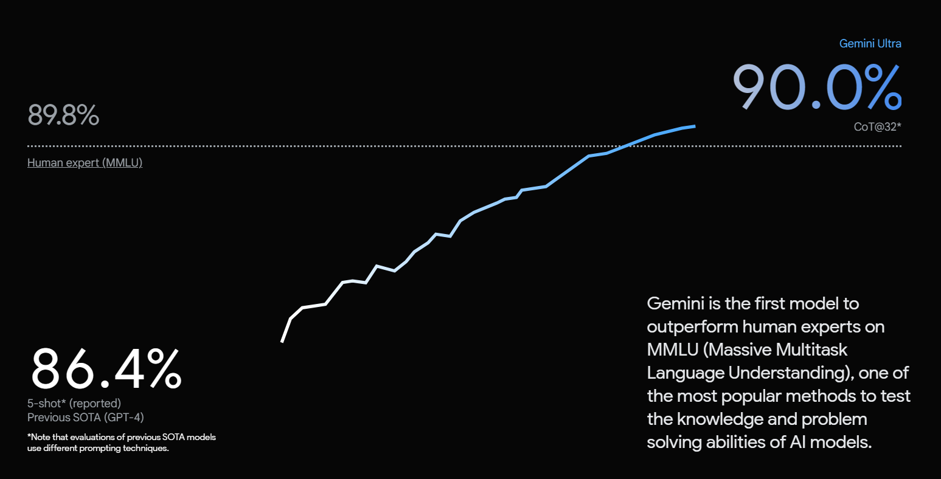
What’s special about Gemini?

Slide 5
Gemini Ultra, Pro, and Nano
- Three innovative models of Gemini, each tailored for different needs and scenarios
- Gemini Ultra: The ultimate solution for complex and demanding tasks, with the highest performance and capacity
- Gemini Pro: The versatile solution for diverse and scalable tasks, with a balanced trade-off between power and efficiency
- Gemini Nano: The efficient solution for simple and on-device tasks, with a minimal footprint and low energy consumption

Slide 6
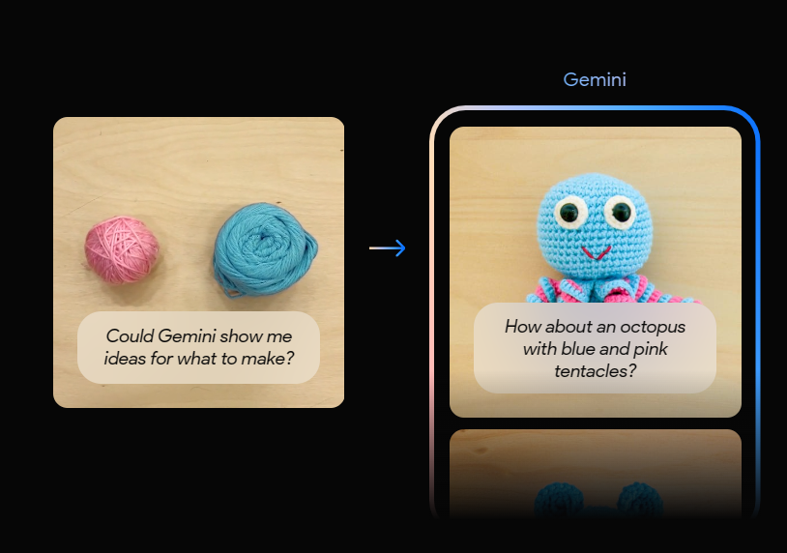
Multimodality At Core
- Gemini can understand, operate across, and combine various information formats
- This enables tasks like reasoning visually across languages

Slide 7


Beyond Text Generation
- Translation between languages.
- Generating code based on natural language descriptions.
- Creating captions for images and videos.
- Summarizing video content.

Slide 8
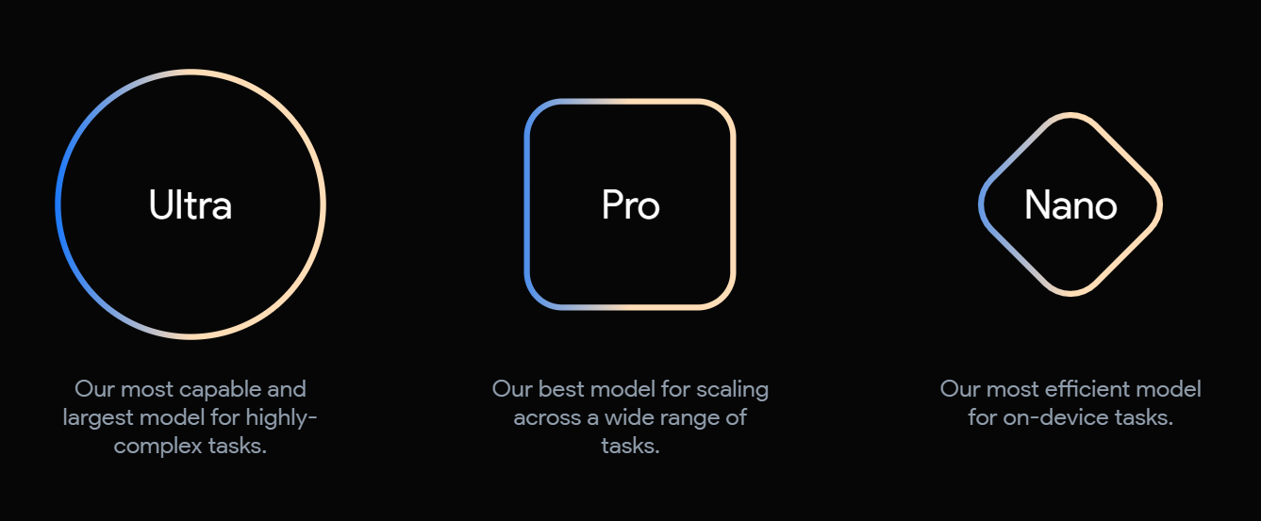
Gemini: flexibility
- Supports various devices and platforms, from data centers to mobile phones
- Optimizes performance and resource utilization, adapting to different hardware capabilities and constraints

Slide 9
Responsible AI
- Google develops AI responsibly, with Gemini's comprehensive safety evaluations
- Gemini checks for bias and toxicity in AI models and outputs
- Google researches potential risk areas and applies rigorous testing techniques

Slide 10
Collaboration & Openness
- How Google leverages the collective wisdom of internal and external experts to develop Gemini
- How Google works with partners to ensure the robustness and fairness of Gemini models

Slide 11
The Road Ahead
- Google's plans for Gemini:
- Enhance capabilities to handle more complex tasks, such as natural language understanding, computer vision, and multimodal reasoning.
- Optimize efficiency and reduce resource requirements, such as memory, computation, and energy consumption.
- Address ethical considerations and ensure responsible use, such as privacy, fairness, accountability, and transparency.

Slide 12
Conclusion: A New Era of AI
- Gemini: a landmark achievement in AI
- Understand the world through multimodal perception
- Interact with the world through natural language and actions
- Learn from the world through self-supervised and reinforcement learning

Slide 13
Thank You !

