Slide 1

Title: Google Gemini: A Multimodal Revolution in AI Subtitle: Understanding, Reasoning, and Creating Across Text, Code, Audio, Image, and Video Company Logo: Google DeepMind

Slide 2

Introduction Image: A collage showcasing different types of data - text, code, audio, image, and video What is Gemini? Briefly introduce Gemini as a family of multimodal large language models developed by Google DeepMind. Highlight its position as the successor to LaMDA and PaLM 2.

Slide 3

Unveiling the Trifecta: Gemini Ultra, Pro, and Nano Image: Three circles representing Gemini Ultra, Pro, and Nano, each with icons indicating their respective strengths Explain the three variants of Gemini: Ultra: For highly complex tasks, boasting the most capability and size. Pro: Best for scaling across a wide range of tasks, offering a balance of power and efficiency. Nano: Most efficient model for on-device tasks, designed for lightweight applications.

Slide 4
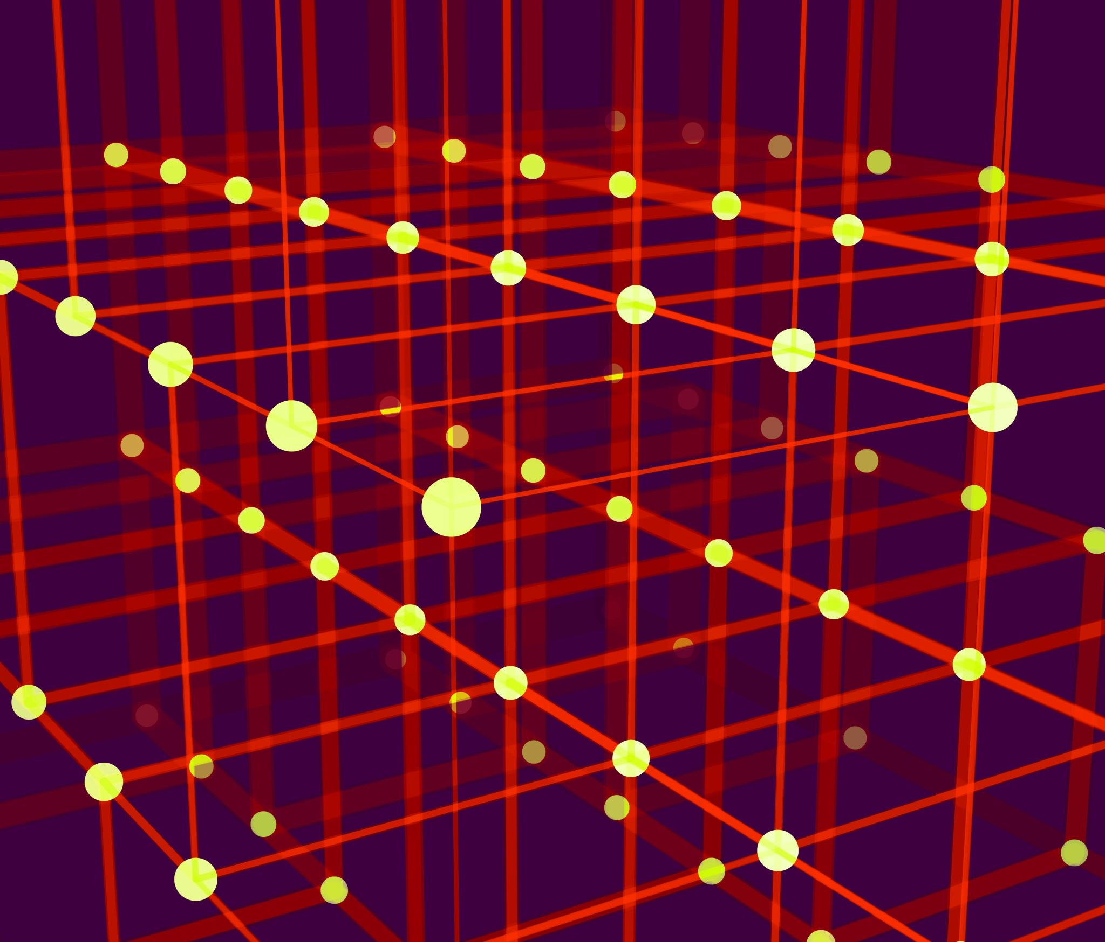
Multimodality at its Core Image: A diagram illustrating how Gemini seamlessly integrates and processes different types of data Emphasize Gemini's ability to understand, operate across, and combine various information formats, including text, code, audio, image, and video. Briefly explain how this enables tasks like reasoning visually across languages.

Slide 5

Beyond Text Generation: A Spectrum of Capabilities Images: Icons representing different capabilities - translation, code generation, image captioning, video summarization, etc. Showcase Gemini's diverse skillset beyond text generation, including: Translation between languages. Generating code based on natural language descriptions. Creating captions for images and videos. Summarizing video content. Answering questions in an informative way, even if they are open ended, challenging, or strange.

Slide 6
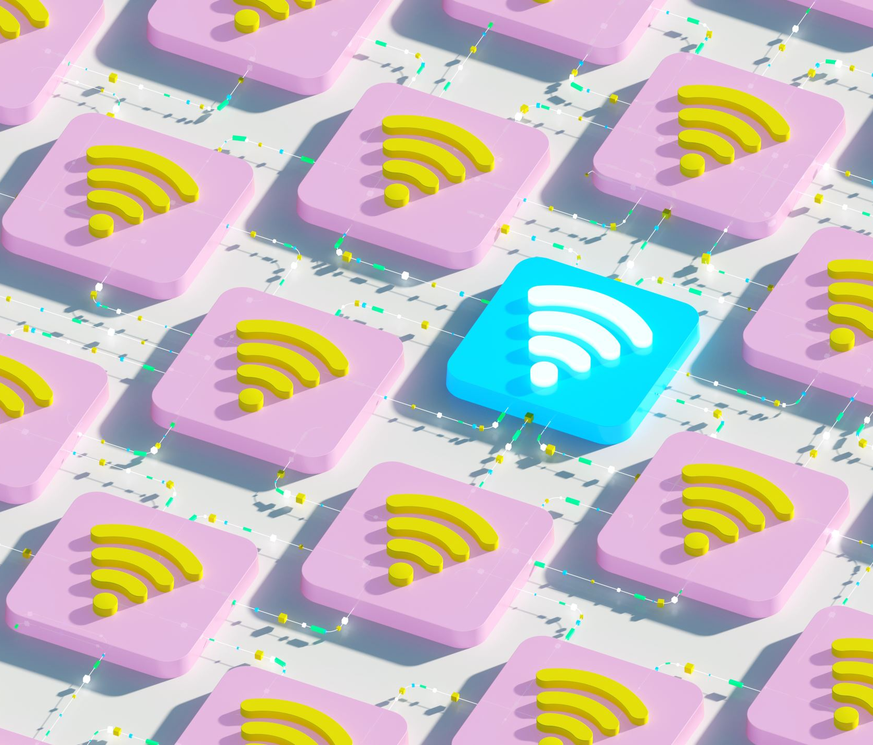
Efficiency and Flexibility: Running Everywhere Image: A spectrum showing Gemini running on various devices, from data centers to mobile phones Highlight Gemini's flexibility and efficiency, allowing it to run on a wide range of devices, from powerful data centers to resource-constrained mobile phones.

Slide 7
Safety First: Unwavering Commitment to Responsible AI Image: A shield icon representing safety and security Underscore Google's commitment to responsible AI development, highlighting Gemini's comprehensive safety evaluations, including bias and toxicity checks. Briefly mention the research into potential risk areas and the application of rigorous testing techniques.

Slide 8

Collaboration and Openness: Building the Future Together Image: A diverse group of people working together around a table Emphasize Google's collaborative approach to Gemini's development, involving teams across Google and external experts. Mention the ongoing work with partners to stress-test models and identify blind spots.

Slide 9
Unveiling the Potential: Real-World Applications Images: Showcasing various applications of Gemini across different fields - education, healthcare, creative industries, etc. Provide some concrete examples of how Gemini is being used in real-world scenarios, such as: Personalized learning experiences in education. Medical diagnosis and treatment assistance in healthcare. Content creation and editing tools in the creative industries. Customer service chatbots and virtual assistants.

Slide 10

The Road Ahead: A Continuous Journey of Innovation Image: A roadmap with milestones representing future advancements Briefly discuss Google's plans for continuous improvement and development of Gemini, focusing on areas like: Expanding capabilities to handle even more complex tasks. Improving efficiency and reducing resource requirements. Addressing ethical considerations and ensuring responsible use.

Slide 11

Conclusion: A New Era of AI Image: A futuristic cityscape symbolizing the transformative potential of AI Reiterate the significance of Gemini as a landmark achievement in AI, paving the way for a future where machines can seamlessly understand and interact with the world around them.

