Slide 1




Estimating Local Bicycle Trips using Mobility Diaries
Research proposal using OpenStreetMap and ODiN Mobility survey data.
Student: Ivo de Geus, MSc
Daily Supervisor: Dr. Marie-Jette Wierbos
1st Academic supervisor: Dr. Ing. Peter van der Waerden
2nd Academic supervisor: Dr. Ing. Dena Kasraian

Slide 2
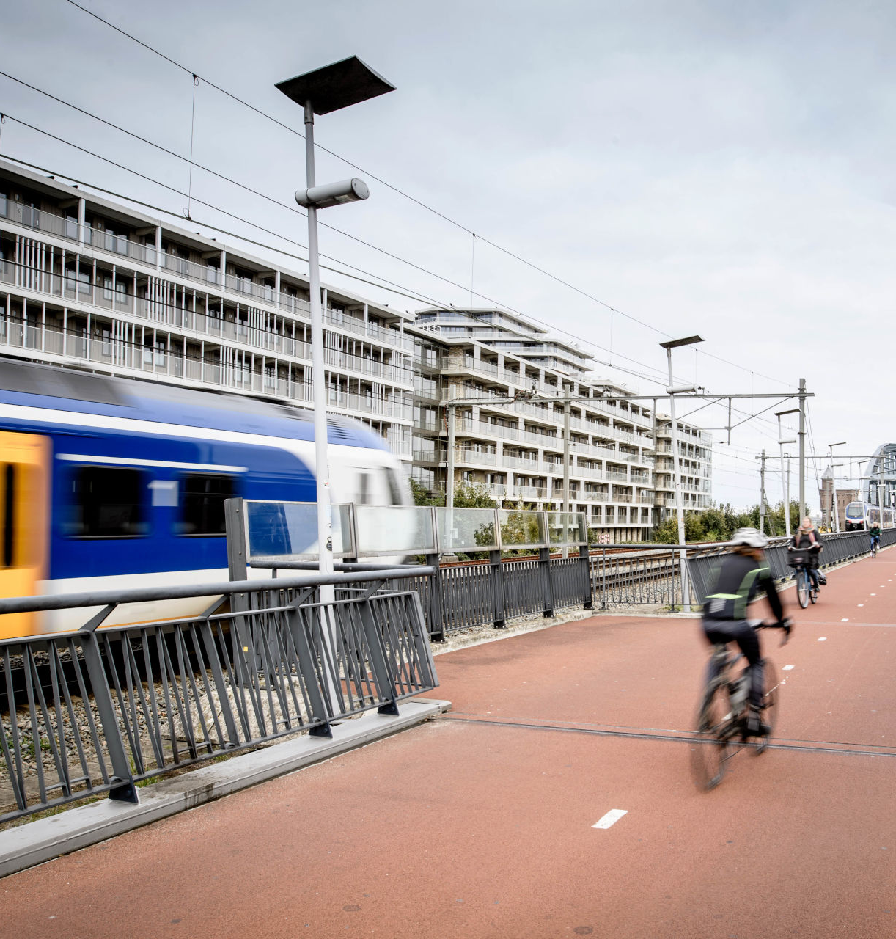
Why?
Estimating cycling traffic difficult with large-scale models.
Existing data as guidance material can be better utilized.
Practical question: How many daily bike trips can we expect from each area?

Slide 3

What?
Goal: estimate and report daily cycling trips generated per area in Netherlands
Cycling design dependent on number of trips generated per day.
How to explain and predict local variances? Factors might include:
  Rural/urban density
  Local competitiveness of other modes
  Socio-economic variables
  Demographic influences

Slide 4

Research Questions
MRQ: How to design a tool to estimate and report bicycle traffic on postcode-4 level?
What factors have most explanatory power regarding local cycling trip generation
How can a non-linear machine-learning model assist with estimating bicycle traffic?
Which method of interaction tool is most fit to make this data accessible?

Slide 5
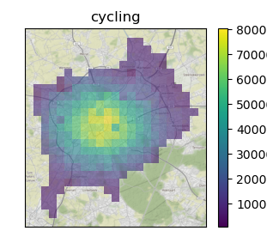
Cycling Trip Generation
Example of Tool
Transit headway (in min)
% with driving licence
20
12
Input variables
MM of daily rain predicted.
10
Population within km² cell
Population reachable by car
5183
837 000
Estimated daily cycling trips from zone:
Population reachable by bike
Output
47 839
630 000
Switch to mode isochrone view
… and other variables, including statistical information of neighboring cells.

Slide 6
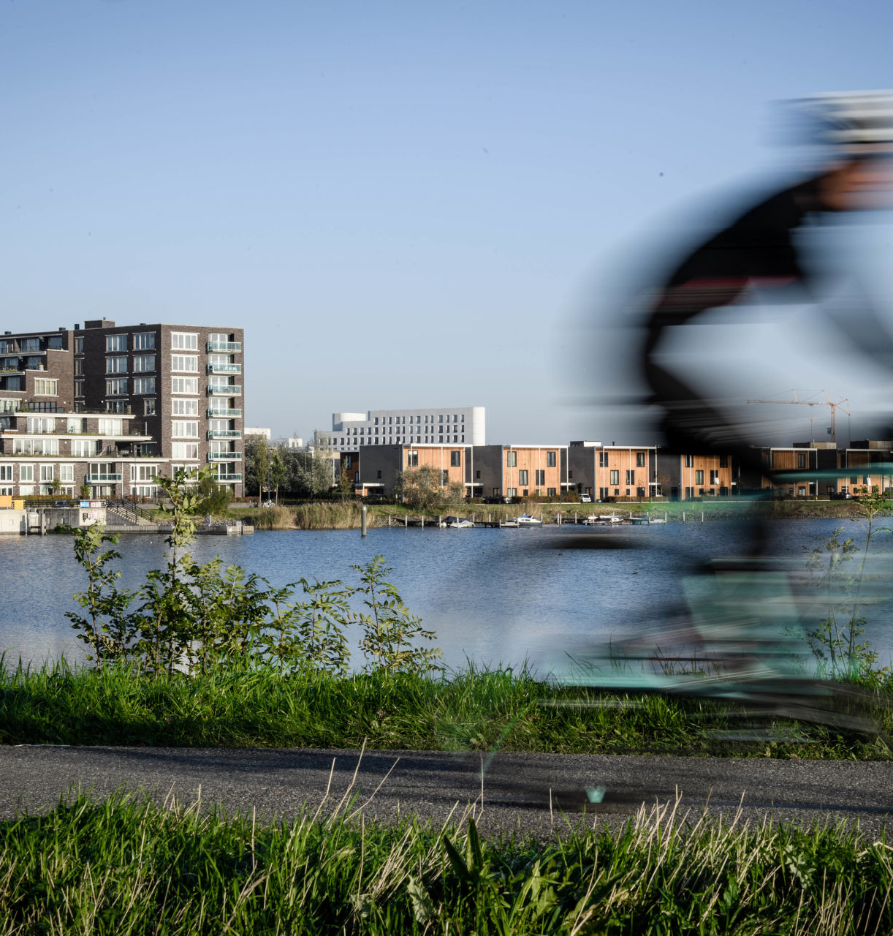
Common Methodologies
Common methods
  Transport models (4-step nested logit models)
  National averages from surveys with bandwidths
  Traffic counts of similar regions
Effective methods, but might not capture non-linearity, with limited local predictive power.

Slide 7
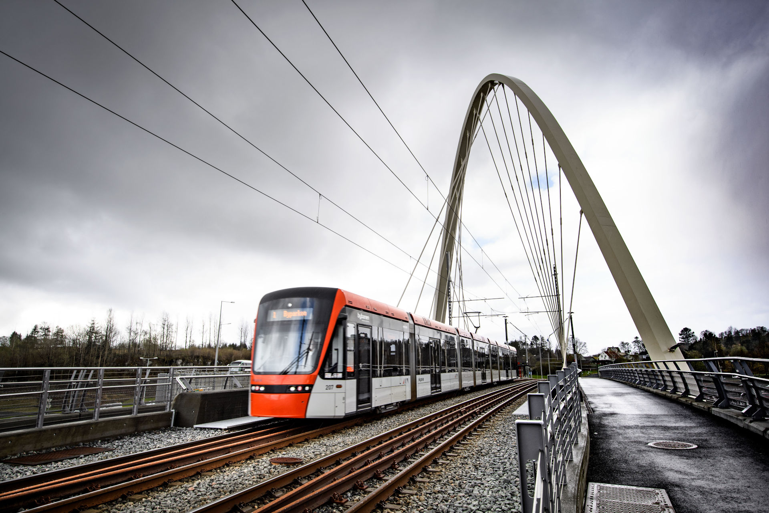
Proposed method
Build feed-forward neural network with predicted cycling trips for each region.
Model trained with mobility diary surveys, with local meta-data.
  Trips made using each mode
  Isochrones for each mode
  Population accessible per mode
  Distance to facilities (in km)
Control for weather data

Slide 8
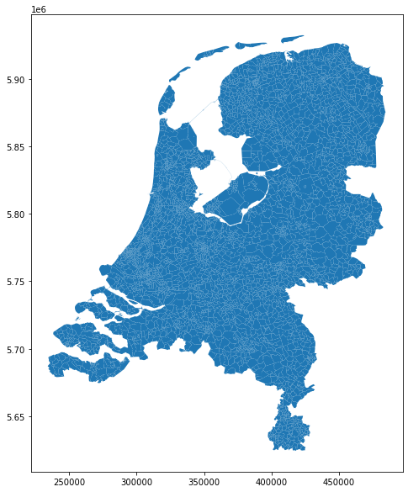
Main data source: Onderweg in Nederland (ODiN)
A representative weighted sample of trips throughout the years 2018, 2019, 2021 and 2022, conducted by the National Board of Statistics (CBS)
Detailed on postcode-4 level, from region to region.
Intra-region trips included, more difficult to predict.
Trip geometry constructed from population-weighted centroids.
Dealing with low sample size per postcode-4 area: group on other variables, such as urbanization level.
Postcode-4 areas in the Netherlands

Slide 9
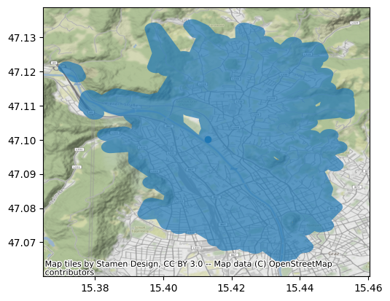
Second data source: Isochrones
Accessibility = Mobility * Proximity (Bertolini, 2012)
Isochrone represents area accessible by that specific mode from an origin, within 30 minutes.
  Expressed as either km2 and population accessible within reach.
  Proposed factor in mode selection (Tenkanen&Toivonen, 2020)
Alternatives generated for following modes:
  Public Transport (variants with walk or bike as access/egress)
  Cycling
  Walking
  Car
Data generated using OpenStreetMap, TransitLand and Graphhopper
Example isochrone in Vienna
Public transport, walking
Bertolini, 2017, Planning the Mobile Metropolis.
Tenkanen and Toivonen, 2020, ‘Longitudinal Spatial Dataset on Travel Times and Distances by Different Travel Modes in Helsinki Region’.

Slide 10
Sample input for FFNN (single trip, sample)
Category | Datum Key | Datum Value
Info about source area (more input variables like shopping malls, HOV, elementary schools) | from_area_pop | 80 000
 | from_area_frac_rent | 0.4
 | from_area_density_class | 4
 | from_area_dist_km_schools | 14
 | etc…
Info about source area mobility reach within 30 minutes of travel time for modes walk, bike, car, pt+walk, pt+bike. | from_area_reach_pop_bike | 50 000
 | from_area_reach_km2_bike | 8.2
 | from_area_reach_pop_car | 80 000
 | from_area_reach_km2_car | 18.3
 | etc…
Individual trip travel duration (viability of choice) | trip_min_bike
 | trip_km_bike
 | trip_min_car
 | trip_km_car
 | etc…
Control: info destination area | to_area_pop | 120 000
 | to_area_frac_rent | 0.8
Control: temperature variant | sum_rain_mm | 12
 | max_temp_c | 7
Target variable | mode_choice (dummy) | car
Example data row on the right
Many variables exposed by postcode information left out, like distance to shopping malls, frequent transit (HOV)
Isochrones and population added to each row from parallel project
  Database of Urban Transport Times
  UrbanTransportTimes.com

Slide 11
Proposed Method
Data Preparation
Loading ODiN mobility surveys
Loading KNMI Weather data
Enriching
(∀ ODiN record)
FFNN Training
Feed ODiN records to FFNN, with output on probability of mode selection.
Run several epochs of training data, comparing mode selection performance and modal split performance.
Statistical and expert Evaluation
Loading postcode-4 data with geometry, population and accessibility information.
Calculate isochrone and population reach for each postcode-4 departure area and each mode.
Calculate mode alternative travel times.
Add weather on day of travel.
Add accessibility information.
Compare population modal split with known modal split
Evaluate regional differences with expert opinion at Sweco.
Prepare GraphHopper routing engine.

Slide 12
Evaluation
Prediction quality of existing mobility diary
  Precision, recall, f1-score
Evaluation of traffic data from tool using expert opinion at Sweco

Slide 13
Discussion
Estimating Local Bicycle Trips using Mobility Diaries
Student: Ivo de Geus, MSc
Daily Supervisor: Dr. Marie-Jette Wierbos
1st Academic supervisor: Dr. Ing. Peter van der Waerden
2nd Academic supervisor: Dr. Ing. Dena Kasraian

Slide 14

Discussion

