Slide 1
Ego4d STA
Short-term Action ANTICIPATION

Slide 2
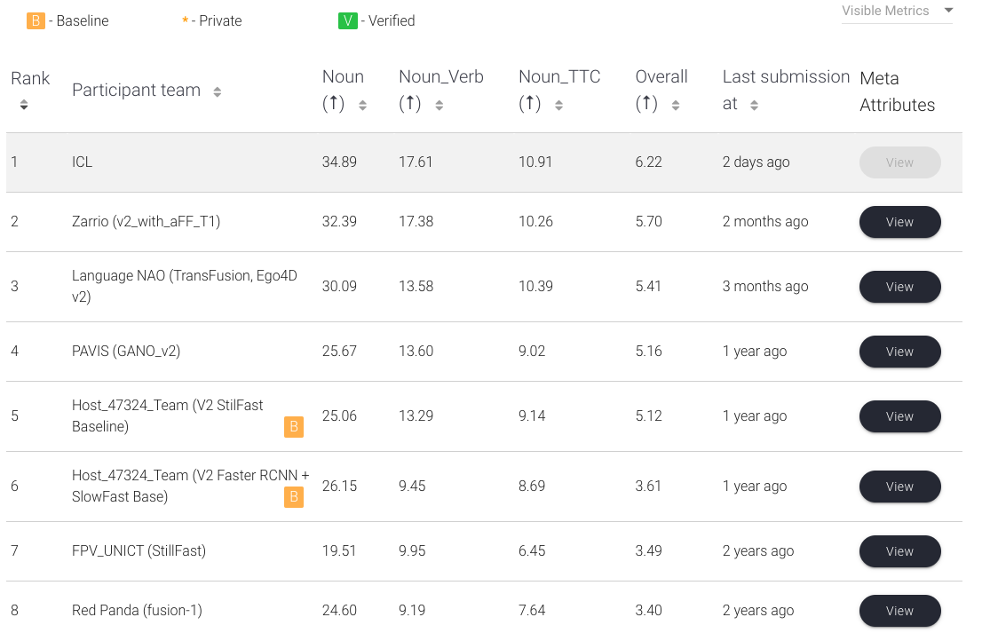
Leaderboard
未查到
仅论文
开源

Slide 3
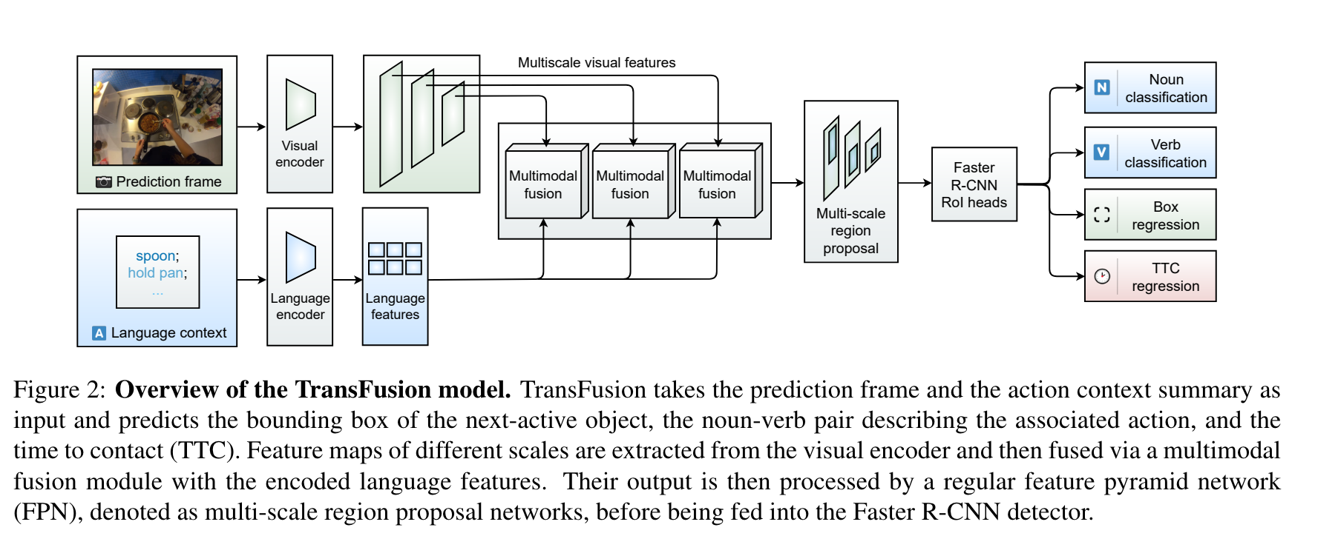
TransFusion #3

Slide 4
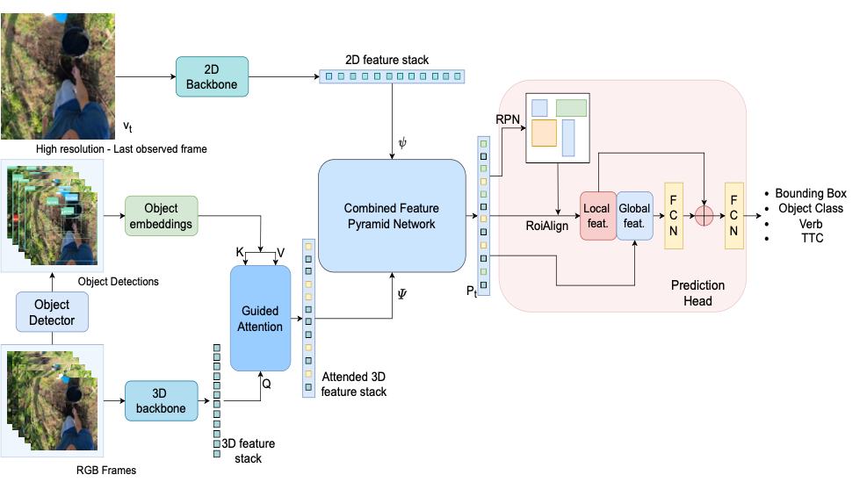
GAANO #4

Slide 5
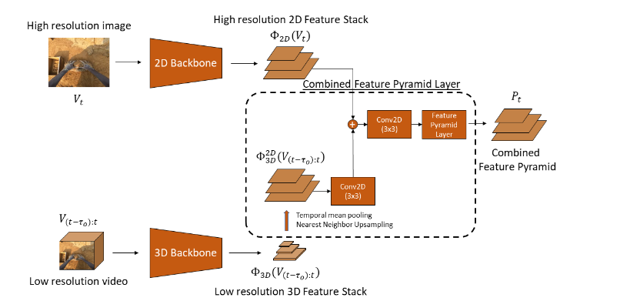
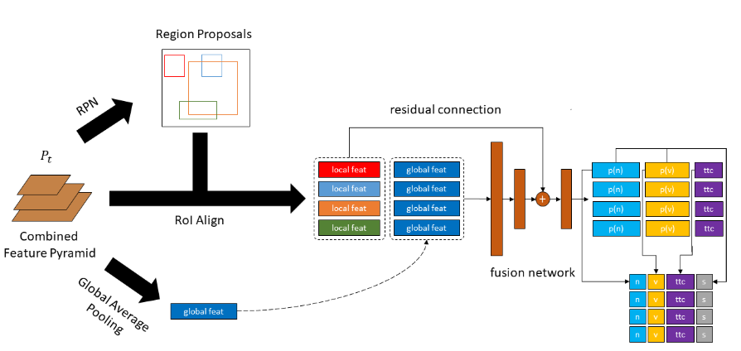
StillFast #5
TwoStage Backbone
FastRCNN
https://github.com/fpv-iplab/stillfast

Slide 6
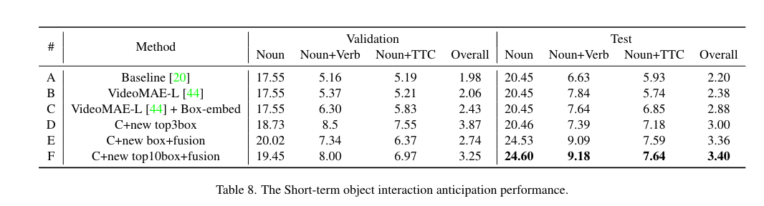
InternVideo #8
Detect(DINO)+ Video-cls(VideoMAE)+box-fusion

