Slide 1
CHAPTER 2
Modeling the Process and Lifecycle
  What We Mean by “process” ?
  Software development product
  Process and resources
  Models of software process
  Techniques for process modeling

Slide 2
2.1 The Meaning of Process
  2.1.1 Process (过程的定义)
    A series of steps involving activities, constrains and resources that produce an intended output of some kind.
    A process usually involves a set of tools and techniques.

Slide 3
    2.1.2. Characteristics (特征):
    Prescribes all of the major process activities 所有活动
    Uses resources under some constraints 约束+资源
    May contain sub-processes as activities 子过程
    Each Activity has entry and exit criteria 活动开始、完成
    The activities are organized in a sequence 活动序列
    The process has a set of guiding principles that explain the goal of each activity 活动目标
    Constraints or controls may apply to activities, resources or product 约束和控制

Slide 4
2.1.3. Life Cycle & Software Life Cycle
(1) Life Cycle 生命周期
  When a process involves the building of some product, we refer to the process as the product’s Life Cycle.
  (2) Software Life Cycle 软件生命周期
  The software development process is also called the Software Life Cycle, since it describes the life of a software product from its conception to its implementation, delivery, use and maintenance.

Slide 5
2.1.4. Value and importance of processes
They impose consistency and structure on a set of activities. 一致性和结构化
The process structure guides actions in making it possible to allow us to examine, understand, control and improve the activities. 检查、理解、控制、改进活动
Process can be used to capture experience. 获取经验

Slide 6
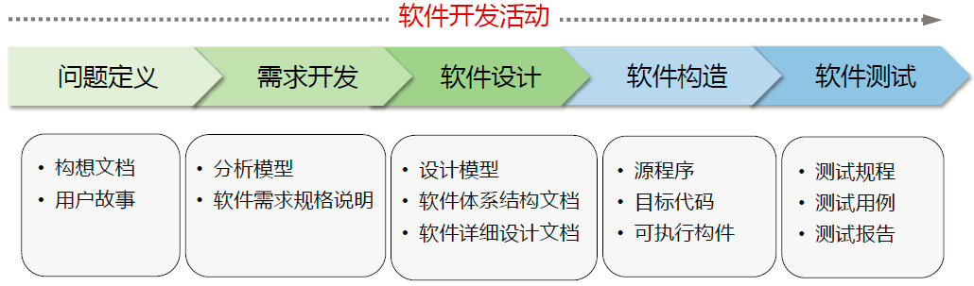
2.1.5. Software development process
    Requirements analysis and definition需求分析
    System design 系统设计
    Program design 程序设计
    Writing or implementing the program 编程
    Unit testing 单元测试
    Integration testing 集成测试
    System testing 系统测试
    System delivery 交付
    Maintenance 维护

Slide 7
  Each stage is itself a process 子过程
  Each activities involves constraints, outputs and resources 活动
  Each has some contribution to software quality of final product 质量贡献
  Each process can be described in a variety of ways, using Text, pictures or combination and each process has its unique features 过程模型

Slide 8
2.2 Software Process Models
2.2.1 Reasons for software process models
  Once a process is written down, it reflects the common understanding of activities, resources and constraints about a specific way to develop software 对软件开发的共同理解
  The Process model helps find inconsistencies, redundancies for its products 发现不一致和冗余
  The process model helps achieve the development goal 明确开发目标
  The process model circumscribes the special situation it should be used to make it be tailored specifically 根据需要裁减

Slide 9
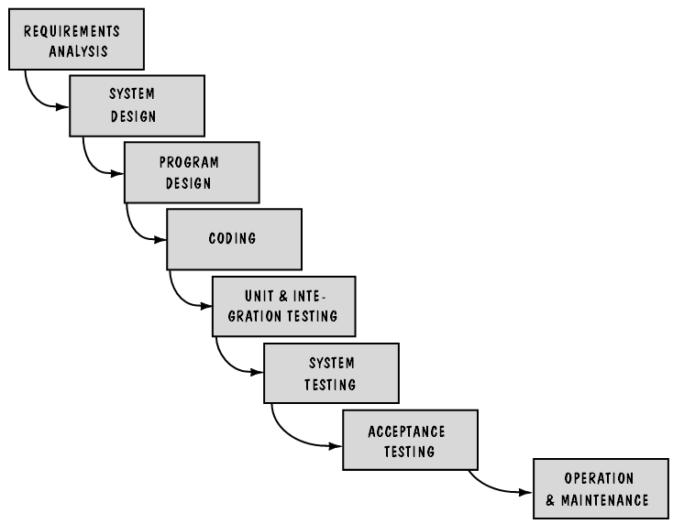
2.2.2 Several of the most popular models
1. Waterfall Model
开发阶段严格按照线性方式进行，每一个阶段具有相关的里程碑和交付产品，且需要确认和验证。
Figure 2.1 The waterfall model

Slide 10
Features of waterfall mode
  (1) Stages are depicted as cascading activities. 阶段之间的线性关系/瀑布特征
    One stage should be completed before next begins.
    It is a very high level view of what goes on and what the sequence of events or activities is.
  (2) Milestones and deliverables are associated with each process activity. 以交付物作为活动结束的里程碑
    It makes explicit which intermediate products are necessary in order to begin the next stage.

Slide 11
Problems with waterfall mode
    (1) The biggest problem is that it does not reflect the way code is really developed. 无法反映真实情况
    Actually software is developed with a great deal of iteration. Solution must be upgraded to reflect some change in business climate or operating environment. Especially when the solution to a problem has never been solved before, and when neither the users nor the developers know all the key factors that affect the desired outcome.
    (2) The model provide no guidance to managers and developers on how to handle changes to products and activities. 无法处理变化
    (3) Its major shortcoming is its failure to treat software as a problem-solving process. 制造业模式

Slide 12
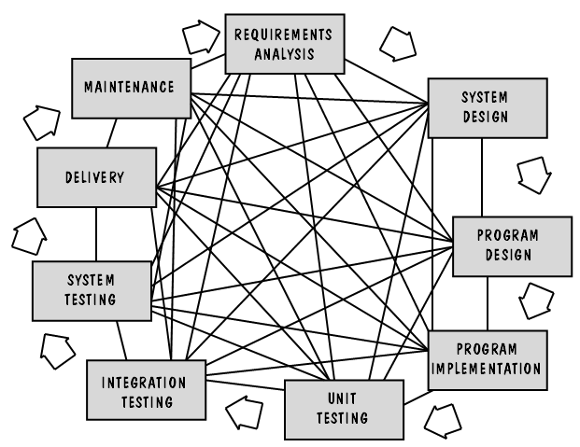
Figure 2.2 The actual software development process

Slide 13
Prototype can be included in the process to control the thrashing
  (1) Prototype 原型
    Is a partially developed product that enables customers and developers to examine some aspect of the proposed system.
  (2) Prototyping 原型法
    Helps to decide what is suitable or appropriate for the finished product.
  (3) Validation 确认
  making sure the product is built according to the requirement specification.
  (4) Verification 验证
  checking the quality of the software implementation.

Slide 14
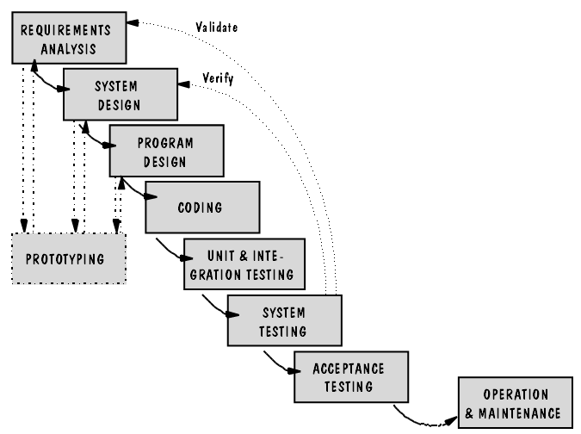
Figure 2.3 The waterfall model with prototyping

Slide 15
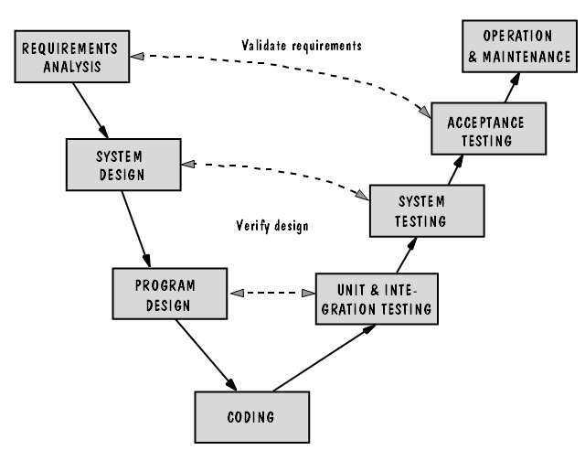
2. V Model
Figure 2.4 The V mode

Slide 16
Features of V mode
  (1)强调测试活动与分析设计活动的关联
  It is a variation of the waterfall model, which demonstrates how the testing activities are related to analysis and design.
    It tells us that each testing should be conducted to validate and verify the corresponding requirement and design specifications.
  (2)问题发现
  The model’s linkage of the left side with the right side of the V implies that, if problems are found during validation and verification, then the left side’s activities should be re-executed to fix and improve the requirements, design and code.

Slide 17
Difference between V mode and waterfall model
  The focus of V model is activities and correctness.
    Whereas the focus of waterfall model is documents or artifacts.

Slide 18
3. Prototyping Model
(See Fig 2.5, p.53)
  It allows all or part of a system to be constructed quickly to understand or clarify related issues.
  It has the same objective as an engineering prototype where requirements or design require repeated investigation to ensure common understanding, correct design and implementation.
  The overall goal is to reducing risk and uncertainty in development.

Slide 19
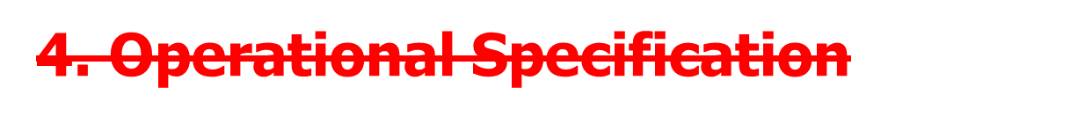
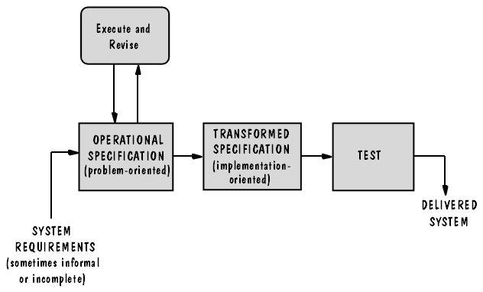
Figure 2.6 The Operational specification model

Slide 20
Features of operational specification model
  The system requirements are evaluated and executed in a way that demonstrates the behavior of the system.评价和运行需求
  The evaluation or execution is enacted by using a software package, because the specification is formulated in a abstract or formal way. 软件包支持
  This model is very different from other models.
    The waterfall model separates the functionality of the system from the design.
    This model allow the functionality and design to be merged.

Slide 21

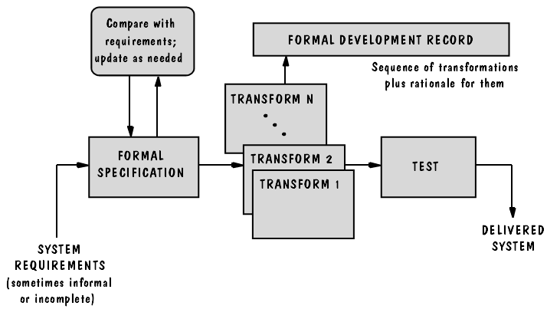
Figure 2.7 The transformational model

Slide 22
Features of Transformational model
  This model tries to reduce the possibilities for error by eliminating several major development steps.
  Once the system requirements are established, a series transformations are used to change the specification (normally a formal one) into a deliverable system. 变换从需求开始
  The transformation is supported by using specifically constructed automatic tools. 变换由特定工具支持
  Major impediment is the need for an abstract and formal specification. 抽象和形式化的描述是主要障碍
  Becoming more popular and acceptance.
  e.g. code generator.

Slide 23
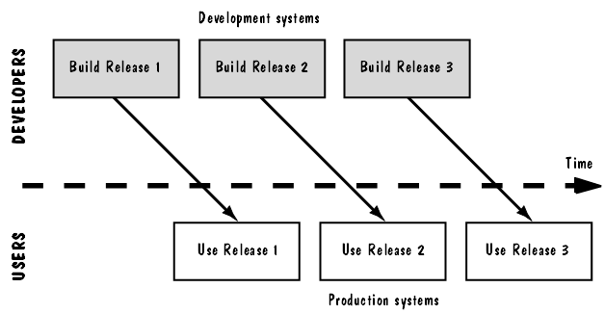
6. Phased Development: Increments & interactions
6.1. Cycle time 循环周期
  The time from the very beginning of the system requirements and the system delivering.
  Today’s business environment no longer tolerates long delays. This model is developed to reduce the cycle time.
6.2. The phased development model
Figure 2.8 The phased model

Slide 24
  6.3. The phased development model
  The system is designed so that it can be delivered in pieces, which enables users to have some functionalities while the rest is being developed. 版本发布与开发并行
  (1) Operational or production system (已发布)
    The system currently being used by customers or users. This is referred to the system in terms of their Release numbers.
  (2) Development system (开发中)
    The next version being prepared to replace the current production system

Slide 25
  6.4. two ways to organize development into releases
  (1) Incremental development (增量开发)
    The system is partitioned into subsystems by functionality.
    The releases are defined by beginning with one small, functional subsystem, and then adding functionalities with new release.
  (2) Iterative development (迭代开发)
    The system is delivered with full functionality, then changes are made to enhance the functionality of each new release.
  In reality, they are combined.

Slide 26
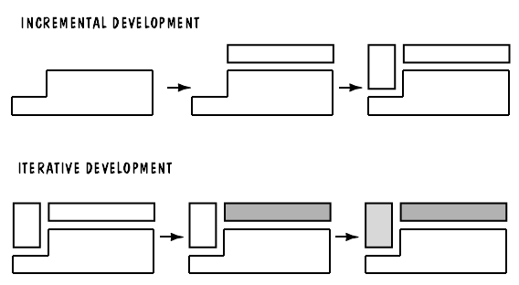
Figure 2.9 The incremental and iterative models

Slide 27
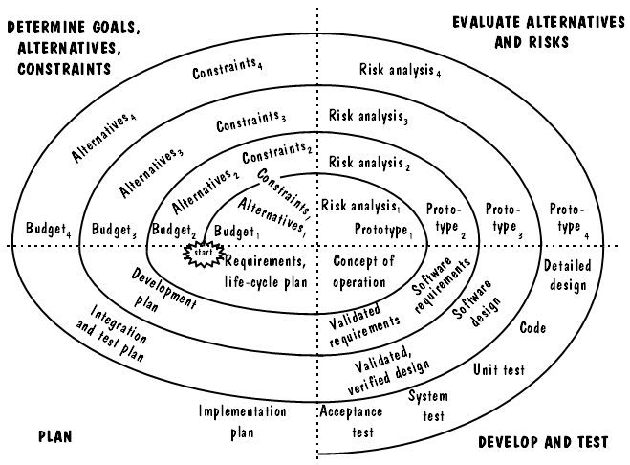
7. Spiral Model
Figure 2.10 The spiral model

Slide 28
Features of Spiral Model
  1. 目的
  The Purpose of this model is to combine development activities with risk management to minimize and control risk. 引入风险管理活动，以降低和控制风险
  2. 迭代产物
  第1次迭代：the concept of operations 操作原型
  第2次迭代： the requirements 需求
  第3次迭代： the design 设计
  第4次迭代： the testing 测试

Slide 29
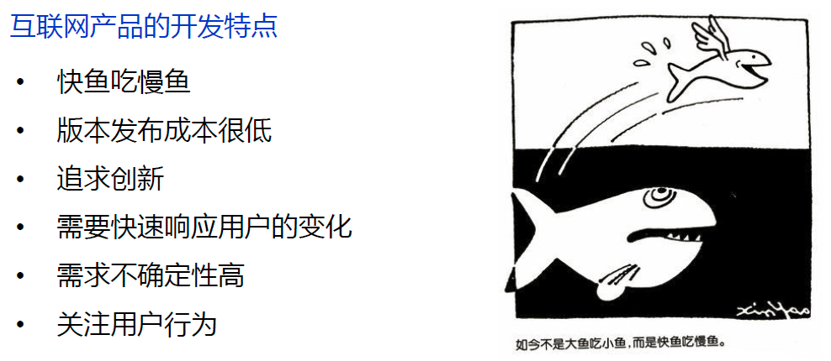
8. Agile Methods 敏捷方法

Slide 30
8.1. Background 背景
早期过程：1970s—1990s, 对过程施加严格控制、管理
近期过程：late 1990s, 抵制严格的形式，灵活，快速，高效
敏捷联盟
  2001年，为了解决许多公司的软件团队陷入不断增长的过程泥潭，一批业界专家一起概括出了一些可以让软件开发团队具有快速工作、响应变化能力的价值观和原则，他们称自己为敏捷联盟。

Slide 31
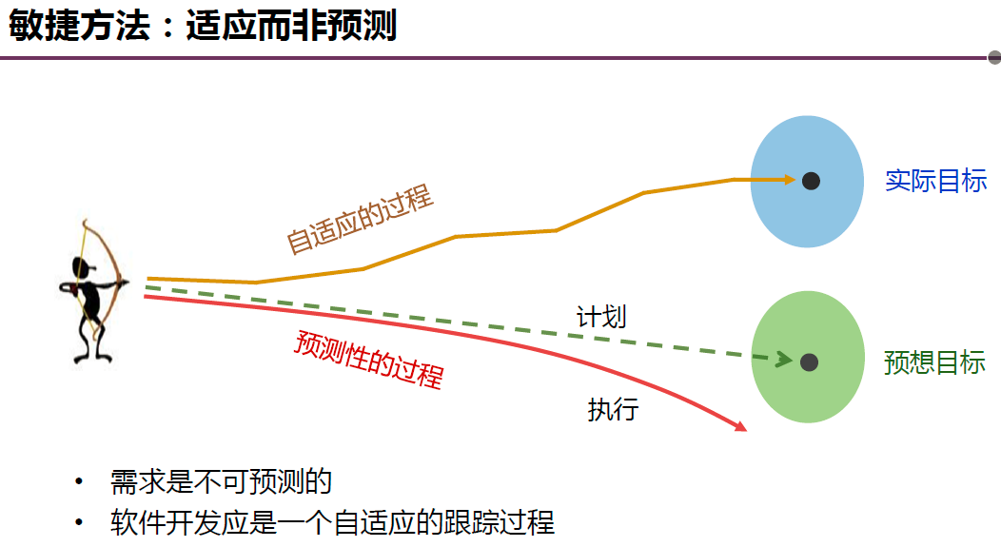
敏捷开发：以人为核心、迭代、循序渐进。在敏捷开发中，软件项目的构建被切分成多个子项目，各个子项目的成果都经过测试，具备集成和可运行的特征。
简言之，就是把一个大项目分为多个相互联系，但也可独立运行的小项目，并分别完成，在此过程中软件一直处于可使用状态。

Slide 32
8.2. “agile manifesto” focuses on 4 tenets
They value individuals and interactions over processes and tools. 重视个体和交流
They prefer to invest time in producing working software rather than in producing documentation. 重视可运行的软件
They focus on customer collaboration rather than contract negotiation. 注重与客户的协作
They concentrate on responding to change rather than on creating a plan and following it. 应变能力

Slide 33
8.3. The overall goal of agile development
To satisfy the customer by “early and continuous delivery of valuable software”. 尽快的、持续的交付发布有价值的软件
It is thought that by building flexibility into the development process, agile methods can enable customers to add or change requirements late in development cycle. 在过程中增加灵活性，以允许后期客户要求的变化

Slide 34
8.4. Examples of agile processes
Extreme programming (XP) 极限编程
  激发开发者的创造性，减少附属的管理程度；
  核心是沟通、简明、反馈和勇气。因为计划永远赶不上变化，XP无需开发人员在软件开始初期做出很多的文档。XP提倡测试先行，为了将以后出现bug的几率降到最低。
Crystal 水晶系列方法
People have a major influence on software quality.人的素质是影响产品质量的主要因素
Productivity increases through better communication and frequent delivery, because there is less need for intermediate work products. 通过更好的交流和频繁的交付可以改进生产率

Slide 35
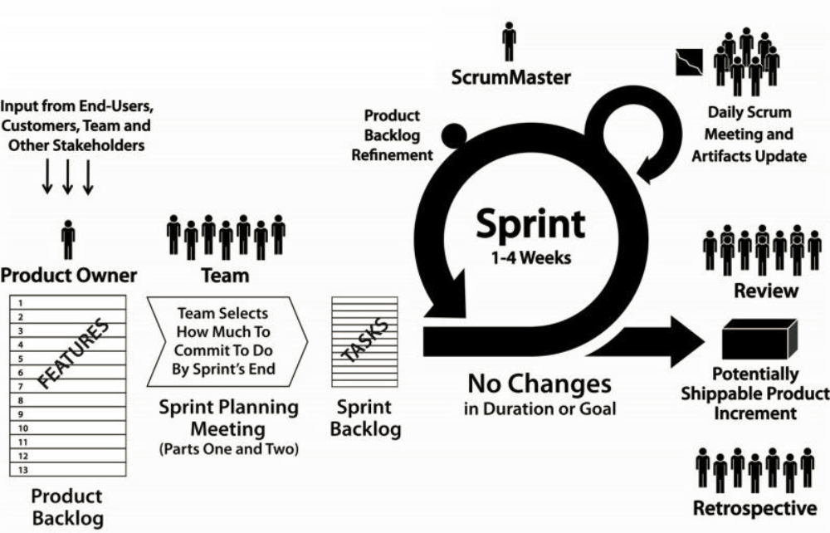
Scrum

Slide 36
Scrum
  核心：迭代、增量的过程骨架。
  角色：product owner、developer team、scrum master.
  sprint(冲刺)：开发团队与客户于每一个阶段开始时挑选应完成的规格部分（目标），开发团队必须尽力于30天后交付成果。 Iterative development
  Sprint planning meeting：在启动每个sprint前召开。一般为一天时间（8小时）。
  Daily Scrum Meeting。在同一时间，同一地点，每天，团队所有成员召开一个简短的会议。每个成员需要汇报：今天完成了什么？是否遇到了障碍？即将要做什么？会议应该简短：不留讨论时间；直到被问起才发言；会议召开时要求参加人站成一个圈；其他人不允许发言
  Sprint review meeting：将这个Sprint的工作成果演示给Product Owner和其他相关的人员。
  Sprint retrospective meeting：对刚结束的Sprint进行总结

Slide 37
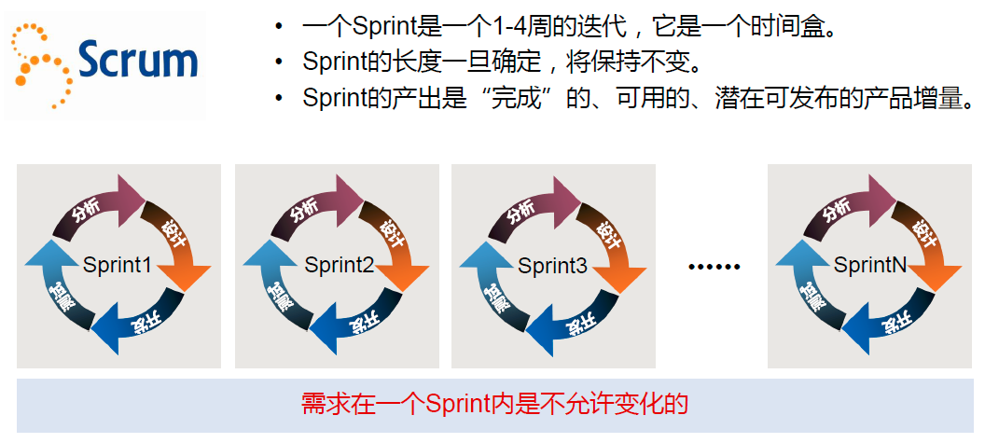
Scrum

Slide 38
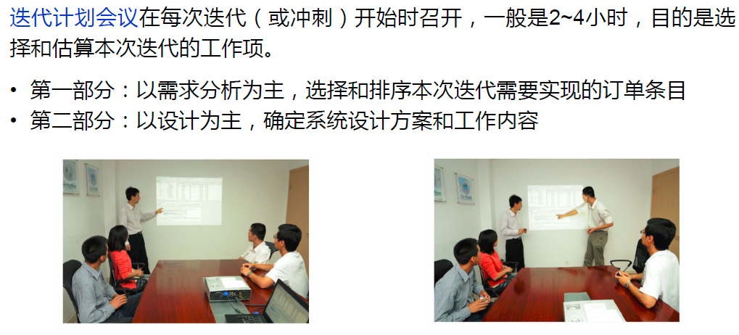
Scrum：迭代计划会议

Slide 39
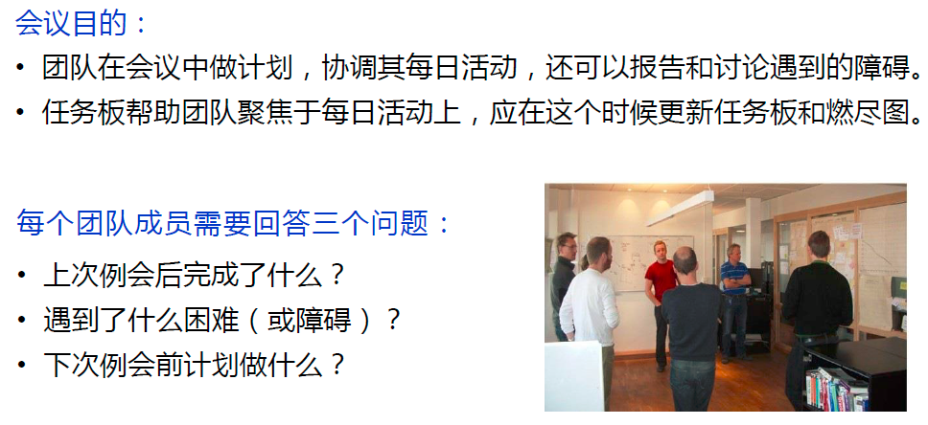
Scrum：每日站立会

Slide 40
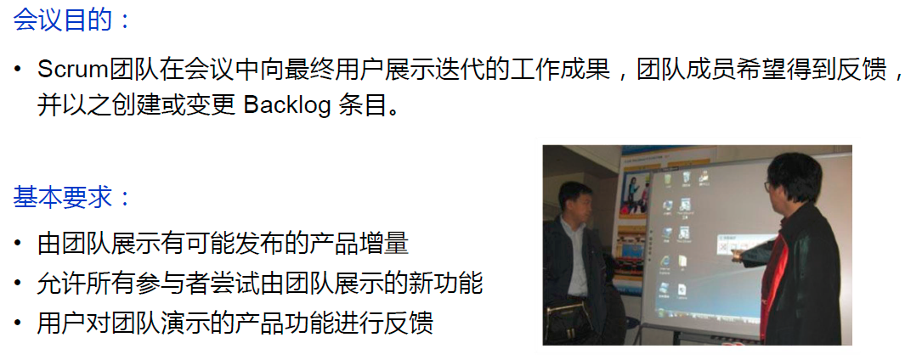
Scrum：迭代评审会议

Slide 41
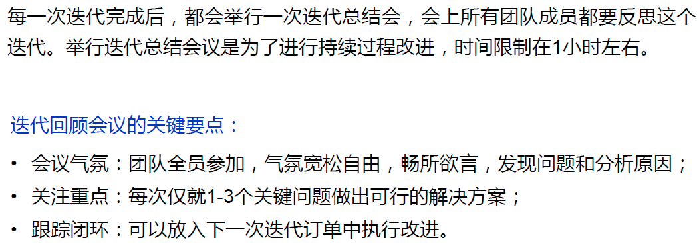
Scrum：迭代回顾会议

Slide 42
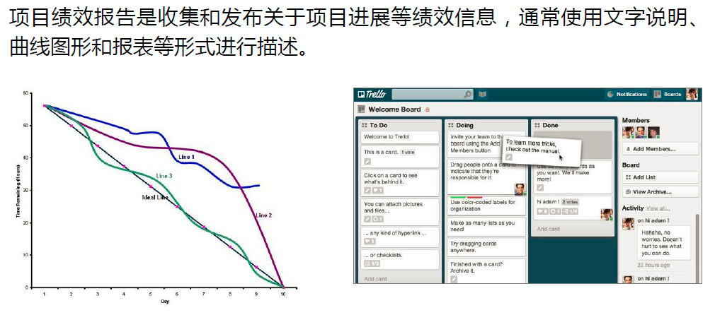
Scrum：项目绩效报告

Slide 43
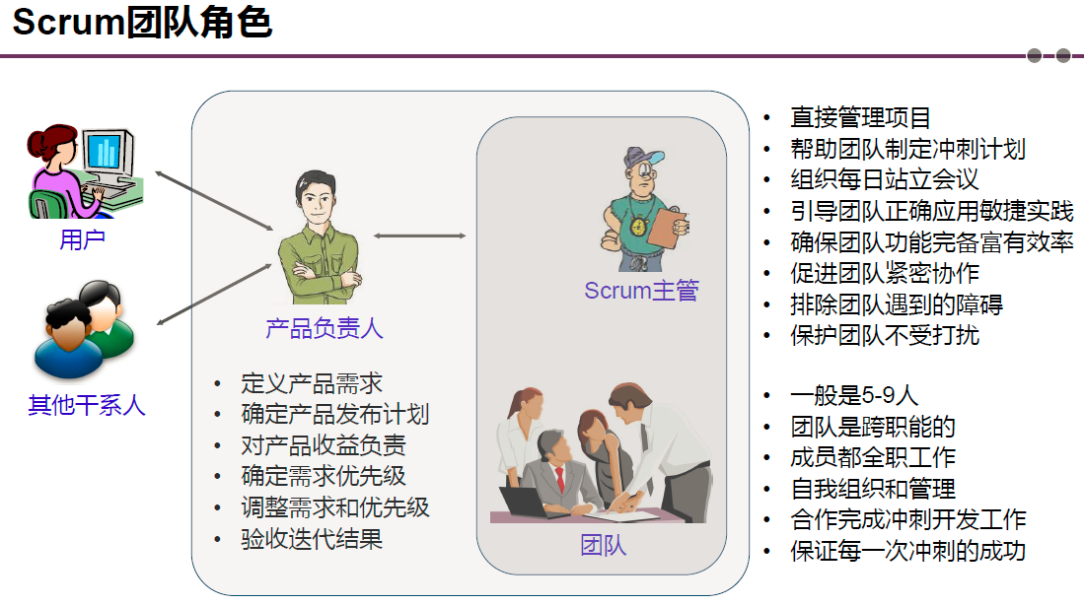
Scrum

Slide 44
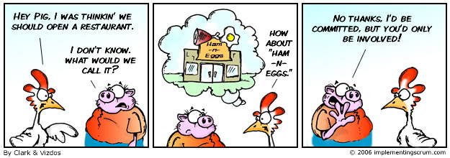
Scrum
Pig role: 产品负责人, Scrum主管/促进者, 开发团队
Chicken: 用户, 利益所有者 (客户，提供商), 经理等

Slide 45
8.5. Extreme programming 极限编程
设计和编程都是人的活动。忘记这一点，将会失去一切。
XP is used to describe the more general concept of agile methods.
It emphasizes 4 characteristics of agility:
communication 客户和开发者之间持续的交流
simplicity 选择满足需求的、最简单的设计、实现方案
courage 尽早、经常交付功能的承诺
feedback 反馈贯穿于所有开发活动中

Slide 46
2. The 12 facets of XP
The planning game 规划
    Stories 场景描述，客户、用户、开发者
    Priorities 需求优先级
    Planning 制定计划
(2) Small release 尽快、频繁的发布
Require a phased-development approach with incremental or iterative cycles.
(3) Metaphor 隐喻
A common vision.
(4) Simple design 简单设计
Design is kept simple by addressing only current needs.
(5) Writing tests first 尽早写测试用例
To ensure that the customer’s needs are the driving force behind development.

Slide 47
(6) Refactoring 重复修改
Revisiting the requirements and design, reformulating then to match new and existing needs.
(7) Pair programming 结对编程
(8) Collective ownership 产权共享
(9) Continuous integration 频繁持续的集成
The emphasis is on small increments or improvements rather than on grand leaps.
(10) Sustainable pace 可持续进步
(11) On-site customer 现场客户
(12) Coding standards 代码规范

Slide 48
2.2.3. Conclusion of process models
    Process models presented here are only a few of those discussed and used.
    Process models should be defined and tailored to the needs of user, customer and developer.
    The development process should be captured as a collection of process models, rather than focusing on a single model or view.
    No matter what process model is used, many activities are common to all.

Slide 49
本章小结
过程的定义 (process)
  一系列步骤
  包含活动、约束、资源
  产生预期结果
过程的特征 (characteristics of process)
  7个特征
两个概念：Life Cycle & Software Life Cycle
过程建模的重要性
  使活动保持一致性和结构化
  有利于检查、理解、控制、改进活动
  获取和传授经验
软件过程建模的原因
  4个原因

Slide 50
几种软件过程模型、特点、优缺点、适用条件
  瀑布模型
  V模型
  原型模型
  阶段化开发模型（增量、迭代及相关概念）
  螺旋模型
  敏捷方法（思想、原则、目标、Scrum、XP及其特征）

Slide 51
本章作业
无。

