Slide 1
CHAPTER 3
Planning and Managing the Project
  Tracking project progress
  Project personnel and organization
  Effort and schedule estimation
  Risk management

Slide 2
3.1 Tracking Progress
  Project begins when customer approaches you to discuss a perceived need
    Usually, customers have several questions
      Do you understand my problem and needs ?
      Can you design a system that will solve the problem or satisfy my needs ?
      How long will it take you to develop such a system ?
      How much will it cost to have you develop such a system ?
    Answering the last 2 questions requires a well-thought project schedule

Slide 3
3.1.1 Project schedule
  1. Project schedule 项目进度
    Describes the development cycle by enumerating the phases or stages, and tasks or activities to be done. The schedule also portrays the interactions among the tasks and estimates the time each task or activity will take.
  Project schedule is a timeline from start to the end of the project, showing the activities that need to be performed: actual time to do work + weekends + holidays etc.

Slide 4
3.1.1 Project schedule
Processes to ensure the timely completion of the project
‐ Define activities
‐ Sequence Activities
‐ Estimate Activity Resources
‐ Estimate Activity Duration
‐ Develop Schedule
‐ Monitor and control Schedule
  2. Activity 活动
    It is a part of the project that takes place over a period of time;
  3. Milestone 里程碑
    It is the completion of an activity – a particular point of time; is the end of a specially designated activity.

Slide 5
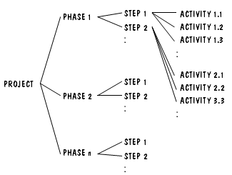
3.1.2 Project Schedule Construction
  Development can be separated into succession of phases; Each phase is composed of steps; And each step can be further subdivided.
    See Fig 3.1, p.84.
    See Table 3.1, p.85, of phases, steps and activities of building a house.
    See Table 3.2, p.86, of milestones of Building a house.

Slide 6
3.1.3 Work Breakdown structure 工作分解结构 WBS
The above analysis can lead to generating a work breakdown structure (WBS).
WBS
  将所有工作任务分类的清单或表格
  是驱动项目的机器
  The structure depicts the project as a set of discrete pieces of work.离散的工作单元

Slide 7
WBS示例：同学聚会晚宴项目
参加者
  1.1获得同学名单
  1.2发邀请
  1.3确定参加者名单
2.地点
2.1访问可选的地点
2.2与餐馆签约
2.3定菜单
3.活动
3.1制定节目单
3.1.1选定主持人
3.1.2选定发言者
3.2安排娱乐节目
3.2.1选择表演者
3.2.2与表演者签约
4.材料
4.1找出可选的印刷者
4.2选定印刷者
…………

Slide 8
WBS讨论
表达形式
  大纲、表格、图形等等
完成者
  项目经理、核心小组
  集体讨论、明确项目要求和必需的任务
任务的划分
  需要个人判断
  两个极端
    把发请柬分解为写信封和贴邮票
    推销员：期望、销售、退休
WBS可复用

Slide 9
3.1.4 Activity Graph 活动图
But the structure gives no indication of the interdependence and concurrency of the work units. 无法表达工作单元之间的依赖和并行关系
  1. Activity 活动
  Each activity can be described with 4 parameters:
    Precursor 前驱活动集合
    Duration 持续时间
    Due-date 完成期限
    Endpoint 活动结束里程碑

Slide 10
2. Activity Graph 活动图
  In an activity graph
    The nodes are the project milestones
    The lines linking the nodes represent the activities involved
  Fig 3.2 is the activity graph for the work described in phase 2 of Table 3.1.

Slide 11
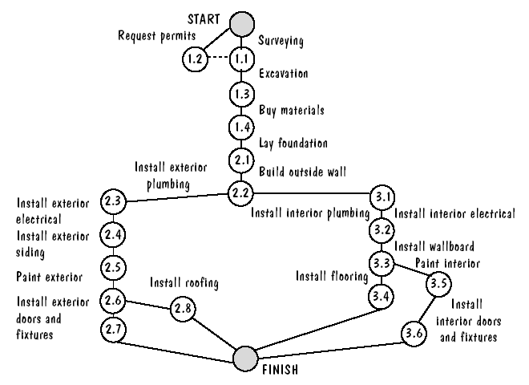
Figure 3.2 Activity graph for building a house

Slide 12
Characteristics of Activity Graph
  Precursors
  Dependency
  Concurrency
    The parallel nature of tasks
  Dashed line link nodes that must all be completed to make afterward activities to start to work
  In an activity graph
    The nodes are the project milestones 节点表示里程碑
    The lines linking the nodes represent the activities involved 边表示活动

Slide 13
3.1.5 Completion estimation ---Critical Path Method (CPM) 关键路径方法
Activity Graphs made more useful
  By adding it information about the estimated time
    It will take to complete each activity.
    The corresponding edge of the graph is labeled with the estimated time.
    See Fig 3.3, p.84
  This graph tells us a lot about the project’s schedule

Slide 14
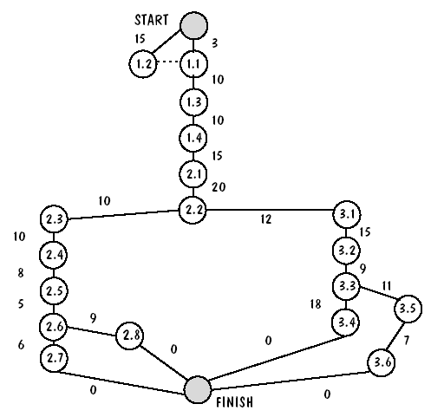
Figure 3.3 Activity graph with durations

Slide 15
关键路径方法（CPM）中的几个概念
  For each activity in the graph 2 times can be computed
  Real time or actual time for an activity （活动的）实际完成时间:
    Is the estimated amount of time required for the activity to be completed.
  Available time （活动的）可用时间
    Is the amount of time available in the schedule for the activity’s completion.
    This is the time allowable for the activity to take in order to make the project on schedule or without delaying the project.
  Slack time of float for an activity （活动的）空闲时间
    Slack time = available time – real time

Slide 16
关键路径方法（CPM）中的几个概念
  Another way of looking at Slack time for an activity
    Latest time is the time the activity may begin without delaying the project 最晚开始时间
    Earliest time is the time the activity may begin as early as possible 最早开始时间
    Slack time = latest time – earliest time 空闲时间

Slide 17
The algorithm of calculating the slack time
The earliest time: (forward pass)从起始节点开始，沿着路径向前递推计算每个活动的最早开始时间：max{前驱活动A_{i}的最早开始时间 + 活动A_{i}的持续时间}
We can work forward from the starting activities along the path to compute the earliest time of every activity.
The latest time: (backward pass)从终止节点开始，沿着路径反向递推计算每个活动的最晚开始时间：min{后继活动Ai的最晚开始时间} – 当前活动的持续时间
Then we can work backward along the path to compute the latest time of every activity..

Slide 18
Critical Path 关键路径
    The longest path has a slack of zero for each of its nodes because it is the path that determines whether the project is on schedule. This is called the Critical Path.
  Critical Path is the one for which the slack at every node is zero. That is, there is no margin for error when performing activities along a Critical Path.
  There may be more than one critical path.
  The late start pushes
    all subsequent critical path activities forward, forcing them to be late, too.
    all subsequent activities not on a critical path forward, forcing them to loss slack time.
  In this way, activity graph helps us to understand the impact of any schedule slippage.

Slide 19
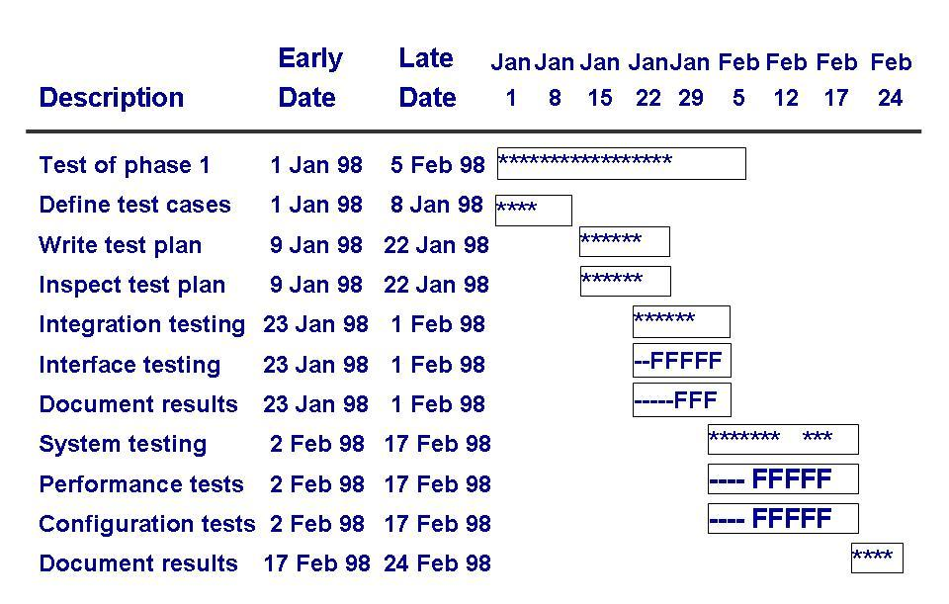
CPM bar chart
  Horizontal bars represent the duration of each activity.
  Bars composed of asterisks indicate the critical path.
  Each activity has associated with it an expected value and a variance of duration.

Slide 20
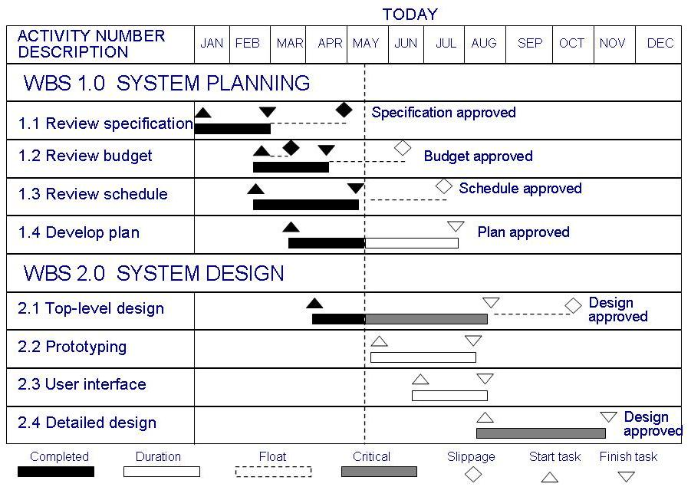
3.1.6 Tools to Track Progress
  Manual tools
  Spreadsheet tools
  Sophisticated tools with complex graphics
  E.g. Gantt Chart
    Activities shown in parallel helps understand which activities can be performed concurrently

Slide 21
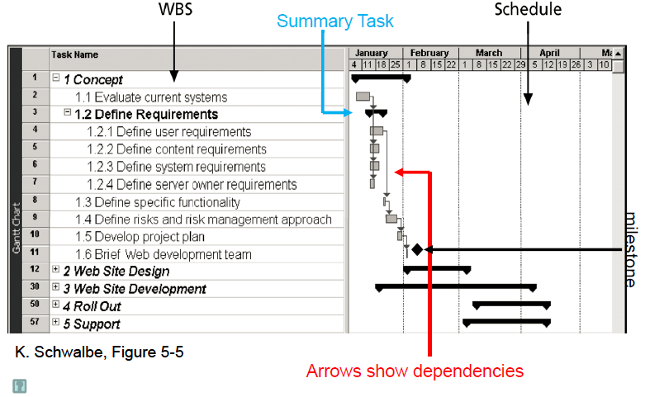

3.1.6 Tools to Track Progress

Slide 22

3.2 Project Personnel 项目中的人员管理

Slide 23
3.2.1 Staff Roles and Characteristics
团队中的角色和人员特征
Staff Roles 团队中的角色
  Key project activities likely include
    Personnel for requirements, system and program design, program implementation and testing, training, maintenance, quality assurance
  The assignment of staff to tasks
    It depends on project size, staff expertise and staff experience
    Assigning different responsibilities to different set of people. E.g. it is useful for program designer to be different from system designer

Slide 24
Staff Characteristics 人员特征 /Choosing Personnel
  Ability to perform the work 工作能力
  Interest in the work 兴趣
  Experience
    with similar applications 类似应用的经验
    with similar tools, languages or techniques 工具,语言,技术
    with similar development environment 类似开发环境的经验
  Training 培训情况
  Ability to communicate with others 交流能力
  Ability to share responsibility with others 承担责任的能力
  Management skills 管理技能

Slide 25
Characteristic differences
    These characteristics can affect an individual’s ability
    Some are good at viewing “the big picture”
      But may not enjoy focusing on detail
      These people may be better suited to system design or testing than to program design or coding
    Sometimes, ability is related to comfort
      Some feel more comfortable or confident in doing something
      The feeling of comfort is important : people are usually more productive

Slide 26
Characteristic differences
    Interest in the work can also determine someone’s ability or success on a project 兴趣
      Though very good at doing something, some may be more interested in trying something new than repeating something /The novelty of the work 创新性工作兴趣
      On the other hand, Some people prefer doing what they know and do best, rather than venturing int o new territory 已熟悉
      It is important that whoever is chosen for a task be excited about performing it, no matter what the reason is.

Slide 27
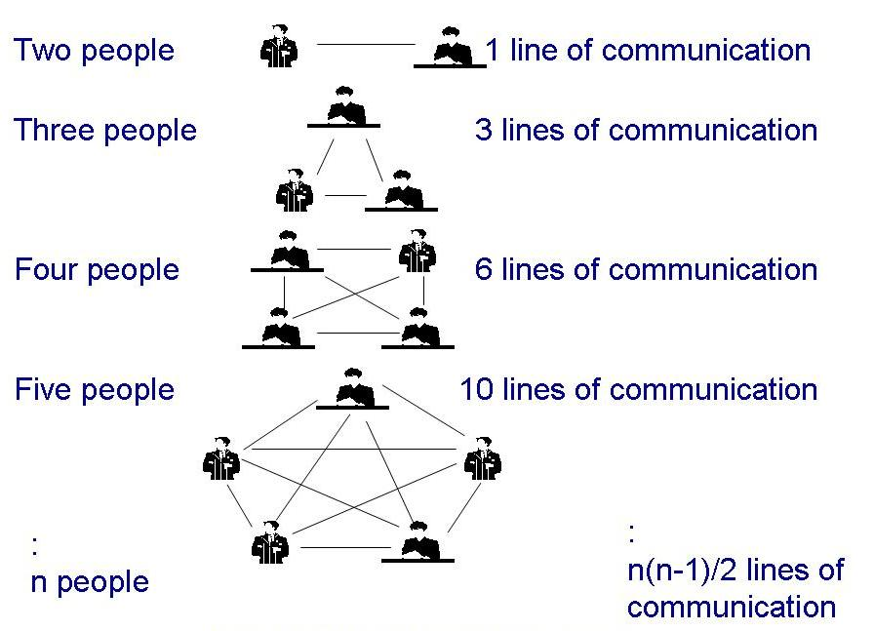
Characteristic differences
Individual ability in communication 沟通、交流
  Project activity needs communication with one another, with users and customers
  Project’s progress is affected not only by the degree of communication, also by ability of individuals to communicate their ideas
  How quickly the lines of communication can grow
    With n people, there are n(n-1)/2 communication lines

Slide 28
3.2.2 Work Styles 工作方式
  Different people have different preferred styles 不同的工作方式
    For interacting with others 交流、沟通方式
    And understanding problems 理解问题的方式
    Example
      Some prefer to do detailed analysis of all possible information before making decisions 周密分析后作决定
      Some may rely on “gut feeling” for most of their important decisions 凭借敏感的直觉作决定

Slide 29
Work Styles 工作方式
  Extroverts and Introverts : communication styles 从交流方式上划分：外向和内向
    When communication with others, some people tell others their thoughts and others ask for suggestions from others for forming an opinion
    The former is Extroverts
    The latter is Introverts
  Intuitive and rational : decision styles 从决策方式上划分：直觉和理性
    Some people base their decision on feelings and emotional reactions to a problem
    Some people base their decision on carefully examining and considering all options

Slide 30
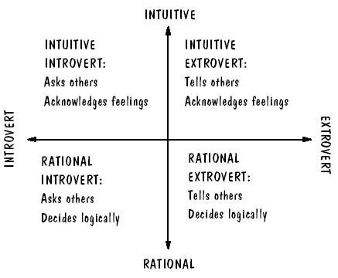
Work Styles 工作方式
Horizontal axis: communication styles
Vertical axis: decision styles

Slide 31
Working with Work styles
  Communication is critical to project success, and work style determine the communication style.
  Understanding work style can help you to be flexible in your approach to others
    Work styles gives you information about the priorities of others
      To introverts, give detailed presentation
      To extroverts, include questions allow him to tell you what he wants and needs
      To intuitive, take advantage of his creativity by soliciting new ideas from him
      To rational, give facts or figures, rather than judgments or feelings
    Work style affect interaction among customers, users and developers
    Work style can also involve choice of workers for a given task

Slide 32
3.2.3 Project Organization 项目组织
  The choice of an appropriate structure depends on several things :选择项目组织结构需要考虑的因素
    The background and work styles of team members
    The number of people on the team
    The management styles of the customer and developers
  Examples:
    Chief programmer team: one person totally responsible for a system's design and development
    Egoless approach: hold everyone equally responsible

Slide 33
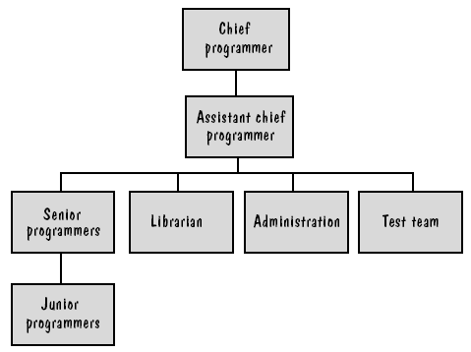
Chief Programmer Team 核心程序员队伍
  An popular organizational structure
    The chief programmer supervises all others, designs all problems, and assign the code development to the other team members.
    Each team member must communicate often with chief, but not necessarily with other team members

Slide 34
Egoless Approach 平等、民主的程序员队伍
Egoless approach
  Every one in the team is equally responsible
  This structure is democratic, all tem members vote on a decision, whether they concern design or testing tasks.
The 2 described before represent extremes 核心组织和平等组织是两个极端情况
  There are many other ways

Slide 35
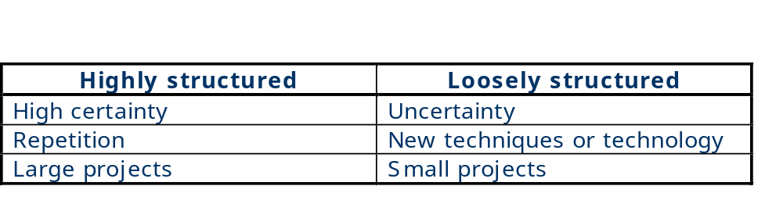
如何选择合适的组织方式
    Characteristics of projects and the suggested organization structure
    Different organizational structure can be combined where appropriate

Slide 36
3.3 Effort Estimation工作量估算
A Crucial Aspect of Project
  成本估算是项目计划和管理的一个关键方面：
  帮助管理者建立合同；
  帮助管理者选择人员和团队组织形式。
  过高的成本估算：客户可能会放弃项目。
  过低的成本估算：软件开发机构会亏损，使项目失败。
  Cost, schedule and effort estimation must be done as early as possible
    Sometime the estimation should be done repeatedly throughout the life cycle to refine the estimation based on more completion information.

Slide 37
The Project budget 项目预算
Type of costs
  显式成本：Facilities, staff, methods and tools
    Facilities include hardware, space, furniture, air-conditioning, and all other items that provide the physical environment
    This cost are well-understood and easy to estimate
  隐式成本：Purchasing software and tools 软件和工具
  The biggest component of cost is effort 工作量（人-天）
    We must determine how many of staff-days of effort will be required to complete the project
    This is the greatest degree of uncertainty
    When workers must communicate and consult with one another, the effort is increased by the time required for meetings, documentation and training.

Slide 38
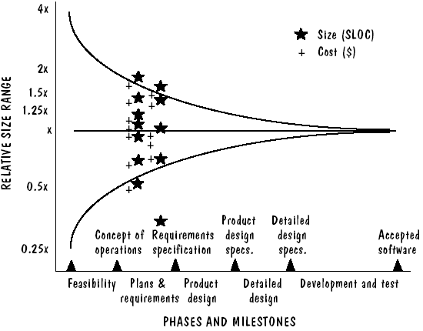
Uncertainty’s affect on size and cost estimation
  The earlier the estimates, the bigger the difference the estimate can differ from the eventual actual cost

Slide 39
3.3.1 Expert Judgment 专家判断法
  1. 专家判断方法
  基于类似项目经验的非形式化的成本估算方法。精确性依赖于估算者的能力、经验、客观性、预测能力等。
  2. 常用方法
  Analogies 类比法
    Asking several experts to make three predictions
    A pessimistic one (x), An optimistic one (y), A most likely guess (z), the estimate is determined by (x+4y+z)/6
  Delphi technique
    based on the average of “secret” expert judgments
  3. Expert Judgment 的缺点
  Inaccuracies; It relies on expert’s ability.

Slide 40
3.3.2 Algorithmic Methods算法估算
Models have been created to express the relationship between effort and the factors that influence it. 工作量及其影响因素之间的关系模型
The expression is described as equations
  E = (a + bS^{c}) m (X)
  Where S : the estimated size of the system
  X : a vector of cost factors, x_{i} through x_{n}
  m : an adjustment multiplier based on these factors
  a, b, c are constants
  Factors may cover as experience, size, application type, …

Slide 41
Some Algorithmic Methods
  1. Walston and Felix (1977)
    Finding from IBM data from 60 projects and form
      E = 5.25 S ^{0.91}
    The basic equation is supplemented with a productivity index
    29 factors can affect the productivity (see Table 3.7)
    Each of the factors is
      weighted by 1, if it increase the productivity
      0, if it has no effect
      -1, if it decrease the productivity
    A weighted sum of the 29 factors was used to generate an Effort Estimation from the equation

Slide 42
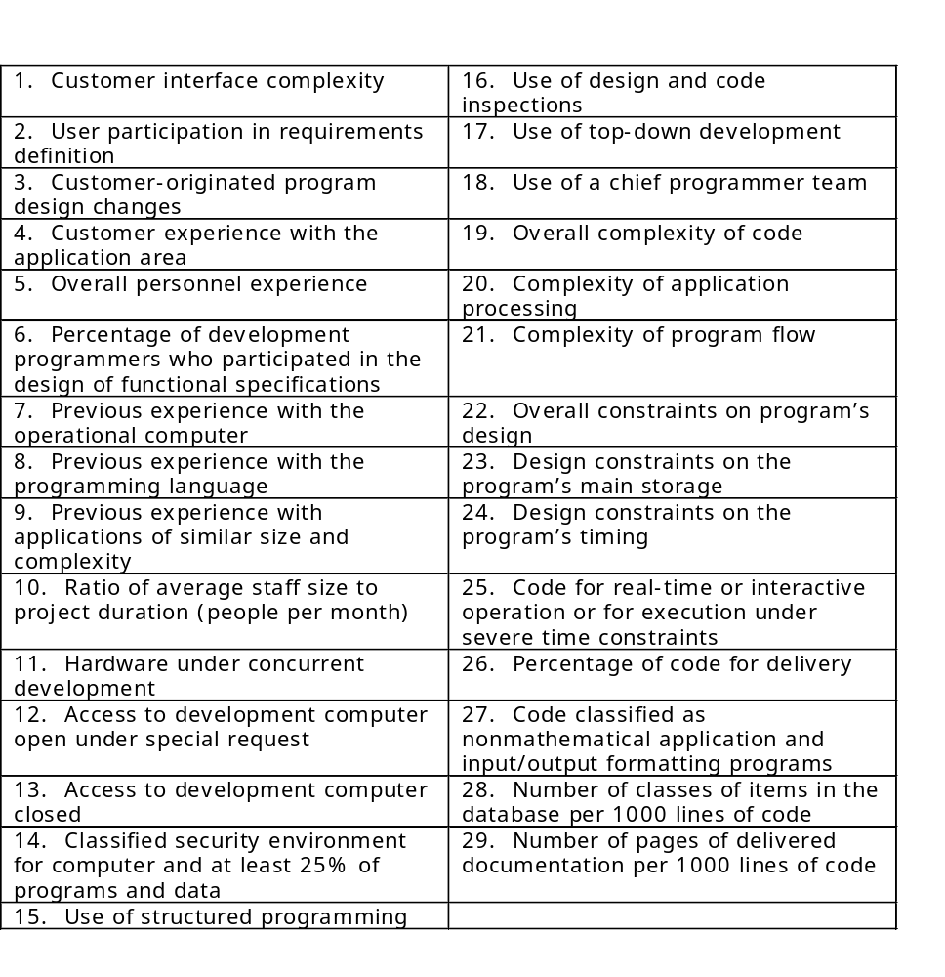
Some Algorithmic Methods
  1. Walston and Felix (1977)

Slide 43
Some Algorithmic Methods
  2. Bailey and Basili (1981) meta-model
    The model reflects your own organization’s characteristics.
    It used a database of 18 projects.
    First, They minimized the standard error estimate and produced an equation
      E = 5.5 + 0.73 S ^{1.16}
    Then, adjust this initial estimate based on the ratio of error
      R = actual effort E / predicated effort E’
      R_{adj} = (p. 110)
    Then, the initial effort is adjusted as E_{adj}
    Finally, other factors that affect effort (see Table 3.8)

Slide 44
Problems with the Previous Algorithmic Methods 主要问题
  Dependent on size as a key variable.
  Estimates are required early, well before accurate size information is available.
  So the models simply translate the effort estimation to a size estimation problem.

Slide 45
3. Boehm’s estimation model:
  COCOMO II model (1990s)
  Reflect three major stages of any development将开发过程划分为3个主要阶段
    Acknowledges that lines of code are impossible to know in the early stage
  At stage 1, plan and prototype stage计划和原型阶段
    It estimate size in application points 通过应用点估算规模
    This captures size in high level effort generators
      Such as number of screens and reports,…
  At stage 2, the early design stage早期设计阶段
    It Employs function points as a size measure 需求中的功能点
    Estimate functionality captured in the requirements
    This offer a richer system description than application points

Slide 46
  COCOMO II model
  At stage 3, the post-architecture stage后体系结构阶段
    Sizing can be done in terms of function points and lines of code, and other factors 功能点/代码行
  This model also includes models of reuse
    Taking into account maintenance and changes in requirements over time
The calculation of the COCOMO II model
  Basic equation : E = b S^{c} m(X)
  m(X) is the cost driver information in Table 3.9

Slide 47
  COCOMO II model
    At stage 1
      Application points supply the size measure 应用点
      Next you classify each application element as simple, medium or difficult as shown in Table 3.10 根据难度分类
      The number to be used for simple, medium and difficult application points is a complexity weight fount in Table 3.11获得复杂度权重
      Then, you sum the weighted reports and screens to obtain a single application point number. 单个应用点的规模
        If r percent of the object will be reused from previous then
        new application point = (application points) * (100-r)/100

Slide 48
  COCOMO II model
    At stage 2
      Based on a function-point calculation, the effort estimate is adjusted for degree of reuse, requirement change, and maintenance. 调整第1阶段的估算
    At stage 2 and 3
      Cost drivers are adjustment factors expressed as effort multipliers based on rating your project experience from “extra low” to “extra high” (see Table 3.12)
        Extra low : less than 3 months of experience
        Very low :
        ……
    Similarly, cost drivers of analyst capability and tool use categories are also used. (see Table 3.13)
    Tools are available

Slide 49
3.4 Risk Management
  Unwelcome events may occur during software development and maintenance.
    Plans should be made to avoid these events.
    If they are inevitable, minimize their negative consequence.
  Risk is an unwanted event that has negative consequences.风险
  Risk management is the way to understand and control the risks on their project. 风险管理
  Boehm’s Top 10 Risk Items

Slide 50
3.4.1 Properties of Risk Event
1. Risk impact: a loss associated with the event 风险影响
    Something negative happens to the project
    Example: a loss of time, quality, money, control, understanding and so on.
    Example:if requirements change dramatically after the design is done, then the project can suffer loss of control and understanding, i.e. time and money.
2. Risk probability: The likelihood that the event will occur 风险概率
    It is estimated and measured from 0 to 1.
    When the probability is 1, then the risk is called a problem, which means that it is certain to happen.

Slide 51
3. Risk control: a set of actions taken to reduce or eliminate a risk.风险控制
  It describes the degree to which we can change the outcome.
  We should determine what we can do to minimize or avoid the impact of the event.
4. Risk exposure 风险成本
  We can quantify the effects of a risk.
    Risk exposure = risk impact × risk probability
  Both Risk impact and Risk probability can change over time.
  So, part of a manager’s job is to track these changes over time and make plans for the risks.

Slide 52
3.4.2 Risk Management Activities
Checklist
Decomposition
Risk identification
Assumption analysis
Decision driver analysis
System dynamics
Risk assessment
Risk analysis
Performance models
Cost models
Network analysis
Risk prioritization
Decision analysis
Quality risk factor analysis
Risk management
Risk exposure
Compound risk reduction
Buying information
Risk reduction
Risk avoidance
Risk transfer
Risk reduction leverage
Risk control
Risk management planning
Development process
Risk element planning
Risk resolution
Risk plan integration
Risk mitigation
Risk monitoring and reporting
Risk reassessment

Slide 53
  Risk Assessment. 风险评估
    (1) Identifying the risks 风险识别
      Make a checklist of problems that may occur
      By decomposing the process into small pieces and anticipate problems that may arise. Or,
      By analyzing assumptions or decisions you are making about how the project will be done, who will do it, and with what resources. In each aspect there may involve some risks.
    (2) Analyzing the risks 风险分析
      Make sure you can understand as much as possible about when, why and where they might occur.
      Many techniques can be used to enhance your understanding : system dynamics models, cost models, performance models,…

Slide 54
Risk Assessment 风险评估
    (3) Assigning priorities to each of the risks 划分优先级
      Priorities are based on the risk exposure
        Includes both the risk impact and the probability of risk occurrence
      Priority scheme : see Fig 3.16, p.122
        For each possible outcome, 2 quantities are estimated
        P(UO) : Probability of an unwanted outcome
        L(UO) : Loss associated with the unwanted outcome
      Risk exposure calculation : to determine the risk Priority
      see Fig 3.16, p.122
        Regression testing : the assurance that existing functionality still works correctly.

Slide 55
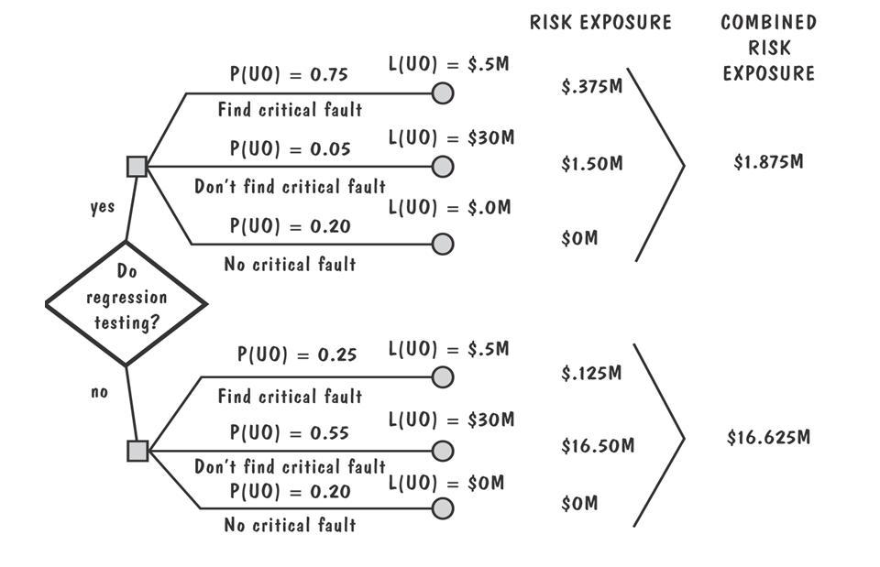
Example of risk exposure calculation
  PU: prob. of unwanted outcome
  LU: lost assoc with unwanted outcome

Slide 56
  Risk control 风险控制
    Risk control involves risk reduction, risk planning and risk resolution 风险控制活动包括风险降低、风险计划、风险解决方案
    Three strategies for risk reduction
      Avoiding the risk: change requirements for performance or functionality 避免风险
      Transferring the risk: transfer to other system, or buy insurance 转移风险
      Assuming the risk: accept and control it 承担风险
    Cost of reducing risk
      Risk leverage = (risk exposure before reduction – (risk exposure after reduction) / (cost of risk reduction)
    Risk management plan : record of your decisions

Slide 57
3.5 The Project Plan
  3.5.1 Purposes 项目计划的目的/作用
    To communicate to customers about the risk analysis and management, project cost estimates, schedule and organization
    Customers can refer to the plan for information about the activities in the development process, making it easy to follow the project’s progress
    Developers can use the plan to confirm with the customer any assumptions about the project, especially about the cost and schedule

Slide 58
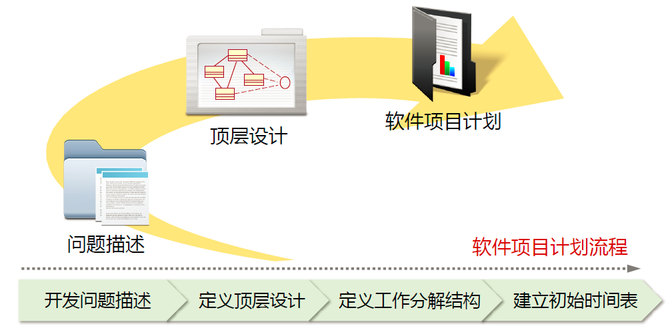
3.5.2 Contents 项目计划的内容

Slide 59

开发问题描述

Slide 60
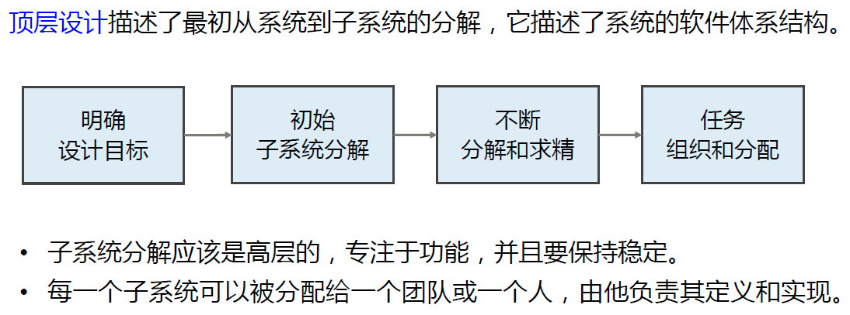
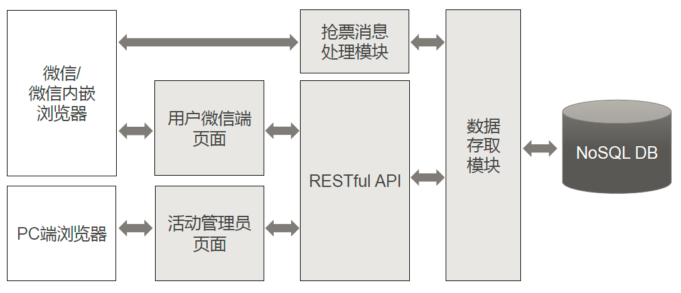
定义顶层设计

Slide 61
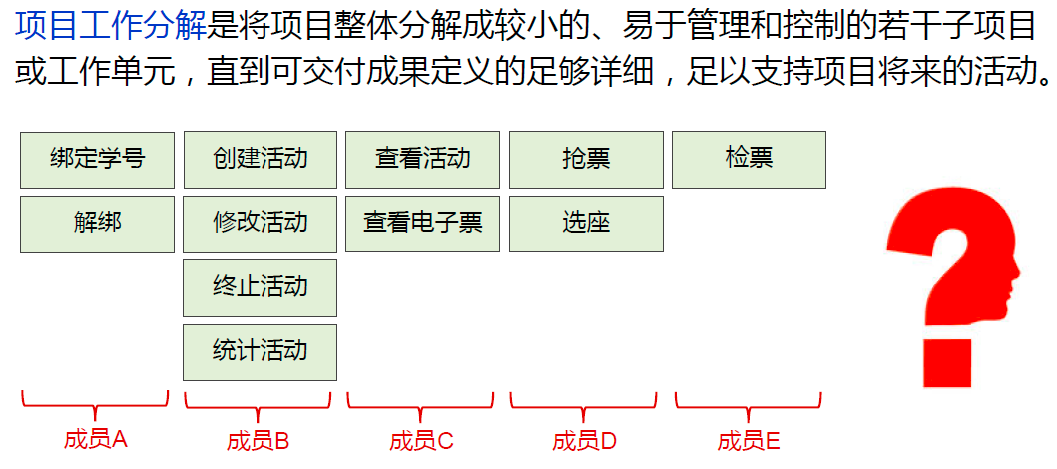
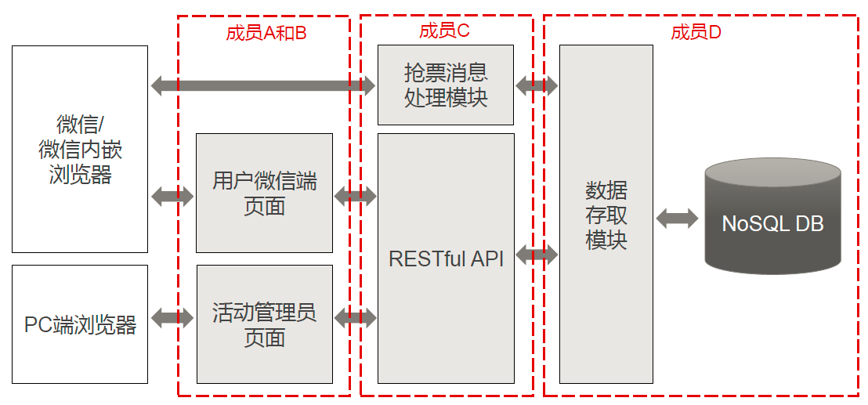
定义项目工作分解

Slide 62
项目计划的内容
Project scope 项目范围
Project schedule 项目进程
Project team organization
Technical description of system
Project standards and procedures
Quality assurance plan
Configuration management plan
Documentation plan
Data management plan
Resource management plan
Test plan
Training plan
Security plan
Risk management plan
Maintenance plan

Slide 63
3.6 , 3.7, 3.8 Are Omitted

Slide 64
本章小结
进度管理部分
项目进程 Project schedule
活动和里程碑 Milestones and activities
工作分解结构 Work breakdown structure (WBS)
活动及其属性 Activity (precursor,duration,due date, endpoint)
活动图 Activity graph
空闲时间 Slack time = available time - real time = latest start time - earliest start time

Slide 65
本章小结
关键路径 Critical path
关键路径方法 Critical path method (CPM)
2. 人员管理部分
关键活动 Key activities requiring personnel
人员特征 Choosing personnel
工作方式 Work styles
选择合适的组织 Choosing project organization

Slide 66
本章小结
3. 成本估算部分
专家判断方法的特征、问题
算法模型 E = (a + bSc) m(X)
COCOMO II 模型
4. 风险管理部分
风险影响 Risk impact
风险概率 Risk probability
风险控制 Risk control
风险成本 Risk exposure = (risk probability) x (risk impact)

Slide 67
本章小结
风险管理活动 Risk management activities (Figure 3.15)
风险降低的3种策略
5. 项目计划
（简单了解）

Slide 68
Review Exam
If a system is being developed where the customers are not sure of what they want, the requirements are often poorly defined. Which of the following would be an appropriate process model for this type of development?
a. prototyping
b. waterfall
c. V-model
d. spiral

Slide 69
Review Exam
The project team developing a new system is experienced in the domain. Although the new project is fairly large, it is not expected to vary much from applications that have been developed by this team in the past. Which process model would be appropriate for this type of development?
  a. prototyping
  b. waterfall
  c. V-model
  d. spiral

Slide 70
下列选项不属于瀑布模型的优点的是（ ）。
A．可迫使开发人员采用规范的方法
B．严格的规定了每个阶段必须提交的文档
C．要求每个阶段交出的所有产品都必须经过质量保证小组的仔细验证
D．支持后期的变动

Slide 71
极限编程（XP）是一种轻量（敏捷）、高效、低风险、柔性、可预测、科学而且充满乐趣的软件开发方式，以下不属于它所倡导的十二个最佳实践的是___ (1)_____。其中____(2)_____是通过预防性、及时性的措施来提高系统的质量的重要实践活动，现在已涌现出了JUnit、NUnit、DUnit等一系列相应的工具来提供支持。
供选择的答案：
① A.受控的需求文档 B.计划游戏 C.现场客户 D.隐喻
② A.集体代码所有制 B.持续集成 C.测试先行 D.重构

Slide 72
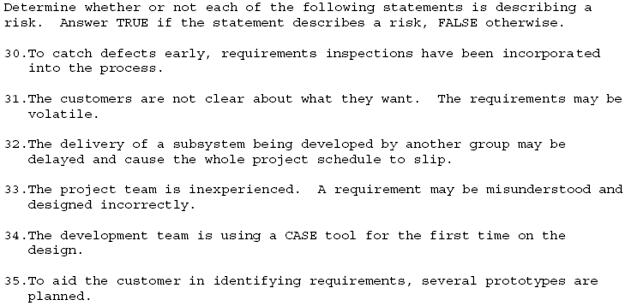

Slide 73
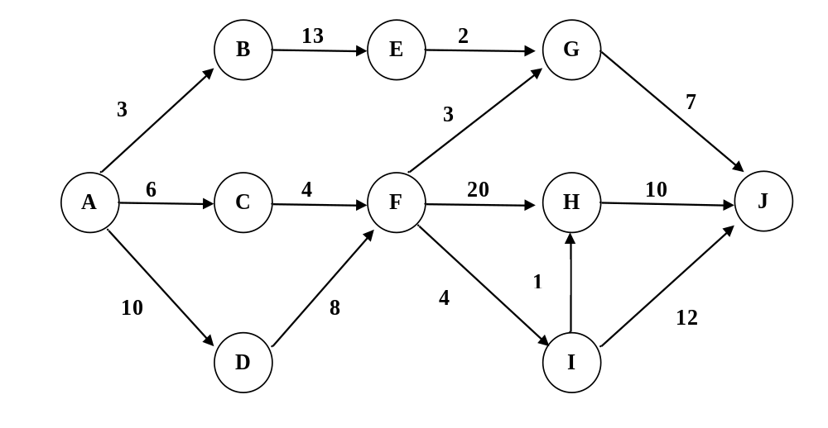
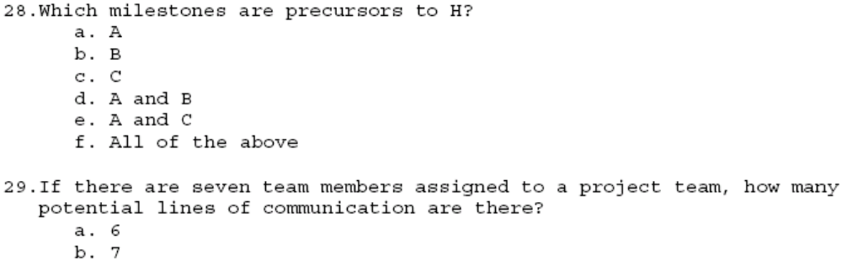

Slide 74
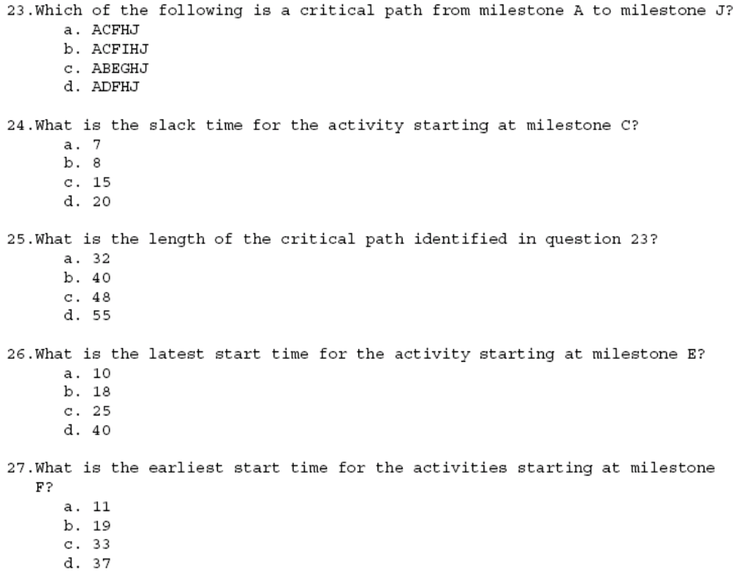

Slide 75
本章课堂作业
标出每个活动的最早开始时间、最晚开始时间，并指出关键路径。

