Slide 1
CHAPTER 4
Capturing the Requirements
  Eliciting requirements from customers
  Modeling requirements
  Reviewing requirements to ensure their quality
  Documenting requirements for use by the design and test teams

Slide 2
Why are requirements important?
--See Sidebar 4.1 on Page 142.
人们并不清楚应该做什么，却一直忙碌不停地开发。

Slide 3
4.1 The Requirements Process
  4.1.1. Requirement 需求的定义
  需求来源于用户的一些“需要”，这些“需要”被分析、确认后形成完整的文档，该文档详细地说明了产品“必须或应当”做什么。
  所以如果只有一些零碎的对话、资料或邮件，你就以为自己已经掌握了需求，那是自欺欺人。
  A proposed software system has a purpose, usually expressed in terms of goals or desired behavior.
  A Requirement:
    Is an expression of desired behavior.
  Requirements:
    Are specific descriptions of functions or characteristics that address the general purpose of the system.

Slide 4
Note: 关注客户及其问题，而不是如何实现。
  Requirements focus on the customer and the problem, not on the solution or the implementation.
4.1.2. The requirements process
  Step 1: Elicition 需求引导
  Step 2: Analysis 分析和建模
  Step 3: Specification 形成文档
  Step 4: Validation 验证和确认

Slide 5
Elicition
Analysis
Specification
validation
Software
Requirments
Specification
Collecting the user’s requirements
Understanding and modeling the desired behavior
Documenting the behavior of the proposed software system
Checking that our specification matches the user’s requirements
Fig 4.1 The process of the determining requirement

Slide 6
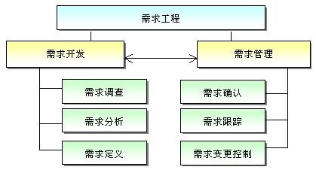
需求工程
  把所有与需求直接相关的活动通称为需求工程。
  需求工程中的活动可分为两大类，一类属于需求开发，另一类属于需求管理。
  需求工程的结构图

Slide 7
4.2 Requirements Elicitation
1. Requirements elicitation is critical/difficult.
  Requirements are ill-formed and ill-understood by everyone.
  Customers know their business ,but cannot always describe their problems to outsiders.
  Developers know about computer solutions, nut not always about how possible solutions will affect the customers’ business activities.
  People have different meanings for the same words.

Slide 8
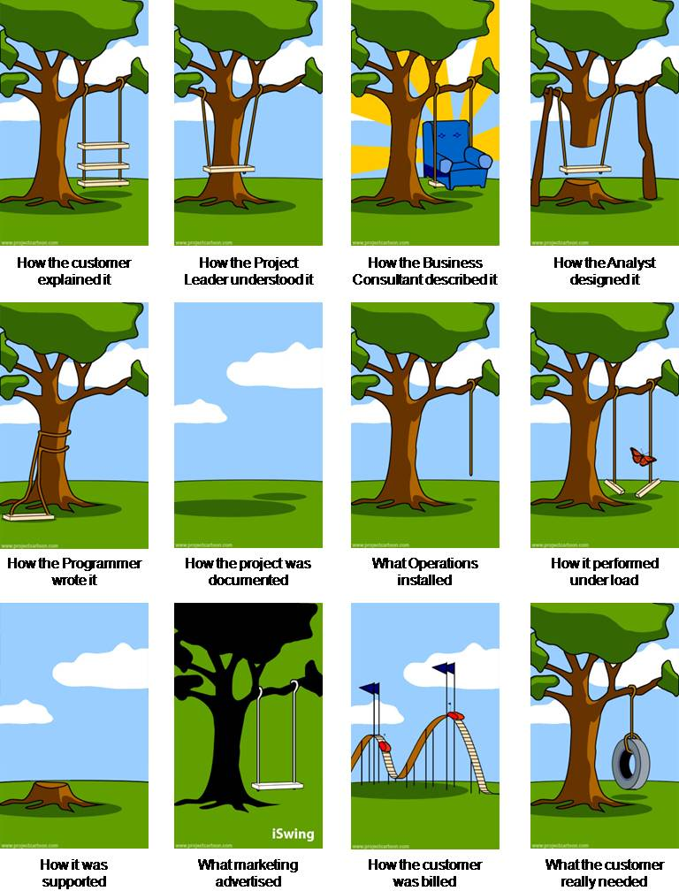
Impedance mismatches

Slide 9
2. Stakeholders: 利益相关者
  Clients who are the ones paying for the software development; 客户
  Customers who buy the software; 顾客
  Users who will use the software; 用户
  Domain experts who are familiar with the software to be developed; 领域专家
  Market researchers; 市场调查人员
  Lawyers or auditors; 律师/审计员
  Software engineers or other technology experts. 技术专家

Slide 10
冲突：
Each stakeholders has a particular view
Different participants may expect different level of detail in the requirements documentation;
Users and developers may have preconceptions about what the other group values and acts;
One of the many skills of a requirements analyst
  Is the ability to understand each view
  to capture the requirements in a way that reflects the concerns of each participants
Good requirements analysis require excellent interpersonal skills and as well as solid technical skills.

Slide 11
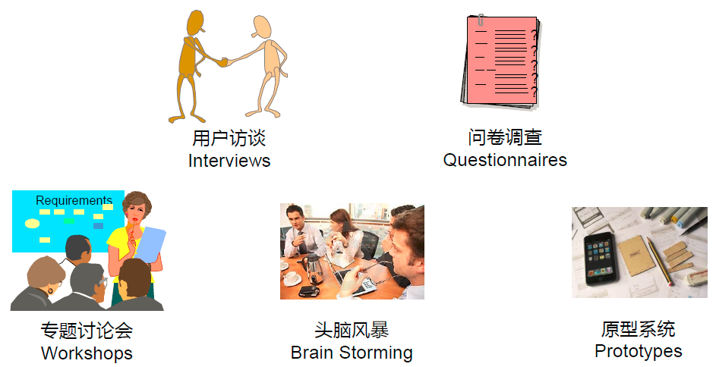
3. means of eliciting requirements 途径
Interviewing users or stakeholders in groups;
Reviewing available documentation;
Observing the current system to get information and better understand;
Apprenticing with users to learn about the task;
Using domain specific strategies;
Brainstorming with current and potential users about how to improve the proposed product.

Slide 12
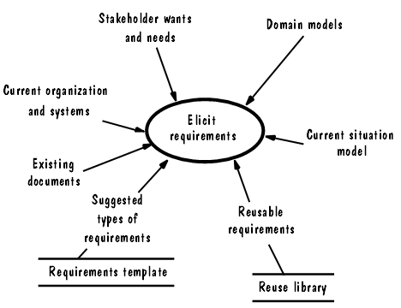
Fig 4.2 Sources of possible requirements (Robertson and Robertson 1999)

Slide 13
4. The goal of the Requirements process 目的
    Requirements are elicited at the beginning of development, and the goal is to determine the nature of the customer’s problem
      Problem and understanding is mostly easily stated in terms of the customer’s business
    Requirements should be focused on the customer and the problem, not on the solution or implementation
      A discussion of any solution is premature until the problem is clearly defined

Slide 14
4.3 Types of Requirements
  1. Functional requirement and Nonfunctional requirement
    See Table 4.2.
  (1) Functional requirement 功能需求 - 系统应该提供的服务、如何对输入做出反应以及系统在特定条件下的行为描述
  (2) Quality/Nonfunctional Requirement 质量/非功能性需求 - 软件系统必须拥有的质量特性，诸如响应时间、易使用性、高可靠性或低维护代价等
  (3) Design Constraint 设计约束 - 已经做出的设计决策或限制问题解决方案集的设计决策，例如平台或构件接口的选择
  (4) Process Constraint 过程约束 - 对用于构件系统的技术和资源的限制，例如客户要求使用敏捷开发方法。

Slide 15
2. Making Requirements Testable
---See Sidebar 4.4
量化
避免代词
每个名次仅在一处定义

Slide 16
3. Resolving Conflicts
  Separate the requirements into 3 categories
    Requirements that absolutely must be met (Essential);
    Requirements that are highly desirable but not necessary (Desirable);
    Requirements that are possible but could be eliminated (Optional).
    The purposes doing so:
      If the system as defined will cost too much, or take too long to develop
      Category 3 requirements can be dropped
      Category 2 requirements can be analyzed for elimination or postponement
      Prioritization can be helpful in resolving conflicts among quality requirements.

Slide 17
4. Requirements can serve several purposes
  客户和分析人员：
  设计人员：
  测试人员：
  维护人员：
  To ensure both we and the customers understand and use the requirements properly, it is important that the requirements be of high quality.
    To this end, we check the requirements to make sure they have the desired characteristics.

Slide 18
5. 2 Kinds of Requirements Documents
    Requirements definition
      written in terms that the customer can understand
      It is complete listing of everything the customer expects the system to do
      It represent the common understanding of the developer and the customer
      It is usually written jointly by the developer and the customer

Slide 19
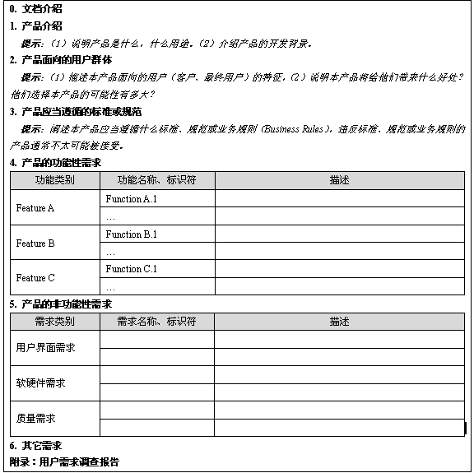
用户需求说明书的参考模板

Slide 20
    Requirements specification
      restates the requirements definition in technical terms
      It is complete listing of everything the customer expects the system to do
      It is appropriate for the development of s system design
      It is the technical counterpart to the requirements definition
      It is written by the requirements analysts

Slide 21
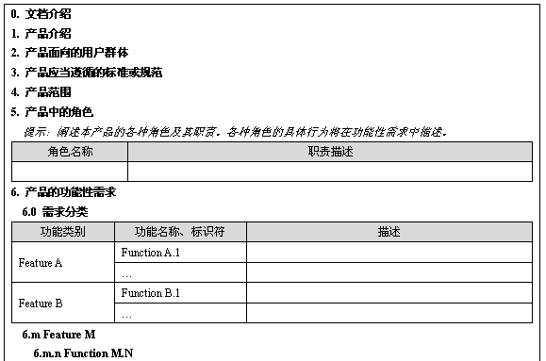
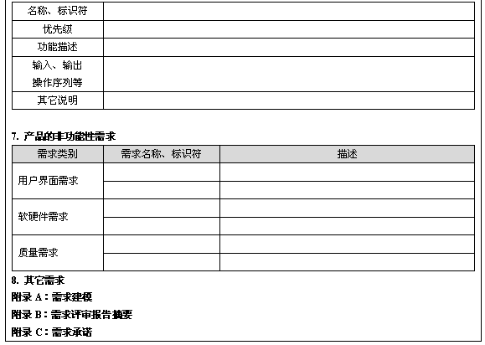
软件需求说明书的参考模板

Slide 22
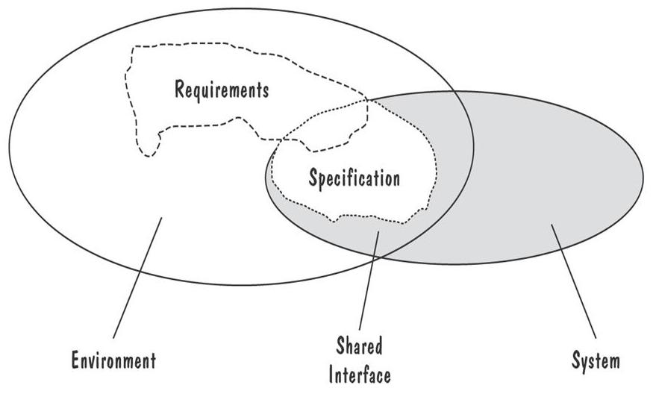
Requirements defined anywhwere within the environment's domain, including the system's interface
Specification restricted only to the intersection between environment and system domain

Slide 23
4.4 Characteristics of Requirements
  Are the requirements correct ? 正确性
    Both we and the customer should review them to assure that they stated without error.
  Are the requirements Consistent ? 一致性
    To make sure there no conflicting or ambiguous requirements.
    2 requirements are inconsistent if it is impossible to satisfy them simultaneously.
  Are the requirements unambiguous ? 确定性
    If multiple readers of the requirements can walk away with different but valid interpretations.

Slide 24
  Are the requirements Complete ? 完整性
    To make sure that every possible states, state changes, inputs, products, constraints and other needed things are described by some requirements.
  Are the requirements feasible ? 可行性
    To make sure there is no requirement which can not be done realistically.
  Is each requirement relevant ? 相关性
    A requirement may restricts the developers unnecessarily or includes functions that are not directly related to the problem at hand.
    We should review the requirements to retain only those that work directly to solve the problem.

Slide 25
  Are the requirements testable ? 可测试性
    We must be able to write tests that demonstrate that the requirements have been met.
  Are the requirements traceable ? 可跟踪性
    Can each function be traced back to a set of requirements that mandate it ?

Slide 26
Examples
  “The system shall provide real-time response to queries.”
    Question : What “real-time response” is ?
    It is better written as :
  “The system shall response to queries in not more than 2 seconds.”
  “Accuracy shall be sufficient to support mission planning.”
    How can we test to see if it satisfies this requirement ?
  “In identifying the position of the satellite, position error shall be less than 50 feet along orbit, less than 30 feet off orbit.”

Slide 27
4.5 Modeling Notations
  It is important to have standard notations for modeling, documenting, and communicating decisions.
    Define requirements in a more rigorous and controlled fashion.
  Modeling can help us to understand the requirements thoroughly
    Holes in the models reveal unknown or ambiguous behavior
    Multiple, conflicting outputs to the same input reveal inconsistencies in the requirements
    Tools can be developed to check for completeness and consistency, and the trace-ability

Slide 28
1. Entity-Relationship Diagrams
  （1）作用
  通过标识对象/实体的名称、属性、联系，建立问题的概念模型
  （2）建模符号
    实体/Entity – a rectangle, represent a collection of objects
    联系/Relationship – edge between 2 entities, with a diamond in the middle of the edge specifying the type of relationship.

Slide 29
    属性/Attribute – is an annotation on an entity that describes data or properties associated with the entity.
    可变实体/Mutable entity – whose membership or relations to members of other entities may change over time.（表达联系的实体）
  主要用于数据库设计的概念模型
  Fig. 4.4, p.158.

Slide 30
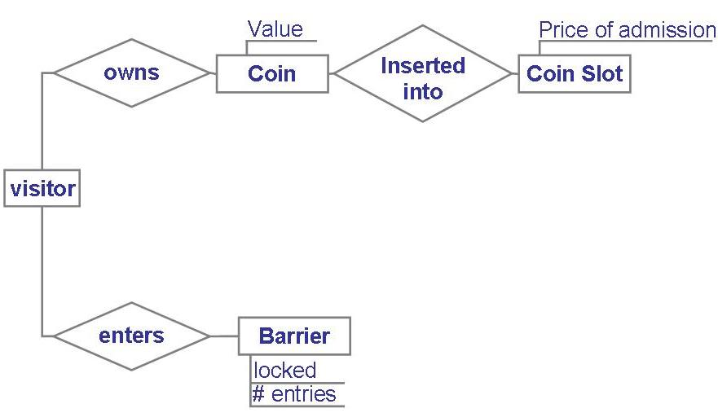
Entity diagram of turnstile problem

Slide 31
Entity-Relationship Diagrams: UML Class Diagram
  Class diagram – a sophisticated ER diagram
  Class
    Real-world entities 现实世界的实体/对象
    attributes and operations 属性和行为
    Scope of class members – public or private / class scope 成员的可见范围
  Association 联系的类型
    indicate relationship between class instances.
    Aggregation association, or HAS-A relationships, represented as white diamond on one end.
    Composition association, instance of the compound class are physically constructed from instances of the compound classes, represented as black diamond on one end.

Slide 32
  Generalization vs Specialization – represented with white triangles, called sub-type or IS-A relation.
  Association can have labels that describe the relationships
  Role names
  Multiplicities
  Association class
  Fig. 4.5, p.160.

Slide 33
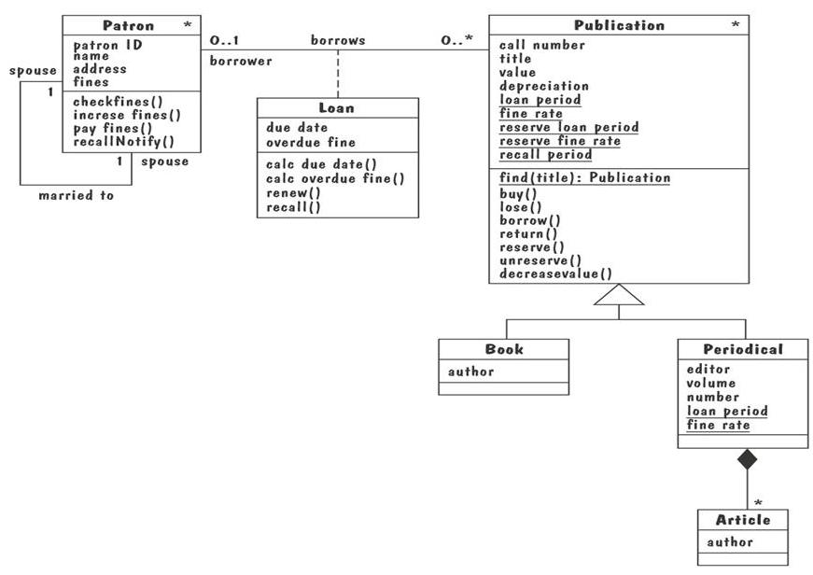

Slide 34
2. Event Traces
Is a graphical description of sequence of events that are exchanged between real-world entities.
建模元素：
  实体
  时间轴
  实体之间的事件/交互（通过消息）
每个图仅表示一种可能的事件跟踪行为
Fig. 4.6, p.162.

Slide 35
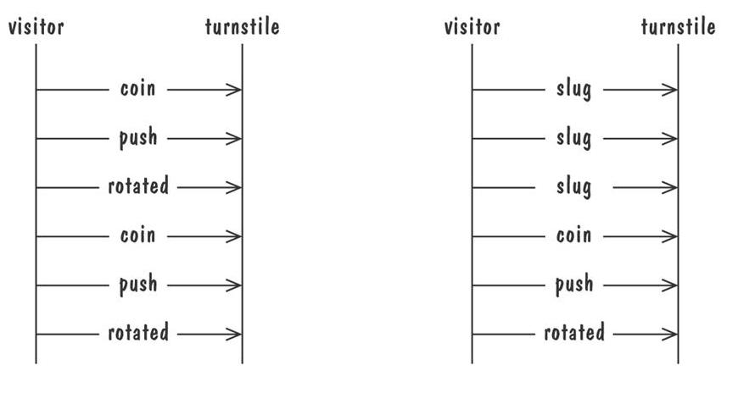
Graphical representation of two traces for the turnstile problem
  trace on the left represents typical behavior
  trace on the right shows exceptional behavior

Slide 36
Event Traces: Message Sequence Chart
Is an enhanced event-trace notation,With facilities for
  creating and destroying entities
  specifying actions and times
  composing events.
Entity
Message
Action
condition
Fig. 4.7, p.163.

Slide 37
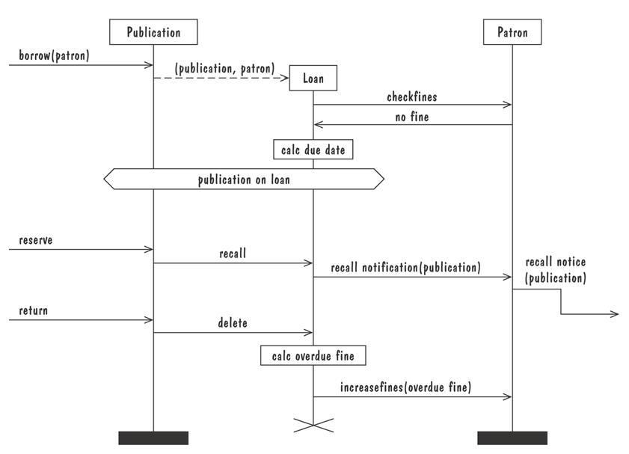
Message sequence chart for library loan transaction

Slide 38
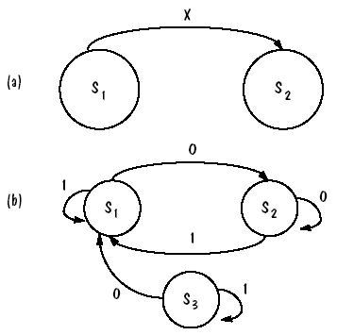
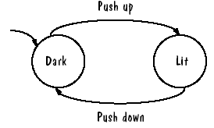
3. State Machine
在一个图中表示事件跟踪的集合/描述动态行为
建模元素
  State
  Transition
    triggering-event/output-event
Deterministic state machine
  for every state and event there is unique response.
Fig. 4.8, p.164.

Slide 39
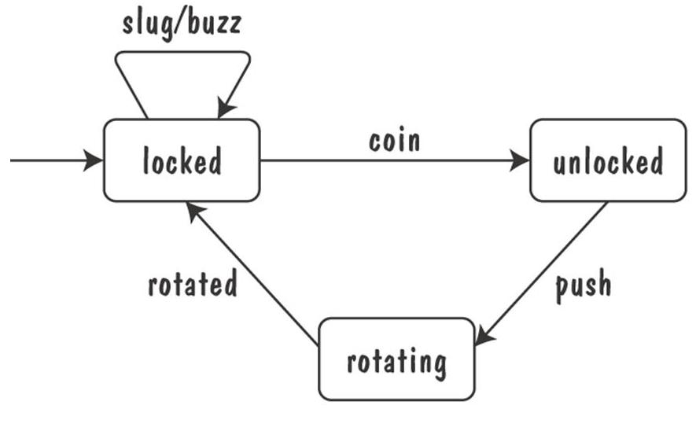
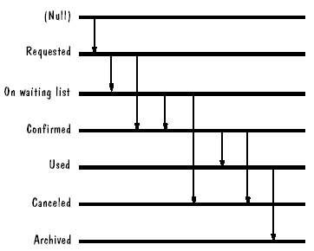
Finite state machine model of the tunstile problem

Slide 40
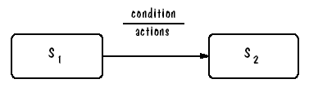
State Machine: UML State-Chart Diagram
描述类图中对象的动态行为。
建模元素
  Start, and Exit states
  Transition --- event/action/ condition
    Event(args) [condition] /action* ^object.event(args)*
    [] condition
    / action
    ^ output event
    * multiple

Slide 41
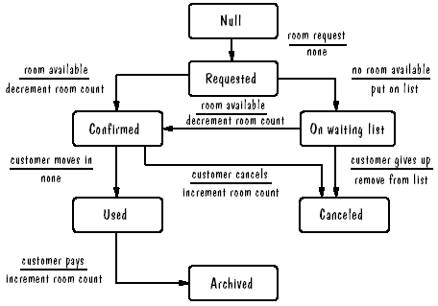

Slide 42
State
  State name
  Local variables
  Actions and activities
Figure 4.9: UML statechart diagram for the Publication class.
Figure 4.10: Messy UML statechart diagram for Publication class.
Figure 4.11: UML statechart diagram for Loan class.

Slide 43
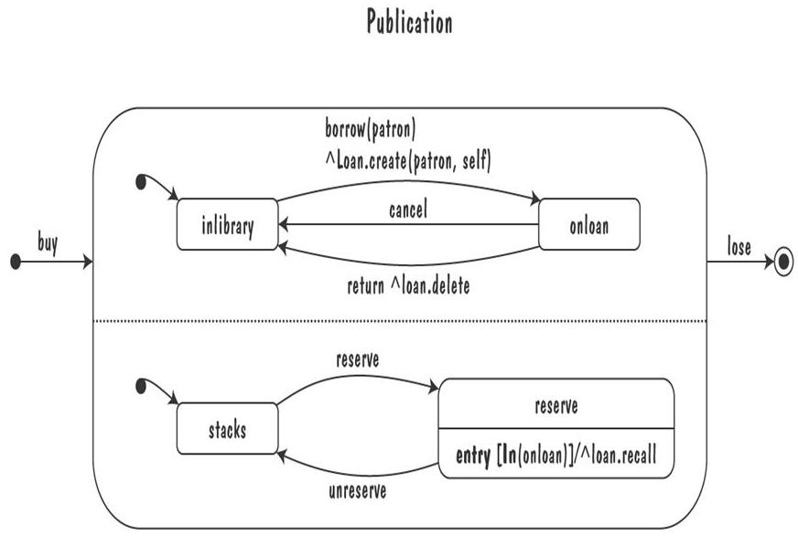
UML Statechart Diagrams (continued)
The UML statechart diagram for the Publication class from the Library class model

Slide 44
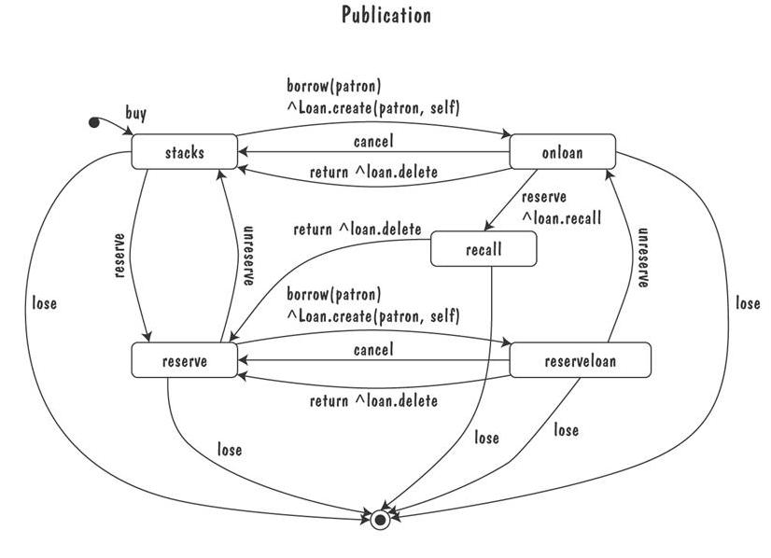
UML Statechart Diagrams (continued)
An equivalent statechart for Publication class that does not make use of state hierarchy or concurrency
  comparatively messy and and repetitive

Slide 45
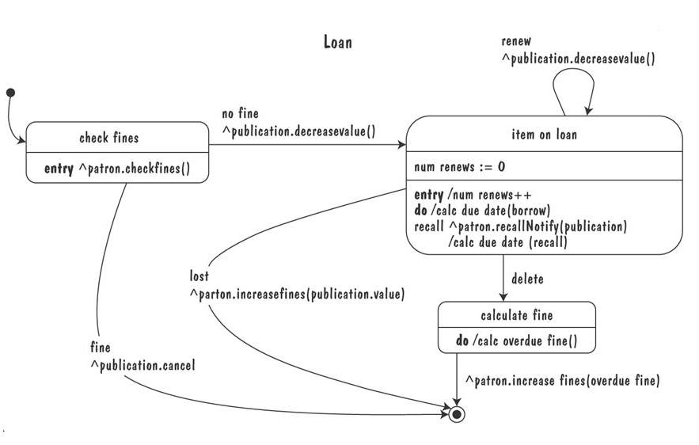
UML Statechart Diagrams (continued)
The UML statechart diagram for Loan association class illustrates how states can be annotated with local variables, actions and activities

Slide 46
State Machine: Petri Nets
用途
  Representing concurrency描述并发事件
    多个事件同时发生时，系统必须进行并发处理
    一个主要的问题是对事件进行同步
  状态转移模型
    several events trigger the move from one to another state :
    F(StateA, Event1,…,EventN) -> StateS
    In more general:
    F(StateA, Event1,…,EventN) -> State1,…,StateM

Slide 47
State Machines Example: Petri Nets
A form or state-transition notation that is used to model concurrent activities and their interaction
  Circles (places) represent activities or conditions 库所
  Bars represents transitions 转移
  Arcs connect a transition with its input places and its ouput places 转移
  The places are populated with tokens, which act as enabling conditions for the transitions 令牌
  Each arc can be assigned a weight that specifies how many tokens are removed from arc's input place, when the transition fires

Slide 48
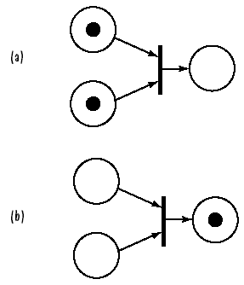
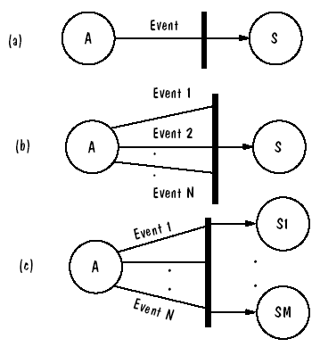
Three types of transitions
Tokens associated with firing rules

Slide 49
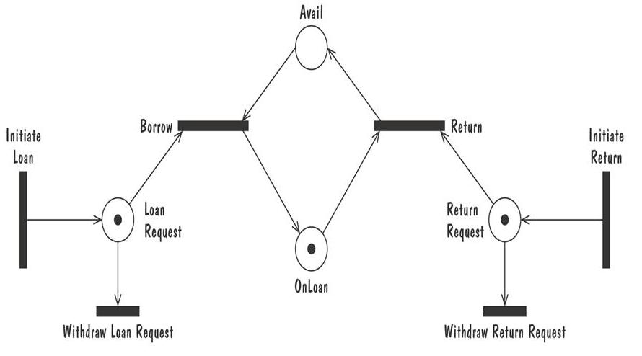
Petri Nets (continued)
Petri net of book loan

Slide 50
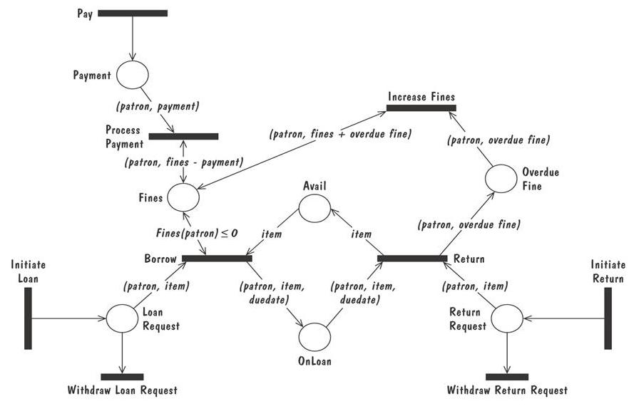
Petri Nets (continued)
A high level Petri net specification for the library problem

Slide 51
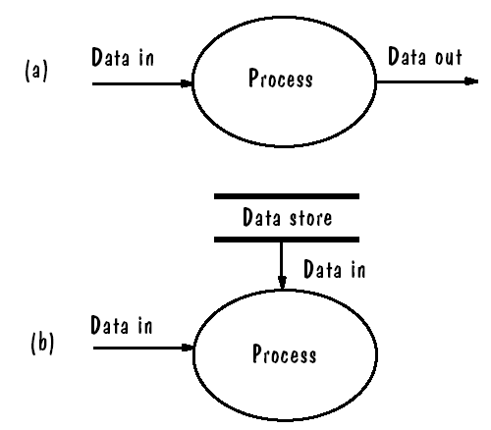
4. 功能模型：Data-Flow Diagrams
用途
  描述分层的功能模型（不同的抽象级别）
  功能和数据的流动（数据是怎样流入系统，经过怎样的加工、变换，怎样流出系统）
建模元素
  Process/Function 过程/功能/加工
  Data flow 数据流
  Data store 数据存储
  Actors 系统之外的实体
对Process进行分层，获得不同的抽象层次，注意数据流的平衡和子图的易理解性

Slide 52
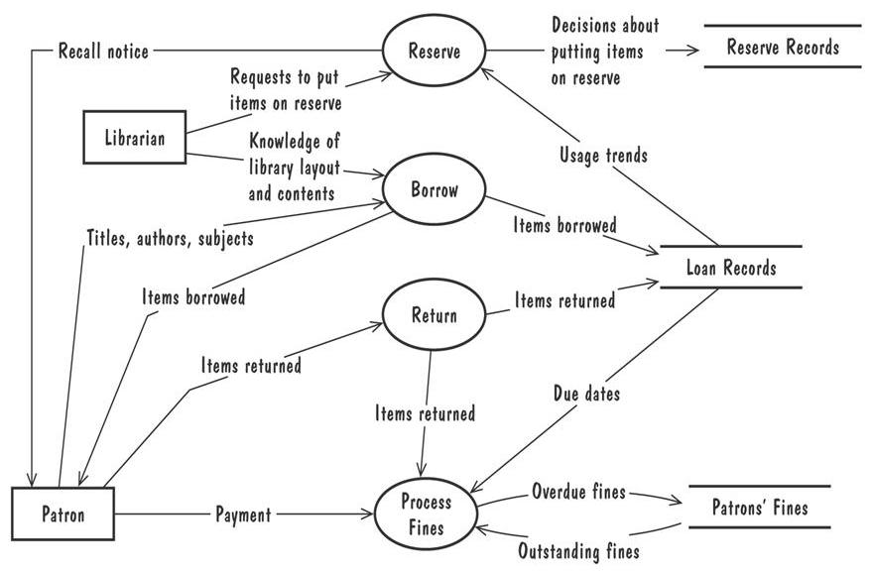
Data-Flow Diagrams (continued)
A high-level data-flow diagram for the library problem

Slide 53
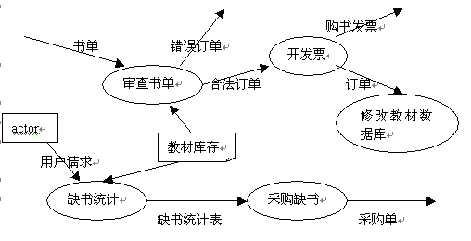
Requirement Definition:
用数据流描述微机教材销售系统。该系统有审查书单，开发票，修改教材数据库，缺书统计，采购缺书的功能。
Requirement Specification(DFD):

Slide 54
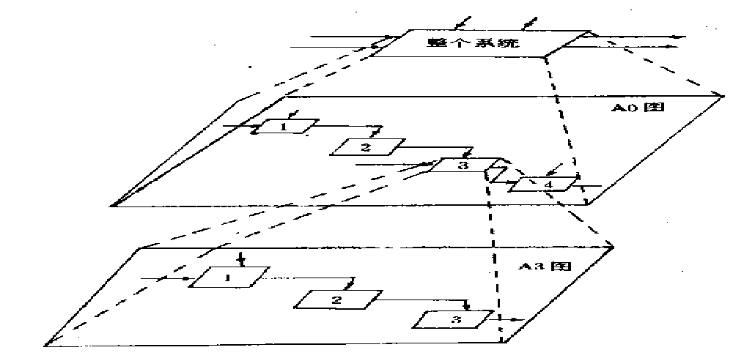
Requirements Hierarchy
  DFD depicts a high-level view of the system
  Each process bubble can be represented as a separate diagram to show the details of the data transformation
  In this way, the requirements hierarchy is formed.
图17.2 递阶层次分解图

Slide 55
Data-Flow Diagrams (continued)
Advantage:
  Provides an intuitive model of a proposed system's high-level functionality and of the data dependencies among various processes
Disadvantage:
  Can be aggravatingly ambiguous to a software developer who is less familiar with the problem being modeled

Slide 56
功能模型：Use case Diagrams
用途
  以用户/外部实体的角度描述系统功能模型（类似顶层的数据流图）
建模元素
  System boundry 系统边界
  Actor 活动者
  Use case 用例
  Relations 活动者与用例、用例之间的联系
示例
  Figure 4.15 Library use cases.

Slide 57
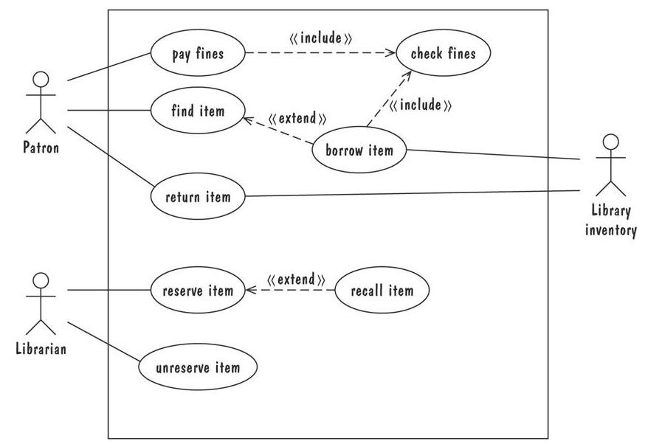
Use Cases (continued)
Library use cases including borrowing a book, returning a borrowed book, and paying a library fine

Slide 58
5. Functions and Relations
Function or Relation
  Formal methods model requirements or software behavior as a collection of mathematical functions or relations
  Example
    unlocked s=locked AND e=coin
    NextState(s,e) = rotating s=unlocked AND e=push
    locked s=rotating AND e=rotated
    Output(s,e) = buzz s=locked AND e=slug
    <none> Otherwise
  Functions are semantically equivalent to state machine.
    Functions can be further described with Pre-Condition and Post-Conditions.

Slide 59
Functions and Relations: Decision Tables 判定表
表达方式
  possible conditions satisfied by the system at a given time 所有可能的条件
  Rules for reacting to stimuli when certain conditions are met and actions to be taken as a result 触发规则
Composition of Decision Table:
Condition Stub
Condition Items
Action Stub
Action Items

Slide 60
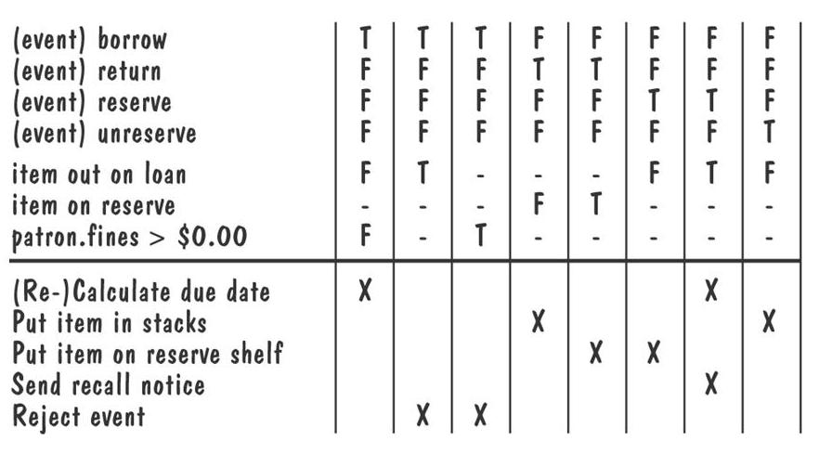
  Table 4.1, p .152
    Decision table for library functions borrow, return, reserve, and unreserve

Slide 61
Requirement Definition:
如果金额超过500元，又未过期，则发出批准单和提货单；如果金额超过500元，但过期了，则不发出批准单；如果金额低于500元，则不论是否过期都发出批准单和提货单，在过期的情况下还需发出通知单。
金 额
>500 >500 <=500 <=500
状 态
未过期 已过期 未过期 已过期
发出批准单
X
X
X
发出批准单
X
X
X
发出批准单
X

Slide 62
Functions and Relations: Decision Tables 判定表
This can generate very large tables
  The number of the states is equal to the number of combinations of conditions, which is 2^{n}
  There may exist redundant rules which are covered by other rules
  We can reduce the size and make them easier to understand
What can the table tell us about the requirements ?
  If every possible set of conditions results in an action, then the requirements specification is complete
  And we can examine the table for consistency and eliminate any conflicting cases.

Slide 63
6. Logic
前面的方法（除E-R图）：operational notation 基于操作，针对特定情况，系统如何反应 case-based behavior
Operational VS Descriptive requirements.
  Describe a problem or a solution In terms of
    Its operational or Situational behavior; VS
    of its properties or its invariant behavior.
A Logic consists of a language for expressing descriptive properties.
  First-order-logic, comprising typed variables, constants, functions, sets, predicates, operators.
  Example:
    num_coin >= num_entries //invariant
    (num_coin > num_entries) => (barrier = unlocked)
    (barrier = locked) ⬄ ┐may-enter

Slide 64
Temporal Logic 时间逻辑
  □f : f is true now and throughout the rest execution;
  ◊ f : f is true now or at some future point in the execution;
  ○ f : f is true in the next point of the execution;
  f W g : f is true until a point where g is true, but g may never be true.
  Example:
    □(insert_coin => ○(may_enter W push))
    □(Vn(insert_coin ^ num_coins=n) => ○(num_coins=n+1))

Slide 65
Logic: OCL(Object Constraint Language)
用途：
  描述对象模型的约束
  Not originally designed for UML, now is tightly coupled with UML, and is annotated as labels.
建模符号:
    Construct allinstances: return all instances of a class;
    Construct forall, and, implies;
    Symbol ->(→): applies the attribute or operation of its right operand to all of the objects in its left operand;
Example: Fig.4.18, p.180

Slide 66
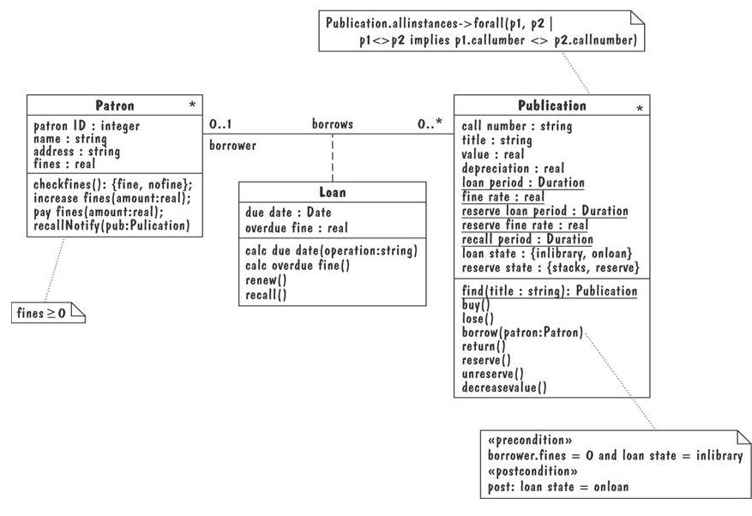
Library classes annotated with OCL properties

Slide 67
Logic: Z notation
特点 A Formal Specification Language
  It express requirements in mathematical way
    They can be evaluated using proofs and automated techniques
  It combines abstract data modeling with set theory and first-order predicate logic
    Used to specify system states and valid state changes
  Tools can be used to check reachable states, deadlocks, non-determinism, and generate a finite-state machine

Slide 68
  建模符号
    Mapping, partial mapping, domain substraction operator
    A Unprimed variable represent a state before an operation is performed, and A primed variable represent a state after the operation performed
    示例See example in p.182
  Formal specification is encouraged
    Especially for the developments of safety critical systems
    The mathematical proof technique can reveal significant problems in the requirements
    Where they are more easily fixed than after its implementation

Slide 69
4.6 Reqtuirements And Spec Languages
迷惑：Why the software-engineering community had developed so many types of software models?
原因：Each paradigm describes software models from a different perspective:
  Entities and relationships, events, traces, states, functions, properties, …
使用：Each paradigm has its own strength
  A complete specification may consist of several models, each illustrates a different aspect.

Slide 70
UML
Contains the following notations
  Use-case diagram (a high-level DFD)
  Class diagram (an E-R diagram)
  Sequence diagram (an event trace)
  Collaboration diagram (an event trace)
  State diagram (a state-machine model)
  OCL properties (logic)
Beyond requirements
  Package diagram
  Component diagram
  Deployment diagram
  Extension facilities

Slide 71
4.7 Prototyping Requirements
Customers or users may directly be involved in the analysis and designing processes
  To make sure the requirements are clear, complete and correct
  Customers know what is needed or wanted
    But they are not certain whether the requirements are realistic
    We should investigate options to find a feasible solution
    Prototyping is a way to help us

Slide 72
Prototyping作用/目的
To elicit the details of proposed system
To solicit feedback from potential users about
  what aspects they would like to see improve
  which features are not so useful
  what functionality is missing
Determine whether the customer's problem has a feasible solution
Assist in exploring options for otimizing quality requirements

Slide 73
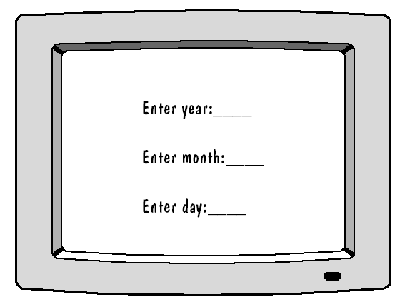
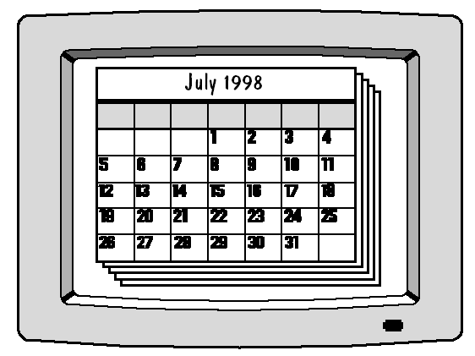
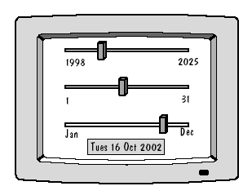
Figure 4.23 First interface prototype
Figure 4.24 Second interface prototype
Figure 4.25 Third interface prototype

Slide 74
Throw-away prototype 抛弃型原型
  Software developed to learn more about a problem or explore the feasibility or desirability of possible solutions
  It is exploratory, not intended as a part of the final product
  Allow us to write “quick-and-dirty”
Evolutionary prototype 演化型原型
  Developed not only to help us answer questions but also to be incorporated into the final product
  Prototype has to eventually exhibit the quality requirements of the final product, and these qualities cannot be retrofitted
Both techniques are sometimes called rapid prototyping

Slide 75
4.8 Requirements Documentation
The Necessity for Requirements Documentation
  We must keep a set of documents requirements, no matter what method we choose for defining requirements
  We and the customers will refer to them throughout developments and maintenance
需求的书写要求
  They must be organized in such a way that they can be tracked throughout 容易跟踪需求条目
  Illustration and diagrams should be used to make them clear enough for idea communication, and they must be precise and consistent with the requirements text 图表精确、与文字一致
  The level at which the requirements are written is important too. 描述的抽象层次

Slide 76
Problems with Requirements Specification
See Sidebar 4.6, p.171
Uneven level of specification 不均衡的描述
  Different Levels of detail, too high or too low
  Use different formats or writing styles
  Over-specified requirements
    When analysts identified particular types of computers and programming language, …
  Under-specified requirements
Recommendations
  Each clause contains only one requirement
  Avoid having one requirement refer another
  Collect like requirements together

Slide 77
1. Requirements Definition
First, outline the general purpose and scope of the system 系统目标和范围
Give Background and rational of the system development 系统开发的背景和理念
  Current methods and procedures in enough detail for systems to replace an existing one
Describe the essential characteristics of an acceptable solution 解决方案的主要特征
Describe the environment in which the system will operate 操作环境
Outline a description of the customer’s proposal. 客户的期望和要求（约束）
List any assumptions we make about how the environment behaves. 假定和前提条件

Slide 78
2. Requirements Specification
The Specification covers exactly the same ground as definition. 描述范围：与需求定义一致
It is written from the developer’s perspective or in terms of the system’s interface 描述角度：系统接口
  Where definition is written in terms of the customer’s vocabulary, referring to objects, states, events ,and activities in the customer’s world.
Rewriting the requirements so that they refer only to those real-world objects (states, events, actions) that are sensed or actuated by the proposed system 描述对象：仅保留系统关心的对象

Slide 79
内容
In the interface, we describe all inputs and outputs in detail,
  including their sources, destination, value ranges and data formats.
Next, we restate the required functionality in terms of interfaces’ inputs and outputs.
Finally, we devise fit criteria for each of the customer’s quality requirements.

Slide 80
IEEE Standard for SRS Organized by Objects
Intodruction to the Document
  1.1 Purpose of the Product
  1.2 Scope of the Product
  1.3 Acronyms, Abbreviations, Definitions
  1.4 References
  1.5 Outline of the rest of the SRS
General Description of Product
  2.1 Context of Product
  2.2 Product Functions
  2.3 User Characteristics
  2.4 Constraints
  2.5 Assumptions and Dependencies
Specific Requirements
  3.1 External Interface Requirements
    3.1.1 User Interfaces
    3.1.2 Hardware Interfaces
    3.1.3 Software Interfaces
    3.1.4 Communications Interfaces
  3.2 Functional Requirements
    3.2.1 Class 1
    3.2.2 Class 2
    …
  3.3 Performance Requirements
  3.4 Design Constraints
  3.5 Quality Requirements
  3.6 Other Requirements
Appendices
Organizations such as IEEE have standards for the content and format of the requirements documents

Slide 81
3. Process Management & Reqs Traceability
There must be direct correspondence between definition and specification.
  It is here that the process management methods used throughout the life cycle begin.
  Process management is a set of procedures that track
    The requirements that define what the system should do;
    The design modules that are generated from the requirements;
    The program code that implements the design;
    The tests that verify the functionality of the system;
    The documents that describe the system.
  See Fig.4.27, p.198

Slide 82
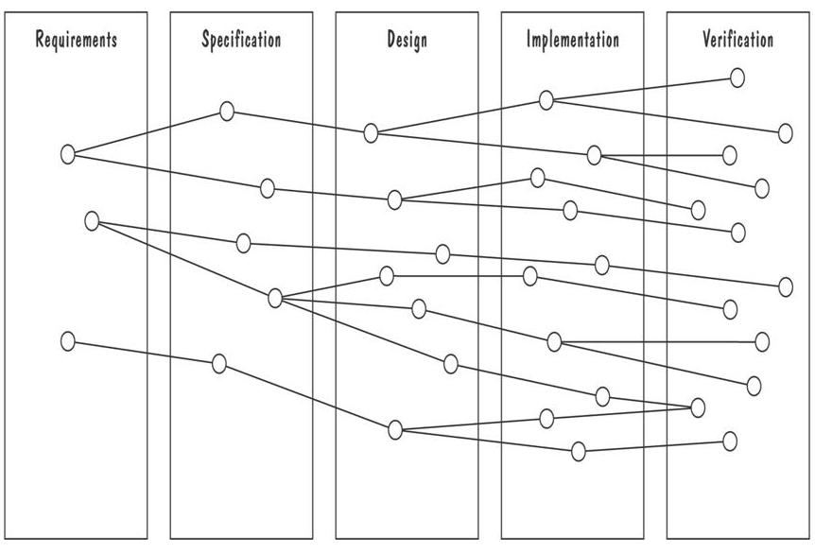
Development Activities
Horizontal threads show the coordination between development activities

Slide 83
4.9 Validation and Verification
需求文档
  开发者和客户之间的技术合同（开发者将要交付什么）
  设计人员的依据（将要构建什么）
确认(validation)和验证(verification)的目的
  分析人员和客户准确、全面的理解彼此的意图
  我们的意图完全反映在需求文档中
Requirement Validation 需求确认
  需求定义文档(requirement definition)精确的反映出客户（所有利益相关人员）的要求
  We build the right system!
Requirement Verification 需求验证
  验证需求文档和产品是一致的（比如代码与设计、设计与需求等等），在需求过程中，即为验证需求规格和需求定义的一致性。
  We build the system right!

Slide 84
4.9.1 Validation
Requirement Validation 需求确认
  Validation makes sure that the the requirements will meet the customer’s needs
Techniques to perform the validation常用技术
  The choice of the technique depends on your experience, preference, appropriateness for your definition and specification techniques
  See Table 4.3, p.199
  Checklist
  Walkthrough
  Formal inspection
  Review

Slide 85
Requirements review 需求评审
  Is a simple way to check the requirements
  In which representatives from our staff and the customer’s examine the requirements
    Representatives include those who will operate the system, prepare the input, use the output, managers of these employees, …
  需求评审的内容
  Review the stated goals and objectives of the system
  Compare the requirements with the goals and objectives
  Review the environment in which the system is to operate
  Review the information flow and proposed functions
  Assess and document the risk, discuss and compare alternatives
  Testing the system: how the requirements will be revalidated as the requirements grow and change

Slide 86
需求评审的内容
When a problem is identified
  Document it, determine its cause, and take action to fix the problem before design begins.
    Example : customer may set a reliability or availability goal that developers deem impossible to meet
    Sidebar 4.8 discuss the nature and number of requirements related problems likely to find
When the validation is completed
  The requirements process is completed

Slide 87
4.9.2 Verification
Requirement Verification 需求验证
  Is the process of determining that the specification is consistent with the requirements definition
Make sure that if we implement a system that meets the specification, then the system will satisfy the customer's requirements
Ensure that each requirement in the definition document is traceable to the specification
Sidebar 4.9 Computer-Aided Verification

Slide 88
需求承诺
  需求承诺是指开发方和客户方的责任人对通过了正式技术评审的《产品需求规格说明书》作出承诺，该承诺具有商业合同的效果。
  需求承诺的“八股文”如下：
    本《产品需求规格说明书》建立在双方对需求的共同理解基础之上，我同意后续的开发工作根据该《产品需求规格说明书》开展。如果需求发生变化，我们将按照“变更控制规程”执行。我明白需求的变更将导致双方重新协商成本、资源和进度等。
    甲方签字 乙方签字
  人们在作出承诺之前务必要认真阅读文档，一定要明白签字意味着什么。

Slide 89
4.10 Measuring Requirements
Measuring requirements
  Information collected during the measuring tell us a lot about the requirements process and its resulted requirements
  The measurements usually focus on 3 areas
    Products 产品（规模、成本等）
    Process（过程、进度等）
    Resources（资源，比如人员等）

Slide 90
Ways to measuring requirements
The number of requirements
  Tell us how large the system will be
  It is an estimation of the product size.
  It is likely that, as design and development occur, the deeper understanding of both the problem and the solution will lead to additional requirements
The number of changes to requirements
  A Large number of changes indicates some instability or uncertainty in the problem
  We should take actions to keep this number as low as possible and practicable

Slide 91
Rating Scheme on Scale from 1 to 5
You understand this requirement completely, have designed systems from similar requirements, and have no trouble developing a design from this requirement
Some elements of this requirement are new, but they are not radically different from requirements that have been successfully designed in the past
Some elements of this requirement are very different from requirements in the past, but you understand the requirement and can develop a good design from it
You cannot understand some parts of this requirement, and are not sure that you can develop a good design
You do not understand this requirement at all, and can not develop a design

Slide 92
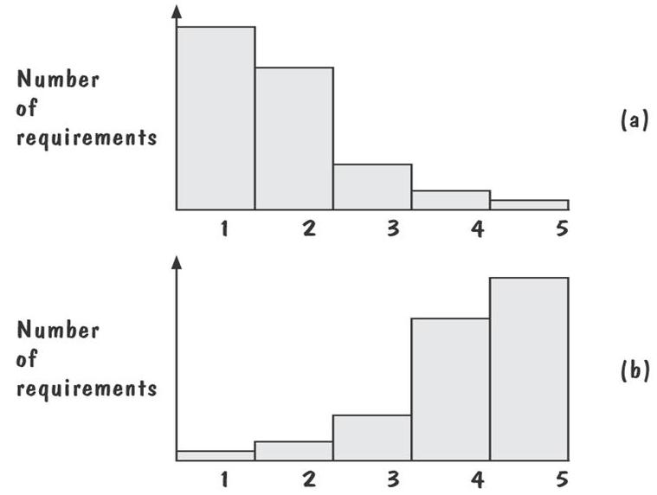
Testers/Designers Profiles
Figure (a) shows profiles with mostly 1s and 2s
  The requirements are in good shape
Figure (b) shows profiles with mostly 4s and 5s
  The requirements should be revised

Slide 93
4.11 Choosing a Requirement Specification Technique
Many more requirements techniques are available
  Each one has useful characteristics
  But There is no one that is best for all projects
  It is important to have a set of criteria to determine which is most suitable for a specific project
  Example : some techniques allow the system to checked for consistency and completeness and errors

Slide 94
Ardis has constructed a set of criteria for evaluating specification methods
  See p.207 : Applicability, implementability, testability, checkability, maintainability, modularity, expressibility, soundness, verifiability, run-time safety, tools maturity, looseness, learning curve, technique maturity, data modeling, discipline
  The importance of each property is different to different development stages
    See Table 4.7, p.208

Slide 95
It may be better to combine several methods
  Some are better at capturing non-functional requirements
  Some are better at describing data requirements
  The choice is dependent to the needs of both developers and customers, as well as the very characteristics of the project

Slide 96
4.12 , …,4.18 Are Omitted

Slide 97
本章小结
4.1 The requirements process
  Requirement 需求及其目的
  The process of determining the requirements 需求获取的过程
  Heavy需求过程与Agile需求过程的区别
4.2 Requirements elicitation
  需求过程中的stakeholders
  需求获取的各种途径
4.3 Types of requirements
  Functional requirements 功能需求

Slide 98
  Quality requirement质量需求/ Nonfunctional requirements非功能需求
  Design constraint 设计约束
  Process constraint 过程约束
  按照优先级划分的三类需求
  怎样使需求可测试testable
  需求文档的作用（对客户、分析人员…）
  需求定义和需求规格两种需求文档的区别和联系
4.4 Characteristics of requirements
  8个特征及其含义

Slide 99
4.5 Modeling notations
  E-R图/UML 类图
  Event traces 事件跟踪/Message sequence chart/UML sequence diagram
  状态机/UML 状态图/Petri Nets
  DFD 数据流图/UML用例图
  Decision tables 判定表/功能及联系图
  Logic 逻辑描述/Z语言/OCL 对象约束语言

Slide 100
4.7 Prototyping requirements
  原型的作用
  抛弃型原型
  演化型原型
4.8 Requirements documentation
  需求定义文档的主要内容
  需求规格文档的主要内容
  过程管理对2种文档的相互跟踪

Slide 101
4.9 Validation and verification
  需求确认
  需求确认的常用技术、手段
  需求评审的有关内容
  需求验证
4.11 Choosing a specification technique
  选择合适的描述需求规格的模型需要考虑的主要原则

Slide 102
本章作业
宠物商店PetStore是一个电子商务网站。以下是功能需求：
客户分为匿名客户和注册客户，对于注册客户以会员方式管理，登记并管理其个人信息，根据其消费积分分为金牌会员、银牌会员、普通会员，以享受不同程度的优惠。
通过浏览器，匿名客户可以查询宠物；创建账户并登陆后才能够使用购物车、创建订单、提交订单、通过信用卡支付等购物活动。每个客户可以同时拥有多个订单，但只能有一个购物车，订单基于购物车内的商品创建。
宠物商店的工作人员能够接受或拒绝客户提交的订单、处理订单、发订单给供应商、接受供应商返回的配送结果。
注册客户可以随时查询其订单状态，当订单尚未处理时，可以取消订单；订单一旦开始处理，不允许客户取消。

Slide 103
本章作业
使用UML用例图表达以上需求。
使用UML类图描述此系统的对象模型。
分析系统中订单的各种状态，并用状态图描述。

