Slide 1
CHAPTER 5
Designing the Architecture
  Views of software architecture
  Common architectural patterns
  Criteria for evaluating and comparing design alternatives
  Software architecture documentation

Slide 2
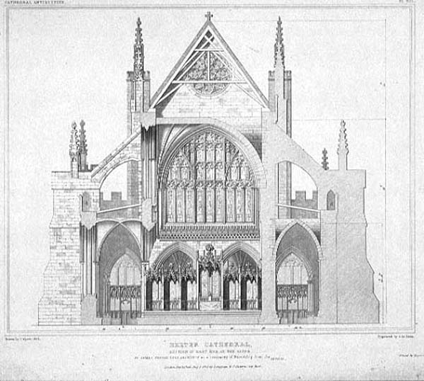
THE DESIGN PROBLEM
The result of the requirements process
  Requirements documents
The next step
  Start designing how the system will be constructed
  For a larger system, we will want to decompose the system into units of manageable size before we contemplate details about the data or code
If requirements are about what the system must do then design is all about how the system will do it.
The Design Problem is to develop a description of a system that can feasibly be implemented by the developers and, if implemented, will meet all of the requirements.

Slide 3
5.1 The Design Process
  1. What is Design ? 什么是设计
  Design is the creative process of figuring out how to implement all of the customer’s requirements; the resulting plan is also called the design
  Early design decisions
    Explain how to decompose the system into units, how the units relate to one another, and describing any externally visible properties of the units
    address the system’s architecture
  Later design decisions address how to implement the individual units

Slide 4
2. Design is a Creative Process
Design is an intellectually challenging task
  Numerous possibilities the system must accommodate
  Nonfunctional design goals (e.g., ease of use, ease to maintain)
  External factors (e.g., standard data formats, government regulations)
We can improve our design by studying examples of good design
Most design work is routine design, solve problem by reusing and adapting solutions from similar problems

Slide 5
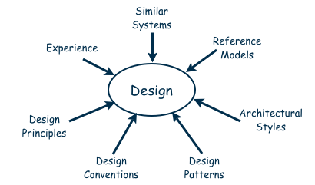
Design is a Creative Process
Many ways to leverage existing solutions
  Cloning: Borrow design/code in its entirety, with minor adjustments
  Reference models: Generic architecture that suggests how to decompose the system

Slide 6
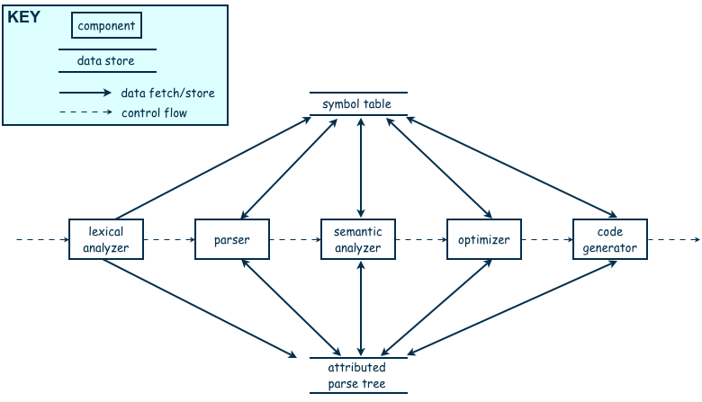
Design is a Creative Process
Reference model for a compiler

Slide 7
Design is a Creative Process
Software architectures have generic solutions too, referred to as architectural styles
  Focusing on one architectural style can create problems
  Good design is about selecting, adapting, and integrating several architectural design styles to produce the desired result
Many tools for understanding options and evaluating chosen architecture, including:
  Design patterns: generic solutions for making lower-level design decisions
  Design convention or idiom: collection of design decisions and advice that, taken together, promotes certain design qualities
  Innovative design: characterized by irregular bursts of progress Design principles: descriptive characteristics of good design
It is only through continuous learning and practice that we improve our design skills

Slide 8
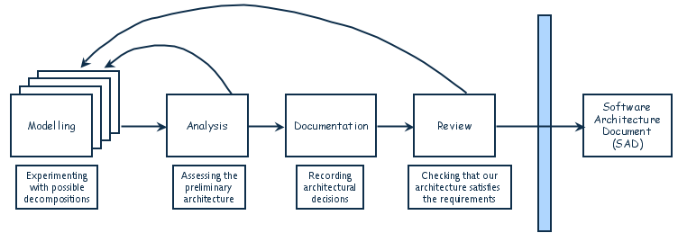
3. Design Process Model
Designing a software system is an iterative process
The process of converging on a software architecture for a proposed system (Figure 5.4)
  Modeling: Experimenting with possible decompositions
  Analysis: Accessing the preliminary architecture
  Documentation: Recording architectural decisions
  Review: Checking that our architecture satisfies the requirements
The final outcome is the software architecture document (SAD)

Slide 9
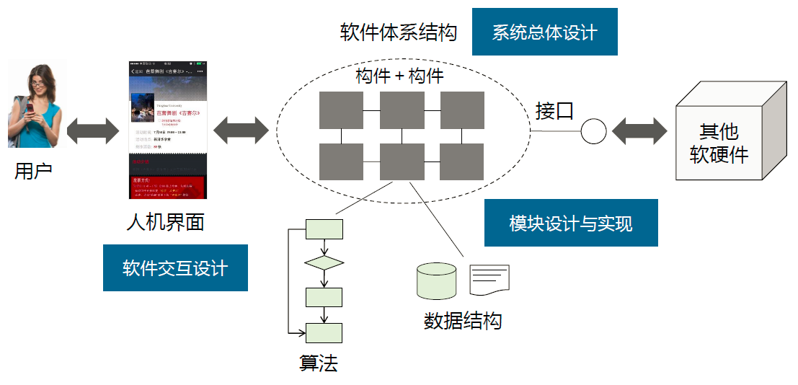

Slide 10
5.2 Modeling Architectures
Software architecture modeling is not so mature as modeling requirements
Each has pros and cons, and there is no universal technique that works best in every situation
More typically, software architectures are modeled using simple box-and-arrow diagrams

Slide 11
5.3 Decomposition and Views
设计的结果：组件及相互联系
  a set of components
  the inter-component interfaces
    to satisfy a specified set of requirements
Two design approaches:
Decomposition-Top down 自上而下
  A traditional approach
  Starting with a high level description of the system’s key elements
  Then, creating the lower level structure and looking at the system’s feature
Bottom up 自下而上
  Used by many of today’s designers
  Packaging together small modules and components into a larger whole 把小的模块和组件整合起来形成更大的整体
Here, we use decomposition.

Slide 12
1. 设计的重要策略： Decomposition 分解
Top level
First level of decomposition
Second level of decomposition

Slide 13
2. Some popular design methods
  Functional decomposition 基于功能模块的分解
  Feature-oriented design 面向服务特征的设计
  Data-oriented decomposition 面向数据的分解
  Process-oriented decomposition面向流程分解
  Event-oriented decomposition 面向触发事件的分解
  Object-Oriented 面向对象的分解
  The decomposition differs from the requirements in that the “how”, not the “what” is concentrated

Slide 14
Six Popular Design Methods
Functional decomposition 基于功能模块的分解
  Is based on partitioning functions or requirements into modules
  Begins with a description of the system-level functions
  Lower-level designs divide system-level functions into subfunctions, which are then assigned to smaller modules
  Also describes which modules (subfunctions) call each other

Slide 15
Six Popular Design Methods
Feature-oriented decomposition 面向特征的分解
  Is a type of functional decomposition that assigns features to modules
  High-level description depicts the system in terms of a service and a collection of features
  Lower-level design describes how each feature augments the service and identifies interactions among models

Slide 16
Six Popular Design Methods
Data-oriented decomposition 面向数据的分解
  Focuses on how data will be partitioned into modules
  High-level description depicts conceptual data structures
  Lower-level descriptions provide detail on how data are distributed among modules and how the distributed data realize the conceptual models

Slide 17
Six Popular Design Methods
Process-oriented decomposition 面向过程的分解
  Partitions the system into concurrent processes
  High-level design
    Identifies the system’s main tasks
    Assigns tasks to runtime processes
    Explains how the tasks coordinate with each other
  Lower-level designs describe the processes in more details

Slide 18
Six Popular Design Methods
Event-oriented decomposition 面向触发事件的分解
  Is based on events that the system must handle and assigns responsibility for events to different modules
  High-level design catalogues the system’s expected input events
  Lower-level designs decompose the system into states and describe how events trigger state transformations

Slide 19
Six Popular Design Methods
Object-Oriented 面向对象的分解
  Assigns objects to modules
  The high-level design identifies the system’s object types and explains how objects are related to one another
  Lower-level designs detail the objects’ attributes and operations

Slide 20
3. 设计的结果：软件单元
设计的结果：软件单元及相互联系
Software units : a system's composite parts
such as, component, subsystem, runtime process, module, class, package, library or procedure
  Module
    a structural unit of the software’s code
    Could be an atomic unit or an aggregation of other modules
  Component
    an identifiable runtime element
    E.g. the parser is a component in a compiler

Slide 21
Modular 模块化的
  Each kind of decomposition separates the design into its composite parts, called modules or components
  In a modular system, each function is performed exactly by one component, and the inputs and outputs are well-defined.
Well-defined component定义明确的组件
  If all inputs to it are essential to its function
    No one input may left out to make the component perform its full function
  And all outputs are produced by one of its actions
    Each output is a result of the component’s functioning
    And no input become an output without having been transformed in some way by the component

Slide 22
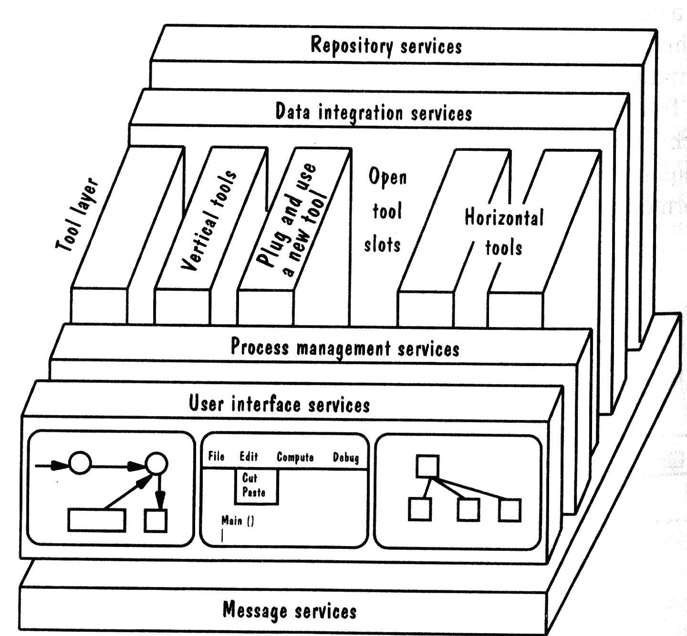
Fig 5.4 The NIST/ECMA reference model for environment integration

Slide 23
Component
Subsystem
Runtime process
Module
Class
Package
Library
Procedure
Software unit
Modular
Well-defined

Slide 24
4. Architectural Views 架构视图
Architectural views (架构视图)
  A view of the design that shows the distribution of the system’s components as well as their communication 展示系统组件的分布情况和它们间的交流情况
  Alternatively, a view of the design that shows the various services that the system is to offer and how the services operate together 展示系统中提供的不同的服务和它们如何同时运转
  Regardless of how the services are mapped to code modules
Decomposition view 分解视图
Dependencies view 依赖视图
Generalization view 泛化视图
Execution view 运行视图
Implementation view 实现视图
Deployment view 部署视图
Work-assignment view 工作分配视图

Slide 25
Common Types of Architectural Views
Decomposition view 分解视图
  The traditional view of a system’s decomposition portrays the system as programmable units
  It’s hierarchical and represented by multiple models.
  See Fig 5.5, p.232
Dependencies view 依赖视图
  Shows dependencies among software units
  It’s useful in project planning and impact assessment when making a design change to some software unit

Slide 26
Common Types of Architectural Views
Generalization view 泛化视图
  Shows software units that are generalizations or specializations of one another
  It’s useful when designing abstract or extendible software unit
Execution view 执行视图
  Shows the runtime structure of a system in terms of its components and connectors
  A traditional box-and-arrow diagram
  Each component is a distinct executing entity, and a connector is some intercomponent communication mechanism

Slide 27
Common Types of Architectural Views
Implementation view 实现视图
  Maps code units to source file that contains their implementation
  It helps programmers find the implementation of a software unit within a maze of source code files
Deployment view 部署视图
  Maps runtime entities onto computer resources
  It helps architect analyze the quality attributes of a design
Work-assignment view 工作分配视图
  Decomposes the system’s design into work tasks that can be assigned to project teams
  It helps project managers plan and allocate project resources, as well as track each ream’s progress

Slide 28
5.4 Architecture Styles and Strategies
从建筑风格开始
建筑风格等同于建筑体系结构的一种可分类的模式，通过诸如外形、技术和材料等形态上的特征加以区分。
之所以称为“风格”，是因为经过长时间的实践，它们已经被证明具有良好的工艺可行性、性能及实用性，并可直接用来遵循或模仿(复用)。

Slide 29


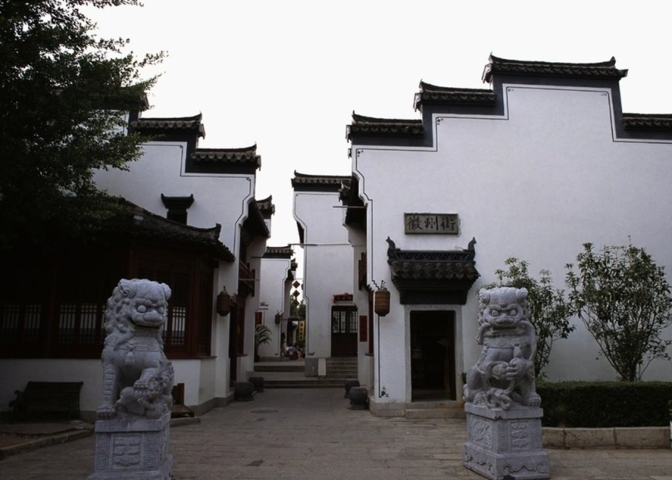
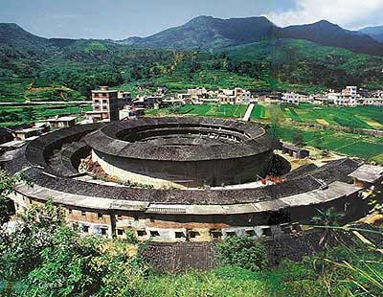
中国古典建筑风格
宫殿风格
园林风格
江南建筑风格
客家建筑风格

Slide 30



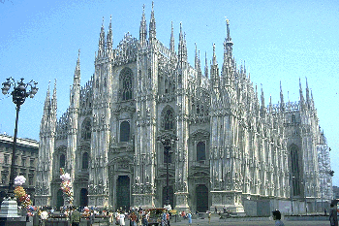
欧洲古典建筑风格
巴洛克风格
文艺复兴建筑风格
拜占庭风格
哥特风格

Slide 31
软件系统同建筑一样，也具有若干特定的“风格” (architecturure style)；
  这些风格在实践中被多次设计、应用，已被证明具有良好的性能、可行性和广泛的应用场景，可以实现“软件体系结构级”的复用
Architectural styles 体系结构风格
generic solutions for software architectures
They are not complete detailed solutions. They are loose templates that offer distinct solutions for coordinating a system’s components.并不是详细的解决方案，而是松散的模板
Their structures codify constrained interactions among components and offer mechanisms for realizing those interactions.

Slide 32
Examples of Architectural Styles and Strategies
Pipes-and-Filter
Client-Server
Peer-to-Peer
Publish-Subscribe
Repositories
Layering

Slide 33
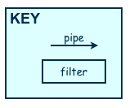
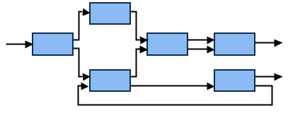
Example: Pipes-and-Filter
The system has
  Streams of data (pipe) for input and output
  Transformation of the data (filter)
KEY
pipe

Slide 34
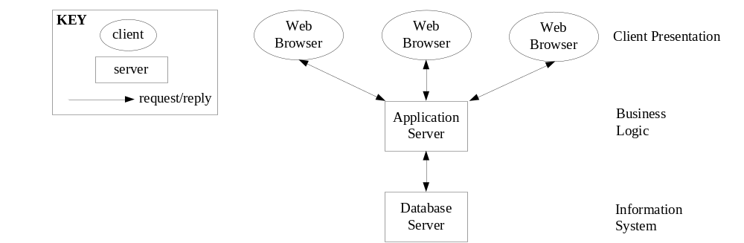
Example: Client-Server
  Server components offer services
  Clients access servers using a request/reply protocol
  The relationship between clients and servers is asymmetric 客户端和服务器的关系是非对称的
    The server know nothing about which, or even how many, clients they serve
    The clients know the server’s identity, and it send messages to the server by using a procedure call
  This architecture improves the system’s modularity and supports reuse
FIGURE 5.7 Three-tiered client-server architecture

Slide 35
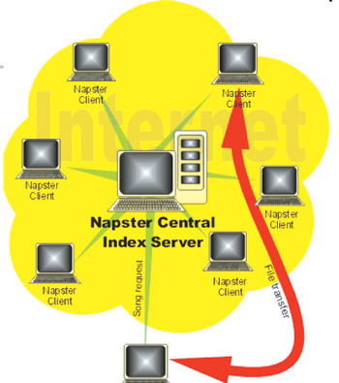

Example: Peer-to-Peer (P2P) 对等模式
Each component executes as its own process and acts as both a client of and a server to other peer components.
Peers communicate by requesting services from each other
E.g. File-sharing networks: Napster

Slide 36
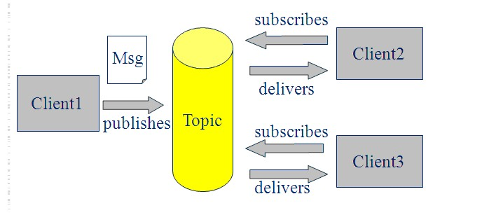
Example: Publish-Subscribe (发布-订阅模式)
Components interact by broadcasting and reacting to events
  A component expresses interest in an event by subscribing to it
  When another component publishes that the event has taken place, the subscribing components are notified
  E.g. 邮件订阅发布
  Publish-subscribe components know nothing about each other
  The underlying publish-subscribe infrastructure is responsible for
    registering event subscriptions
    delivering published events to he appropriate components

Slide 37
Example: Layering （层次模式）
Layered system
  The layers are hierarchical
  Each layer provides services to the layer above it and as a client to the layer below
  The design includes protocols that explain how each pair of layers will interact 设计中包括解释两层之间如何交互的协议
  Normally, each layer can only access the layer that just outside one layer

Slide 38
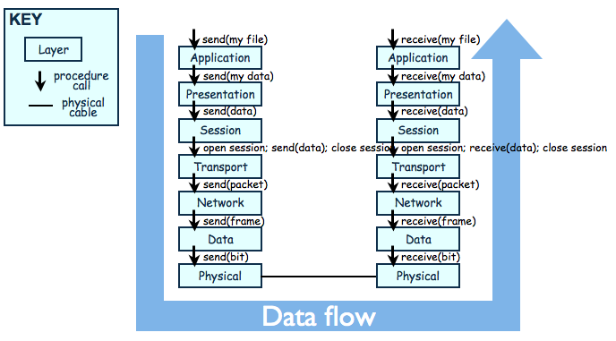
Layering （层次模式）
Layered architecture of OSI model for network communications

Slide 39
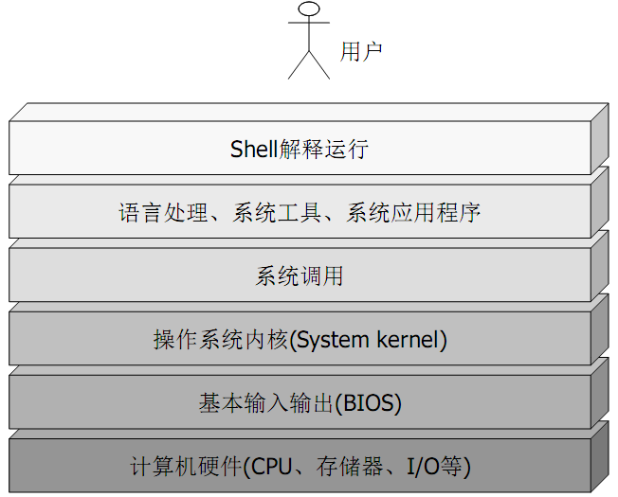
计算机操作系统的层次结构

Slide 40
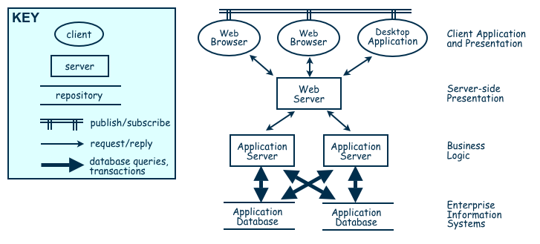
Combining Architectural Styles
Actual software architectures rarely based on purely one style
Architecture styles can be combined in several ways:
  We might use different styles at different levels of our system’s decomposition
  We may use a mixture of architectural styles to model different components or different types of interactions among components.
Combination of Publish-Subscribe, Client-Server, and Repository Architecture Styles

Slide 41
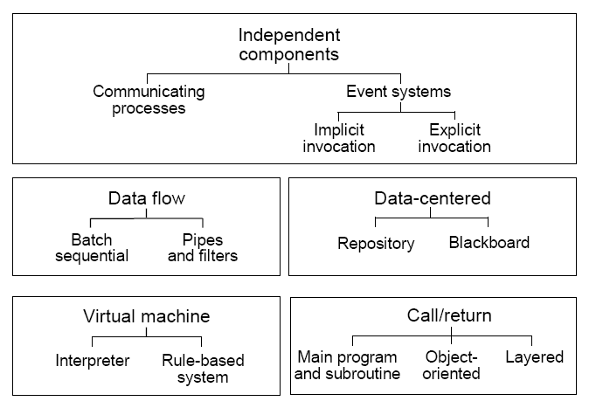
Types of Architectural Styles

Slide 42


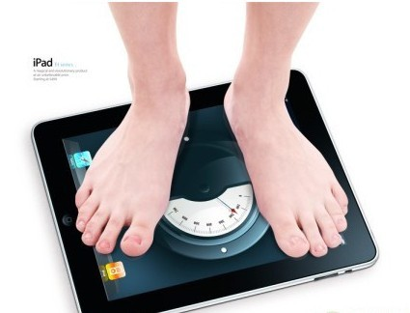

5.5 Achieving Quality Attributes
As we design the system, we want to select architectural styles that promote the required quality attributes
现代人总是通过考察多方面的生理因素来判断是否健康，如测量身高、体重、心跳、血压、血液、体温等。如果上述因素都合格，那么表明这人是健康的。如果某个因素不合格，则表明此人在某个方面不健康

Slide 43

通过类比理解软件质量： 软件质量是许多质量属性的综合体现，各种质量属性反映了软件质量的方方面面。人们通过改善软件的各种质量属性，从而提高软件的整体质量。
人们通过多个质量属性构成一个“软件质量模型” (software quality model)来评价一个软件质量，比如《Boehm软件质量模型》、《McCall质量模型》等
可移植性
设备独立性
模块独立性
可靠性
精确性
完整性
效率
完全性
总体 效用
易用性
连续性
人体工程学
可说明性
设备功效
易操作性
可测试性
沟通良好
自我操作性
可维护性
架构性
易懂性
简明性
Boehm软件质量模型
易懂性
易更改
可维护性

Slide 44
Architectural styles provide general beneficial properties
To support specific quality attribute tactics are utilized
Software Quality Attributes
  Modifiability 修改性
  Performance 性能
  Security 安全性
  Reliability 可靠性
  Robustness 健壮性
  Usability 易用性
  Business Goals 商业目标

Slide 45
1. Modifiability 可修改性
Modifiability is the basis of most of the architectural styles and is essential: Design must be easy to change
Two classifications of affected software units:
  Directly affected
  Indirectly affected
Directly affected units’ responsibilities change to accommodate a system modification
Indirectly affected units’ responsibilities do not change, but implementations must be revised

Slide 46
Tactics for minimizing the impact on directly affected software units – focus on clustering anticipated changes
  Anticipate expected changes: identify design decisions that are most likely to change, and encapsulate each in its own software unit 预测预期的变化
  Cohesion: Keeping software units highly cohesive increases the chances that a change to the system’s responsibilities is confined to the few units that are assigned those responsibilities 内聚
  Generality : The more general the software units, the more likely change can be accommodated by modifying a unit’s inputs rather than modifying the unit itself 泛化/通用性

Slide 47
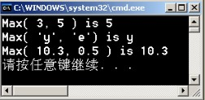
Generality 泛化模块
  C++中函数模板
  Template <typename T>
  T Max(const T a, const T b){
  return a>b? a:b;
  }
  Int main(){
    cout<<Max(3, 5)<<endl;
    cout<<Max('y', 'e') <<endl;
    cout<< Max(10.3, 0.5)<<endl;
  }
函数模板
int max (int a, int b)
{return a>b ? a:b;}
char max (char a, char b)
{return a>b ? a:b;}
double max (double a, double b)
{return a>b ? a:b;}
Notes:
The more general our software units, the more likely we can accommodate change by modifying a unit’s inputs rather than
modifying the unit itself

Slide 48
Tactics for minimizing the impact on indirectly affected software units – focus on reducing dependencies among software units
  Coupling: Lowering coupling reduces the likelihood that a change to one unit will ripple to other units 耦合
  Interfaces: If a unit interacts with other units only through their interfaces, then changes to one unit will not spread beyond the unit’s boundary unless its interface changes 如果软件单元只通过接口来进行交互，那么某个软件单元的变化不会影响其他单元，除非它的接口也发生了变化
  Multiple interfaces: A unit modified to provide new data or services can offer them using a new interface to the unit without changing any of the unit’s existing interfaces 当某个单元需要提供新的数据或服务时，可以为其提供一个新的接口，而不改变已有的接口

Slide 49
2. Performance性能
性能优化就好像从海绵里挤水一样，你不挤，水就不出来，你越挤海绵越干。有些人认为现在的计算机不仅速度越来越高，而且内存越来越大，因此软件性能优化的必要性下降了。这种看法是不对的，殊不知随着机器的升级，软件系统也越来越庞大了和复杂了，性能优化仍然大有必要。
Performance attributes describe constraints on system speed and capacity, including response time, throughput, load
  Response time (响应时间): how fast does our software respond to requests?
  Throughput (吞吐量): how many requests can it process per minute?
  Load (负载): how many users can it support before response time and throughput start to suffer?

Slide 50
Tactics for improving performance include:
  To increasing computing resources
    To buy faster computers, more memory, or additional communication bandwidth
  Improve utilization of resources 提高资源利用率
    We can make our software more concurrent, thereby increasing the number of requests that can be processed at the same time
    We can replicate and distribute shared data, thereby reducing contention for the data
  Manage resource allocation more effectively 管理资源分配
    First-come/first-served: Requests are processed in the order in which they are received
    Explicit priority: Requests are processed in order of their assigned priorities
    Earliest deadline first: Requests are processed in order of their impending deadlines
  Reduce demand for resources

Slide 51
3. Security安全性
Two key architectural characteristics that are particularly relevant to security: immunity and resilience. 免疫力和恢复力
  Immunity: ability to thwart an attempted attack
    The architecture encourages immunity by:
      Ensuring all security features are included in the design
      Minimizing exploitable security weaknesses
  Resilience: ability to recover quickly and easily from an attack
    The architecture encourages resilience by:
      Segmenting functionality to contain attack
      Enabling the system to quickly restore functionality

Slide 52
4. Reliability可靠性
A software system or unit is reliable, if it correctly performs its required functions under assumed conditions.
Software is made more reliable by preventing or tolerating faults 防错容错
  A fault is the result of human error, compared to a failure, which is an observable departure from required behavior
Passive fault detection 被动
  Design a system to wait until a failure occurs
Active fault detection and handling 主动
  Periodically check for symptoms of faults, or try to anticipate when failures will occur
Several approaches:
  ping/echo (命令/响应); Heartbeat monitor (心跳检测); Exception(异常); Redundancy(冗余)

Slide 53
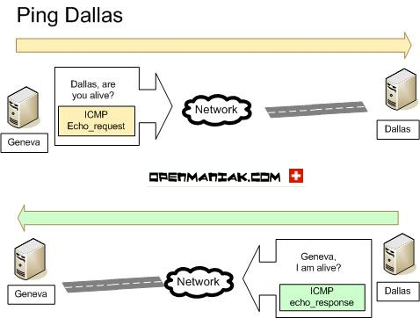
ping/echo (命令/响应)
One component issues a ping and expects to receive back an echo within a predefined time.

Slide 54
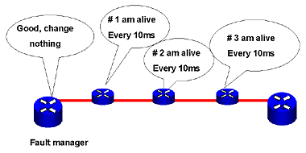
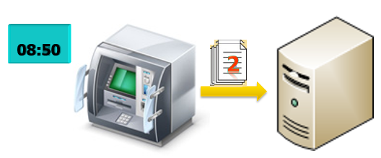
Heartbeat monitor(心跳)
One component emits a heartbeat message periodically and another component listens for it.
If the heartbeat fails, the originating component is assumed to have failed and a fault correction component is notified.
The heartbeat can also carry data.
E.G. an automated teller machine can periodically send the log of the last transaction to a server. This message not only acts as a heartbeat but also carries data to be processed.

Slide 55
5. Robustness 健壮性
Our system is said to be robust if it include mechanisms for accommodating or recovering from problems in the environment or in other units.
Reliability vs. Robustness
  Reliability has to do with whether our software is internally free of errors 软件内部错误少
  Robustness has to do with how well our software is able to withstand errors or surprises from its environment 软件承受错误的能力

Slide 56
Mutual suspicion : each system component assumes that others contain faults, and checks its input for correctness and consistency 每个组件假设其它组件存在缺陷，并且检查输入的正确性和一致性
  E.g. a payroll program would ensure that hoursWorked is nonnegative before calculating an employee's pay
Public double calEmpPay (String empID, int hoursWorked){
if(hoursWorked<0){
error(“hoursWorked is negative”);
}
double pay = getEmpPayPerHour(empID);
double totalPay = hoursWorked*pay;
return totalPay;
}

Slide 57
6. Usability易用性
Usability attributes reflect the ease with which a user is able to operate the system
A few user-interface decisions do significantly affect the software’s architecture
  The user interface should reside in its own software unit, or possibly its own architectural layer, to make customization of UI easier
    Separate the user interface from the rest of the application

Slide 58
Designing the User Interfaces 界面
UIs can be tricky things to design
  because different people have different styles of perceiving, understanding and working
Issues involved in UIs design
  Metaphors 隐喻
  A mental model 智力模型
  The navigation rule for the model 导航规则
  Look 可视界面
  Feel 交互方式
The goal of the above elements
  Is to help users gain rapid access to the content of the complex systems without loosing comprehension

Slide 59
In order to design comfortable and effective UIs, 2 key issues must be considered : culture and preference
Culture Issues 文化因素
  Culture differences and group dynamics of users 不同团队的文化差异
  Beliefs, values, norms, traditions, mores, and myths of users 信仰、价值观、行为准则…
  Language translation is not enough to assure culture transition
  Culture is determined not just by nationality, but also by region, sex, profession, age, corporation..
User Preference 用户爱好
  Users with different backgrounds have different preference
  Backgrounds : sex, age, education, proficiency,…
Prototyping is important in UIs development

Slide 60
Principles in Designing User Interface
◇Consistency 一致性
I/O,Face,Layout,Function keys…
◇Suitability 合适性
The interface is suitable with content…
◇Simplicity 简单性
Reduce the operation steps…
Make the simple things simple and hard things possible
◇Feedback information 反馈
◇Help information for error operation 有效帮助信息
◇Provide reversible operation 补偿/可逆操作
……

Slide 61
7. Business goals
The most common of the goals is minimizing the cost of development and the time to market
  Buy vs. build
    Save development time, money
    More reliable
    Existing components create constraints; vulnerable to supplier
  Initial development vs. maintenance costs
    Save money by making system modifiable
    Increased complexity may delay release; lose market to competitors
  New vs. known technologies
    Acquiring expertise costs money, delays product release
    Either learn how to use the new technology or hire new personnel
    Eventually, we must develop the expertise ourselves

Slide 62
5.6 Collaborative Design 协作设计
A team will work collaboratively to produce a design, often by assigning different parts of the design to different people
Several issues
  Who is best suited to design a specific part
  How to document the design
  How to coordinate the design components towards a unified whole
Important to view group interaction in its cultural and ethical contexts

Slide 63


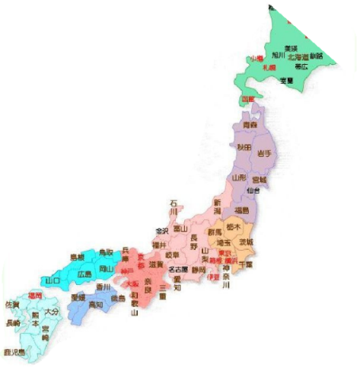

Harmony is very important!
Parallel communication and anonymity is important!
Group interaction in its cultural and ethical contexts is important
Outsourcing 外包
  Software development activities are outsourced to other companies or divisions, some of which may be located in other countries
  In such cases, a collaborative design team may be distributed around the world, and the importance of understanding group behavior will increase

Slide 64
Collaborative Design
Yourdon identifies four stages in distributed development
  In the first stage, a project is performed at a single site with on-site developers from foreign countries.
  In the second stage, on-site analysts determine the system’s requirements. Then, the requirements are provided to off-site groups of designers and programmers to continue development.
  In the third stage, off-site developers build generic products and components that are used worldwide.
  In the fourth stage, the off-site developers build products that take advantage of their individual areas of expertise.

Slide 65
Section 5.7 are omitted.

Slide 66

5.8 Documenting Software Architectures
SAD (software architecture document) is the final outcome of the software architecture design process.
  It can help to communicate the vision of architectural design to the various members of the development team, then we will get a consistent understanding of the system’s architecture
A SAD should include:
  System overview
  Views
  Software units
  Analysis data and results
    Enough details about the system’s architecture, computing resources, and execution environment
  Design rationale 设计原理
  Definitions, glossary, acronyms

Slide 67
In addition, the SAD is identified with a version number or date of issue
In a SAD, a decomposition view, an execution view and a deployment view are essential
  Design is collection of views
  We should show how the views relate one another
  We can document a mapping between two views as a table
Design rationale (设计原理): The critical issues and trade-offs that were considered in generating the design
  Rationale is usually expressed in terms of the system’s requirements 设计原理通常依据系统的需求来表述
  Such as, design constraints that limit the solution space; or quality attributes to be optimized

Slide 68
5.9 Architecture Design Review
Design review is an essential part of engineering practice
2 ways to evaluate a SAD
  Validation 确认
  make sure the design satisfies all of the requirements specified by the customer 确认设计能够满足用户需求
  Verification 验证
  ensure that the design adheres to good design principles, and that the design documentation fits the needs of its users 确保设计遵循良好的设计原则，设计文档满足阅读者的需要

Slide 69
Validation (确认)
During validation, we make sure that all aspects of the requirements are addressed by our design
Key people to the review:
  The analyst(s) who helped to define the system requirements
  The system architect(s)
  The program designer(s) for this project
  A system tester
  A system maintainer
  A moderator
  A recorder
  Other interested system developers who are not otherwise involved in this project
  If major faults or misunderstandings arise, we may agree to revise the design

Slide 70
Verification (验证)
To evaluate the quality of the design and the documentation
we examine the design to judge whether it adheres to good design principles: P278
  It the architecture modular, well structured and easy to understand?
  Can we improve the structure and understandability of the architecture?
  ……
Method for evaluating the quality of the SAD:
Passive review process
  Reviewers read the documentation and look for problems
Active review process
  Each reviewer represents a different class of reader and is asked questions suitable to his or her use of a SAD
  The reviews must answer given questions by looking up information in the SAD

Slide 71
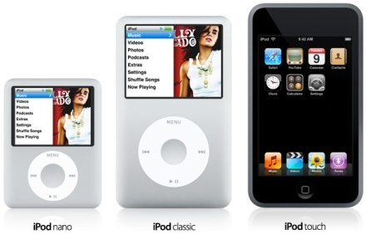
5.10 Software Product Lines
Product family (产品族): a collection of derived products
The iPod has evolved into a product family.
There's the Nano, the Touch, the Classic and the Shuffle;
All of these members of the iPod family fulfill the basic needs of being an iPod, they can all play music in the same manner, and all follow the same basic procedure and software

Slide 72
Product line (产品线): the company develop the family of products, rather than develop the products individually, to save the cost and effort
  The products may appear to be quite different from one another, varying in size, quality, features, or price
  But they have enough in common to allow the company to take advantage of economies of scope by sharing
    Technologies
    Assembly facilities
    Business plans
    Marketing strategies
    Distribution channels
    …

Slide 73
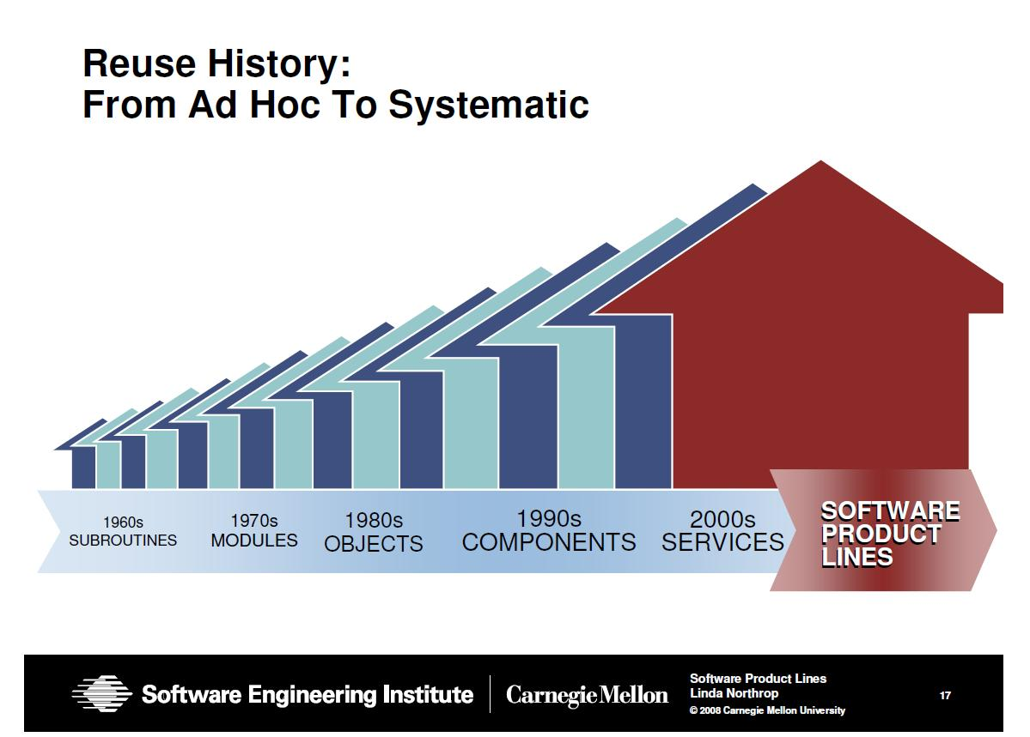
Notes:
重用从模块，对象这种小规模发展到系统性的大规模重用——生产线

Slide 74
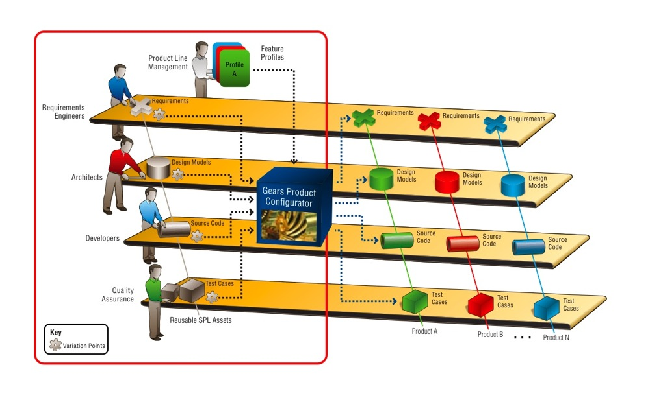
5.10 Software Product Lines

Slide 75
The family’s commonalities are described as a collection of reusable assets, all stored in a core asset base.
When developing products in the family , we retrieve assets from the base as needed
Elements in the core asset base:
  Requirements
  Software architecture
  Models and analysis results
  Software units
  Testing
  Project planning
  Team organization

Slide 76
Product lines are based not just on commonalities among products but also on the best way to exploit them
  首先，根据企业战略计划确定想要建立的产品族，通过已有的知识和良好的判断预测其市场前景和需求
  其次，审视计划，确保这些产品有足够多的共同点，从而可以通过产品线的方法开发。

Slide 77
Advantages of product-line architecture: P282
  Component replacements
  Component specializations
  Product-line parameters
    We regard software units as parameters, so that varying the parameters results in a set of possible system configurations
  Architecture extensions and retractions

Slide 78
本章小结
5.1 概念：
  What is design 什么是设计；与需求区别
  System’s architecture
  Design process model 设计过程模型
  Software Architecture Document (SAD)
5.3 分解设计和视图
  6 popular design methods 创建设计的6种方式/角度
  Software unit 软件单元/Modules模块/component 组件
  Modular system 模块化的系统
  Well-defined software unit 定义明确的软件单元
  7 kinds of architectural views 7种视图

Slide 79
本章小结
  5.5 Software Quality Attributes良好设计需要保证的质量属性
  Modifiability 修改性
  Performance 性能
  Security 安全性
  Reliability 可靠性
  Robustness 健壮性
  Usability 易用性
  Business Goals 商业目标

Slide 80
本章小结
5.6 Collaborative Design 协作设计
  Several issues
  Outsourcing 外包
5.8 Documenting Software Architectures
  SAD (software architecture document)
5.9 体系结构设计评审
  Validation 确认
  Verification 验证

