Slide 1
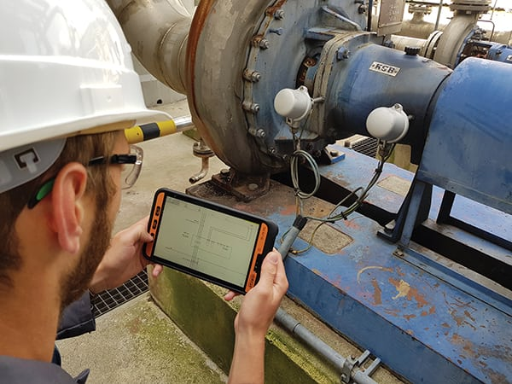
Augmented Reality for Chemical Engineering Education
Lorena C. de S. Moreira - Carine M. Rebello - Hanna Knuutila - Idelfonso B. R. Nogueira
Source: Ecom instruments

Slide 2
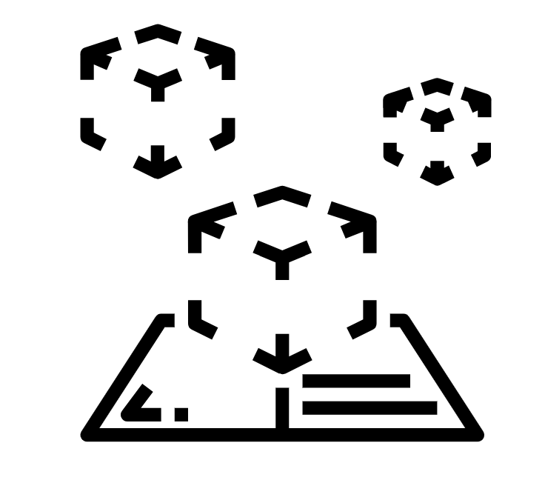
Introduction
"Educational systems have not kept pace with the changing nature of work, resulting in many employers saying they cannot find enough workers with the skills they need.“*
*Manyika, J. Technology, jobs, and the future of work. 2017. Report

Slide 3
Introduction
The Information and Communications Technologies used in education, as a reflection of social evolution, started to present themselves as an important support to the development of teaching activities.
Augmented reality (AR) is considered a major technology in this context.
This work provides a literature overview regarding Augmented Reality in Chemical Engineering Education, identifying existing studies on teaching chemical engineering using AR technology.

Slide 4
Method
Planning
Driving
Results
Set goal
Identify primary studies
Evaluate the results of the reports
Set protocol
Define the research questions;
Define search strategy;
Define selection criteria
Select primary studies (use of selection and quality criteria)
Characterization of AR chemical engineering Studies
Extract important data
Develop and disseminate the results
Bibliometric analysis with terms augmented reality, engineering, and education
Interpret results
Comparison between samples from engineering and chemical engineering
Bibliometric analysis with terms augmented reality, chemical engineering and education

Slide 5
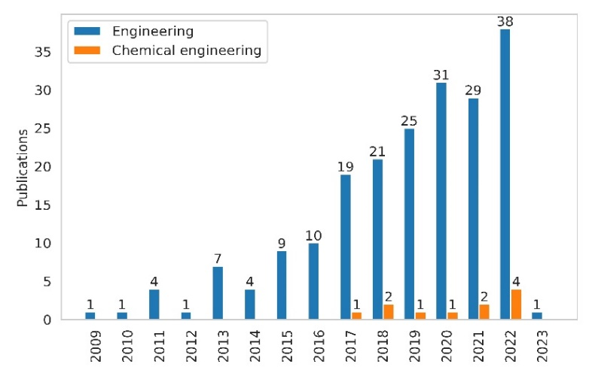
Results
The reduced number of publications in chemical engineering reveals a gap and a need for studies in this field.
Comparison between samples from Engineering and Chemical Engineering
Notes:
A bibliometrics analysis (Bibliometrix) was done. Initially we listed more than 200 publications related to the terms "augmented reality, "engineering", and "education" on the Web of Science and Scopus platforms. After this stage, to contemplate only works related to chemical engineering, it was decided to refine the search and use the terms "augmented reality", "chemical engineering", and "education". In this sense, Figure 1, 11 publications were found addressing the topics of this work. The reduced number of publications in the field of chemical engineering reveals a gap and a need for studies in this field.

Slide 6
Results
Table 1 presents the central studies found in the area, the year of publication, their respective AR platforms, and applications.
Authors | Year | Platforms | AR Chemical Engineering Application
Low et al. | 2022 | EON-XR | Industrial equipment
Solmaz et al. | 2022 | ProBuilder + PIXYZ + OpenFOAM + COMSOL + SALOME + Blender + Unity | Fluid dynamics simulations
Solmaz et al. | 2021 | Pubchem + Pymol + Blender + Unity | Liquid-soap synthesis, from reaction mechanism to industrial production
Barrett et al. | 2018 | ZeroMQ library + OpenCV + Unity | Chemical reactor system simulation
Ismail et al. | 2017 | SOP, Vuforia, Unity | Laboratory experimentation activities
Table 1 – AR Chemical Engineering studies
Notes:
Table 1 presents the central studies found in the area, the year of publication, their respective platforms, and applications in augmented reality. Some of the 11 publications in the sample are not included in the table because they are far from the topic of interest (4), duplicated (1), or are about taxonomy (1).

Slide 7
Results
AR Platforms Used in Chemical Engineering
Unity
Vuforia
ARToolKit
Unity is a cross-platform game engine widely used for developing AR-based tools.
Vuforia is an AR development platform that allows developers to build AR applications for mobile devices.
ARToolKit is an open-source low-cost AR tool.
Notes:
Table 1 presents the central studies found in the area, the year of publication, their respective platforms, and applications in augmented reality. Some of the 11 publications in the sample are not included in the table because they are far from the topic of interest (4), duplicated (1), or are about taxonomy (1).

Slide 8
Analysis: AR in Chemical Engineering
Current State of Research
Number of Publications
Most Used Platform
Applications of AR in Chemical Engineering
We conducted a bibliometric analysis of publications related to the use of AR in chemical engineering education and identified 11 relevant studies.
Unity is currently the most widely used platform for developing AR-based educational tools in chemical engineering.
No direct reports of application of AR in Chemical Engineering education were found.
Notes:
Make a link of abstraction and chemical engineering teaching, for example heat transfer, mass transfer….

Slide 9
Analysis: The Role of ICTs
The Emergence of Modern Devices in Education:
Over the past two decades, there has been a profound shift in the educational landscape due to ICTs.
The classroom dynamic has evolved from blackboards and chalk to interactive whiteboards, tablets, and online collaboration tools.
Distance learning, e-learning platforms, and massive open online courses have democratized education, making it accessible anywhere.
Notes:
Table 1 presents the central studies found in the area, the year of publication, their respective platforms, and applications in augmented reality. Some of the 11 publications in the sample are not included in the table because they are far from the topic of interest (4), duplicated (1), or are about taxonomy (1).

Slide 10

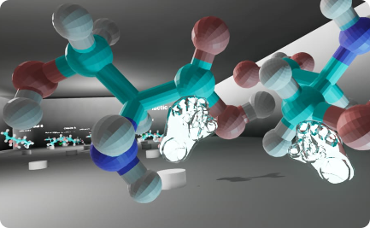
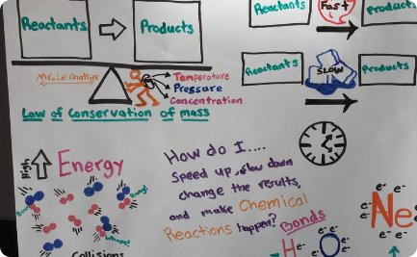
Analysis: The Role of ICTs
Enhanced Learning Experience
Improved Mastery of Concepts
Increased Motivation
Studies show that using AR in education leads to higher student engagement and motivation levels, especially in complex topics.*
AR provides a more immersive and interactive learning experience, allowing students to manipulate and explore virtual objects in a real-world context.
AR enables students to visualize abstract concepts and complex processes, thus improving their understanding and mastery of the subject matter.
*Ibanez, M. B., & Delgado-Kloos, C. (2018). Augmented reality for STEM learning: A systematic review. Computers & Education, 123, 109-123.
Notes:
Make a link of abstraction and chemical engineering teaching, for example heat transfer, mass transfer…. Source: This study presents a systematic review of the literature on the use of augmented reality technology to support science, technology, engineering and mathematics (STEM) learning. It synthesizes a set of 28 publications from 2010 to 2017.

Slide 11
Analysis: Challenges
Challenges of Implementing AR in Chemical Engineering Education
1
Integration with Curriculum
2
Development Skills
3
Cost
The development of AR-based tools requires specialized skills that may not be available in all educational institutions.
The development and implementation of AR-based tools can be costly and may require significant investments in hardware and software.
AR-based tools should be aligned with the curriculum and learning objectives to be effective in enhancing student learning.
Notes:
Make a link of abstraction and chemical engineering teaching, for example heat transfer, mass transfer….

Slide 12
Analysis: Final Remarks
Future Directions for AR-Based Tools in Chemical Engineering Education
Personalized Learning
Collaborative Learning
Emerging AR Technologies
AR-based tools can be customized to meet the individual needs and learning styles of each student, enhancing their learning experiences and outcomes.
AR-based tools can be used to facilitate collaborative learning activities, enabling students to work together to solve complex problems and share knowledge and expertise.
New AR technologies such as spatial computing and mixed reality offer exciting possibilities for enhancing chemical engineering education.
Notes:
Researchers need to design features that allow students to acquire basic competences related with STEM disciplines, and future applications need to include metacognitive scaffolding and experimental support for inquiry-based learning activities.

Slide 13
Ongoing project: AR Applications in Heat Transfer and Fluid Flow teaching
1
Heat Transfer
AR can be used to simulate and visualize heat transfer processes, allowing students to explore the effects of different parameters on the heat transfer rate.
Fluid Flow
2
AR can be used to visualize and manipulate fluid flow patterns, enabling students to better understand the behavior of fluids in different situations.
3
AR Platform Development
We are currently developing an AR platform for teaching heat transfer and fluid flow topics in chemical engineering, integrating AR technologies with the latest pedagogical practices.
Notes:
Make a link of abstraction and chemical engineering teaching, for example heat transfer, mass transfer….

Slide 14

Please let us know if you have any questions Idelfonso B. R. Nogueira
idelfonso.b.d.r.nogueira@ntnu.no

