Slide 1

Database Systems:
Design, Implementation, and Management
Eighth Edition
Chapter 2
Data Models
Database Systems, 8th Edition

Slide 2
Objectives
About data modeling and why data models are important
About the basic data-modeling building blocks
What business rules are and how they influence database design
How the major data models evolved
How data models can be classified by level of abstraction
Database Systems, 8th Edition

Slide 3
Introduction
Designers, programmers, and end users see data in different ways
Different views of same data lead to designs that do not reflect organization’s operation
Data modeling reduces complexities of database design
Various degrees of data abstraction help reconcile varying views of same data
Database Systems, 8th Edition

Slide 4
Data Modeling and Data Models
Data models
  Relatively simple representations of complex real-world data structures
    Often graphical
Model: an abstraction of a real-world object or event
  Useful in understanding complexities of the real-world environment
Data modeling is iterative and progressive
Database Systems, 8th Edition

Slide 5
The Importance of Data Models
Facilitate interaction among the designer, the applications programmer, and the end user
End users have different views and needs for data
Data model organizes data for various users
Data model is an abstraction
  Cannot draw required data out of the data model
Database Systems, 8th Edition

Slide 6
Data Model Basic Building Blocks
Entity: anything about which data are to be collected and stored
Attribute: a characteristic of an entity
Relationship: describes an association among entities
  One-to-many (1:M) relationship
  Many-to-many (M:N or M:M) relationship
  One-to-one (1:1) relationship
Constraint: a restriction placed on the data
Database Systems, 8th Edition

Slide 7
Business Rules
Descriptions of policies, procedures, or principles within a specific organization
  Apply to any organization that stores and uses data to generate information
Description of operations to create/enforce actions within an organization’s environment
Must be in writing and kept up to date
Must be easy to understand and widely disseminated
Describe characteristics of data as viewed by the company
Database Systems, 8th Edition

Slide 8
Discovering Business Rules
Sources of business rules:
  Company managers
  Policy makers
  Department managers
  Written documentation
    Procedures
    Standards
    Operations manuals
  Direct interviews with end users
Database Systems, 8th Edition

Slide 9
Discovering Business Rules (continued)
Standardize company’s view of data
Communications tool between users and designers
Allow designer to understand the nature, role, and scope of data
Allow designer to understand business processes
Allow designer to develop appropriate relationship participation rules and constraints
Database Systems, 8th Edition

Slide 10
Translating Business Rules into Data Model Components
Generally, nouns translate into entities
Verbs translate into relationships among entities
Relationships are bidirectional
Two questions to identify the relationship type:
  How many instances of B are related to one instance of A?
  How many instances of A are related to one instance of B?
Database Systems, 8th Edition

Slide 11
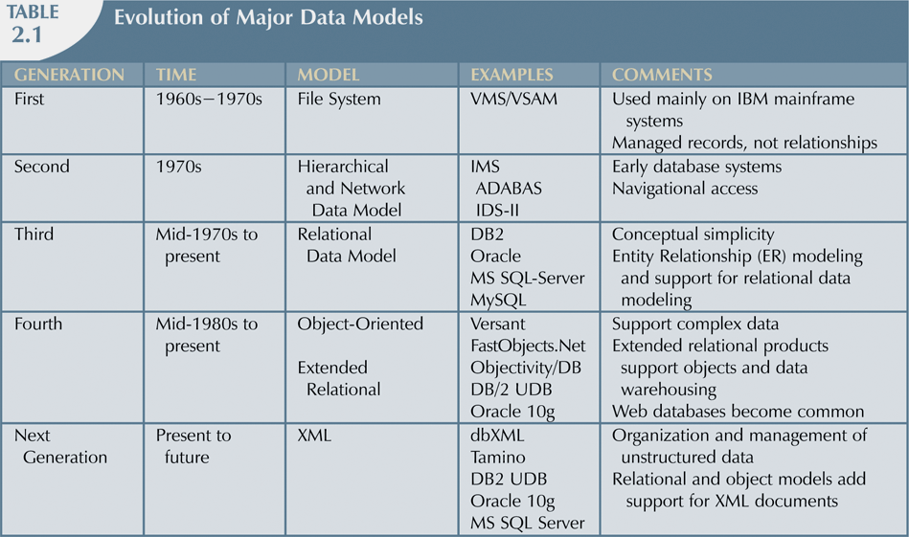
The Evolution of Data Models
Database Systems, 8th Edition

Slide 12
The Hierarchical Model
Developed in the 1960s to manage large amounts of data for manufacturing projects
Basic logical structure is represented by an upside-down “tree”
Hierarchical structure contains levels or segments
  Segment analogous to a record type
  Set of one-to-many relationships between segments
Database Systems, 8th Edition

Slide 13
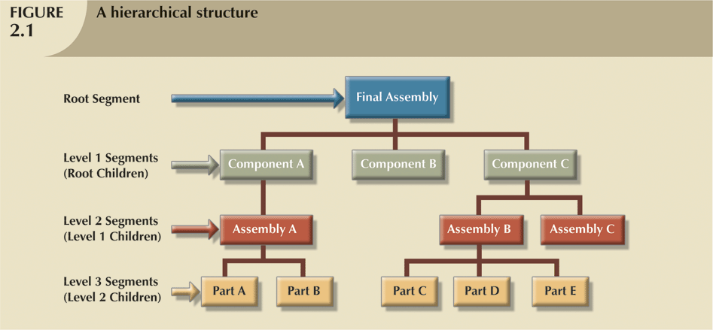
Database Systems, 8th Edition

Slide 14
The Hierarchical Model (continued)
Foundation for current data models
Disadvantages of the hierarchical model:
  Complex to implement
  Difficult to manage
  Lacks structural independence
  Relationships do not conform to 1:M form
  No standards for how to implement
Database Systems, 8th Edition

Slide 15
The Network Model
Created to represent complex data relationships more effectively
  Improves database performance
  Imposes a database standard
Conference on Data Systems Languages (CODASYL) created the DBTG
Database Task Group (DBTG): defined environment to facilitate database creation
Database Systems, 8th Edition

Slide 16
The Network Model (continued)
Schema
  Conceptual organization of entire database as viewed by the database administrator
Subschema
  Database portion “seen” by the application programs
Data management language (DML)
  Defines the environment in which data can be managed
Database Systems, 8th Edition

Slide 17
The Network Model (continued)
Resembles hierarchical model
  Record may have more than one parent
Collection of records in 1:M relationships
Set composed of two record types
  Owner
    Equivalent to the hierarchical model’s parent
  Member
    Equivalent to the hierarchical model’s child
Database Systems, 8th Edition

Slide 18
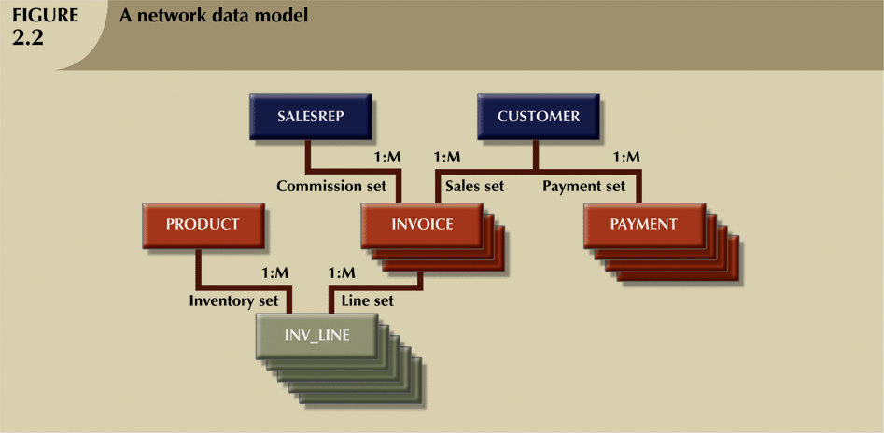
Database Systems, 8th Edition

Slide 19
The Network Model (continued)
Disadvantages of the network model
  Cumbersome
  Lack of ad hoc query capability placed burden on programmers to generate code for reports
  Structural change in the database could produce havoc in all application programs
Database Systems, 8th Edition

Slide 20
The Relational Model
Developed by E. F. Codd (IBM) in 1970
Table (relations)
  Matrix consisting of row/column intersections
  Each row in a relation called a tuple
Relational models considered impractical in 1970
Model conceptually simple at expense of computer overhead
Database Systems, 8th Edition

Slide 21
The Relational Model (continued)
Relational data management system (RDBMS)
  Performs same functions provided by hierarchical model
  Hides complexity from the user
Relational diagram
  Representation of entities, attributes, and relationships
Relational table stores collection of related entities
Database Systems, 8th Edition

Slide 22
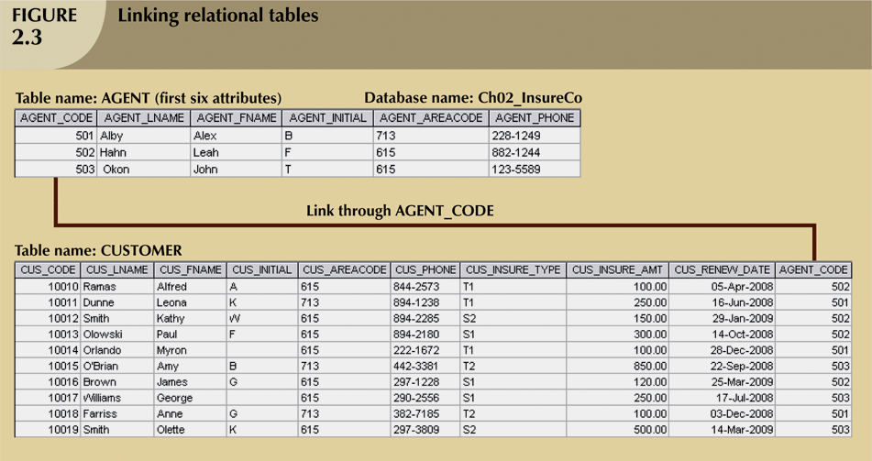
Database Systems, 8th Edition

Slide 23
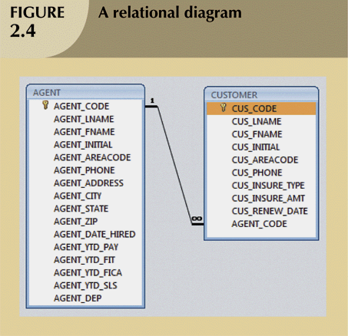
Database Systems, 8th Edition

Slide 24
The Relational Model (continued)
SQL-based relational database application involves three parts:
  User interface
    Allows end user to interact with the data
  Set of tables stored in the database
    Each table is independent from another
    Rows in different tables related based on common values in common attributes
  SQL “engine”
    Executes all queries
Database Systems, 8th Edition

Slide 25
The Entity Relationship Model
Widely accepted standard for data modeling
Introduced by Chen in 1976
Graphical representation of entities and their relationships in a database structure
Entity relationship diagram (ERD)
  Uses graphic representations to model database components
  Entity is mapped to a relational table
Database Systems, 8th Edition

Slide 26
The Entity Relationship Model (continued)
Entity instance (or occurrence) is row in table
Entity set is collection of like entities
Connectivity labels types of relationships
Relationships expressed using Chen notation
  Relationships represented by a diamond
  Relationship name written inside the diamond
Crow’s Foot notation used as design standard in this book
Database Systems, 8th Edition

Slide 27
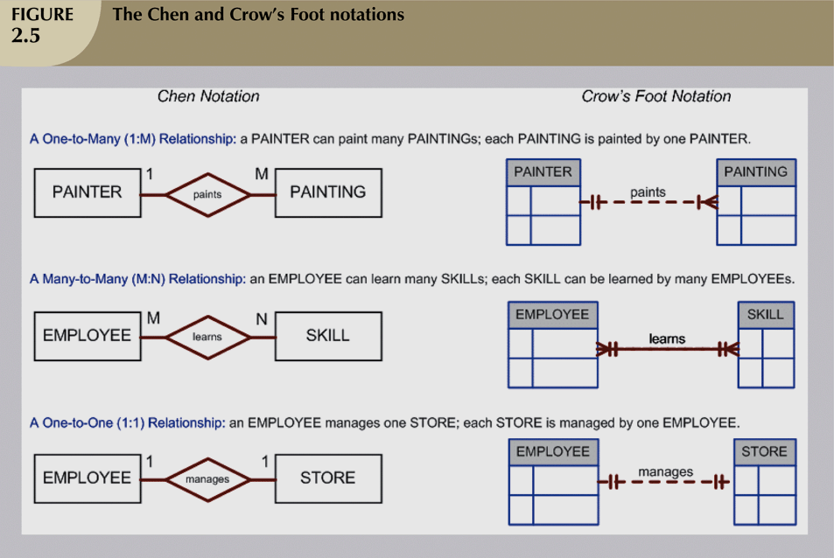
Database Systems, 8th Edition

Slide 28
The Object-Oriented (OO) Model
Data and relationships contained in single structure known as an object
OODM (object-oriented data model) is the basis for OODBMS
  Semantic data model
Objects contain operations
Object is self-contained: a basic building-block for autonomous structures
Object is an abstraction of a real-world entity
Database Systems, 8th Edition

Slide 29
The Object-Oriented (OO) Model (continued)
Attributes describe the properties of an object
Objects that share similar characteristics are grouped in classes
Classes are organized in a class hierarchy
Inheritance: object inherits methods and attributes of parent class
UML based on OO concepts that describe diagrams and symbols
  Used to graphically model a system
Database Systems, 8th Edition

Slide 30
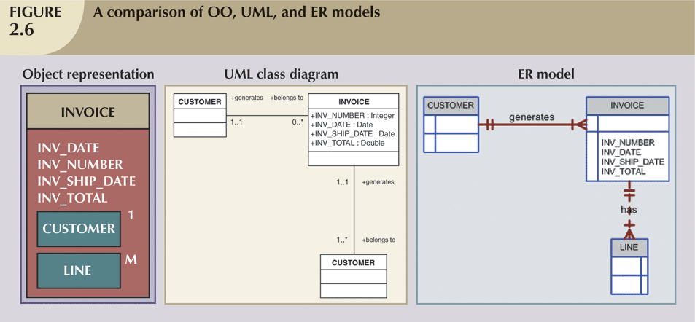
Database Systems, 8th Edition

Slide 31
The Convergence of Data Models
Extended relational data model (ERDM)
  Semantic data model developed in response to increasing complexity of applications
  Includes many of OO model’s best features
  Often described as an object/relational database management system (O/RDBMS)
  Primarily geared to business applications
Database Systems, 8th Edition

Slide 32
Database Models and the Internet
Internet drastically changed role and scope of database market
Focus on Internet makes underlying data model less important
Dominance of Web has resulted in growing need to manage unstructured information
Current databases support XML
  XML: the standard protocol for data exchange among systems and Internet services
Database Systems, 8th Edition

Slide 33
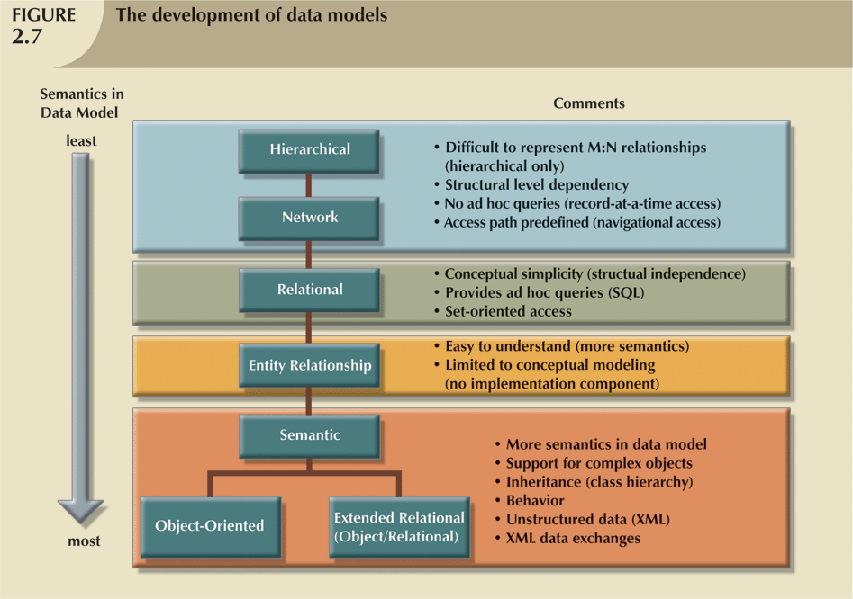
Database Systems, 8th Edition

Slide 34
Data Models: A Summary
Common characteristics:
  Conceptual simplicity with semantic completeness
  Represent the real world as closely as possible
  Real-world transformations must comply with consistency and integrity characteristics
Each new data model capitalized on the shortcomings of previous models
Some models better suited for some tasks
Database Systems, 8th Edition

Slide 35
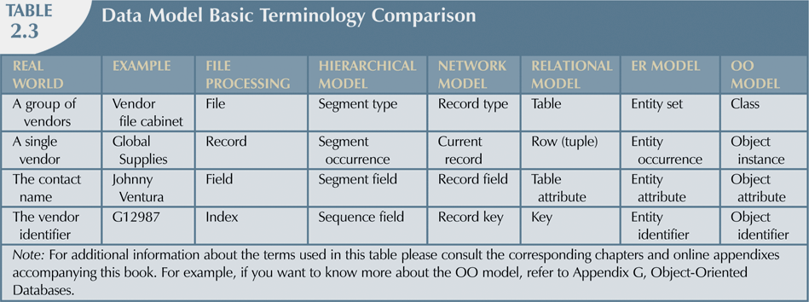
Database Systems, 8th Edition

Slide 36
Degrees of Data Abstraction
Database designer starts with abstracted view, then adds details
ANSI Standards Planning and Requirements Committee (SPARC)
  Defined a framework for data modeling based on degrees of data abstraction (1970s):
    External
    Conceptual
    Internal
Database Systems, 8th Edition

Slide 37
The External Model
End users’ view of the data environment
ER diagrams represent external views
External schema: specific representation of an external view
  Entities
  Relationships
  Processes
  Constraints
Database Systems, 8th Edition

Slide 38
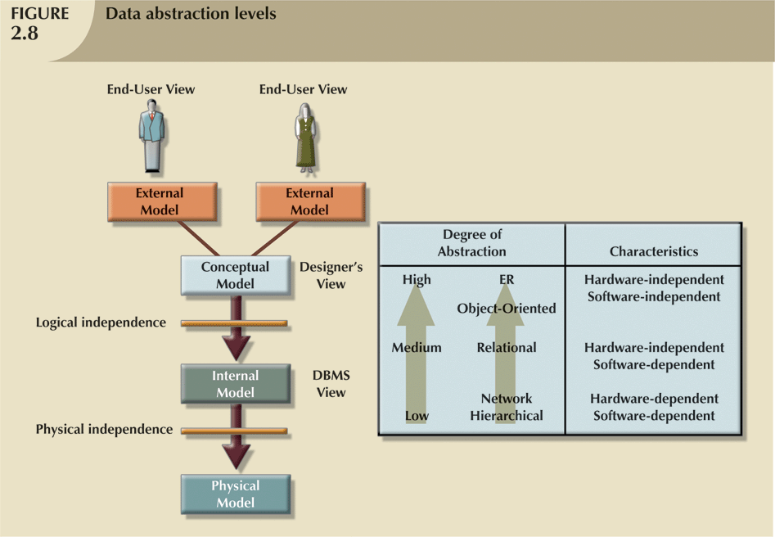
Database Systems, 8th Edition

Slide 39
The External Model (continued)
Easy to identify specific data required to support each business unit’s operations
Facilitates designer’s job by providing feedback about the model’s adequacy
Ensures security constraints in database design
Simplifies application program development
Database Systems, 8th Edition

Slide 40
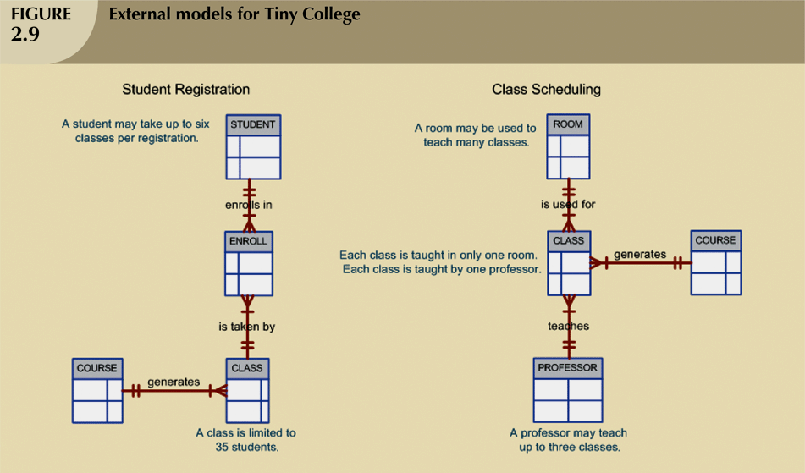
Database Systems, 8th Edition

Slide 41
The Conceptual Model
Represents global view of the entire database
All external views integrated into single global view: conceptual schema
ER model most widely used
ERD graphically represents the conceptual schema
Database Systems, 8th Edition

Slide 42
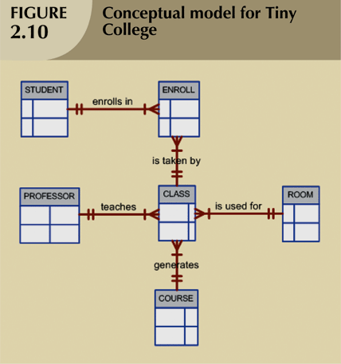
Database Systems, 8th Edition

Slide 43
The Conceptual Model (continued)
Provides a relatively easily understood macro level view of data environment
Independent of both software and hardware
  Does not depend on the DBMS software used to implement the model
  Does not depend on the hardware used in the implementation of the model
  Changes in hardware or software do not affect database design at the conceptual level
Database Systems, 8th Edition

Slide 44
The Internal Model
Representation of the database as “seen” by the DBMS
  Maps the conceptual model to the DBMS
Internal schema depicts a specific representation of an internal model
Depends on specific database software
  Change in DBMS software requires internal model be changed
Logical independence: change internal model without affecting conceptual model
Database Systems, 8th Edition

Slide 45
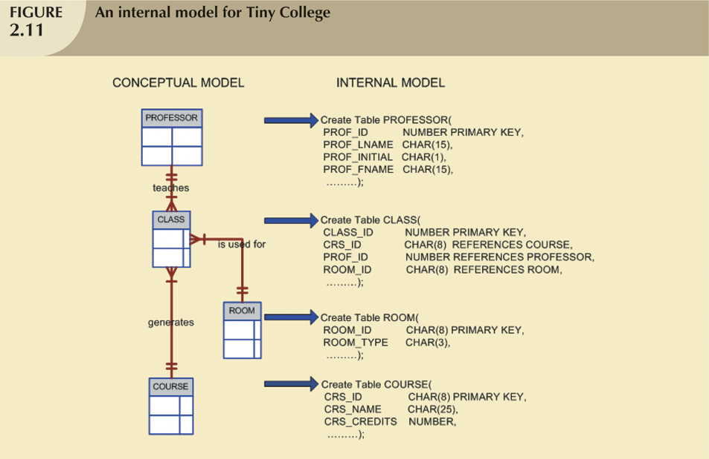
Database Systems, 8th Edition

Slide 46
The Physical Model
Operates at lowest level of abstraction
  Describes the way data are saved on storage media such as disks or tapes
Requires the definition of physical storage and data access methods
Relational model aimed at logical level
  Does not require physical-level details
Physical independence: changes in physical model do not affect internal model
Database Systems, 8th Edition

Slide 47
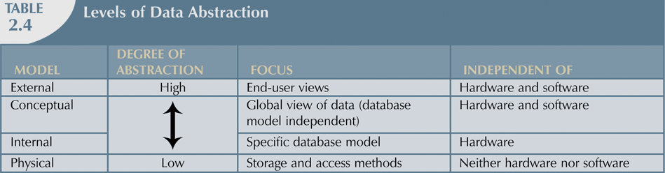
Database Systems, 8th Edition

Slide 48
Summary
A data model is an abstraction of a complex real-world data environment
Basic data modeling components:
  Entities
  Attributes
  Relationships
  Constraints
Business rules identify and define basic modeling components
Database Systems, 8th Edition

Slide 49
Summary (continued)
Hierarchical model
  Set of one-to-many (1:M) relationships between a parent and its children segments
Network data model
  Uses sets to represent 1:M relationships between record types
Relational model
  Current database implementation standard
  ER model is a tool for data modeling
    Complements relational model
Database Systems, 8th Edition

Slide 50
Summary (continued)
Object-oriented data model: object is basic modeling structure
Relational model adopted object-oriented extensions: extended relational data model (ERDM)
OO data models depicted using UML
Data modeling requirements are a function of different data views and abstraction levels
  Three abstraction levels: external, conceptual, internal
Database Systems, 8th Edition

