Slide 1

Database Systems: Design, Implementation, and Management
Eighth Edition
Chapter 3
The Relational Database Model

Slide 2
Objectives
In this chapter, you will learn:
  That the relational database model offers a logical view of data
  About the relational model’s basic component: relations
  That relations are logical constructs composed of rows (tuples) and columns (attributes)
  That relations are implemented as tables in a relational DBMS
Database Systems, 8th Edition

Slide 3
Objectives (continued)
In this chapter, you will learn: (continued)
  About relational database operators, the data dictionary, and the system catalog
  How data redundancy is handled in the relational database model
  Why indexing is important
Database Systems, 8th Edition

Slide 4
A Logical View of Data
Relational model
  View data logically rather than physically
Table
  Structural and data independence
  Resembles a file conceptually
Relational database model easier to understand than hierarchical and network models
Database Systems, 8th Edition

Slide 5
Tables and Their Characteristics
Logical view of relational database based on relation
  Relation thought of as a table
Table: two-dimensional structure composed of rows and columns
  Persistent representation of logical relation
Contains group of related entities = an entity set
Database Systems, 8th Edition

Slide 6
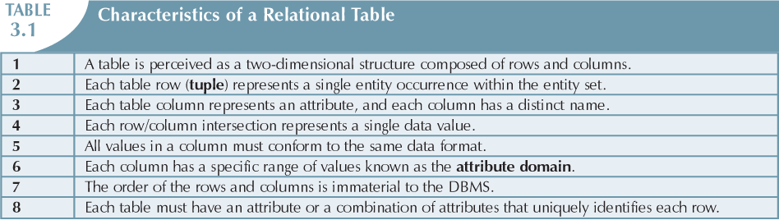
Database Systems, 8th Edition

Slide 7
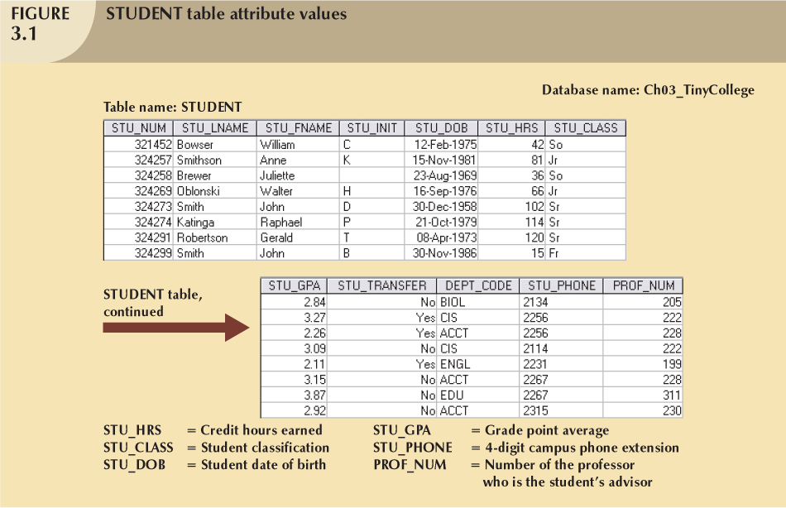
Database Systems, 8th Edition

Slide 8
Keys
Each row in a table must be uniquely identifiable
Key is one or more attributes that determine other attributes
Key’s role is based on determination
  If you know the value of attribute A, you can determine the value of attribute B
Functional independence:
  Attribute B functionally dependent on A if all rows in table that agree in value for A also agree in value for B
Database Systems, 8th Edition

Slide 9
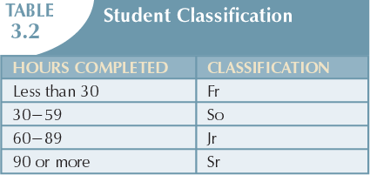
Database Systems, 8th Edition

Slide 10
Keys (continued)
Composite key
  Composed of more than one attribute
Key attribute
  Any attribute that is part of a key
Superkey
  Any key that uniquely identifies each row
Candidate key
  A superkey without unnecessary attributes
Database Systems, 8th Edition

Slide 11
Keys (continued)
Nulls:
  No data entry
  Not permitted in primary key
  Should be avoided in other attributes
  Can represent
    An unknown attribute value
    A known, but missing, attribute value
    A “not applicable” condition
Database Systems, 8th Edition

Slide 12
Keys (continued)
Nulls:
  Can create problems when functions such as COUNT, AVERAGE, and SUM are used
  Can create logical problems when relational tables are linked
Database Systems, 8th Edition

Slide 13
Keys (continued)
Controlled redundancy:
  Makes the relational database work
  Tables within the database share common attributes
    Enables tables to be linked together
  Multiple occurrences of values not redundant when required to make the relationship work
  Redundancy exists only when there is unnecessary duplication of attribute values
Database Systems, 8th Edition

Slide 14
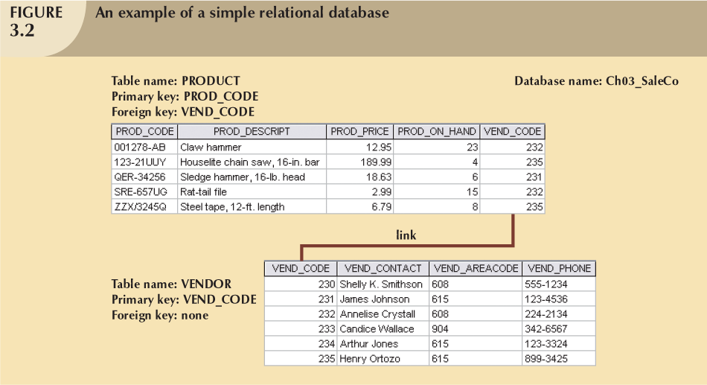
Database Systems, 8th Edition

Slide 15
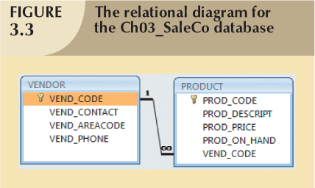
Database Systems, 8th Edition

Slide 16
Keys (continued)
Foreign key (FK)
  An attribute whose values match primary key values in the related table
Referential integrity
  FK contains a value that refers to an existing valid tuple (row) in another relation
Secondary key
  Key used strictly for data retrieval purposes
Database Systems, 8th Edition

Slide 17
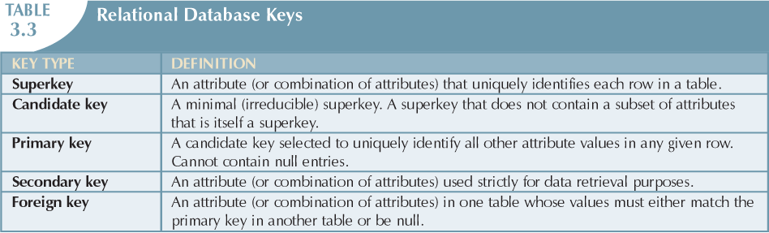
Database Systems, 8th Edition

Slide 18
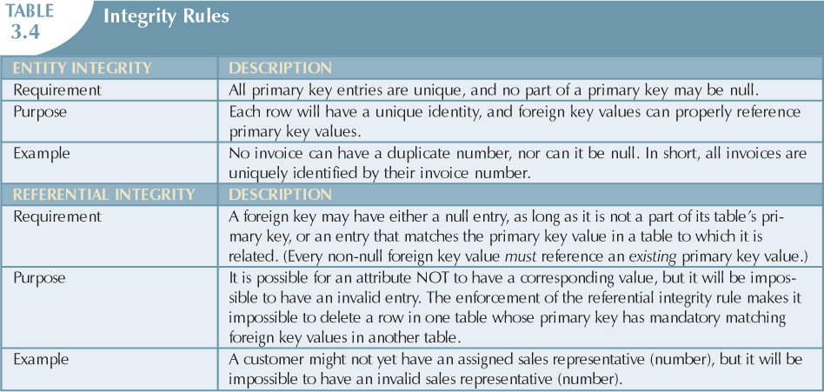
Database Systems, 8th Edition

Slide 19
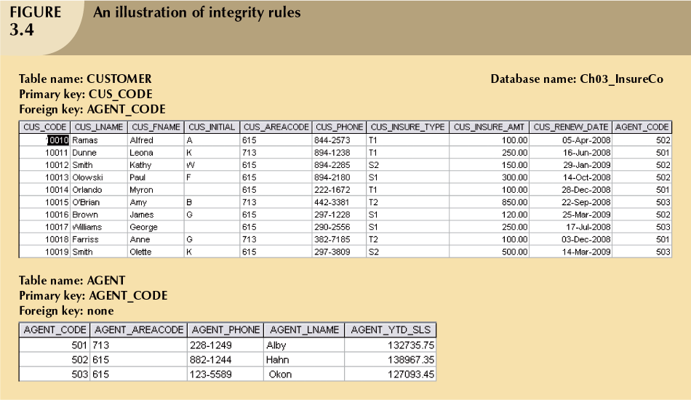
Database Systems, 8th Edition

Slide 20
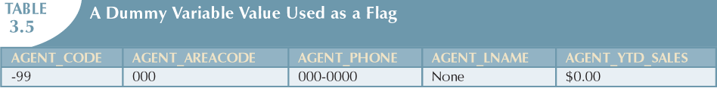
Integrity Rules
Many RDBMs enforce integrity rules automatically
Safer to ensure application design conforms to entity and referential integrity rules
Designers use flags to avoid nulls
  Flags indicate absence of some value
Database Systems, 8th Edition

Slide 21
Relational Set Operators
Relational algebra
  Defines theoretical way of manipulating table contents using relational operators
  Use of relational algebra operators on existing relations produces new relations
    UNION INTERSECT
    DIFFERENCE PRODUCT
    SELECT PROJECT JOIN DIVIDE
Database Systems, 8th Edition

Slide 22
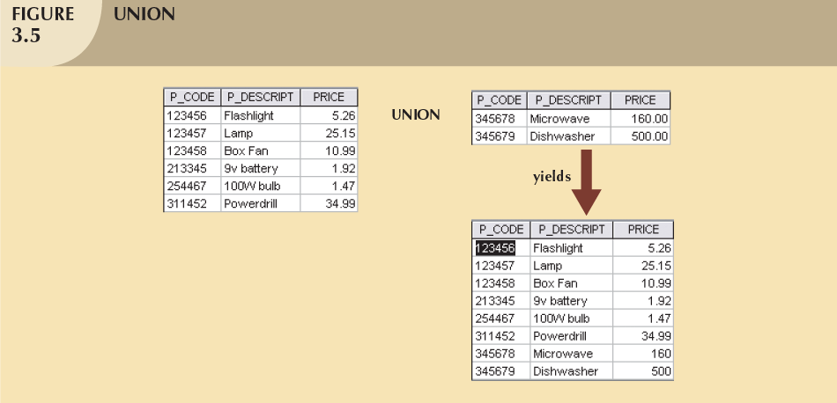
Database Systems, 8th Edition

Slide 23
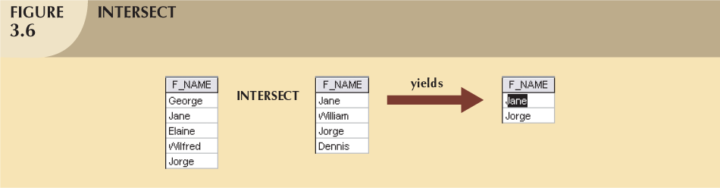
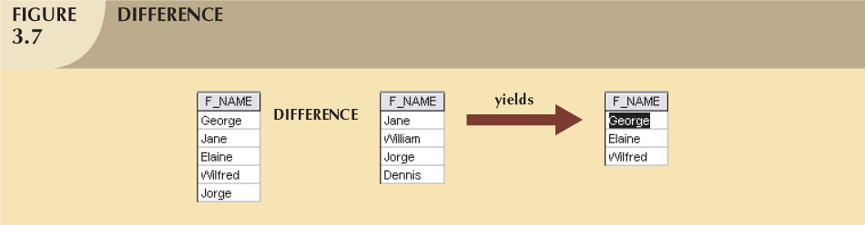
Database Systems, 8th Edition

Slide 24
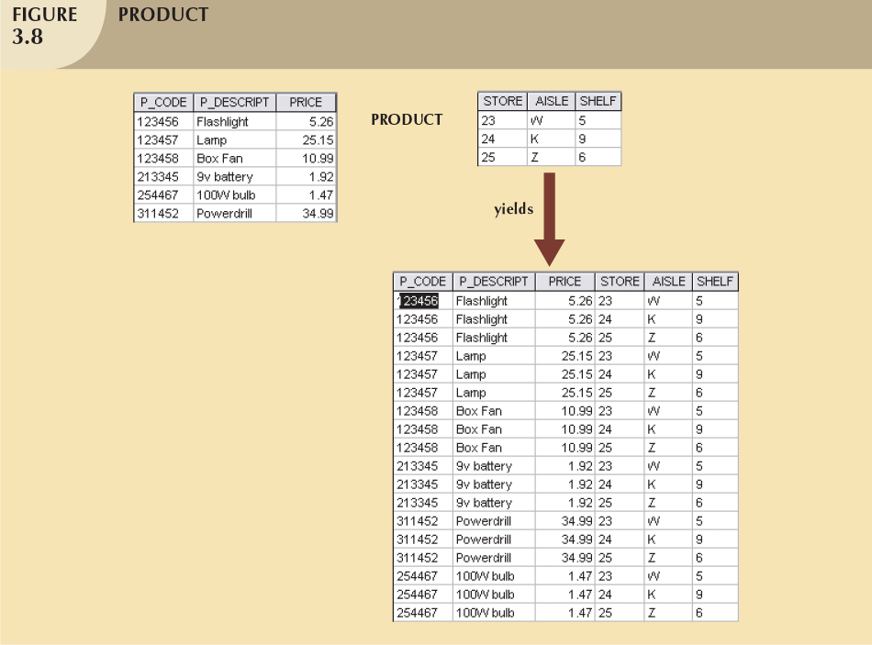
Database Systems, 8th Edition

Slide 25
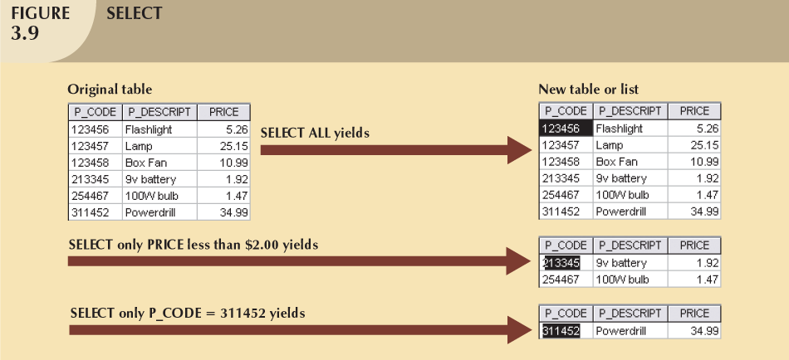
Database Systems, 8th Edition

Slide 26
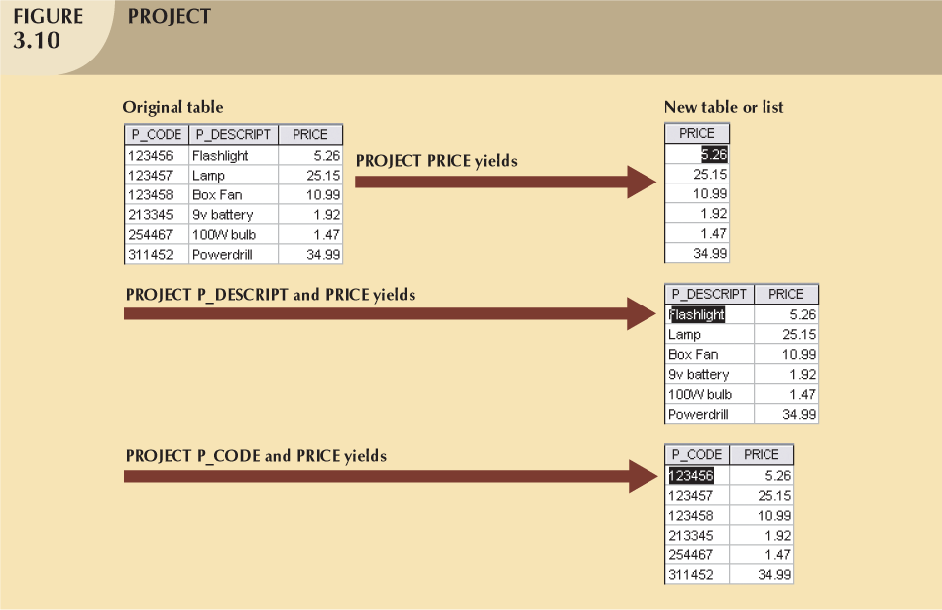
Database Systems, 8th Edition

Slide 27
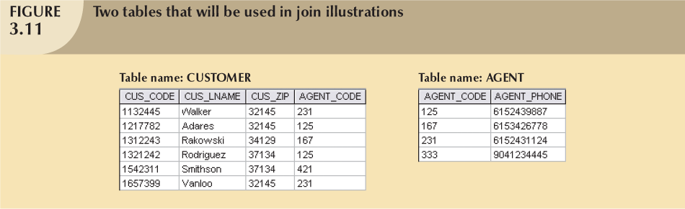
Database Systems, 8th Edition

Slide 28
Relational Algebra Operators (continued)
Natural Join
  Links tables by selecting only rows with common values in their common attribute(s)
  Result of a three-stage process:
    PRODUCT of the tables is created
    SELECT is performed on Step 1 output to yield only the rows for which the AGENT_CODE values are equal
      Common column(s) are called join column(s)
    PROJECT is performed on Step 2 results to yield a single copy of each attribute, thereby eliminating duplicate columns

Slide 29
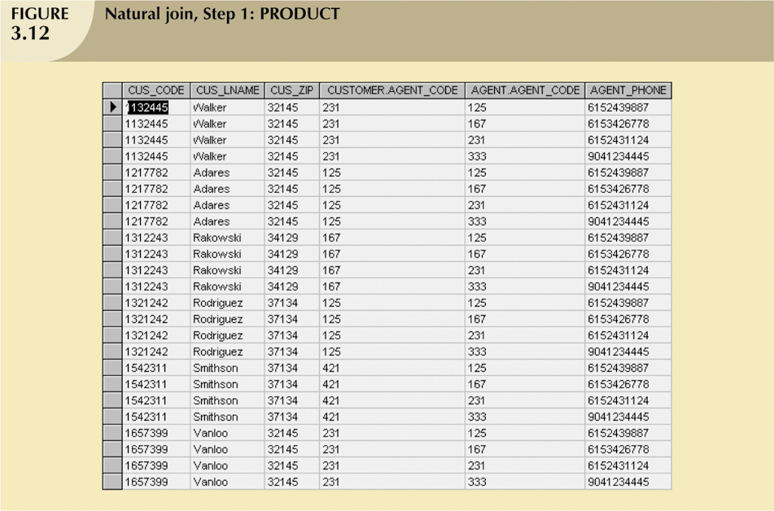
Relational Algebra Operators (continued)

Slide 30
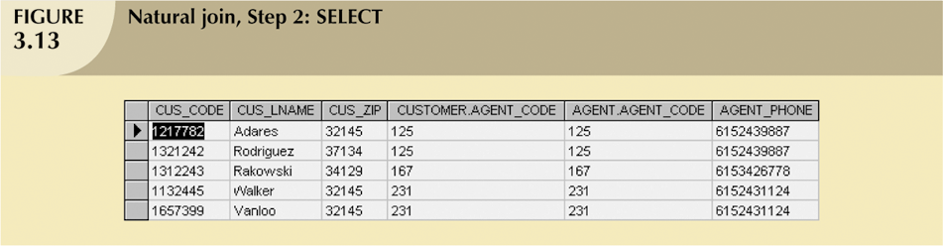
Relational Algebra Operators (continued)

Slide 31
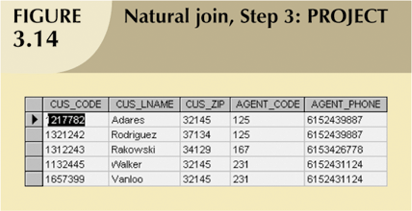
Relational Algebra Operators (continued)

Slide 32
Relational Algebra Operators (continued)
Natural Join:
  Final outcome yields table that
    Does not include unmatched pairs
    Provides only copies of matches
  If no match is made between the table rows
    the new table does not include the unmatched row

Slide 33
Relational Algebra Operators (continued)
Natural Join (continued):
  The column on which the join was made - that is, AGENT_CODE - occurs only once in the new table
  If the same AGENT_CODE were to occur several times in the AGENT table,
    a customer would be listed for each match

Slide 34
Relational Set Operators (continued)
Natural Join
  Links tables by selecting rows with common values in common attribute(s)
Equijoin
  Links tables on the basis of an equality condition that compares specified columns
Theta join
  Any other comparison operator is used
Outer join
  Matched pairs retained and any unmatched values in other table left null
Database Systems, 8th Edition

Slide 35
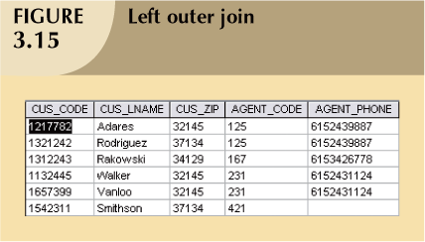
Database Systems, 8th Edition

Slide 36
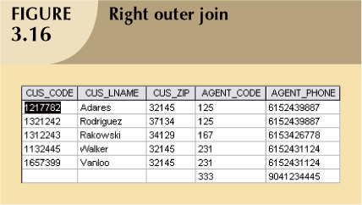
Database Systems, 8th Edition

Slide 37
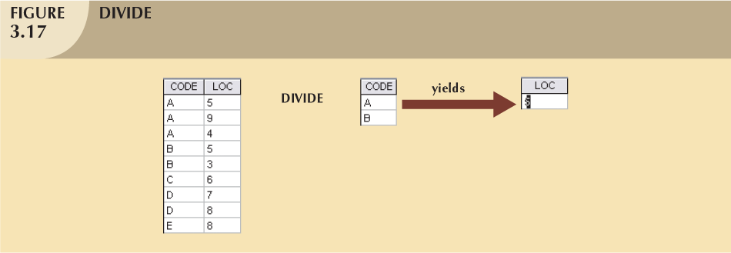
Database Systems, 8th Edition

Slide 38
The Data Dictionary and System Catalog
Data dictionary
  Provides detailed accounting of all tables found within the user/designer-created database
  Contains (at least) all the attribute names and characteristics for each table in the system
  Contains metadata: data about data
System catalog
  Contains metadata
  Detailed system data dictionary that describes all objects within the database
Database Systems, 8th Edition

Slide 39
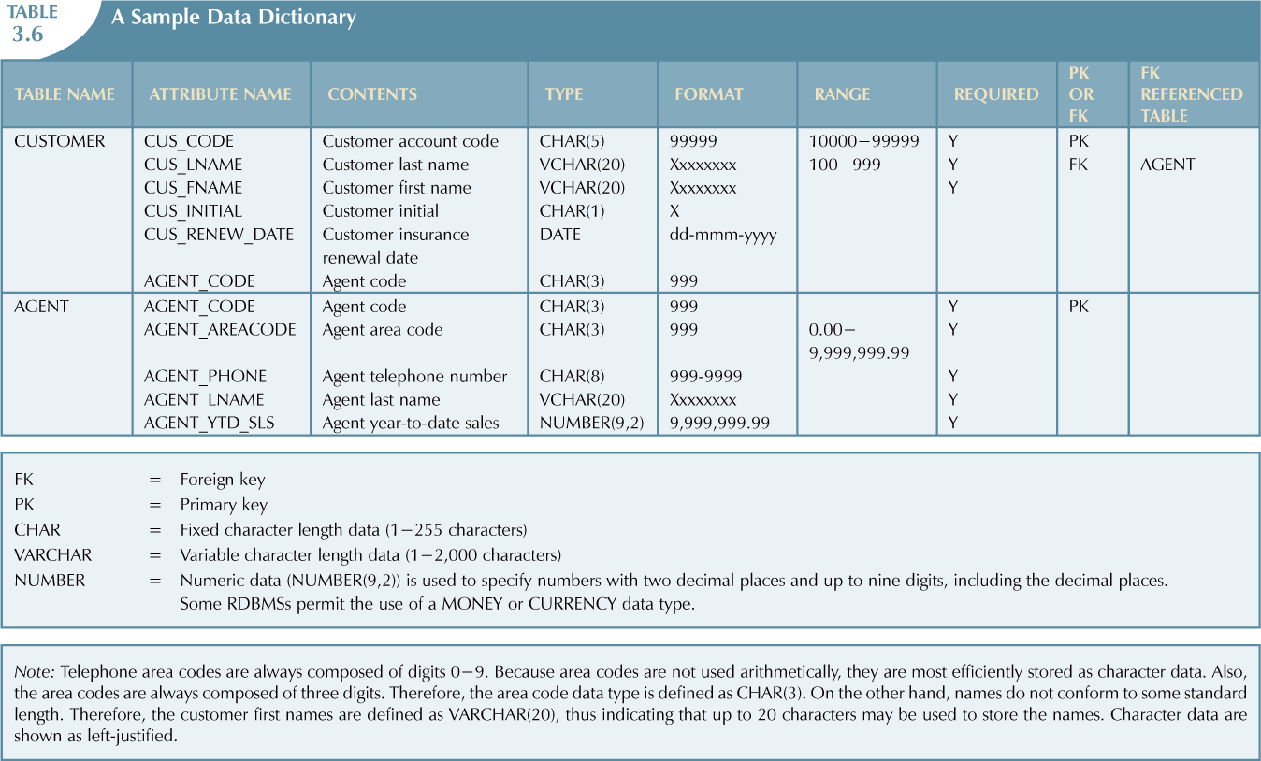
Database Systems, 8th Edition

Slide 40
Relationships within the Relational Database
1:M relationship
  Relational modeling ideal
  Should be the norm in any relational database design
1:1 relationship
  Should be rare in any relational database design
Database Systems, 8th Edition

Slide 41
Relationships within the Relational Database (continued)
M:N relationships
  Cannot be implemented as such in the relational model
  M:N relationships can be changed into two 1:M relationships
Database Systems, 8th Edition

Slide 42
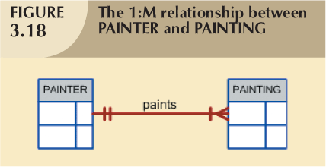
The 1:M Relationship
Relational database norm
Found in any database environment
Database Systems, 8th Edition

Slide 43
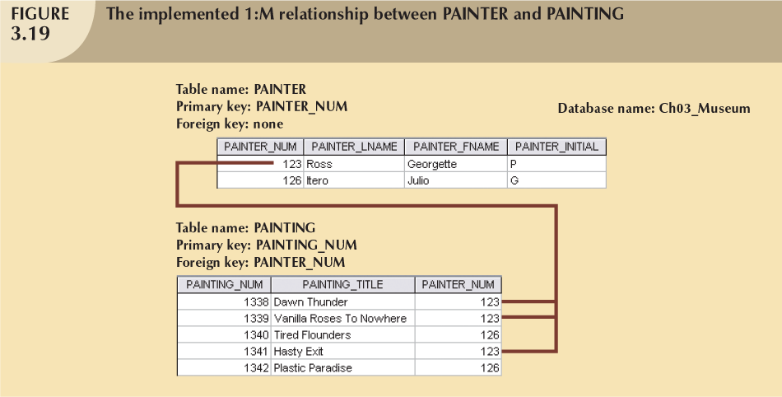
Database Systems, 8th Edition

Slide 44
The 1:1 Relationship
One entity related to only one other entity, and vice versa
Sometimes means that entity components were not defined properly
Could indicate that two entities actually belong in the same table
Certain conditions absolutely require their use
Database Systems, 8th Edition

Slide 45
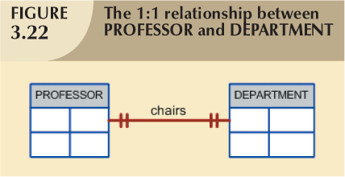
Database Systems, 8th Edition

Slide 46
The M:N Relationship
Implemented by breaking it up to produce a set of 1:M relationships
Avoid problems inherent to M:N relationship by creating a composite entity
  Includes as foreign keys the primary keys of tables to be linked
Database Systems, 8th Edition

Slide 47
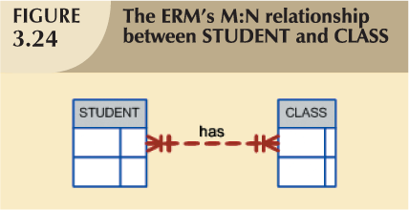
Database Systems, 8th Edition

Slide 48
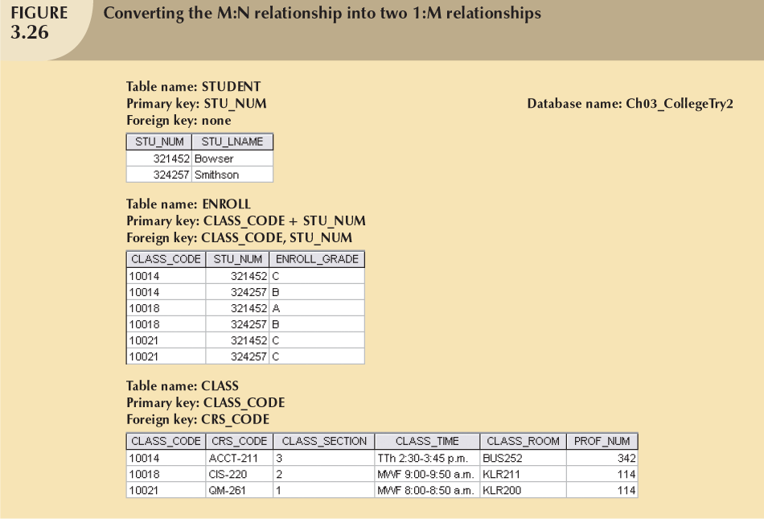
Database Systems, 8th Edition

Slide 49
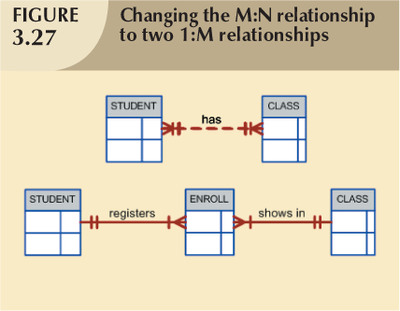
Database Systems, 8th Edition

Slide 50
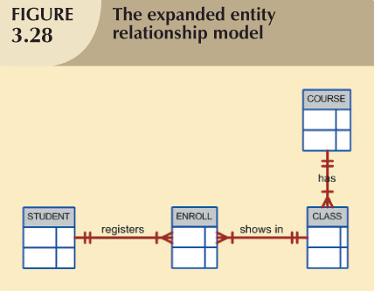
Database Systems, 8th Edition

Slide 51
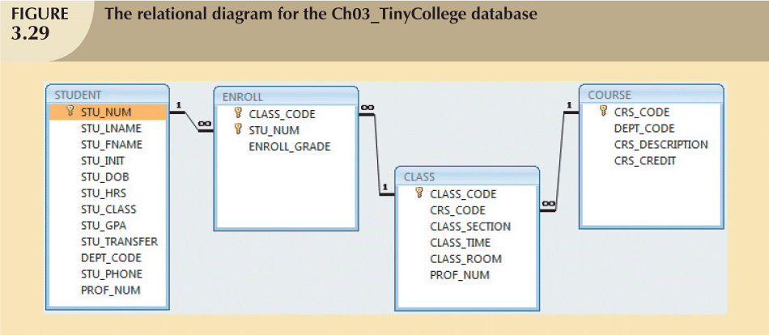
Database Systems, 8th Edition

Slide 52
Data Redundancy Revisited
Data redundancy leads to data anomalies
  Such anomalies can destroy the effectiveness of the database
Foreign keys
  Control data redundancies by using common attributes shared by tables
  Crucial to exercising data redundancy control
Sometimes, data redundancy is necessary
Database Systems, 8th Edition

Slide 53
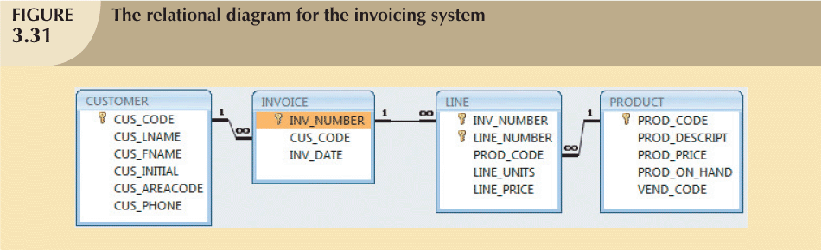
Database Systems, 8th Edition

Slide 54
Indexes
Orderly arrangement to logically access rows in a table
Index key
  Index’s reference point
  Points to data location identified by the key
Unique index
  Index in which the index key can have only one pointer value (row) associated with it
Each index is associated with only one table
Database Systems, 8th Edition

Slide 55
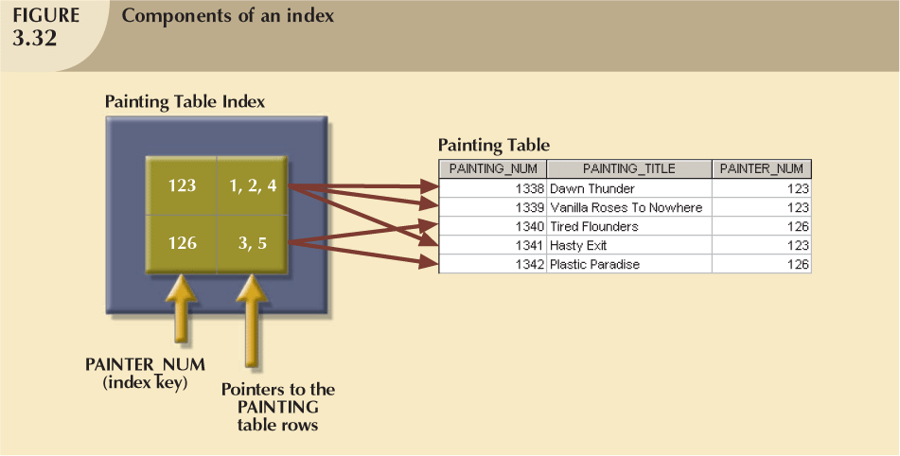
Database Systems, 8th Edition

Slide 56
Codd’s Relational Database Rules
In 1985, Codd published a list of 12 rules to define a relational database system
  Products marketed as “relational” that did not meet minimum relational standards
Even dominant database vendors do not fully support all 12 rules
Database Systems, 8th Edition

Slide 57
Summary
Tables are basic building blocks of a relational database
Keys are central to the use of relational tables
Keys define functional dependencies
  Superkey
  Candidate key
  Primary key
  Secondary key
  Foreign key
Database Systems, 8th Edition

Slide 58
Summary (continued)
Each table row must have a primary key that uniquely identifies all attributes
Tables linked by common attributes
The relational model supports relational algebra functions
  SELECT, PROJECT, JOIN, INTERSECT UNION, DIFFERENCE, PRODUCT, DIVIDE
Good design begins by identifying entities, attributes, and relationships
  1:1, 1:M, M:N
Database Systems, 8th Edition

