Slide 1
A Java Application for Music Visualization Through Amplitude, Frequency Extraction, and 2-D Java Graphics
Isaac Delgado
Mentor: Ismail Alihan Hadimlioglu, MSc.

Slide 2
Overview
Introduction
Literature Review
Methodology
Evaluation & Discussion
Conclusion
Future Work

Slide 3
Introduction
Music Study
Music Theory, Musicology
Physical (wave forms)
Psychology (emotion, perception, etc.)
Glenn Schellenberg-“Music Lessons Enhance IQ”
Visualization adds another dimension to Music
Visualization helps us understand music
Understand correlation with intelligence
Understand mind

Slide 4
Literature Review
To create a Music Application we must understand Music
Logical Structure (octave change, patterns)
Psychological structure (emotion, perception)
Diana Deutsch “The Psychology of Music”
Catterall & Rauscher “Unpacking the impact of music on intelligence ”
correlation DOES NOT IMPLY causation

Slide 5

Literature Review
Adobe After Effects
https://youtu.be/kJCYPShh758?t=1m
C++
Forefront of major applications today
Microsoft Office, Facebook, MySQL
OpenGL
Powerful, flexible,…..scary

Slide 6
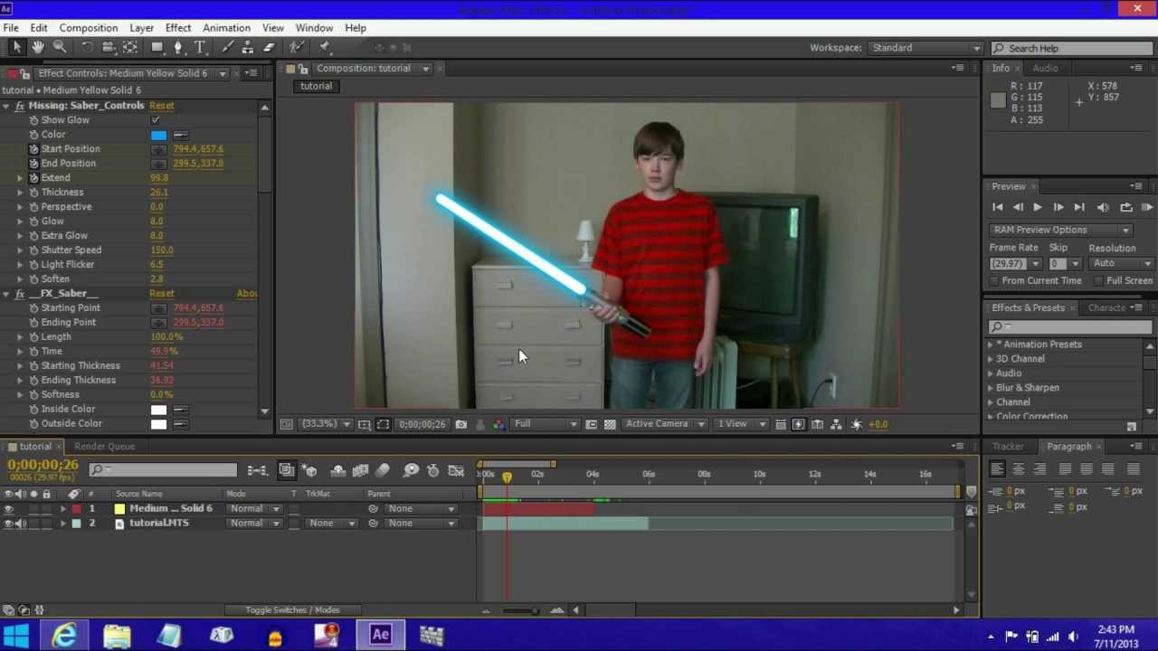

Slide 7

Literature Review
Java
Lighter
Less powerful than C++ but safer
Does not let you touch memory
JVM
JavaFX
Application development ease
AudioSpectrumListener

Slide 8
Literature Review
“The Structure Of Music: a listener’s guide” by Robert Erickson
Melody is a body in motion.
Jones & Nevile, Physical Relationships
Frequency-Shape; (higher frequency the smaller the object)
Amplitude-Brightness; (higher amplitude the brighter the object)
Synesthesia
seeing or attributing colors to specific musical tones
Klemenc, B., Ciuha, P. Subelj, L., & Bajec, M.
Created a system of colors that will harmonize the colors with harmonized notes
Craig Stuart Sapp; used color for identifying changes

Slide 9
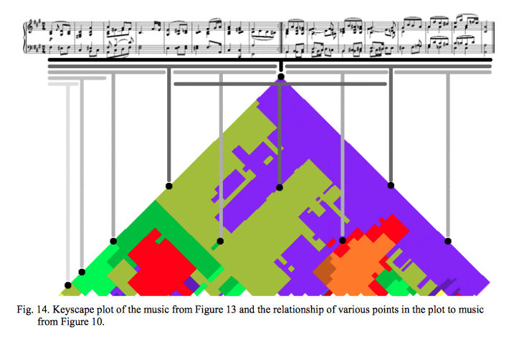

Slide 10
Methodology
Initial Process
C++;
OpenGl; 3-D Graphics
Java; 2-D graphics

Slide 11
Methodology
Application Design
NetBeans; Integrated Development Environment (IDE)
3 Audio tracks were used
C-Scale with Skips (C-E-G-B-D-B-G-E-C)
Octave Change
Chopin-Nocturne in E-flat major Op. 9, No.2
I tried to implement Fast-Fourier Transformation (FFT)….couldn't do it
MatLab; Spectrogram and using FFT functions

Slide 12
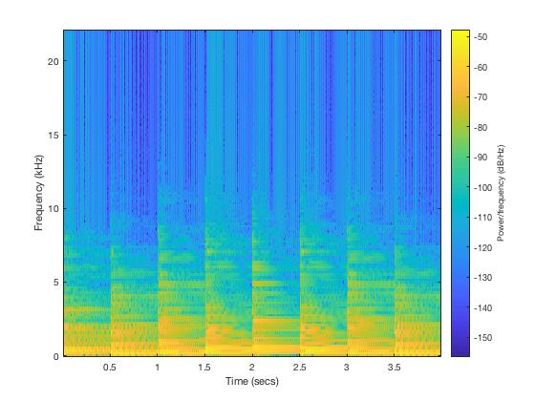
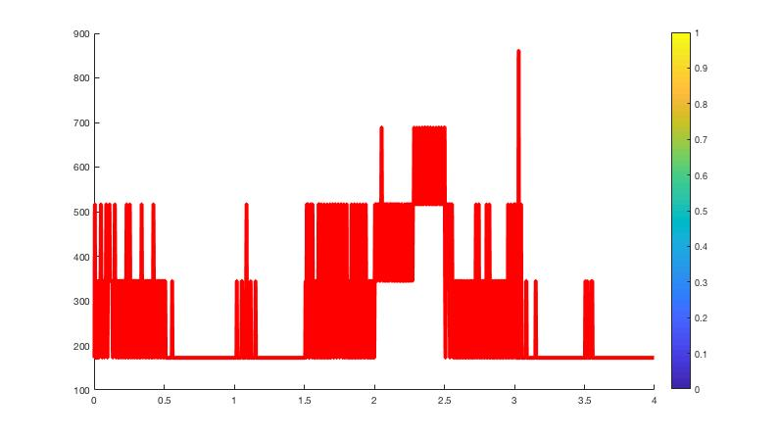
Methodology
C-Scale with Skips

Slide 13
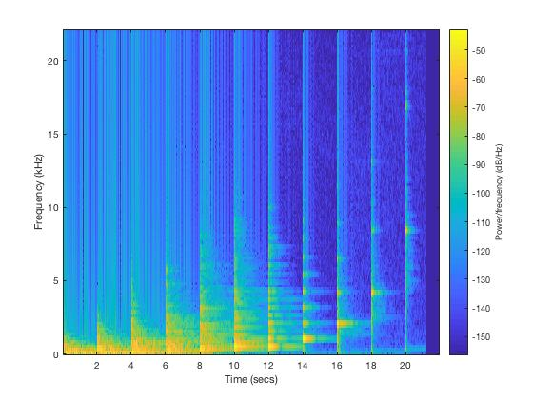
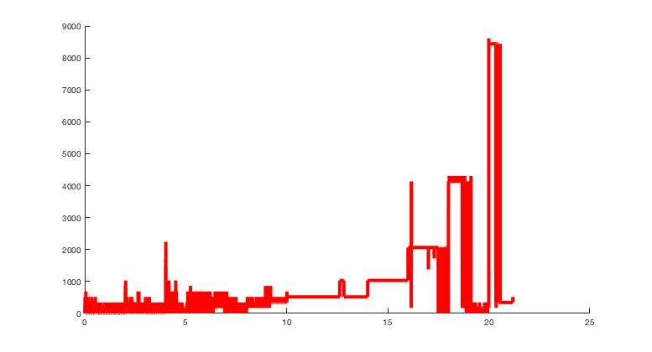
Methodology
Octave Change

Slide 14
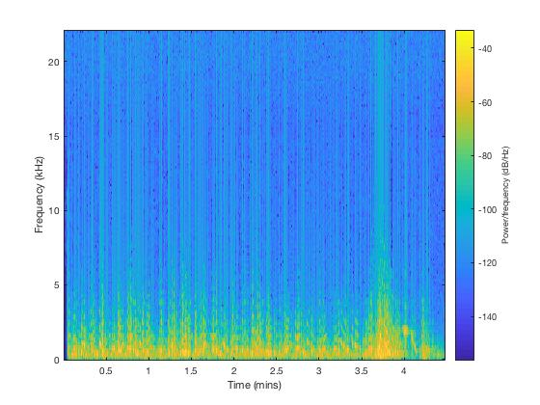
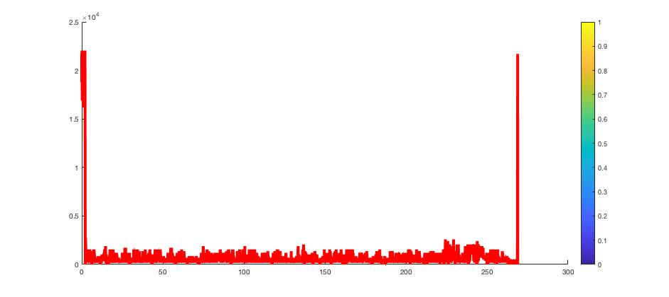
Methodology
Chopin-Nocturne in E-flat major Op. 9, No.2

Slide 15
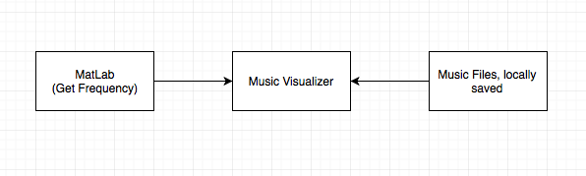
Methodology
Systems Structure

Slide 16
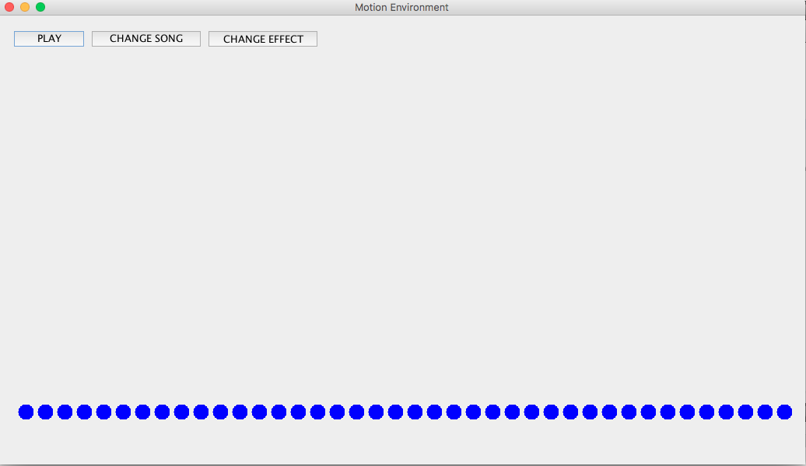
Methodology
Graphical User Interface (GUI)

Slide 17
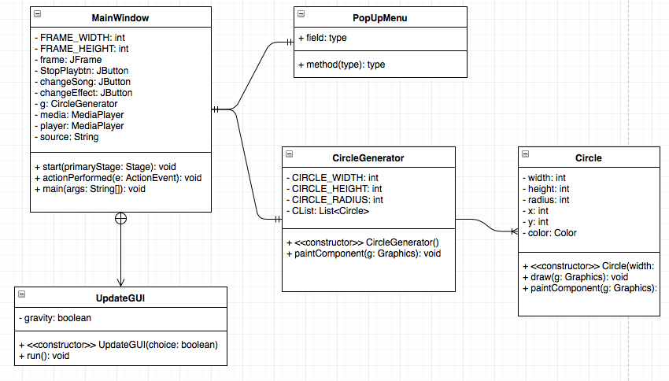
Methodology
Java Application Structure

Slide 18
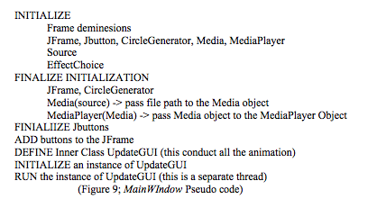
Methodology
MainWindow Class

Slide 19
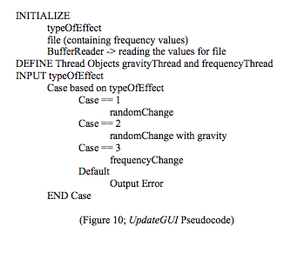
Methodology
UpdateGUI Class

Slide 20
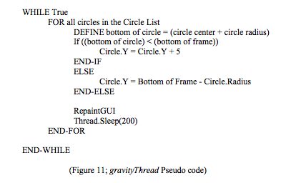
Methodology
gravityThread

Slide 21
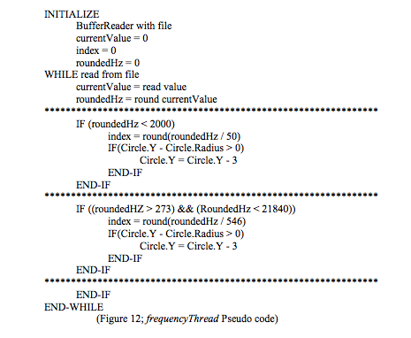
Methodology
frequencyThread

Slide 22
Methodology
Frequency filtering Numbers
Lowest Hz = 172, Highest Hz = 22000
22000 - 172 = 21828
21828 / 40 = 545.7
21828 + 12 = 21840
21840 / 40 = 546
172 / 546 = 0.315 → 0 ///can’t have this
546 / 2 = 273 , thus 273/546 = 0.5 → 1
172 / 50 = 3.44 → to get smaller frequency behavior

Slide 23
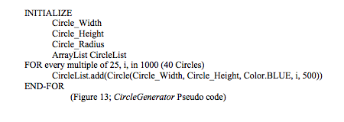
Methodology
CircleGenerator

Slide 24
Evaluation & Discussion
Was able to visualize change in amplitude
Gravity-Random is better than just Random effect
Frequency effect, no concrete conclusion, however successful seeing frequency change
There could have been so much more done with frequency
Although challenging to implement
Not synchronized with music
Even though I captured change, I did not get meaningful change

Slide 25
Conclusion
Music Visualization requirements
Tools and Literature Available
Reviewed application design and structure, and its outcome
Application is a precursor to future music visualizing systems
Help uncover the relationship between music education and intelligence

Slide 26
Future Work
C++
OpenGL
Frequency needs to handled more gracefully
NO TEXT FILES
Better algorithms
Deeper Music Theory and composer ideology is needed

Slide 27
Images in Order of Appearance
https://i.ytimg.com/vi/aWOjJ5oFpuo/maxresdefault.jpg
https://www.opengl.org/img/opengl_logo.png
https://www.wired.com/wp-content/uploads/blogs/wiredenterprise/wp-content/uploads//2012/04/java_logo2.jpg

