Slide 1

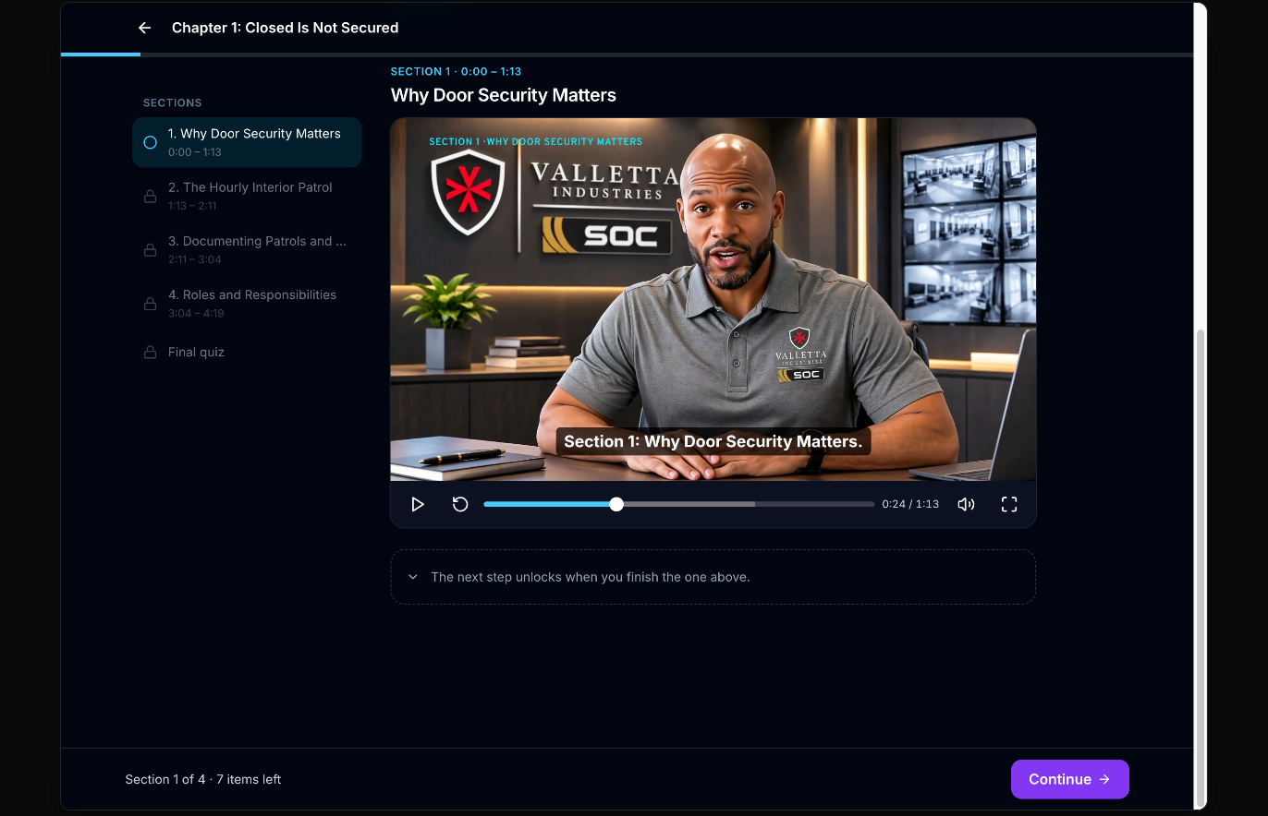
AUDIT-READY TRAINING FOR EVERY HHS SITE
VALLETTA INDUSTRIES
PREPARED FOR
U.S. DEPARTMENT OF HEALTH AND HUMAN SERVICES
Tailored Mission Protect courses that extend your site trainers to 11 sites and 300 officers, on any device.
MISSION PROTECT BY VALLETTA INDUSTRIES · NOVEMBER 2026
Service-Disabled Veteran-Owned · GSA Schedule · SeaPort-NextGen · CMMC Level 1
Notes:
Purpose: show HHS what we already do for USDA, what we would do for HHS, and why it helps.
Open with the frame: Mission Protect adds to the in-person training HHS already runs. It doesn't replace it. It is tailored to HHS directives, keeps every officer in compliance, and is audit-ready.
Scale for HHS: 11 sites, 300 officers. On screen: Chapter 1 of the Door Security Verification module, from The Risks of Routine: Sustaining Operational Vigilance, the course built for HHS.

Slide 2




A training layer on top of the program HHS already runs
THE PROPOSAL
01
02
03
04
ENHANCE
TAILORED
COMPLIANT
AUDIT-READY
Site trainers keep running hands-on training. Mission Protect carries the policy, legal and procedural knowledge between sessions.
Courses built from HHS directives and post orders, not generic off-the-shelf content.
Every officer at every site tracked against the same required curriculum.
Certificates, quiz scores and completion records, ready the moment an auditor asks.
See slide 3 →
See slide 7 →
See slide 4 →
See slide 12 →
Proven at USDA NBAF today. Ready to scale across 11 HHS sites and 300 officers.
Notes:
Four talking points: enhance, tailored, compliance, audit-ready.
Each card is clickable in slideshow mode and jumps to the slide that proves it.

Slide 3












In-person training stays. Mission Protect carries the rest
01 ENHANCE
ON SITE
ON ANY DEVICE
Led by your HHS site trainer
Delivered and tracked in Mission Protect
Combatives
First aid
Legal authority and use of force
Directives and post orders
+
Full mission profiles
Weapons training
Incident response
Biosafety, PPE and CBRN
Qualification training
Physical training
Refreshers when policy changes
Proof of completion
No sending officers to outside schools for knowledge training. It runs in-house, on each officer's schedule.
Notes:
Each HHS site has a site trainer. We do combatives, first aid, full mission profiles, weapons training, qualification training and physical training. That isn't going to stop.
Mission Protect enhances it: the knowledge side (law, policy, directives, response procedures) moves onto a phone, tablet or desktop, and every completion is recorded.
We don't have to send people to outside training for this. We do it in house.

Slide 4
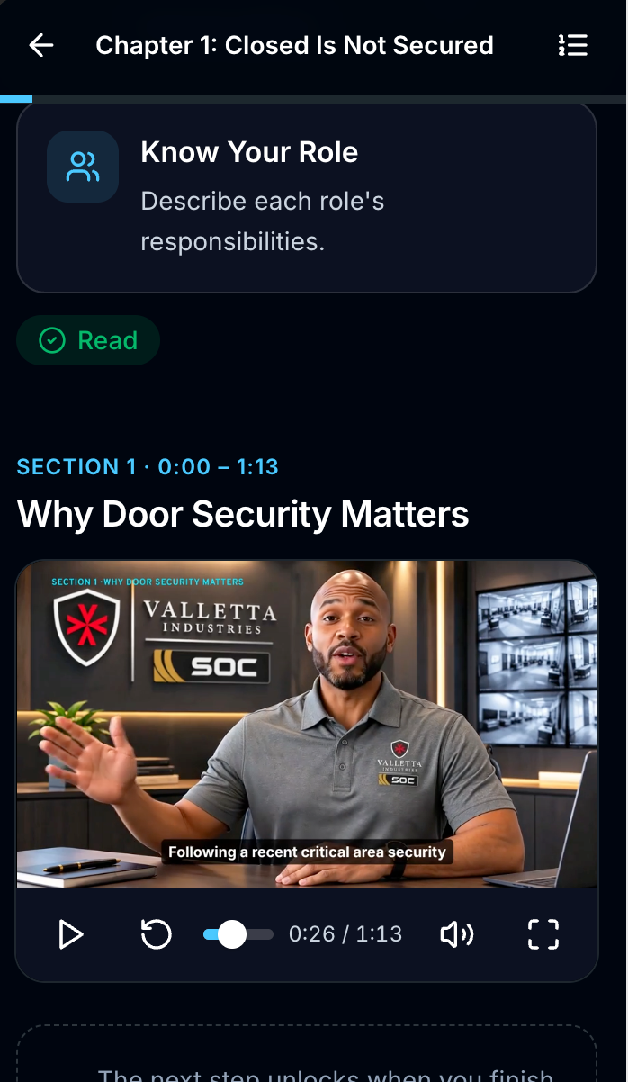
Keeping USDA NBAF's armed officers in compliance
PROVEN TODAY · USDA
National Bio and Agro-Defense Facility, Manhattan, Kansas: a BSL-4 federal laboratory
1,665
certificates issued to USDA NBAF officers since September 1, 2026
49
39
640
1,650
armed security officers trained and tracked
required training courses in the library
hours of training completed
final quizzes passed
Source: Mission Protect platform records for the USDA NBAF account, Sept 1 – Nov 6, 2026.
Notes:
This is what we do for a current client today.
USDA NBAF: we keep 49 guards in compliance with USDA training requirements. The full TR-01 to TR-39 curriculum runs in Mission Protect.
Numbers from the platform as of Nov 6, 2026: 1,666 certificates (one per officer per course, across 44 officers), 640 hours of training, 1,650 final quizzes passed, 4,271 chapter completions. (The platform shows 51 user accounts on the USDA account, including admins; 49 is the guard count.)
Bridge: we can do the same for HHS at scale across 11 sites and 300 employees.

Slide 5

39 courses already built for armed federal security officers
COURSE LIBRARY
9
6
7
8
9
AUTHORITY, LAW AND ETHICS
USE OF FORCE AND OFFICER SAFETY
CRITICAL INCIDENT RESPONSE
POST OPERATIONS
SAFETY, HEALTH AND CBRN
TR-01 Legal Obligations
TR-02 Code of Ethics
TR-03 Fraud, Waste & Abuse
TR-04 Government Equipment
TR-05 Law & Definitions
TR-06 Criminal & Civil Law
TR-07 PII & Sensitive Info
TR-30 Federal Property Rules
TR-34 Detention & Arrest
TR-08 Officer Safety
TR-09 Use of Force
TR-10 Deadly Force
TR-11 Alternate Use of Force
TR-12 De-escalation
TR-13 Defensive Tactics
TR-14 Active Shooter
TR-32 IED Recognition
TR-33 Sabotage & Terrorism
TR-35 Special Situations
TR-36 Code Adam
TR-37 Hostage Situations
TR-38 Civil Disturbance
TR-15 Patrolling
TR-16 Two-Way Radios
TR-17 Crime Scene & Evidence
TR-18 Conflict Resolution
TR-19 Report Writing
TR-20 General & Post Orders
TR-22 Traffic Control
TR-31 Property & Lost/Found
TR-21 Substance Abuse
TR-23 Crime & Fire Prevention
TR-24 Respectful Workplace
TR-25 Biosafety
TR-26 Biohazard Safety
TR-27 PPE
TR-28 BSL-4 / CBRN Response
TR-29 CBN Threat Response
TR-39 BLS / CPR / AED
100 videos and 15 hours of training content. Every course ends in a scored final quiz and a certificate of completion. The biosafety, PPE and CBRN modules were built for a BSL-4 federal laboratory.
Notes:
Walk through the course summary. This is the full USDA armed-officer curriculum, TR-01 through TR-39, already built and running.
Five areas: authority, law and ethics; use of force and officer safety; critical incident response; post operations; safety, health and CBRN.
Point out that much of this carries straight over to HHS officers, and the rest can be tailored.

Slide 6

18 of HHS's 38 approved weekly training subjects already have a course
HHS TRAINING REQUIREMENTS
18
8
10
2
ALREADY BUILT · READY TO ASSIGN
ADAPT AN EXISTING COURSE
BUILD FOR HHS
ENHANCE CURRENT DELIVERY METHODS
TR-01 Legal Obligations
TR-16 Radio Procedures
TR-20 General & Post Orders
TR-23 Crime Prevention
TR-22 Parking & Traffic
TR-18 Customer Relations
TR-19 Reports & Report Writing
TR-32 Bomb Threat Response
TR-29 Chemical Threat
TR-04 Gov't Computers & Phones
TR-26 Bio-Hazard Safety
TR-31 Lost and Found
TR-24 Workplace Violence
TR-14 Active Shooter
TR-39 First Aid & CPR
TR-09 Use of Force
TR-12 Verbal De-escalation
TR-08 Situational Awareness
TR-14 Incident Response
TR-35 Emergency Procedures
TR-19 Emergency Notifications
TR-23 Fire Safety
TR-07 OPSEC
TR-17 Theft Reports
TR-21 Intoxicated Persons
TR-16 Base Radio
Policies & Procedures
Contractor Policies
ASPR Policies & Procedures
ASPR Badging & Visitors
Lock & Key Control
CCTV Systems
Electronic Security Systems
Non-Disclosure Agreement
CIFSO Training Plan
Satellite / Starlink
FEMA NIMS / ICS courses
Site Physical Fitness
Kinetic skills (baton, OC,
combatives, firearms) pair
pre-hands-on platform study
with use-of-force policy.
Mapped against the 38 approved weekly training subjects. Another 14 are built in as best practices for officer development. Online platform instruction provides upfront knowledge and use-of-force policy before officers go hands-on with site trainers.
Notes:
The HHS weekly training list has 38 approved subjects, plus 14 best-practice subjects for officer development. This slide shows how they line up with what Mission Protect already has.
18 already have a finished course we can assign on day one; the course numbers are on the slide.
8 are partly covered by an existing course that we would adapt to HHS procedures.
10 are specific to HHS and ASPR (badging, ASPR policies, lock and key control, CCTV, Starlink). We would build those the way we built the Door Security Verification module, in about a week each.
NIMS / ICS stays with FEMA's online IS courses, and Mission Protect tracks completion. Hands-on skills (combatives, firearms, range, OC / baton, fitness) stay with the site trainers.

Slide 7
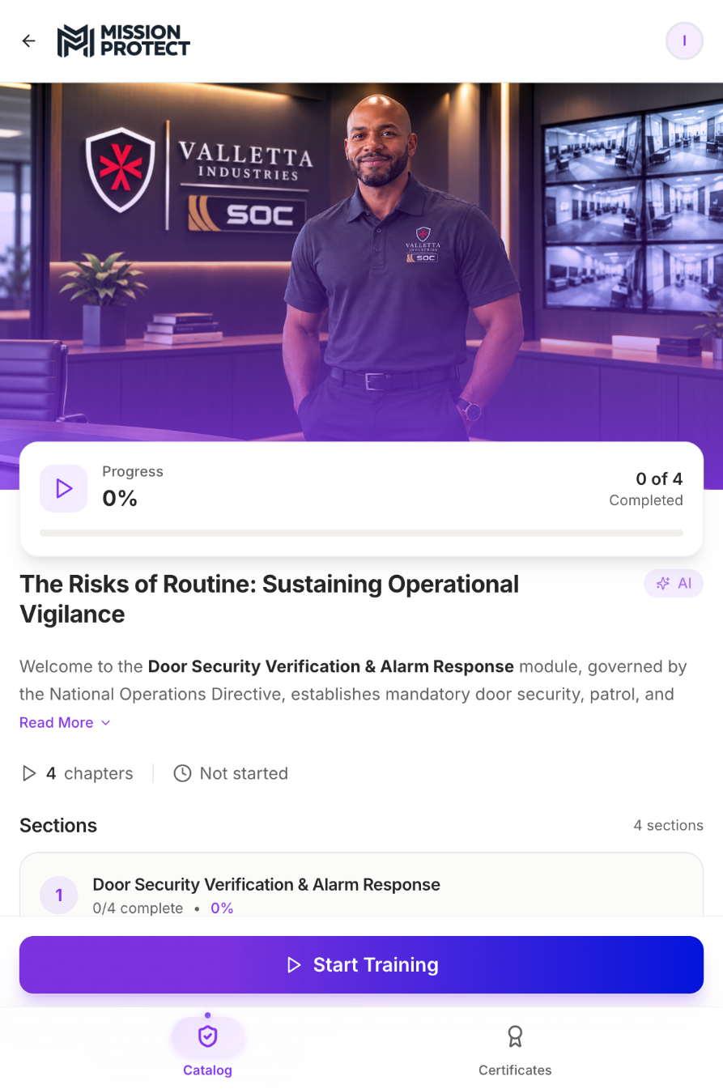
The Risks of Routine: Sustaining Operational Vigilance
02 TAILORED · BUILT FOR HHS
The HHS rollout course. Its first module, Door Security Verification and Alarm Response, is built from the National Operations Directive and already loaded for HHS reviewers.
01
Closed Is Not Secured
4:19
02
Push, Pull, Verify
5:34
03
Door Alarm Response and IDS Testing
2:39
04
Reporting, Call-Down, and Training Requirements
3:41
4
16 min
100%
chapters, each with knowledge checks
of video across the course
required to pass each final quiz
Notes:
Here's an example of tailored training: The Risks of Routine: Sustaining Operational Vigilance, the HHS rollout course. Its first module, Door Security Verification and Alarm Response, has four chapters built straight from the directive.
Chapters: 1 Closed Is Not Secured (4:19); 2 Push, Pull, Verify (5:34); 3 Door Alarm Response and IDS Testing (2:39); 4 Reporting, Call-Down, and Training Requirements (3:41).
It's already assigned to HHS as beta content, so HHS reviewers can open it today.

Slide 8


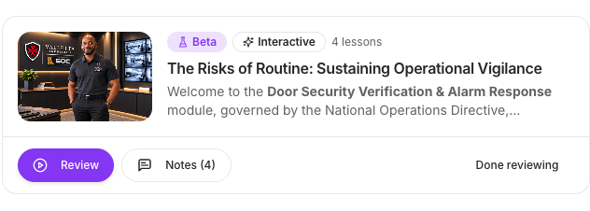
From directive to deployed course in under a week
02 TAILORED · HOW WE BUILD IT
STEP 1
STEP 2
STEP 3
STEP 4
STEP 5
INTAKE
SCRIPT
PRODUCE
BUILD
APPROVE
HHS shares the directive, post orders or SOP.
Valletta trainers write the objectives and script.
Narrated video in Valletta SOC branding.
Sections, knowledge checks and a final quiz.
HHS reviewers sign off in beta, then it goes live to every site.
6 days
The Risks of Routine: Door Security Verification and Alarm Response module: catalog opened October 29, all four chapters published November 4, 2026.
Left: The Risks of Routine course waiting in the HHS reviewer queue in Mission Protect today.
Notes:
This is how easy it is for our team. HHS hands us a directive; we script it, produce the video, build the interactive chapter and put it in front of HHS reviewers in beta.
The Door Security Verification module went from new catalog (Oct 29) to all four chapters published (Nov 4) in six days.
Reviewers use + Feedback inside the course to leave notes, photos or documents at any point. We fix it, then publish to every site.

Slide 9

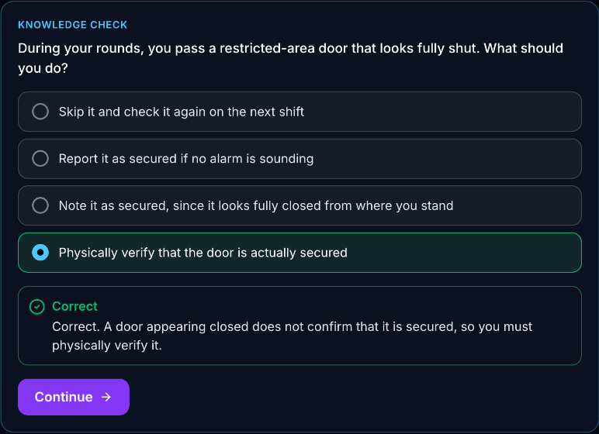

Officers work through every section, not just press play
INTERACTIVE TRAINING
Video in short sections
Each section matches the chapter outline.
A check after every section
Instant feedback explains the right answer.
Sections unlock in order
No skipping ahead to the quiz.
Final quiz to finish
10 questions, 100% to pass, 3 attempts.
Notes:
Make it interactive. The chapter is broken into short video sections tied to the outline on the left.
After each section there's a knowledge check (shown: the correct answer on the door-verification question). In learner mode, sections unlock in order and reading blocks must be marked as read.
Each chapter ends in a final quiz: 10 questions, 100% to pass, 3 attempts.

Slide 10

Officers make the call, then see why
SCENARIO-BASED TRAINING
“You pass a restricted-area door that looks fully shut.”
Verify, don't assume
Officers pick a response; the feedback explains why only physical verification counts.
“You're assigned to the Rover for a two-hour post.”
Apply the post orders
How many patrols? Two, one in each hourly period, even on a two-hour rotation.
“Operations keep you from your hourly patrol.”
Escalate the right way
The first step is to notify the shift supervisor immediately, not to handle it alone.
“A lone individual holds a cashier at gunpoint.”
Classify the threat before acting
From the active-assailant module: tell an armed robbery from an active shooter, then respond.
Scenario questions are live in 23 Mission Protect lessons. Site trainers then run the same calls live.
Notes:
Scenario-based training is where Valletta started: site trainers run full mission profiles and role-player drills. Mission Protect carries that approach into every lesson.
Each knowledge check is a situation at the post, not a definition. The officer picks a response and the feedback explains the right call.
The first three examples are from the Door Security Verification module of The Risks of Routine; the fourth is from the active-assailant module. Scenario questions are already live in 23 lessons.
Online scenarios build the judgment. Site trainers then practice the same calls live.

Slide 11

Watch Chapter 1: Closed Is Not Secured
SEE IT IN ACTION
▶ WATCH ON GOOGLE DRIVE 4:19 · Door Security Verification, Chapter 1 of 4
Notes:
Click the video (or the link under it) to play Chapter 1 from Google Drive. The link is set so anyone with it can view.
Video link: https://drive.google.com/file/d/1z1E6xkxvw3wb0zrKb5F64yIMbBaA_C4y/view?usp=sharing

Slide 12
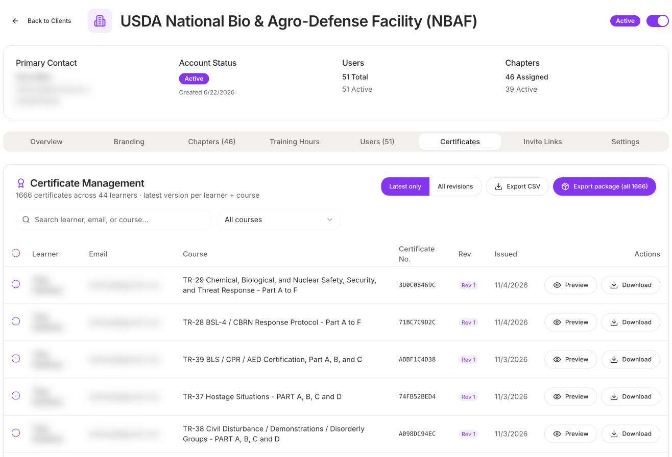

Every course leaves a record an auditor can check
03 COMPLIANT · 04 AUDIT-READY
Who completed the required training?
Completion by officer, course and site
Watch time is logged as it happens. The platform marks completion, not the officer.
Did they understand it?
Scored final quizzes
Pass mark and attempt limits set per course; every score and attempt is kept.
Can you prove it?
A numbered certificate per course
Issued automatically for each officer and course, with the date earned.
Can we see it all at once?
One-click certificate package
Every certificate PDF plus a CSV register in one ZIP, the way USDA requests it each month.
USDA NBAF certificate register: 1,666 certificates, 44 officers. Names blurred.
Notes:
Really highlight the audit-ready narrative. That's huge.
Completion is recorded by the platform as the officer watches. Officers can't mark themselves complete. Every course ends in a scored quiz with a set pass mark and attempt limit. Certificates are numbered and issued automatically.
On screen: the real USDA NBAF certificate register (learner names and emails blurred). 1,666 certificates across 44 officers. One click exports the whole set as a package (every certificate PDF plus a CSV register), which is what USDA asks for each month. Site leadership can also get an end-of-day progress email.

Slide 13
Every device feeds the same training record
ANY DEVICE
46%
5%
48%
desktop and laptop
tablet
phone
Share of USDA NBAF chapter activity by device, Sept 1 – Nov 6, 2026.
Notes:
All these modules work on desktop, laptop, phone and tablet. Easy.
At USDA, nearly half of chapter activity happens on a phone (48%), 46% on desktop or laptop, 5% on tablet. Officers train where they are, between posts or at home, and it all lands in the same record.

Slide 14
One platform for 11 sites and 300 officers
SCALE
PHASE 1 · NOW
SITE
SITE
SITE
SITE
Pilot the tailored course
01
02
03
04
The Risks of Routine course in beta with HHS reviewers; feedback goes straight to our team.
PHASE 2
SITE
SITE
SITE
SITE
Build the HHS core curriculum
05
06
07
08
Map HHS requirements to the 39-course library and tailor courses to HHS directives.
SITE
SITE
SITE
300
PHASE 3
09
10
11
Roll out to all 11 sites
OFFICERS
Enroll 300 officers. Site trainers and leadership get daily compliance reporting.
One curriculum, one record, every site.
ONGOING
Keep it current
New directive in, updated course out, in days rather than months.
Notes:
We can do this at HHS at scale across eleven sites and three hundred employees. That's the narrative.
Phase 1 is already underway: The Risks of Routine, starting with its Door Security Verification module, is in beta for HHS reviewers. Phase 2 maps HHS requirements to the existing library and tailors courses. Phase 3 rolls out to all 11 sites.
After that, when a directive changes, the course changes with it.

Slide 15
Start with one course, then scale to every site
NEXT STEPS
01
Review The Risks of Routine
VALLETTA INDUSTRIES
HHS reviewer access in Mission Protect is already live.
Built By Operators
02
Share the first directives and post orders
UEI CKXMD3HBP1P7
DUNS 118055280
CAGE 92SX6
UID S100027899
CMMC Level 1
Service-Disabled Veteran-Owned
GSA Schedule · SeaPort-NextGen
403 Columbia Street #9, Covington, LA 70433
We turn them into tailored HHS courses.
03
Choose the pilot sites
Then set the rollout schedule for all 11 sites.
vallettaindustries.com
missionprotect.io
Notes:
Close on the ask: review The Risks of Routine course, send us the first directives, pick pilot sites.
Contacts and credentials are on the right.

