Slide 1
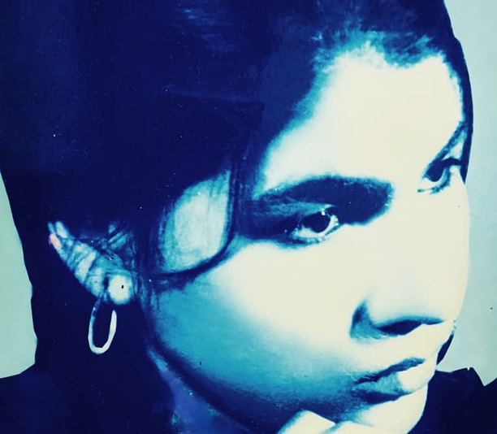

www.munawwarfoundation.org
MUNAWWAR
FOUNDATION
2024-25
ANNUAL REPORT

Slide 2
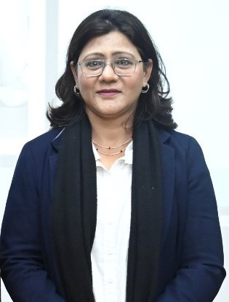
A WORD
FROM THE PRESIDENT
As we embark on this journey, I am filled with gratitude for the love and encouragement from family, friends, and the community.
Your support strengthens our resolve and brings us closer to making a difference.
I am honored to lead the Munawwar Foundation. May it be a beacon of hope and a testament to the power of love and kindness.
Thank you for joining us in this endeavor. Together, we can continue to spread the light that Munawwar brought into the world.
SABA WAHEED FAROOQI
PRESIDENT

Slide 3
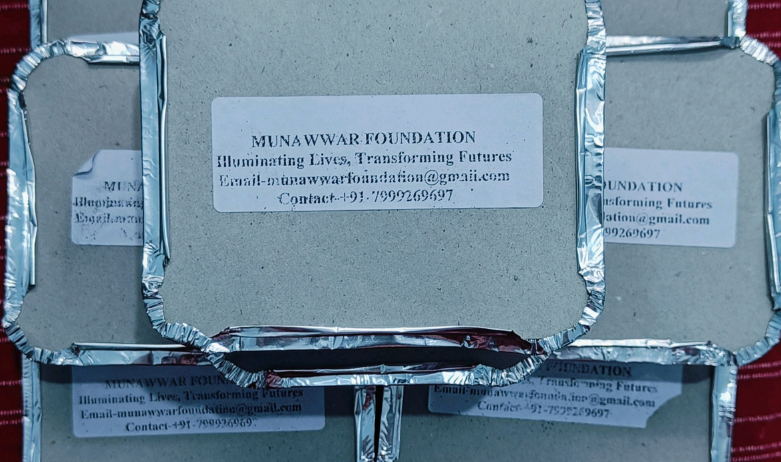
MUNAWWAR FOUNDATION-"ILLUMINATING HEARTS, TRANSFORMING FUTURES"
ANNUAL REPORT
YEAR 2024-25
COMBAT
HUNGER
A STEP TOWARDS HUMANITY
Break Bread with the Needy the act of sharing food with those who are hungry or less fortunate, offering not just physical nourishment but also emotional connection and dignity. This gesture transcends mere charity, creating a bond between giver and receiver, reminding us of our shared humanity. By breaking bread together,
we can foster hope, alleviate suffering, and build a more inclusive and caring society. It serves as a powerful reminder that small acts of kindness can make a significant impact in the lives of those in need.

Slide 4
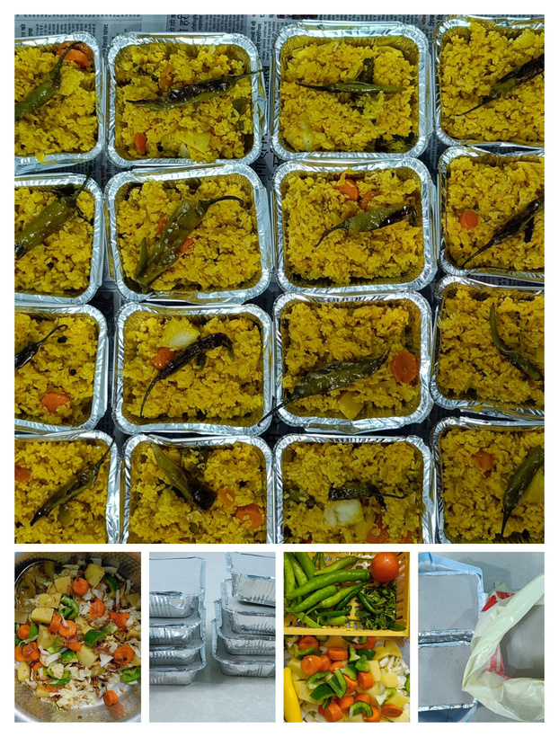
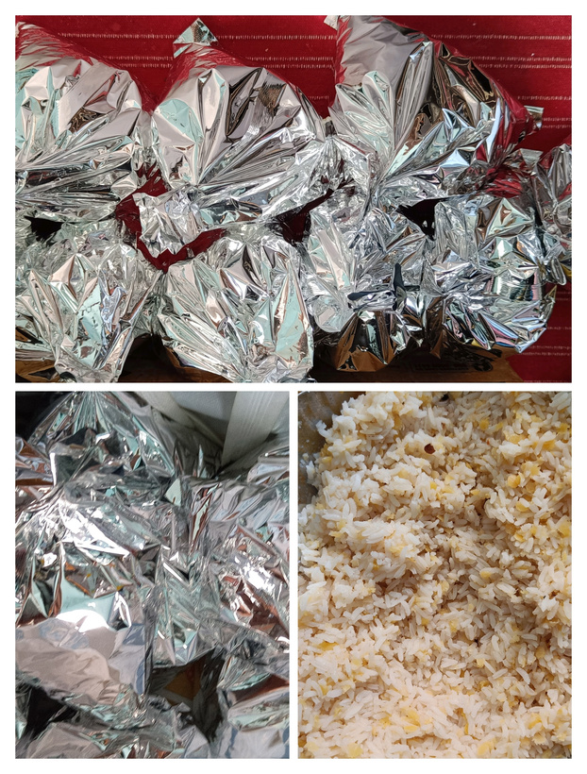
MUNAWWAR FOUNDATION-"ILLUMINATING HEARTS, TRANSFORMING FUTURES"
ANNUAL REPORT
YEAR 2024-25
COMBAT
HUNGER
We believe that food is not just a necessity — it’s a right every human deserves. Through this initiative, we strive to ensure that no one starts their day hungry or helpless.
Our volunteers distribute freshly prepared meals with love and respect, restoring smiles on weary faces. Each breakfast served is a message of empathy, reminding society that kindness still exists.
MUNAWAR FOUNDATION stands committed to uplifting lives, one meal at a time.
We invite everyone to join hands in this humanitarian cause and help us spread warmth and nourishment.
A STEP TOWARDS HUMANITY
MUNAWAR FOUNDATION continues its noble mission of serving humanity with compassion and care.
Every morning, our team reaches out to the roadside beggars and homeless individuals, offering them a nutritious breakfast.
This small act of kindness is aimed at bringing nourishment, dignity, and hope to those who often go unnoticed.

Slide 5
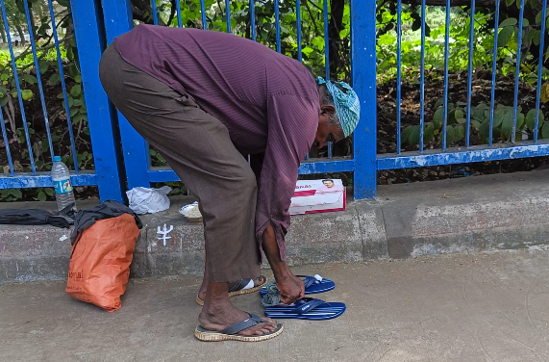
MUNAWWAR FOUNDATION-"ILLUMINATING HEARTS, TRANSFORMING FUTURES"
ANNUAL REPORT
YEAR 2024-25
AID THE LESS FORTUNATE
-FOOTWARE DISTRIBUTION
"Aid the less fortunate" refers to offering support and assistance to individuals or groups who are struggling due to poverty, hardship, or lack of resources. It involves providing help in various forms, such as financial support, food, shelter, or emotional encouragement.
This act aims to improve the living conditions and well-being of those who are vulnerable. Such assistance often comes from charitable organizations, communities, or individuals. Ultimately, it promotes equality and helps lift people out of difficult circumstances.

Slide 6
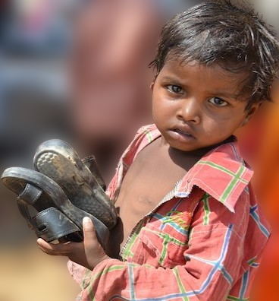
MUNAWWAR FOUNDATION-"ILLUMINATING HEARTS, TRANSFORMING FUTURES"
ANNUAL REPORT
YEAR 2024-25
MUNAWWAR FOUNDATION
continues its journey of compassion through its initiative “Aid the Less Fortunate.”
As part of this noble effort, the Foundation organized a footwear distribution drive for the underprivileged and homeless. Each pair symbolizes care, dignity, and protection for those who need it most.
This initiative reflects our belief that small acts of kindness can make a big difference in someone’s life. The smiles and gratitude received from beneficiaries inspire us to continue serving with greater dedication.
Every step we take together brings us closer to a more compassionate world.

Slide 7
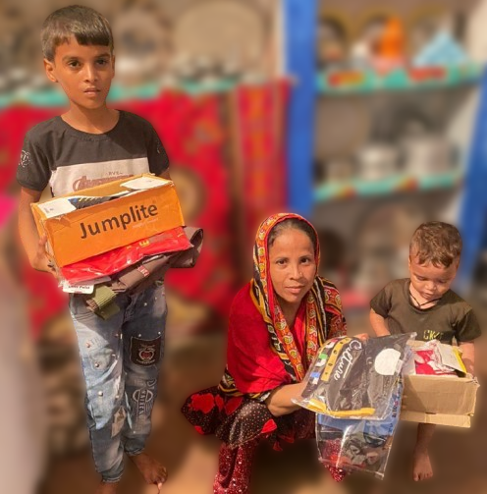
MUNAWWAR FOUNDATION-"ILLUMINATING HEARTS, TRANSFORMING FUTURES"
ANNUAL REPORT
YEAR 2024-25
SUSTAINED ASSISTANCE
-RECURRING HELP
Abdullah, a poor boy, sells tea door to door to fulfill his family’s needs. After his father passed away due to illness, Abdullah became the sole provider for his family, which includes his mother and younger brother. To support them in their difficult times.
MUNAWWAR FOUNDATION has adopted the family of Mr. Abdullah under its “Sustained Assistance – Recurring Help Initiative.”
Through this adoption, the Foundation ensures regular aid in the form of food, healthcare, education, and basic necessities.
The goal is not just temporary relief, but long-term empowerment and stability for the family. Our team remains in close contact to monitor their needs and provide ongoing guidance and care.

Slide 8
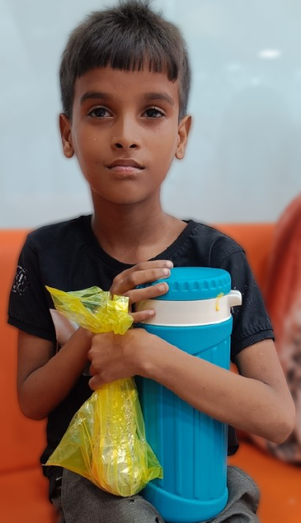
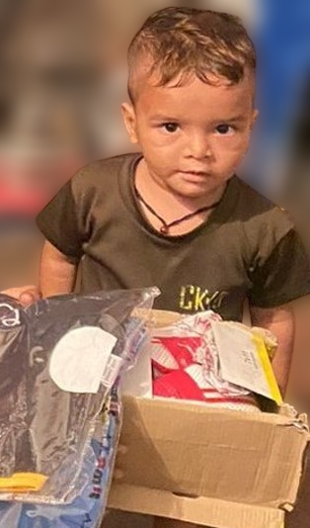
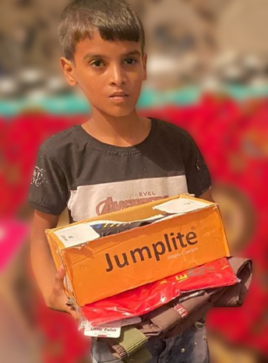
MUNAWWAR FOUNDATION-"ILLUMINATING HEARTS, TRANSFORMING FUTURES"
ANNUAL REPORT
YEAR 2024-25
MUNAWWAR FOUNDATION has adopted Abdullah’s family under its “Sustained Assistance- Recurring Help” initiative.
A step beyond charity — it’s a promise of continuous care, dignity, and hope. Together, we strive to rebuild lives… not for a day, but for a lifetime.

Slide 9
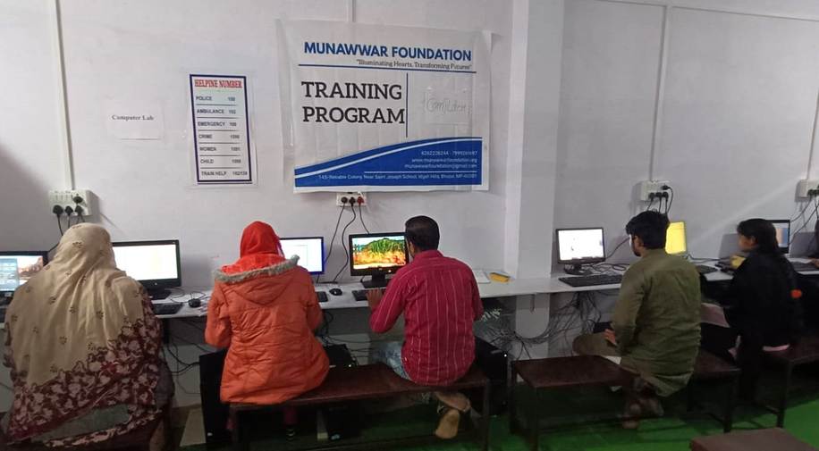

MUNAWWAR FOUNDATION-"ILLUMINATING HEARTS, TRANSFORMING FUTURES"
ANNUAL REPORT
YEAR 2024-25
COMPUTER TRAINING
-DIGITAL LITERACY INITIATIVE
MUNAWWAR FOUNDATION proudly launches its Computer Training Program under the “Digital Literacy Initiative.”
In today’s world, digital knowledge is no longer a privilege — it’s a necessity.
This program aims to empower underprivileged youth, women, and job seekers by equipping them with essential computer skills.
From basic computer operations to digital communication and online awareness, participants gain practical, career-ready training.
The initiative focuses on creating opportunities for employment and self-reliance through technology.
Our trained instructors ensure that every learner, regardless of background, feels confident in using digital tools.
By bridging the digital divide, MUNAWWAR FOUNDATION strives to build a more informed and connected community.

Slide 10
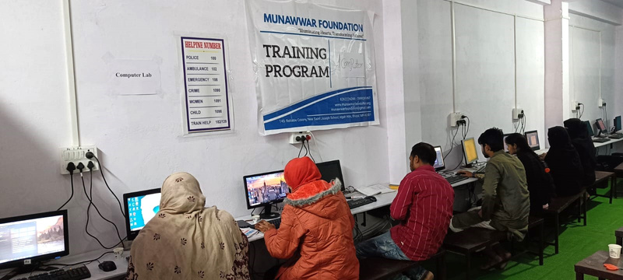
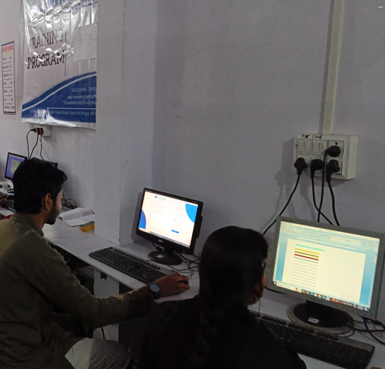
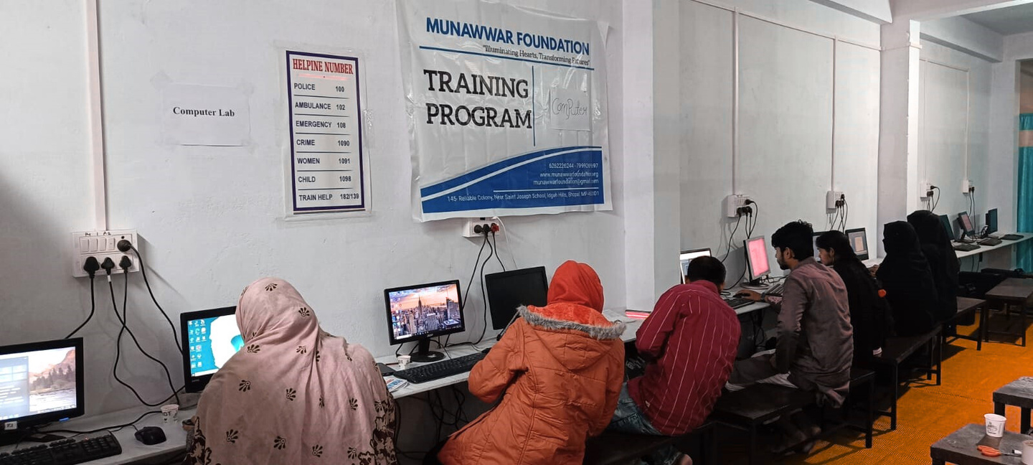
MUNAWWAR FOUNDATION-"ILLUMINATING HEARTS, TRANSFORMING FUTURES"
ANNUAL REPORT
YEAR 2024-25
We believe that digital literacy opens doors to education, employment, and empowerment.
Through this initiative, we are shaping a future where knowledge and opportunity go hand in hand.
Every keystroke is a step toward
progress, dignity, and independence.

Slide 11
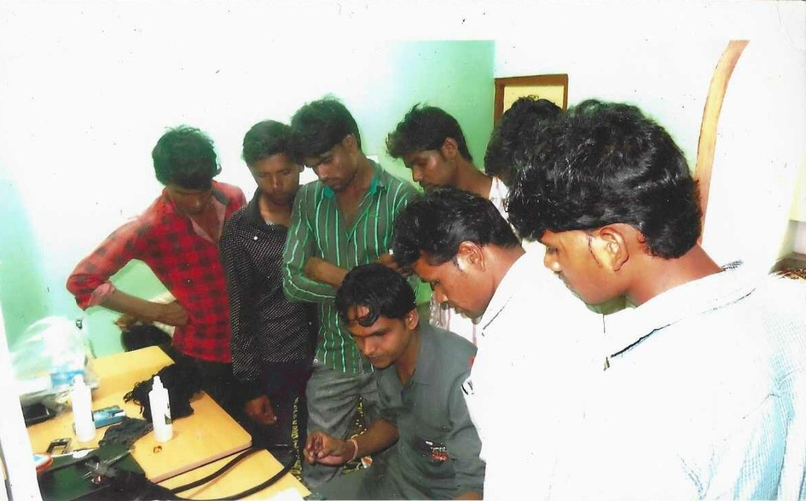
MUNAWWAR FOUNDATION-"ILLUMINATING HEARTS, TRANSFORMING FUTURES"
ANNUAL REPORT
YEAR 2024-25
CELL PHONE REPAIR TRAINING
-HARNESS SKILLS TO SHAPE YOUR DESTINY
MUNAWWAR FOUNDATION
introduces the Cell Phone Repair Training Program under its skill development initiatives.
This program is designed to equip unemployed youth and aspiring technicians with practical, hands-on training in mobile repair. In today’s digital age, mobile technology is essential — and skilled repair professionals are always in demand.
Through this initiative, trainees learn diagnosis, troubleshooting, component replacement, and software repair techniques. Our expert trainers ensure that every participant gains real-world knowledge and confidence to start their own career. The goal is to empower individuals to become self-reliant entrepreneurs and contribute to their family’s income.

Slide 12
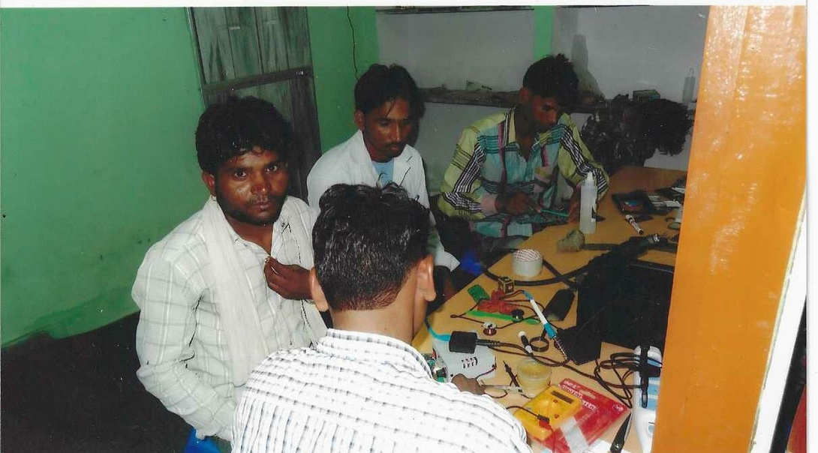
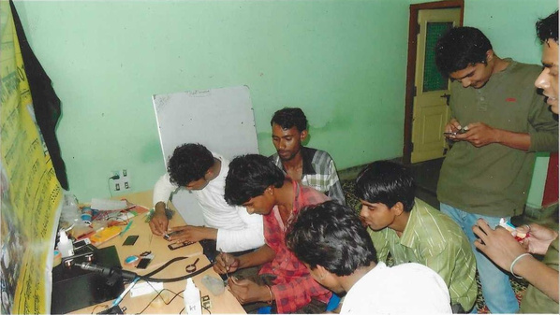
MUNAWWAR FOUNDATION-"ILLUMINATING HEARTS, TRANSFORMING FUTURES"
ANNUAL REPORT
YEAR 2024-25
This program reflects MUNAWWAR FOUNDATION’s commitment to skill-based education and sustainable growth. Every trained youth is a step toward building a stronger, self-sufficient society.
With the right skills, determination, and guidance — anyone can shape their own destiny.
By harnessing skills, we help transform potential into livelihood and dreams into achievements.

Slide 13
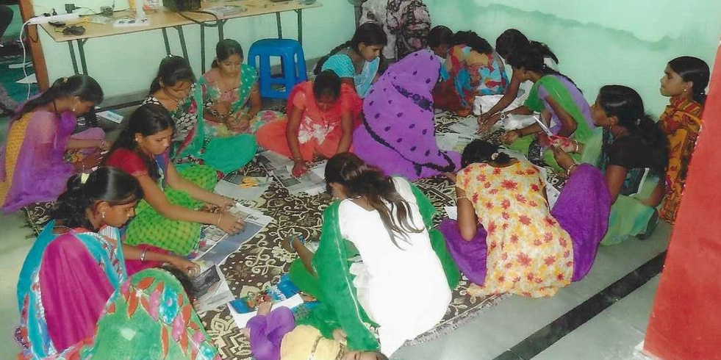
MUNAWWAR FOUNDATION-"ILLUMINATING HEARTS, TRANSFORMING FUTURES"
ANNUAL REPORT
YEAR 2024-25
FEMALE-FOCUSED SEWING AND DESIGN INITIATIVE
-SEWING SKILL DEVELOPMENT PROGRAM
MUNAWWAR FOUNDATION proudly introduces the Women’s Sewing Skill Development Program under its Female-Focused Sewing and Design Initiative. This initiative is specially designed to empower women from underprivileged backgrounds by providing them with practical tailoring and design skills.
The training includes sewing techniques, fabric cutting, stitching, embroidery, and basic fashion design.
Participants are guided by skilled instructors who help them learn both traditional and modern styles of garment making.

Slide 14
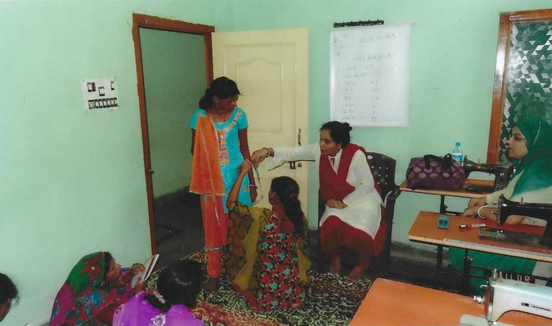
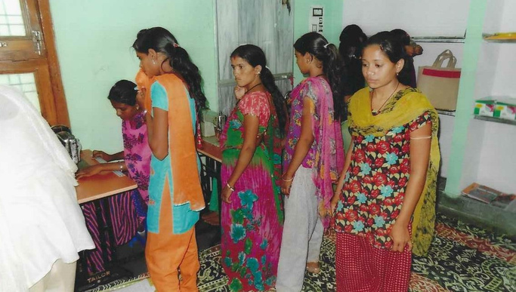
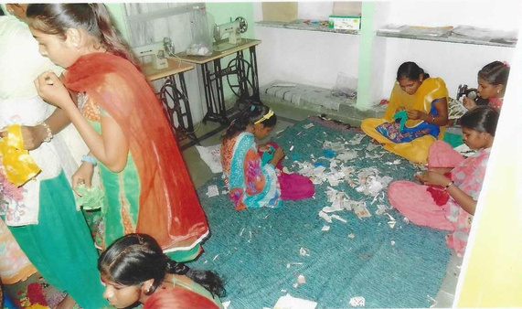
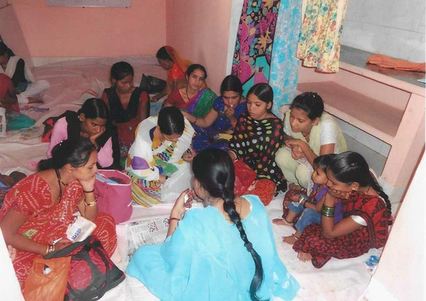
MUNAWWAR FOUNDATION-"ILLUMINATING HEARTS, TRANSFORMING FUTURES"
ANNUAL REPORT
YEAR 2024-25
The aim is to enable women to become financially independent and confident contributors to their families and communities.
By mastering sewing and design, they gain the power to transform creativity into livelihood, program also promotes entrepreneurship, encouraging participants to start small tailoring units or home-based businesses.
MUNAWWAR FOUNDATION believes that empowering a woman means empowering an entire family.
Through this initiative, we aim to create a community of skilled, self-sufficient women shaping their own future. It’s more than just a sewing class — it’s a journey of growth, strength, and empowerment.
Together, we are weaving threads of hope, independence, and change.

Slide 15
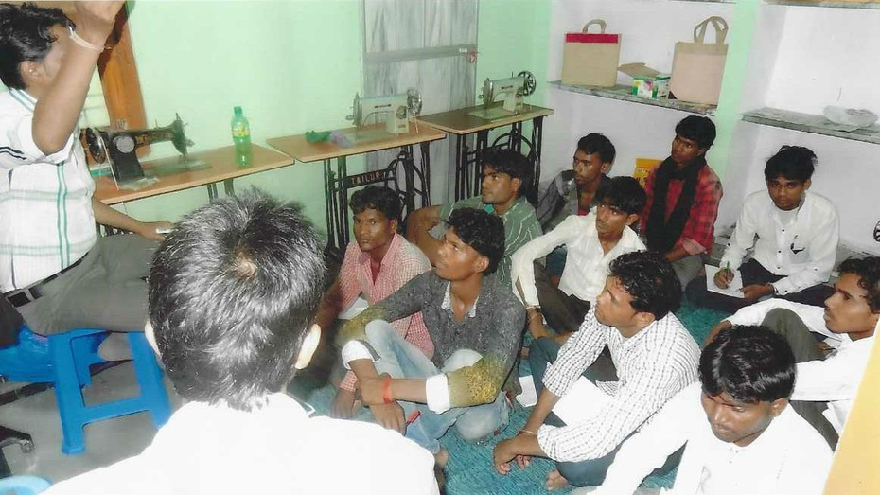
MUNAWWAR FOUNDATION-"ILLUMINATING HEARTS, TRANSFORMING FUTURES"
ANNUAL REPORT
YEAR 2024-25
MEN’S CLOTHING STITCHING WORKSHOP
-SKILL DEVELOPMENT IN MEN’S APPAREL MAKING
The Munawwar Foundation’s Skill Development Program in Men’s Apparel Making is a transformative initiative designed to equip individuals with professional tailoring and garment-making skills.
This program focuses on teaching essential techniques such as cutting, stitching, fitting, and designing men’s clothing, while also incorporating modern trends and styles.

Slide 16
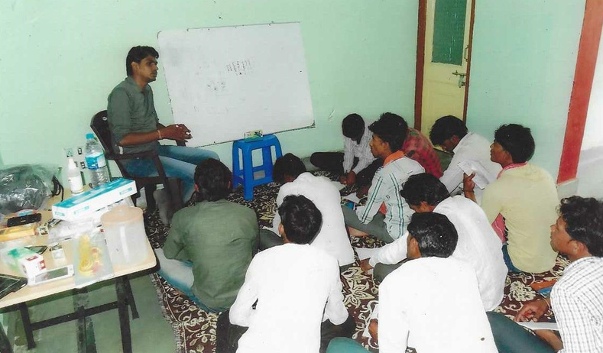
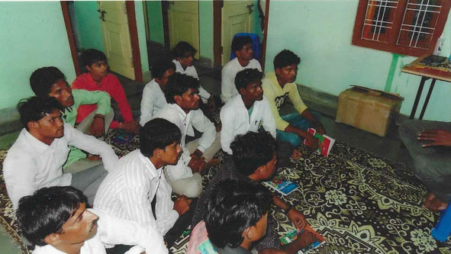
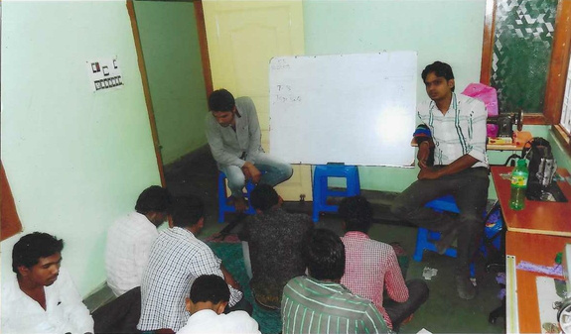
MUNAWWAR FOUNDATION-"ILLUMINATING HEARTS, TRANSFORMING FUTURES"
ANNUAL REPORT
YEAR 2024-25
With a commitment to community development, the Munawwar Foundation aims to create opportunities for growth and success, enabling individuals to build better futures through the art of men’s apparel making.
By providing hands-on training and fostering entrepreneurial abilities, the initiative empowers participants to pursue sustainable livelihoods and achieve economic self-reliance.

Slide 17
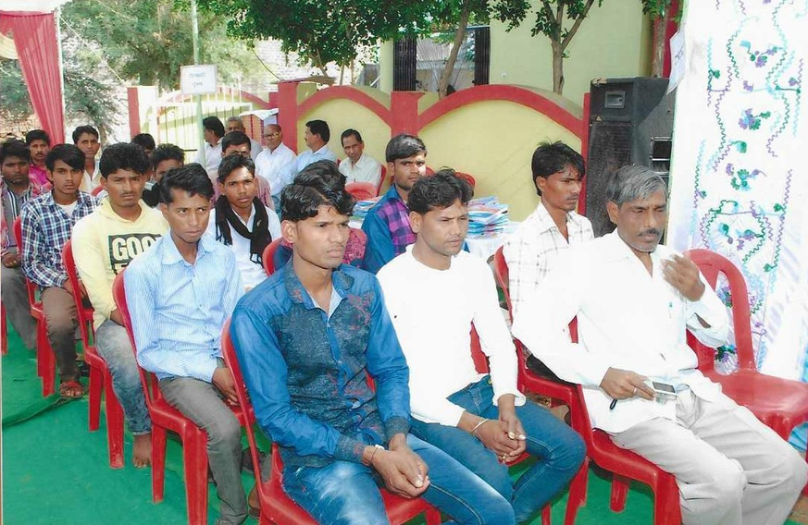
MUNAWWAR FOUNDATION-"ILLUMINATING HEARTS, TRANSFORMING FUTURES"
ANNUAL REPORT
YEAR 2024-25
MALE AWARENESS CAMPAIGN
-AGAINST RAPE AND VIOLENCE
This campaign aims to raise awareness about the critical issues of rape, domestic violence, and their societal impact. Through educational workshops, community outreach, and media campaigns, the program challenges harmful stereotypes and encourages men to take responsibility for creating a safe and respectful environment.
By promoting healthy relationships, empathy, and the importance of consent, the Munawwar Foundation works to reshape societal norms and empower men to become active participants in ending violence. The goal of this campaign is to foster a culture of respect, equality, and non-violence, ensuring a safer future for all.

Slide 18
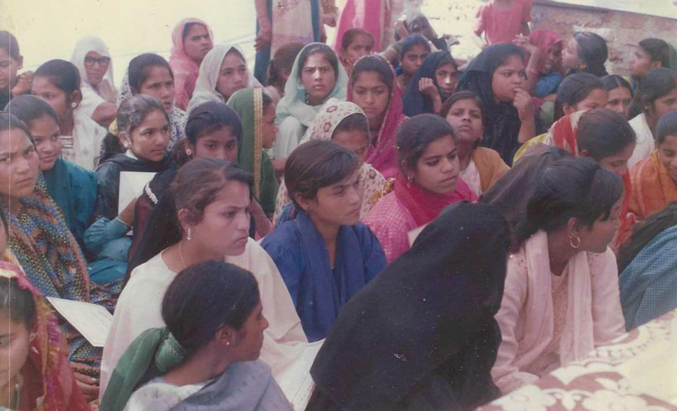
MUNAWWAR FOUNDATION-"ILLUMINATING HEARTS, TRANSFORMING FUTURES"
ANNUAL REPORT
YEAR 2024-25
WOMEN'S SANITATION & WELLNESS PROGRAM
The Women's Sanitation and Wellness Program by the Munawwar Foundation is a dedicated initiative aimed at enhancing women's health through comprehensive education and access to essential resources. This program focuses on providing women with the knowledge and tools necessary to maintain proper hygiene and overall well-being.
By addressing critical aspects of women's health, the initiative seeks to empower women to lead healthier lives and make informed decisions about their bodies.
The Munawwar Foundation strives to create a supportive environment where women can learn about and discuss health issues openly, ultimately contributing to improved quality of life and health outcomes for women in the community.

Slide 19
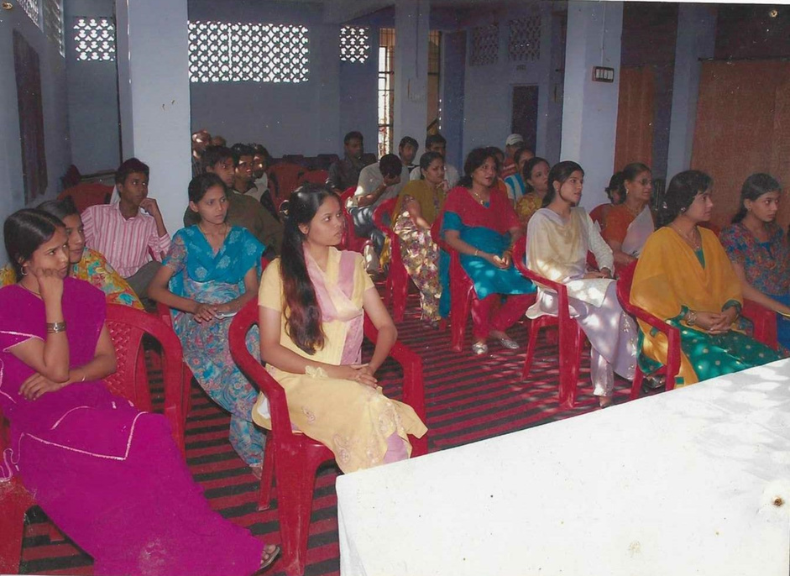
MUNAWWAR FOUNDATION-"ILLUMINATING HEARTS, TRANSFORMING FUTURES"
ANNUAL REPORT
YEAR 2024-25
WOMEN'S RIGHTS &
LEGAL AWARENESS SEMINAR
The Women’s Rights and Legal Awareness Seminar by the Munawwar Foundation is a transformative initiative designed to empower women with knowledge about their rights and the legal protections available to them. This seminar aims to educate women about critical issues, including laws against domestic violence, workplace harassment, property rights, and gender equality.
Through engaging sessions led by legal experts and advocates, participants are provided with practical information on how to access legal aid, report violations, and safeguard their rights.
The seminar also fosters discussions about societal challenges and solutions, encouraging women to become proactive in advocating for justice and fairness. By building legal literacy and confidence,

Slide 20
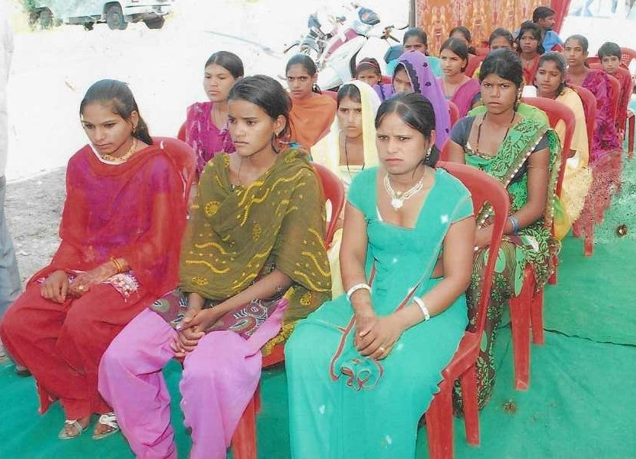
MUNAWWAR FOUNDATION-"ILLUMINATING HEARTS, TRANSFORMING FUTURES"
ANNUAL REPORT
YEAR 2024-25
START-UP SKILLS & FINANCIAL AWARENESS
The Start-Up Skills and Financial Awareness Program by the Munawwar Foundation is an empowering initiative designed to equip individuals with the knowledge and tools needed to launch and manage successful businesses.
This program focuses on fostering entrepreneurial thinking, teaching essential skills such as business planning, market analysis, and effective communication.

Slide 21
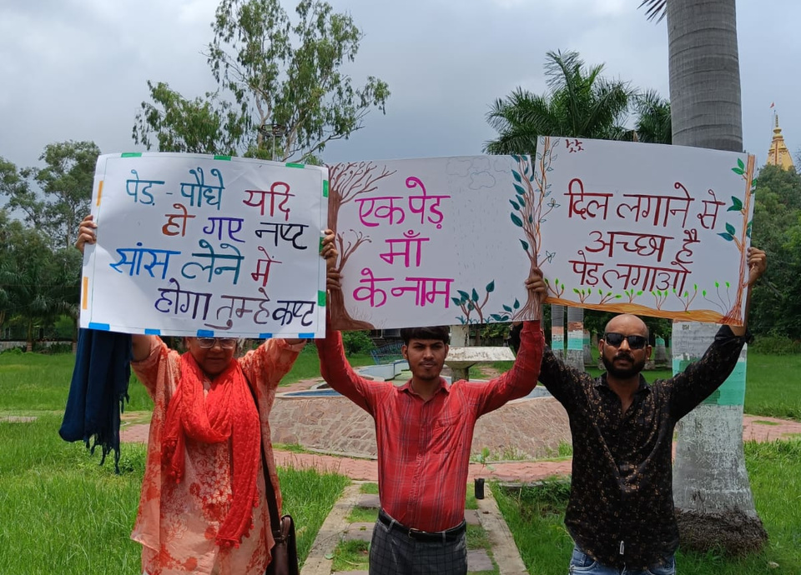
MUNAWWAR FOUNDATION-"ILLUMINATING HEARTS, TRANSFORMING FUTURES"
ANNUAL REPORT
YEAR 2024-25
LEAF TO LIFE
-PLANTATION PROGRAM
Leaf to Life is a transformative initiative dedicated to fostering a greener and healthier planet through tree plantation and environmental conservation. By promoting the planting of native species, it aims to enhance biodiversity and combat climate change.
The program inspires communities to participate actively in sustainable practices and ecological restoration. It emphasizes long-term care for the planted trees to ensure meaningful environmental impact. Together, it envisions a future where every leaf planted contributes to life on Earth.

Slide 22
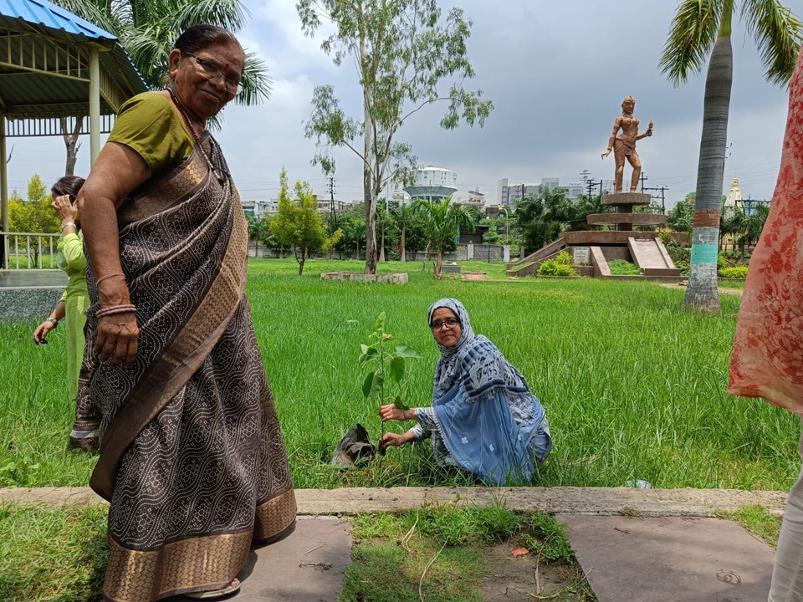
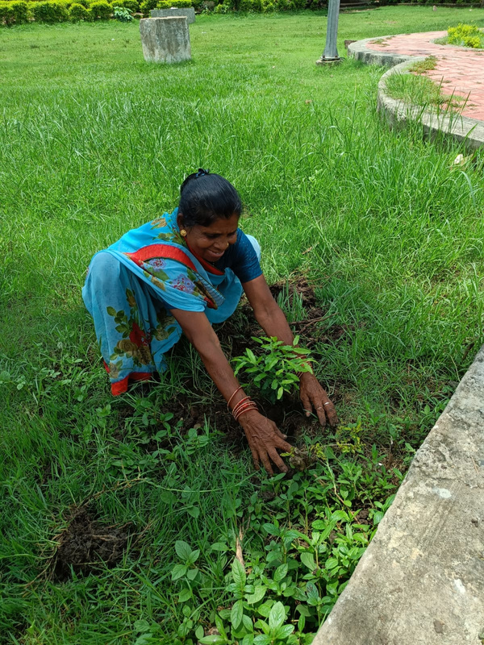
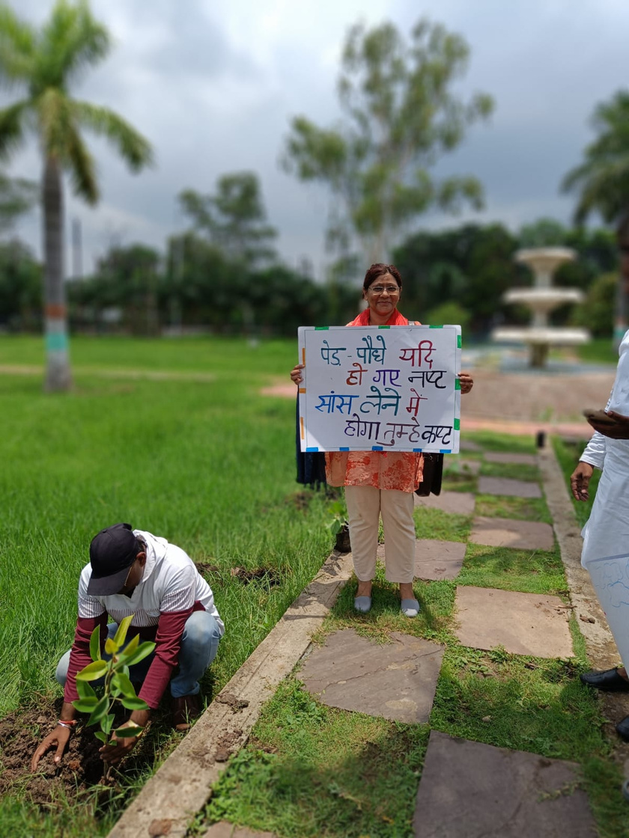
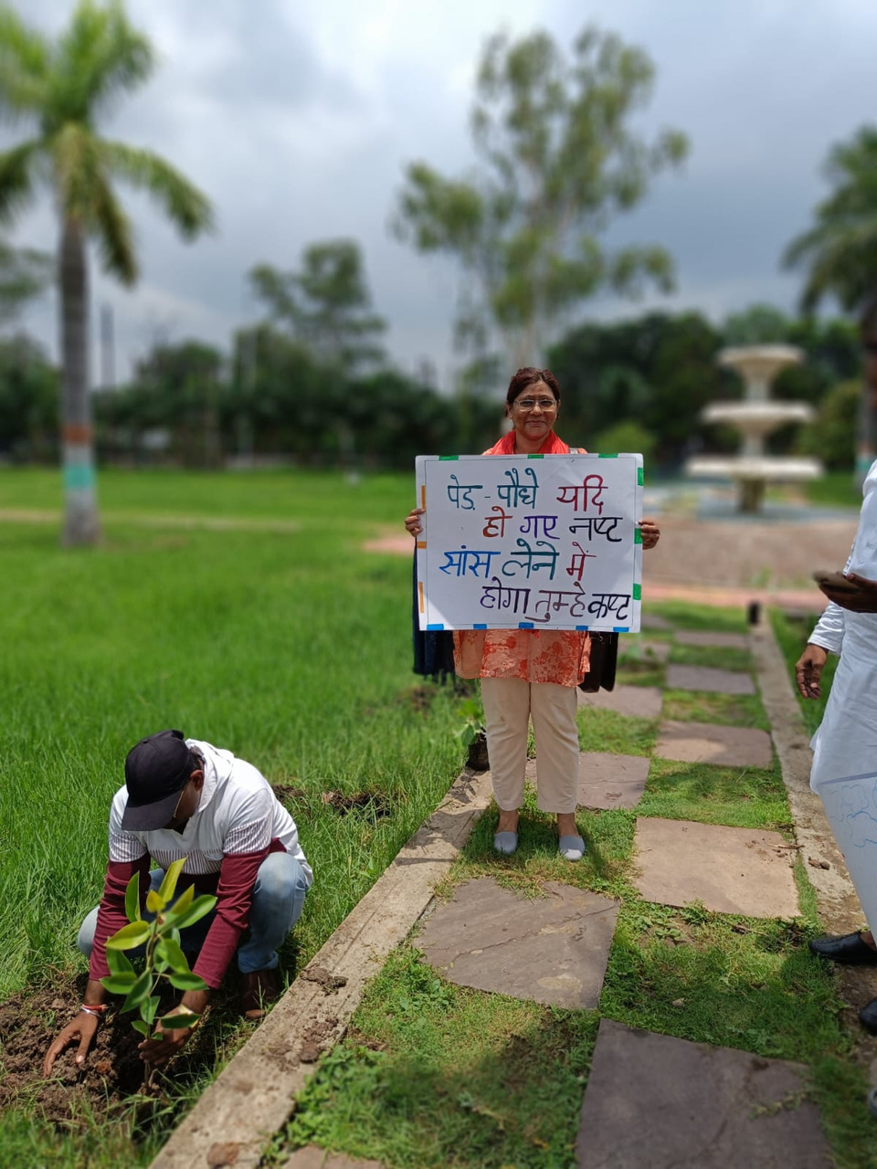
MUNAWWAR FOUNDATION-"ILLUMINATING HEARTS, TRANSFORMING FUTURES"
ANNUAL REPORT
YEAR 2024-25

Slide 23
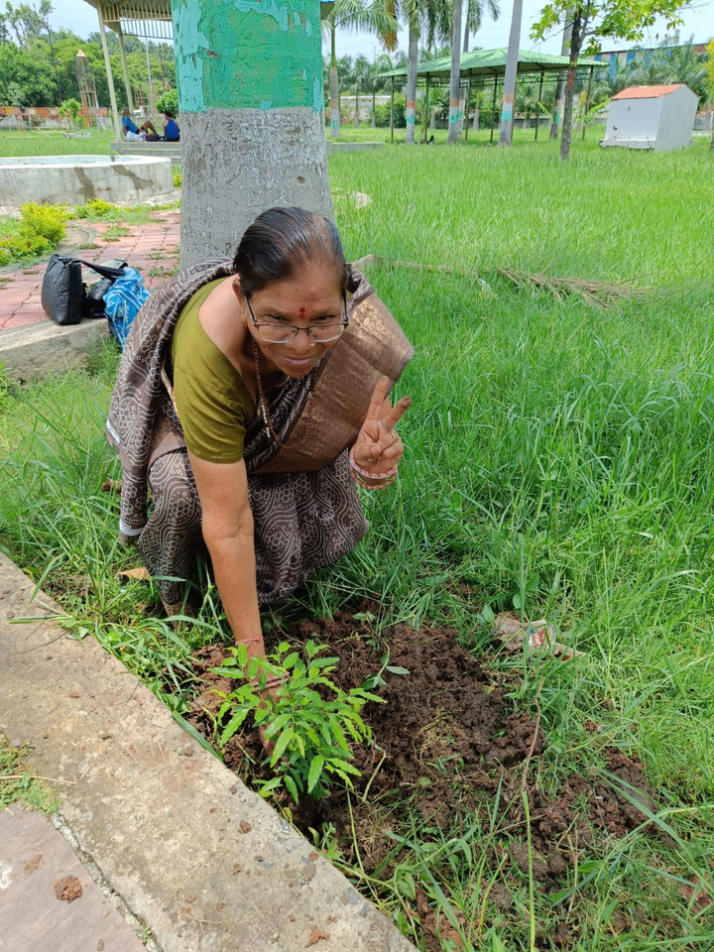
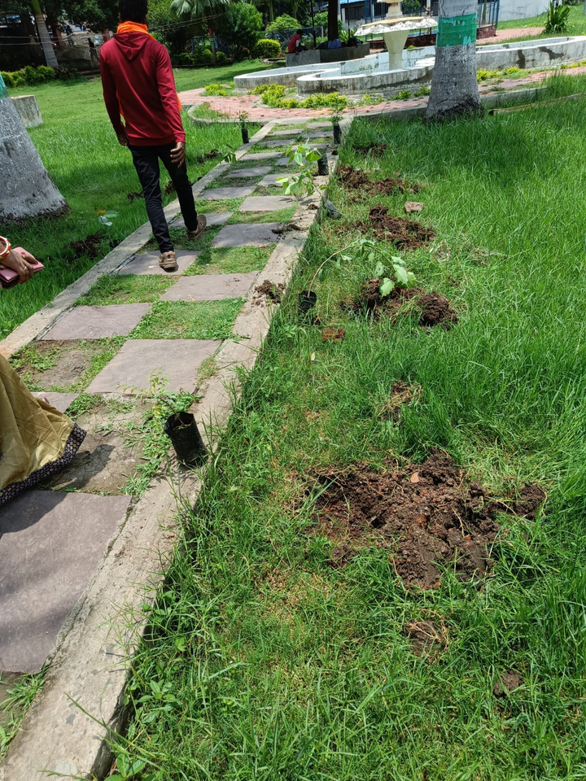
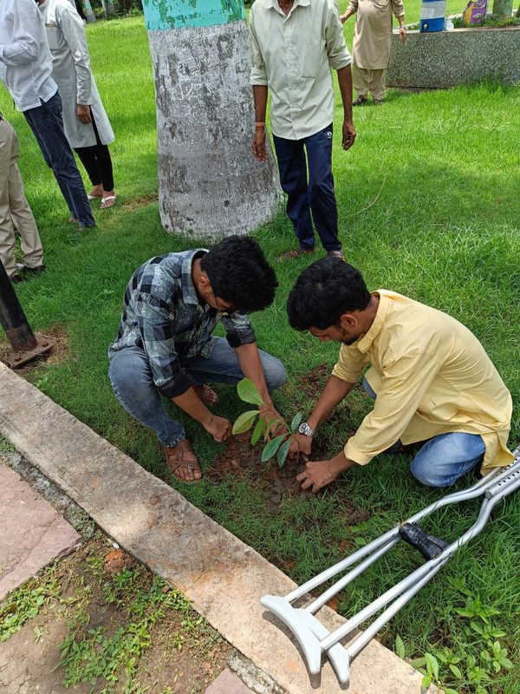
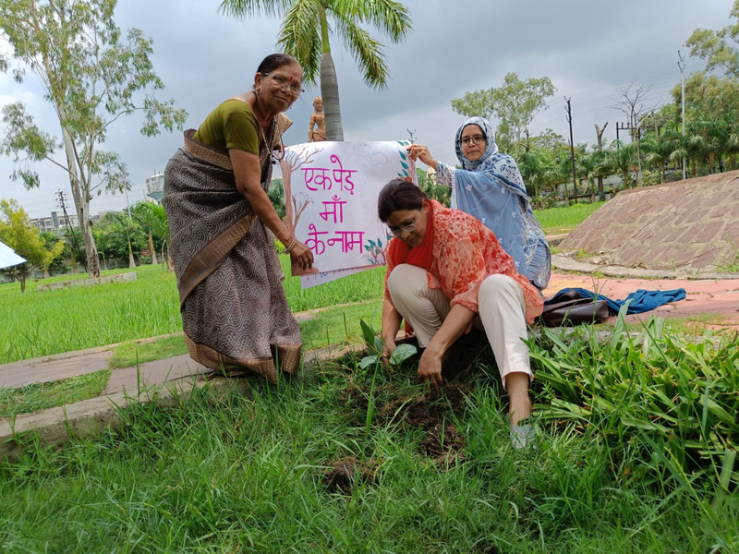
MUNAWWAR FOUNDATION-"ILLUMINATING HEARTS, TRANSFORMING FUTURES"
ANNUAL REPORT
YEAR 2024-25

Slide 24
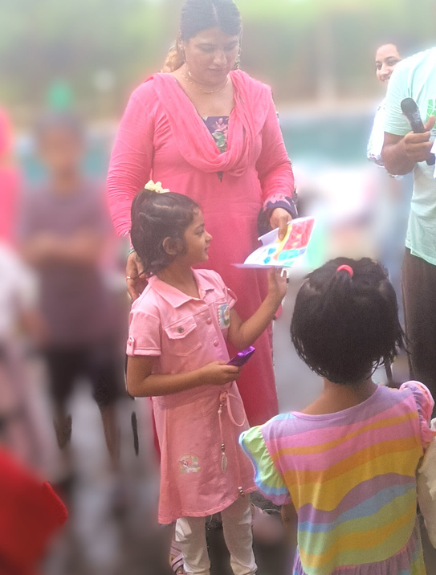
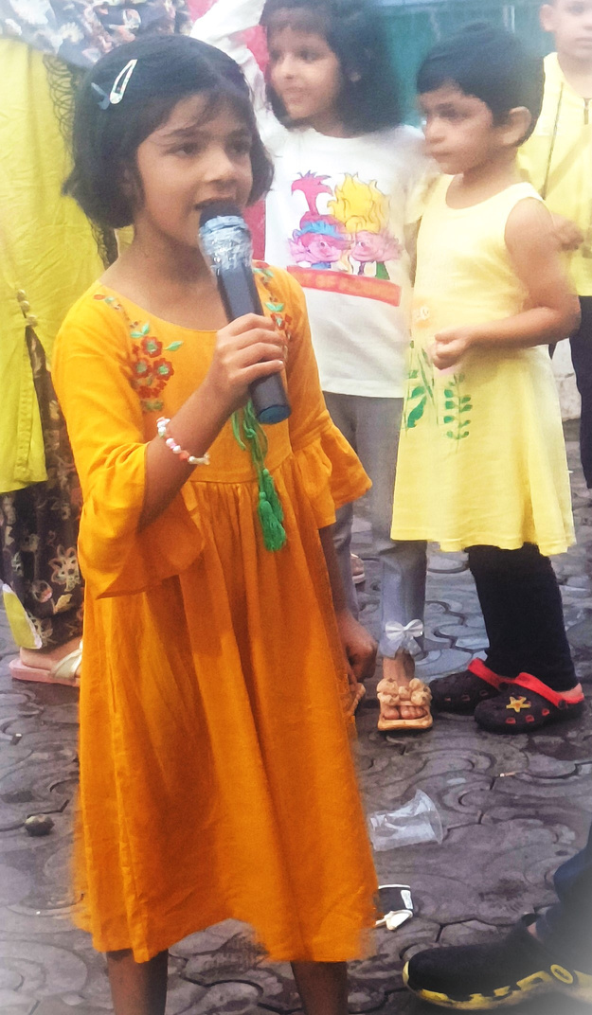
MUNAWWAR FOUNDATION-"ILLUMINATING HEARTS, TRANSFORMING FUTURES"
ANNUAL REPORT
YEAR 2024-25
LEARN TOGETHER
-LEARNING PROGRAMS
The “Learn Together” initiative by Munawar Foundation is a special educational programme designed to nurture young minds through interactive and joyful learning experiences.
This initiative focuses on providing children with foundational academic skills, creative thinking, and moral values in a fun and engaging environment.

Slide 25
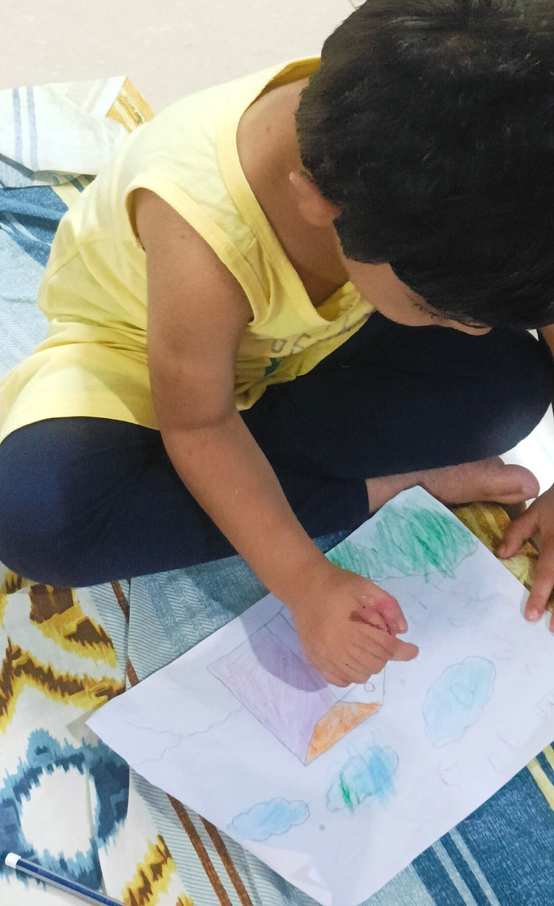
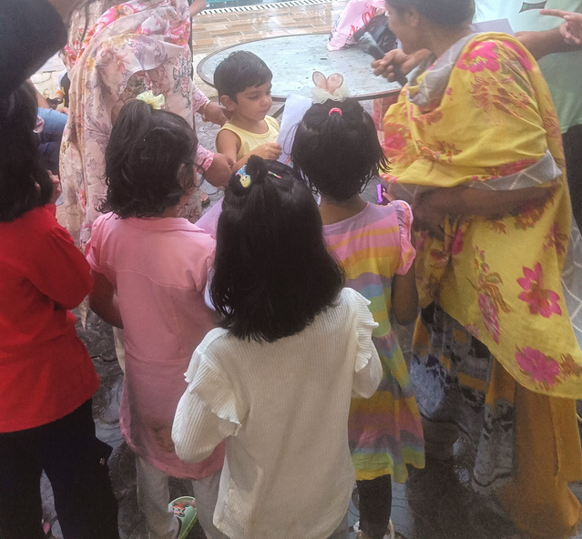
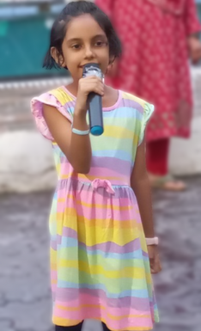
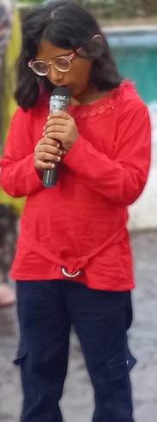
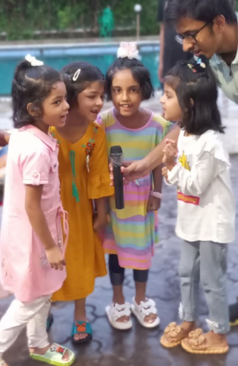
MUNAWWAR FOUNDATION-"ILLUMINATING HEARTS, TRANSFORMING FUTURES"
ANNUAL REPORT
YEAR 2024-25
Our aim is to bridge learning gaps, encourage curiosity, and build confidence among children through group-based activities, storytelling, digital learning tools, and practical knowledge sessions.

Slide 26
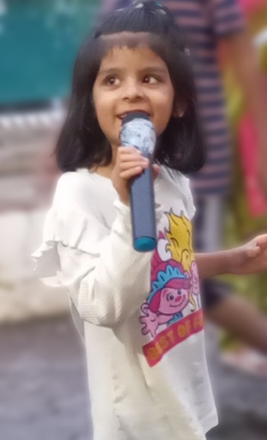
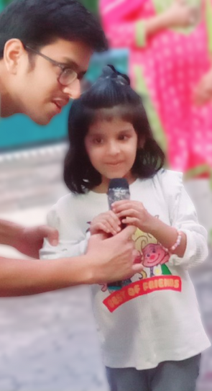
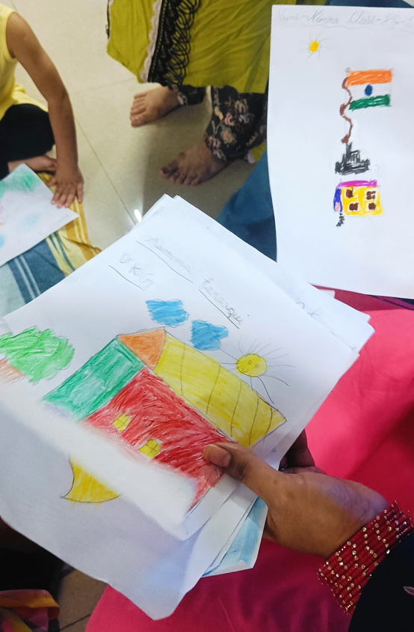
MUNAWWAR FOUNDATION-"ILLUMINATING HEARTS, TRANSFORMING FUTURES"
ANNUAL REPORT
YEAR 2024-25
The programme empowers every child to learn at their own pace while fostering teamwork, empathy, and lifelong love for learning.
Munawar Foundation believes that “Education is not preparation for life — it is life itself.” Through Learn Together, we are shaping brighter futures, one child at a time.

Slide 27

MUNAWWAR FOUNDATION-"ILLUMINATING HEARTS, TRANSFORMING FUTURES"
ANNUAL REPORT
YEAR 2024-25
RAISING AWARENESS FOR BONE MARROW DONATION
By leading through example, the founder aims to raise awareness about the simplicity and importance of the donation process, encouraging more individuals to take part in this life-saving initiative. Their dedication serves as a powerful message to the community about the impact of collective action in combating serious health challenges.
The founder of the Munawwar Foundation took a significant step toward promoting awareness of bone marrow donation by personally registering as a donor. This selfless act highlights their commitment to inspiring others to join the cause and emphasizes the critical role of bone marrow donations in saving lives.

Slide 28

MUNAWWAR FOUNDATION-"ILLUMINATING HEARTS, TRANSFORMING FUTURES"
ANNUAL REPORT
YEAR 2024-25
KUDOS AND PRAISE
-PUBLIC ACKNOWLEDGMENT
The Munawwar Foundation facilitates and recognizes outstanding contributions to social work by honoring individuals and organizations dedicated to making a positive impact on society. Through various initiatives and events, the foundation acknowledges the tireless efforts of social workers who address critical issues such as poverty, education, health, and human rights.
By celebrating these efforts, the Munawwar Foundation aims to inspire others to engage in meaningful social work, fostering a community committed to making a difference. Their recognition helps elevate the importance of social contributions and encourages continued dedication to humanitarian causes.

Slide 29

MUNAWWAR FOUNDATION-"ILLUMINATING HEARTS, TRANSFORMING FUTURES"
HONORING A LEGACY
Founding the Munawwar Foundation in Memory of My Loving Mother-Life is a tapestry woven with threads of love, loss, and the indelible impact of those we hold dear. I want to share a deeply personal journey—one that has led to the creation of the Munawwar Foundation, a tribute to my mother’s remarkable legacy.
A Tribute to an Unforgettable Soul-
My mother, Munawwar, was more than just a parent to me. She was a guiding light, a source of unwavering strength, and a wellspring of compassion. Her life was a testament to kindness and selflessness, and her impact on those around her was profound. She had an incredible ability to lift spirits, offer comfort, and make every person she met feel valued and loved.
When she passed, it felt as though a part of my world had dimmed. The void was immense, and the grief was overwhelming. But in the midst of the sorrow, I realized that the best way to honor her memory was not to dwell on the loss, but to celebrate her life and the values she held dear.
The Birth of the Munawwar Foundation-The Munawwar Foundation was born from this realization. Its mission is to carry forward my mother’s legacy of kindness and service. The foundation aims to support and uplift communities through various programs and initiatives inspired by her values.
We embark on a journey of compassion, empowerment, and transformation under the guiding light of our motto: Illuminating Hearts, Transforming Futures.

Slide 30

STAY
CONNECTED
DROP US A
LINE
145-Reliable Colony, Saint Joseph School, Idgah Hills, Bhopal-462001
7999269697 - 6262226244
munawwarfoundation@gmail.com
www.munawwarfoundation.org
we continue our journey of creating positive change...
FOLLOW US
Instagram- @munawwarfoundation
Facebook- @MunawwarFoundation

