Slide 1

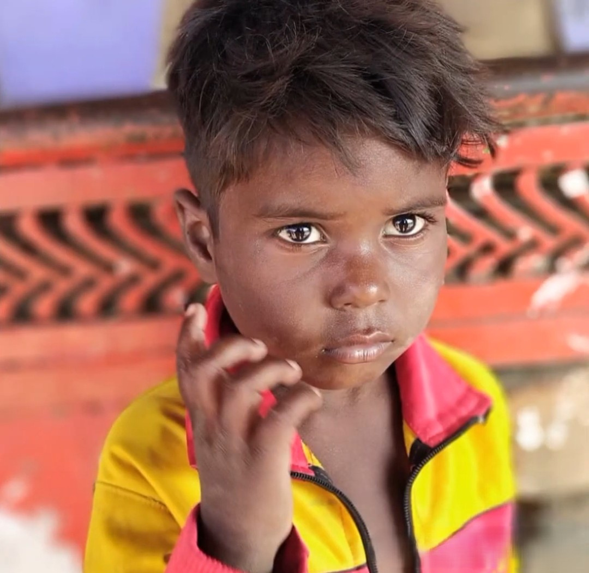
MUNAWWAR FOUNDATION
"Illuminating Hearts, Transforming Futures"
2025-26
ANNUAL
REPORT
Munawwar Foundation is a non-profit organization dedicated to empowering communities through education, skill development, and social welfare initiatives. Established with a vision to create an inclusive and self-reliant society, the Foundation works tirelessly to uplift underprivileged sections by providing access to knowledge, training, and livelihood opportunities.
Munawwar Foundation has initiated a range of impactful programs focusing on digital literacy, women empowerment, vocational training, health awareness, and community development. Each project reflects the Foundation’s core belief — that sustainable change begins with education and skill-building.
As we present this annual report, we reaffirm our commitment to fostering growth, equality, and empowerment — building a future where every individual can thrive with dignity and purpose.
7999269697
munawwarfoundation.org
munawwarfoundation@gmail.com

Slide 2
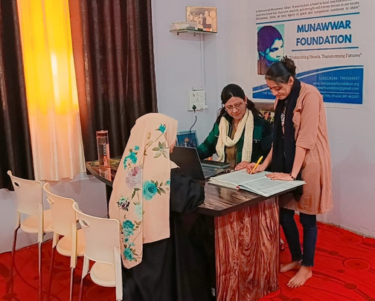
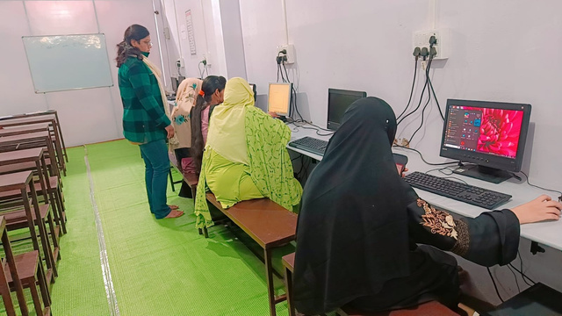
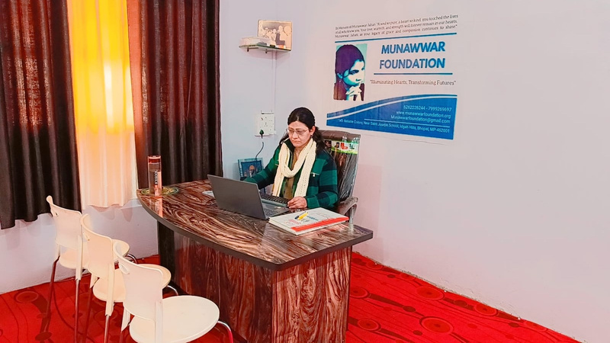
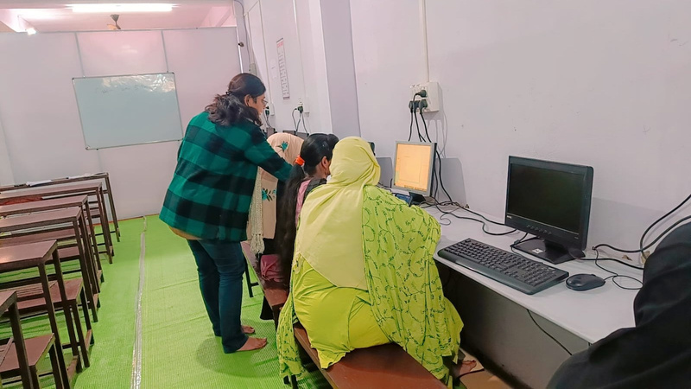
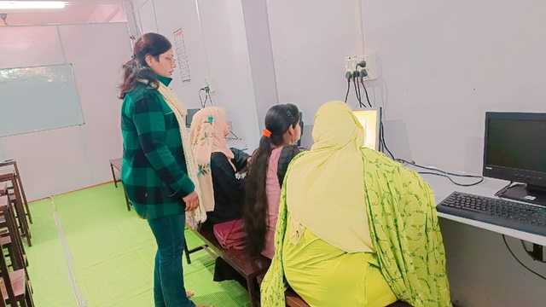

MUNAWWAR FOUNDATION-"Illuminating Hearts, Transforming Futures"
Digital Literacy & Computer Training
ANNUAL REPORT 2025-26
Objective: To empower youth and women with essential computer and digital skills.
Target Group: School dropouts, rural youth, and homemakers.
Activities:
  Basic computer operations, MS Office, and internet usage.
  Online application and job search training.
  Expected Outcome: Increased employability and confidence in using technology for education and livelihood.

Slide 3
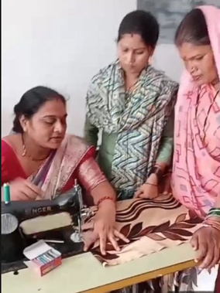
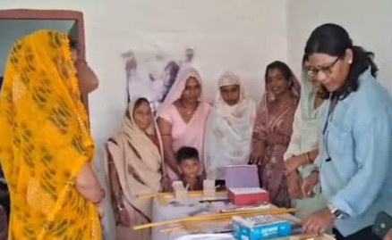
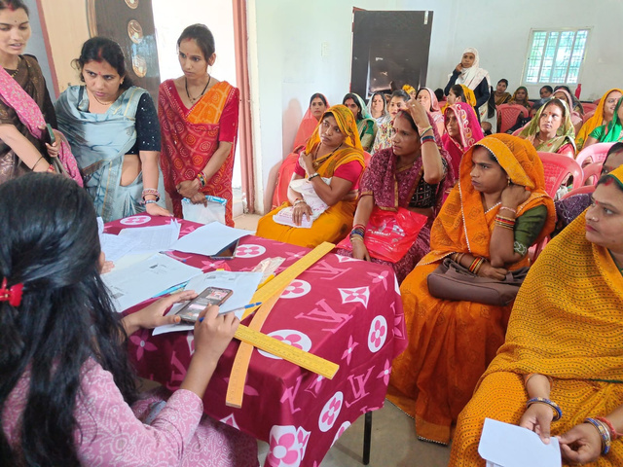
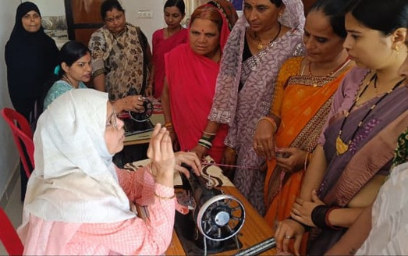
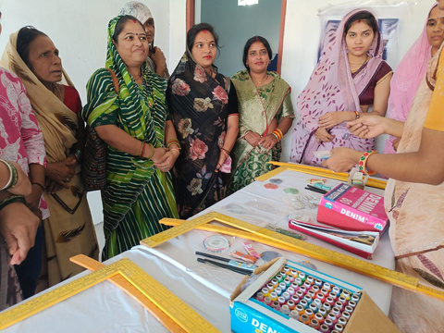
MUNAWWAR FOUNDATION-"Illuminating Hearts, Transforming Futures"
Sewing & Design Skill Development
ANNUAL REPORT 2025-26
Objective: To create self-employment opportunities for women through tailoring and garment design.
Target Group: Economically weaker women, men and girls.
Activities:
  Hands-on stitching, cutting, and design training.
  Support to start small tailoring units.
  Expected Outcome: Financial independence and income generation for women participants.

Slide 4
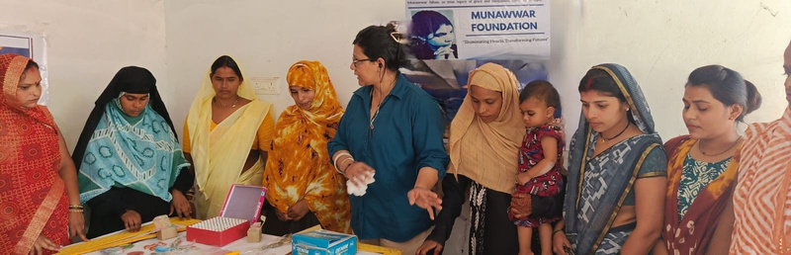
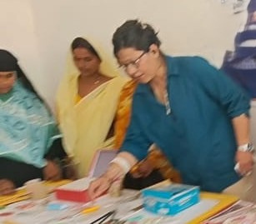
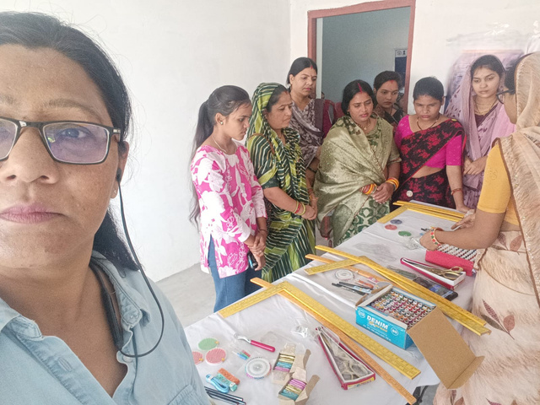
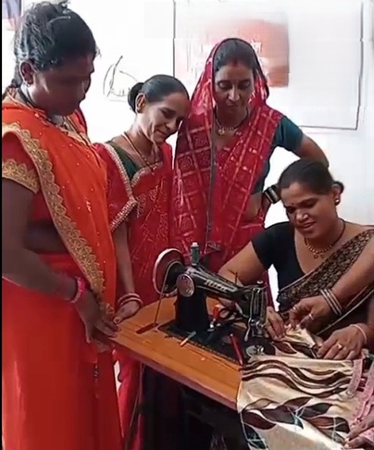
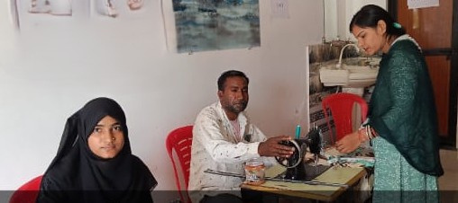
MUNAWWAR FOUNDATION-"Illuminating Hearts, Transforming Futures"
Sewing & Design Skill Development
ANNUAL REPORT 2025-26

Slide 5
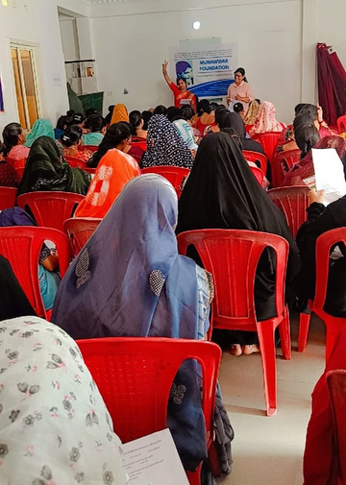
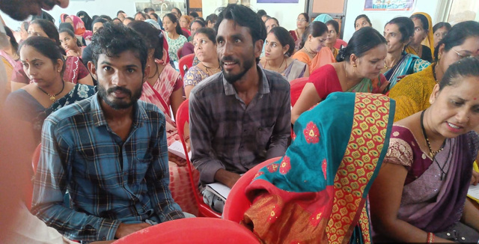
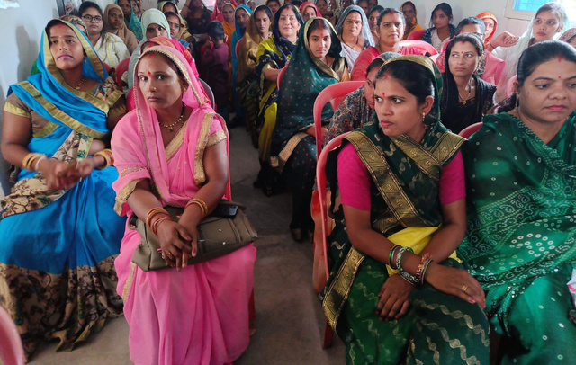
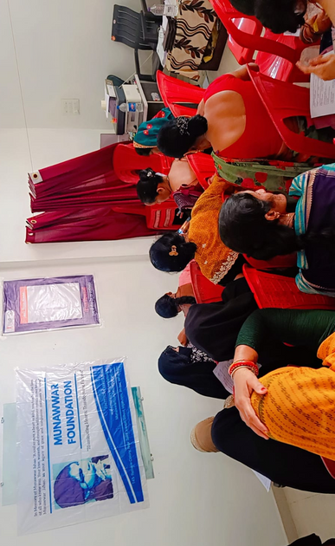
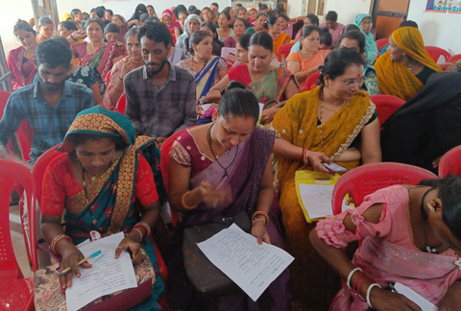
MUNAWWAR FOUNDATION-"Illuminating Hearts, Transforming Futures"
Online Selling & Entrepreneurship Training
ANNUAL REPORT 2025-26
Project: Online Selling & Entrepreneurship Training
Objective: To promote digital entrepreneurship through e-commerce education.
Target Group: Small business owners, artisans, and women entrepreneurs.
Activities:
  Training on product listing, photography, and online marketing.
  Guidance on using platforms like Amazon, Meesho, and Flipkart.
  Expected Outcome: Increased digital presence and sales opportunities for trainees.

Slide 6
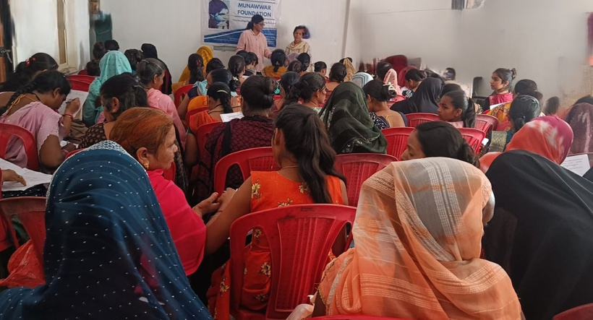
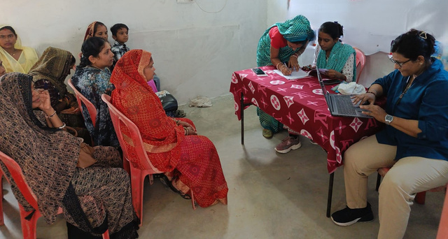
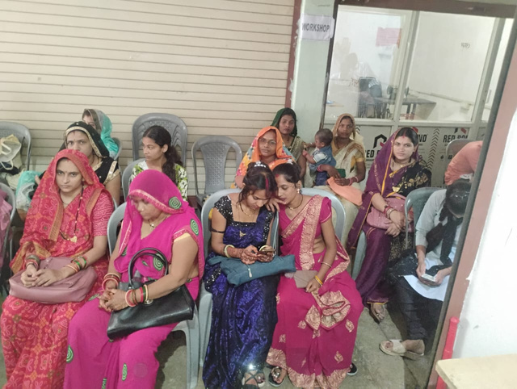
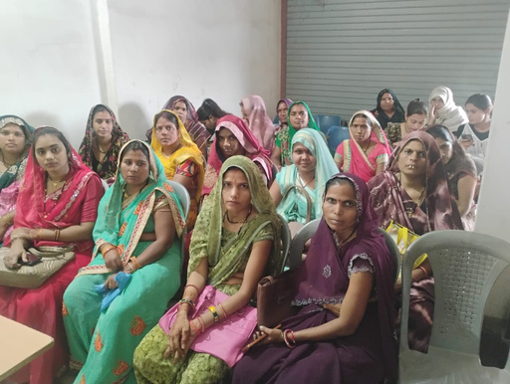
MUNAWWAR FOUNDATION-"Illuminating Hearts, Transforming Futures"
Online Selling & Entrepreneurship Training
ANNUAL REPORT 2025-26

Slide 7
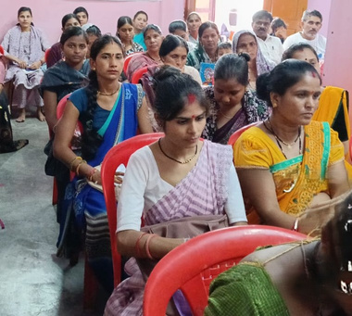
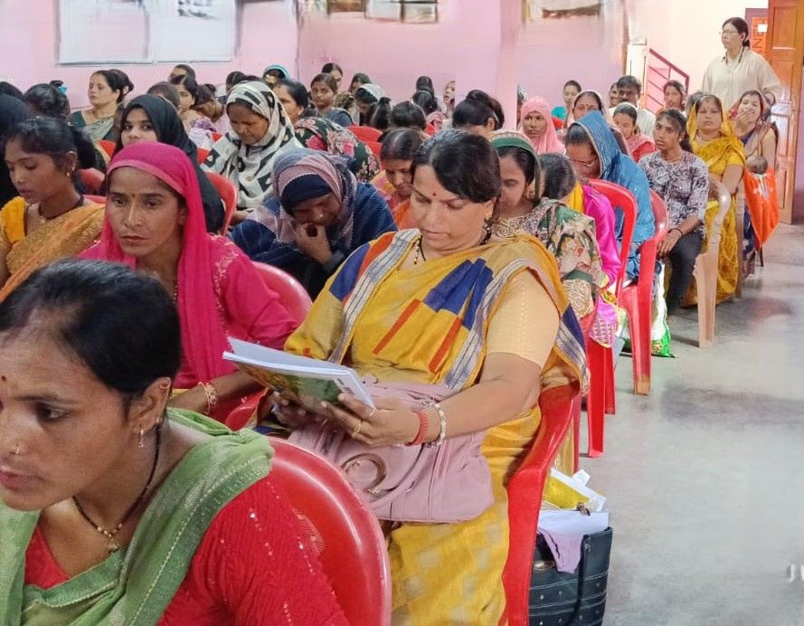
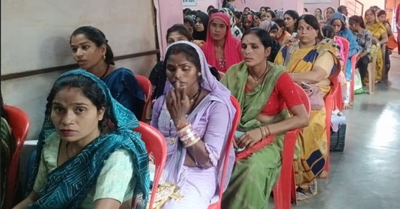
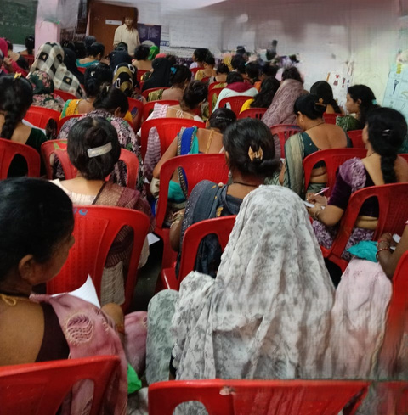
MUNAWWAR FOUNDATION-"Illuminating Hearts, Transforming Futures"
Health & Hygiene Awareness
ANNUAL REPORT 2025-26
Objective: To improve community health and hygiene practices.
Target Group: Women, children, and rural families.
Activities:
  Free health check-up camps and doctor consultations.
  Menstrual hygiene awareness and sanitary pad distribution.
  Expected Outcome: Better health awareness and hygiene habits in target communities.

Slide 8
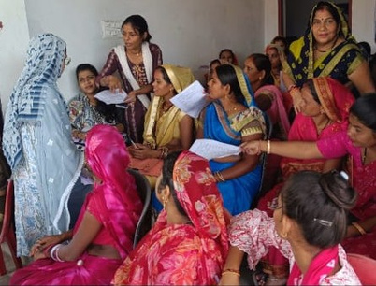
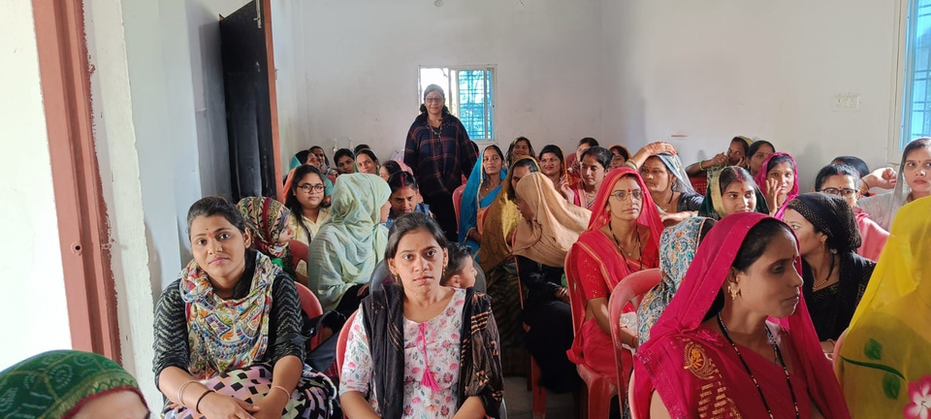
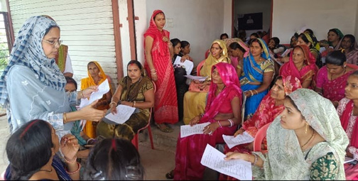
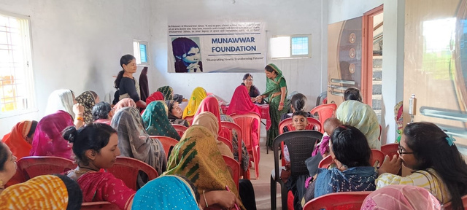
MUNAWWAR FOUNDATION-"Illuminating Hearts, Transforming Futures"
Importance of
Education Program
ANNUAL REPORT 2025-26
Objective:
To promote education as a fundamental tool for empowerment and social transformation.
Target Group:
Underprivileged children, school dropouts, and youth from low-income communities.
Activities:
  Organizing awareness sessions for parents to emphasize the value of schooling.
  Providing basic learning materials and digital access to enhance the quality of education.

Slide 9
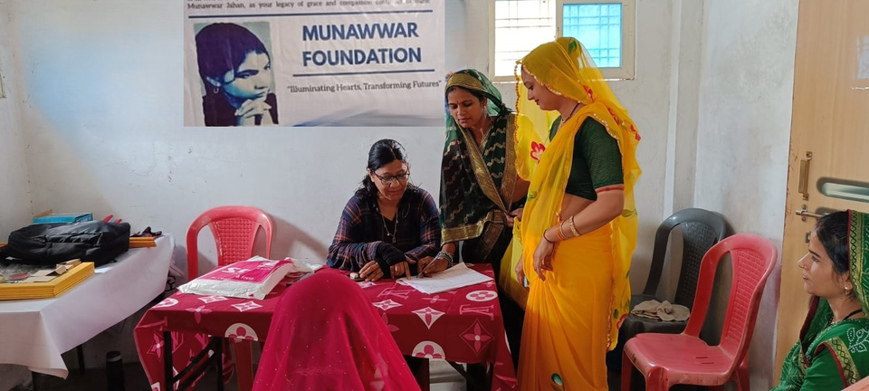
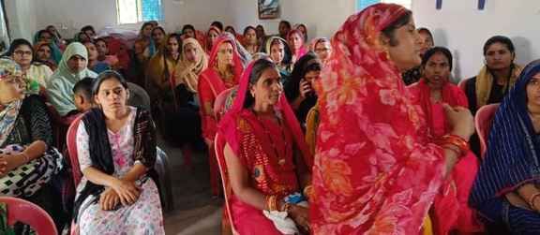
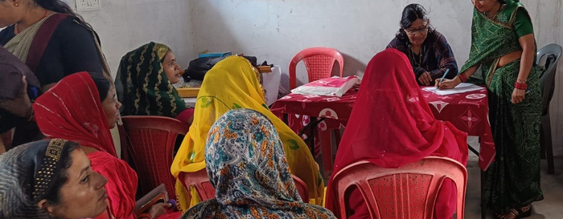
MUNAWWAR FOUNDATION-"Illuminating Hearts, Transforming Futures"
Importance of
Education Program
ANNUAL REPORT 2025-26

Slide 10
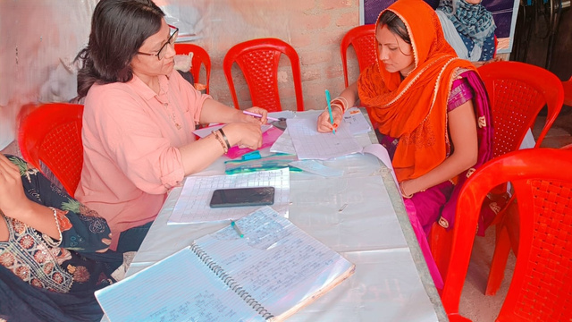
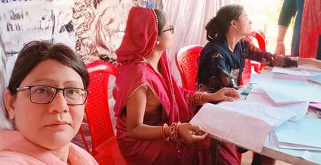
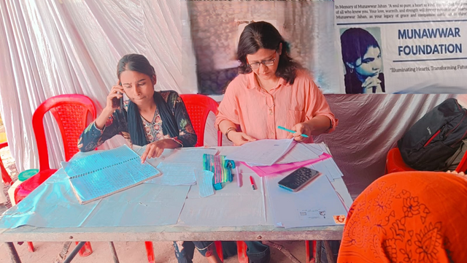
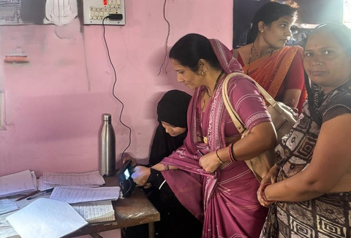
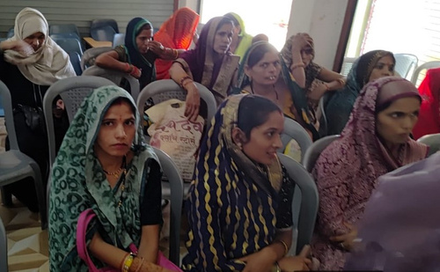
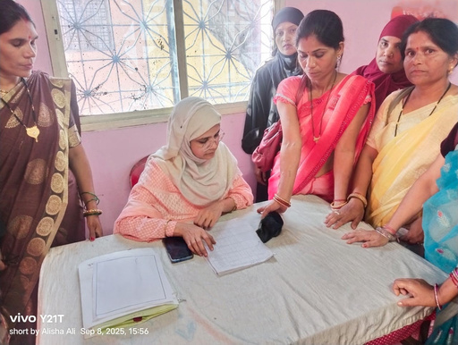
MUNAWWAR FOUNDATION-"Illuminating Hearts, Transforming Futures"
Financial Literacy for Women
ANNUAL REPORT 2025-26
Objective:
To empower women with the knowledge and skills to manage their personal and household finances effectively.
Target Group:
Women from rural and economically weaker sections of society.
Activities:
  Conducting workshops on basic banking operations, savings, and budgeting.
  Training sessions on the use of digital payment systems and financial planning.
  Awareness programs on government financial schemes and self-help group (SHG) benefits.
  Encouraging women to develop entrepreneurial mindsets and manage small businesses efficiently.

Slide 11
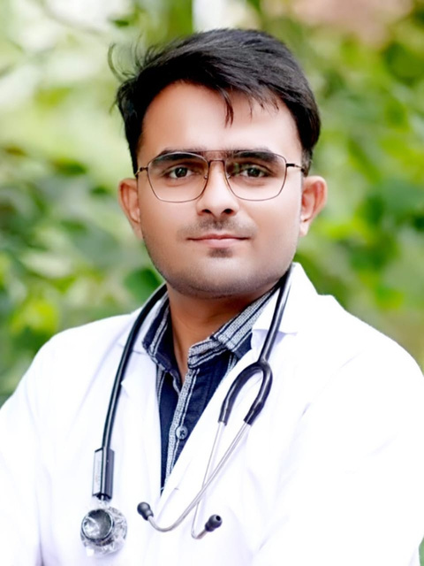
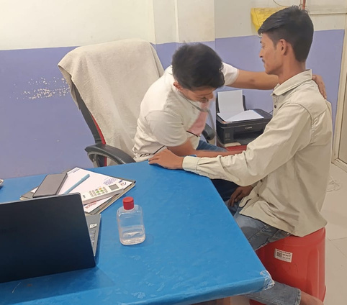
MUNAWWAR FOUNDATION-"Illuminating Hearts, Transforming Futures"
Healthcare
Support Initiative
ANNUAL REPORT 2025-26
Objective:
To ensure timely medical assistance and healthcare support for underprivileged individuals through direct collaboration with doctors and clinics.
Target Group:
Economically disadvantaged individuals, elderly persons, and those unable to afford medical treatment.
Activities:
  Identifying patients in need of medical attention and referring them to partner doctors or clinics for consultation and treatment.
  Collaborating with medical professionals to provide subsidized or free healthcare services.
  Supplying essential medicines and supporting follow-up care when required.
  Raising awareness about preventive health practices and the importance of timely medical check-ups.
Expected Outcome:
Better access to medical treatment for the needy, improved health outcomes through early intervention, and strengthened collaboration between the Foundation and healthcare professionals for community welfare.
Dr. Fardeen Sheikh is a compassionate young doctor dedicated to serving humanity through his medical expertise. In collaboration with Munawwar Foundation, he provides free medical consultations and treatment to underprivileged and needy patients. His commitment reflects a true spirit of social responsibility and empathy. Dr. Sheikh believes that quality healthcare should be accessible to all, regardless of financial status. Through his selfless service, he brings hope and healing to countless lives. His voluntary efforts have made a remarkable difference in the community.
The initiative not only promotes better health but also spreads awareness about preventive care. Munawwar Foundation deeply values his noble
contribution and dedication to social welfare.

Slide 12
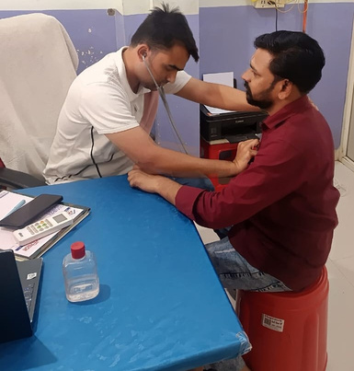
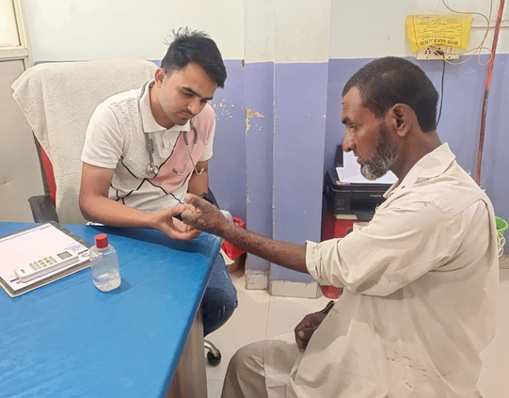
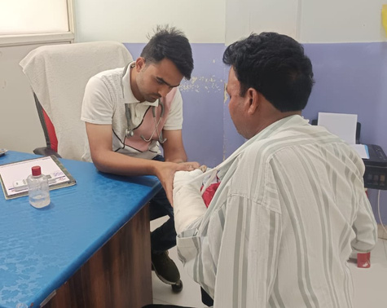
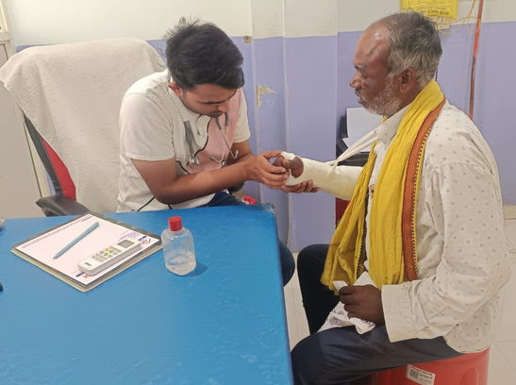
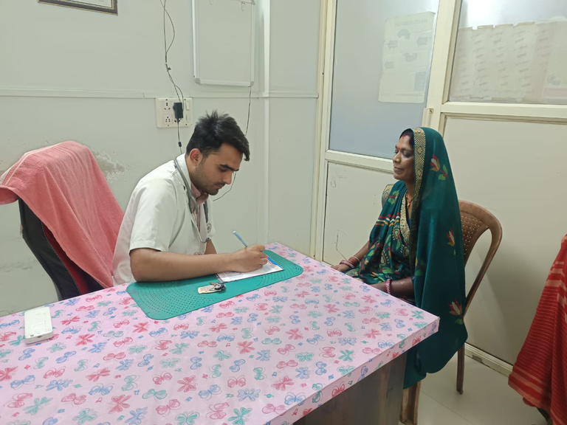
MUNAWWAR FOUNDATION-"Illuminating Hearts, Transforming Futures"
Healthcare
Support Initiative
ANNUAL REPORT 2025-26

Slide 13
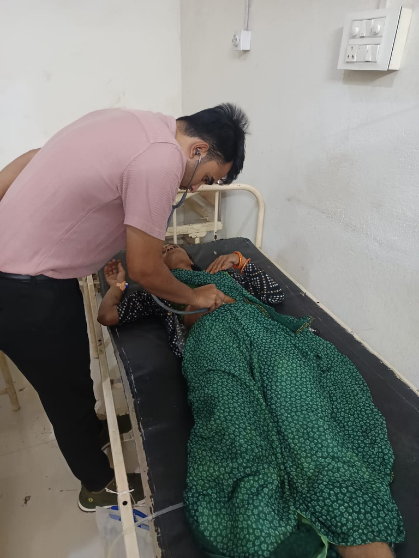



MUNAWWAR FOUNDATION-"Illuminating Hearts, Transforming Futures"
Healthcare
Support Initiative
ANNUAL REPORT 2025-26

Slide 14







MUNAWWAR FOUNDATION-"Illuminating Hearts, Transforming Futures"
Continuous Breakfast Distribution for the Underprivileged
ANNUAL REPORT 2025-26
Objective:
To ensure that vulnerable and homeless individuals start their day with a healthy and nutritious meal, promoting dignity and care within the community.
Target Group:
Underprivileged and homeless individuals, daily wage earners, and people living in extreme poverty.
Activities:
  Regular distribution of freshly prepared breakfast at designated community points and public areas.
  Engagement of volunteers to maintain hygiene, timely service, and respectful interaction.
  Awareness activities to encourage empathy and social responsibility towards the less fortunate.
Expected Outcome:
Improved nutrition, enhanced well-being, and a stronger sense of belonging among the underprivileged, reinforcing the Foundation’s commitment to compassion and community care.

Slide 15











MUNAWWAR FOUNDATION-"Illuminating Hearts, Transforming Futures"
About Us
Teamwork at
Munawwar Foundation
ANNUAL REPORT 2025-26
The success of Munawwar Foundation lies in the dedication, passion, and teamwork of its members. Each initiative undertaken by the Foundation is a result of collective effort, shared vision, and a deep sense of social responsibility. The team comprises professionals, educators, volunteers, and community workers who work hand in hand to turn ideas into impactful actions.
From planning and mobilization to on-ground execution, every project reflects the team’s coordination and commitment to excellence.
Regular meetings, brainstorming sessions, and capacity-building workshops keep the team motivated and aligned with the Foundation’s mission.
The Foundation encourages a culture of inclusivity, mutual respect, and continuous learning among its members. Team leaders ensure that every voice is heard and every contribution is valued. The seamless collaboration between field volunteers and management enables the organization to reach diverse communities effectively.
Driven by compassion and purpose, the Munawwar Foundation team continues to inspire change — transforming challenges into opportunities and vision into reality.
TEEN SQUAD

Slide 16
Together, We Continue the Journey of Change
As we reflect on another year of compassion and impact, we extend our heartfelt gratitude to all who have been part of the Munawar Foundation family.
Your trust, support, and belief in our mission inspire us to keep moving forward — empowering lives, nurturing hope, and building a better tomorrow.
Stay connected with our mission as we continue
to create meaningful change, one initiative at a time.
STAY CONNECTED-
145-Reliable Colony, Saint Joseph School,
Idgah Hills, Bhopal-462001
DROP US A LINE-
7999269697 - 6262226244
munawwarfoundation@gmail.com
www.munawwarfoundation.org
FOLLOW US-
Instagram- @munawwarfoundation
Facebook- @MunawwarFoundation
MUNAWWAR FOUNDATION-"Illuminating Hearts, Transforming Futures"

