Slide 1
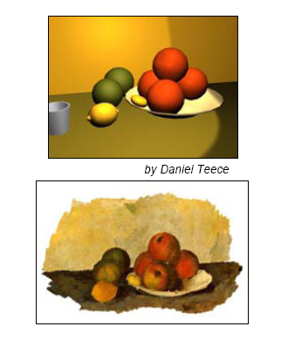
Non-Photorealistic Rendering

Slide 2
Overview
Toon Shading
Silhouette Edge Rendering
  Surface Angle Silhouetting
  Procedural Geometry Silhouetting
  Silhouetting by Image Processing
  Silhouette Edge Detection
  Hybrid Silhouetting
Lines
  Edge Highlighting
  Polygon Edge Rendering
  Hidden-Line Rendering
  Haloing

Slide 3
Toon Shading
Objects are drawn with solid lines separating areas of different solid colors
Integrating 3D models with 2D cell animations
Approaches
  With textures no lighting: Quantize textures
  Shading
    Fill with solid color
    Use two tones: lit and shadowed
  Compute the diffuse shader dot product (n.l) for each vertex and using this value as a texture coordinate to access a one-D texture map. The texture map contains only two shades: light and dark.

Slide 4
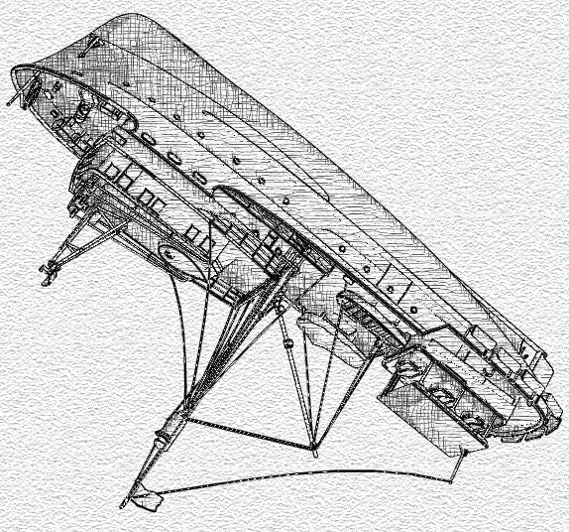
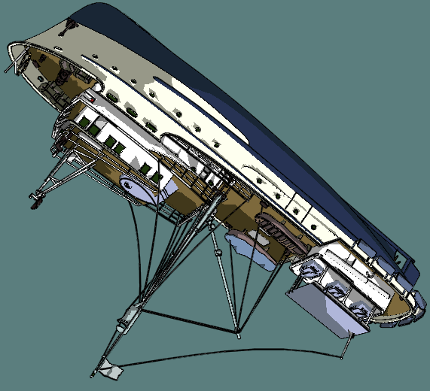

Slide 5
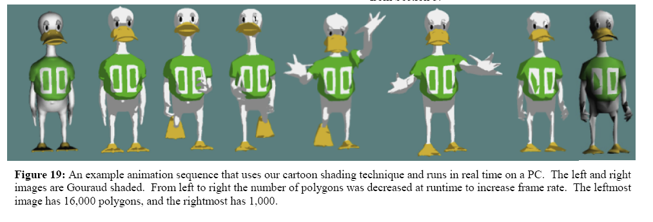
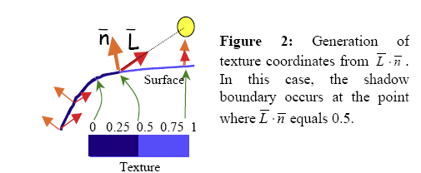
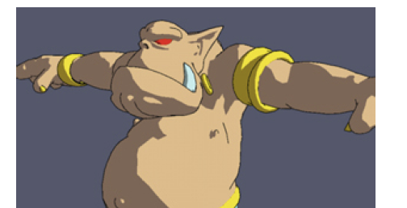
Stylized Rendering Techniques For Scalable Real-Time 3D Animation
Adam Lake Carl Marshall Mark Harris† Marc Blackstein
Graphics Algorithms and 3D Technologies Group (G3D)
Intel Architecture Labs (IAL)
†University of North Carolina at Chapel Hill

Slide 6
Silhouette Edge Rendering
Different types of edges for toon rendering
  A boundary edge:
    A border edge is not shared by two polygons, the edge of sheet of paper. A solid object has no boundary edges.
  A crease edge:
    shared by two polygons and the angle between two polygons is greater than some value (60). Or a crease edge is one in which he vertex normals differ between the two neighbouring polygons (Cube)
  A material edge:
    two triangles with different materials
  A silhouette edge:
    two neighbouring triangles face in different directions compared to some direction vector

Slide 7
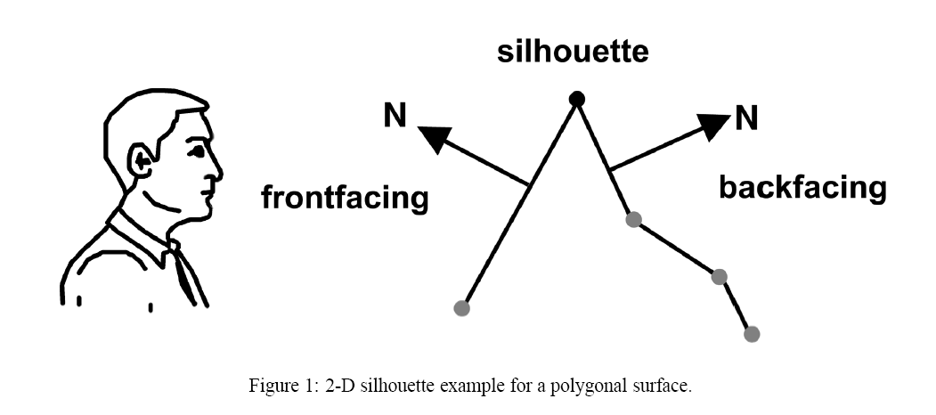

Slide 8
Surface Angle Silhouetting
The dot product between the direction to the viewpoint and the surface normal can be used to give a silhouette edge
If the value is near zero, then the surface is nearly edge-on to the eye and so is likely to be near a silhouette edge.
Approach:
  Shade the surface using a spherical EM with a black ring around the edge
  Works for some models

Slide 9
Procedural Geometry Silhouetting
Render the frontfaces normally, then render the backfaces in a way as to make their silhouette edges visible.
Approach:
  1-) Draw only edges nor faces of the backfaces. Works fine with single pixel wide lines
  2-) Move backfaces otuwards by shifting their vertices along the shared vertex normals, by an amount proportional to their z-distance from the eye (shell, halo method)
  Render a sphere, expand it by a radius that is 5 pixels wide with respect to the sphere’s centre. Render only this expanded version’s backfaces in black. The silhouette edges will be 5 pixels wide.

Slide 10
Silhouetting by Image Processing
Looking at discontinuities in neighbouring Z-buffer values, most silhouette edge locations can be found
Advantages: all primitives, curved surfaces (image based)

Slide 11
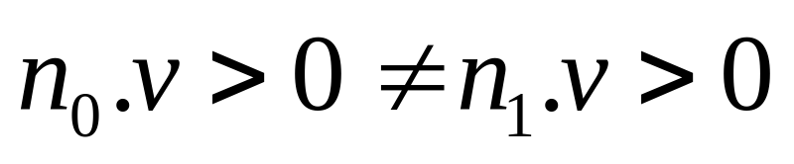
Silhouette Edge Detection
Detect edges directly and render them
More fine control on how the lines are rendered
The test for S Edges:
No and N1 are two triangle normals, v is the view direction from the eye to the edge

Slide 12
Hybrid Silhouetting
Northrup/Markosian approach:
  Both image and geometric elements
Approach
  Find a list of silhouette edges
  Render all the object’s triangles and silhouette edges with different ID numbers (different color)
  Read ID buffer, determine visible s edges
  Check the visible edges for overlaps
  Link them together to form smooth stroke paths
  Stylize strokes

Slide 13
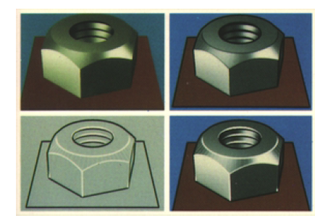

Slide 14
Lines
Edge Highlighting
  To highlight and object we draw its edges in a different color, without having to redraw the surface itself
  No polygon rendering !
Polygon Edge Rendering
  How to ensure that the lines are rendered in front of the polygons

Slide 15
Lines
Render all lines with a bias
  Each line is rendered slightly closer than it should truly be, so that it will be above the surface

