Slide 1
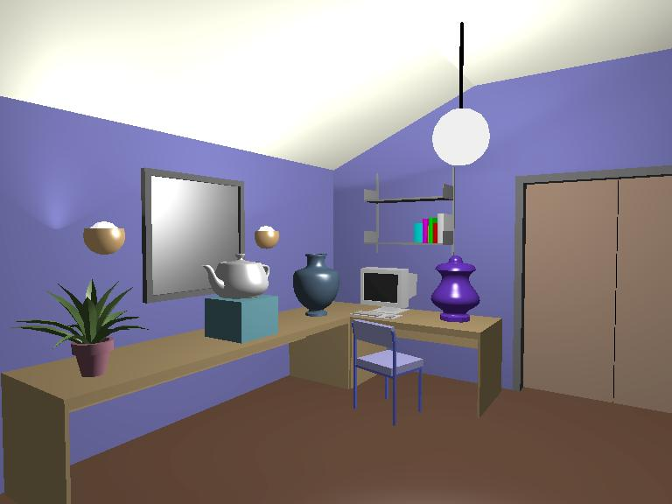
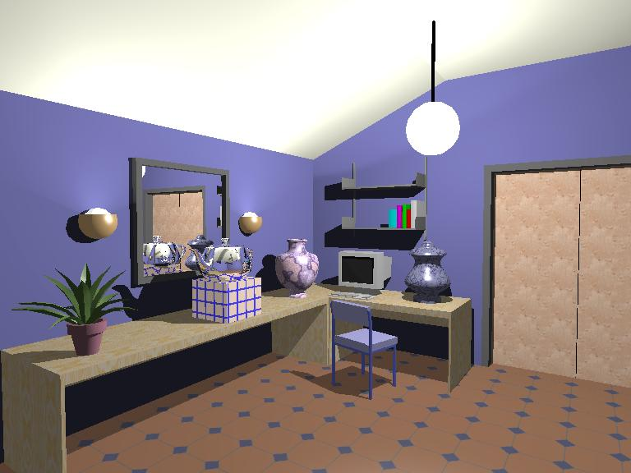
Illumination and Shading

Slide 2
Illumination and Shading
Problem: Model light/surface points interaction to determine final color and brightness
lighting

Slide 3
Shading
Apply the lighting model at a set of points across the entire surface
Shading

Slide 4
Illumination Model
The governing principles for computing the illumination
A illumination model usually considers:
  Light attributes (intensity, color, position, direction, shape)
  Object surface attributes (color, reflectivity, transparency, etc)
  Interaction among lights and objects
  What are the OpenGL Illumination features ?

Slide 5
Basic Light Sources
Light intensity can be
independent or
dependent of the
distance between object
and the light source
Point light
Directional light
Spot light
Area light

Slide 6
Local Illumination
Local illumination: only consider the light, the observer position, and the object material properties
OpenGL does this
θ

Slide 7
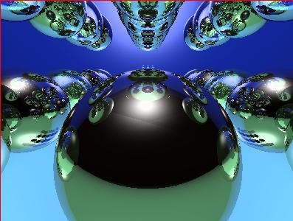
Global Illumination
Global illumination: take into account the interaction of light from all the surfaces in the scene
Example: Ray tracing
object 4
object 3
object 2
object 1

Slide 8
Simple Local Illumination
The model used by OpenGL
Consider three types of light contribution to compute the final illumination of an object
  Ambient
  Diffuse
  Specular
Final illumination of a point (vertex) =
ambient + diffuse + specular

Slide 9
Ambient Light Contribution
Ambient light = background light
Light that is scattered by the environment
Frequently assumed to be constant
Very simple approximation of global illumination
No direction: independent of light position, object orientation, observer’s position or orientation
object 4
object 3
object 2
object 1

Slide 10
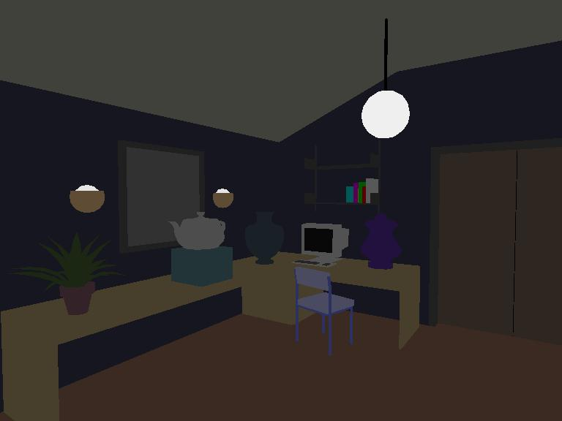
Ambient Light Example

Slide 11
Ambient Light Calculation
Each light source has ambient light contribution (Ia)
Different objects can reflect different amounts of ambient
Different ambient reflection coefficients Ka, 0 <= Ka <= 1
So, ambient light from an object is:
Ambient = Ia x Ka

Slide 12


Diffuse Light Contribution
Diffuse light: The illumination that a surface receives from a light source and reflects equally in all direction
It does not matter where
the eye is

Slide 13
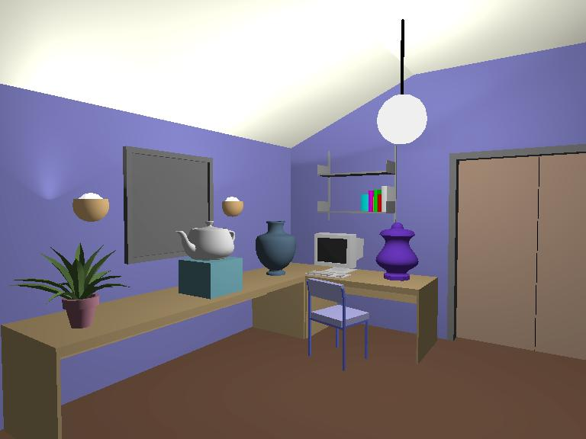
Diffuse Lighting Example

Slide 14
Diffuse Light Calculation
Need to decide how much light the object point receive from the light source – based on Lambert’s Law
Receive more light
Receive less light

Slide 15
Diffuse Light Calculation
Lambert’s law: the radiant energy D that a small surface patch receives from a light source is:
D = I x cos (θ)
I: light intensity
θ: angle between the light vector and the surface normal
light vector (vector from object to light)
θ
N : surface normal

Slide 16
Diffuse Light Calculation
Like ambient case, different objects reflect different amount of diffuse light
different diffuse reflection coefficient Kd, (0 <= Kd <= 1)
So, the amount of diffuse light that can be seen is:
Diffuse = Kd x I x cos (θ)
N
L
θ
θ
cos(θ) = N.L

Slide 17

Specular light contribution
The bright spot on the object
The result of total reflection of
the incident light in a concentrate
region
See lots specular
See no specular

Slide 18
Specular light example

Slide 19
Specular light calculation
How much reflection you can see depends on where you are
Only position the eye can see specular from P
if object has an ideal reflection surface
But for non-perfect surface you will
still see specular highlight when you move
a little bit away from the idea reflection
direction
When φ is small, you see more specular
highlight
θ ?
φ
p

Slide 20
Specular light calculation
Phong lighting model
specular = Ks x I x cos(φ)
Ka: specular reflection coefficient
N: surface normal at P
I: light intensity
V: vector from P to viewer’s eye
R: mirror-reflection direction
φ: angle between V and R
cos(φ): the larger is n, the smaller
is the cos value
cos(θ) = R.V
n
L
N
R
θ θ
φ
V
n
p

Slide 21
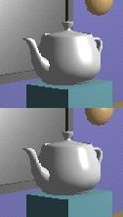
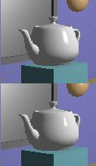
Specular light calculation
The effect of ‘n’ in the phong model
n = 10
n = 90
n = 30
n = 270

Slide 22
Put it all together
Illumination from a light:
Illum = ambient + diffuse + specular
= Ka x I + Kd x I x (N.L) + Ks x I x (R.V)
If there are N lights
Total illumination for a point P = Σ (Illum)
Some more terms to be added (in OpenGL):
  Self emission
  Global ambient
  Light distance attenuation and spot light effect
n

Slide 23
Adding Color
Sometimes light or surfaces are colored
Treat R,G and B components separately
Illumination equation goes from:
Illum = ambient + diffuse + specular
= Ka x I + Kd x I x (N.L) + Ks x I x (R.V)
To:
Illum_r = Ka_r x I_r + Kd_r x I_r x (N.L) + Ks_r x I_r x (R.V)
Illum_g = Ka_g x I_g + Kd_g x I_g x (N.L) + Ks_g x I_g x (R.V)
Illum_b = Ka_b x I_b + Kd_b x I_b x (N.L) + Ks_b x I_b x (R.V)
n

Slide 24
Adding Color
Material | Ambient Kar, Kag,kab | Diffuse Kdr, Kdg,kdb | Specular Ksr, Ksg,ksb | Exponent, n
Black plastic | 0.0 0.0 0.0 | 0.01 0.01 0.01 | 0.5 0.5 0.5 | 32
Brass | 0.329412 0.223529 0.027451 | 0.780392 0.568627 0.113725 | 0.992157 0.941176 0.807843 | 27.8974
Polished Silver | 0.23125 0.23125 0.23125 | 0.2775 0.2775 0.2775 | 0.773911 0.773911 0.773911 | 89.6

Slide 25

Lighting in OpenGL
Adopt Phong lighting model
  specular + diffuse + ambient lights
  Lighting is computed at vertices
    Interpolate across surface (Gouraud/smooth shading)
    Use a constant illumination (get it from one of the vertices)
Setting up OpenGL Lighting:
  Light Properties
  Enable/Disable lighting
  Surface material properties
  Provide correct surface normals
  Light model properties

Slide 26
Light Properties
Properties:
  Colors / Position and type / attenuation
glLightfv(light, property, value)
1
2
3
constant: specify which light you want to set the property
E.g: GL_LIGHT0, GL_LIGHT1, GL_LIGHT2 … you can
create multiple lights (OpenGL allows at least 8 lights)
(2) constant: specify which light property you want to set the value
E.g: GL_AMBIENT, GL_DIFFUSE, GL_SPECULAR, GL_POSITION
(check the red book for more)
(3) The value you want to set to the property

Slide 27
Property Example
Define colors and position a light
  GLfloat light_ambient[] = {0.0, 0.0, 0.0, 1.0};
  GLfloat light_diffuse[] = {1.0, 1.0, 1.0, 1.0};
  GLfloat light_specular[] = {1.0, 1.0, 1.0, 1.0};
  GLfloat light_position[] = {0.0, 0.0, 1.0, 1.0};
  glLightfv(GL_LIGHT0, GL_AMBIENT, light_ambient);
  glLightfv(GL_LIGHT0, GL_DIFFUSE, light_diffuse);
  glLightfv(GL_LIGHT0, GL_SPECULAR, light_specular);
  glLightfv(GL_LIGHT0, GL_POSITION, light_position);
colors
Position
What if I set
Position to
(0,0,1,0)?

Slide 28
Types of lights
OpenGL supports two types of lights
  Local light (point light)
  Infinite light (directional light)
Determined by the light positions you provide
  w = 0: infinite light source (faster)
  w != 0: point light – position = (x/w, y/w, z/w)
  GLfloat light_position[] = {x,y,z,w};
  glLightfv(GL_LIGHT0, GL_POSITION, light_position);

Slide 29

Turning on the lights
Turn on the power (for all the lights)
  glEnable(GL_LIGHTING);
  glDisable(GL_LIGHTING);
Flip each light’s switch
  glEnable(GL_LIGHTn) (n = 0,1,2,…)

Slide 30
Controlling light position
Modelview matrix affects a light’s position
Two options:
Option a:
  Treat light like vertex
  Do pushMatrix, translate, rotate, .. glLightfv position, popmatrix
  Then call gluLookat
  Light moves independently of camera
Option b:
  Load identity matrix in modelview matrix
  Call glLightfv then call gluLookat
  Light appears at the eye (like a miner’s lamp)

Slide 31
Material Properties
The color and surface properties of a material (dull, shiny, etc)
How much the surface reflects the incident lights (ambient/diffuse/specular reflecetion coefficients)
glMaterialfv(face, property, value)
Face: material property for which face (e.g. GL_FRONT, GL_BACK,
GL_FRONT_AND_BACK)
Property: what material property you want to set (e.g. GL_AMBIENT,
GL_DIFFUSE,GL_SPECULAR, GL_SHININESS, GL_EMISSION, etc)
Value: the value you can to assign to the property

Slide 32
Material Example
Define ambient/diffuse/specular reflection and shininess
GLfloat mat_amb_diff[] = {1.0, 0.5, 0.8, 1.0};
GLfloat mat_specular[] = {1.0, 1.0, 1.0, 1.0};
GLfloat shininess[] = {5.0}; (range: dull 0 – very shiny 128)
glMaterialfv(GL_FRONT_AND_BACK, GL_AMBIENT_AND_DIFFUSE,
mat_amb_diff);
glMaterialfv(GL_FRONT, GL_SPECULAR, mat_speacular);
glMaterialfv(GL_FRONT, GL_SHININESS, shininess);
refl. coeff.

Slide 33
Global light properties
glLightModelfv(property, value)
Enable two sided lighting
  property = GL_LIGHT_MODEL_TWO_SIDE
  value = GL_TRUE (GL_FALSE if you don’t want two sided lighting)
Global ambient color
  Property = GL_LIGHT_MODEL_AMBIENT
  Value = (red, green, blue, 1.0);
Check the red book for others

Slide 34
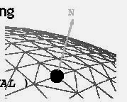
Surface Normals
Correct normals are essential for correct lighting
Associate a normal to each vertex
glBegin(…)
    glNormal3f(x,y,z)
    glVertex3f(x,y,z)
    …
    glEnd()
The normals you provide need to have a unit length
  You can use glEnable(GL_NORMALIZE) to have OpenGL normalize all the normals

Slide 35
Lighting revisit
Where is lighting performed in the graphics pipeline?
v1, m1
modeling and
viewing
per vertex
lighting
projection
v2, m2
v3, m3
Rasterization
texturing
shading
viewport
mapping
interpolate
vertex colors
clipping
Display

Slide 36
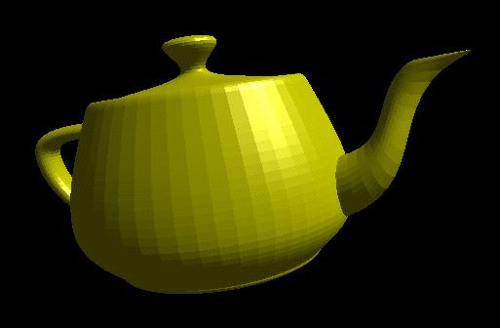

Polygon shading model
Flat shading - compute lighting once and assign the color to the whole (mesh) polygon

Slide 37
Flat shading
Only use one vertex normal and material property to compute the color for the polygon
Benefit: fast to compute
Used when:
  Polygon is small enough
  Light source is far away (why?)
  Eye is very far away (why?)
OpenGL command: glShadeModel(GL_FLAT)

Slide 38
Mach Band Effect
Flat shading suffers from “mach band effect”
Mach band effect – human eyes accentuate the discontinuity at the boundary
perceived intensity
Side view of a polygonal surface

Slide 39
Smooth shading
Fix the mach band effect – remove edge discontinuity
Compute lighting for more points on each face
Flat shading
Smooth shading

Slide 40
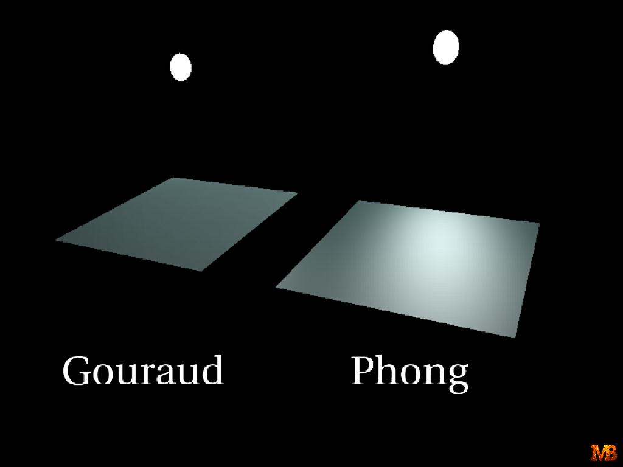
Smooth shading
Two popular methods:
  Gouraud shading (used by OpenGL)
  Phong shading (better specular highlight, not in OpenGL)

Slide 41
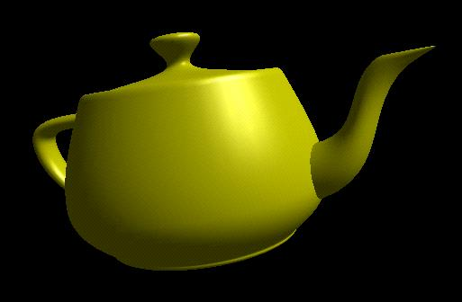

Gouraud Shading
The smooth shading algorithm used in OpenGL
glShadeModel(GL_SMOOTH)
Lighting is calculated for each of the polygon vertices
Colors are interpolated for interior pixels

Slide 42
Gouraud Shading
Per-vertex lighting calculation
Normal is needed for each vertex
Per-vertex normal can be computed by averaging the adjust face normals
n1
n
n2
n3
n4
n = (n1 + n2 + n3 + n4) / 4.0

Slide 43
Gouraud Shading
Compute vertex illumination (color) before the projection transformation
Shade interior pixels: color interpolation (normals are not needed)
C1
for all scanlines
Ca = lerp(C1, C2)
Cb = lerp(C1, C3)
C2
C3
* lerp: linear interpolation
Lerp(Ca, Cb)

Slide 44
Gouraud Shading
Linear interpolation
Interpolate triangle color: use y distance to interpolate the two end points in the scanline, and use x distance to interpolate interior pixel colors
x = a / (a+b) * v1 + b/(a+b) * v2
a
b
v1
x
v2

Slide 45
Gouraud Shading Problem
Lighting in the polygon interior can be inaccurate

Slide 46
Phong Shading
Instead of interpolation, we calculate lighting for each pixel inside the polygon (per pixel lighting)
Need normals for all the pixels – not provided by user
Phong shading algorithm interpolates the normals and compute lighting during rasterization (need to map the normal back to world or eye space though)

Slide 47
Phong Shading
Normal interpolation
Slow – not supported by OpenGL and most graphics hardware
n1
na = lerp(n1, n2)
nb = lerp(n1, n3)
lerp(na, nb)
n2
n3

Slide 48
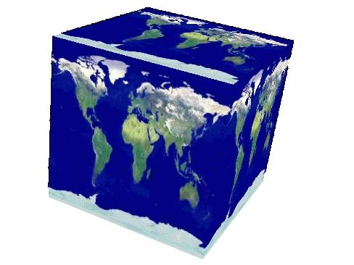
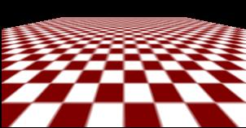
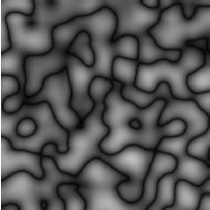
Texture Mapping
A way of adding surface details
Two ways can achieve the goal:
  Surface detail polygons: create extra polygons to model object details
    Add scene complexity and thus slow down the graphics rendering speed
    Some fine features are hard to model!
  Map a texture to the surface (a more popular approach)
Complexity of images does
Not affect the complexity
Of geometry processing
(transformation, clipping…)

Slide 49
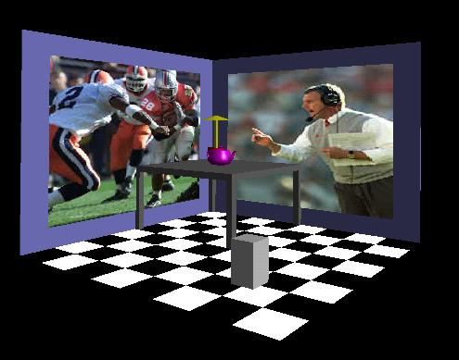
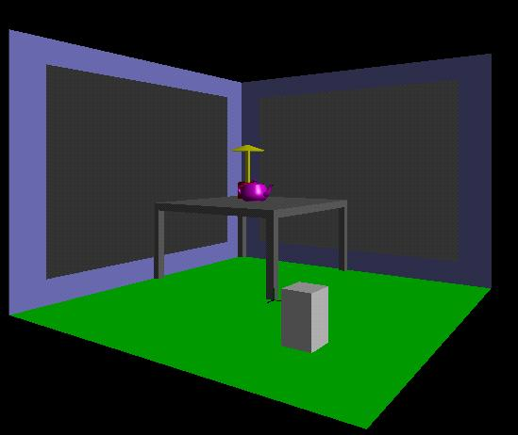

Texture Mapping
1. projection
3. patch texel
3D geometry
2. texture lookup
2D projection of 3D geometry
t
2D image
S

Slide 50
Texture Representation
Bitmap (pixel map) textures (supported by OpenGL)
Procedural textures (used in advanced rendering programs)
(1,1)
Bitmap texture:
A 2D image - represented by 2D array
texture[height][width]
Each pixel (or called texel ) by a unique
pair texture coordinate (s, t)
The s and t are usually normalized to
a [0,1] range
For any given (s,t) in the normalized range,
there is also a unique image value (i.e.,
a unique [red, green, blue] set )
t
s
(0,0)

Slide 51
Texture Value Lookup
For given texture coordinates (s,t), we can find a unique image value from the texture map
(1,1)
How about coordinates that are not
exactly at the intersection (pixel) positions?
Nearest neighbor
Linear Interpolation
Other filters
(0,0)
(0.25,0)
(0.5,0)
(0.75,0)
(1,0)

Slide 52

Map textures to surfaces
Establish mapping from texture to surfaces (polygons):
- Application program needs to specify texture coordinates for each corner of the polygon
(1,0)
(1,1)
The polygon can be
in an arbitrary size
(0,0)
(1,0)

Slide 53
Map textures to surfaces
Texture mapping is performed in rasterization
(0,1)
(1,1)
For each pixel that is to be painted, its texture coordinates (s, t) are determined (interpolated) based on the corners’ texture coordinates (why not just interpolate the color?)
The interpolated texture coordinates are then used to perform texture lookup
(0,0)
(1,0)

Slide 54
OpenGL texture mapping
Texturing steps in your program
1) Specify texture
    read or generate image
    Assign to texture
  2) Specify texture mapping parameters
    Wrapping, filtering, etc.
  3) Enable GL texture mapping (GL_TEXTURE_2D)
  4) Assign texture coordinates to vertices
  5) Disable GL texture mapping (if you don’t need to perform texture mapping any more)

Slide 55
Specify textures
Load the texture map from main memory to texture memory
  glTexImage2D(Glenum target, Glint level, Glint
iformat, int width, int height, Glenum format,
Glenum type, Glvoid* img)
Example:
  glTeximage2D(GL_TEXTURE_2D, 0, GL_RGB, 64, 64, GL_RGB, GL_UNSIGNED_BYTE, myImage);
  (myImage is a 2D array: GLuByte myImage[64][64][3]; )
The dimensions of texture images must be powers of 2

Slide 56
Fix texture size
If the dimensions of the texture map are not power of 2, you can
  Pad zeros 2) use gluScaleImage()
60
Ask OpenGL to filter the data
for you to the right size –
you can specify the output resolution
that you want
100
128
Remember to adjust the texture coordinates
for your polygon corners – you don’t want to
Include black texels in your final picture
64

Slide 57
Texture mapping parameters
What happen if the given texture coordinates (s,t) are outside [0,1] range?
E.g: glTexParameteri(GL_TEXTAURE_2D, GL_TEXTURE_WRAP_S, GL_CLAMP)
(1,1)
(2,2)
(2,2)
(0,0)
(0,0)
(0,0)
GL_Clamp
If (s >1) s = 1
If (t >1) t = 1
texture
GL_Repeat

Slide 58
Texture mapping parameters
Since a polygon can get transformed to arbitrary screen size, texels in the texture map can get magnified or minified.
Filtering: interpolate a texel value from its neighbors or combine multiple texel values into a single one
texture
polygon projection
texture
polygon projection
Magnification
Minification

Slide 59
Texture mapping parameters
OpenGL texture filtering:
Nearest Neighbor (lower
image quality)
glTexParameteri(GL_TEXTURE_2D,
GL_TEXTURE_MIN_FILTER, GL_NEAREST);
2) Linear interpolate the neighbors
(better quality, slower)
glTexParameteri(GL_TEXTURE_2D,
GL_TEXTURE_MIN_FILTER,
GL_LINEAR)
Or GL_TEXTURE_MAX_FILTER

Slide 60
Texture color blending
Determine how to combine the texel color and the object color
  GL_MODULATE – multiply texture and object color
  GL_BLEND – linear combination of texture and object color
  GL_REPLACE – use texture color to replace object color
E.g: glTexEnvf(GL_TEXTURE_ENV, GL_TEXTURE_ENV_MODE, GL_REPLACE);

Slide 61
Enable (Disable) Textures
Enable texture – glEnable(GL_TEXTURE_2D)
Disable texture – glDisable(GL_TEXTURE_2D)
Remember to disable texture mapping when you draw non-textured polygons

Slide 62
Specify texture coordinates
Give texture coordinates before defining each vertex
glBegin(GL_QUADS);
glTexCoord2D(0,0);
glVertex3f(-0.5, 0, 0.5);
…
glEnd();

Slide 63
Transform texture coordinates
All the texture coordinates are multiplied by Gl_TEXTURE matrix before in use
To transform texture coordinates, you do:
  glMatrixMode(Gl_TEXTURE);
  Apply regular transformation functions
  Then you can draw the textured objects

Slide 64
Put it all together
…
glTexParameteri(GL_TEXTURE_2D, GL_TEXTURE_WRAP_S, GL_REPEAT);
glTexParameteri(GL_TEXTURE_2D, GL_TEXTURE_WRAP_T, GL_REPEAT);
glTexParameteri(GL_TEXTURE_2D, GL_TEXTURE_MAG_FILTER, GL_NEAREST);
glTexParameteri(GL_TEXTURE_2D, GL_TEXTURE_MIN_FILTER, GL_NEAREST);
glTexEnvf(GL_TEXTURE_ENV, GL_TEXTURE_ENV_MODE, GL_REPLACE);
…
glEnable(GL_TEXTURE_2D);
glTexImage2D(GL_TEXTURE_2D, 0, GL_RGB, 64, 64, 0, GL_RGB, GL_UNSIGNED_BYTE, mytexture);
Draw_picture1(); // define texture coordinates and vertices in the function
….

Slide 65
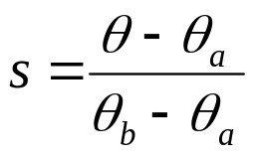
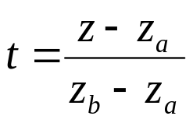
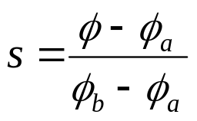
Other Stuff
Wrapping texture onto curved surfaces. E.g. cylinder, can, etc
Wrapping texture onto sphere
Bump mapping: perturb surface normal by a quantity proportional to texture

Slide 66
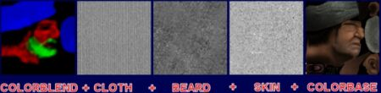
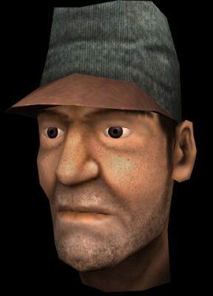

Slide 67
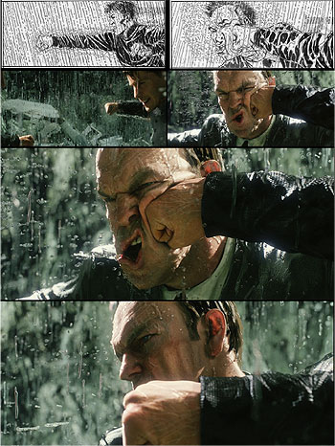

Slide 68
