Slide 1
Animation Principles

Slide 2
Why animation works
Many still images
Rapid succession
Persistence of vision
  Must overcome flicker

Slide 3
Animation is Expensive !
30 frames/second
30 minutes = 54.000 frames
5 minutes/frame, 12 hour/day ~1 year
Limited animation
Computer-assisted animation

Slide 4
What can we do ?
  Is the goal to replace or augment the artist?
    What does the artist bring to the project?
  Is the scene/plot fixed or responsive to user?
    What can we automate?

Slide 5
Overview
Traditional Methods
  Cartoons, stop motion
Keyframing
  Digital inbetweens
Motion Capture
  What you record is what you get
Simulation
  Animate what you can model (with equations)

Slide 6
Thinking About Animation
Low level: Individual frames
Mid level: Sequences & scenes
High level: Story & message
Computer helps all 3 levels

Slide 7
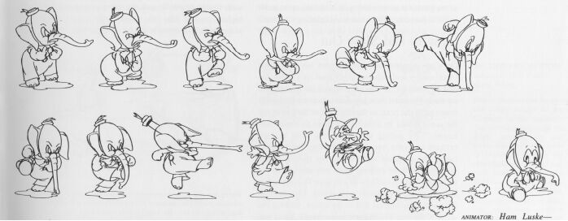
Traditional 2D Animation
Hand-drawn cells
Stacks of cells over background
Only redraw cells that change
  Limited animation

Slide 8
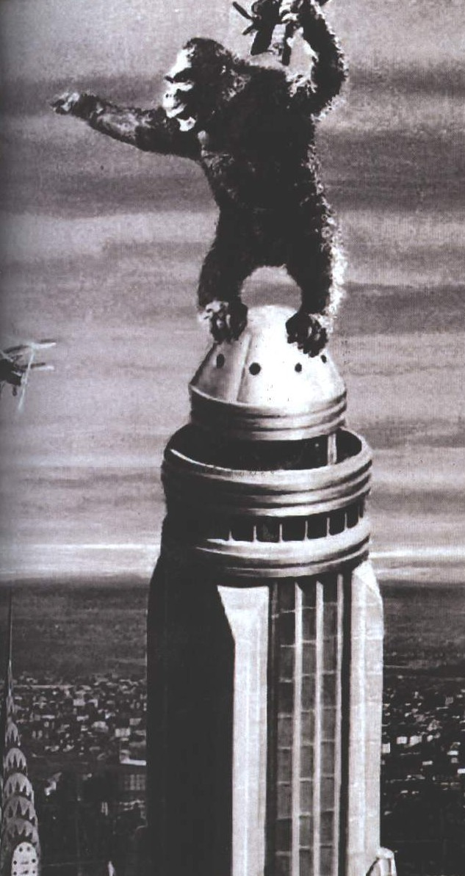
Traditional 3D Animation
Individual frames
Stop motion
  King Kong
Puppetry
  Claymation
Experimental forms

Slide 9
Computer-Assisted Animation
3D
  Create models, sets, poses
  Computer interpolation
  Computer rendering and compositing

Slide 10








Computer-Assisted Animation
2D
  Create and draw frames
  Computer aided ink & paint

Slide 11
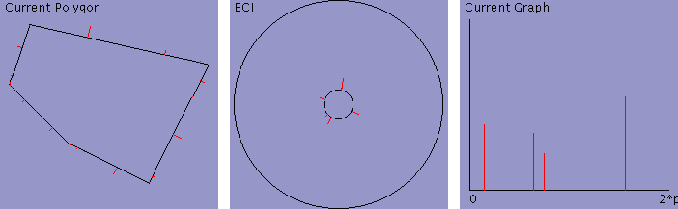
2D Morphing
Image interpolation
Feature matching
Multiple layers
http://web.mit.edu/manoli/ecimorph/www/ecimorph.html

Slide 12

2D Computer Animation
What gets interpolated ?
  Strokes
  Outlines
  Colors
High-quality compositing

Slide 13
3D Computer Animation
Interpolate
Render
Compose

Slide 14
3D Computer Animation
What gets interpolated ?
  Shape geometry
  Shape appearance
  Light source information
  Cameras
  Anything !

Slide 15
Object Animation
Location
Geometry
Transformation & deformations
Appearance and textures
Light sources

Slide 16
Camera Animation
FOV (Field of View)
Focal length
Position and orientation

Slide 17
Object Interpolation
Parameterized transformation
  Rotation
  Scaling
  Deformation
Interpolate parameters
Build new transformations

Slide 18
3D Animation Methods
Low level manual
High level manual
Automated

Slide 19
Parametric Interpolation
Any number of parameters
User-specified smoothness
Transformation & deformations
Parameter source
  User
  Measurements: rotoscope, motion capture
  Procedual

Slide 20
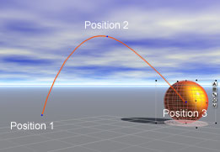
Keyframing
Traditional animation technique
Dependent on artist to generate ‘key’ frames
Additional, ‘inbetween’ frames are drawn automatically by computer

Slide 21
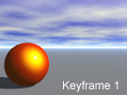
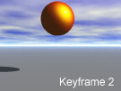
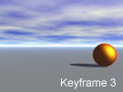
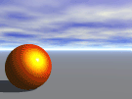
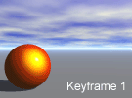
Keyframing
How are we going to interpolate ?

Slide 22
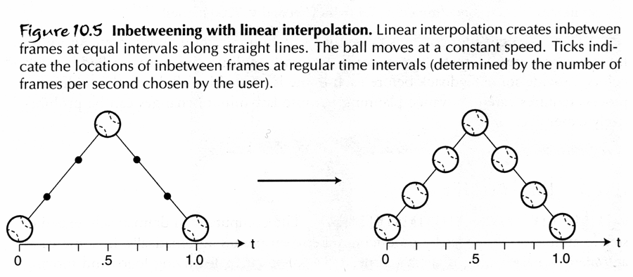
Keyframing
Linear Interpolation
Simple, but discontinuous velocity

Slide 23
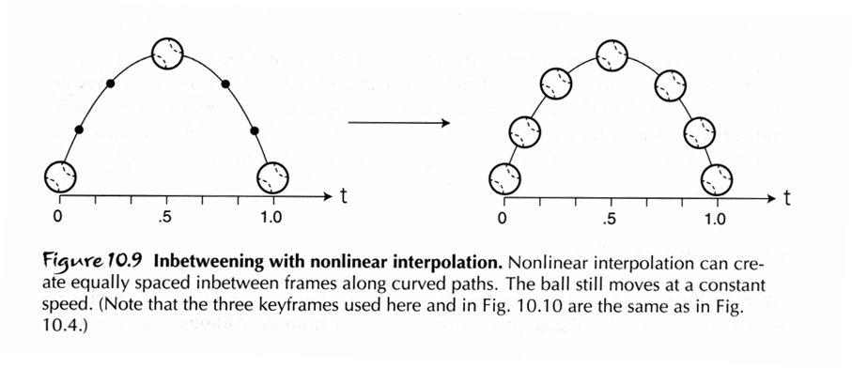
Keyframing
Nonlinear Interpolation
Smooth ball trajectory and continuous velocity, but loss of timing

Slide 24
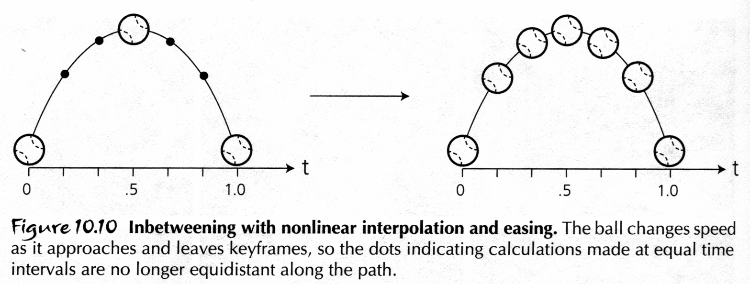
Keyframing
Easing
Adjust the timing of the inbetween frames. Can be automated by adjusting the stepsize of parameter, t.

Slide 25
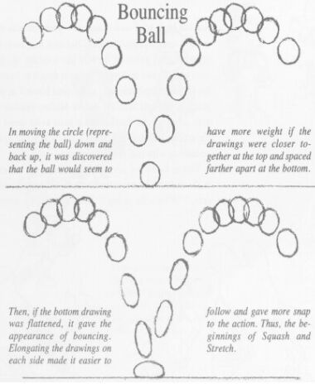
Keyframing
Interpolating time
captures accuracy
of velocity
Squash and stretch
replaces motion
blur stimuli and
adds life-like
intent

Slide 26
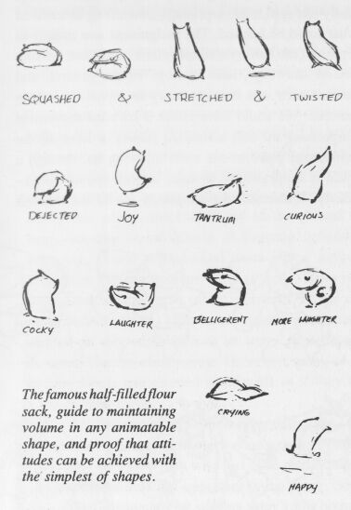
Keyframing
Ease-in and
ease-out is like
squash and
stretch
Can we
automate the
inbetweens for
these?
“The Illusion of Life, Disney Animation”
Thomas and Johnson

Slide 27
Keyframing
Many parameters can be interpolated to generate animation
Simple interpolation techniques can only generate simple inbetweens
More complicated inbetweening will require a more complicated model of animated object and simulation

Slide 28
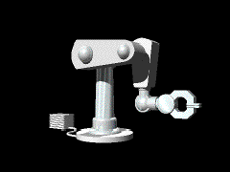
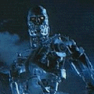
Kinematics
The study of object movements irrespective of their speed or style of movement
Specify position and time
Give velocity, acceleration of parts
Nested interpolation
Each transformation accessible

Slide 29
Degree of Freedom
The variables that affect an object’s orientation
How many degrees of
freedom when flying?
Six
  x, y, and z positions
  roll, pitch, and yaw

Slide 30
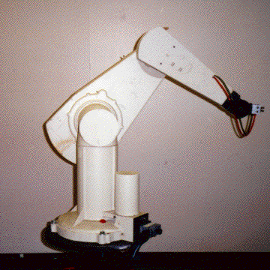
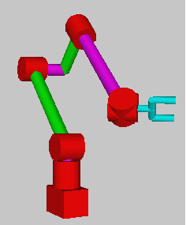
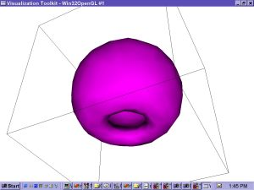
DOF
And this robot arm ?
Six again
  2-base, 1-shoulder, 1-elbow, 2-wrist

Slide 31
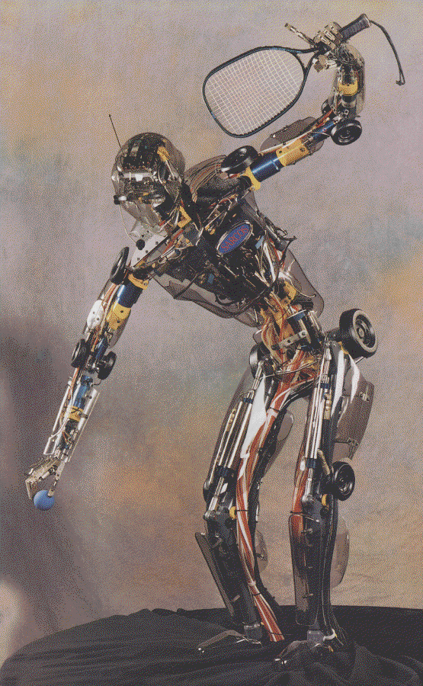
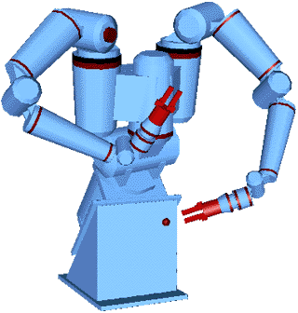
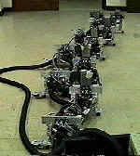
DOF
More examples

Slide 32
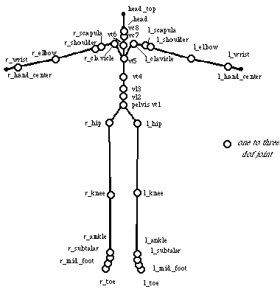
Humanoid
A family of parent-child spatial relationships are functionally defined
  Moon/Earth/Sun movements
  Articulations of a humanoid
Limb connectivity is built into model (joints) and animation is easier

Slide 33
Kinematics
Forward Kinematics
  Compute configuration (pose) given individual DOF values
    Good for simulation
Traverse kinematic tree and propagate transformations downward
  Use stack
  Compose parent transformation with child’s
  Pop stack when leaf is reached

Slide 34
Inverse Kinematics
Goal-driven
Supports constraints
Control what you care about
Let computer fill the rest
Compute individual DOF values that result in specified end effector position
  Good for control
Given end effector position, compute required joint angles
MULTIPLE / INFINITE SOLUTIONS OR NO SOLUTION

Slide 35

Constraints
Parametric restrictions
Aids in inverse kinematics
  Put the foot on the ground
Restricts model to “sensible” poses and motion
Can be frustrating
?
End Effector
Base

Slide 36
Simulation
Precompute model parameters
May be expensive
Many methods available
Complex motion
  Flocking
  Cloth
  Liquids

Slide 37
Dynamics
Physical Simulation
Bases on physics
Requires physical data
  Mass, center of mass, moments of inertia, friction…
Accurate motion
Difficult to control

Slide 38
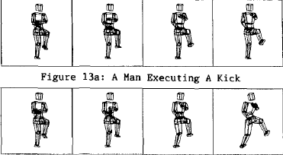
Dynamics
A man executing a kick
The same kick on a frictionless floor

Slide 39
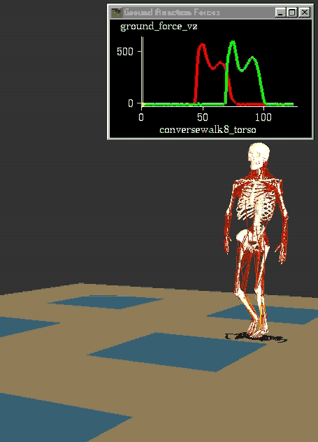
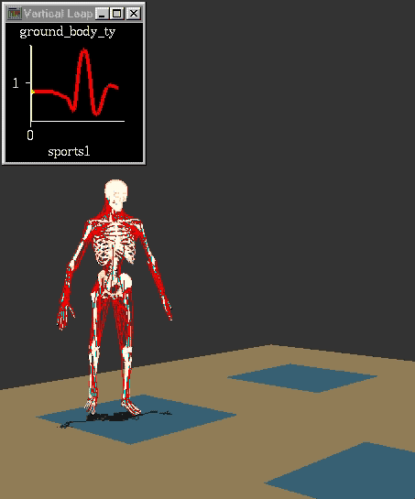

Slide 40
Parameterized Motion
Capture
Synthesize

Slide 41
Compositing
Multiple renders
Overlay results
Time savings
Extra control

Slide 42
Particle Systems
Points
Color
Motion
Geometry

Slide 43
Scripting
Programming language
Results of simulation
  With constraints
Can include 2D transitions

Slide 44
Artificial Intelligence
High level ‘director’s language’
Conversations
Shots
Scripts

Slide 45
Combined Methods
Key-framing major components
Simulation for details
  Secondary motion

Slide 46
Conclusions
The computer is not the animator
Many types of motion control
Different skills involved
Emotion requires acting

Slide 47
Skeletons and Skins
Modern approach is called “skinning.”
Basic idea:
  Create a jointed skeleton.
  Attach the skin to the skeleton.
  Move skeleton around – skin follows it.
Skin is a 3D model made out of triangles.
Skeleton is invisible – only the skin is seen by the player.

Slide 48
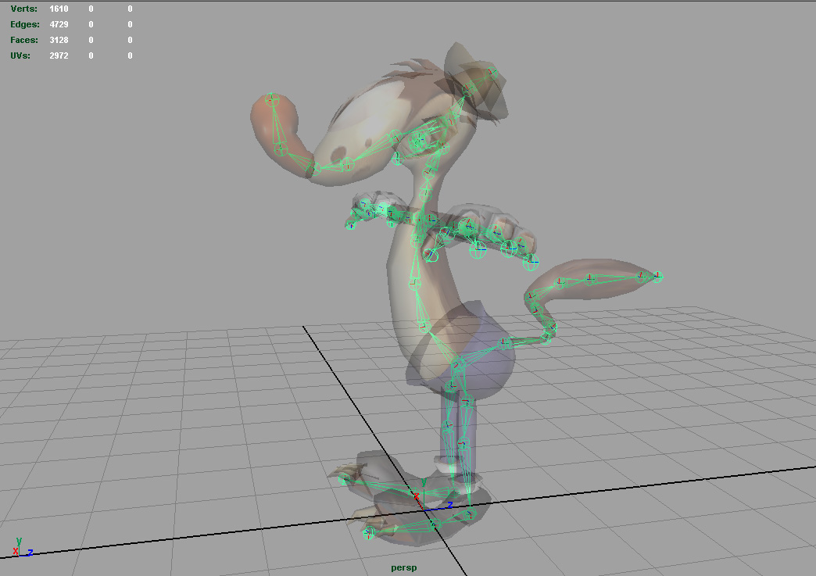
Skeletons and Skins (2)

Slide 49
Skeletons and Skins (3)
Each vertex of each triangle is attached to one or more bones.
  We use weights to define bones’ influences.
  Weights at a joint must always add up to 1.

Slide 50
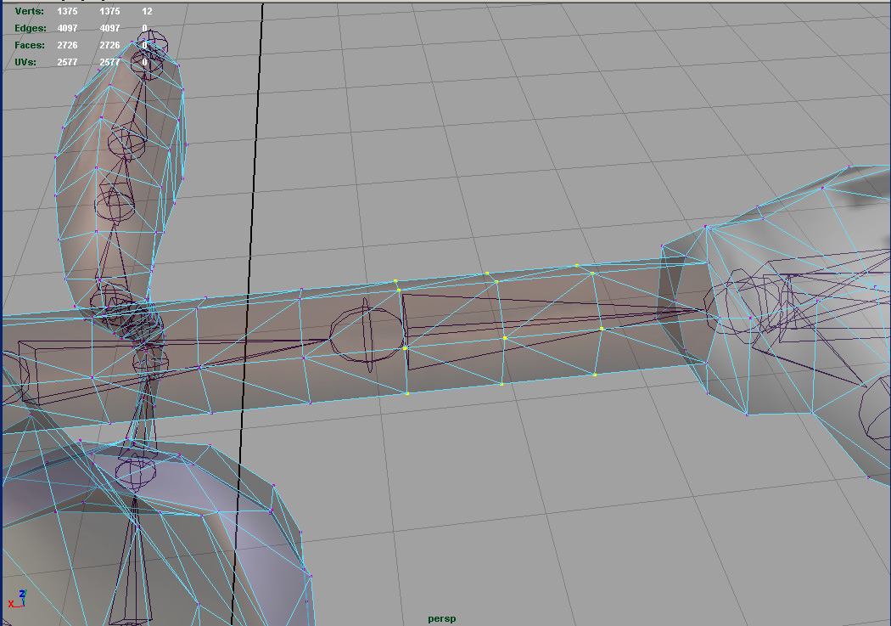
Skeletons and Skins (4)

Slide 51
Skeletons and Skins (5)
Skeletons have two kinds of poses:
  Bind Pose: The skeleton’s pose when the skin was first attached.
  Current Pose: Any other pose of the skeleton; usually a frame of an animation.
The bind pose is like a “home base” for the character’s skeleton.
If you drew the mesh without its skeleton, it would appear in its bind pose.
Notes:
Demonstrate using my own body!

Slide 52
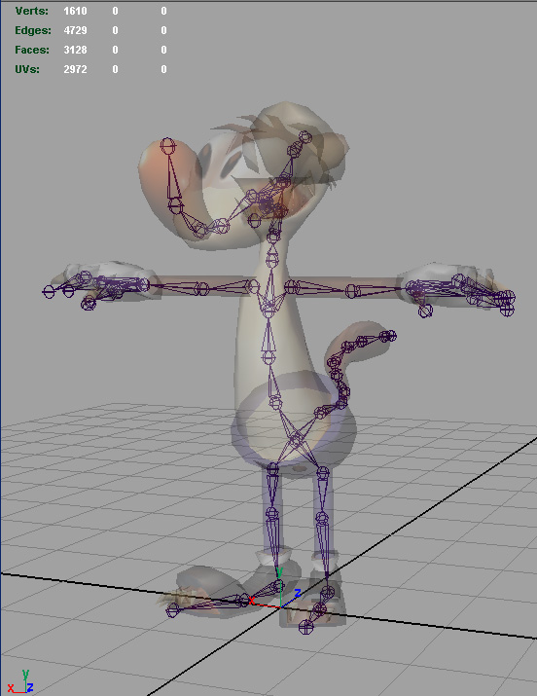
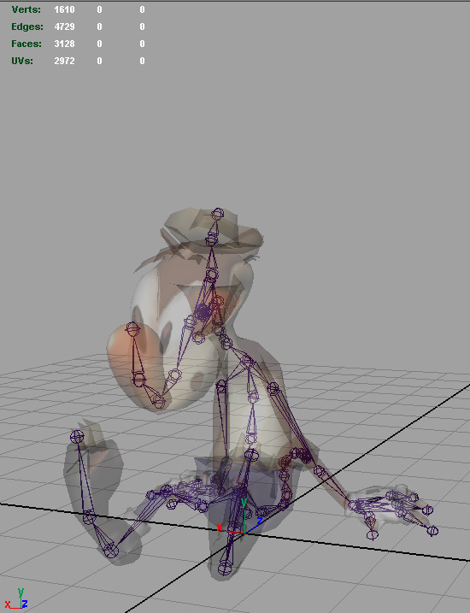
Skeletons and Skins (6)
Bind Pose
Current Pose

Slide 53
How Skinning Works
Consider a single vertex (v) skinned to the joint J₁. The skeleton is in bind pose:
y
v
J₁
J₀
x

Slide 54
How Skinning Works (2)
We want to find the vertex’s new location (v') in the current pose.
y
v
v'
x

Slide 55
How Skinning Works (3)
The basic idea is to transform the vertex:
  from model space
  into joint space
The coordinates of the vertex are invariant in joint space!
  So, we can move the joint around all we want.
When we’re done, we go back to model space to find the final position (v').

Slide 56
How Skinning Works (4)
Here’s the original vertex (v), but now in the joint space of J₁:
y
v
J₁
J₀
x

Slide 57
How Skinning Works (5)
No matter what pose the skeleton is in, v and v' are the same when in joint space.
y
v
v'
x

Slide 58
How Skinning Works (6)
Finally, we go back to model space to find the final location of the vertex (v').
y
v
v'
x

Slide 59
The Math of Skinning
Let X_{i} be the translation of joint i.
y
v
X₁
X₀
x

Slide 60
The Math of Skinning (2)
Let Q_{i} be the rotation of joint i.
y
v
Q₁
Q₀
x

Slide 61
The Math of Skinning (4)
Now consider what happens when we move the skeleton into the current pose:
y
v'
J₀
J₁
x

Slide 62
The Math of Skinning (5)
This time, let T_{i} be the translation of joint i,
and let R_{i} be the rotation of joint i:
y
R₀
v'
T₀
T₁
R₁
x

Slide 63
The Math of Skinning (7)
We multiply v by B^{–1} to get it into joint space from the bind pose.
Then we multiply that by P to get it back into model space, in the current pose.

Slide 64
The Math of Skinning (9)
We can find v' for any pose imaginable!
y
v
v'
x

Slide 65
The Math of Skinning (10)
We do these calculations on each and every vertex in the model.
Then we draw the final vertices.
For vertices that are affected by more than one joint, we take a weighted average of the positions due to each joint.

Slide 66
Animation: Bringing Characters to Life
An animation is really just a sequence of poses at various points in time. The poses are called keys.
An animation can be described mathematically as:
{ P_{j} (t) } ∀ j
i.e. a set of pose matrices (keys) for all joints j, each of which is a function of time t.
To play back the animation, we extract a pose at the current time index, skin the model to that pose, and then draw the model.

Slide 67
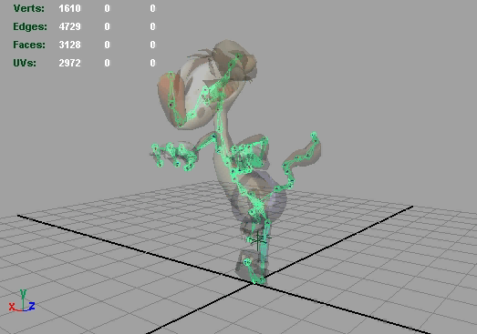
Bringing Characters to Life (2)
Run Weasel, run!

Slide 68
Bringing Characters to Life (3)
In a simple animation system, the keys are equally spaced in time.
If we further restrict ourselves to integer time indices, then extracting a pose amounts to selecting the appropriate key.
Joint 1:
Joint 2:
Joint 3:
time 0 1 2 3 4 …
time = t
… N–1

Slide 69
Bringing Characters to Life (3)
To reduce memory overhead, the keys can be compressed, and might not be uniformly spaced.
We will want to allow the time index to be a real number (i.e. floating-point).
So, extracting a pose now requires interpolation between adjacent key frames.
Joint 1:
Joint 2:
Joint 3:
time 0 1 2 3 4 …
time = t
… N–1

Slide 70
Interpolation and Blending
To interpolate positions, we use simple vector linear interpolation (LERP).

Slide 71
Interpolation and Blending (2)
To interpolate rotations, we must use quaternions. (It is next to impossible to interpolate matrices.)
We have two choices when interpolating quats:
  Linear interpolation (LERP)
  Spherical linear interpolation (SLERP)

Slide 72
Interpolation and Blending (3)
A quaternion LERP is identical to a vector LERP, but with 4 components.
SLERP is like a LERP, but the weights are no longer (1-β) and β. Instead they are:

Slide 73
Interpolation and Blending (4)
LERP and SLERP can be used to interpolate between adjacent key frames for a specific time t.
Interpolation can also be used to blend two entirely different animations together!
For example, instead of a character being able to walk or run, he can do anything in between!
The blend factor controls how much walk and how much run we see.
  β=0: full walk β=1: full run
  β=0.5: half walk, half run

Slide 74
The Animation Pipeline
Typical animation pipeline:
  Pose extraction at current time t
  Pose blending
  Matrix palette generation
  Palette-driven rendering
The matrix palette maps directly to modern vertex shader architectures (a.k.a. indexed skinning).

Slide 75
Advanced Topics
Key frame compression techniques
Representing animations as spline curves instead of interpolated key frames
Action state machines
Skeletal partitioning
Rag-doll physics
…

