Slide 1
Advanced Lighting and Shading

Slide 2
Overview
Radiometry and Photometry
Colorimetry
BRDF Theory and Implementation
Vertex Shaders
Pixel Shaders
Shading Languages
Motion Blur
Depth of Field
Reflections
Refractions
Shadows
Global Illuminations

Slide 3
Overview
Using more elaborate multitexturing methods, vertex and pixel shaders
How light interact with matter
Special effects
How global illumination is used for real-time rendering
Fixed function pipeline vs Programmable function pipeline

Slide 4
Radiometry
CG light model is very simple
  Same brightness over distance
  Diffuse and Specular comp. are just numbers
Objects appear to be
  Flat painted: pure diffuse
  Shiny plastic: specular color is light color
  Metallic: specular color includes object color

Slide 5
Radiometry
A better model
  Photons as particles
  Absorption and reflectance of photons depending on wavelength

Slide 6
Radiometry
Radiometry
  Deals with the measurement of radiation throught the electromagnetic spectrum
  Frequency range between 3x10^11 and 3x10^16 Hertz
  1000 to 0.01 micrometer wavelength
  Includes: infrared, visible and ultraviolet
Photometry
  Similar to radiometry but weights everything by the sensibility of human vision system
  Visible Band: 380 to 780 nanometers
  450 blue, 540 green, 650 red
  But not perception of the color itself but rather the perceived strength of the various wavelengths

Slide 7
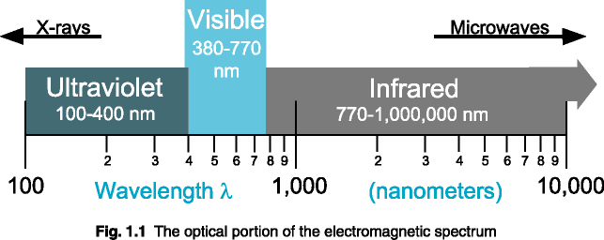

Slide 8
Radiometry
555 nm
CIE photometric curve
Human Eye’s response to various wavelengths of light

Slide 9
Radiometry
Radiant Energy Q measured in J, joules
Radiant Flux Φ , Power P: number of J per second emitted dQ/dt. Watt=J/sec
After photons leave a light source
  Measure how they arrive at a surface
Radiant flux density: Watt/sqmeter
Any point on the surface u=d Φ/dA
If the flux is uniform u= Φ/A

Slide 10
Radiometry
Radiant flux density
For the flux arriving the surface
  Irradiance E
For the flux leaving a surface
  Radiosity B

Slide 11
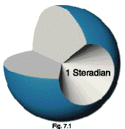

Radiometry
In CG lights and viewer are points not surfaces
For measurements solid angels in steradians (sr) used
Solid angle is a concept of a 2D angle extended to 3D
A solid angle of 4PI steradians covers the whole unit sphere

Slide 12
Radiometry
Radiance L, what we store in a pixel
Incoming laser beam hitting a surface
Either arriving or leaving a surface
Watts per square meter per steradian
dw is the differential solid angle (a ray)
Θ: the angle of the incoming light compared with the surface’s normal

Slide 13
Radiometry
dω

Slide 14
Radiometry
Surface independent radiance is a fixed amount for a given direction and location
The radiance is a function of six variables (radiance distribution)
  3 for location
  2 for direction
  Wavelength
Describe all light travelling anywhere in space
Radiance distribution is the set of all possible environment maps for a scene

Slide 15
Radiometry
An objects radiance values is not affected by distance
Surface will have same luminance regardless of its distance from the viewer
Contradiction: The light’s intensity drops off with the square of the distance !
As you go far away from the light source fewer rays (solid angle!) will reach your eye
Digital photography

Slide 16
Radiometry
At 10 meters light covers 4000 pixels
At 20 meters light covers 1000 pixels
The radiance at each light pixel is constant
Only the number of the pixels that changes

Slide 17
Radiometry
Lambert’s five times rule
  If the distance from the light source is five times or more that of the light’s width, then the inverse square law is a reasonable approx.
  Closer than this: the solid angle the light covers will vary noticeably different than the inv. Law
  Use Radiosity techniques

Slide 18
Radiometry
Photometry
  Luminance = Radiance
  Candelas per squaremeter (nit)
  Laptop LCD: 100-250 nits
  CRT 50-125 nits

Slide 19
Colorimetry
Humans can distinguish 10 million different colors
The eye had three different types of cone receptors in the retina.
Each responding differently to various wavelengths
The brain receives only three different signals from these receptors
Three numbers can be used to represent any visible spectrum

Slide 20
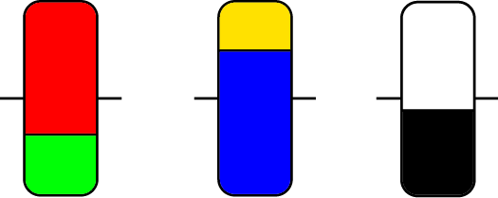
Colorimetry
Hypothesis of 3 types of receptors: Red/Green, Blue/Yellow, Black/White
Explains well several visual phenomena
+
0
-
+
0
-
+
0
-
Red/Green
Receptors
Blue/Yellow
Receptors
Black/White
Receptors

Slide 21
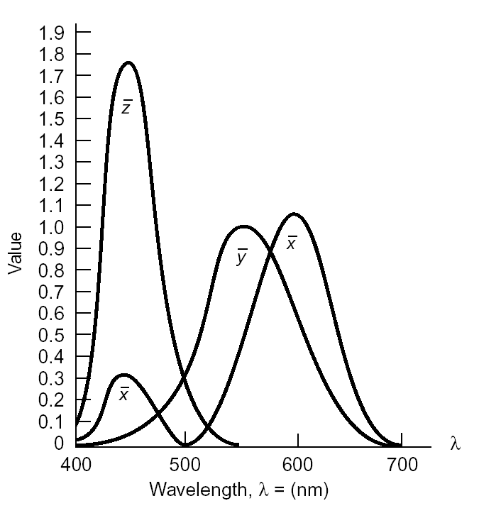
Colorimetry
X, Y and Z tristimulus values are weights
that define a color in CIE XYZ space
X+Y+Z=1
There are conversion functions from RGB to XYZ functions for each device !

Slide 22
BRDF
Bidirectional Reflectance Distribution Function
It is a function that describes how light is reflected from a surface
Used to describe the material
Input
  Incoming and outgoing azimuth and elevation angles
  Wavelength of the incoming light
Output
  Relative amount of energy reflected in the outgoing direction given the incoming direction

Slide 23
The BRDF
dω_{r}
dω_{i}
Bidirectional Reflectance Distribution Function f_{r}(dω_{i}, dω_{r})
Measures the portion of incident irradiance (E_{i}) that is reflected as radiance (L_{r})
f_{r}(ω_{i}, ω_{r}) = dL_{r}(ω_{r})/dE_{i}(ω_{i})
Or the ratio between incident radiance and reflected radiance
f_{r}(ω_{i}, ω_{r}) = dL_{r}(ω_{r})/(L_{i}(ω_{i}) cosθ dω)
Ranges from 0 to ∞ – infinite when radiance distribution from single incident ray

Slide 24
Illumination via the BRDF
The Reflectance Equation
The reflected radiance is
  the sum of the incident radiance over the entire hemisphere
  foreshortened
  scaled by the BRDF

Slide 25
Parameterizations
6-D BRDF f_{r}(ω_{i}, ω_{r}, x)
  Incident direction L
  Reflected direction V
  Surface position x
  Textured reflection (BTDF)
4-D BRDF f_{r}(ω_{i}, ω_{r})
  Homogeneous material
  Anisotropic, depends on incoming azimuth
  e.g. hair, brushed metal, ornaments
3-D BRDF f_{r}(θ_{i}, θ_{r}, φ_{i} – φ_{r})
  Isotropic, independent of incoming azimuth
  e.g. Phong highlight
1-D BRDF f_{r}(θ_{i})
  Perfectly diffuse
  e.g. Lambertian

Slide 26
BRDF Attributes
Helmholtz Reciprocity
f_{r}(ω_{i}, ω_{r}) = f_{r}(ω_{r}, ω_{i})
  Materials are not a one-way street
  Incoming to outgoing pathway same as outgoing to incoming pathway
Conservation of Energy
  When integrated, must add to less than one
  Materials must not add energy (except for lights)
  Materials must absorb some amount of energy

Slide 27
Diffuse Reflection
θ
ρ_{d} = 1
Uniform
  Sends equal amounts of light in all directions
  Amount depends on angle of incidence
Perfect
  all incoming light is reflected
  no absorption

Slide 28
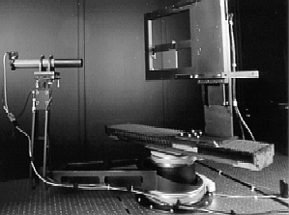
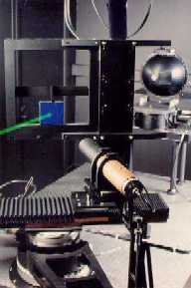
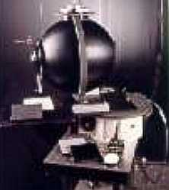
Modeling BRDF’s
Mathematical derivation
  Use laws of physics, geometry
  Statistical model of idealized material
Simulation
  Model material directly
  Render light reflected onto hemisphere
Measurement
  Reflect real light off of real material
  Gonioreflectometer

Slide 29
The Reflectivity
Σρ E_{i}
E_{i}
Measures the portion of incident irradiance (E_{i}) from direction ω_{i} that is reflected as intensity (I_{r}) in direction ω_{r}
ρ(ω_{i}, ω_{r}) = dI_{r} /dE_{i}
The reflected intensity is the forshortened incident intensity scaled by the reflectivity
I_{r} = ρ(ω_{i}, ω_{r}) I_{i} cosθ_{i} dω_{i}
Sum of reflectance ranges from zero (blackbody) to less than one (conservation of energy)
(1−Σρ) E_{i}
ρ I_{i} cosθ_{i} dω_{i}
I_{i}
Incoming intensity I_{i}
spread over this area
Portion of intensity over
region dA is cos θ I_{i}

Slide 30
Illumination via Reflectivity
I_{r} = k_{a}ρ_{a} I_{a} (N ⋅ L) + Σ (k_{d}ρ_{d} I_{d} + k_{s}ρ_{s} I_{s}) (N ⋅ L) dω
Constants k_{d} + k_{s} = 1
Intensities
  I_{a} = average color of reflected light in scene
  I_{d} = color of material
  I_{s} = color of light source
Reflectivities
  Ambient: ρ_{a}(V,L) = 1/ (N ⋅ L) – constant color regardless of surface orientation
  Lambertian: ρ_{d}(V,L) = 1 – reflects light uniformly in all directions
  (Phong) Specular: ρ_{s}(V,L) = (V ⋅ R)^{n}/ (N ⋅ L) – focuses light in reflected direction

Slide 31
From Phong to Physically-Based Rendering (PBR)
Phong limitations: non-energy conserving, empirical
Modern models: Cook–Torrance, GGX, Disney BRDF
Physically-based shading is industry standard (Unreal, Unity, Pixar)

Slide 32
D–F–G: Core Components of Microfacet BRDF
Normal Distribution Function (D): GGX
Fresnel (F): Schlick Approximation
Geometry/Microshadowing (G): Smith
BRDF = DFG / 4(N·L)(N·V)

Slide 33
Modern PBR Material Workflow
PBR texture maps: BaseColor, Metallic, Roughness, Normal, AO
Artist-facing workflow
Materials defined by real physical parameters

Slide 34
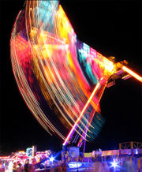
Motion Blur
Moving left to right
  blur horizontally
If the camera is tracking an object
  The background blurs
Methods
  Render the blur itself for moving objects
  Average a series of images using the accumulation buffer
  Vertex shaders:
    First pass: render the object normally
    Second pass: vertex shader applies the previous frame’s and the current frame’s transform to each vertex. The difference gives a motion vector per vertex.

Slide 35
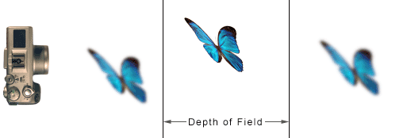
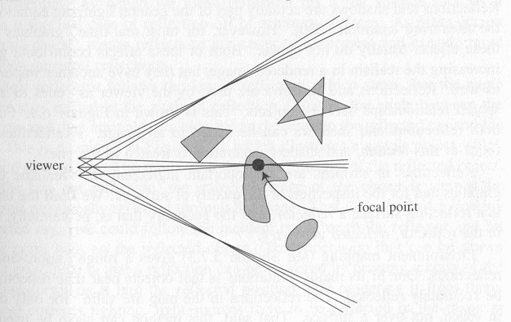
Depth of Field

Slide 36
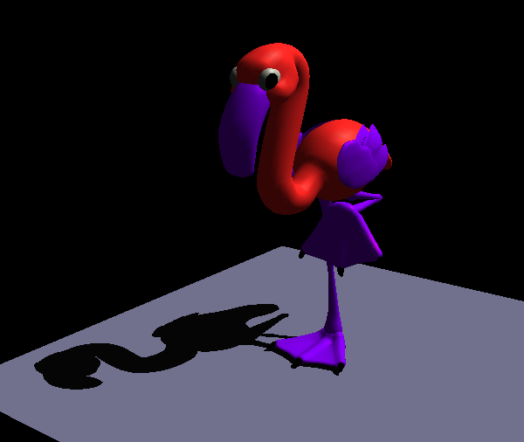
Reflections
Reflections, refractions and shadows are all global illumination
Easier to estimate the spatial relationships between objects
EM is used for reflections of objects at a distance
Limitation of EM:
  Reflected objects are located far from the reflector
  The same texture is used for all reflection rays

Slide 37
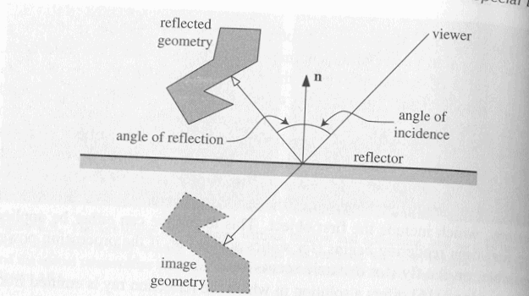
Reflections
Planar Reflections
  Reflection of a flat surface (mirror)
  Law of Reflection
    Angle of incidence = angle of reflection

Slide 38
Reflections
Instead of following the reflected ray, follow the incident ray through the reflector and hit the same point on the reflected object.
  A reflection can be rendered by creating a copy of the object
  Transforming it into the reflected position
  Rendering it from there.
  Correct lighting: reflect the light sources in the plane
The reflector has to be partially transparent if the reflection is to be visible
Transparency is a reflectivity factor:
  More reflective with increasing transparency

Slide 39
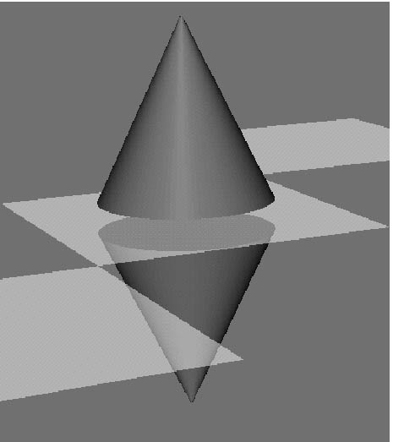
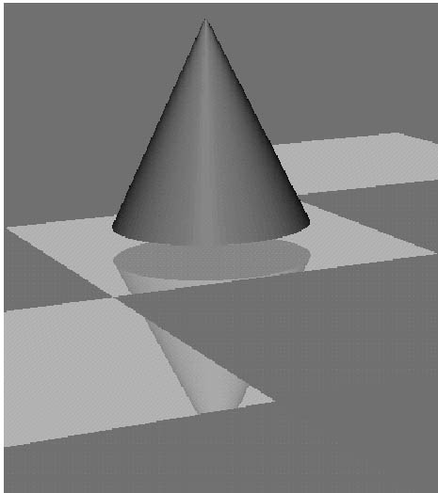
Reflections
Use stencil buffer for the surfaces which has partially no reflection
The reflected geometry is rendered when with stencil turned on

Slide 40
Reflections
How should you render?
1) the ground plan polygon into the stencil buffer
2) the scaled (1,1,-1) model, but mask with stencil buffer
3) the ground plane (semi-transparent)
4) the unscaled model

Slide 41
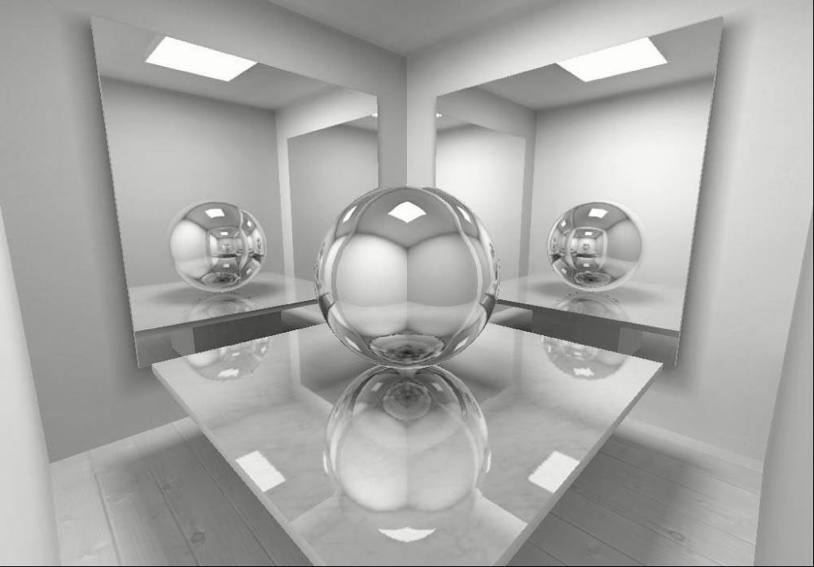
Reflections
Instead of the scale-trick, you can reflect the camera position and direction in the plane
Then render reflection image from there

Slide 42
Glossy Effects
Fogged reflections
  Vertex shaders
  Accumulation and stencil buffers for fuzzy reflections, frosted glass

Slide 43
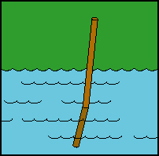
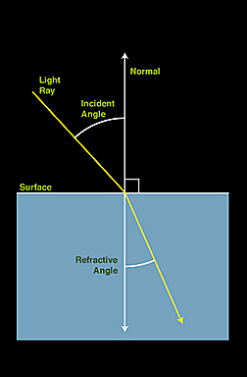
Refractions
Combination of different effects
Fresnel term
  A blend factor between of reflection and refraction
  Underwater objects are visible when looking directly into water, but looking at a grazing angle mostly hides what is below
Snell’s Law
  Relationship between incoming and outgoing vectors when moving from one medium to other
  Water 1.33, glass 1.5, air 1.0 (n refraction index)

Slide 44
Refractions
Simulating refraction
  Use a transform matrix to properly warp an image generated from a refracted viewpoint.
  Use environment bump mapping
  http://www.ps.missouri.edu/rickspage/refract/refraction.html

Slide 45
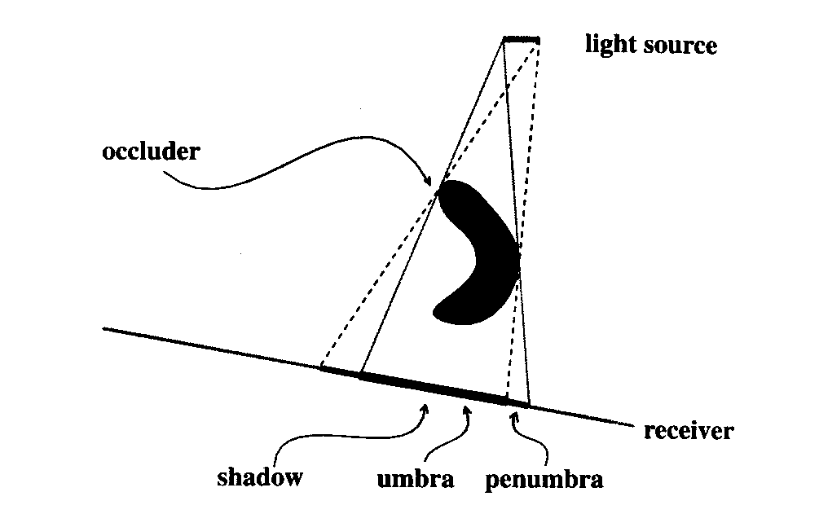
Shadows

Slide 46
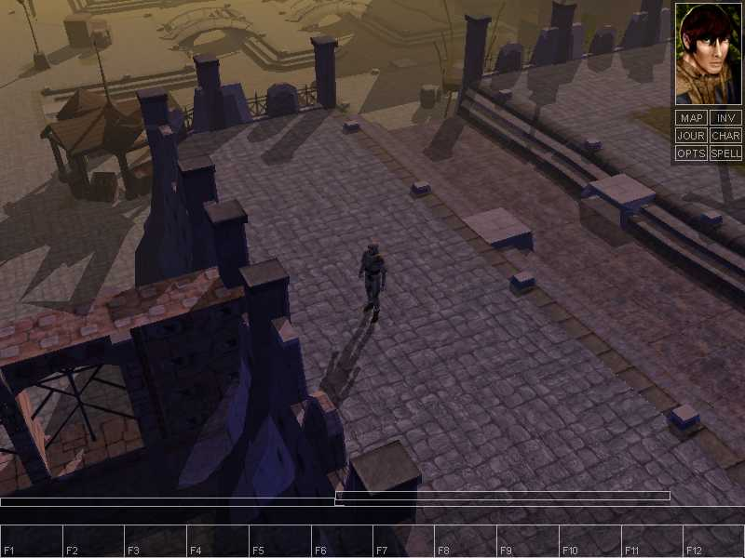

Slide 47
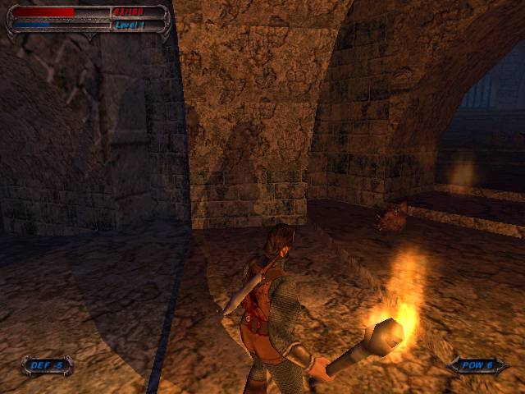

Slide 48
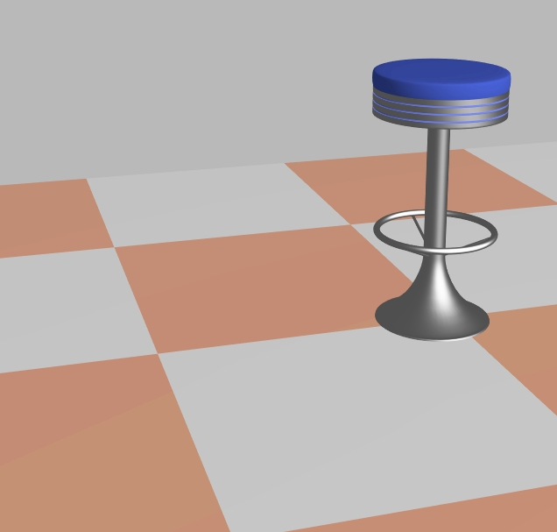
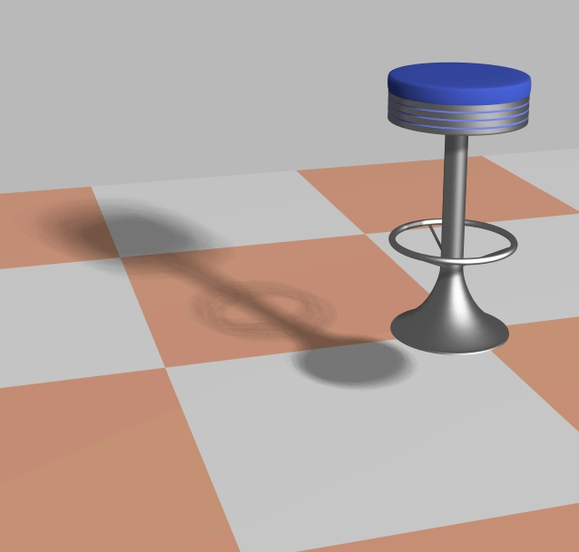

Slide 49
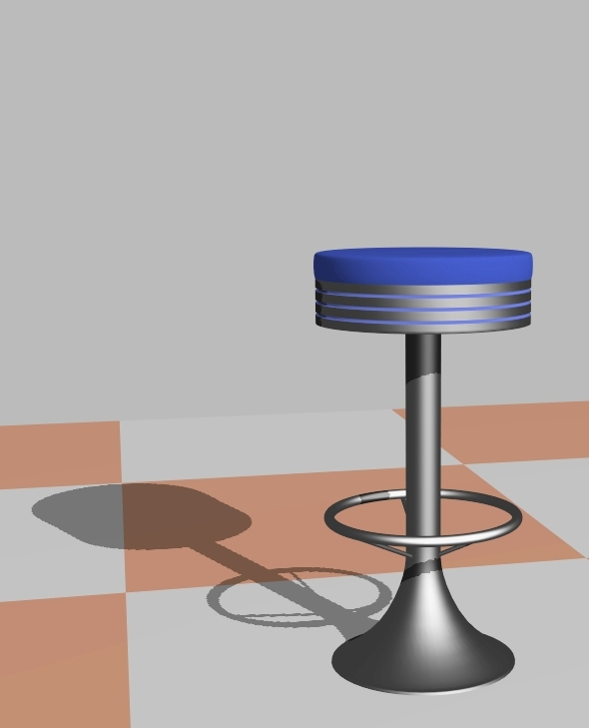


Slide 50
Shadows
It is better to have an inaccurate shadow than none at all.
Give a visual cue

Slide 51
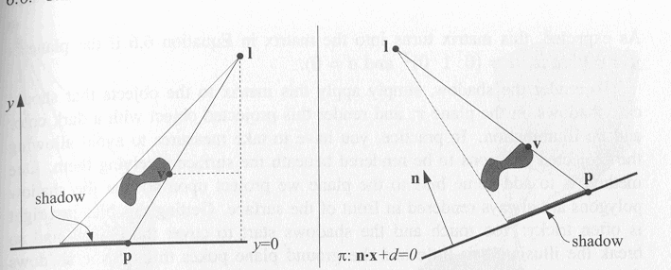
Shadows
Planar Shadows two types: Projection and Soft
  Projection Shadows
    3D object is rendered a second time to create a shadow. Project the vertices onto a plane

Slide 52
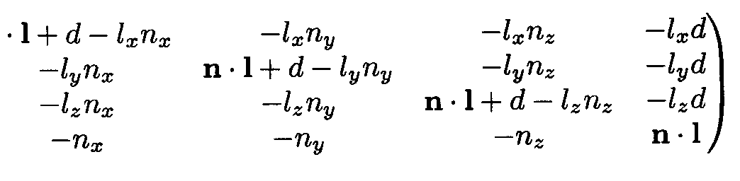
Shadows
Mv=p
M=(

Slide 53
Shadows
To render shadow apply the projection matrix to the objects that should cast shadows on the plane PI and render this projected object with a dark color and no illumination
Use stencil buffer for shadows falling outside of the plane
For semitransparent shadows more care
Projective shadows has to be rendered at each frame even if the shadow is not changing
Shadows are view-independent
We can use textures !

Slide 54
Shadows
Soft Shadows
  Whenever a light source has an area
  Generic way: Area light = N number of point lights
  For a each of these point light sources an image is rendered and added to the accumulation buffer
  Heckbert, Herf method:
    use a frustrum. For each point light source, the occluders inside the pyramid formed by the point light source and the receiver parallelogram are transformed into a parallelepiped with the matrix M.
    Sample the light source with point lights
    The shadow has to be recomputed when the objects or the light source moves

Slide 55
Shadows
Gooch’s method
  Move the receiving plane’s location up and down and the projections cast upon it are averaged.
  Nested shadows: looks better, fewer samples
  Problem: If the object touches the receiver then the shadow will not be modelled correctly
  Large Umbra: projected shadow is larger than the object. In reality, if an area light is larger than the width of an occluder, the occluder will cast a smaller umbra region

Slide 56
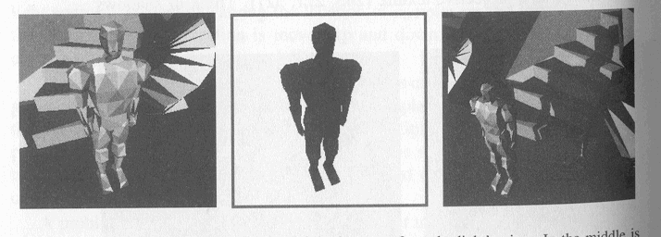
Shadows
Shadows on Curved Surfaces
  Use Shadow textures
    Each vertex on the receiver has a u,v texture coordinate computed for it and has the texture applied to it.

Slide 57
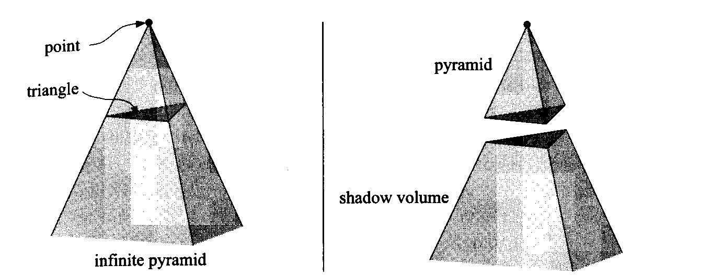
Shadows
Shadow Volumes
  Extending the lines from a point through the vertices of a triangle to infinity yields an infinite pyramid. The part under the triangle, the part that does not include the point, is a truncated infinite pyramid, and the upper part is simply a pyramid.
  If the point is a light source -> any part of an object that is inside the volume of the truncated pyramid is in shadow.

Slide 58
Shadow Volumes
Shadow volume concept
Create volumes of space in shadow from each polygon in light.
Each triangle creates 3 projecting quads

Slide 59
Shadow Volumes
To test a point, count the number of polygons between it and the eye.
If we look through more frontfacing than backfacing polygons, then in shadow.
backfacing
frontfacing

Slide 60
Merging Volumes
Edge shared by two polygons facing the light creates front and backfacing quad
This interior edge makes
two quads, which cancel out

Slide 61
Shadows
Solution:
  Clear the stencil buffer
  The whole scene is drawn into the frame buffer with only ambient and emission components
  Z-buffer updates and writing to color buffer turned off
  Front facing polygons of the shadow volumes are drawn
  Increase the stencil buffer wherever a polygon is drawn
  One more pass with stencil buffer-> drawing only the backfacing polygons of the shadow volume
  The values of the stencil buffer is decremented if the polygon is drawn
  Final rendering with diffuse and specular components and displayed only where the value of the stencil buffer is 0.
  0 means that the ray has gone out of shadow as many times as it has gone into a shadow volume ->illuminated by light

Slide 62
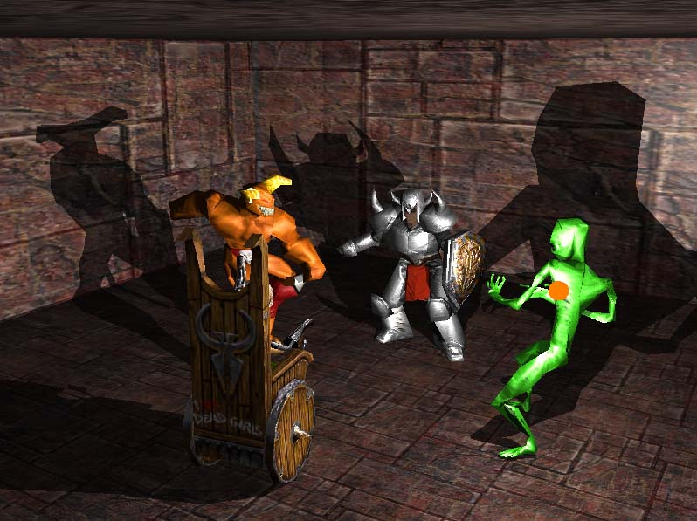

Slide 63
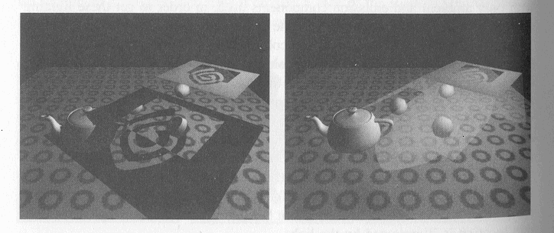
Shadows
On the left a square with cutouts casts a shadow on various objects.
On the right the various faces of the shadow volume are shown.

Slide 64
Focus on shadow volumes, because currently most popular, and works on most hardware

Slide 65
Shadows
Shadow Map
  Render from light’s view (white is far and black is near)
  Render the scene using the Z-buffer algorithm, from the position of the light source that is to cast shadows. For each pixel in the Z-Buffer, the z-depth now contains the distance to the object closest to the light source. Z-Buffer is called shadow map.
  Render the scene second time with respect to the viewer. Now as each drawing primitive is being rendered its location is compared to the shadow map
  If a rendered point is farther away from the light source than the value in the shadow map, then that point is in shadow otherwise it is not.

Slide 66
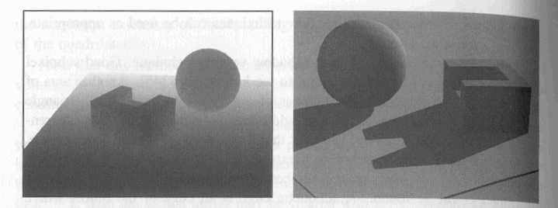
Shadows

Slide 67
Shadows
Optimizations
  Great cost: Performance and Memory
  It is difficult to perceive correct shadow -> you can generate fast fakes !
  If the framerate is high, inaccuracies are ok
    Use low level of detail model to cast shadow
    Update the relevant shadow information only every other frame or less seldom (use distance also)
    Use culling for lights

Slide 68
Image-Based Lighting (IBL)
Uses HDR environment maps for realistic lighting
Diffuse irradiance + Specular prefilter
Standard in modern engines (UE5, Unity HDRP)

Slide 69
Modern Shadow Techniques
Legacy: Shadow Volumes, Planar Shadows
Standard: Shadow Maps, PCF, PCSS, CSM
Emerging: Ray-Traced Shadows

Slide 70
Real-Time Ray Tracing (RTX, DXR, Vulkan RT)
Hybrid Rasterization + Ray Tracing
Ray shaders: Generation, Closest Hit, Miss
Accurate shadows, GI, reflections

Slide 71
Modern Global Illumination
SSGI, Light Probes, SDF GI (UE5 Lumen)
RTX GI and real-time path tracing
Hybrid GI used in current engines

Slide 72
Classical vs Modern Mapping
Phong → Microfacet GGX
Shadow Volumes → PCSS/CSM/RT Shadows
CubeMap → IBL + RT Reflections
Accumulation Buffer → Temporal DOF/Post-process

Slide 73
Modern Rendering Architectures
Forward, Deferred, Forward+, Clustered Shading
Hybrid deferred + ray tracing
Support for thousands of lights

Slide 74
From Fixed-Function to Fully Programmable GPU Pipelines
Legacy fixed-function pipelines (pre-2005)
Modern fully programmable pipeline
Shader stages: Vertex, Tessellation, Geometry, Fragment, Compute, RT stages
Shader languages: GLSL, HLSL, MSL, WGSL

