Slide 1
CS307 Recitatıon 3 Fork & PIPE
Gorkem Yar - gorkemyar@sabanciuniv.edu
Niyazi Ahmet Metin - ahmet.metin@sabanciuniv.edu

Slide 2
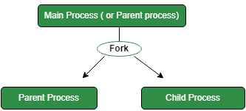
FORK
Fork() is a system call.
When fork() is called, the operating system creates a new process by duplicating the entire address space of the parent process, including code, data, and stack.
After a child process is created, both processes will concurrently execute the same instruction following the fork() call.
Scheduler in CPU can reorder the execution of parent and child processes

Slide 3
Differences Between Parent and Child
Although parent and child processes start with identical memory and state, they evolve independently after the fork() call.
Changes made by one process do not affect the other.
The fork() call returns different values to the parent and child processes:
In the parent process, it the child's process ID (PID). (some positive number)
In the child process, it returns 0, indicating that it is the child.
If it returns some negative number, it means fork failed.

Slide 4
Some Functıons in C
fork(): The Fork system call is used for creating a new process in Linux, and Unix systems, which is called the child process, which runs concurrently with the process that makes the fork() call (parent process)
getpid(): Returns the process ID of the calling process. This is often used by routines that generate unique temporary filenames.
wait(NULL): A call to wait() blocks the calling process until one of its child processes exits or a signal is received. After child process terminates, parent continues its execution after wait system call instruction.
waitpid(): The waitpid() system call suspends execution of the current process until a child specified by pid argument has changed state. By default, waitpid() waits only for terminated children.
Examples from Vscode

Slide 5
Pipe
Pipe is one-way communication. We can use a pipe such that one process write to the pipe, and the other process reads from the pipe.
Terminal:
Connects inputs and outputs of commands together using ”|”
Try: man ls | grep –e -a
It will return the functionality of the “–a” option for ls command (-e option enables dash “-” to be written as an argument).

Slide 6
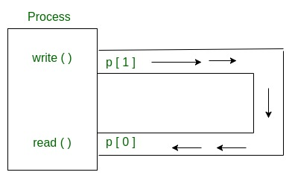
PIPe

Slide 7
Pıpe
Look at examples
Check dup and dup2: https://www.geeksforgeeks.org/dup-dup2-linux-system-call/

