Slide 1

IDENTARA · OPEN RESEARCH
Open IGA Operating Framework
The operating layer for identity governance programs, published.
why
who
what
which
how
when
v0.1 draft · CC BY 4.0 · DOI 10.5281/zenodo.21251831 · github.com/identara/iga-operating-framework
Notes:
This deck teaches the Open IGA Operating Framework in one session and is built to be reused: it is a companion of the framework itself, licensed CC BY 4.0, so any team can adapt it for an engagement as long as the attribution on the closing slide stays. Everything shown here exists in full in the repository.

Slide 2

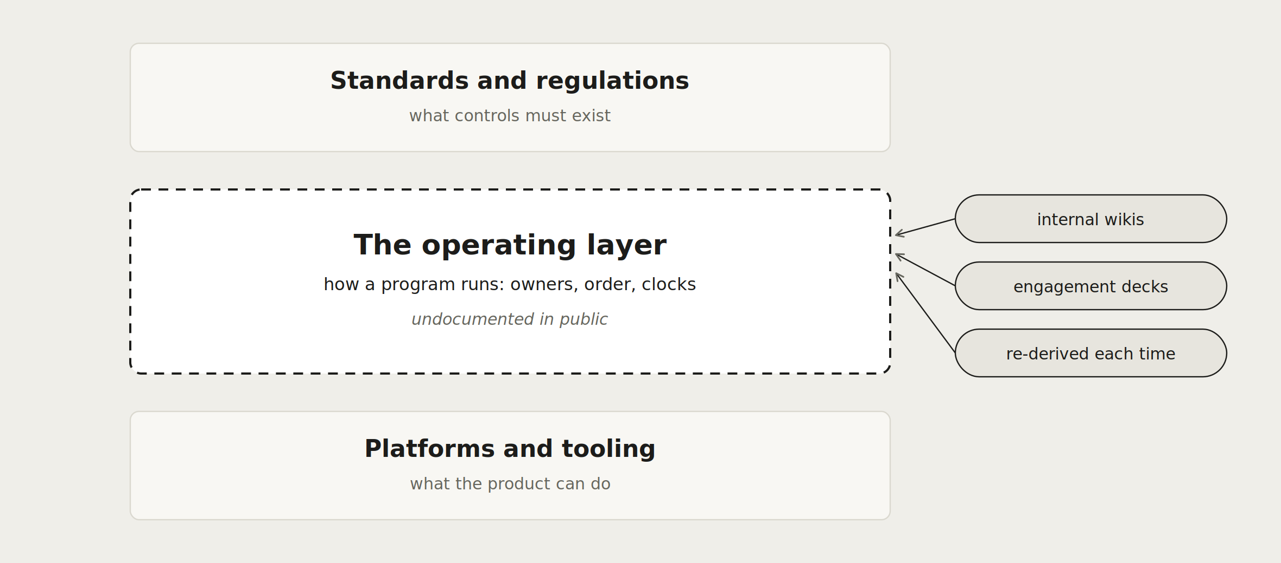
The operating layer of identity governance is undocumented
This framework publishes that layer once, in the open, so an engagement carries judgment instead of scaffolding.
Notes:
Frame the gap visually before the solution: standards above, platforms below, and the dashed layer between them is where programs actually run, sourced today from internal wikis and engagement decks and re-derived every time. The framework's mission is that dashed box, published once.

Slide 3
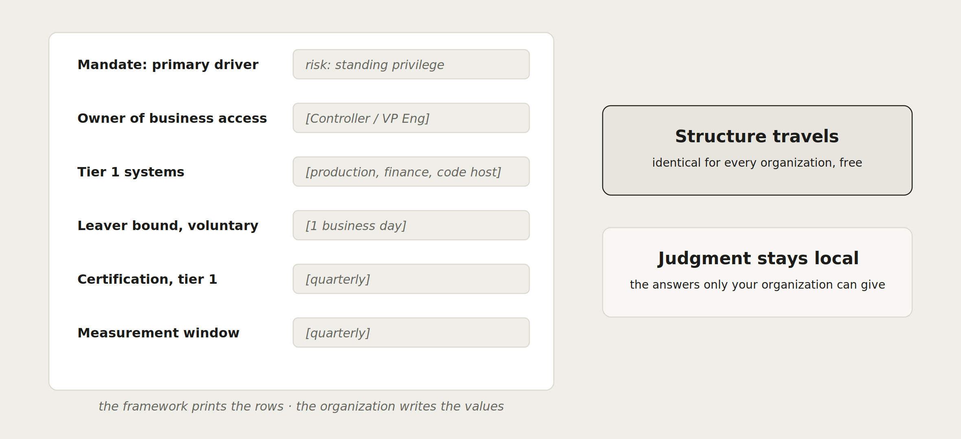
What the framework supplies, and what stays yours
Notes:
This split is the framework's core economics and the honest engagement pitch, drawn as a form: the printed rows travel identically to every organization and are now free, and the bracketed values are the work only the client can do. The counts on the Fernway slide later make the same point with numbers.

Slide 4
PART ONE
The operating core
why who what
Notes:
Part one walks the six-layer core. Each layer gets one slide with the same shape: what it fixes, how it breaks, and the worksheet that captures it.

Slide 5
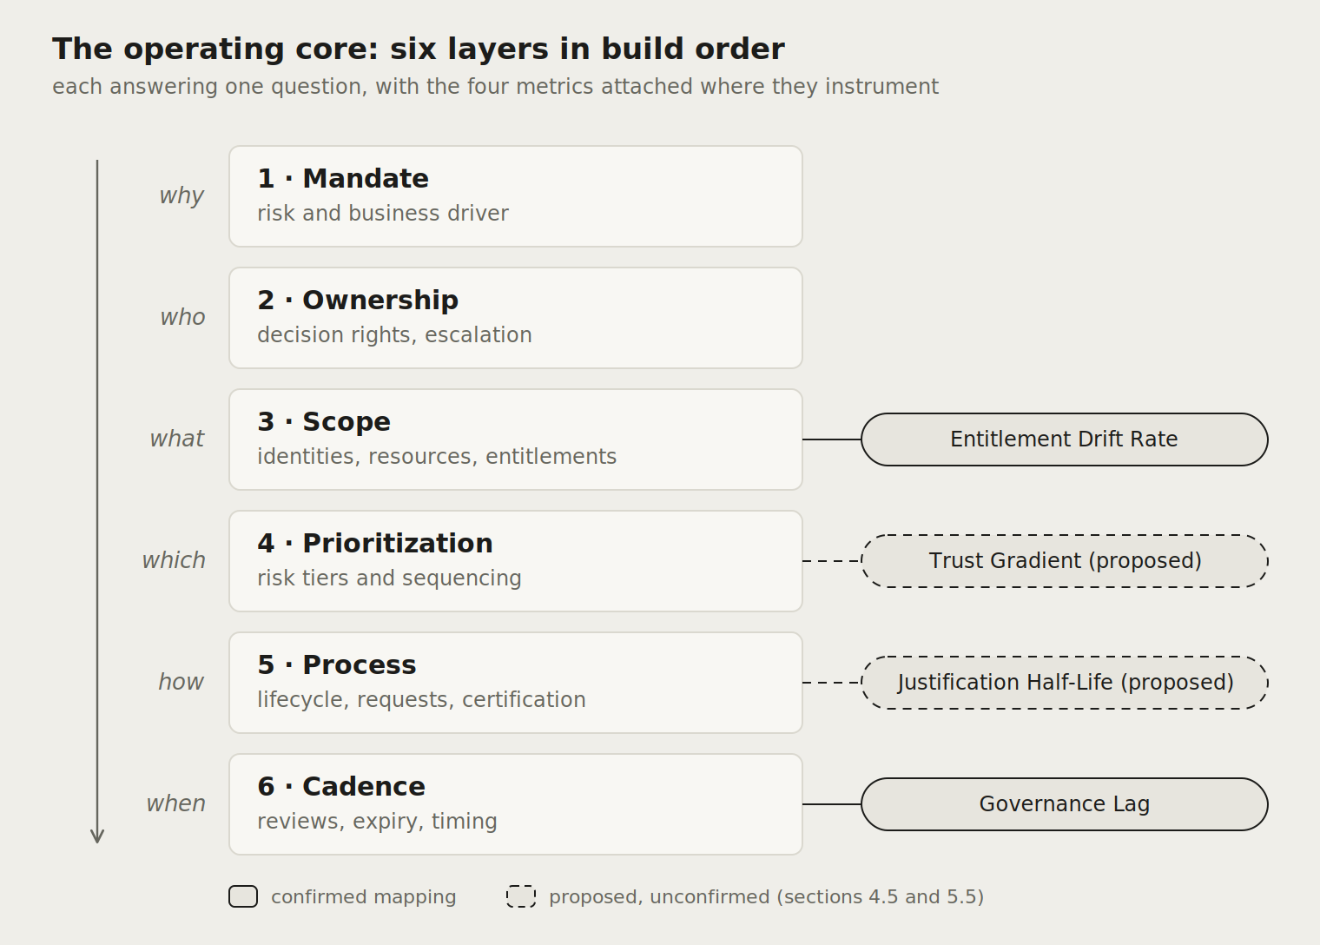
Six layers, one build order
Each layer answers one question, and each depends on the ones above it: authority before owners, owners before scope, scope before sequence.
Skipping a layer produces a recognizable failure, which is why every chapter carries failure modes with observable signals.
Solid metric connections are confirmed; dashed ones are proposed and wait on pilot evidence.
Notes:
The diagram is the whole framework on one page. Read it top down as a build order: a program that starts writing processes before fixing the mandate is building on sand, and the failure modes in each chapter describe exactly what that looks like. Note the honesty in the dashed connectors: two metric mappings are proposed rather than settled.

Slide 6
Two independent axes: where you start, what you become
 | Regulated enterprise | Small product organization | Public sector body
Greenfield | New banking subsidiary | Startup standing up its first controls | Newly created agency
Bluefield | Bank mid-migration to a new platform | Scale-up replacing its early tooling | Ministry modernizing one directorate
Brownfield | Established insurer, never governed centrally | Ten-year-old SaaS with entitlement debt | Legacy department estate
Starting state sets the on-ramp: chapter 4 defines one per state.
Archetype sets the target shape each layer takes, carried by profiles.
The six layers are the same in every cell.
Notes:
Orient the room on this grid before anything else: most confusion about applicability dissolves once starting state and archetype are separated. Bluefield, the partial rebuild beside a live legacy estate, is borrowed from migration practice because identity lacks a native term for the middle state. Every organization in the room sits in exactly one cell.

Slide 7
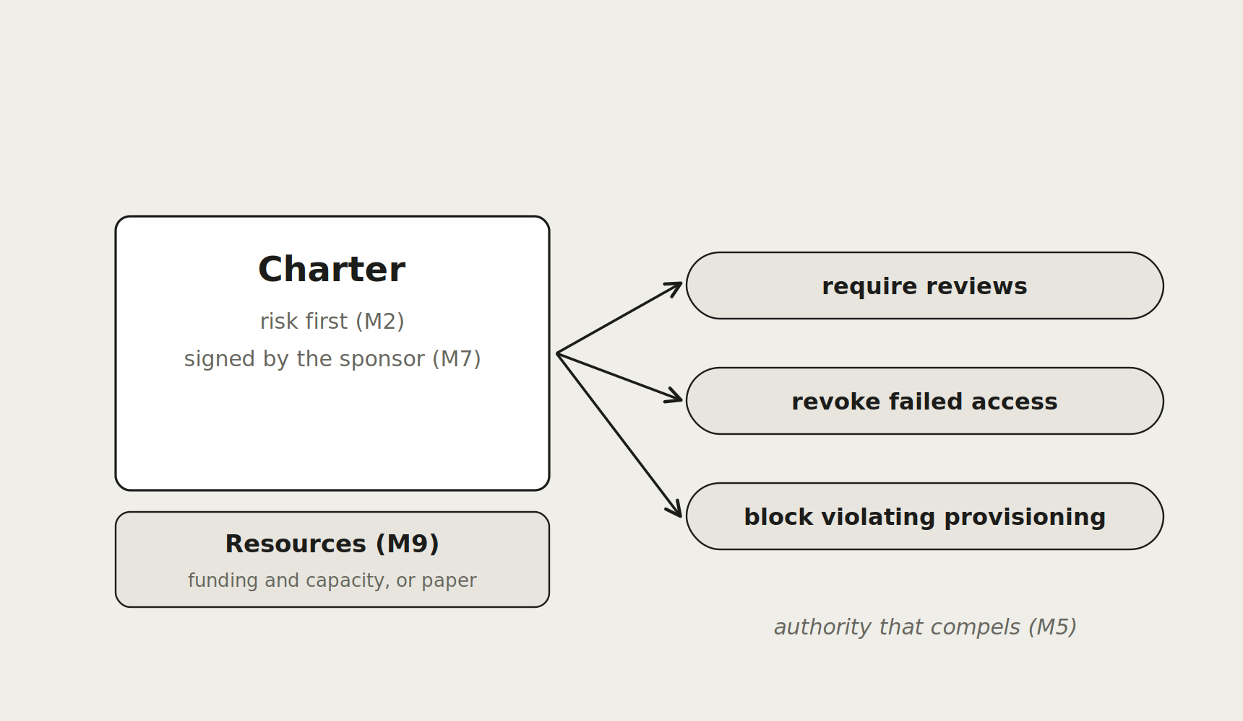
why
1 · Mandate
How it breaks
F5 · Unfunded mandate
Observable signal: Certifications and reviews slip for capacity reasons while the charter's obligations stay unchanged.
Companion: Program charter template · full chapter: core/01
Notes:
Layer 1, Mandate, answers why. Walk the diagram left to right; it carries the layer's key decisions with their identifiers in place. Then land on the failure card: the observable signal is something the room can check in their own environment this week, which is what makes the framework a diagnostic rather than a lecture.

Slide 8
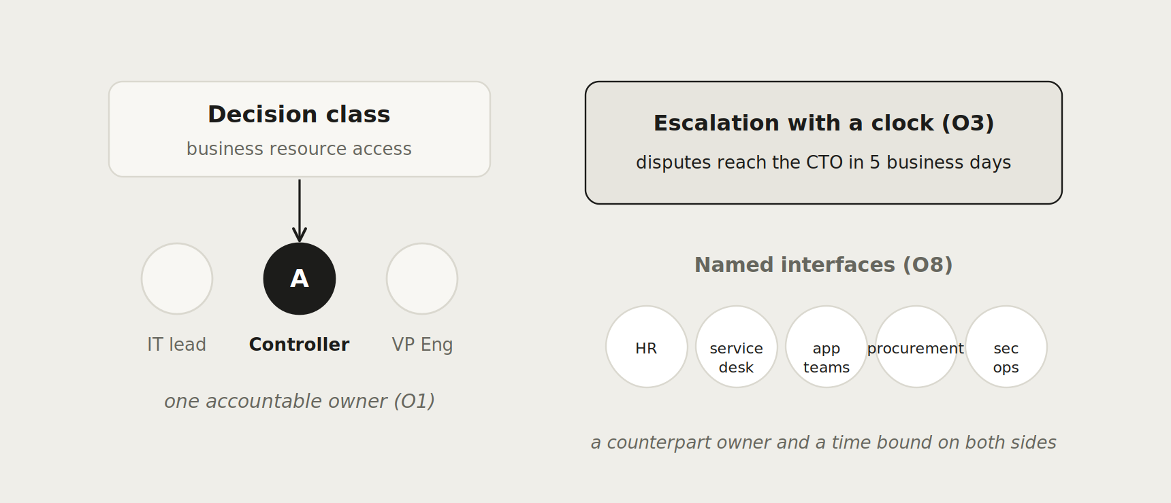
who
2 · Ownership
How it breaks
F1 · IT by default
Observable signal: Access decisions sit with people who cannot judge business need, and certifications turn into formalities.
Companion: Decision-rights and RACI starter · full chapter: core/02
Notes:
Layer 2, Ownership, answers who. Walk the diagram left to right; it carries the layer's key decisions with their identifiers in place. Then land on the failure card: the observable signal is something the room can check in their own environment this week, which is what makes the framework a diagnostic rather than a lecture.

Slide 9
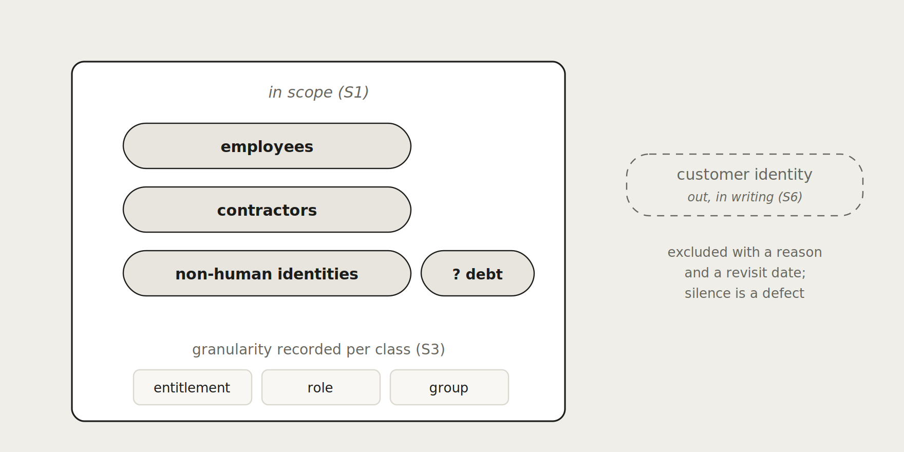
what
3 · Scope
How it breaks
F4 · Non-human blind spot
Observable signal: Nobody can state how many service accounts exist, and the unknown population is not recorded as debt.
Companion: Scope register template · full chapter: core/03
Notes:
Layer 3, Scope, answers what. Walk the diagram left to right; it carries the layer's key decisions with their identifiers in place. Then land on the failure card: the observable signal is something the room can check in their own environment this week, which is what makes the framework a diagnostic rather than a lecture.

Slide 10
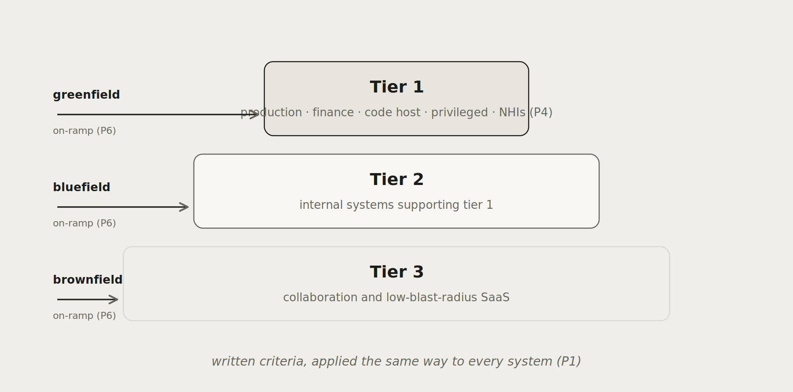
which
4 · Prioritization
How it breaks
F1 · Uniform governance
Observable signal: The wiki is certified as often as payroll, and reviewer attention is spent where risk is not.
Companion: Tier criteria and on-ramp worksheet · full chapter: core/04
Notes:
Layer 4, Prioritization, answers which. Walk the diagram left to right; it carries the layer's key decisions with their identifiers in place. Then land on the failure card: the observable signal is something the room can check in their own environment this week, which is what makes the framework a diagnostic rather than a lecture.

Slide 11
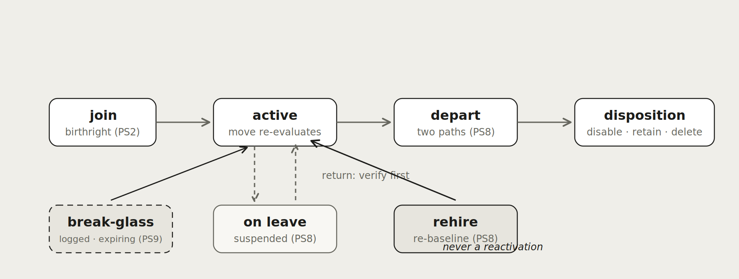
how
5 · Process
How it breaks
F7 · Rehire trap
Observable signal: A returning identity is reactivated with prior-tenure entitlements and no new justification on record.
Companion: Lifecycle and certification checklists · full chapter: core/05
Notes:
Layer 5, Process, answers how. Walk the diagram left to right; it carries the layer's key decisions with their identifiers in place. Then land on the failure card: the observable signal is something the room can check in their own environment this week, which is what makes the framework a diagnostic rather than a lecture.

Slide 12
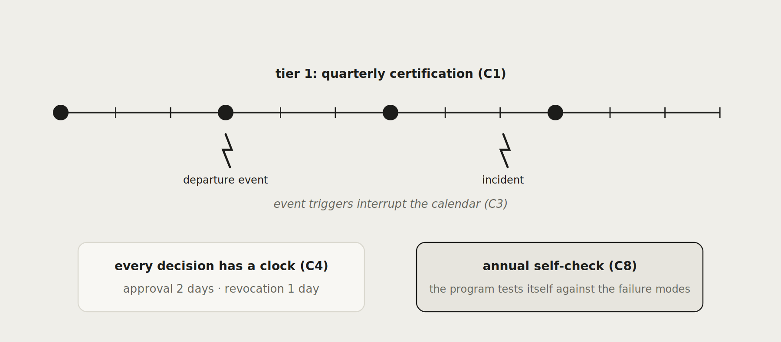
when
6 · Cadence
How it breaks
F1 · Calendar theatre
Observable signal: Access changes cluster at campaign dates rather than at the events that should have triggered them.
Companion: Cadence table template · full chapter: core/06
Notes:
Layer 6, Cadence, answers when. Walk the diagram left to right; it carries the layer's key decisions with their identifiers in place. Then land on the failure card: the observable signal is something the room can check in their own environment this week, which is what makes the framework a diagnostic rather than a lecture.

Slide 13
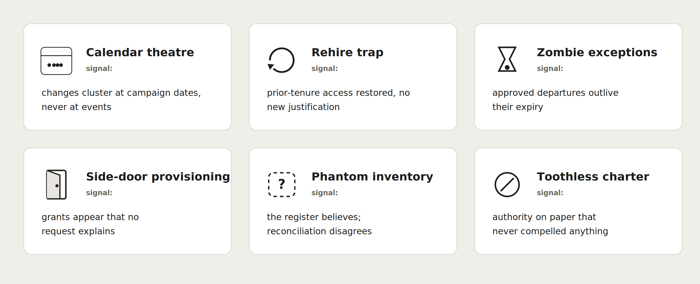
32 ways programs break, each with a checkable signal
The framework carries the full catalogue; C8 makes checking it an annual obligation, and the signals double as an audit-readiness sweep.
Notes:
Failure modes are the framework's memorable surface, and the names are deliberate: a room that laughs at calendar theatre has recognized it. Every failure mode carries a signal checkable against real data, which turns the framework into a self-assessment instrument before any project starts.

Slide 14
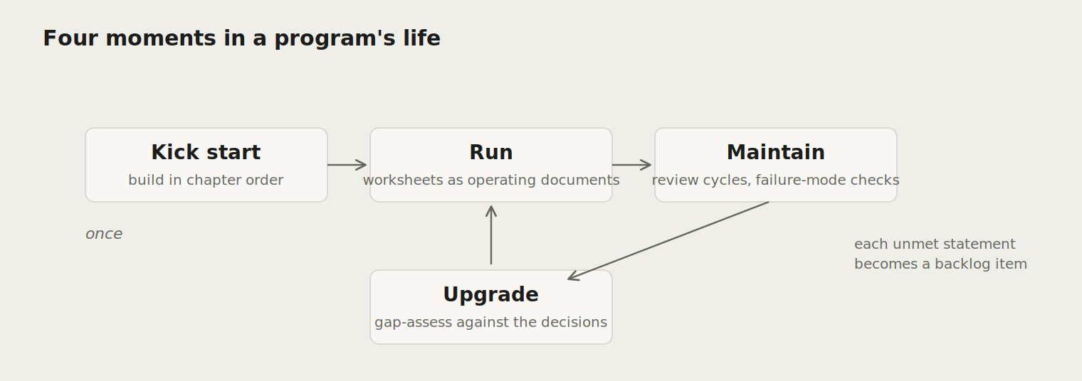
Four moments in a program's life
Kick start once, in chapter order: each layer's worksheet builds on the previous.
Run: the worksheets become operating documents rather than project artifacts.
Maintain: review cycles plus the C8 failure-mode self-check.
Upgrade: gap-assess against the numbered decisions; every unmet statement is a backlog item.
Notes:
The framework serves a program at four moments, and an engagement can enter at any of them. Kick start is the greenfield path; upgrade is the brownfield one, where the numbered decisions become a gap assessment and the output is a sequenced backlog rather than a rebuild.

Slide 15
PART TWO
Measurement
how fast
Notes:
Part two covers the metrics layer: what the four metrics read, why activity measures are insufficient, and where the honest boundaries sit.

Slide 16
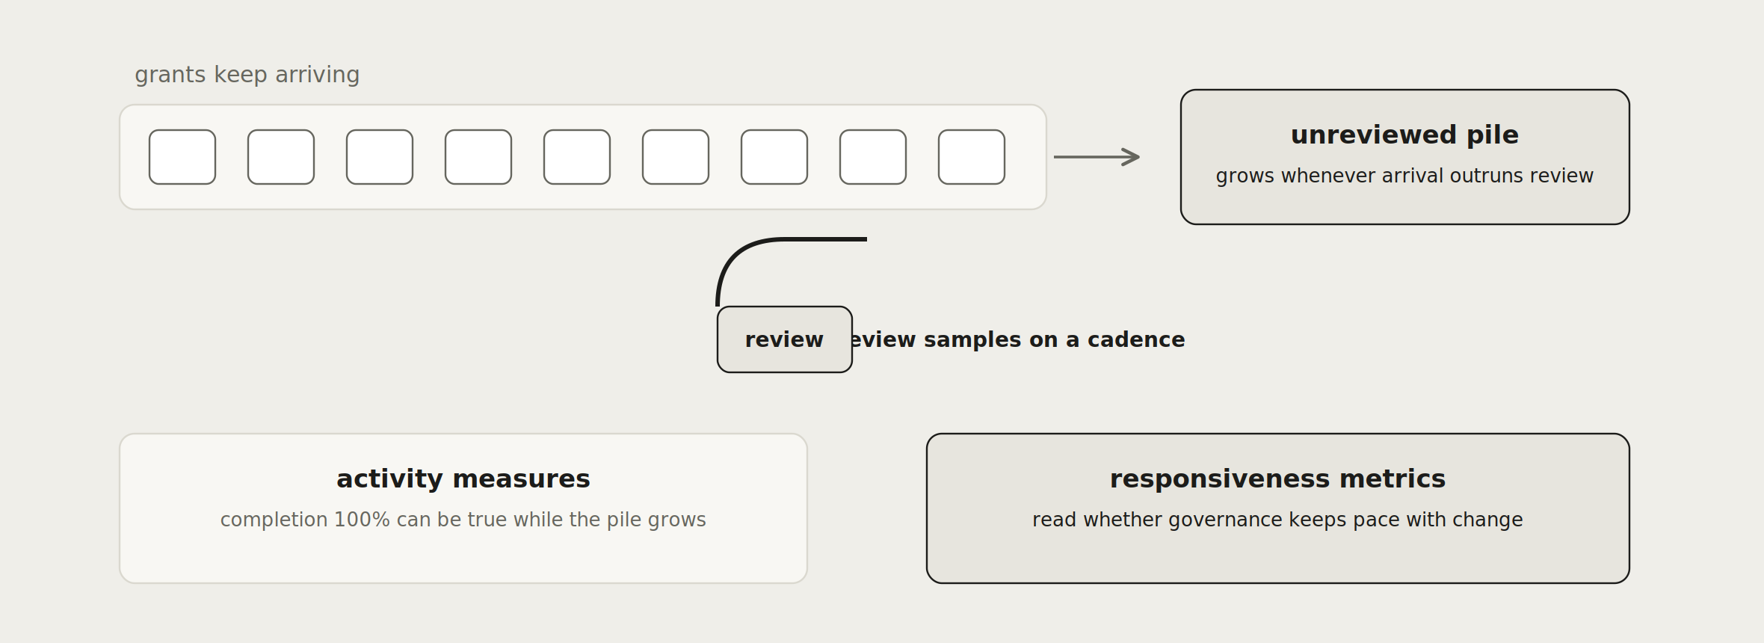
Activity says work happened. Responsiveness says it kept pace.
Entitlement Drift Rate
confirmed
Governance Lag
confirmed
Justification Half-Life
proposed
Trust Gradient
proposed
Notes:
The conveyor is the argument: grants keep arriving, review samples on a cadence, and whenever arrival outruns review the unreviewed pile grows while completion still reads one hundred percent. The four metrics read that gap. Be explicit about the honesty markers: two mappings confirmed, two proposed pending pilot evidence.

Slide 17
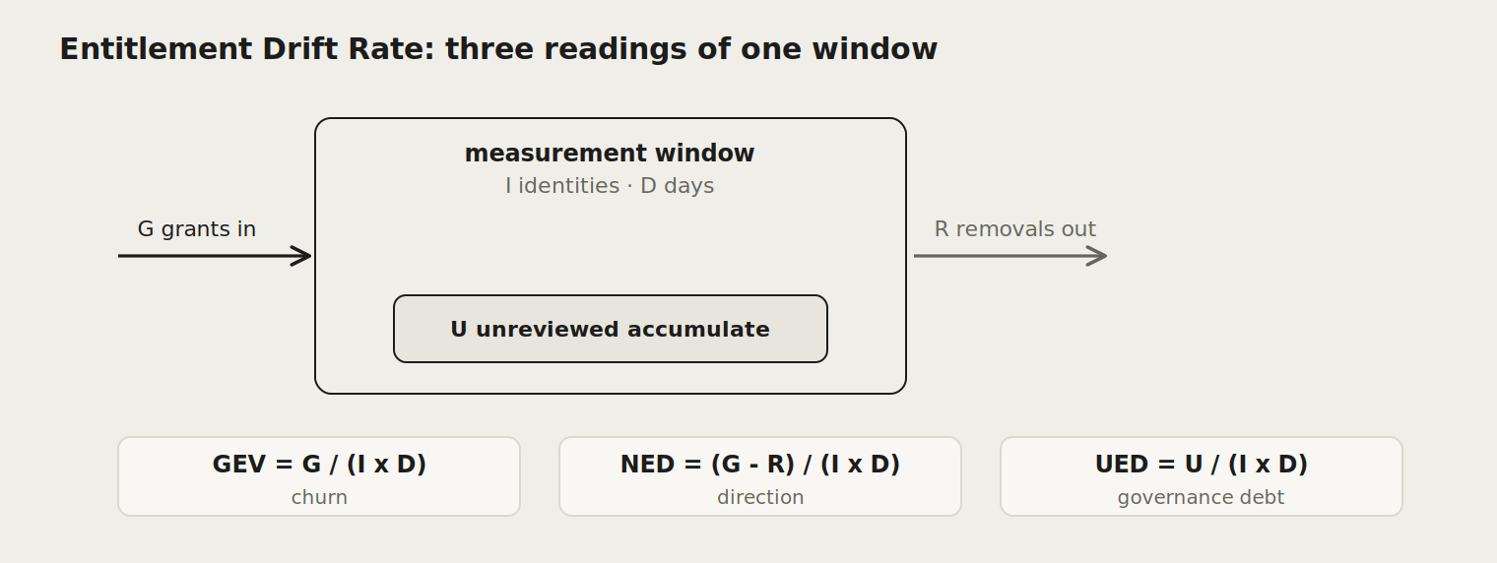
Entitlement Drift Rate: three readings of one window
GEV = G / (I x D)
churn, independent of direction
NED = (G - R) / (I x D)
expansion or contraction
UED = U / (I x D)
governance debt
Report the per-campaign figure: 1.6 unreviewed entitlements per identity per campaign lands in an executive room; 0.018 per identity per day does not. Same measurement, declared window (MS1).
Notes:
EDR is phase one because it needs only data the governance platform already holds: grants, removals, and campaign dates. The three variants exist because a net number hides churn. The reporting guidance matters in practice: keep the definition's per-day unit for computation and headline the per-campaign equivalent for any audience above the platform team.

Slide 18
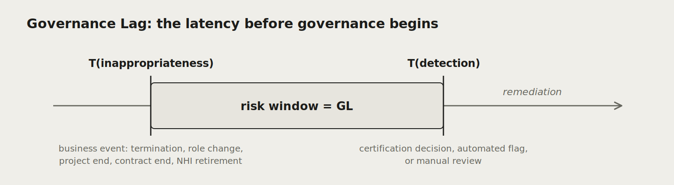
Governance Lag: the risk window before governance begins
74 days
human median
GL = T(detection) - T(inappropriateness)
211 days
non-human
Worked sample from the source paper, non-normative: the gap between the two numbers is the machine-identity governance vacuum made visible.
Notes:
Governance Lag reads the latency nobody measures: the time between access becoming inappropriate and governance noticing. A program that revokes in two hours after detecting in four months carries a four-month lag. The sample numbers are illustrative, drawn from the source paper, and the human versus non-human gap is usually the slide that wins the room.

Slide 19
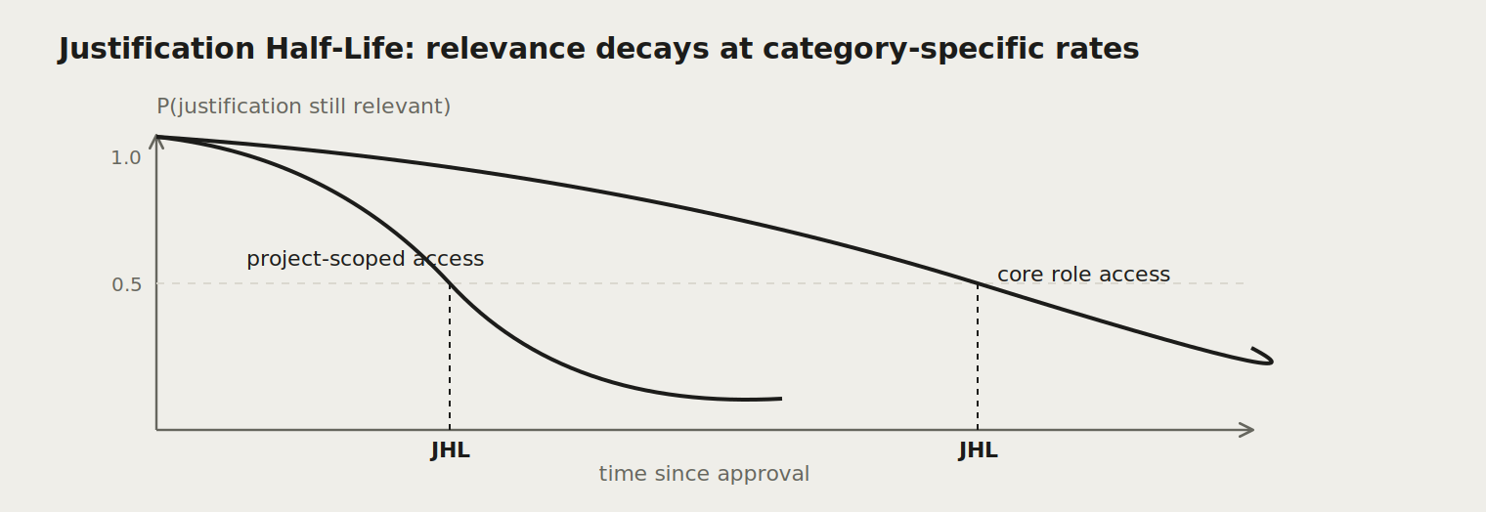
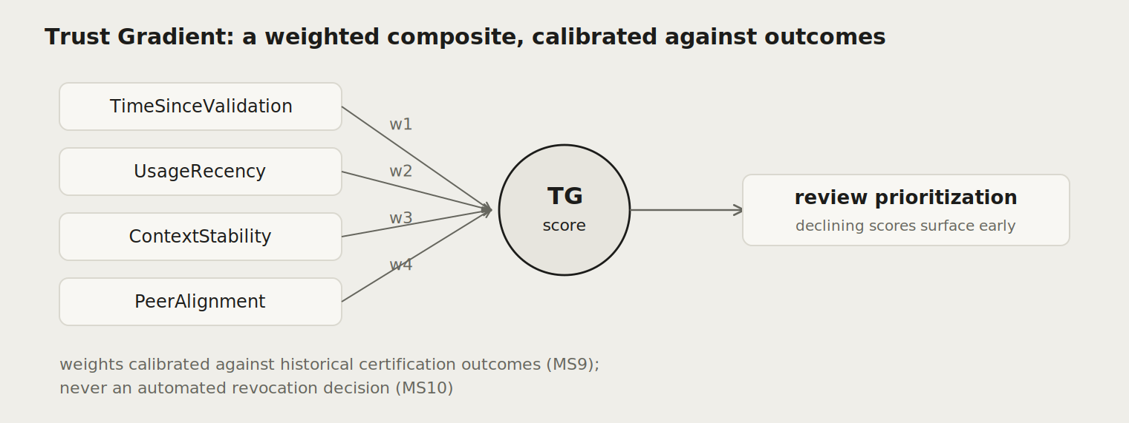
Two more metrics, honestly labelled: proposed
Justification Half-Life reads how fast the reason for access decays, and makes certification cadence risk-proportionate. Trust Gradient turns bulk certification into continuously prioritized attention. Both layer mappings await empirical confirmation against pilot data, and neither carries normative weight until that evidence exists.
Notes:
Present these two with their status visible: proposed, pending pilot evidence. That labelling is a feature in a consulting context, because it demonstrates the framework distinguishes what it knows from what it hypothesizes, which is exactly the discipline clients should demand of any measurement program.

Slide 20
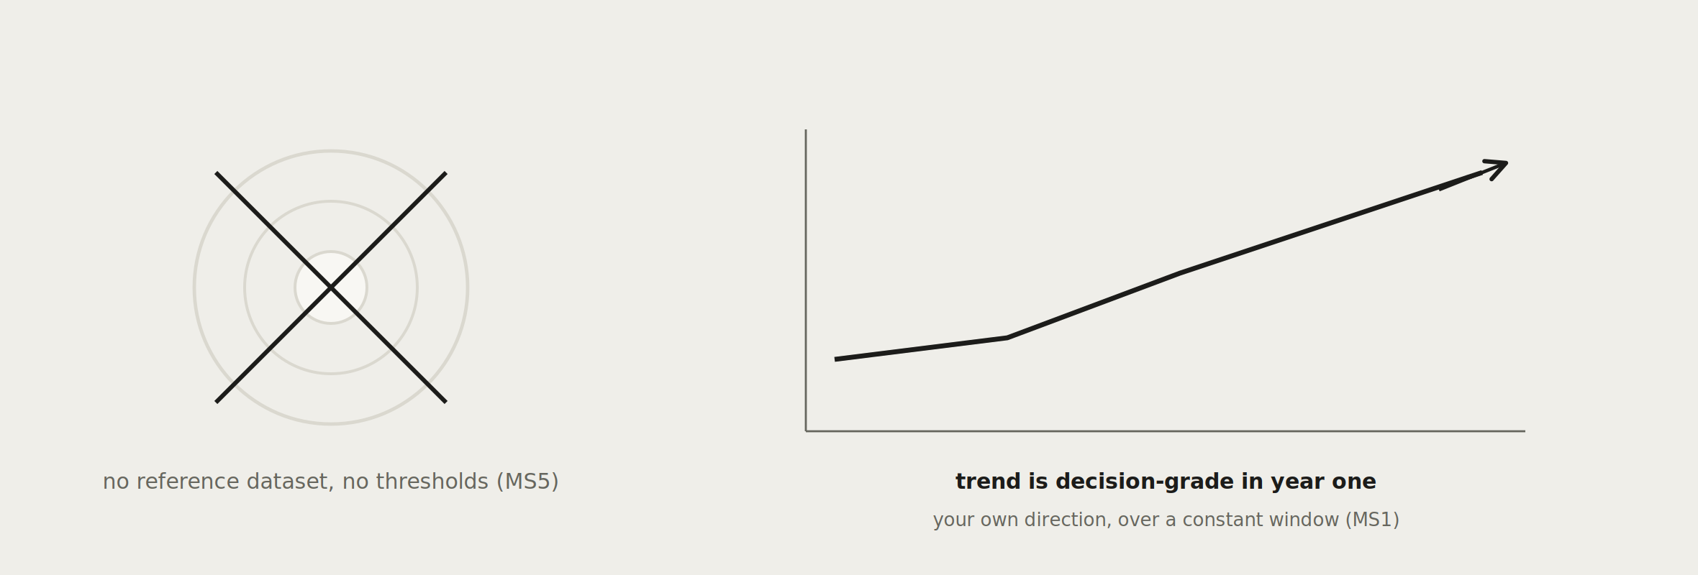
Where are the benchmarks?
MS5: targets and thresholds are the program's own until published reference data exists. A threshold without a reference dataset is a guess wearing authority.
Notes:
Every executive room asks what good looks like. The drawn answer: the target has no needle yet because no reference dataset exists, and the trend line is what is decision-grade in year one, your own direction over a constant window. In an engagement this converts from weakness to differentiator, because it is the answer a measurement scientist would give.

Slide 21
PART THREE
Using it in an engagement
when
Notes:
Part three is the reuse story: the worked example, the four-step engagement arc, and where the framework's status and governance stand.

Slide 22
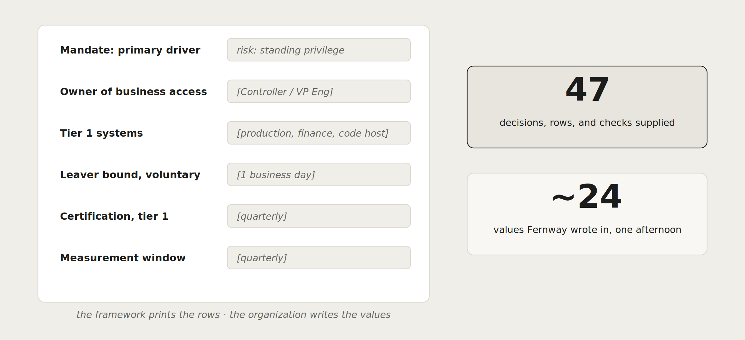
One organization, end to end: the worked example
Fernway Software is fictional: a 300-person greenfield SaaS, walked through all six layers in examples/ with every worksheet filled.
Notes:
The worked example drawn as its ratio: forty-seven pieces of supplied structure against roughly two dozen locally written values, an afternoon of decisions Fernway was equipped to make. Use it as the pre-read that teaches the mechanics and as the template for the client's own walkthrough.

Slide 23
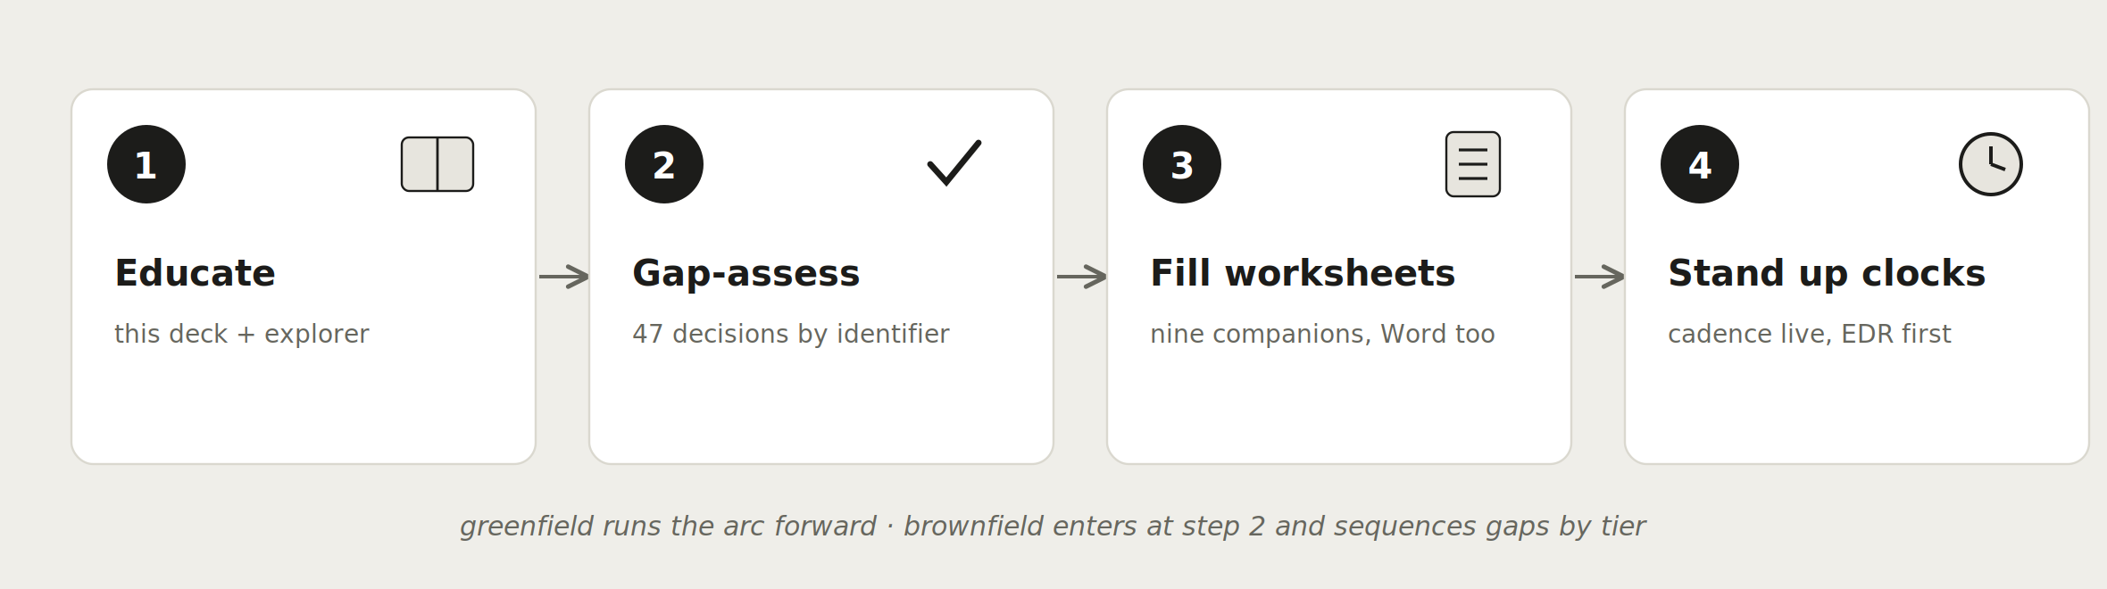
The engagement arc: four steps, all artifacts in the repository
Notes:
This is the reuse slide: a complete engagement shape built entirely from public artifacts. Nothing here requires the framework's author, which is the point of an open operating layer. The paid differentiation is speed, judgment, and pattern recognition across the values column of the Fernway split.

Slide 24
Where the framework stands, and how it changes
v0.1 public draft: nothing ratified, normative language carried for review
Confirmed: EDR on Scope, GL on Cadence. Proposed: TG on Prioritization, JHL on Process, pending pilot evidence
Feedback lands as repository issues, cited by statement identifier; templates are pre-shaped for it
Archetype profiles are the contribution surface: TEMPLATE.md plus AP1 to AP5
GOVERNANCE.md separates editorial from normative change; a named review panel gates any 1.0
Statement census
47
core decisions: M, O, S, P, PS, C
12 + 5
metrics statements and profile rules
Notes:
Close the education with the honest status. The framework states what is settled, what is proposed, and how each kind of change happens, and it invites disagreement in citable form. In an engagement this slide doubles as the answer to why trust a v0.1: because the version tells you exactly what it does and does not claim.

Slide 25
GET IT
github.com/identara/iga-operating-framework
Everything in this deck exists in full in the repository: chapters, metrics, worksheets, worked example, interactive explorer
Reuse this deck freely in your own sessions and engagements; it is a companion of the framework, CC BY 4.0
Keep the attribution when you adapt it, and file what you disagree with as an issue, by statement identifier
Ganesh, V. Open IGA Operating Framework (v0.1). Identara. DOI 10.5281/zenodo.21251831. CC BY 4.0.
Notes:
End on the handoff: the repository is the deliverable, this deck is one companion of it, and the attribution line is the licence condition for reuse. If the room takes one action, it is the failure-mode self-check against their own environment, because that is where the framework stops being a presentation and starts being a finding.

