Slide 1


Stable identifiers: status and next steps
Anton Güntsch
Freie Universität Berlin
Botanic Garden & Botanical Museum Berlin-Dahlem
Dept. of Research and Biodiversity Informatics
BiodiversityInformatics@bgbm.org

Slide 2
(Very) brief history
2012: RBGE paper on HTTP-URI-based identifiers for herbarium specimens.
2013: ISTC decides to conduct pilot implementations across CETAF-institutions.
2013: collaboration with pro-iBiosphere.
2014: official CETAF „Product“.
Güntsch: stable identifiers ISTC 2015, Joensuu

Slide 3
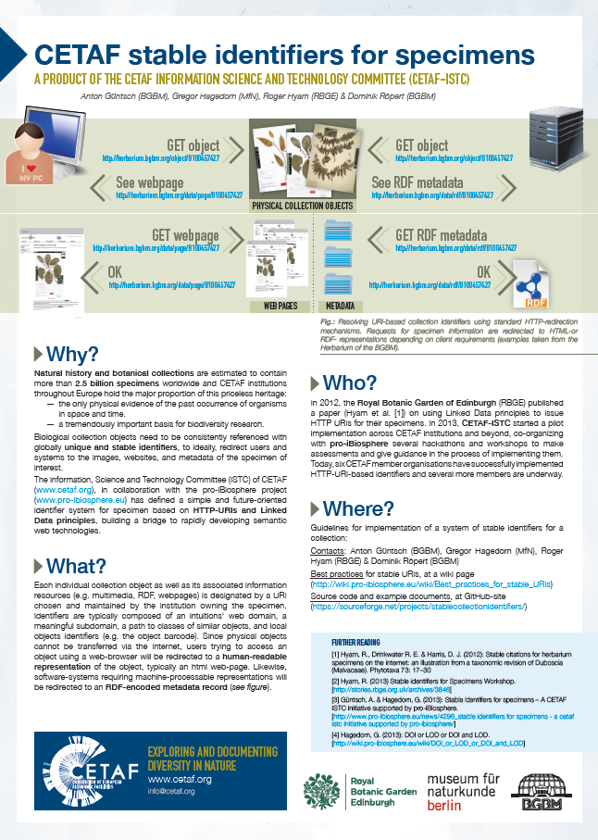
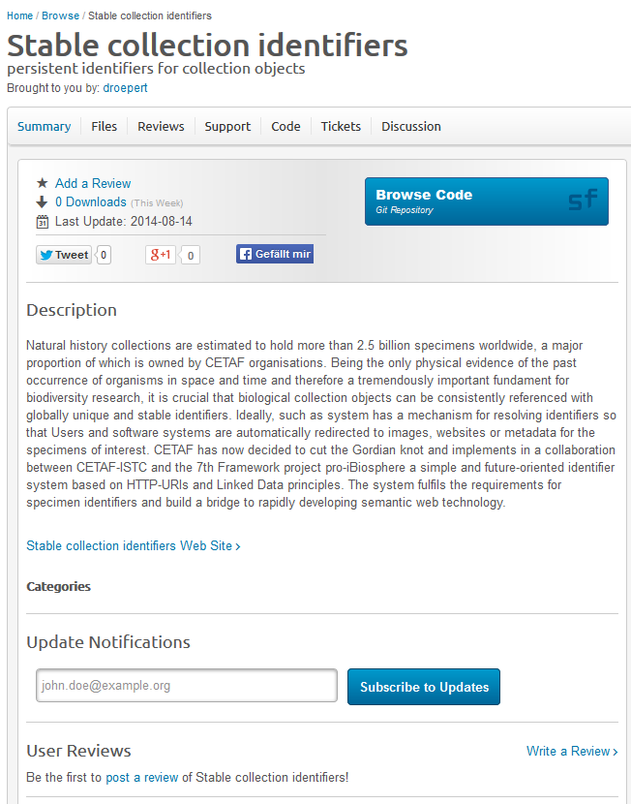
The Product
Güntsch: stable identifiers ISTC 2015, Joensuu

Slide 4
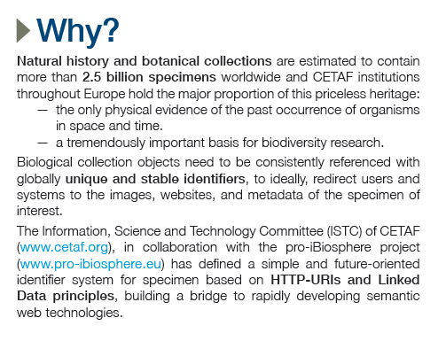
The Product
Güntsch: stable identifiers ISTC 2015, Joensuu

Slide 5
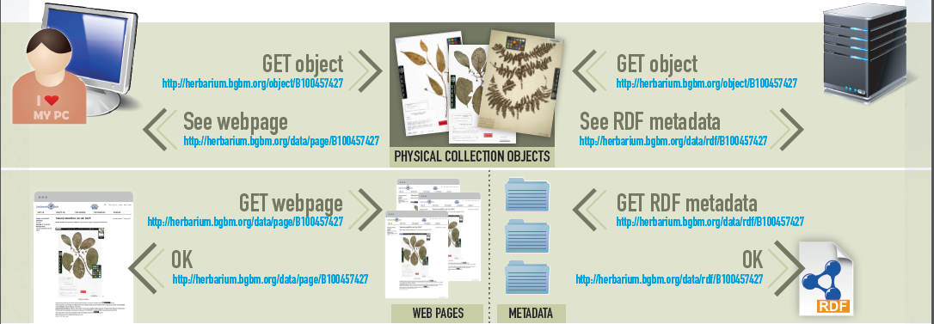
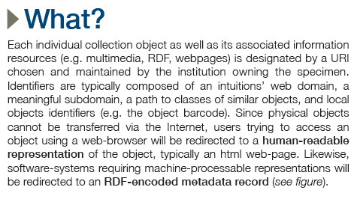
The Product
Güntsch: stable identifiers ISTC 2015, Joensuu

Slide 6
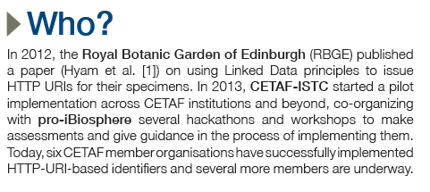
The Product
Güntsch: stable identifiers ISTC 2015, Joensuu

Slide 7
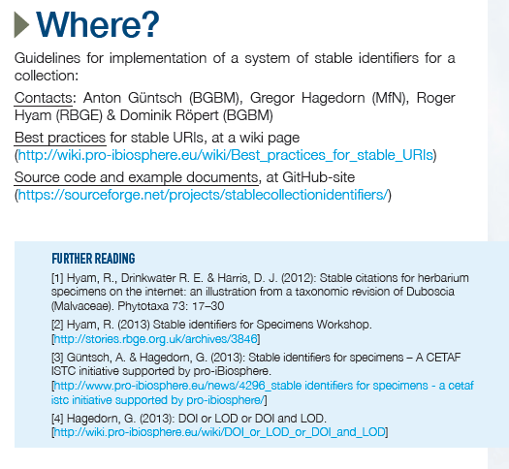
The Product
Güntsch: stable identifiers ISTC 2015, Joensuu

Slide 8
Participating CETAF institutions
RBGE
BGBM
MfN
Kew
MNHN
KEW
IBSAS
Naturalis (from 5/2015 on)
JACQ (potentially 25 collections)
Güntsch: stable identifiers ISTC 2015, Joensuu

Slide 9
Status
8 Institutions on board is a great success (bearing in mind endless identifier discussions in TDWG and elsewhere).
Present implementations provide an elegant mechanism for citing specimens.
No components for discovery.
Metadata weakly linked to external ressources.
Güntsch: stable identifiers ISTC 2015, Joensuu

Slide 10
Next steps
Should be easy to implement (without additional funding).
Should demonstrate the potential of LoD.
Should provide elements which can be used to attracted further funding.
Güntsch: stable identifiers ISTC 2015, Joensuu

Slide 11
Ideas
Equip identifier implementations with simple catalog function which can be used for discovery and aggregation.
  Concept and pilot implementation already in place.
  Very easy to implement.
RDF harmonization and linking out to external resources.
  Less implementation works.
  More brainstorming, agreeing, documenting.
Güntsch: stable identifiers ISTC 2015, Joensuu

Slide 12
Discussion
More ideas?
Who wants to contribute?
How can we organise the work?
Güntsch: stable identifiers ISTC 2015, Joensuu

